Slide 1
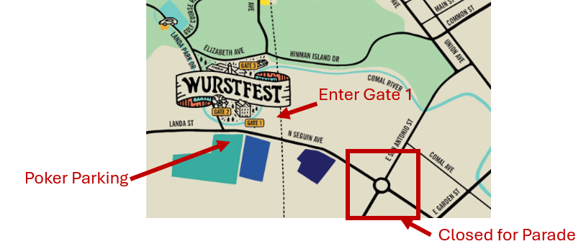
Handicap Parking for Poker
Gate 2
Loop 337

