Slide 1


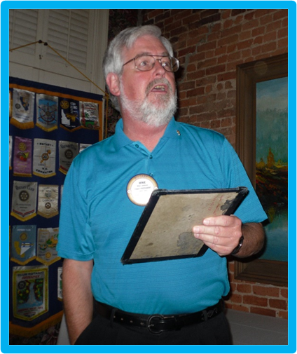
Mike Johnson
Rotary Club of Grass Valley
February 1993 – May 2012
Youth Services (New Generations) Chair
Managed club RYLA Program
Established REGLE participation
Coordinated district RYLA and REGLE activities
Supported Rotary Youth Exchange (RYE)
Wrote and presented Child Protection Procedures
Lyman Gilmore Middle School projects

