Slide 1

New Rotarian Orientation Mar 2025

Slide 2
Topics
What is Rotary
History
Structure
Member Requirements and Rules
Our Club
Resources/Websites
Getting Involved

Slide 3
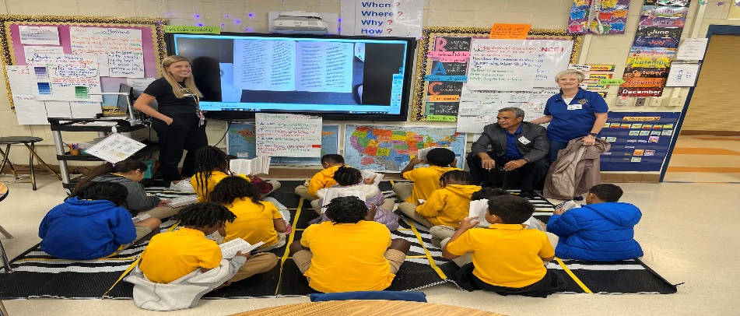
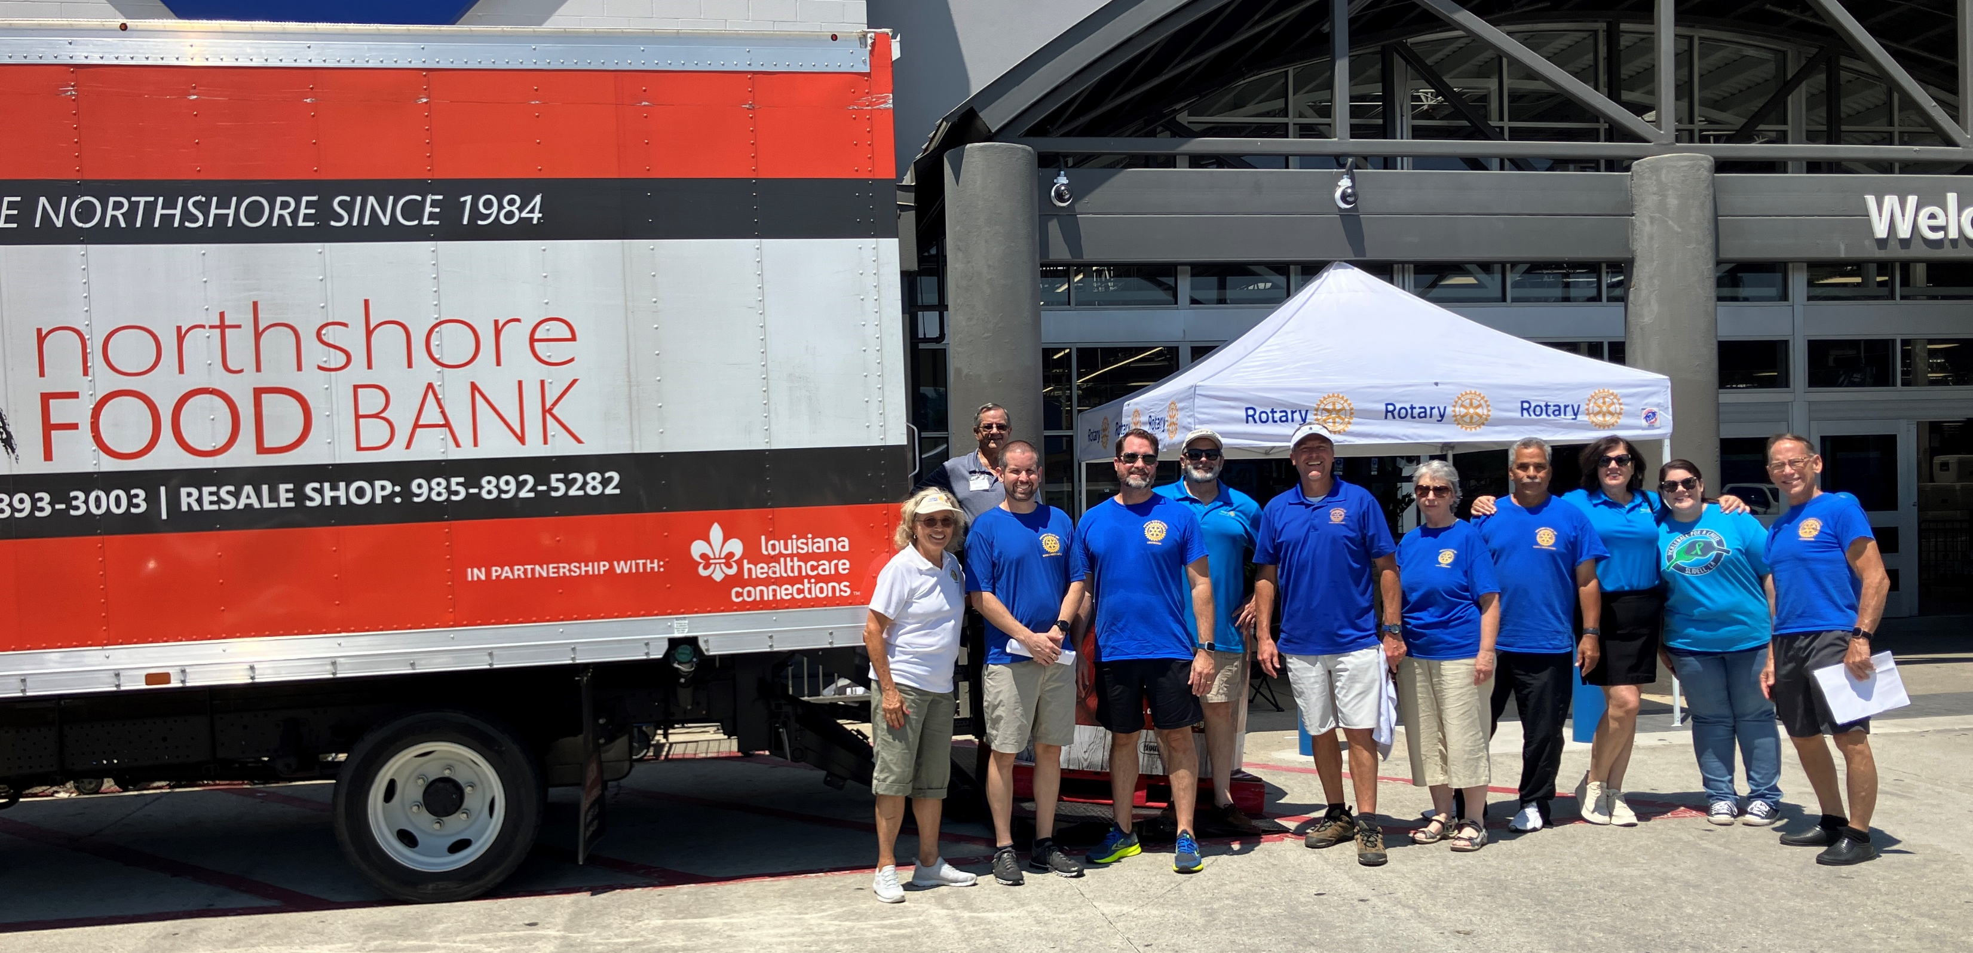
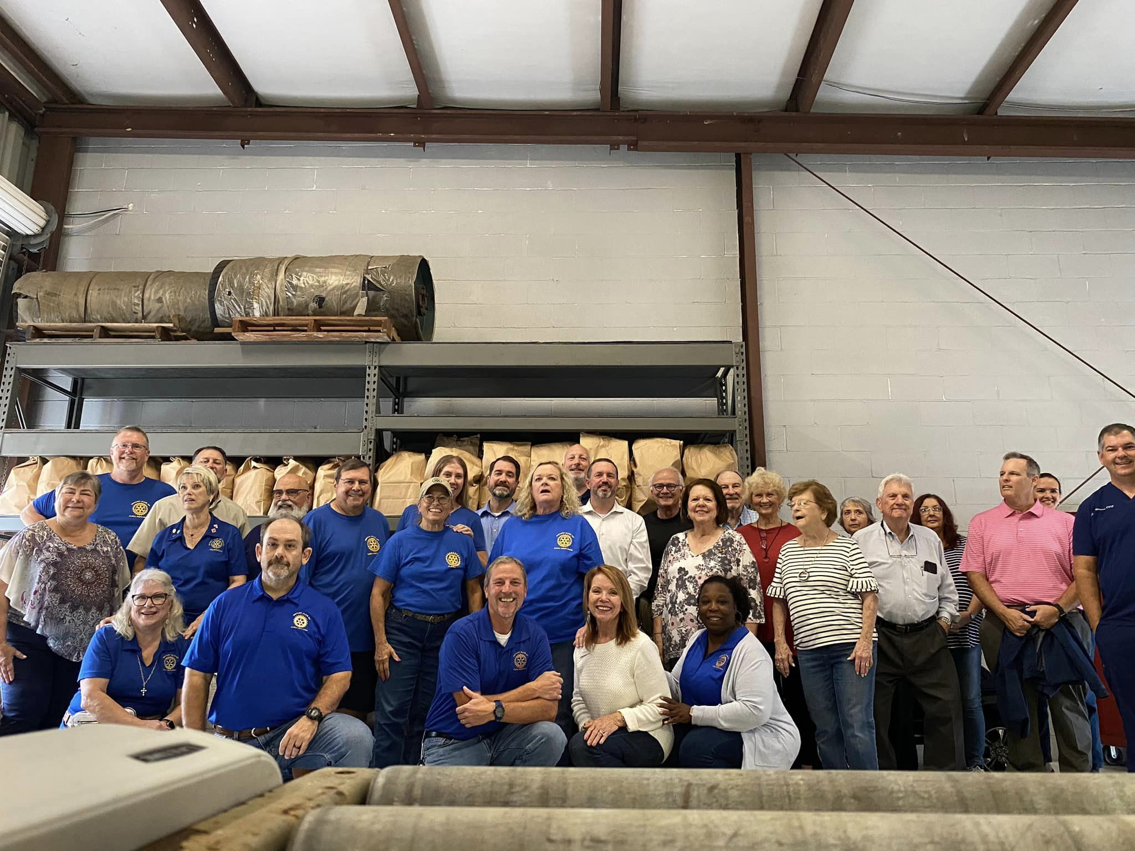
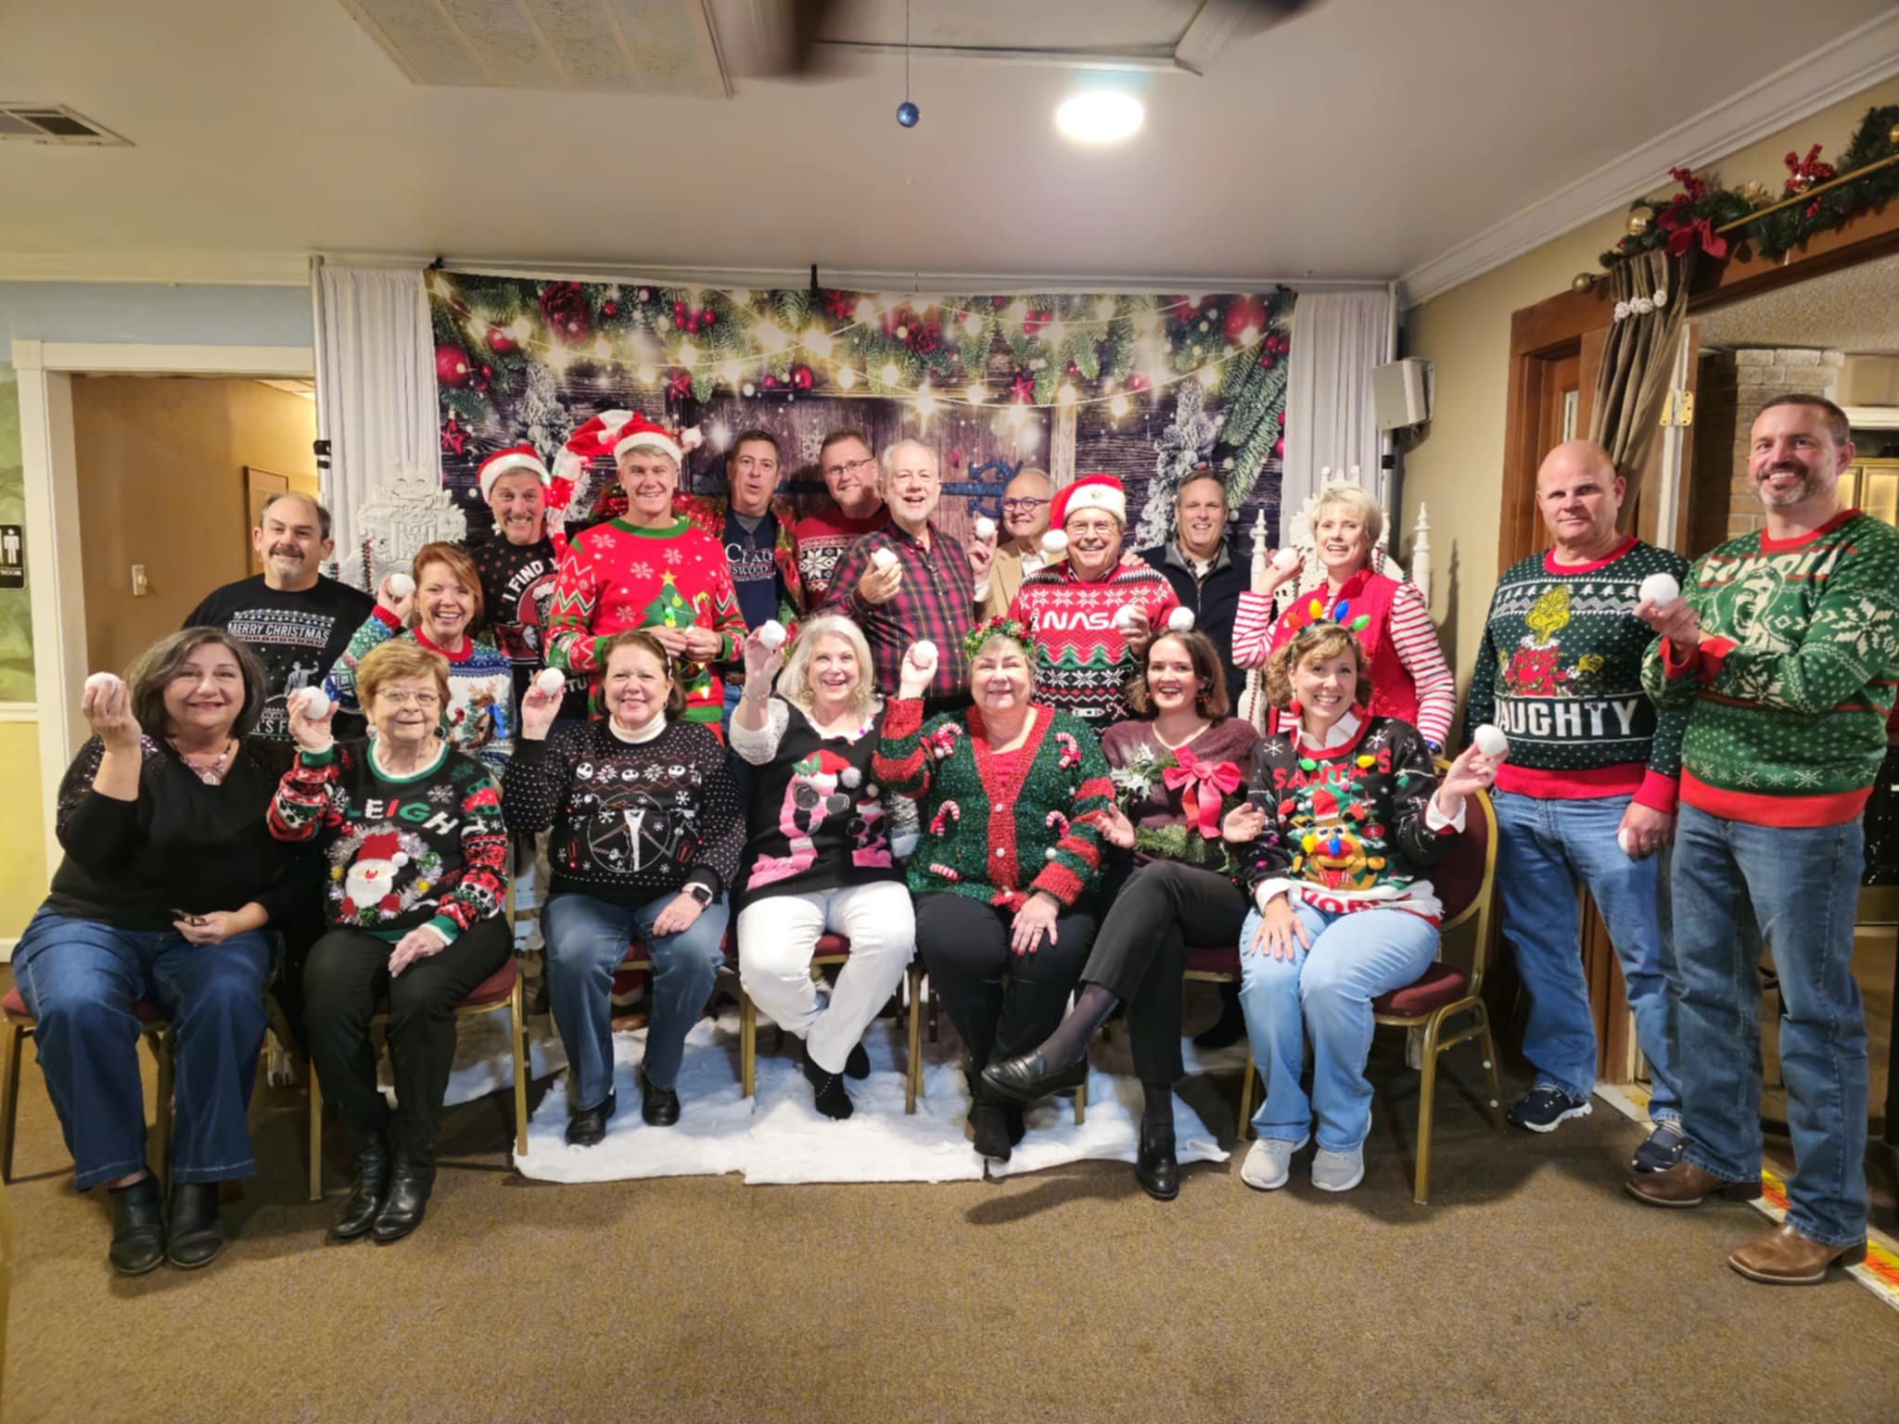
Welcome to Rotary
We are neighbors, community leaders and global citizens uniting for the common good. With you we can accomplish more.

Slide 4
Rotary
Rotary is a global network of more than 1.2 million neighbors, friends, and leaders who see a world where people unite and take action.

Slide 5
Rotary Mission
The Object of Rotary is to encourage and foster the ideal of service as a basis of worthy enterprise and, in particular, to encourage and foster:
FIRST: The development of acquaintance as an opportunity for service;
SECOND: High ethical standards in business and professions; the recognition of the worthiness of all useful occupations; and the dignifying of each Rotarian’s occupation as an opportunity to serve society;
THIRD: The application of the ideal of service in each Rotarian’s personal, business, and community life;
FOURTH: The advancement of international understanding, goodwill, and peace through a world fellowship of business and professional persons united in the ideal of service.
Motto: “Service Above Self”

Slide 6
Creed
Four Way Test – of the Things we think, say, and do:
Is it the truth?
Is it fair to all concerned?
Will it build goodwill and better friendships?
Will it be beneficial to all concerned?
Rotary Code of Conduct (hand out)

Slide 7

History
1905 -117th Anniversary in 2024
Paul Harris and 3 others
Rotating Meeting Places
President of first Rotary Club:
Silvester Schiele
First RI President: Paul Harris
Over the Past 100 Years Rotary Clubs have been Established in 200 Countries

Slide 8
Rotary Structure
International
Zones
Districts
Territories
Clubs
Associated Organizations

Slide 9
Rotary International
Headquarters: Chicago, Illinois
President: Stephanie Urchick, United States
Rotary Clubs Worldwide > 45,000

Slide 10
Rotary Foundation
Since 1947 more than $1.6 Billion donated to Rotary Activities via Grants from the Foundation
Annual Grants >$141,000,000

Slide 11

Rotary Foundation Area of Focus
Notes:
Educational Projects:
University Teachers
Vocational Training
Humanitarian
Disaster Relief
Financial support for orphanages
Peace and Goodwill
Ambassadorial Scholarships
largest international privately funded scholarship program
Group Study Exchange teams
Peace Studies/Conflict Resolution, Master Degrees at six universities
worldwide
Health
Polio Plus
Other Immunizations
Various Surgeries

Slide 12
Rotary Foundation
Major Donors
Paul Harris Fellows
Benefactors
Distribution of Funds
50% Worldwide Projects
50% Returned to Districts

Slide 13
Polio Plus
Eradicate Polio Worldwide
RI Campaign started in 1977
Rotary’s Contribution
$1.2 Billion by 2016 plus Millions of in-kind Dollars
2 Billion Children since 1985
122 Countries benefited
US$202 Million is Current Pledge for Eradication Campaign

Slide 14

Our District 6840
Governor Samatha Walley
Established - Feb 1910
48 clubs in southeastern Louisiana and southern Mississippi.
District divided into 10 Territories, consisting of 3-5 clubs.
Our club is in Lake Territory in SE La.
2100 >members
IEsternational Service

Slide 15
Associated Organizations
Interact Clubs Age 15-18
Rotaract Age 18-30
Inner Wheel – Auxiliary

Slide 16
New Member Requirements
A) Give 5-minute speech about themselves at Induction
B) Attend New Member Orientation
C) Support the Secretary and welcome members at the front table or shadow Greeter for two (2) meetings 7-7:30 am
D) Sit at a different table for three (3) meetings

Slide 17
Membership Rules
Attend meetings
Pay Dues
Participate in Club Projects
Propose New Members

Slide 18
Membership Dues
Quarterly Payment of Dues & Other Costs
Dues: RI, District & Club
Rotary Foundation & Club Benefactor
Meals, Social Functions
Initiation Fee

Slide 19
Membership Projects
Participate in Club Projects & Activities
Fundraising
Avenues of Service
Club Service
Community Service
Vocational Service
International Service
Notes:
Examples of Fundraising:
Weekly Raffle
Sale of Sweet Potatoes
Golf Tournament
Heritage Festival-also community service
Examples of Club Service:
Greeter at Registration Table
Help with Newsletter and Website
Caring Committee
Examples of Community Service:
Thanksgiving Baskets
Examples of Vocational Service:
4 Way Test Coloring Books at Elementary Schools
Member Programs
Examples of International Service:
Shots for Tots
Ambassadorial Scholarship
Polio Plus
Avoidable Blindness
Host of GSE Team-explain in general terms

Slide 20
Our Club
Rotary Club of Slidell North Shore
President for 2024-2025: Rich Delgado
Established: March 1984
Members : 49

Slide 21
Club Officers and Directors
President Rich Delgado
President-elect Aaron Hirsh
Past President Joel Bruno
Secretary Mike Rich
Treasurer David Brignac
Director Tim Pillsbury
Director Nancy Author
Director Leo Rohlinger

Slide 22
Rotary Club of Slidell Northshore Administration
Club Officers & Board of Directors
Club Members proposed by Nominating Committee (Past Presidents); Elected by membership.
Interested/Active Club Members
Budget and Grant Requests

Slide 23
Rotary Club of Slidell Northshore Committees
Club Roles:
Speakers/Program: Tim Club Public Image: Kentrell
Foundation: Neil, Laurie Interact: Rich, Aaron
Membership: Rich, Joel, BJ RYLA: Tanya (chair), Lydia
Rotary Awards: Laurie J Orientation: Lisa
Greeter Coordinator: Dave Kronlage International: Jim T, Steve E
District Grants: Steve E ClubRunner/Website: Mike R
Vocationals: vacant Club Historian & Photographer: Doyle
Socials: Alison (Chair) Caring: Laurie P
Fundraising:
Flags Coordinator: Scott Bonson
Heritage Festival (clubs’ joint committee): Sharron, Aaron, Doyle, Tanya, Mike Jugan
Holiday Sweet Potatoes: Neil, Dave Kaufman
Wreaths (Slidell Noon club coordinates): Laurie J
Big Game Raffle (Metairie club coordinates): Steve E

Slide 24
Rotary Club of Slidell North Shore Service Project Committees
Service Projects Coordinator: Nancy Arthur
Bridge House/Grace House Drive: Laurie J, Mike J
Rotarian and Refreshment Rosies: Sharron, Laurie J
Keep Slidell Beautiful: Ken, Nancy
Irma Cry-Ken Levy Scholarships: Doris, Tanya, Cindy, Ken
Dictionaries: Tanya, Lisa
Thanksgiving Baskets: Melinda, Dave B, Joel
Red/Blue Tribute Program: Rich
Senior Support: Fred, Nancy
Children’s Wish Golf Tourney: Steve E, Damianna
Project Christmas: BJ
Northshore Food Bank: Rich

Slide 25
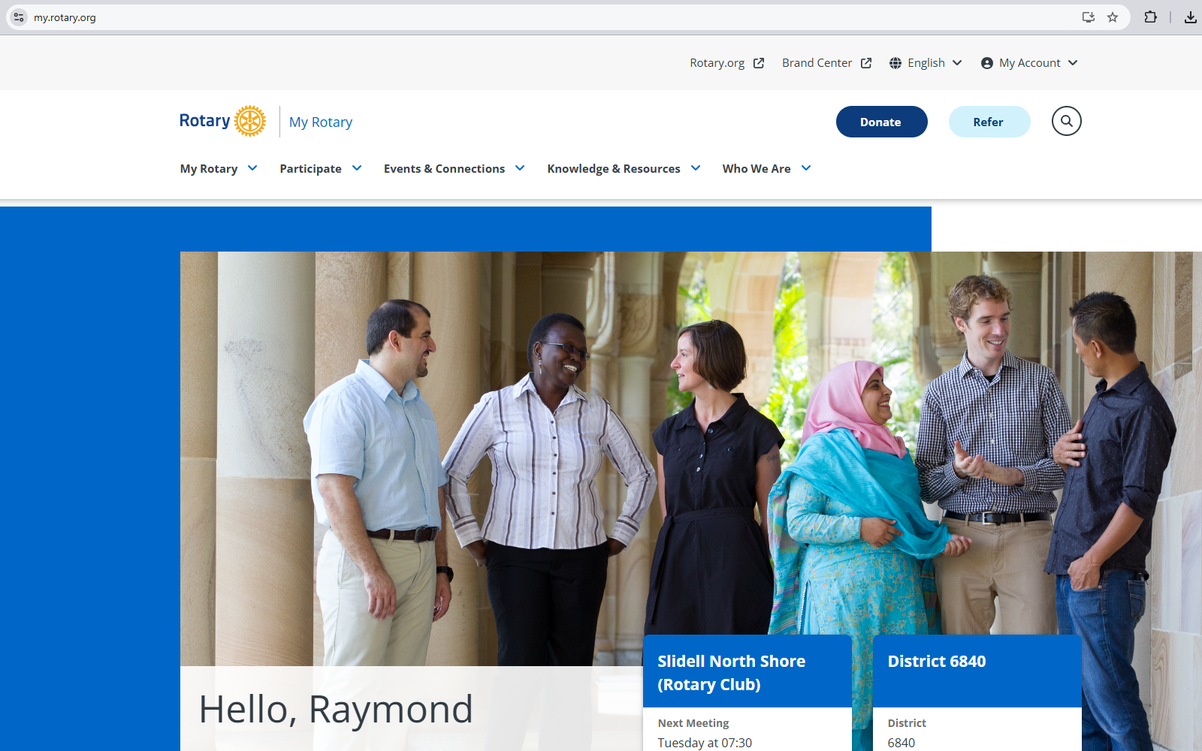
My Rotary
Rotary International Website

Slide 26
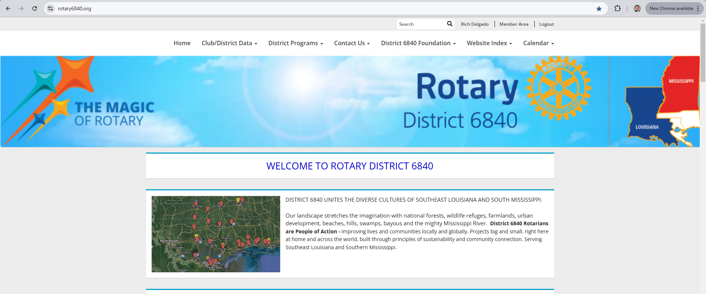
My Rotary
District 6840 Website
(Club Runner)

Slide 27
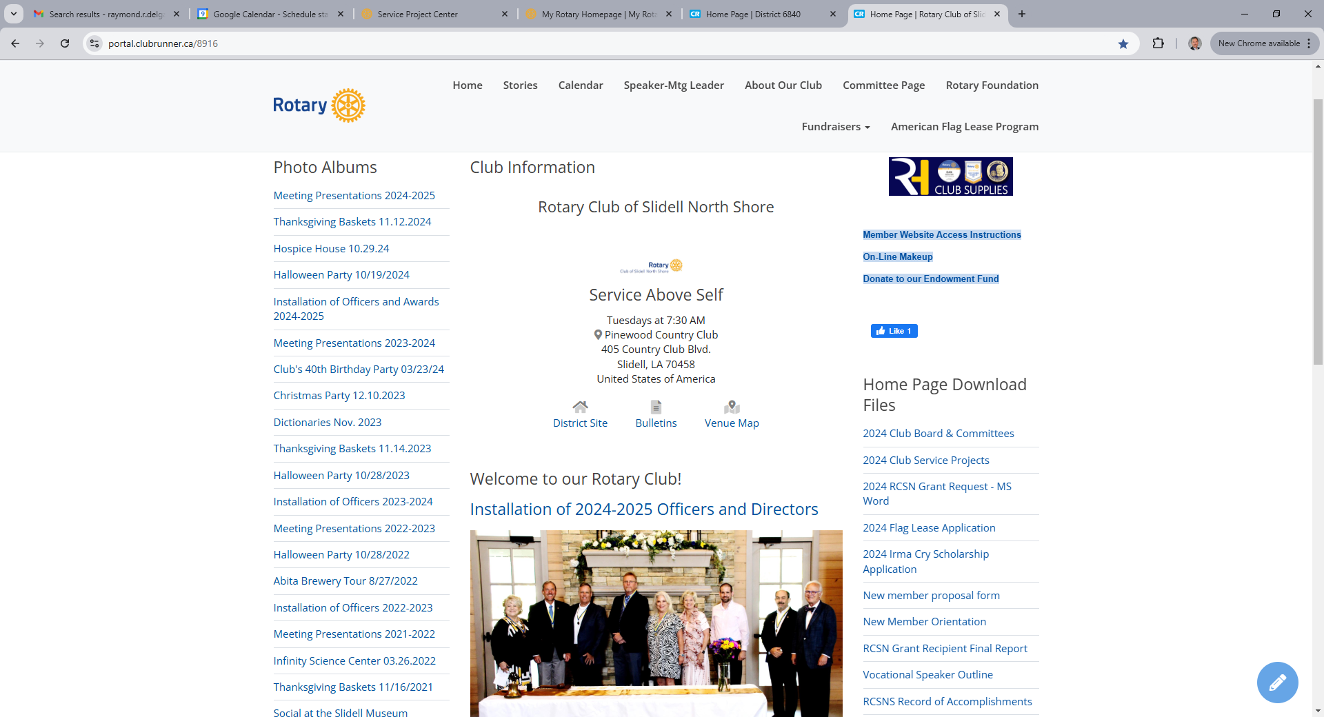
My Rotary
Club Website
(Club Runner)

Slide 28
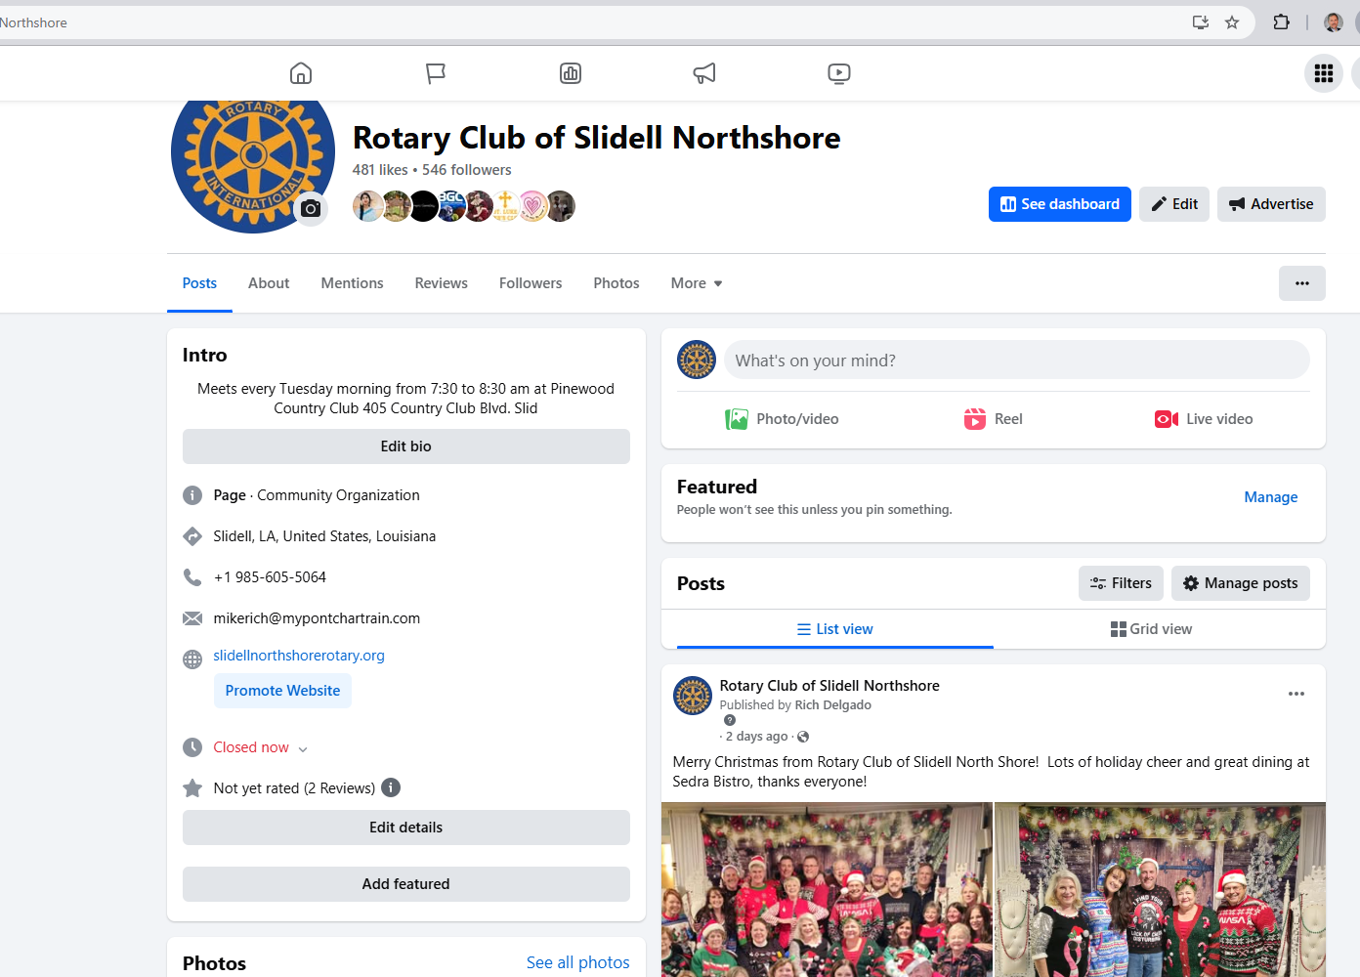
My Rotary
Club Facebook

Slide 29
Getting Involved
Club Committees
Club Projects
Board Meetings
Club Meetings
Club Social Activities

Slide 30
Personal Reward in Being an Involved Rotarian
Satisfaction of helping less fortunate in our Community
Satisfaction of helping less fortunate Worldwide
Develop Business relationship with fellow Rotarians in our Club and District

Slide 31
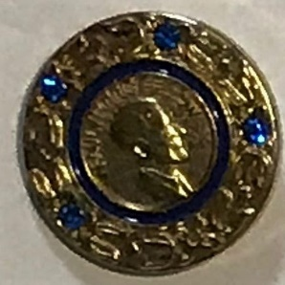
Personal Recognition for Being an Involved Rotarian
Rotarian of Year by Club & District Certificate
District Service Award Certificate
Paul Harris Fellow Medallion

Slide 32
Always Remember
Rotarians
Make A
Difference

Slide 33
Extra Slides

Slide 34
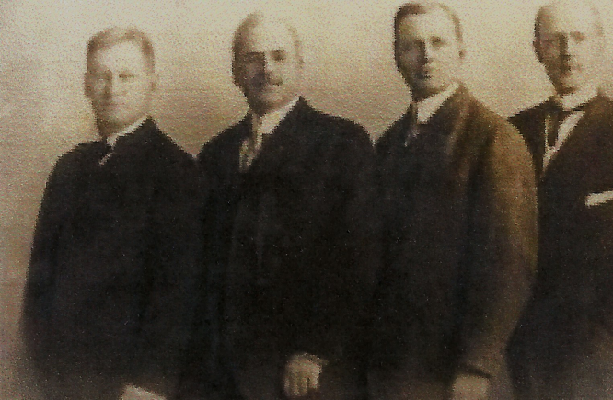
You are attending this briefing due to the vision of these men-
Gustavus Loehr, Silvester Schiele, Hiram Shorey, Paul V. Harris

Slide 35
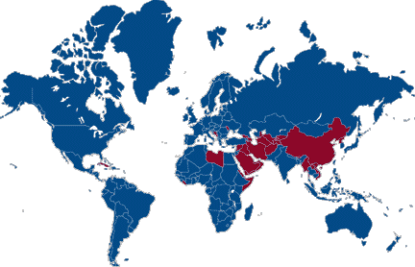
Over the Past 100 Years Rotary Clubs have been Established in 200 Countries

Slide 36
Rotary International Information Resources
Rotary Magazine
www.rotary.org
My Rotary website
Annual Convention
Official Licensed Branding

Slide 37
Joining Rules
Sponsored by a Club Member
Visit Club Meetings
Meet Classification Guidelines
Reviewed by Membership
Approval by Board of Directors and Club Membership

Slide 38
Membership Rules
Meeting Attendance
Weekly meetings
60% required attendance
Perfect Attendance Desired
Meeting makeup: at other Rotary Clubs, Club Board Meeting, District event and on the Internet

Slide 39
Joining Rules
Classification Principle
Any profession
No more than 10% of total membership from any one profession
Member to be a business owner or management level

Slide 40
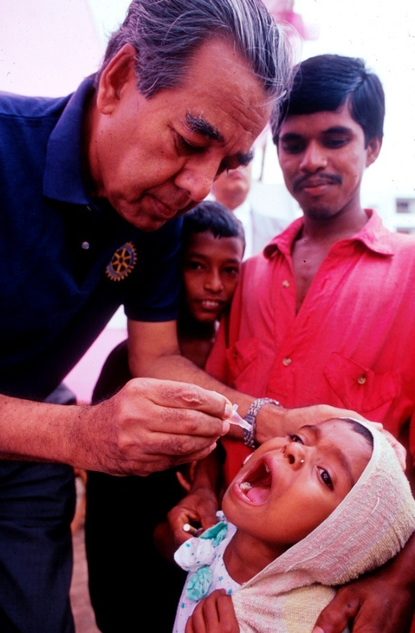
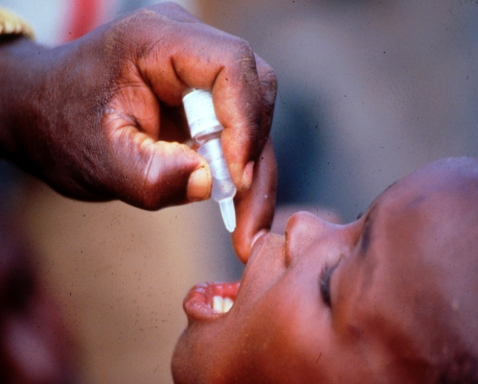
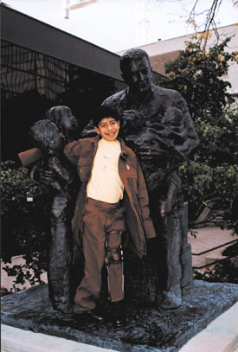
Polio Plus

Slide 41
And Make Commitments
Consider
Areas that really interest you?
What committees will you join?
What service projects will you participate in?
What club office would you aspire to hold?

Slide 42
Key Events
District Annual Conference
June 5-7 2025
Waveland, MS
International Conference
June 21-25, 2025
Calgary, Canada

