Slide 1
Summary of Findings – CHNR Member Survey
August 2023

Slide 2
Background
Nov 2022 Strategic Visioning
Feb 2023 Input from Club on Strategic Visioning
Mar 2023 Incoming Board Retreat and development of Ascertainment Interview
Jun/Jul 2023 75% of membership participated in 1:1 interviews

Slide 3
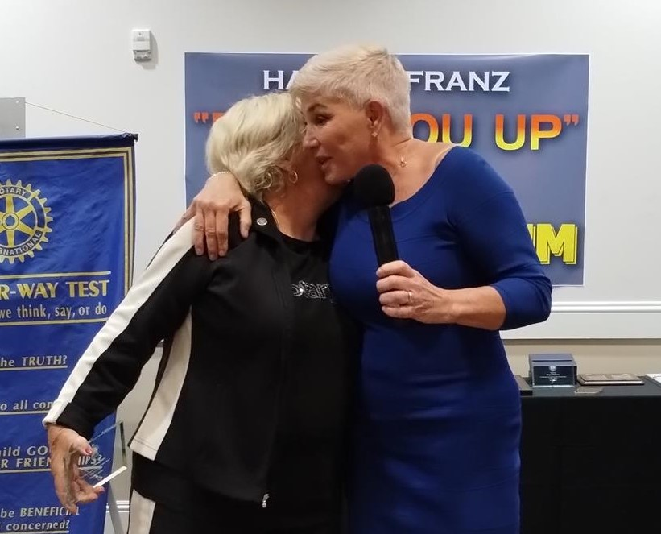
Key areas explored
What makes Rotary meaningful and worthwhile
When and how we meet
Costs to members
Revenue generation
Member and community engagement
Projects

Slide 5
Meeting logistics
70% open or neutral to change
30% opposed to change
Lunch Costs
Lunch costs
Most did not find them a barrier

Slide 6
Revenue generation
Transparency about Club finances
Increase recognition for donors
Partnerships for fundraisers
Raffle
Do things differently

Slide 7
Member and Community Engagement
We have lots to offer!
Engage new members
Family involvement
Social & project engagement
Corporate memberships
Opportunities for everyone to participate
Member expertise for mentorships

Slide 8
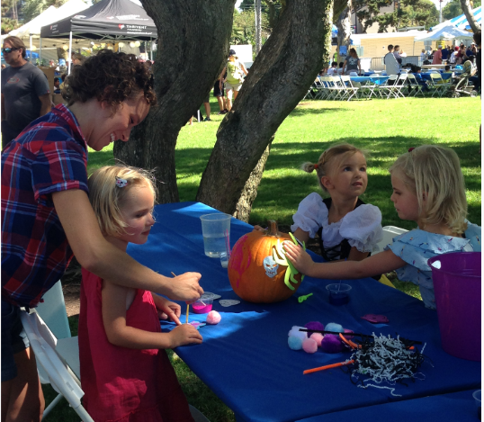
Projects
We love projects!
Are we doing too many?
Prioritize

Slide 9
Observations
Member engagement and appreciation
Care about our Club and its future
Desire for more transparency
Diversity is good
Communication
Mentorship
Revenue
Rotary International awareness
Make projects inclusive

