Slide 1
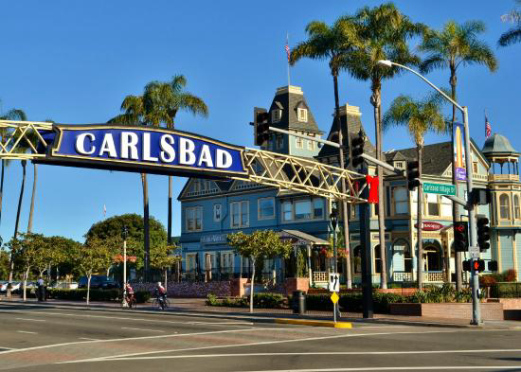

We Are Carlsbad Hi-Noon Rotary
Rotary Year 2026-27

Slide 2

Carlsbad Hi-Noon Rotary
Carlsbad Hi-Noon Rotary (CHNR) was founded in 1980. We are one of two Rotary clubs located in Carlsbad, California, a coastal city of approximately 115,000 residents 35 miles north of San Diego.
Our club meets every other Monday (except Federal holidays) for lunch. Our meetings start at 12PM (Hi-Noon). For specific details regarding our meeting times, locations and speakers see the club webpage at (carlsbadhinoonrotary.org) Follow us on Facebook: Carlsbad Hi-Noon Rotary Club
As of 1 July 2026 we have 51 members – we’re always open to new recruits who want to join us in making a positive difference in our communities—local and worldwide.
Our current President is Kori Dolkas and the President-Elect, who will lead the club in 2027-2028 is Bob Stonebrook.

Slide 3
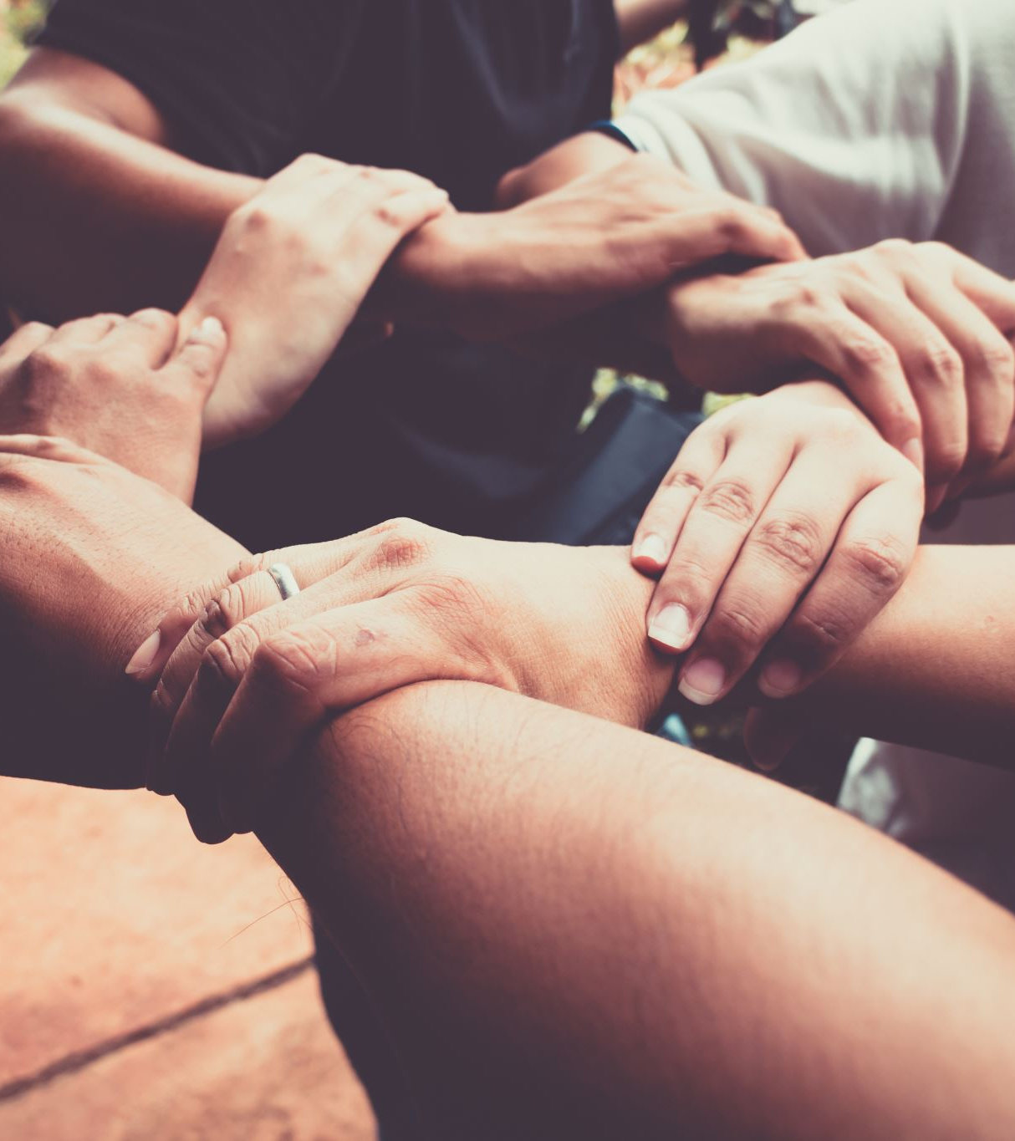
Carlsbad Hi-Noon Rotary
At Carlsbad Hi-Noon Rotary we pride ourselves on our “Service Above Self.” During Rotary Year 2025-26 we completed over 50 service projects, accounting for 2,461 volunteer hours coordinated through the following committees:
  Community Service
  Youth Service
    We also sponsor and support a Rotary Interact Club at Carlsbad High School
  Vocational Service
  International Service
  Club Service is an active program focused on team building, club cohesion and morale (fun stuff) enjoying 25 events this past year.

Slide 4
Carlsbad
Hi-Noon Rotary
Community Service – Providing hands-on service to organizations impacting the quality of life in Carlsbad.
During the 2025-2026 Rotary Year this club participated in 26 community-based projects involving 625 volunteer hours:
  Volunteered at North County Food Bank packing food for those in need (10 events).
  Volunteered at Brother Benno’s serving meals to homeless (12 events). Provided $5,000 grant for sock and underwear for homeless.
  Provided holiday gifts for 14 Carlsbad families facing financial hardship.
  Planned and coordinated Rotarians at Work Day, a hands-on community support project. This year’s project was a restoration and maintenance project for a local hospice.
  Supported a community cleanup and refresh of Carlsbad’s Hosp Park, Carlsbad Hi-Noon Rotary Picnic Area.
  Packaged 20,000 meals with Harvest Pack and donated them to North County Food Bank.

Slide 5
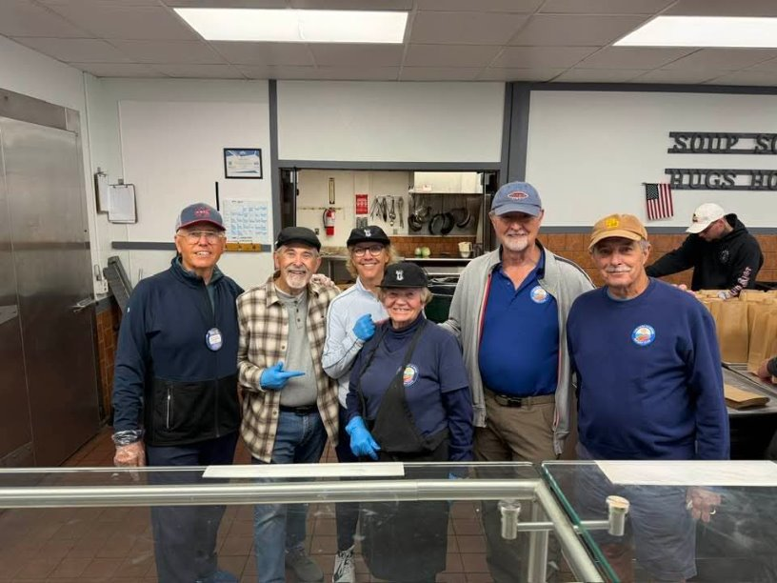
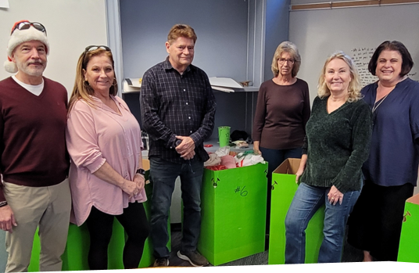
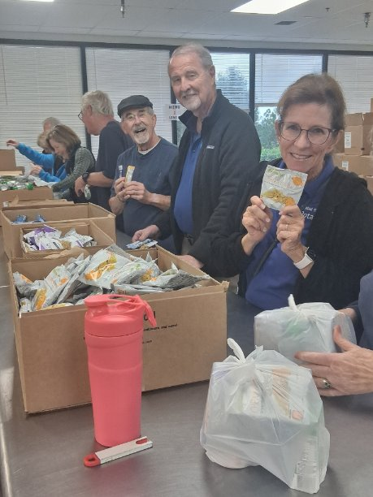
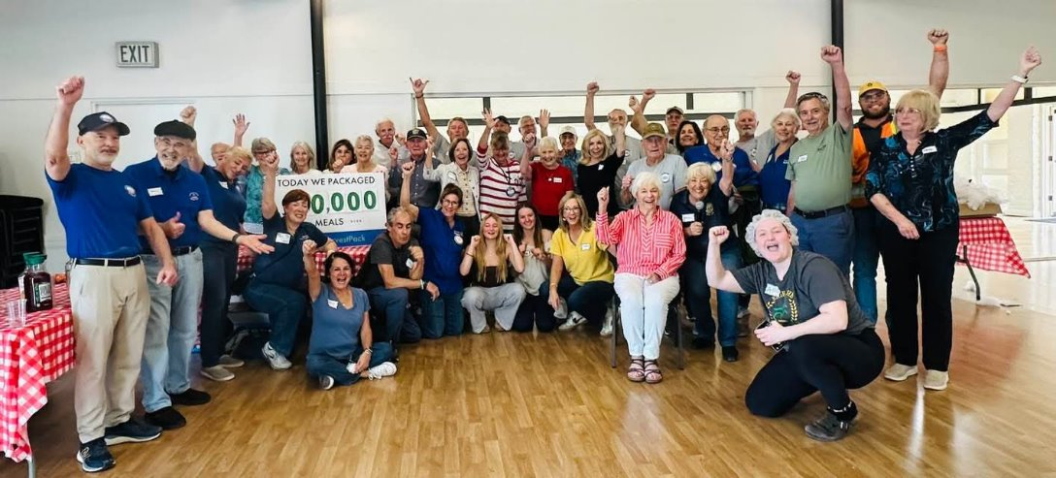
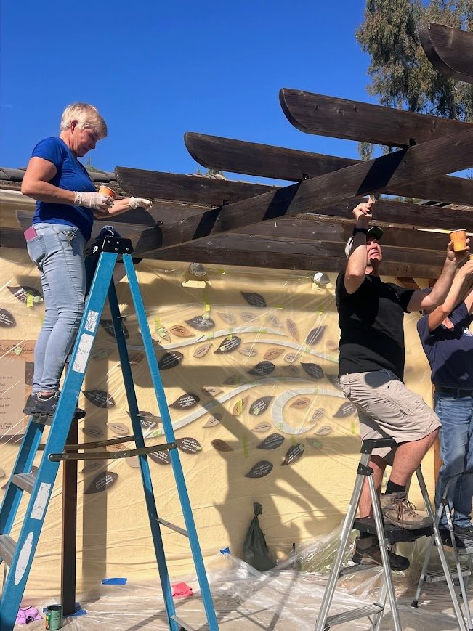
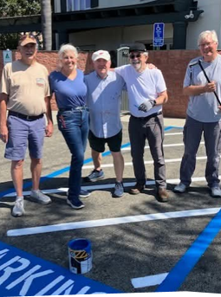
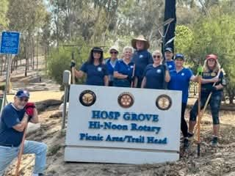
Carlsbad
Hi-Noon Rotary
Holiday Gifts for Needy Families
Community Service
Clockwise from Top/Left
Father Benno’s, Jefferson School Families, Harvest Pack Meal Pack, Rotarians at Work, RAW2, Hosp Park Refresh, Food Bank.

Slide 6
Carlsbad
Hi-Noon Rotary
Youth Service – providing resources to the young people of Carlsbad in a variety of contexts, including:
Leadership Development
  LEAD (leadership for middle school leaders)
  RYLA - (leadership for high school leaders)
Professional Skills
  Middle School Essay Competition
  High School Speech Competition
  Model UN, for speaking skills, negotiating skills, and teamwork
  Musical Instrument Competition
Education
  Junior Achievement curriculum, for financial acumen
  Book Fair - providing elementary school students with books they own
  What Grownups Do For Work - an interactive program with middle school students where we share our work experiences in all of our various fields of expertise
Service
  Interact, a form of a Rotary Club for high school students, offering the students an opportunity to provide services to local people as well as international projects
Fun and health exercise
  Pickleball equipment and skills training for elementary school students
Youth Service

Slide 7
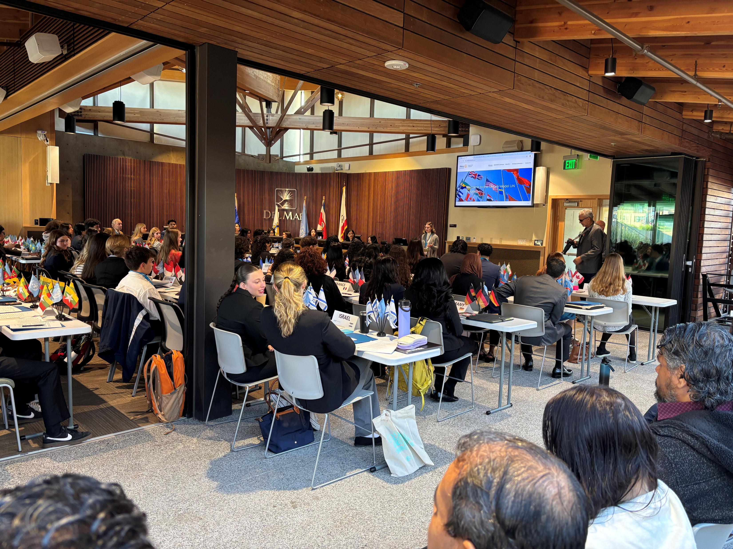
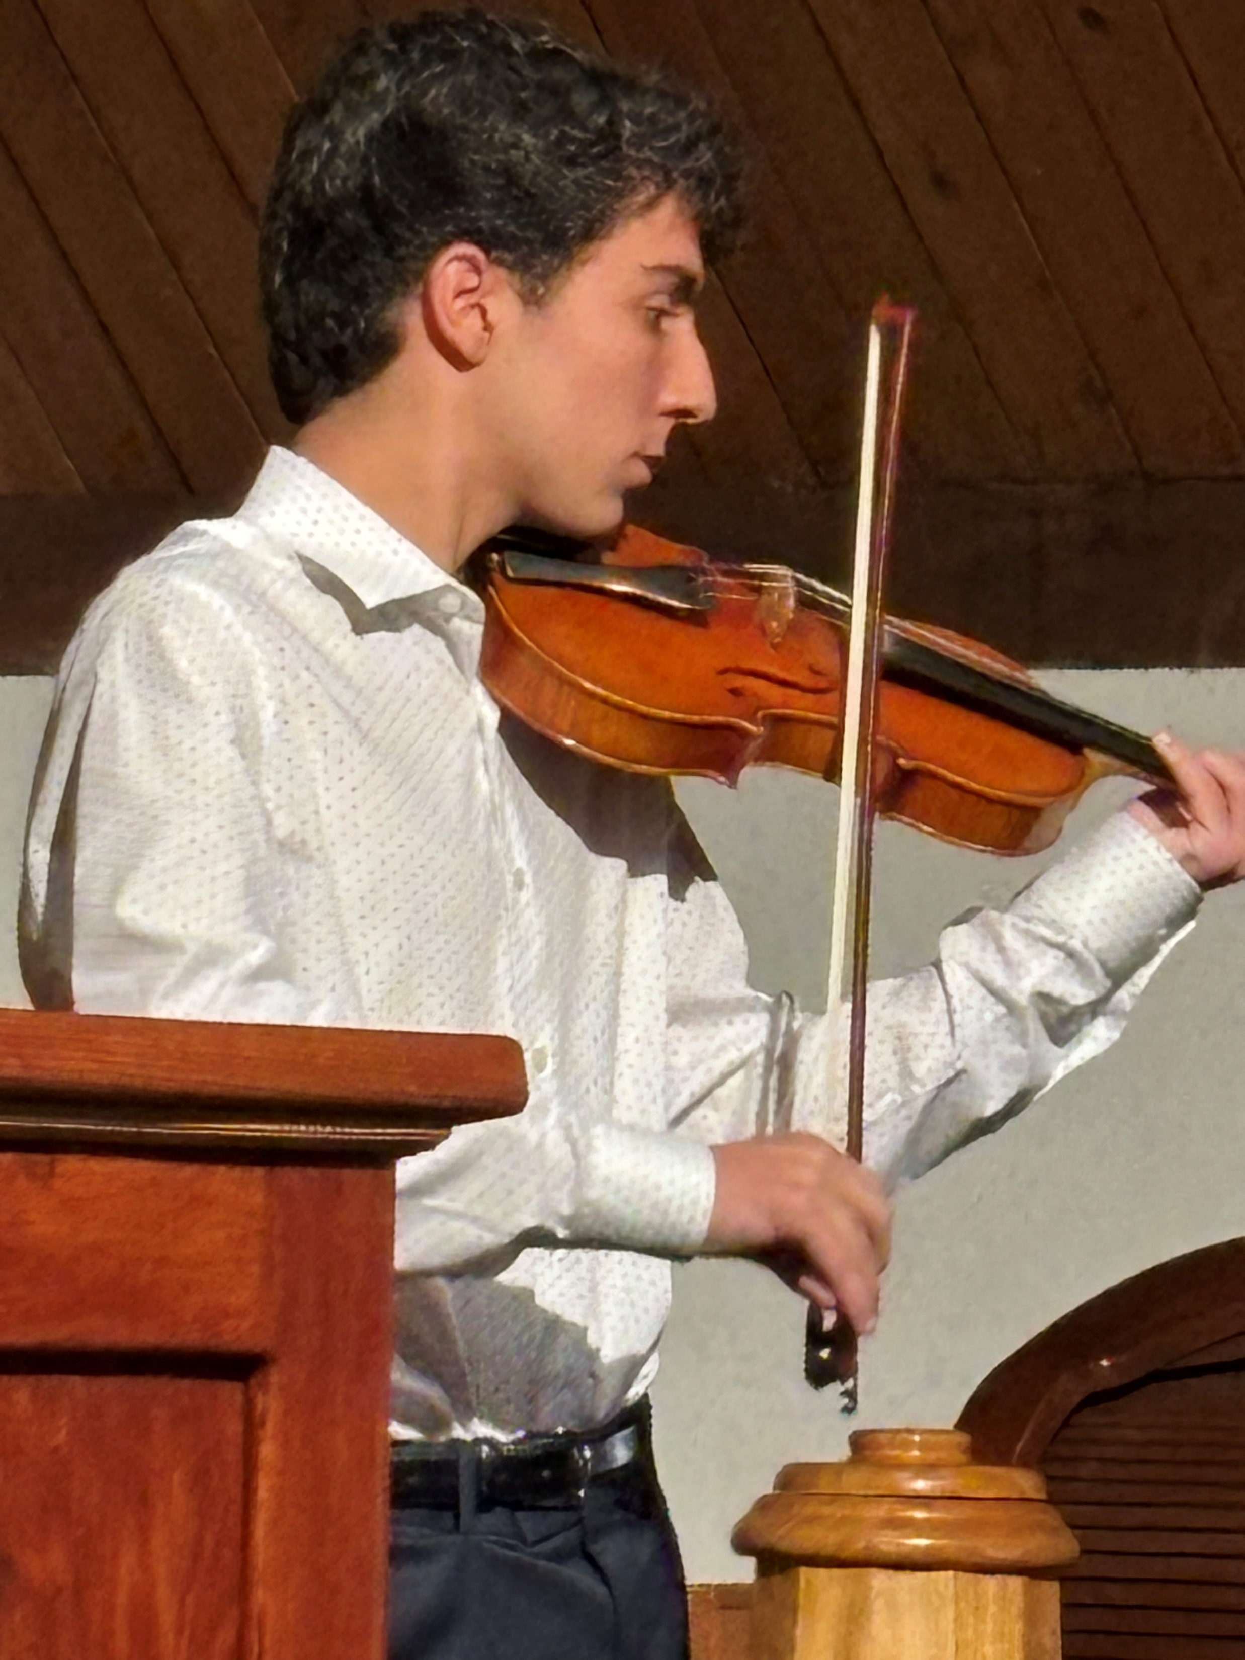
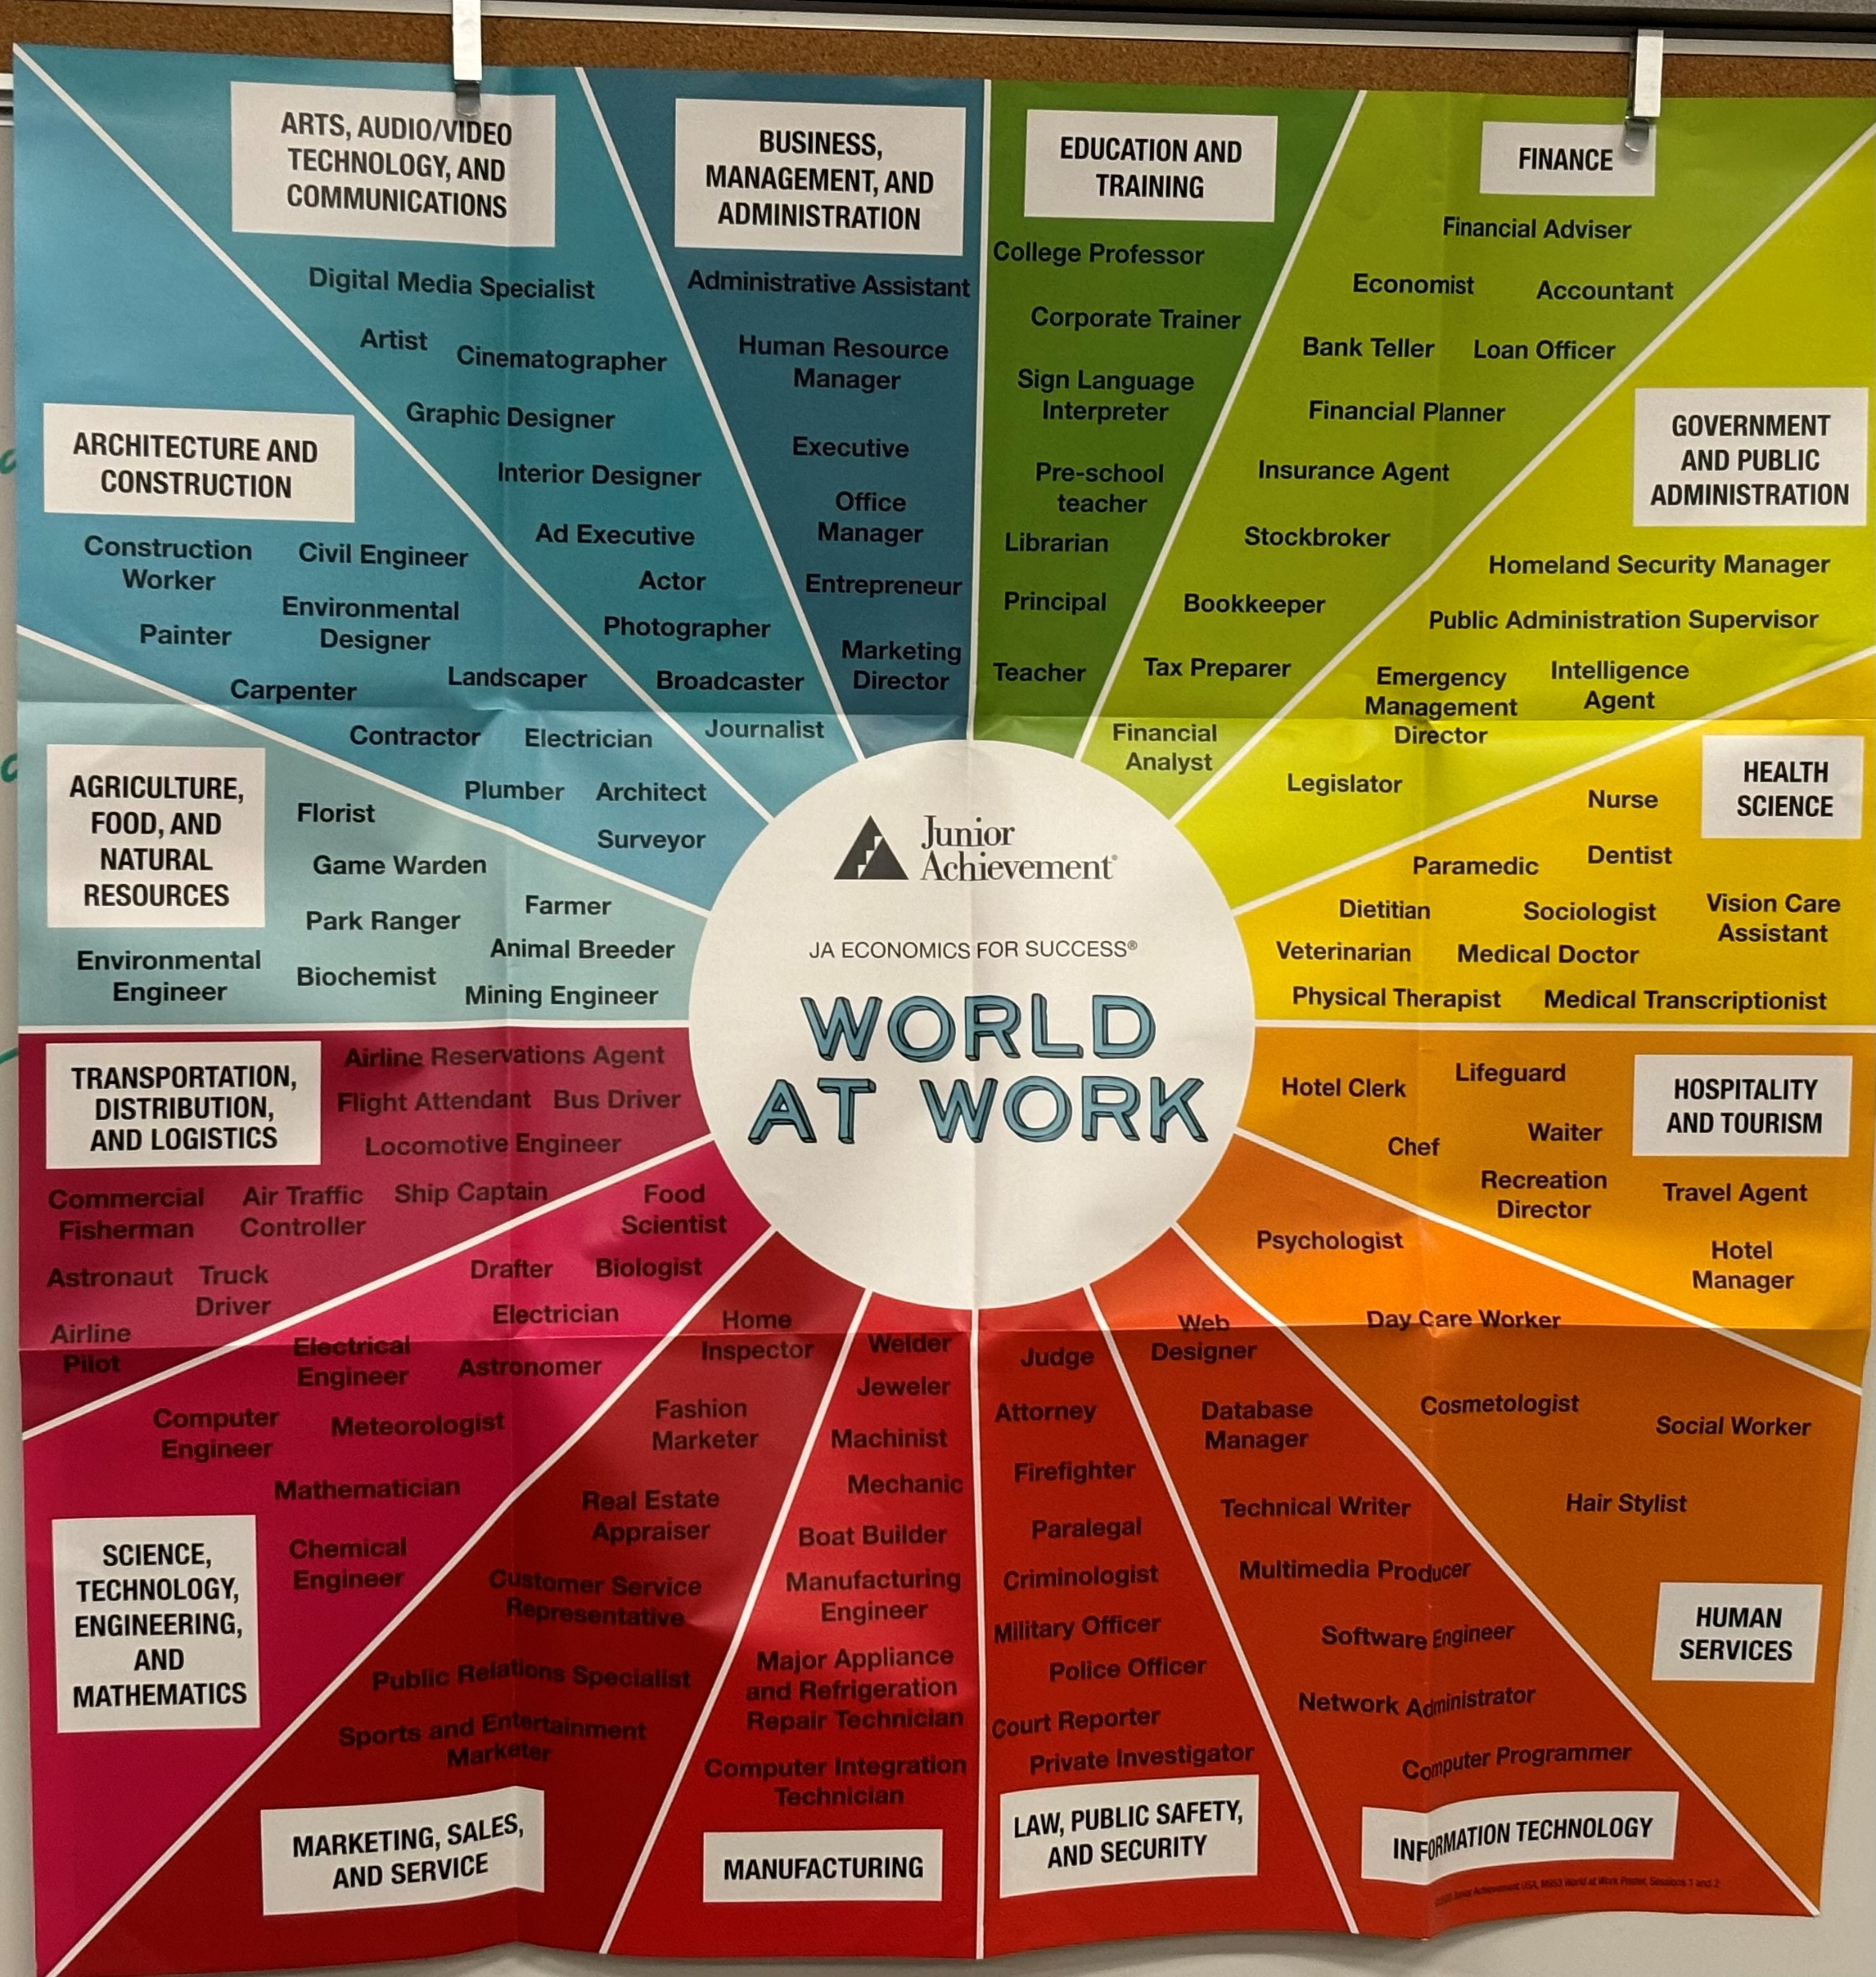
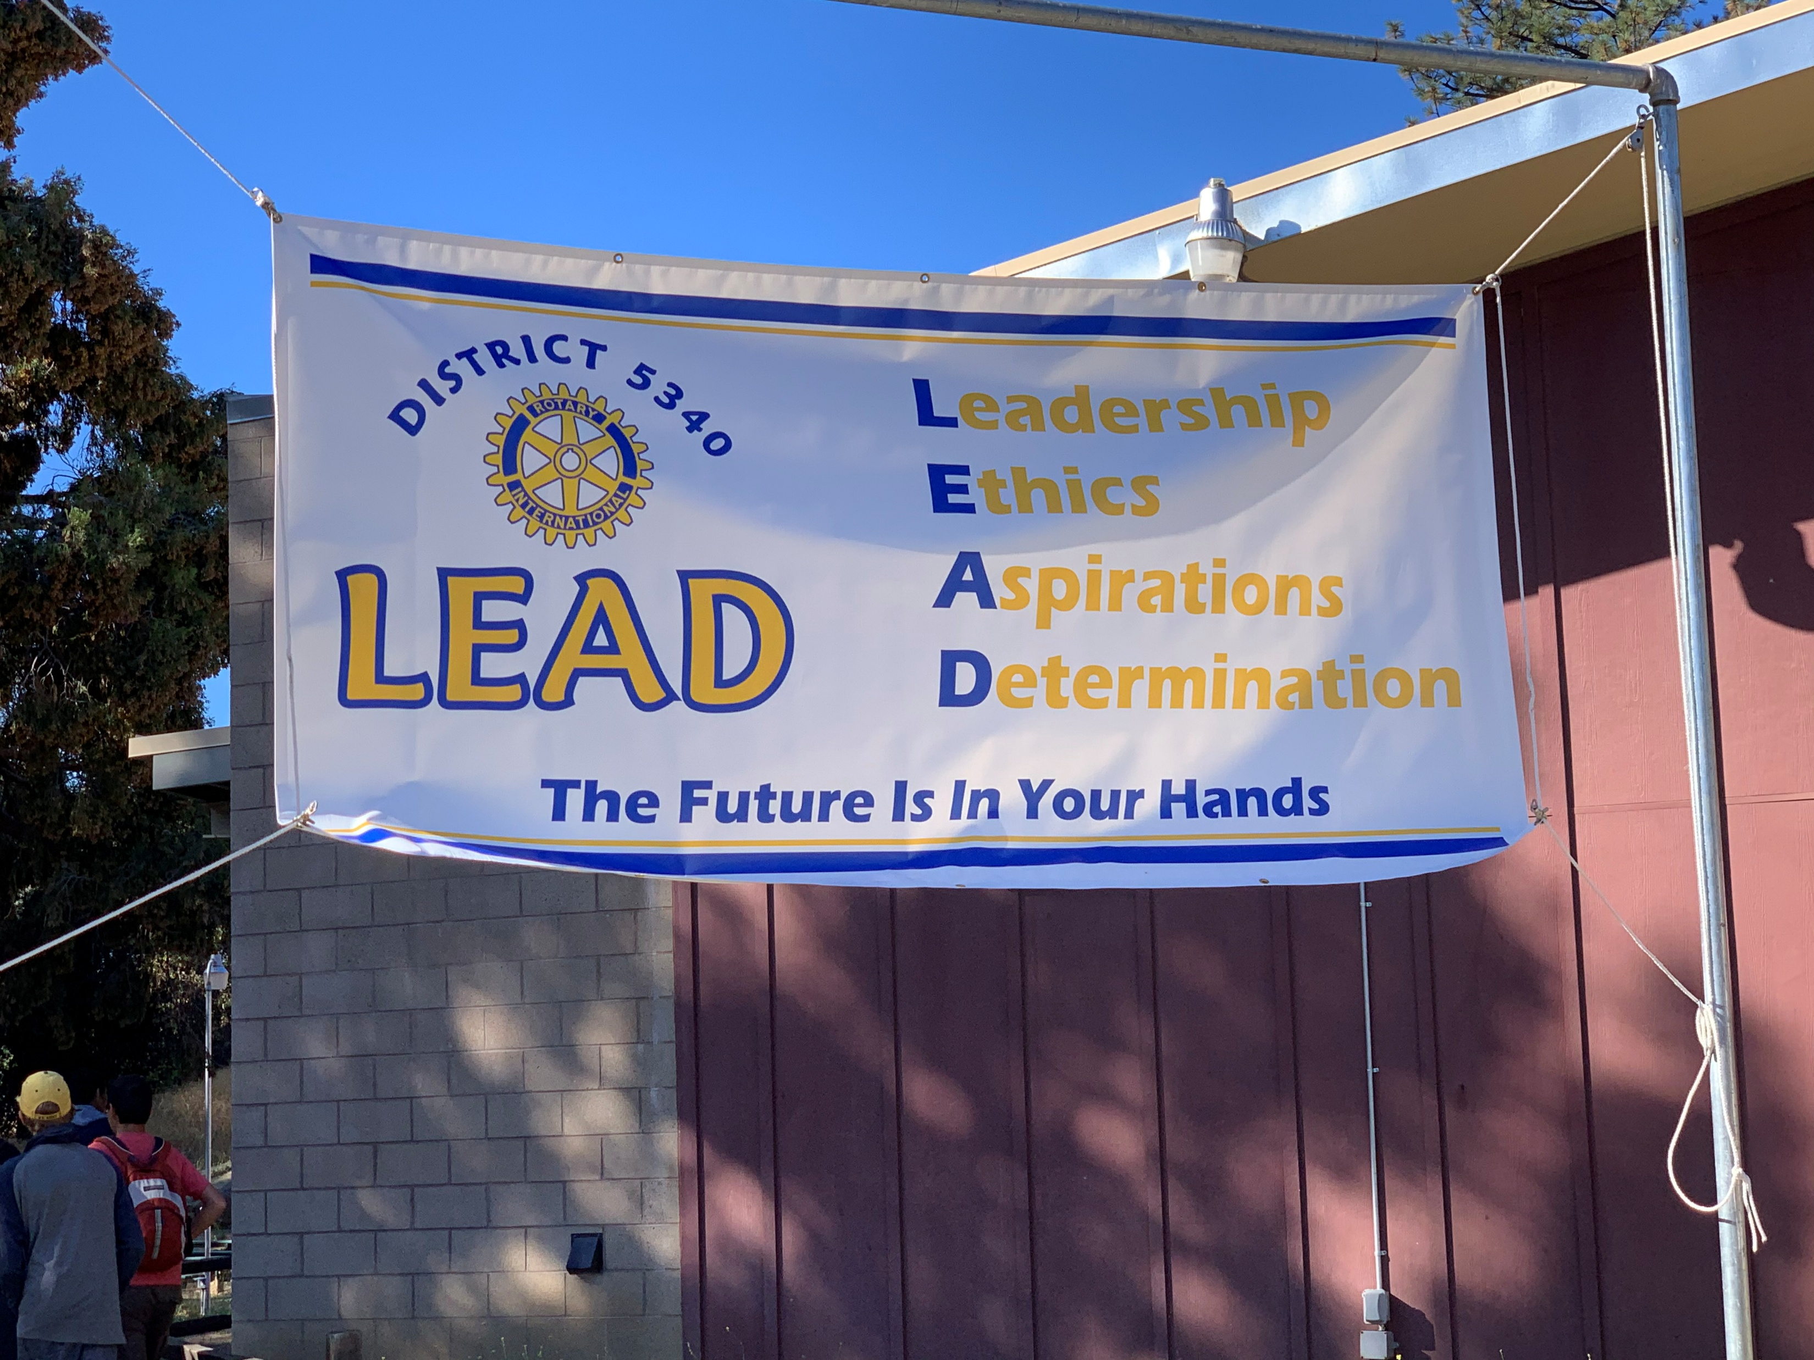
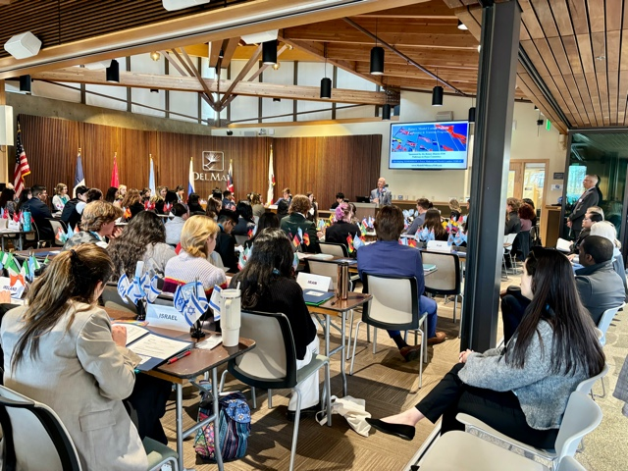
Carlsbad
Hi-Noon Rotary
Model UN
Top left and clockwise:
Model UN, Music Competition, LEAD Conf., What Grownups do for Work
Scholarship recipients
Youth Service

Slide 8
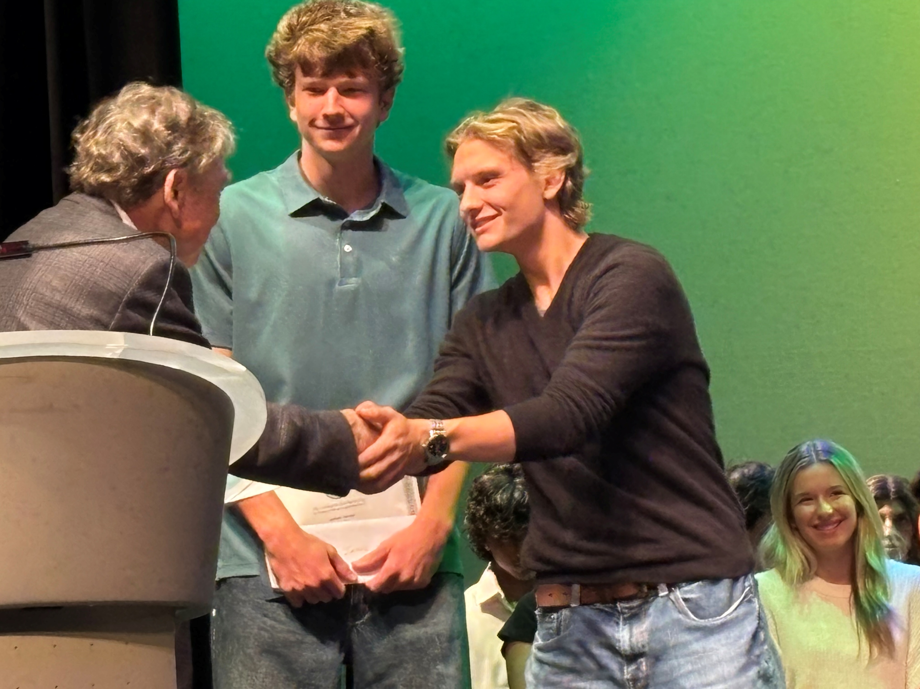
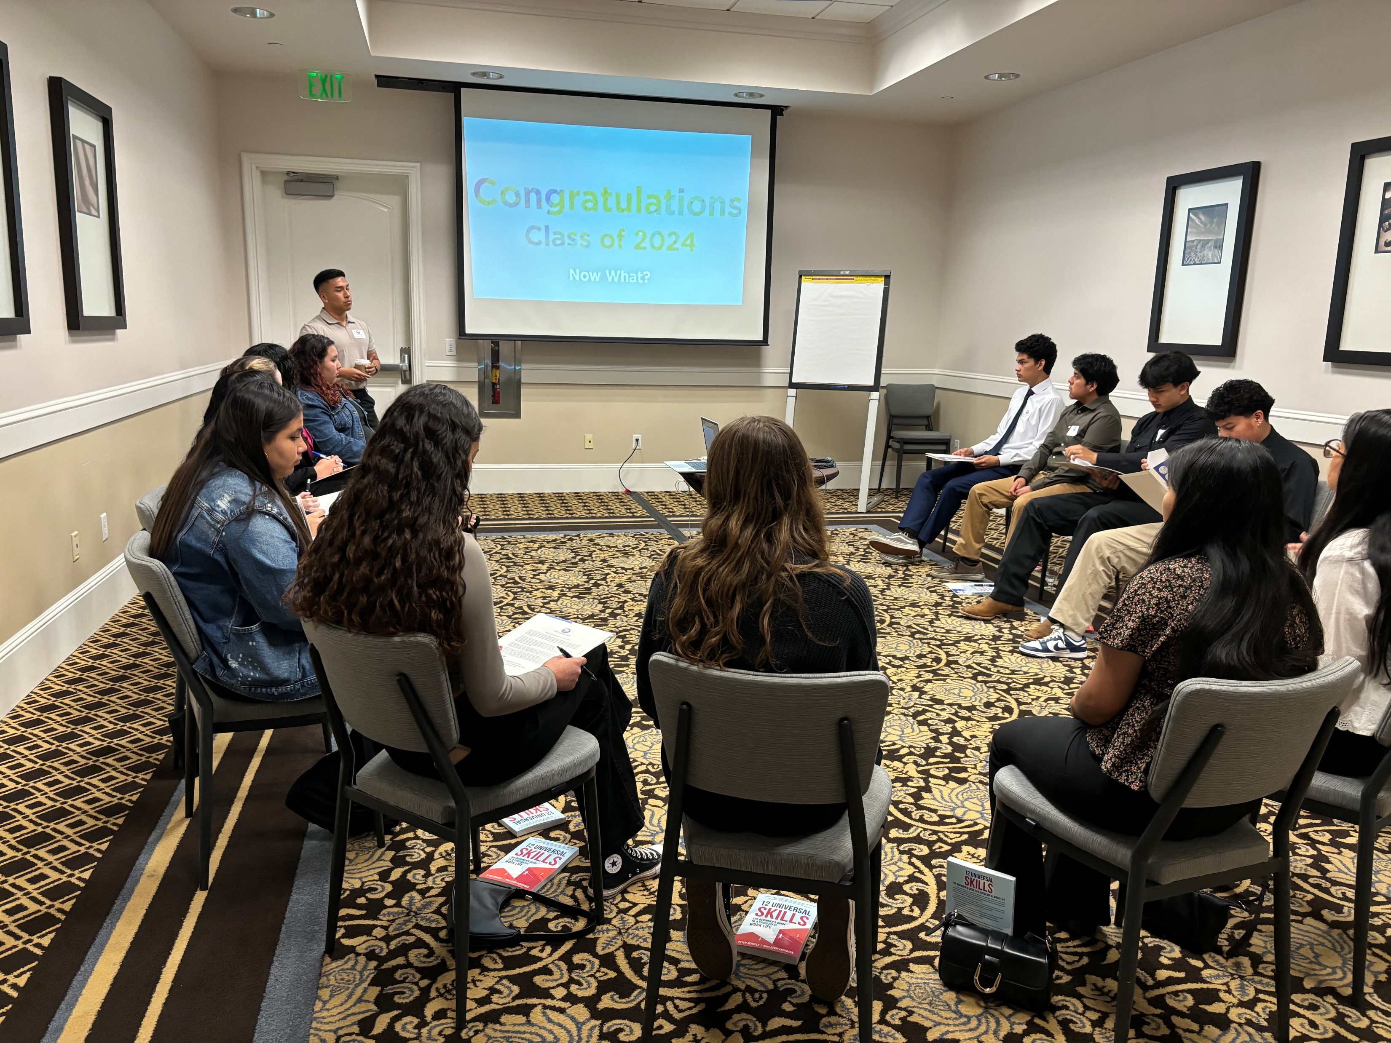
Carlsbad
Hi-Noon Rotary
Vocational Service: during the 2025-26 club year our members planned and implemented :
  AVID (Advance Via Individual Determination) Youth one-day conference for high school students.
  RYLA (Rotary Youth Leadership Awards) a weekend camp for high school student leaders to increase their interpersonal skills.
  Scholarship Program that raised $52,000 to provide scholarships to local college and trade-school bound students.
RYLA Camp
Vocational Service
Scholarship Recipients
Left: Scholarship Recipients
Right: RYLA

Slide 9
Carlsbad
Hi-Noon Rotary
International Service - A busy year for the International Service Program. During the 2025-2026 Rotary Year this club:
  In Europe, we helped fund equipment for a mental health facility focused on the needs of Ukrainian and Polish children. Additionally, we funded an emergency generator for a regional hospital in Ukraine that had lost access to power and heat (in December) due to Russian attacks on energy infrastructure.
  In Mexico, we helped support an event focused on over 400 disabled children. We also funded a bike give away (42 bikes) for children that needed them to get to school.
  In Central America, we helped rehabilitate and equip an activity space in a rural school outside Santa Ana, El Salvador
  In Africa, we supported a water treatment project in support of a girl’s school in Kenya and school gardens in Atlantis, South Africa, an area with significant levels of food insecurity. During this year, we also took on the role of Rotary International Partner (and satisfied our 15% funding obligation) for a Global Grant project, to establish a counselling facility for an underserved area outside Kampala Uganda.
  In 2026-2027 we intend to reengage in those same regions, in many cases working through our developed relationships with local Rotary clubs.

Slide 10
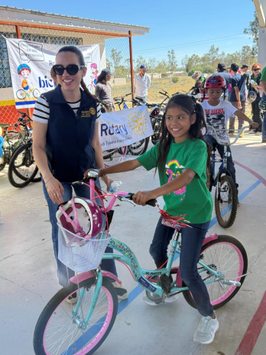
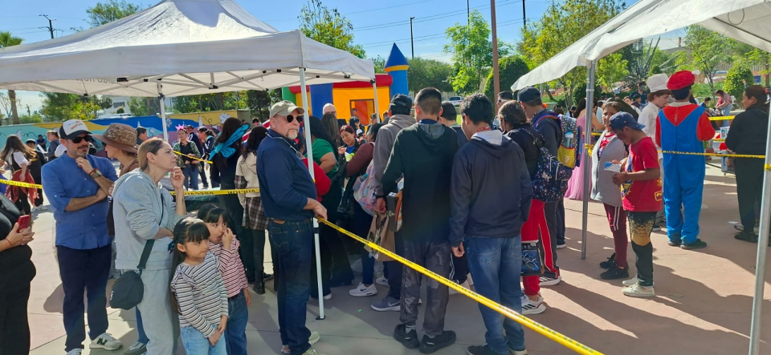
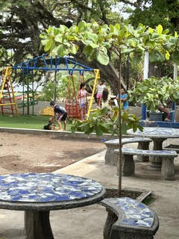
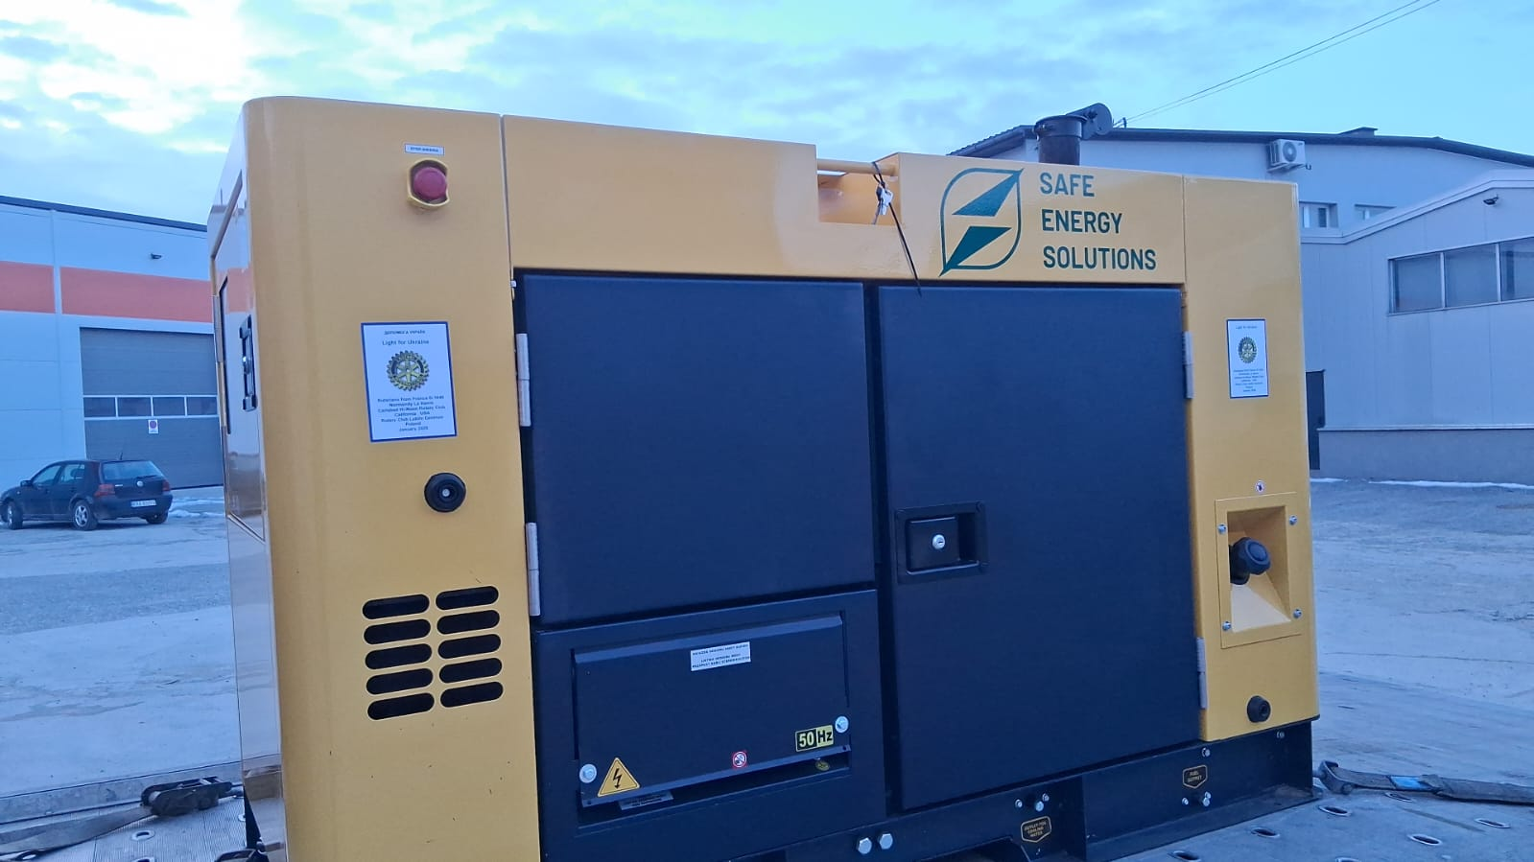
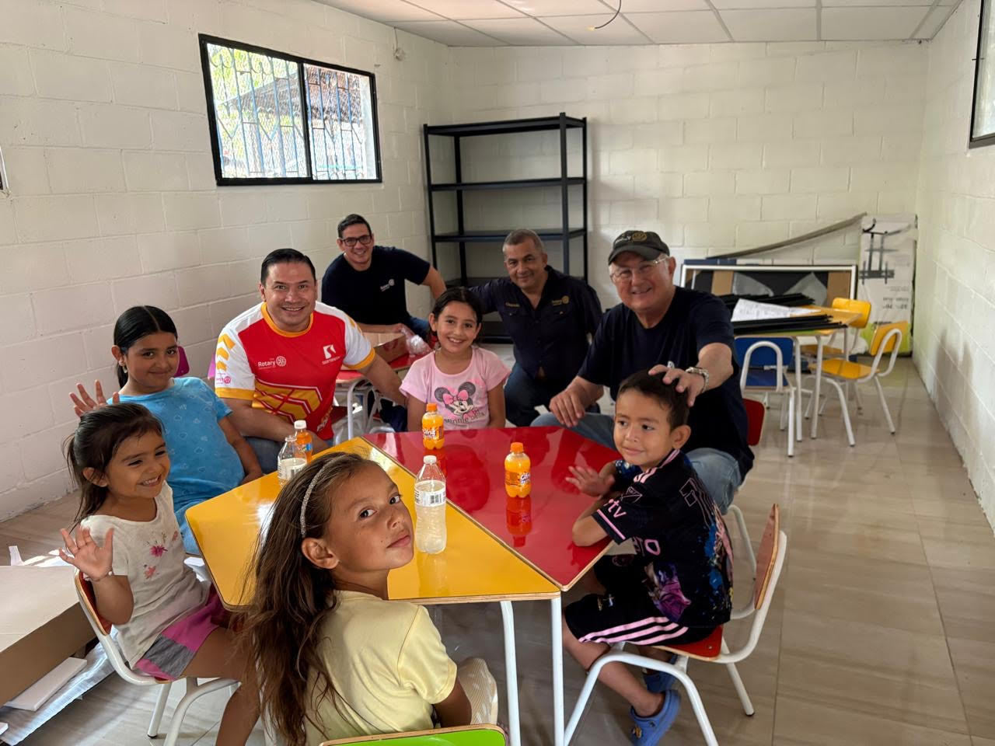
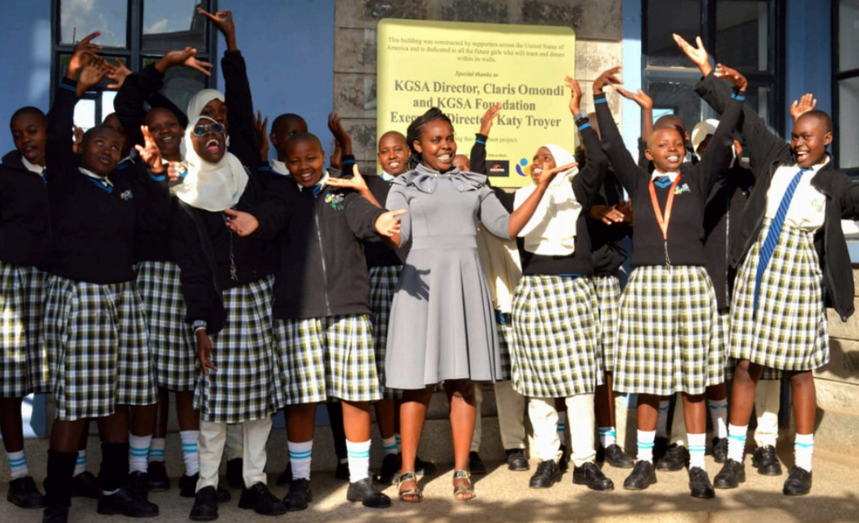
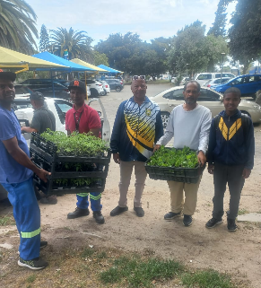
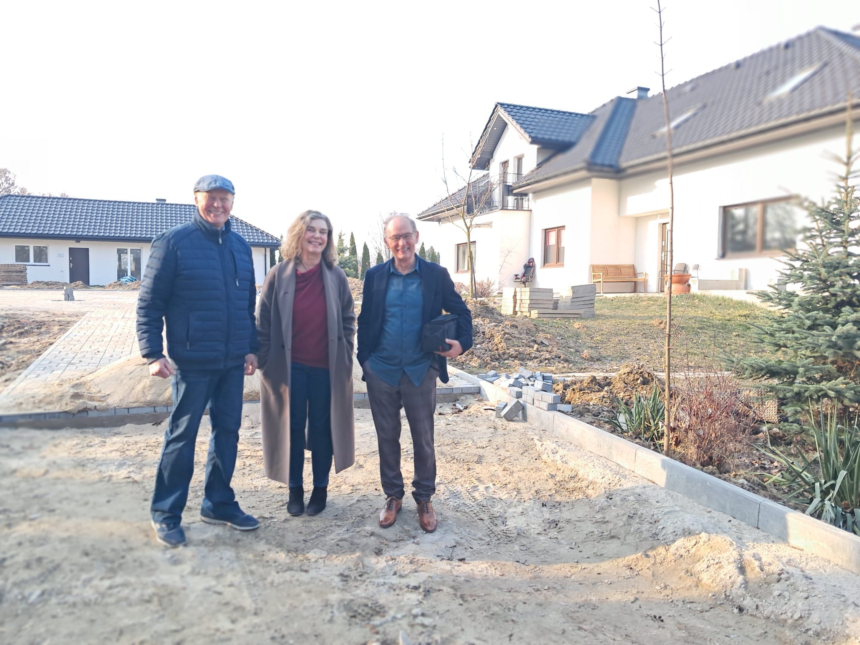
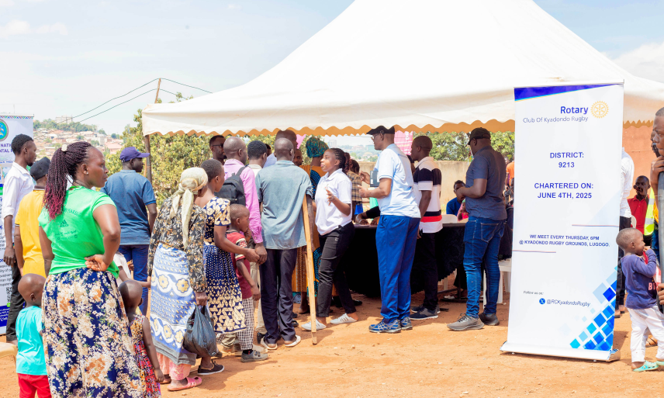
Carlsbad
Hi-Noon Rotary
International Service:
Top left, clockwise. Tijuana Bike Project, Tres Reyes Kids event, El Salvador School rehab, Kibera Girls Soccer Academy water project, Kampala Counseling, Mental Health facility Poland, Atlantis, S.A. school gardens, El Salvador school activity room. Center is the emergency generator for Ukrainian hospital.

Slide 11
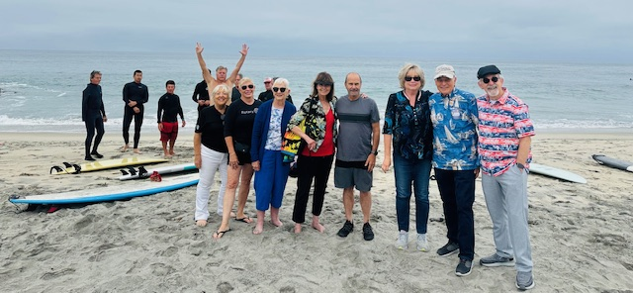
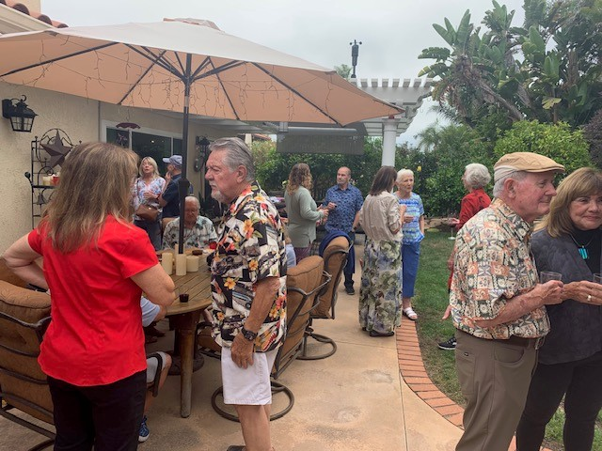
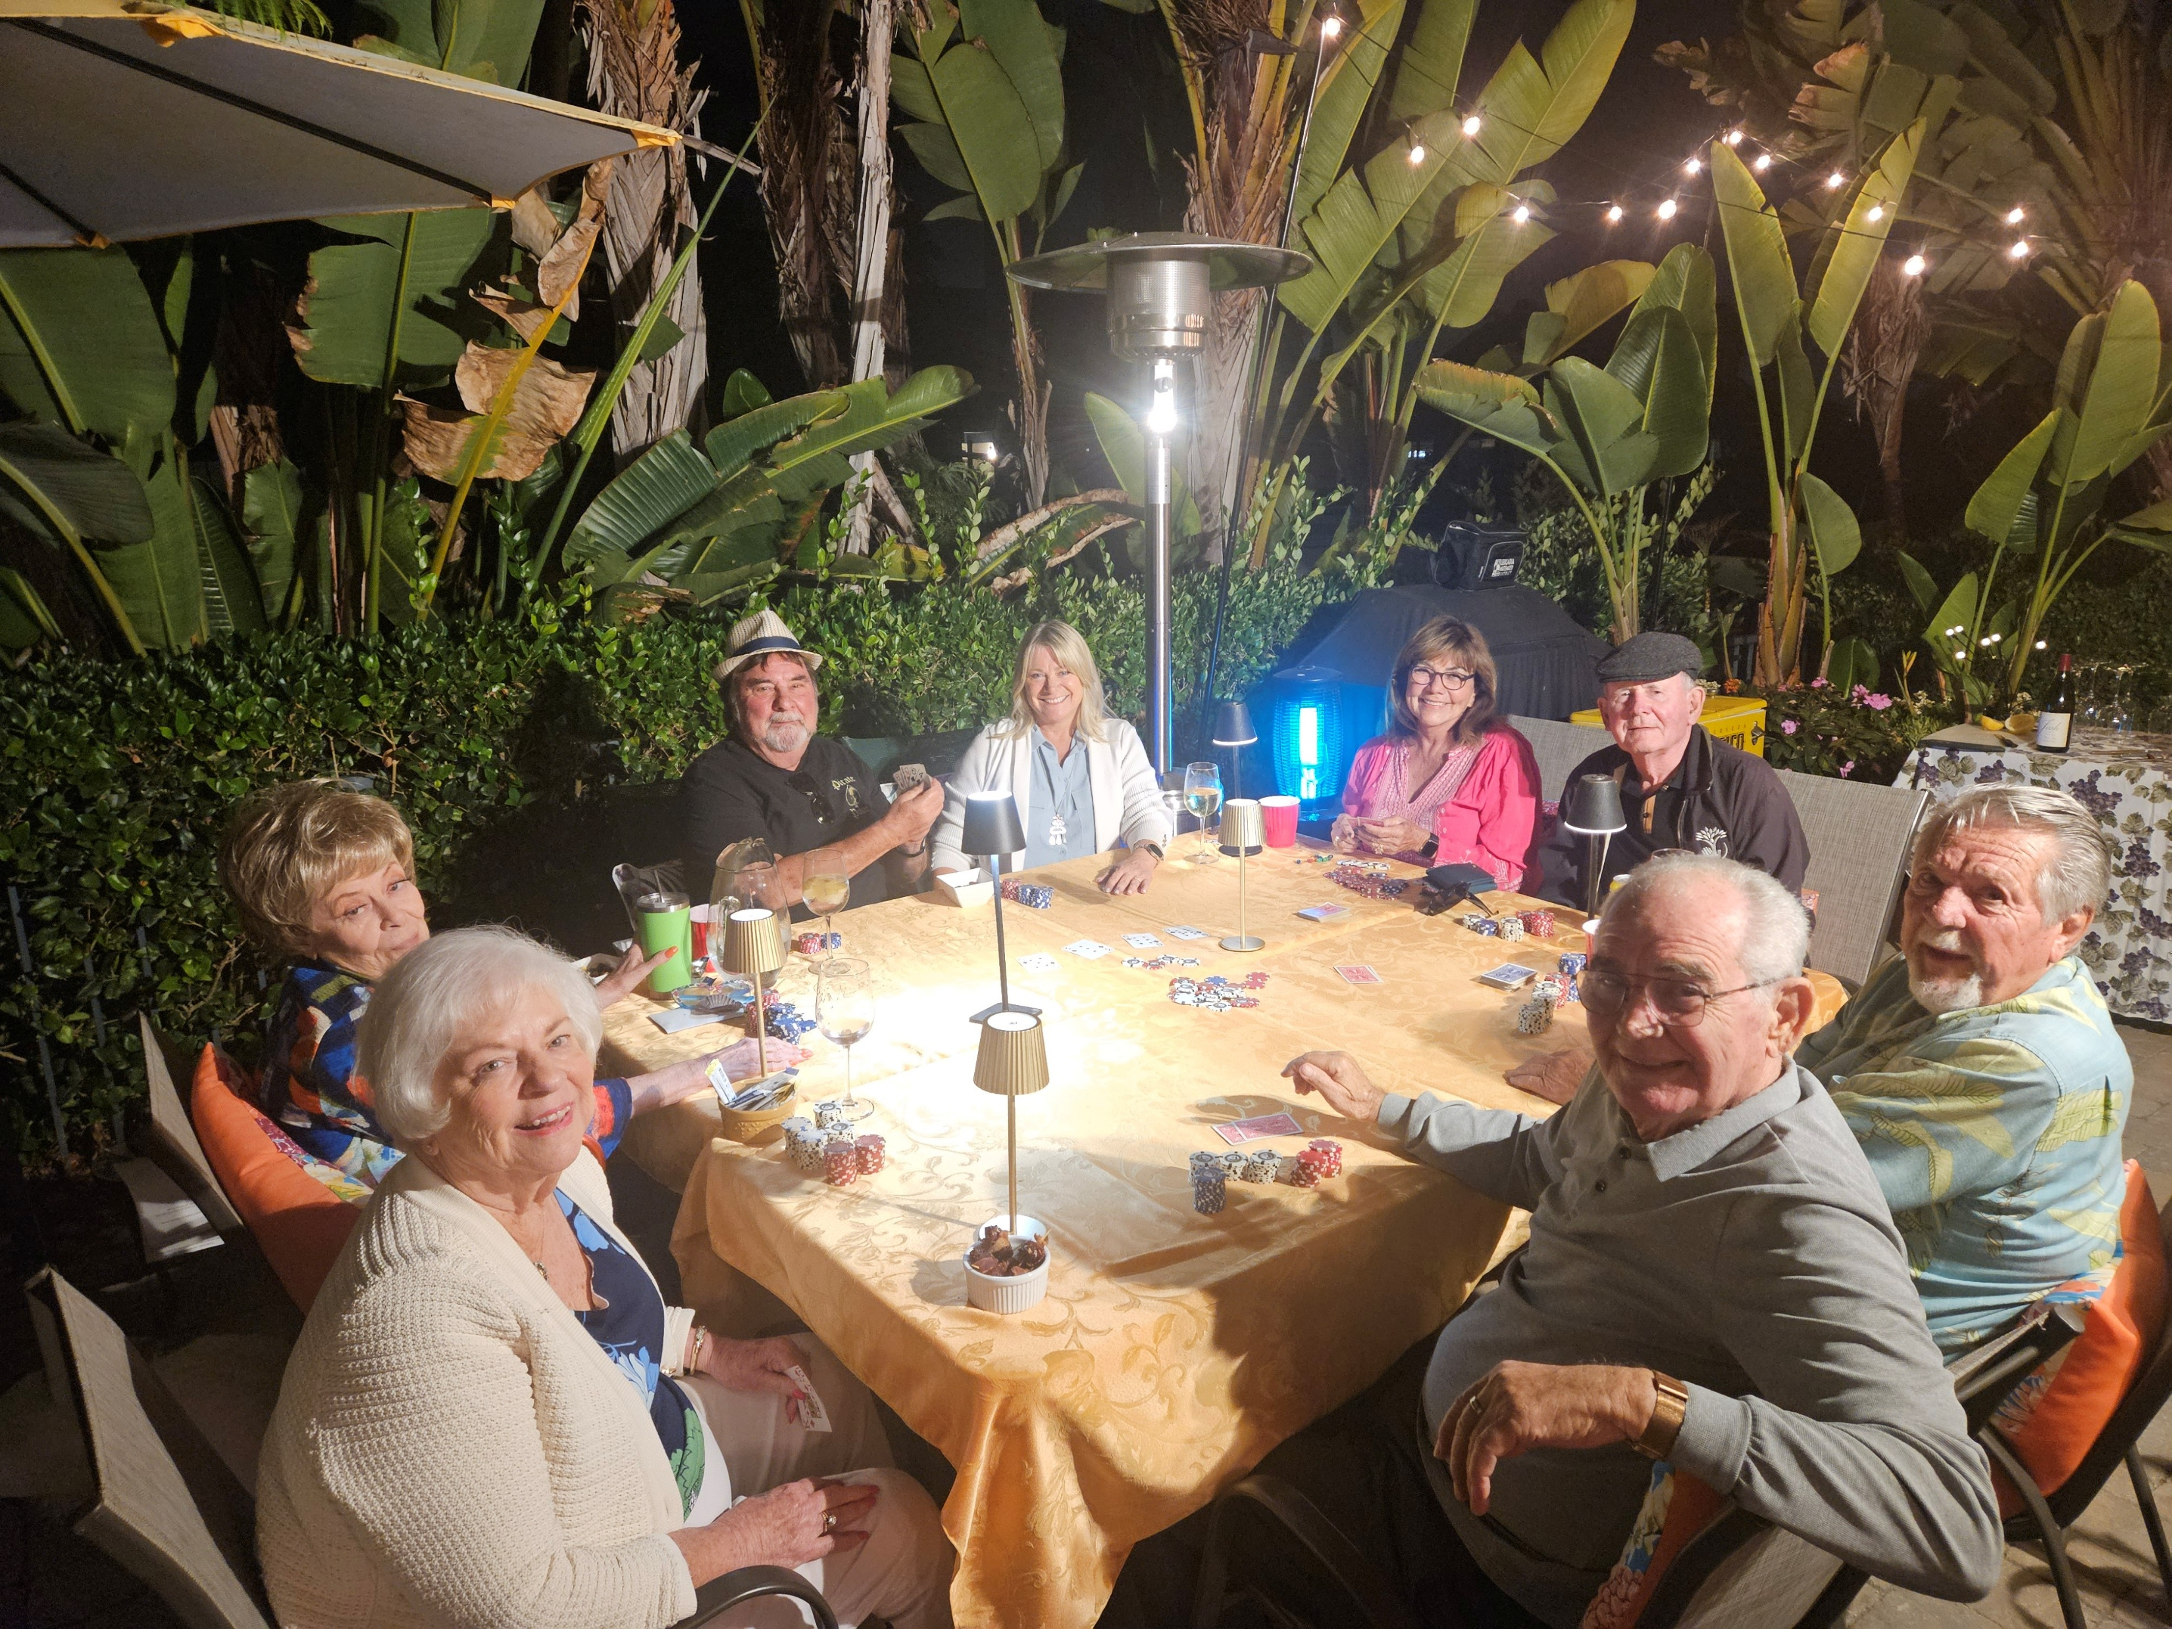
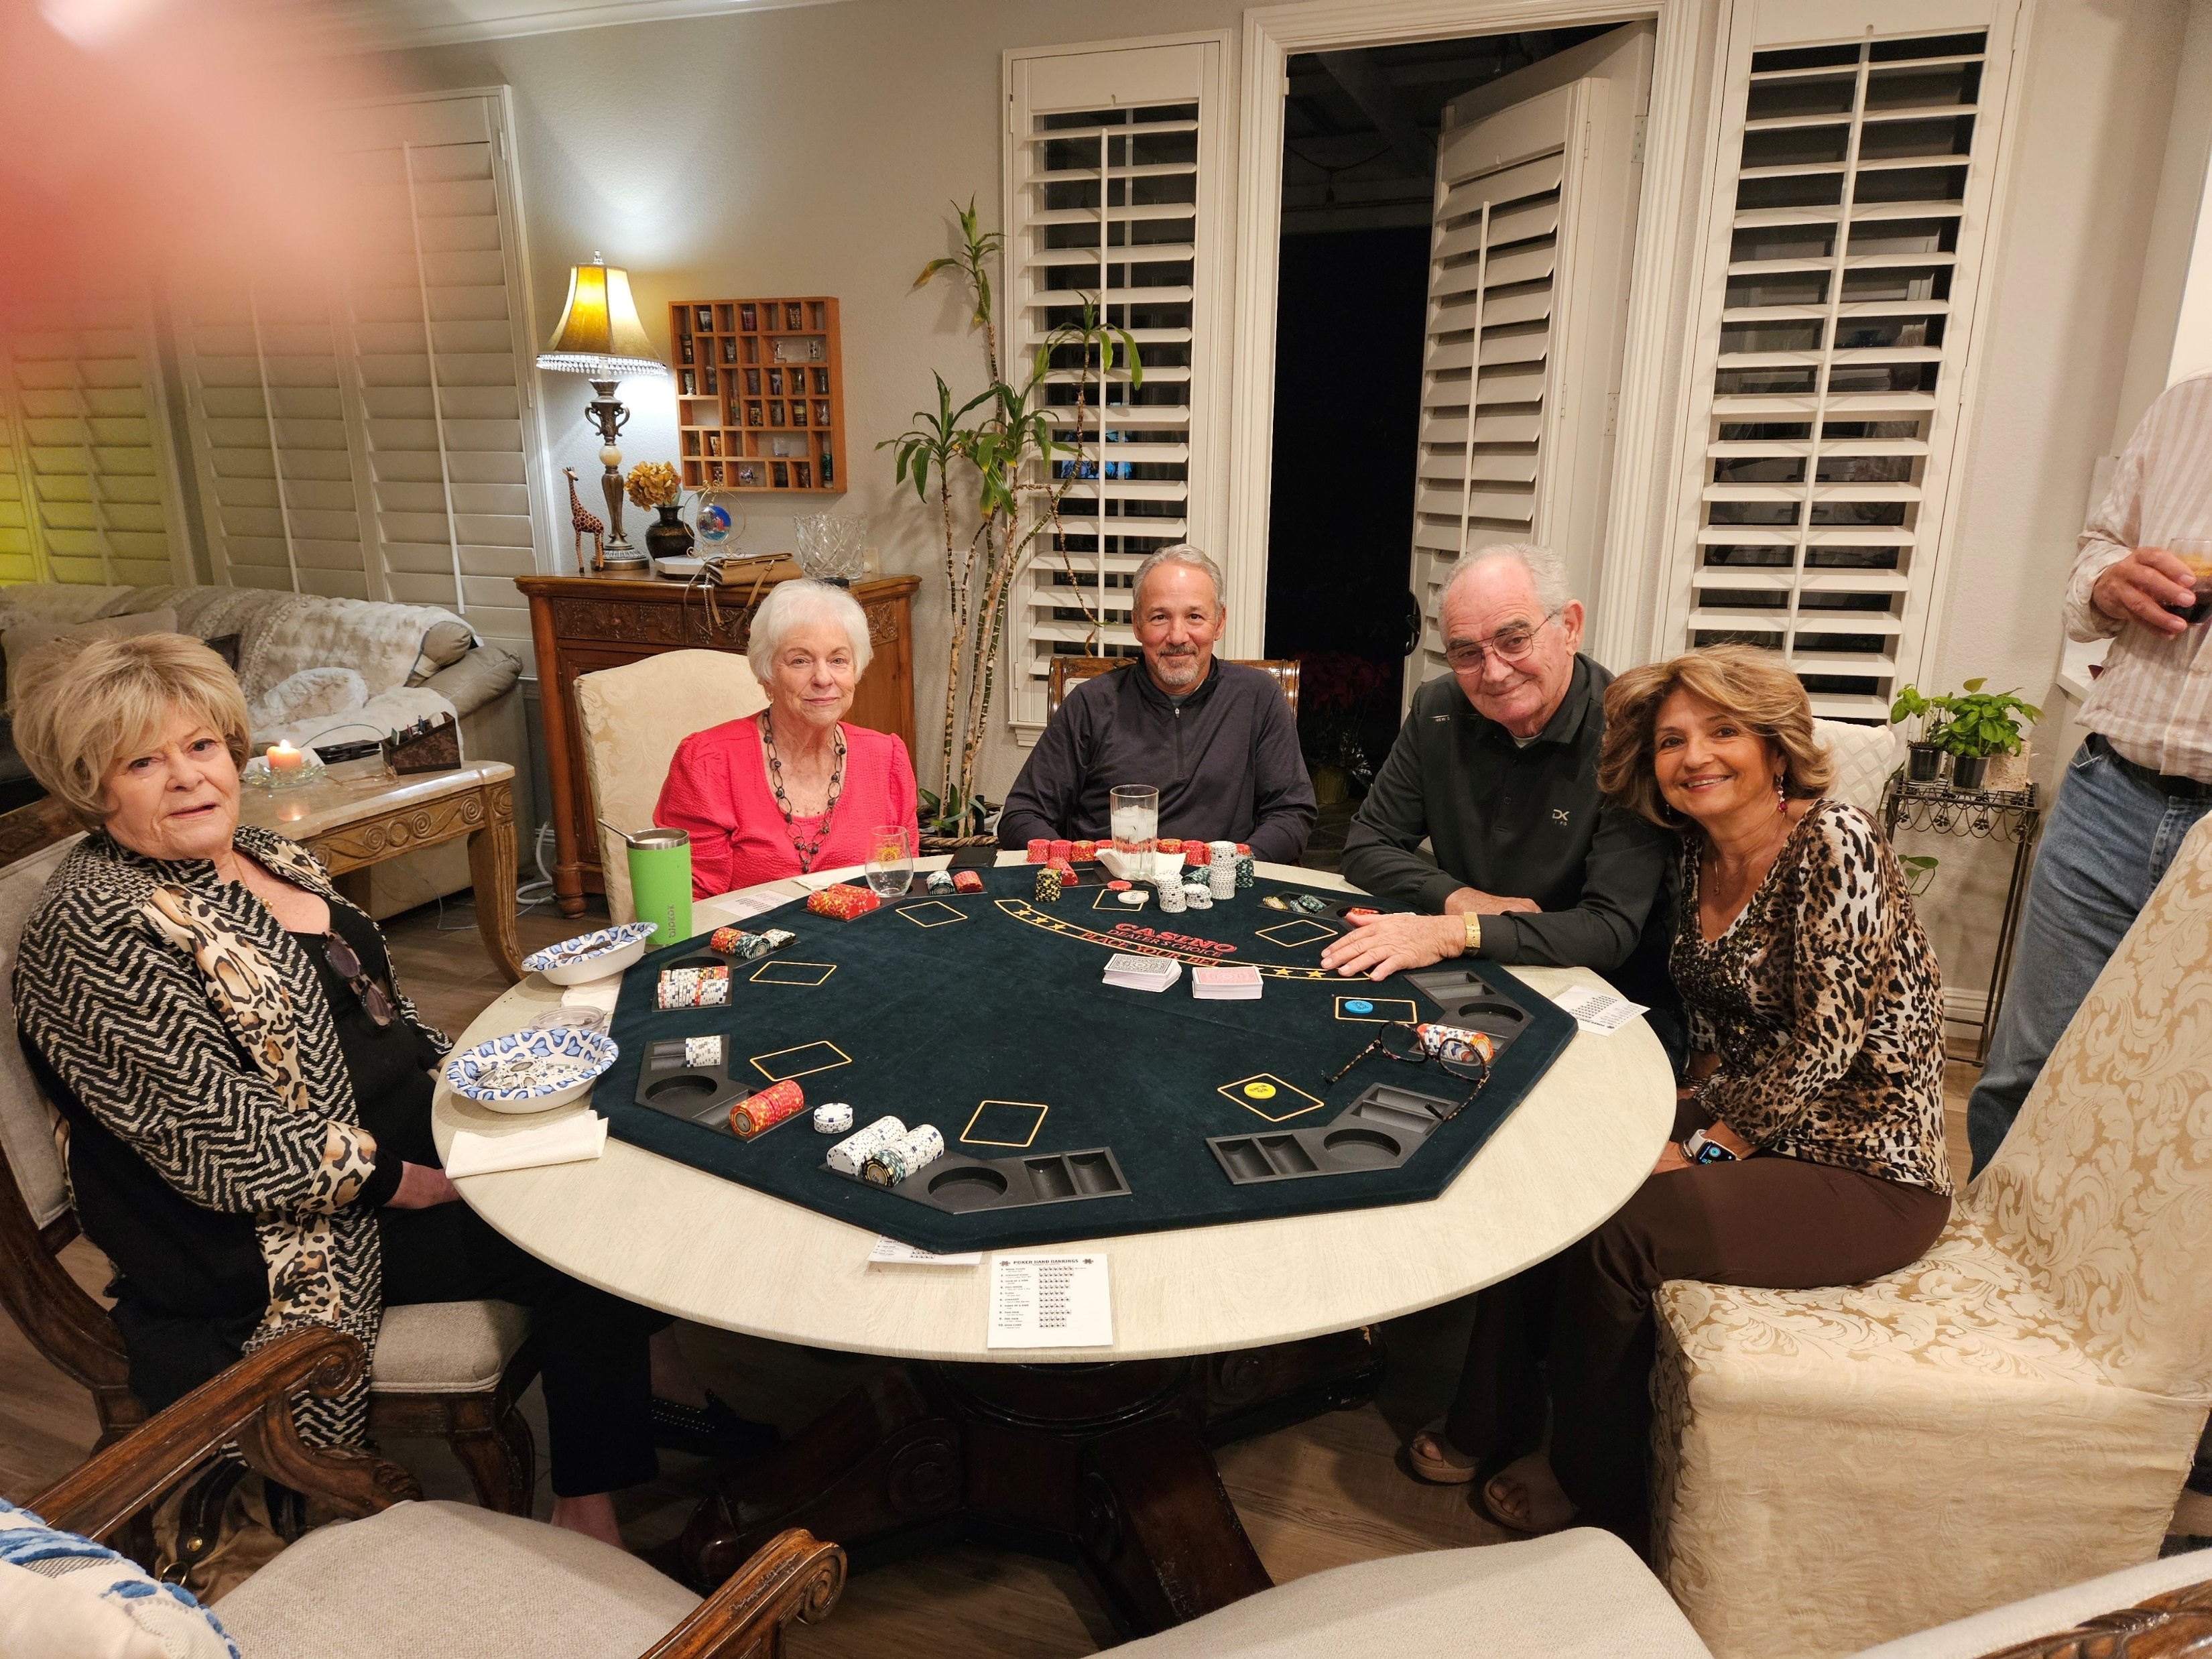
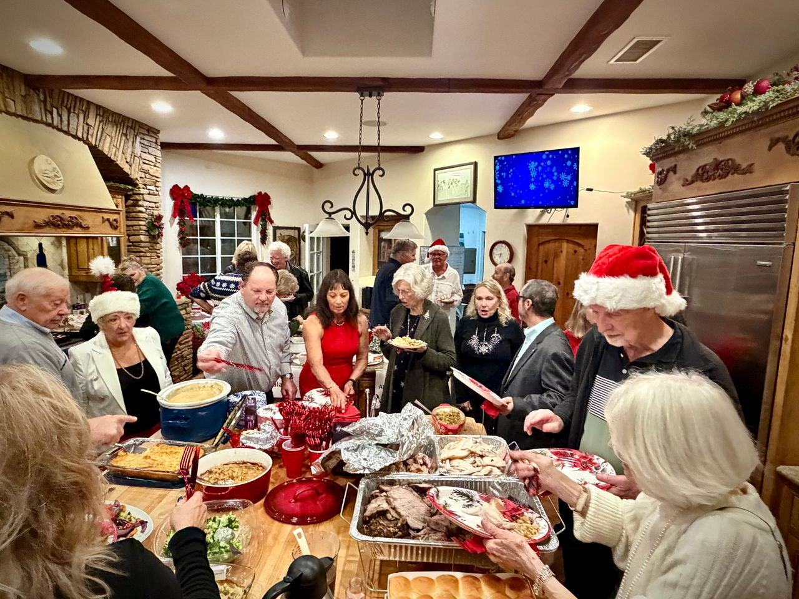
Carlsbad
Hi-Noon Rotary
Oktoberfest Dance Contest
Carlsbad Hi-Noon Rotary – PEOPLE OF ACTION – Who Have a Good Time Doing Good

Slide 12
Carlsbad
Hi-Noon Rotary
Welcome to Carlsbad Hi-Noon Rotary
Looking for a meaningful way to give back, build friendships, and create a lasting impact in the Carlsbad community? Welcome to the Carlsbad Hi-Noon Rotary Club — a dynamic group of passionate leaders, professionals, and neighbors united by one mission: Service Above Self.
Since 1980, Carlsbad Hi-Noon Rotary has been changing lives locally and around the world through hands-on service, scholarships, youth leadership programs, community partnerships, and fundraising events that truly make a difference. With more than 5,400 volunteer hours contributed last year alone, our members are people of action — serving seniors, feeding families, supporting students, improving schools, and helping communities across the globe.
From sponsoring Carlsbad High School’s Interact Club and awarding college and trade school scholarships, our club combines service, friendship, and fun in everything we do. Whether we’re packaging meals for families in need, mentoring students, supporting local nonprofits, providing volunteers for community projects or working on international humanitarian projects, we believe even small actions can create lasting change.
And Rotary isn’t just about volunteering — it’s about connection. Our Monday meetings are welcoming, engaging, and filled with inspiring speakers, community updates, and opportunities to build lasting friendships with people who care deeply about making a positive impact.
If you want to grow personally, serve your community, and be part of something bigger than yourself, we invite you to join us.
Come Visit Us
Carlsbad Hi-Noon Rotary meets two Mondays each month at noon at the Holiday Inn in Carlsbad, off Palomar Airport Road. Visitors are always welcome.
Explore membership opportunities, upcoming events and meeting dates at: www.carlsbadhinoonrotary.org.
Come see why so many members say Rotary has changed their lives — and discover how you can help change lives too.

Slide 13
Carlsbad
Hi-Noon Rotary
Rotary International’s strength lies in its 1.4 million committed and selfless Rotarians – who focus their energies through dynamic Rotary clubs and Rotary districts – to help make a difference locally and globally. The challenges, the needs, can seem unsurmountable, and the resources available limited, but that’s where the power of engaged people comes into play. Individuals and individual clubs make a difference, but they can also leverage their ability and resources with other clubs and community groups in ways that make even the most daunting task manageable.
At Carlsbad Hi-Noon Rotary we pride ourselves on what we do, but also on who we do it with. If you are another club, another community group or business, or even a committed individual and are interested in working with us to make a difference, in Carlsbad, or globally, let us know. Visit our website at (carlsbadhinoonrotary.org) or come to a meeting.
This year we commit, as part of a vital and vibrant community, to Create Lasting Impact!

