Slide 1
August 13, 2014
Continued on page 5.

Slide 2
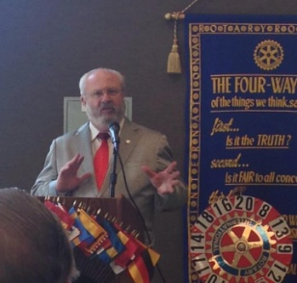
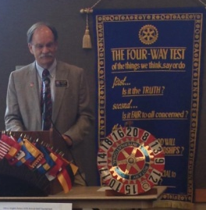
SPEAKER OF THE WEEK
District Governor, Fred Teichert
The District Governor, Fred Teichert, discussed
the theme of “Build Rotary” as a way to
remember what we do for ourselves and for
others.
B is for belonging and building community.
U is for usefulness and unity (4 way test).
I is for influence—people are proud to associate with a group that attracts leaders.
L is for laughter and the fun and fellowship of the club.
D is for “do or die” (survival of the club) or “do it now”. We need to make it attractive for people to join the club.
He also mentioned the Rotary
Club Locator so one can find
other meetings—either for
make-ups or to get new ideas.
He also said the Rotary
International website is much
improved and suggested that
we spend time exploring
it.
Fred Teichert showed the
2015 District Conference promotional video. It will be in Rohnert Park April 24-26, 2015. There will be a golf tournament, and the themes of Veterans and Literacy will be highlighted. Friday night will feature time at the Charles M. Schulz Museum. On Saturday, there will be wine tasting, Children’s Museum of Sonoma County, and more!
UPCOMING MEETINGS/EVENTS
August 19, 2014 7:30AM Club Board Meeting -Waffle Square
August 20, 2014 Meeting- Ken Cross, Habitat for Humanity
August 27, 2014 Meeting-Fellowship
September 3, 2014 Meeting-New Generations
September 10, 2014 Meeting-Roteract and Interact Clubs
September 17, 2014 Meeting-Los Rios Community College Chancellor
September 19, 2014 Golf Tournament
September 24, 2014 Meeting Fellowship
Fred Rowe introducing Fred Teichert.
Quote For The Day
"In matters of style, swim with the current; In matters of principle, stand like a rock.“ Thomas Jefferson

Slide 3
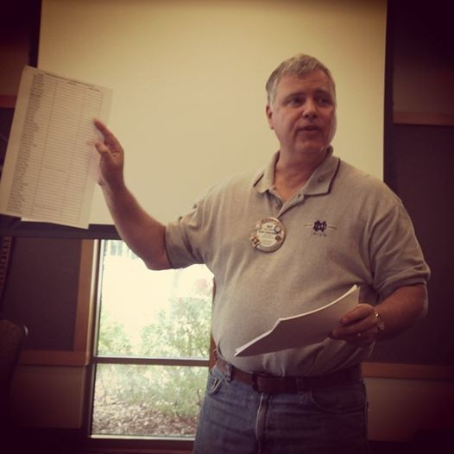
WEEKLY REPORT
Doug Loehrer, our Fine Master, opened with a joke about basketball fans.
Visiting Rotarians: Rose Ruiz from Lincoln Rotary and Alan Osterstock
of Roseville Rotary are here to support their co-worker, Darlene Spurgeon,
who will be inducted as a member today. Sac State Rotoract President
Brian Tolentino, Taylor Landess from Mesa Verde Interact Club, Colin
Bross, the principal at Mesa Verde HS, Fred Teichert, our District Governor,
and Fred Rowe, Assistant District Governor.
Introduction of Guests: Here also to support Darlene Spurgeon are her husband, Michael Spurgeon, mother, Susan Snider, and friends, Teresa and Michael Kaiser. Our RYE student from Belgium, Camille Simonis. Nancy Teichert, wife of Fred. Joyce Blonskij, wife of John. Karla, Irina, and Olga, scholarship winners. Carlos Verrett, who is visiting for the 3rd time and is applying for membership.
Foundation Minute (Justin Whitsell): Please keep an eye out for opportunities to apply for a mini-grant. Also any members of the Foundation Board for last year and any who want to be a member this year, please stay after the meeting for a few minutes.
Membership Minute (Ray Riehle): Find a partner and visit 3 businesses a month.
Bring a flyer into a business and talk about Rotary to the businesspeople. We have
to get the word out to increase our membership base!
Rotary International (Bob Churchill): $10 a month (the cost of a lunch—you
won’t miss it!) will get you a Paul Harris in 8.3 short years. Some of that money
comes back to the club as well as aids in the polio eradication and clean water
efforts abroad.
Doyle Phelan announced there are still 2 squares
left on the football pool poster, and they are $33
each.
Jessica Mang read a
letter from one of the
scholarship recipients
thanking the club for
making a difference in her life.
The Citrus Heights Chamber of
Commerce still has room in their
golf tournament for more
players
…Continued on page 6.
BIRTHDAYS & ANNIVERSARIES
Birthdays
Jack Mintz 8/21
Vincent Jenkins 8/29
Jack Frost 8/29
Anniversaries
Jessica & Ed Mang 8/6
Jennifer & Chad Riffe 8/6
Doyle & Loy Phelan 8/17
Alex & Jeni Turcotte 8/25
Steve & Julie Bruce 8/28
Rotary Anniversaries
Dean Henricks 32 yrs. Mel Turner 4 yrs.
Anne Osborne 3 yrs. John Blonskij 1 yr.
Elizabeth Morabito 2yrs.

Slide 4
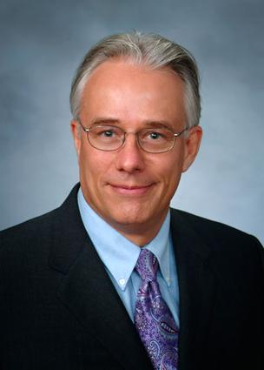
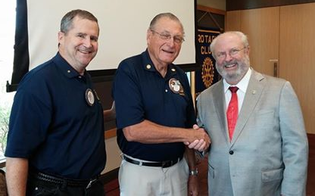
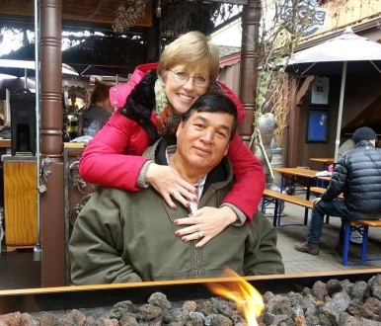
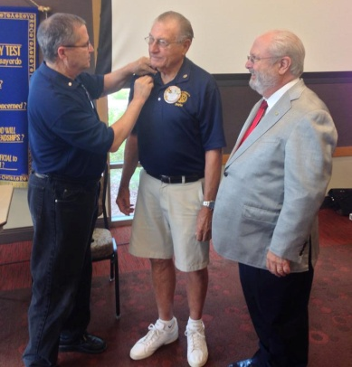
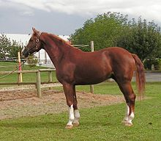
Ken Cross, CEO - Habitat for Humanity
Vision
A world where everyone has a decent place to live.
Mission Statement
Building affordable homes in partnership with families in need, supported by a host of volunteers, faith based organizations, donors and corporations for the betterment of our community.
Paul Harris Award
Fred Teichert and Bob Churchill presented Doyle Phelan with a Paul Harris Award. This is Doyle’s 7th Paul Harris—Congratulations, Doyle!
To become a Paul Harris Fellow, you give $1,000 or more to the Annual Fund, Polio Plus,
or an
approved
Foundation
grant. You
are
recognized as a Multiple Paul Harris Fellow with
each
Additional
gift of
$1,000.
Rotarian: Ronda Rivera
Spouse: Thomas Rivera
Children: Heather, twins Erica and Erin,
and Sean, Son in laws Scott, Wayne and
Rusty, and soon to be daughter in law Annie.
Grandchildren: Four grandsons Wayne
AKA "Trey", Cody, Zach and Clayton. One
granddaughter Lucy, and one grandchild on the way early next year.
Business: Government-Human Resources & City Information Director and Risk Manager for City of Citrus Heights Pets: Two dogs John and Wayne I love it when my husband is
outside yelling for John Wayne. Thirty plus chickens, four pigs
and one horse Shawnee. What do you like best about being a
Rotarian? Friendships and
contributing to our community Who invited you to join rotary? Charlie was the first to
invite me but I joined as a corporate member with Henry Tingle and David Wheaton who were invited by Bill Van Duker. If you could do only do one thing to change the
world, what would it be? Ending child abuse Favorite Movie? Seven Brides for
Seven Brothers, While You Were
Sleeping, Avatar, How To Train Your Dragon, Flight of the Navigator, The Abyss, and a whole lot more.
Favorite TV Show? Grey's Anatomy, Jeopardy First Job? Assembling Easter baskets for TG&Y stores

Slide 5
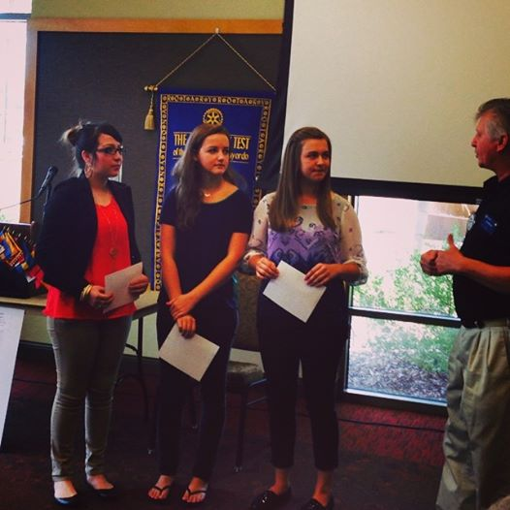
John Blonskij spun $20 for the honor of having lunch with his wife, which does not happen often enough.
Fine Master (Doug Loehrer)
Doug asked all the past presidents to stand up, and he asked whose pin he found outside. Jack Duncan admitted it was his. Doug asked for someone to give $3 for Jack to get his pin back and also $3 to whoever was not wearing his pin.
Doug said it was nice that Darlene brought friends to her induction, and anyone who did not do the same was fined $1.
John Blonskij introduced three of the six scholarship winners, Karla, Irina, and Olga and handed them their first $500 check.
These ladies will be attending a
Jackpot is $100
Camille Simonis - $9
Mel Turner - $3
local community college. The Rotary Club of Citrus Heights is excited to see these ladies move forward in reaching their goals.
Tina Shaw
announced that on
Wednesday,
October 22nd, the
club will be dark for
lunch because we
are having a mystery
dinner instead!
Meet at the community center at 5 pm, and transportation to and from the mystery location will be provided.
Watch Huang's membership message
Turning bicycle parts into wheelchairs for polio survivors

Slide 6
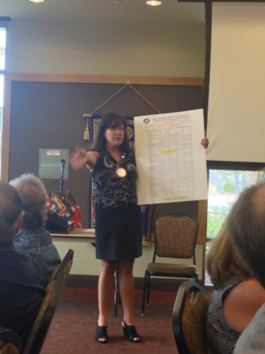
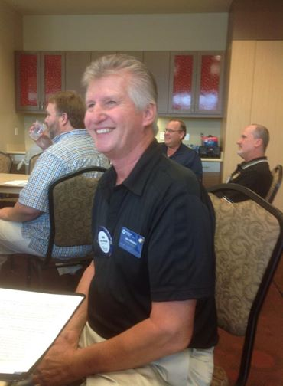
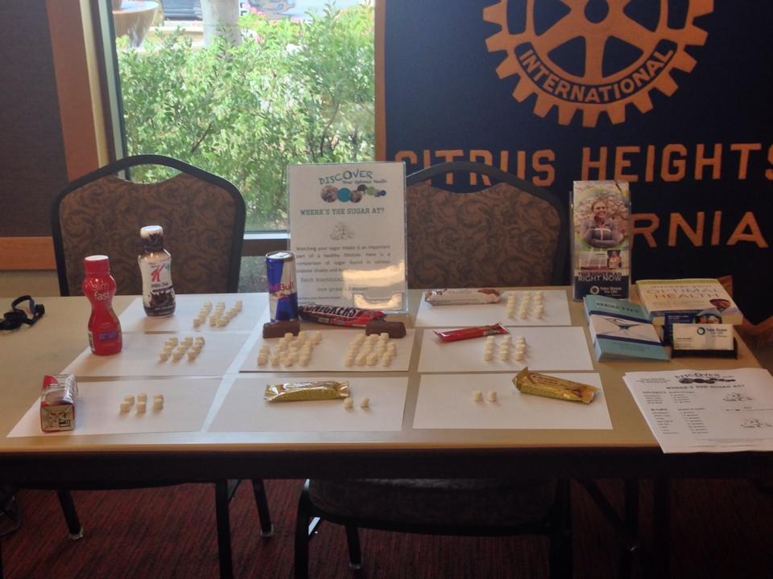
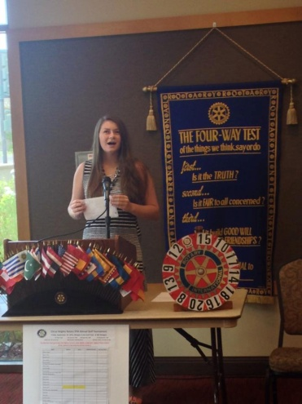
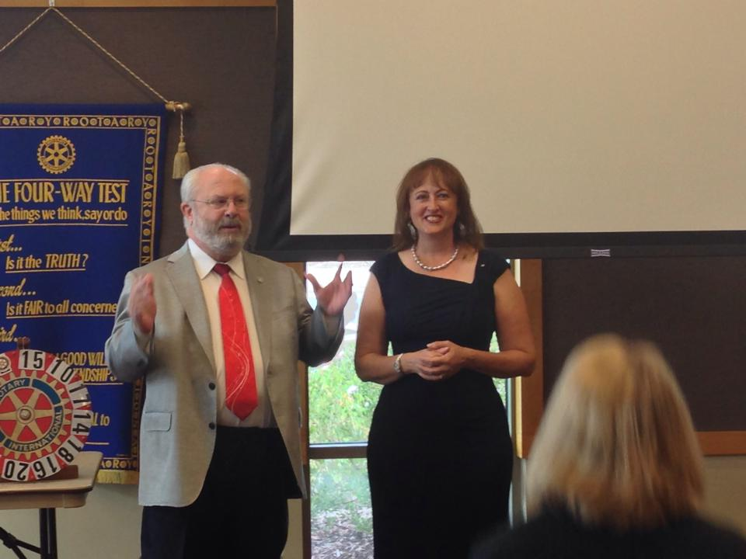
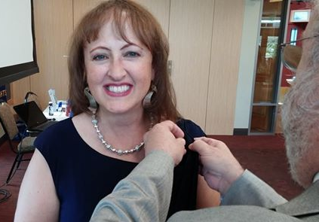
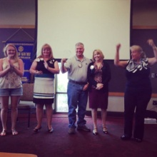
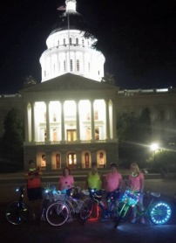
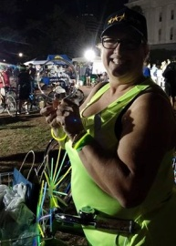
Citrus Heights Rotary Club 37th Annual Golf Tournament Christi Woodards needs everyone’s help in making our golf tournament a success! Find a foursome, become a sponsor, or bring in a raffle item! September 19, 2014 – 8 AM Shotgun Morgan Creek Golf Club, Roseville, CA Details 4-Player Scramble Shotgun Start at 8a.m. Lunch/Raffle/Awards at 1:30p.m. Foursome: $600; Single: $125 Sponsorship Opportunities Eagle Sponsor: $900 Birdie Sponsor: $750 Bogie Sponsor: $350 Tee Box Sponsor: $200 Contact Christi Woodards, Golf Chair: 916-728-1916 or Christi.woodards@steadfastmgmt.com. Click HERE for more info.
Vocational Minute: John Blonskij He and his wife Joyce brought along a pitcher of pineapple and mint water to show how drinking water does not have to be boring. Water is better than Coke! He talks to his clients to find out their goals and then works to help them achieve those goals. He teaches about portion control and getting fit. There are 8 different meal plans he works with, and the most popular is the 5-in-1 plan. Please see John if you want to improve your health today!
Taylor Landess from the MVHS
Interact Club wants to strengthen the
club presence on campus. She wants
kids to become interested in joining
when they are freshman and
sophomores instead of mostly senior.
She also wants to implement getting
pins or other rewards based on the
level of involvement of the student.
She would also like new shirts to
reflect the theme “Involve to Resolve”.
Fred Teichert inducted Darlene Spurgeon into the club—welcome Darlene! Fred also disclosed there is a new member sponsor pin. Darlene was here for our veteran’s lunch on July 2nd. She works at the Placer Food Bank. She is married to Michael, and she has a 19 year old son, currently in Texas, and a 23 year old daughter, who is local. She thanks Michael, her mom, her friends, and her co-workers for coming to support her today.
President Jessica Mang
Called up the people who
Participated in the Lunar
Lunacy fundraiser for Point West Rotary. The Citrus Heights Rotary Club had the largest group supporting this fundraiser. Thank you to Point West Rotary for putting on this great fundraiser.
CHECK OUT ALL THE MEETING AND EVENT PICTURES ON THE WEBSITE!!!!

