Slide 1
Red Lion Dallastown Rotary Website

Slide 2
Log In
In your web browser type our web address:
www.redliondtownrotary.org
You will be redirected to our ClubRunner Site

Slide 3
Log In
Click on the Login link at the top right. All members can login. The system will recognize your level automatically and grant you the appropriate access.

Slide 4
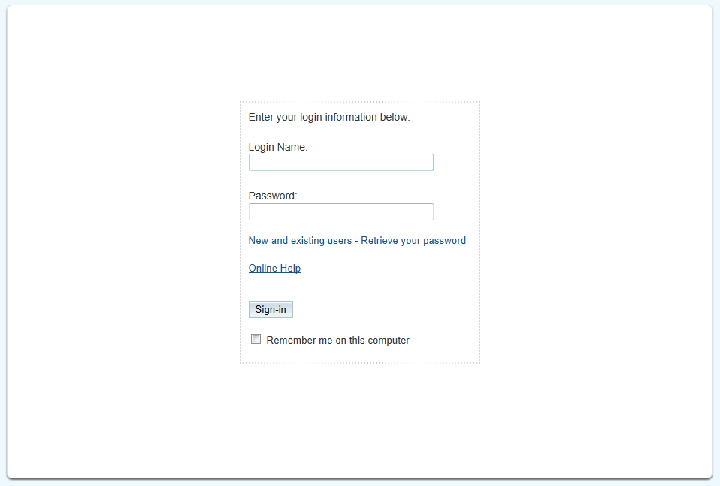
Logging In – User Name
On the Login page, your username has been designated as your First.Last.9133

Slide 5
Logging In – Request Password
On the Login page, click on ‘New and Existing Users – Retrieve Your Password’

Slide 6
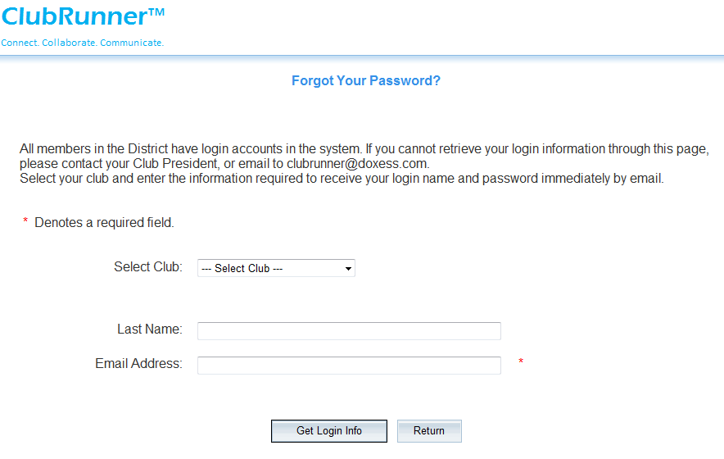
Logging In – Request Password
Choose club from list, enter last name and email address
Press Get Login Info button. Watch for the email to arrive in your inbox.

Slide 7
What can Regular Members Do?
Once logged in, any Rotarian in the District can:
Update their own membership profile
View and download district directory reports
Search for members in the online directory
Register for any District event
Access District Committees and view/post info if a member of that committee

Slide 8
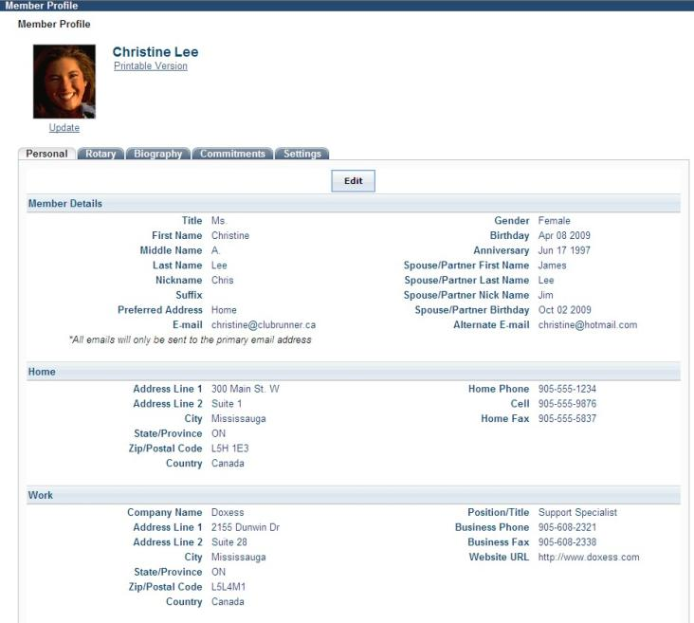
Member Profile
Click on various tabs to access more information.

Slide 9
Club Runner Mobile App for Android or iPhone
Club Runner Mobile App
https://site.clubrunner.ca/page/clubrunner-mobile-app-now-available
1-877-4MY-CLUB

