Slide 1
Opportunity
Charity Ball
Fellowship
Homeless
Village Surplus
Pensioner Accommodation
Botanic Gardens
Wounded Service Personnel
GC Ramble
The Rotary Foundation & Polio Plus
Youth
Programs
Service
Disaster
Relief
Tertiary Assistance
3rd World Education
Employee
Recognition
Vocational
Trivia Challenge
Sick Kids
Member Donations
Fun

Slide 2
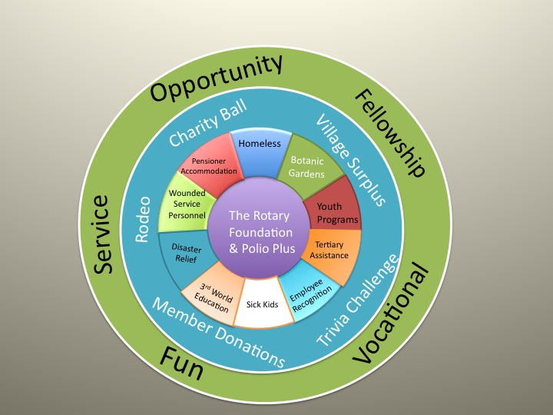
The Rotary Foundation & Polio Plus
Support for The Rotary Foundation and worldwide campaigns such as Polio Plus is the heart of our club.
The mission of The Rotary Foundation is to enable Rotarians to advance world understanding, goodwill, and peace through the improvement of health, the support of education, and the alleviation of poverty.
It helps fund Rotary’s humanitarian activities, from local service projects to global initiatives. Grants are available from the Foundation to invest in projects and provide scholarships.
The Foundation also leads the charge on worldwide Rotary campaigns such as eradicating polio (Polio Plus Campaign) and promoting peace.

Slide 3
Gold Coast Rotary is also passionate about our support for other causes internationally and within our own community.

Slide 4
Homeless
Suns Horizon Partnership
Gold Coast Project for Homeless Youth
Gold Coast Youth Services
Youth Health & Education Services House
[‘Bannister House’]
Rosie’s Youth Mission
Surfers Paradise Anglican Crisis Care

Slide 5
Botanic Gardens
Partnership with Friends of Gold Coast Regional Botanic Gardens
Opportunities for hands-on activities
Construction of Rotary Education Shelter – 2015-16
Annual Gardens Breakfast
District grant for Indigenous Plant signage in 2016-17

Slide 6
Youth Programs
Sponsor Participants for District 9640 Youth Seminars:
Rotary Youth Leadership Award
Rotary Youth Program of Enrichment
Rotary Youth Transition Seminar
Model United Nations
Rotary Youth Driver Awareness
Youth Exchange Program
National Science Summer School

Slide 7
Tertiary Assistance
Griffith University
3 Year Ernie Hicks Scholarships
The scholarship is awarded annually to a person who has overcome significant personal adversity while achieving entrance to university, and demonstrates a mature approach to study.
Final Year Ken Baguley Bursary
This bursary aims to prepare young people for a complex world by providing maximum education opportunities and assistance to all students, but particularly to those in more difficult circumstances.
Australian Industry Trade College
This annual scholarship assists a young person with potential but lacking financial support to complete their education and transition into a full-time apprenticeship

Slide 8
Employee Recognition
Stage Annual ‘Pride of Workmanship’ Award for staff of local businesses
Providing businesses with the opportunity to publicly recognise effort of loyal employees.
Investigating staging ‘Employee of Year’ Event

Slide 9
Sick Kids
Rotary Oceania Medical Aid for Children
Provides medical treatment for children from developing countries in the form of life saving and/or dignity restoring surgery not accessible to them in their home country.
Give Me 5 for Kids
Money raised helps provide our local community with aid and support to sick children and their families in times of need.
Ronald McDonald House
The Houses are attached to major women and children’s hospitals and provide a 'home-away-from-home' for seriously ill children and their families.

Slide 10
3rd World Education
Cambodian Village Meals
In partnership with Qld Girls Guides, set up and support provision of clean water and meals for Cambodian village school.
Price-Mason Scholarships
Vietnamese Catholic Convent Orphanage/school run by nuns who have been the source of assistance to ROMAC for getting past the Vietnamese Government's extensive red tape with patients coming to Australia for treatment.
Funds high school education annually for 30 Students whose parents cannot afford high cost.
St Jude’s School in Tanzania
Quality education for the very poorest children. Achieving outstanding results with local staff.
Annual Funding for 2 teachers

Slide 11
Disaster Relief
Disaster Aid Australia
Annual sponsor Family Survival Pack
2015 – Fiji Cyclone Winston
Drought Relief via District 9630
Hay for farmers 2014
Bushfire Relief via RAWCS
Blue Mountain Bushfires 2013
Flood Relief - 2012
New kitchens for Condamine
Relining for Ipswich homes

Slide 12
Wounded Service Personnel
Ken Bromley Memorial Wounded Service Personnel Convalescent Association
Fully paid holidays to Gold Coast from anywhere in Australia for service personnel wounded in action
Recognising the sacrifice made by the individual and his/her family
4 or 5 families per year identified via ‘Soldier On’ or ‘Mates4Mates’ to enjoy holiday
Funded by investments managed by Committee of Gold Coast Rotary members

Slide 13
Pensioner Accommodation
Rotary Village operated and maintained by Gold Coast Rotary:
Quality low cost rental accommodation for 14 elderly persons on social security
Construction of final two units completed in 2014
Surplus from Rental Payments available for Community projects

Slide 14
Causes need Funds
Rotary Village
Volunteer management generates surplus for projects
Fundraising Events
Annual ROMAC Trivia Challenge
Charity Ball & Auction (2014 -
Bulls on the Beach Rodeo (2009 – 2012)
Gold Coast ramble (2017-
Donations
Member Donations to The Rotary Foundation
Donations to other causes
Investments
Judicious investment of accumulated funds
Charity Ball
Homeless
Village Surplus
Pensioner Accommodation
Botanic Gardens
Wounded Service Personnel
Youth
Programs
GC Ramble
The Rotary Foundation & Polio Plus
Disaster
Relief
Tertiary Assistance
3rd World Education
Employee
Recognition
Trivia Challenge
Sick Kids
Member Donations

Slide 15
Opportunity
Charity Ball
Fellowship
Homeless
Village Surplus
Pensioner Accommodation
Botanic Gardens
Wounded Service Personnel
The Rotary Foundation & Polio Plus
Youth
Programs
GC Ramble
Service
Disaster
Relief
Tertiary Assistance
3rd World Education
Employee
Recognition
Vocational
Trivia Challenge
Sick Kids
Member Donations
Fun

Slide 16
provides Opportunities
1. To serve and support one of our many causes
2. To enjoy fellowship and have fun
3. To network with a broad range of local professions and businesses
4. To be a member of Rotary International, a global network of volunteer leaders who dedicate their time and talent to tackle the world’s most pressing humanitarian challenges

