Slide 1
Wes Brooks
District 6840 • Asst. Gov. ClubRunner
Rotary Club of Hattiesburg • P.R. & Communications Chair

Slide 2
DISCLAIMER
** FOR INTERNAL USE ONLY **
This is not a paid endorsement for the ClubRunner™ platform, nor should it be replicated or used for profit or gain. This is purely for informative and educational purposes for those District 6840 Clubs who may be considering or have recently acquired the ClubRunner™ solution.
The information shared here are from my own experiences using this platform over the last four years. –Wes Brooks

Slide 3
What is ClubRunner™?
ClubRunner™, is an award-winning software for clubs that want to effectively:
Boost Public Relations
Increase visibility
Improve communication between members
Better organize their club
It is an online service comprised of powerful tools designed to:
Give your club a strong online presence
Maintain your club data
Boost communications
Organize events and volunteers
Help your club run more efficiently and easily

Slide 4
That’s great, but what we really want to
know is…
…HOW MUCH DOES IT COST?

Slide 5
CLUB SIZE | PER MONTH | PER YEAR
20 members and smaller | $22.95 | $275.40
21—30 members | $28.95 | $347.40
31—40 members | $34.95 | $419.40
41—50 members | $39.95 | $479.40
51—80 members | $45.95 | $551.40
81—120 members | $57.95 | $695.40
121—200 members | $68.95 | $827.40
201—300 members | $91.95 | $1103.40
301—500 members | $114.95 | $1379.40

Slide 6
Okay, but are there
additional costs?

Slide 7
Only if you would like ClubRunner™ to
host your club’s website.
You can create a new one or transfer your existing
URL to the ClubRunner™ platform.
One time set up fee:
$199

Slide 8
What does ClubRunner™ offer?
Website Designer
Member Directory
Email Message Center
E•Bulletin
Contacts Module
Event Planner & Calendar
Volunteers Module
Dues & Billing
Attendance Manager
RI Database Integration
Custom Reports & Directories
Photo Albums
Committee Management
Online Payment & E-Commerce
MyEventRunner
Mobile App
Social Media Integration
Sponsorship Feature

Slide 9
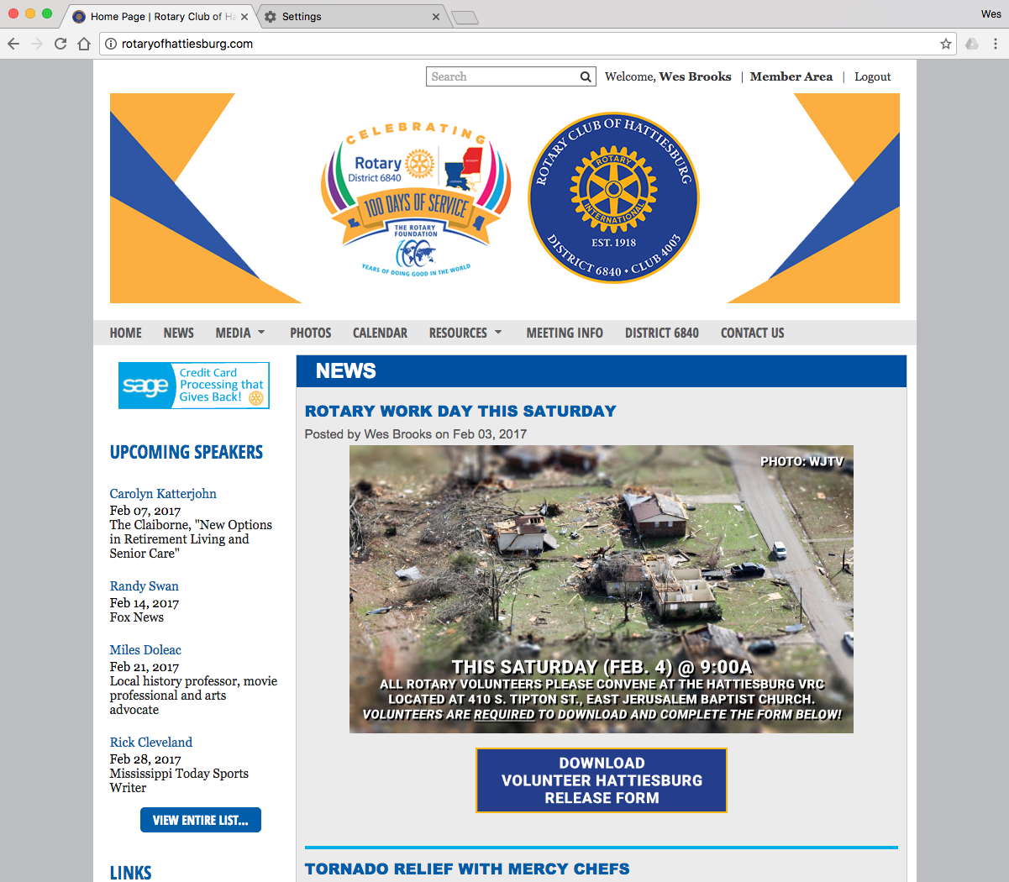
Member Access
Members will login by clicking
on the “Member Area” tab in
the upper right of the screen.

Slide 10
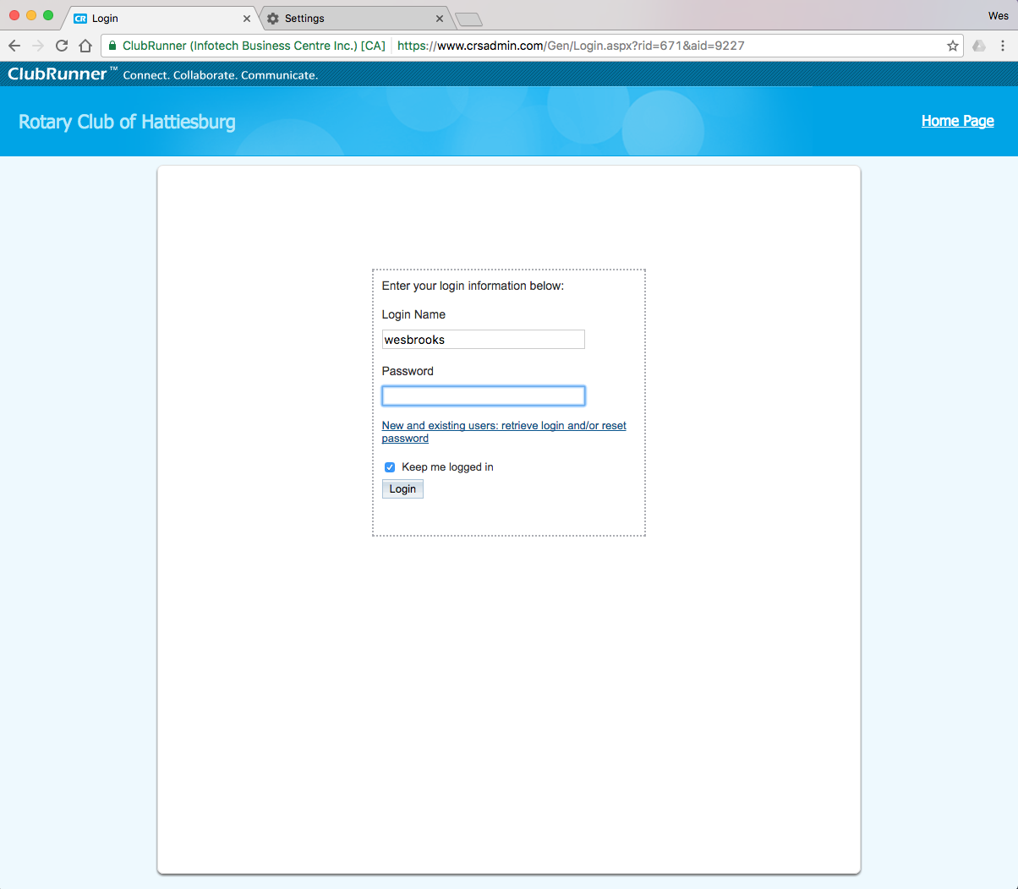
Secure Login
If your Club already uses ClubRunner™ members will enter their username and password in the secure login portal here.
If you are new to ClubRunner members will click on the link below and their temporary password will be sent to the Email address on file for that respective member.

Slide 11
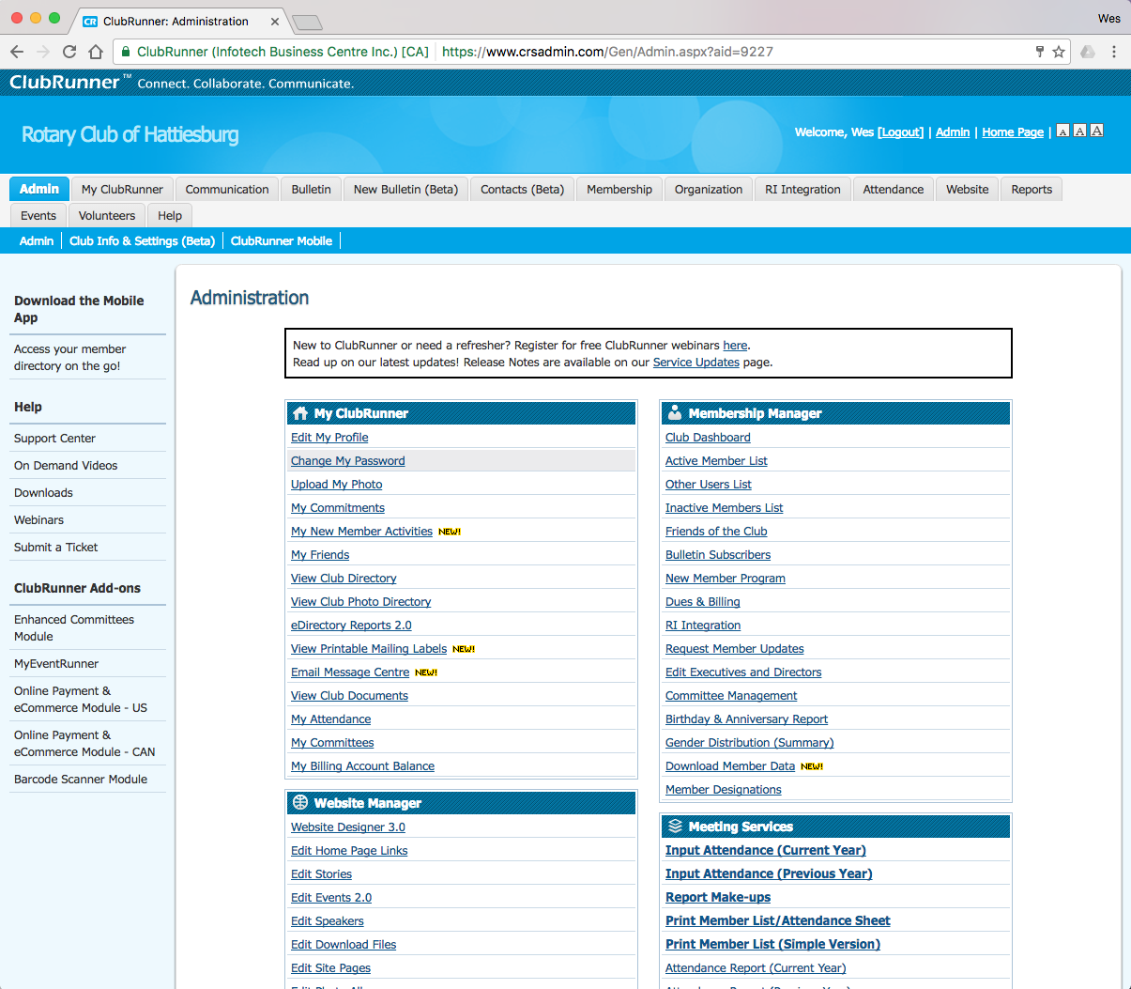
My ClubRunner™
Members can update their information (e.g. password, contact info, profile picture). Officers and Chairs can report attendance, manage club documents, invoice club members for dues.
Members will also have the
ability to pay their dues/fees/
assessments here.

Slide 12
Membership Manager
Manage your active and
inactive members, “friends of
the club,” members dues/
fees/assessments, designate
officers and directors, and
manage RI Integration.

Slide 13
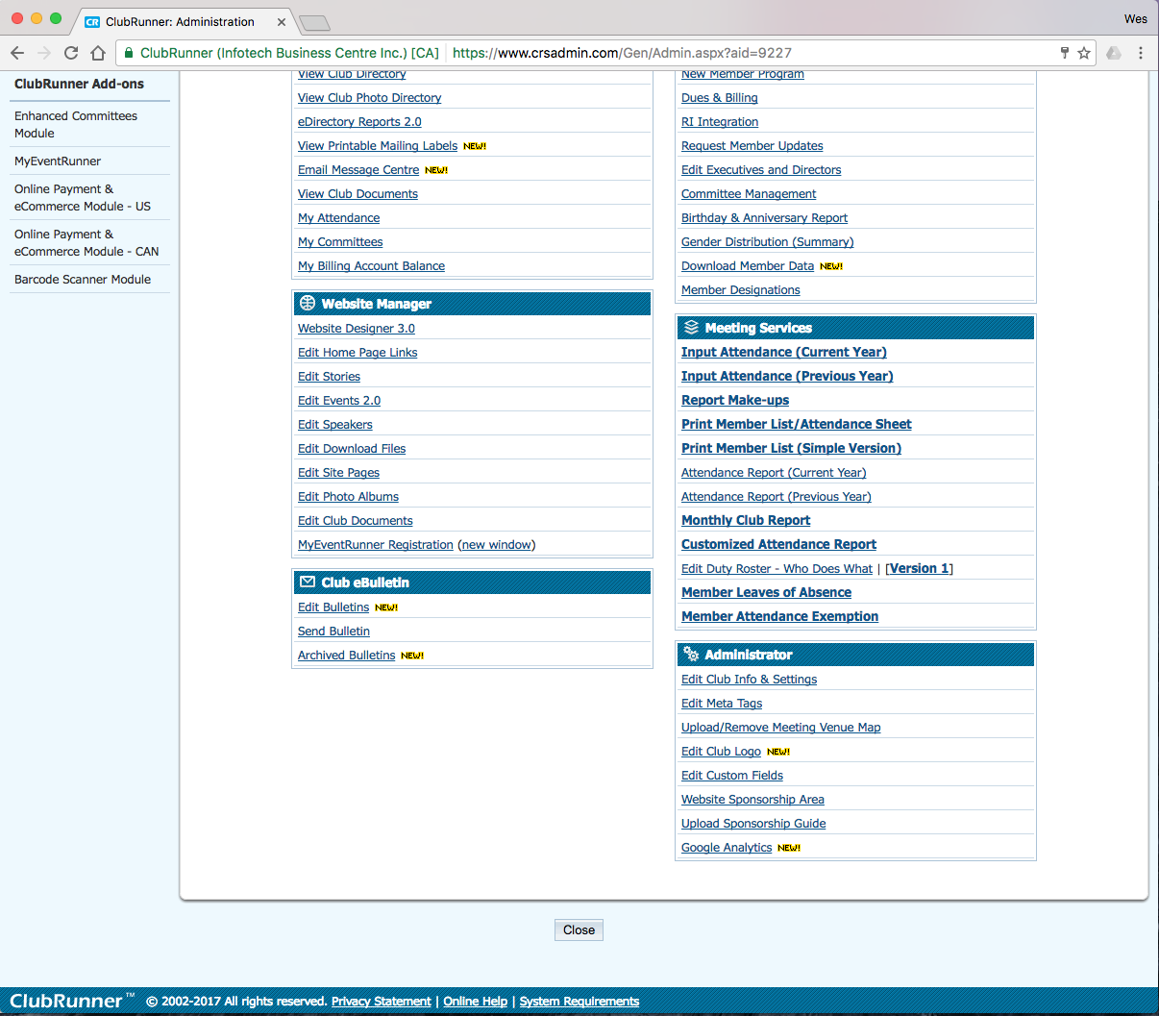
Meeting Services
NO MORE REPORTING THE SAME INFORMATION TWICE
This is your one-stop-shop for reporting attendance. Opt-in with RI Integration and your data automatically syncs with District 6840 and Rotary International!

Slide 14
Website Manager
If you don’t have website building experience…
DON’T WORRY!
ClubRunner™ makes it easy for those with no experience to manage their club’s website.
Choose the “theme” or look of your website from pre-made templates, manage files online, submit stories, and manage photos and photo albums.

Slide 15
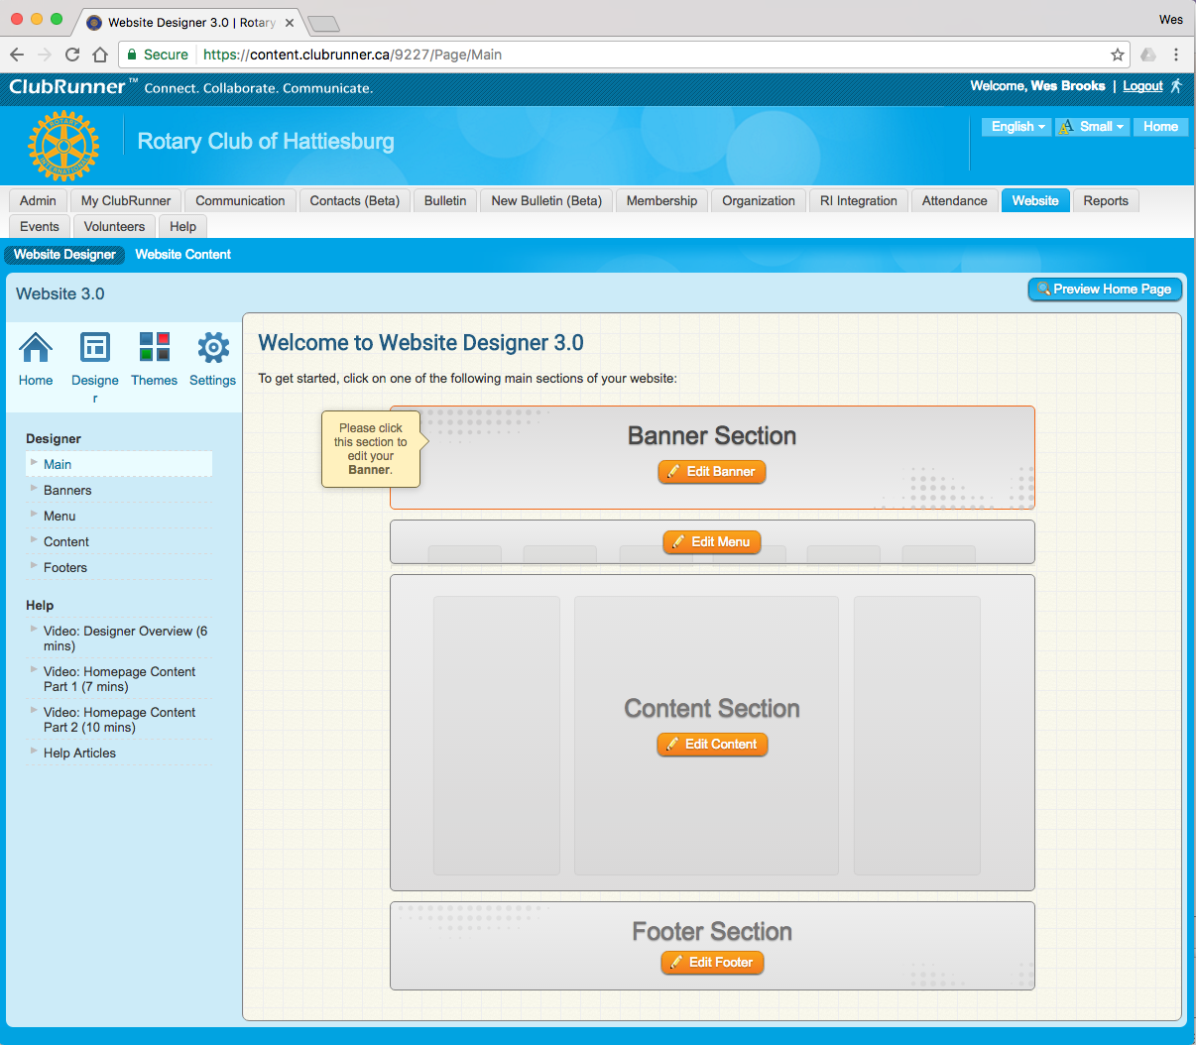
Website Designer
Post upcoming speakers, club stories and provide links for
members and non-members
so they can find out more
about the great things your
club is doing.

Slide 16
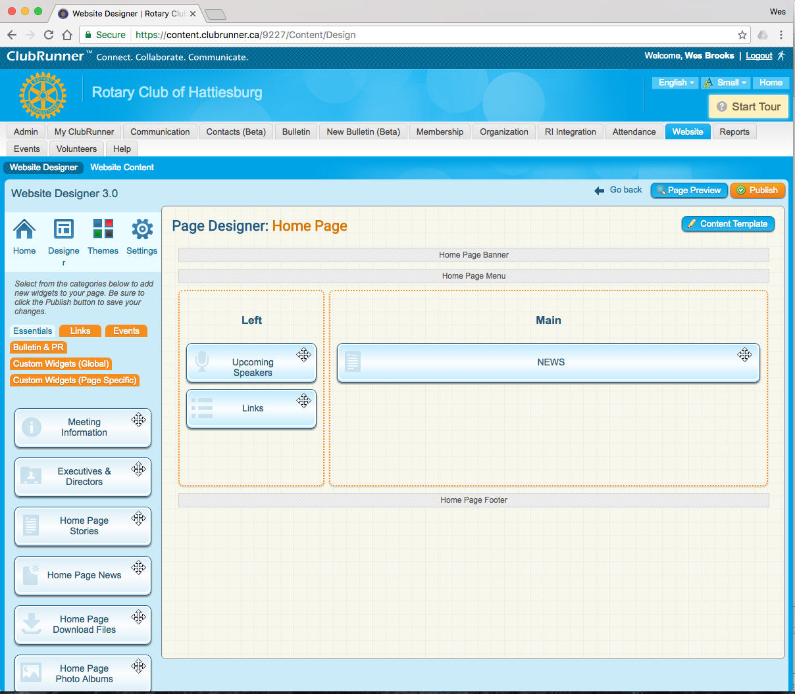
Website Designer
Post upcoming speakers, club stories and provide links for
members and non-members
so they can find out more
about the great things your
club is doing.

Slide 17
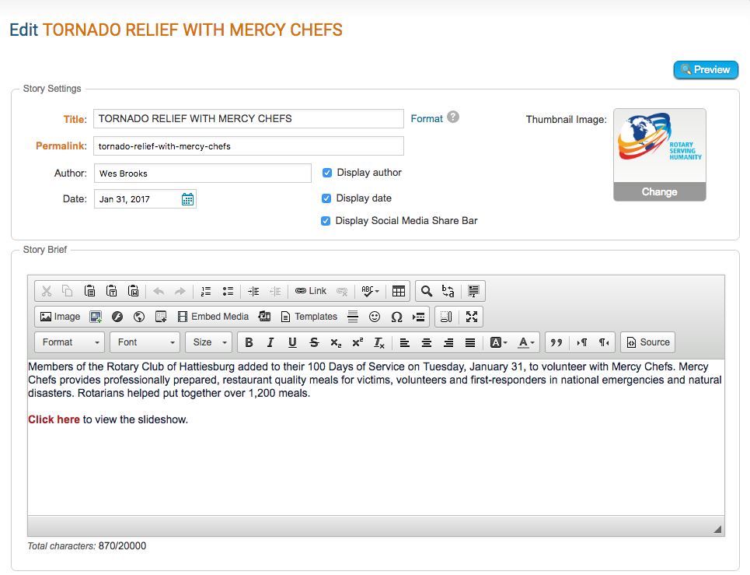
Website Designer
Adding Content
To add a story to the home page, any member who has been granted editor rights can log in, then type content into the built-in editor.
Pictures are automatically resized and compressed for optimized downloading on the web and are saved in your image library for future use.
Options available to allow you publish or save as draft, hide or show an article on the home page, story library, and eBulletin.

Slide 18
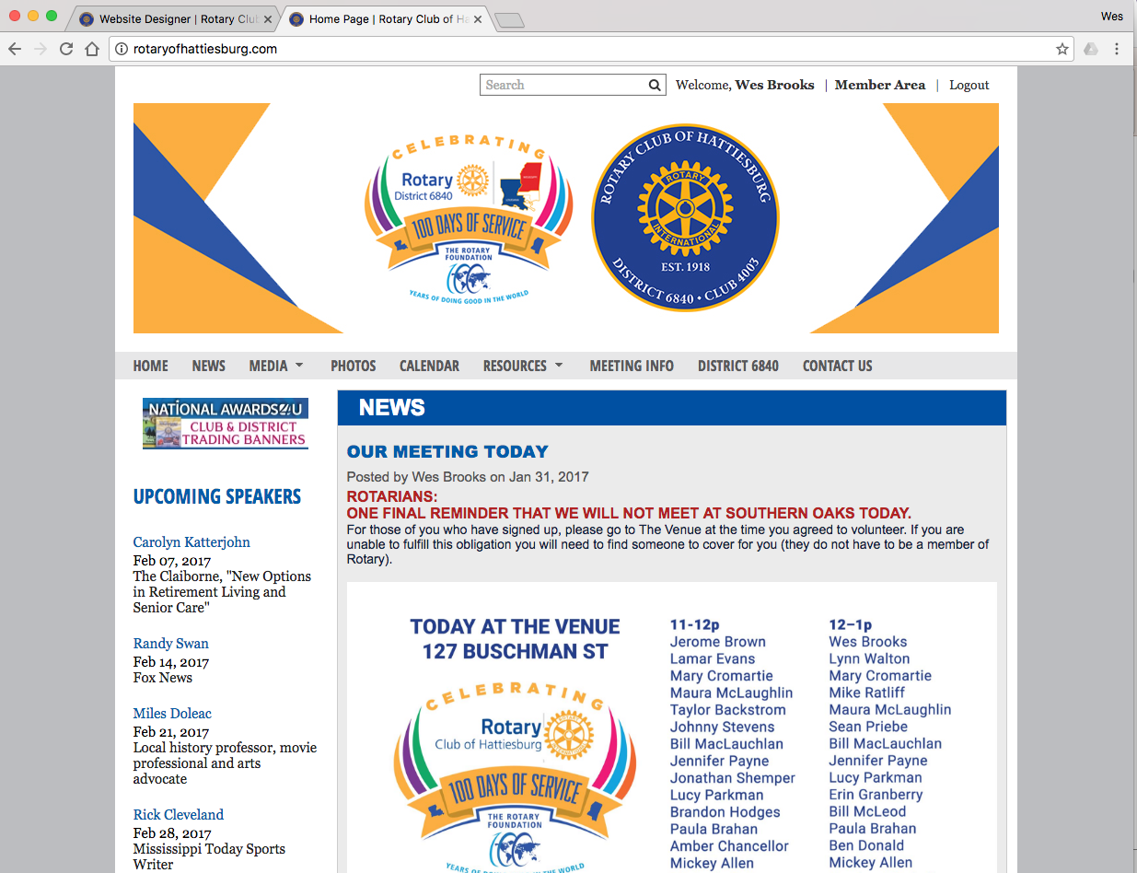
Website Designer
Adding Content
Press the publish button and your content appears immediately.
Links can also be embedded in your article to go to other sites or download forms or documents.

Slide 19
Please visit
www.rotaryofhattiesburg.com
to see how we’ve employed the ClubRunner™ solution to improve communication and collaboration for our club.

