Slide 1
Bill McLeod
Asst. District Governor, Hub Territory
Wes Brooks
Past President 2014-2015
Rotary Club of Hattiesburg

Slide 2
rotary.org
My Rotary

Slide 3
My Rotary

Slide 4
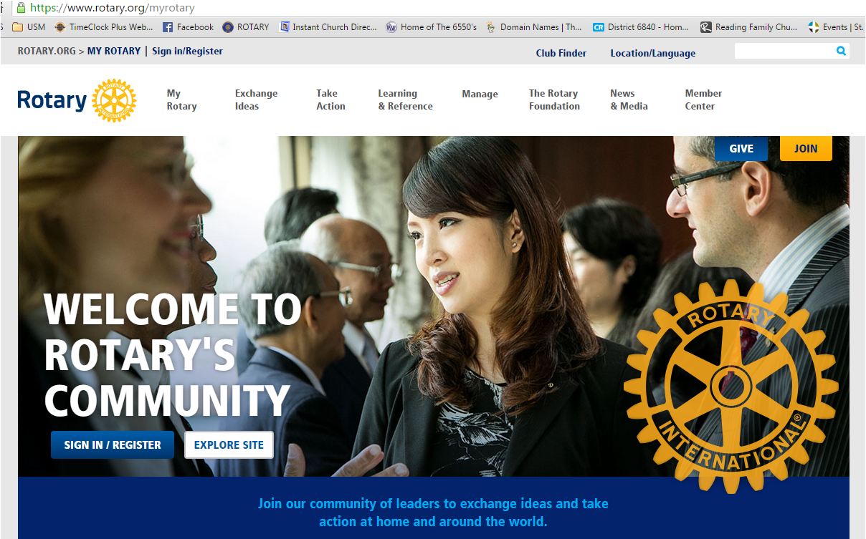

Slide 5
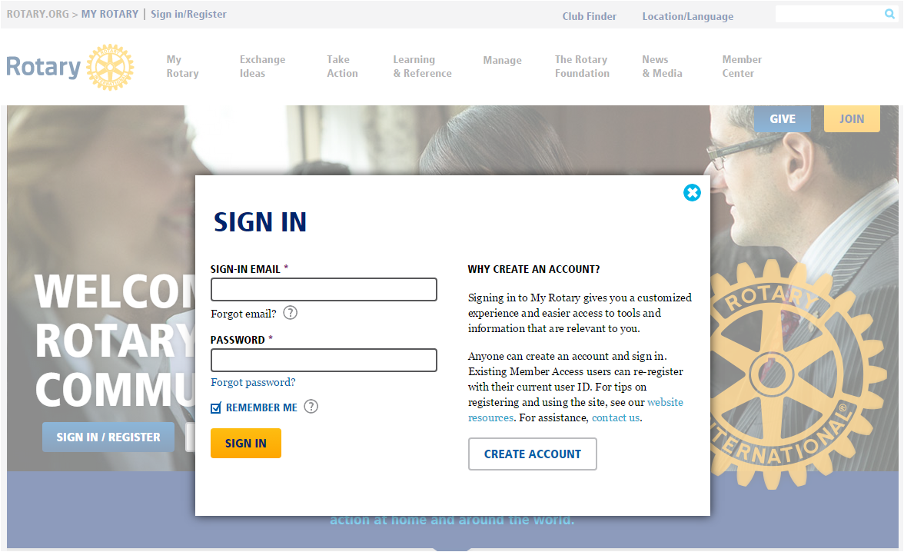

Slide 6
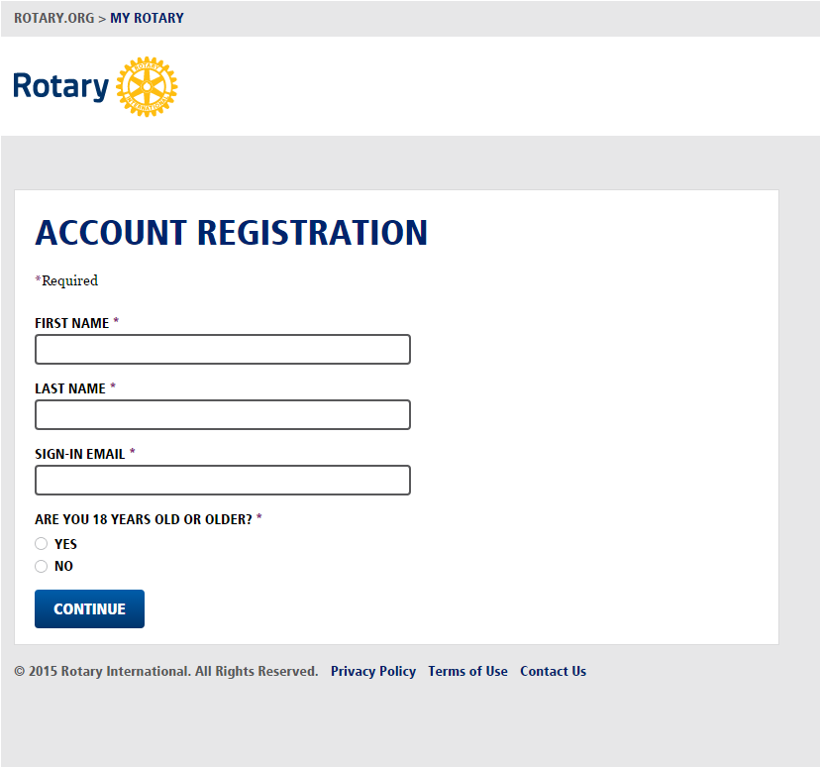
Use the email you initially provided when you joined (unless you have since notifiedthem that it’s changed).
You will receive a confirmation from
Rotary (donotreply@rotary.org) with a link.
If you do not receive a confirmation email you will need to contact rotary.org directly or have your Club’s Secretary or President contact them to have your information confirmed.

Slide 8
district6840.org

Slide 9
What is ClubRunner®?
ClubRunner® is an administration and communication software platform that enables clubs and districts to effectively…
reach members
Improve communication between members
Improve organization

Slide 10
Why ClubRunner®?
Website Designer
Emails
Member Directory
E•Bulletins
Reports
RI Integration
Committees

Slide 11
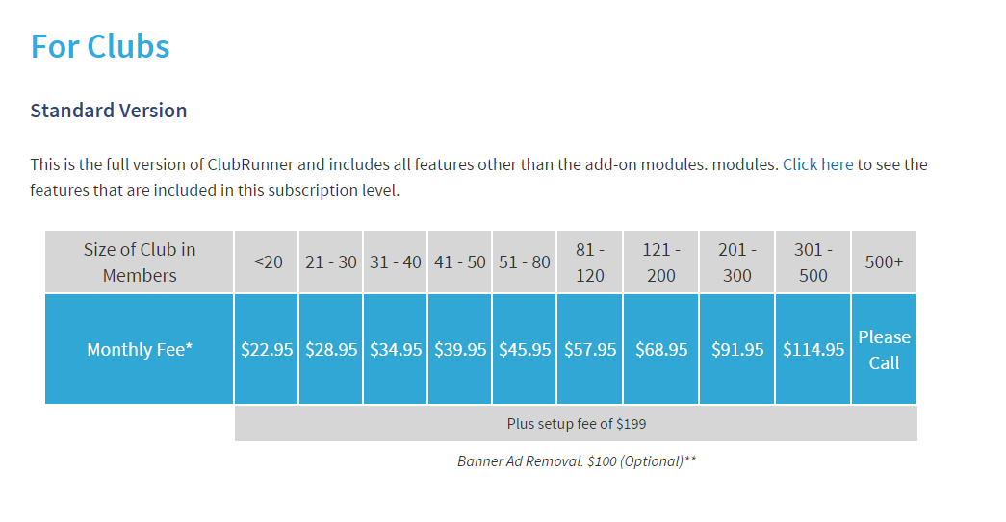
**Available with free trial**
$420/year

Slide 12
For more detailed information on the ClubRunner® solution, please visit:
www.clubrunner.ca

Slide 13
Questions?

Slide 14
Wes Brooks
hattiesburgrotary@gmail.com
rotaryofhattiesburg.com
(601) 596-6000

Slide 15
Thank You &
Service Above Self!

