Slide 1
Hugh O'Brian Youth Leadership
HOBY

Slide 2
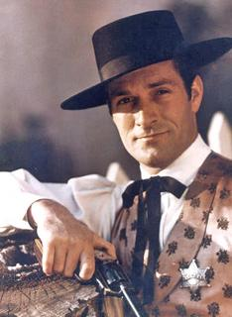
HOBY History
Founded in 1958 by veteran actor Hugh O’Brian
Brought about by a challenge from Dr. Albert Schweitzer in the jungles of Africa
Limited to California at first
Young men invited as Ambassadors for the first leadership seminars and females invited in later years

Slide 3
HOBY Mission and Vision
Mission-To inspire and develop our global community of youth and volunteers to a life dedicated to leadership, service and innovation
Vision- To motivate and empower individuals to make a positive difference within our global society through understanding and action based on effective and compassionate leadership.

Slide 4
HOBY Core Values
Volunteerism
Integrity
Excellence
Diversity
Community Partnership

Slide 5
Local and National Programs
More than 4,000 committed HOBY volunteers plan and execute HOBY programs each year. At both the seminars and on the corporate boards.
Due to the selfless efforts of volunteers and the contributions of generous donors, more than 9,000 students participate in HOBY programs annually.

Slide 6
HOBY South Dakota
Each high school in the state of South Dakota is invited to select one or two sophomore to be the official representatives to the HOBY seminar.
HOBY seminars are held around the world to inspire youth to become leaders in their families, schools, communities, peer groups & states.

Slide 7
HOBY SD 2013 Seminar
Theme: HOBY Super Squad
Motto: With Leadership Comes Great Responsibility
Held on the campus of Dakota State University
May 30-June 2, 2013

Slide 8
HOBY SD 2013 Seminar cont.
Purpose: Teaching you how to think, not what to think.
3 phases:
personal leadership
group leadership
society leadership
All phases are designed to prove the incredible power of dedication and selfless service
Also to teach them that they are empowered to make a positive impact.
All leadership phases then combined to for leadership for service.
Take the power of leadership and give back
100 hr challenge.
L4S project: Alex’s Lemonade Stand

Slide 9
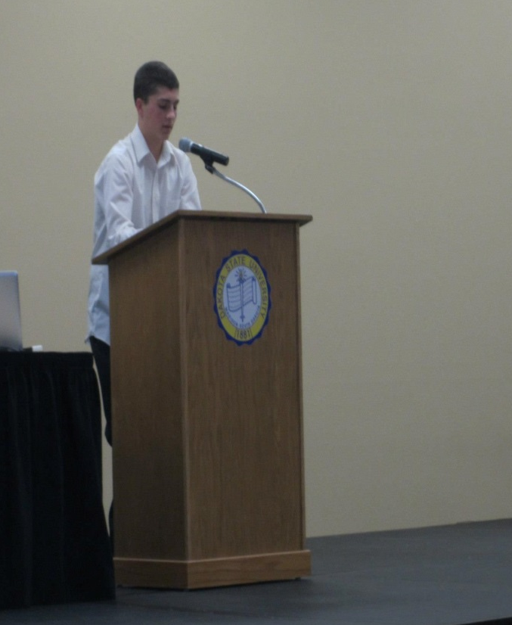
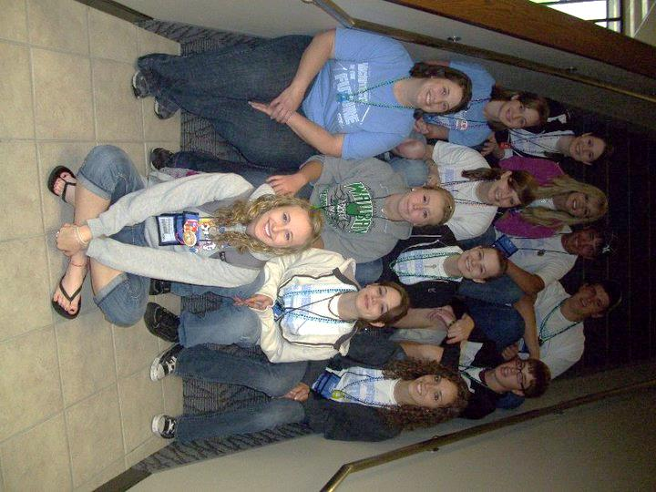
Our experiences
Ambassador experience:
Josh Westhause
Vermillion 2013 ambassador
Staff experience:
Cassie Donahoe
Alumni year 2010
On Staff for 3 years

