Slide 1

Water conservation
Anatomy of a Rotary Foundation Grant
A ROTARY FOUNDATION GLOBAL GRANT PROJECT IN THANE DISTRICT, INDIA
Rotary Club of Mission Viejo
Rotary Year 2014-15
Notes:
It is easy to be discouraged by the daily news. If we simply believe the headlines, the world is sinking deeper and deeper into war, inhumanity, and devastation. However, there is also evidence that, outside of war zones, there is less starvation, destitution, ignorance and disease than any time in human history. We simply don’t hear of the progress that it being made. The Rotary Foundation is a major player in that progress.
We talk about how The Rotary Foundation is the principal philanthropic entity of Rotary International and give out pins commemorating levels of giving to the Foundation. Thousands of Rotary Foundation projects are going on around the world all the time. Perhaps the best way to understand the value of your donations would be to look at one of the these: our most recent Global Grant project for Water Conservation in India. I call it the “Anatomy of a Rotary Foundation Grant.”

Slide 2
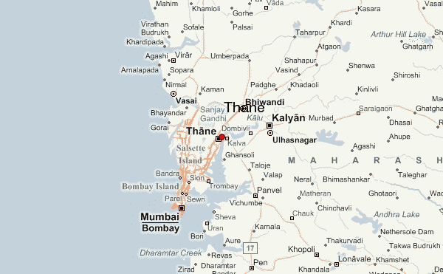
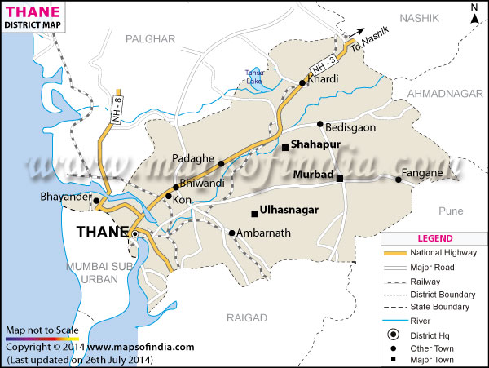
THE LOCATION
Murbad (pop. 18,700)
27 Miles from Thane (pop.1.8 million)
48 Miles from Mumbai (pop. 18.4 million)
Notes:
Our grant takes place in the Thane District of India in the State of Maharastra. The project serves villages close of Murbad, highlighted on the map by arrows. Murbad is about 27 miles east of the City of Thane and about 48 miles northeast of Mumbai.

Slide 3
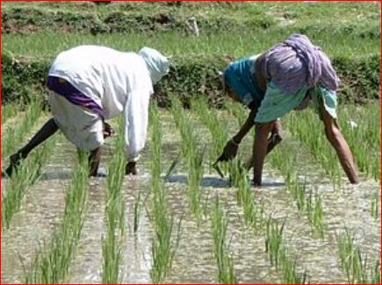
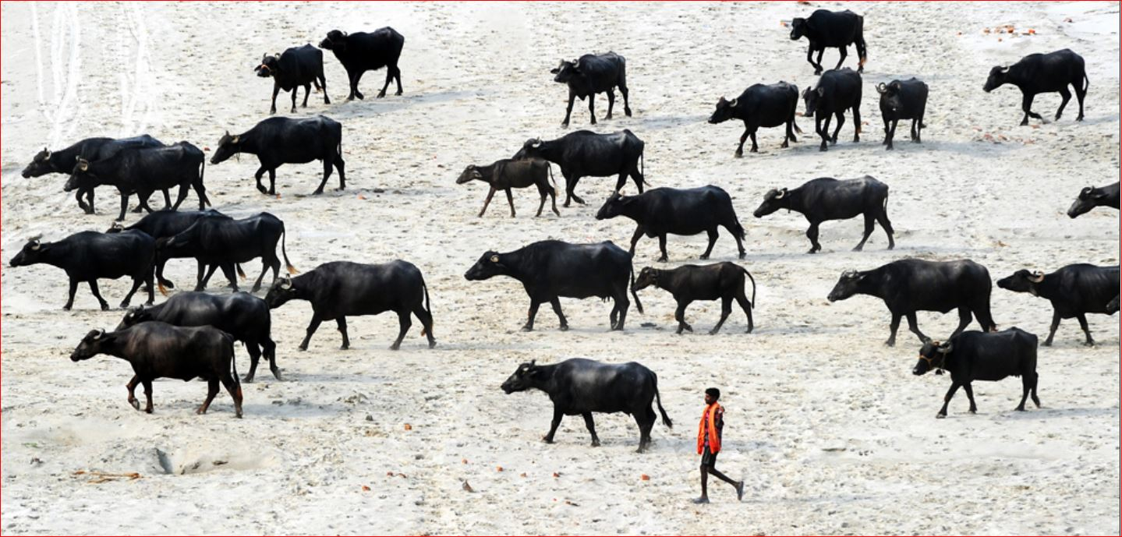
THE PEOPLE (Rural Thane District)
PRINCIPALLY SUBSISTANCE FARMING (RICE CULTIVATION)
USUALLY ONE CROP PER YEAR
LIVESTOCK
LOW INCOME <$3,000/Yr.
Livestock
Rice Cultivation
Notes:
The villagers are mainly subsistence farmers. The chief crop is rice. Some farmers also raise livestock. There is usually only enough water for one crop a year, if that. The average income is less than $3,000 per year.

Slide 4
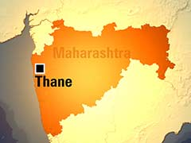
Record low rainfall
THE PROBLEM
Drought
Notes:
For the past 4 or 5 years, the State of Maharastra has experience drought on a par with California, creating a need for clean water.

Slide 5
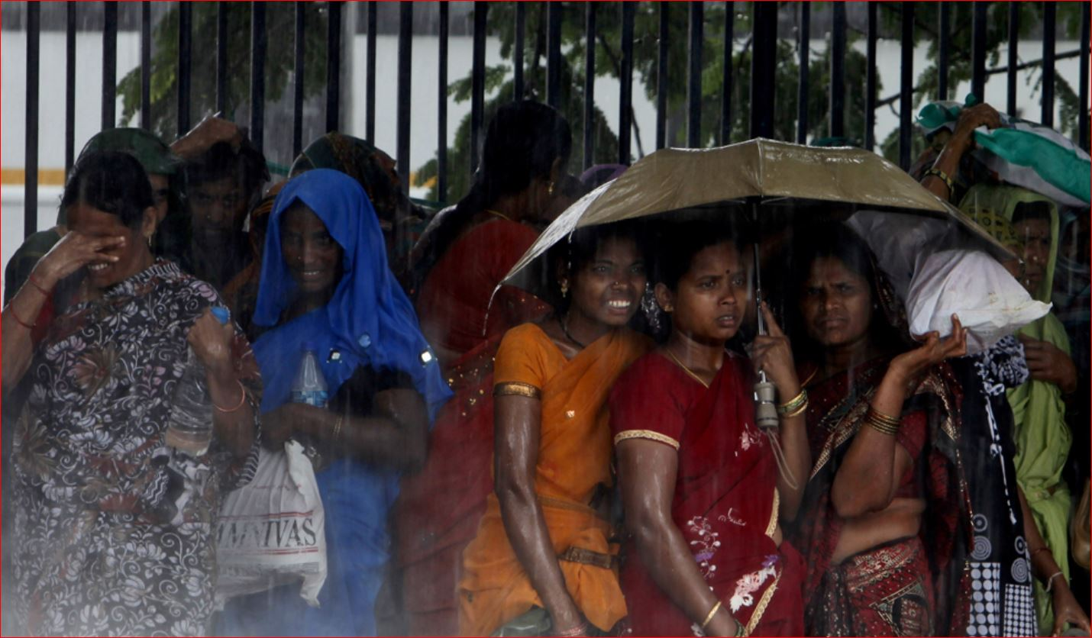
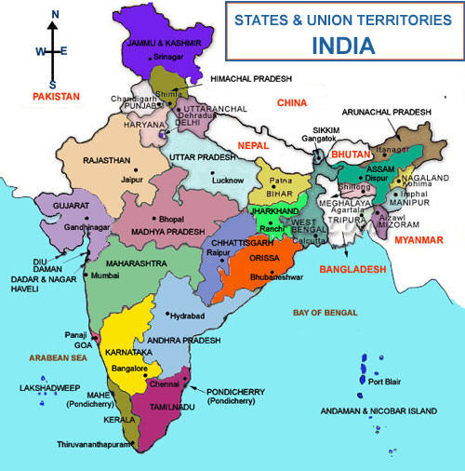
THE ANSWER
The Annual Monsoons
June-September
The States of India
Typical Monsoon Downpour
Notes:
A logical solution would be to preserve water from the summer monsoons, which fall annually in this part of India. The map shows the states of India. Maharastra is show in green in the central west part of the country.

Slide 6
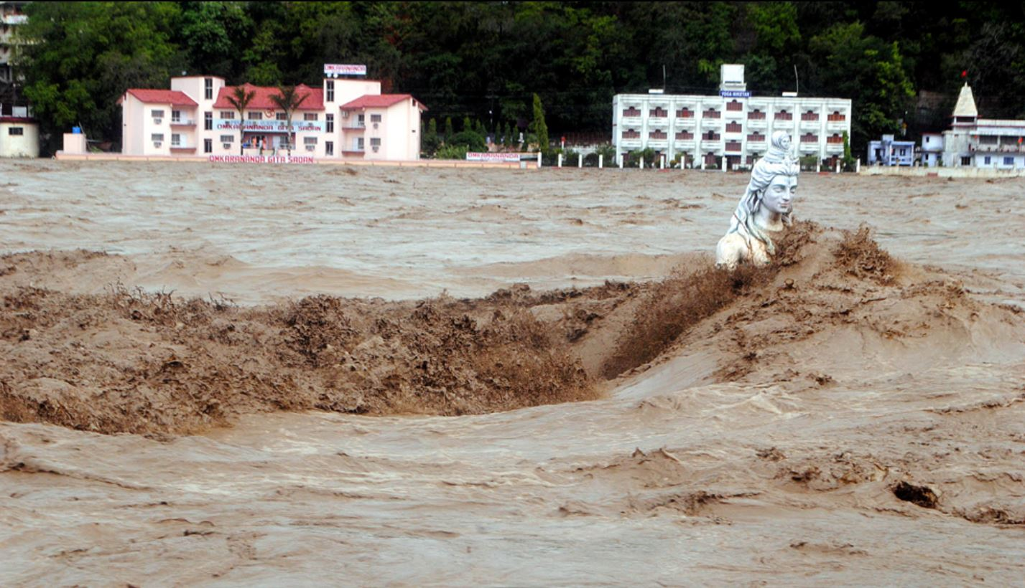
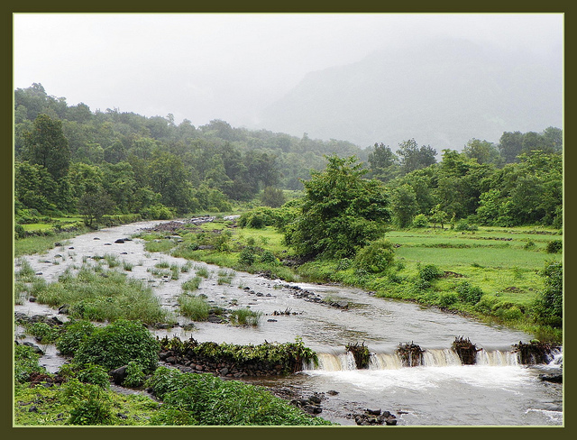
THE CHALLENGE
Torrential Downpours
Water Runs Off
Earthen Dams Wash Away
Water Runoff
Water Runoff
Notes:
The monsoons bring torrential rains which come during a certain time of the year. The water simply runs off into the rivers and eventually the Arabian Sea. The farmers try to conserve it with earthen dams, which simply wash away.

Slide 7
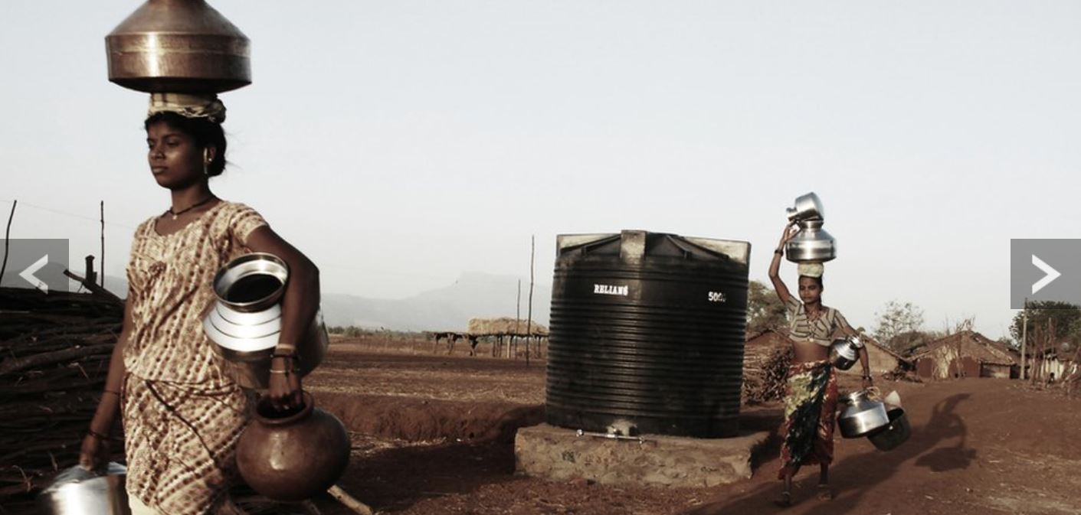
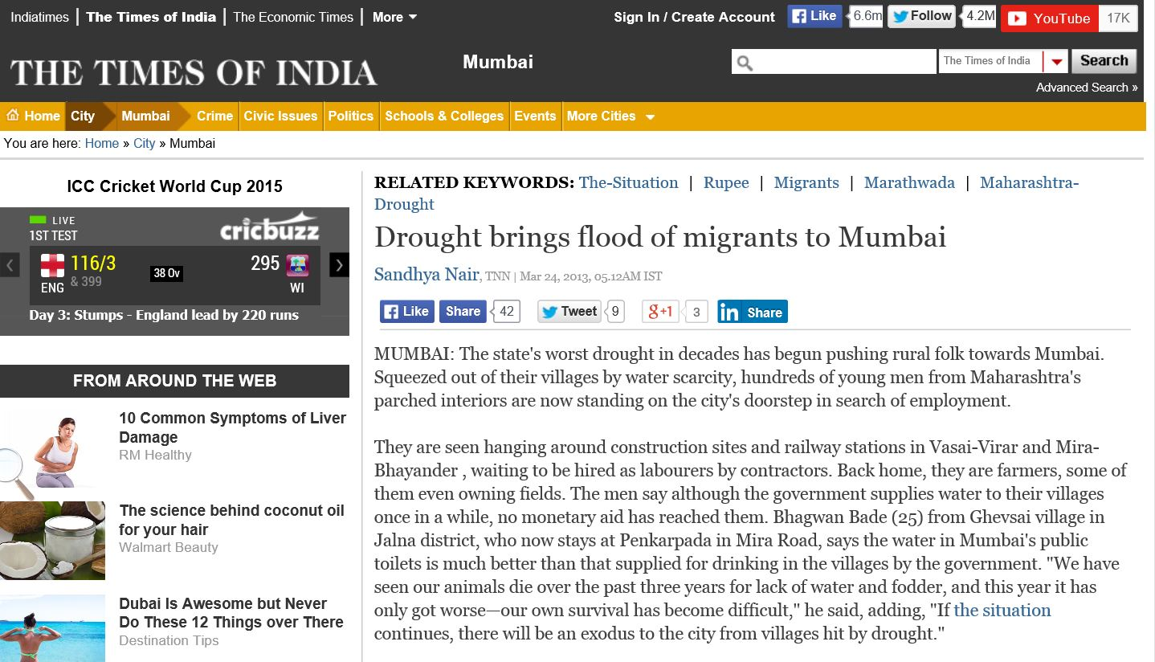
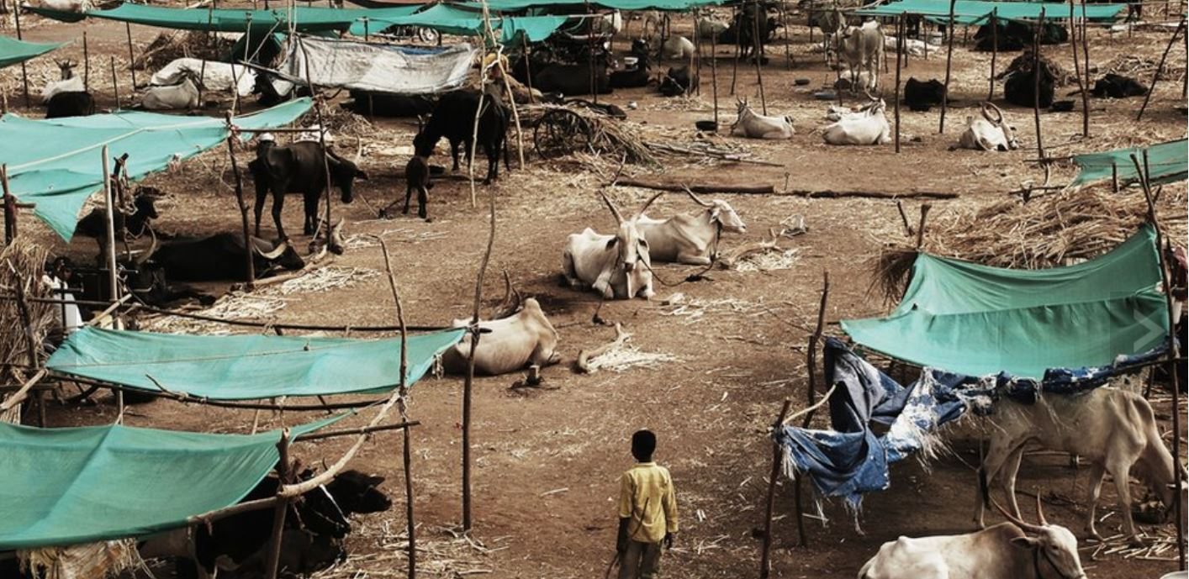
THE IMPACT
Water for One Crop per Year
Insufficient Clean Drinking Water
Exodus to the Cities for Water and Work
Children Pulled out of School
Carrying Water
Newspaper Laments Migrants to Mumbai
Squatter Encampment
Notes:
The drought results in insufficient water to support the population for the entire year. After the rice is harvested in the early fall, families do not have clean water to drink, to support livestock, or to raise a second crop. This has caused residents to migrate to the cities in search of water and work. Children are pulled out of school, and families wind up in squatter camps, railway stations and the like.

Slide 8
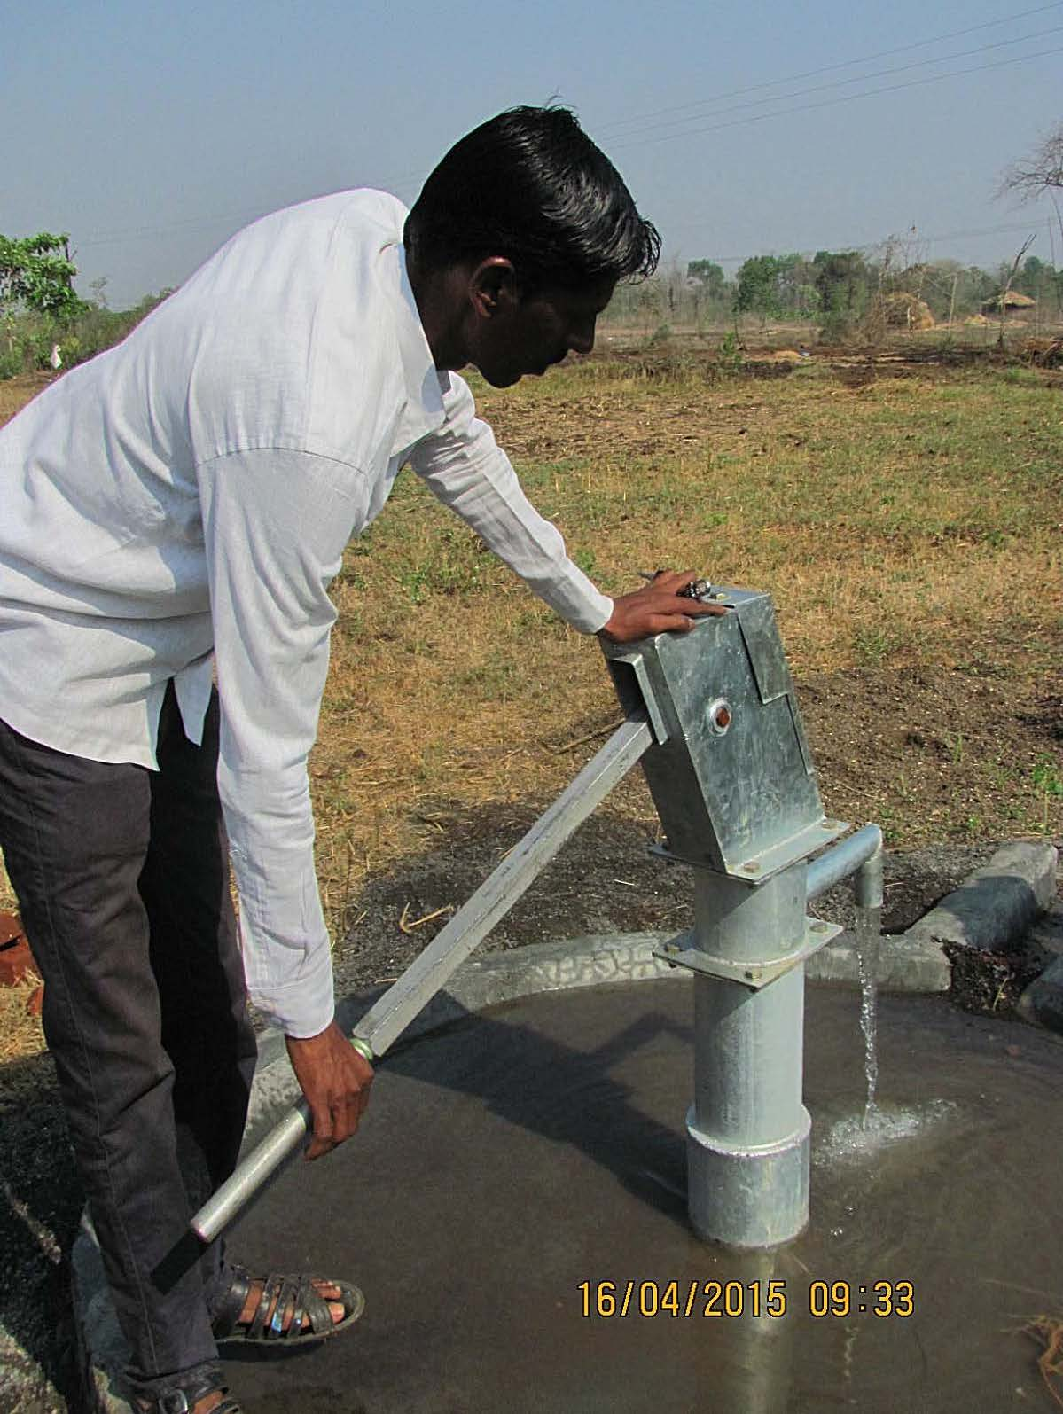
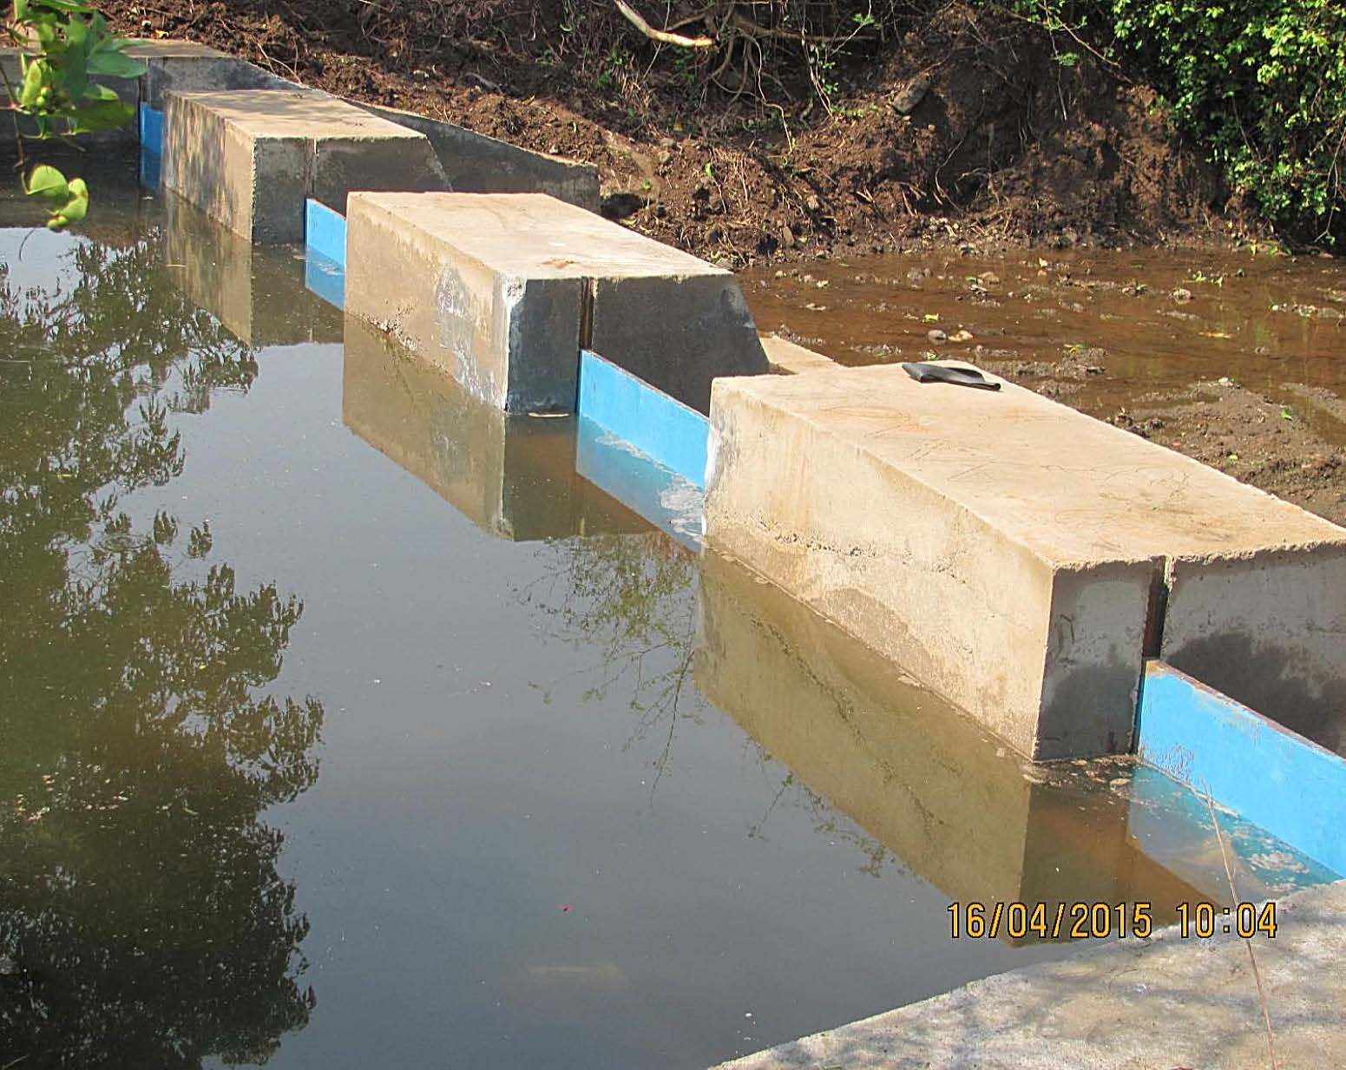
THE SOLUTION
5 Check Dams for Water Reclamation
Check Dams Provide for Irrigation and Livestock
Check Dams Raise the Water Table
5 Bore Wells for Drinking Water
Bore Well
Check Dam
Notes:
The Rotary Club of Thane East has found that permanent check dams can conserve the monsoon rain water, provide water for irrigation and livestock, and raise the water table. Bore wells, combined with sanitation projects, provide clean drinking water year round to farming families.

Slide 9
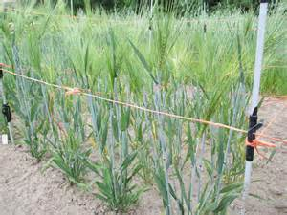
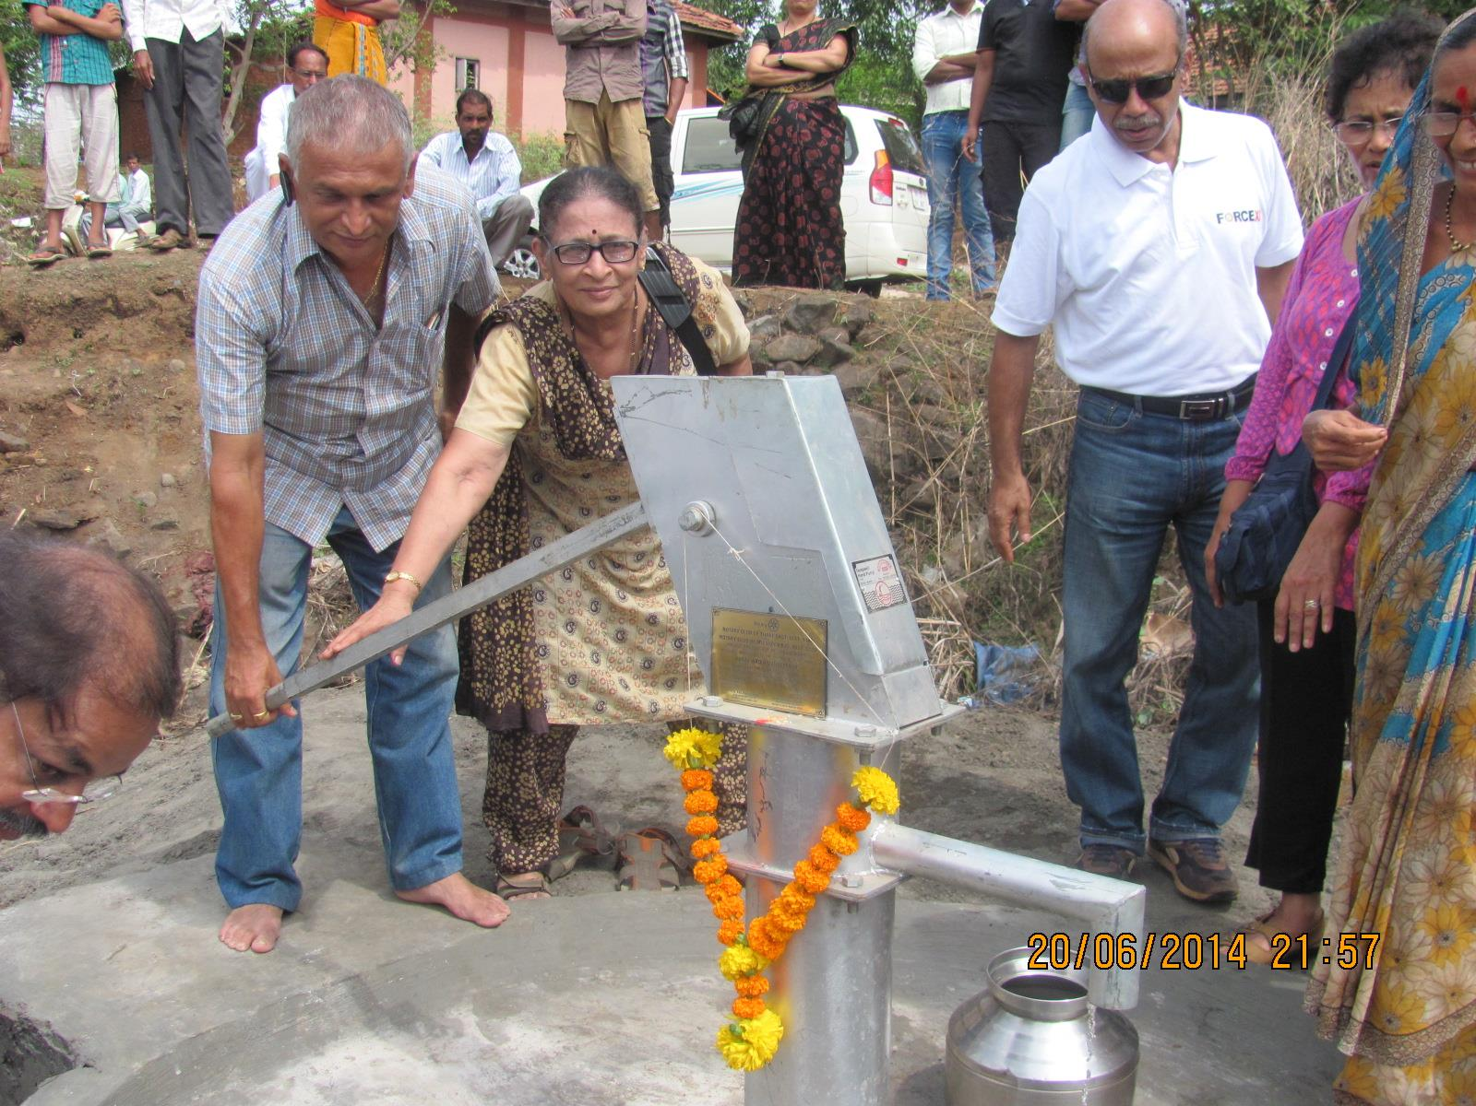
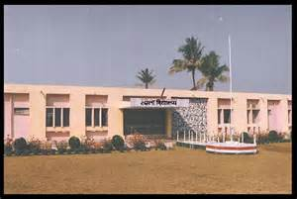
THE RESULT
Sufficient Water for a 2nd Crop (Often Barley)
No Need to Migrate to the Cities for Work and Water
Clean Drinking Water
Children Stay in Schools
Barley Cultivation
New Bore Well
Local School
Notes:
This has enabled farmers to irrigate a second crop after the rice is harvested so they do not need to seek work in the cities. The children can stay in their schools year round, and everyone has convenient access to clean drinking water.

Slide 10
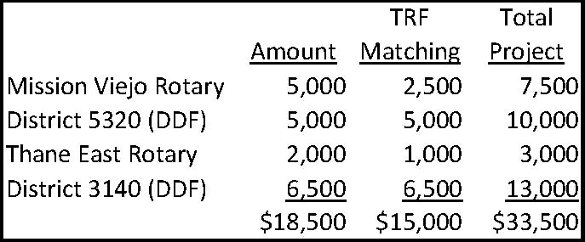
THE FINANCING
Our District Matches Our $5,000 Contribution with DDF
TRF Matches 50% of Our Contribution
TRF Matches 100% of Our District’s DDF
Thane East Rotary Donates $2,000
TRF Matches 50% of Thane East’s Donation
Rotary District 3140 Contributes $6,500 in DDF
TRF Matches 100% of District 3140’s DDF
TRF=The Rotary Foundation
DDF=District Designated Funds
Notes:
Our club contribution of $5,000 set in motion a $33,500 project to construct 5 permanent check dams and drill 5 bore wells. Our District matched our donation with $5,000 in DDF (District Designated Funds). The Rotary Foundation matched ½ of our contribution and 100% of the District’s DDF. Out partners in the Rotary Club of Thane East donated $2,000, and their District gave $6,500 in DDF. The Rotary Foundation again matched the club’s contribution at 50% and the Indian District ‘s DDF at 100%.

Slide 11

THE COST
5 Check Dams: $28,689
5 Bore Wells: $4,590
Admin. & Audit Expenses: $221
Total: $33,500
Source of the Funds
Notes:
This slide shows the actual cost of the check dams and bore wells. Note that each check dam costs less than $6,000, and each bore well less than $1,000.

Slide 12
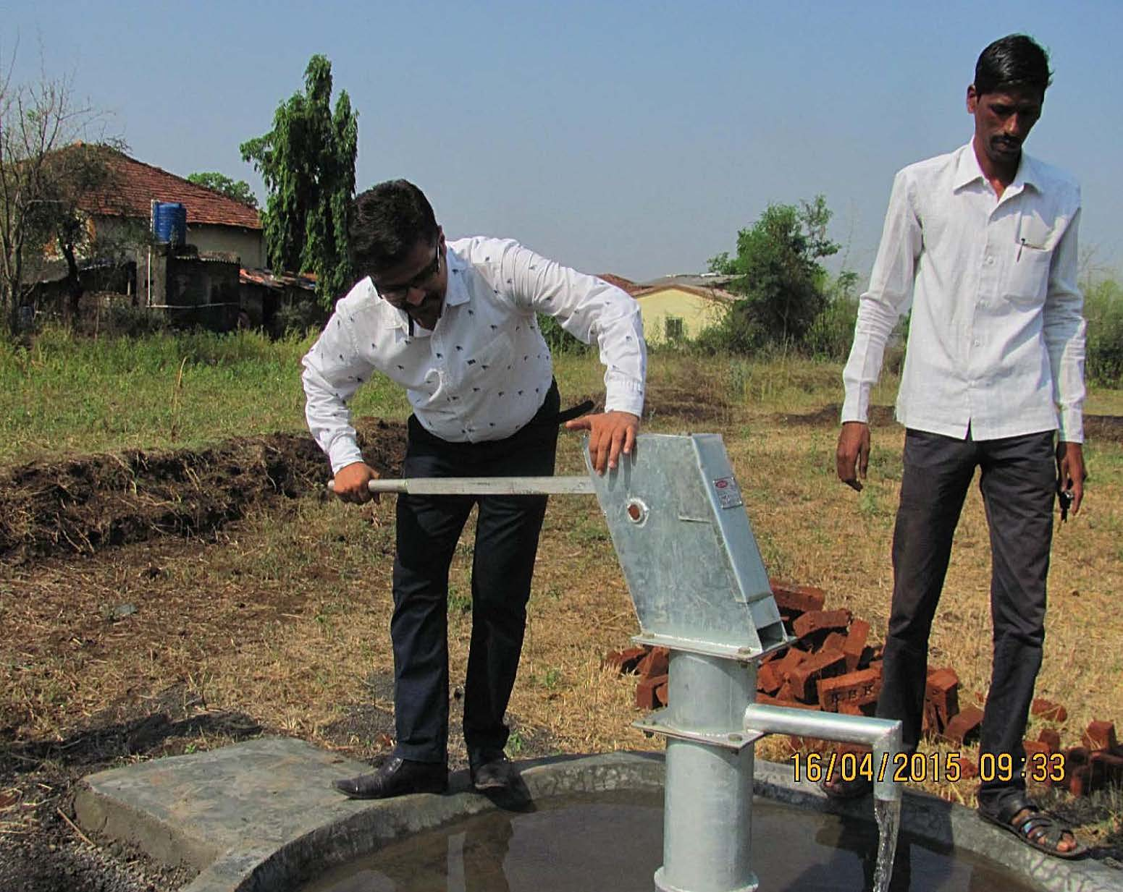
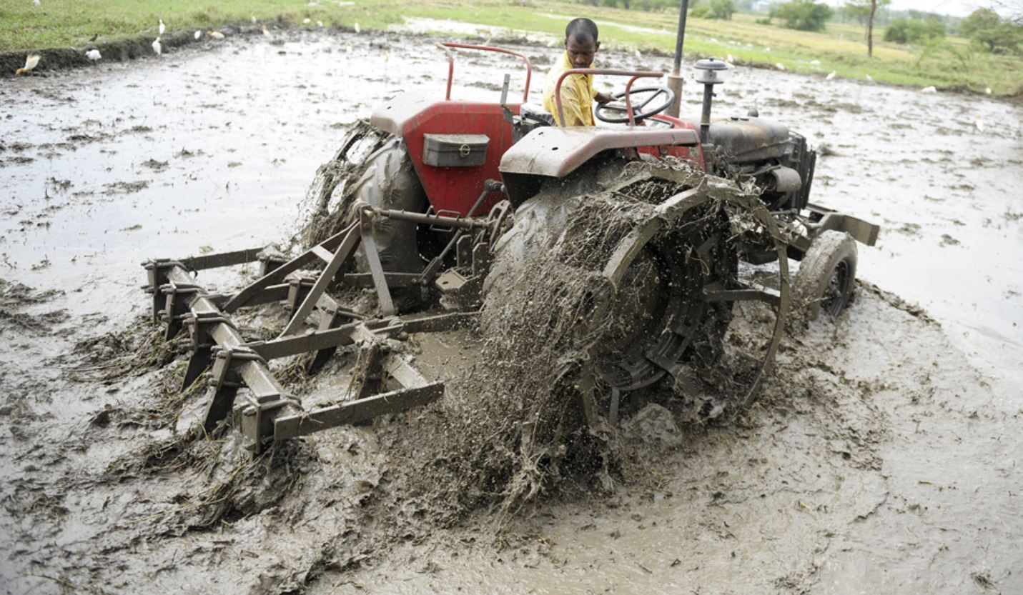
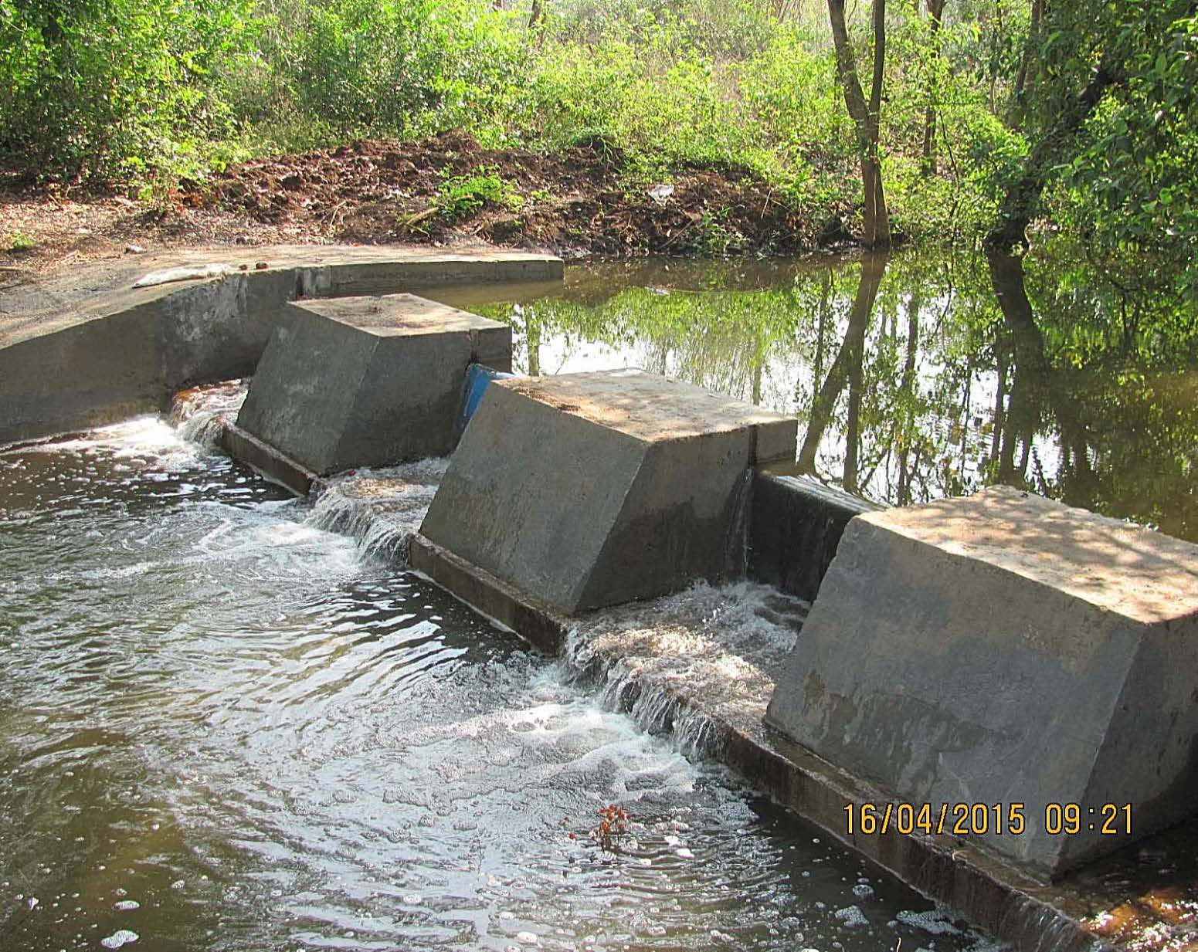
HOW CAN SO MUCH BE ACCOMPLISHED
WITH SUCH LIMITED RESOURCES?
The Voluntary Nature of Rotary Service (The Magic of Rotary):
The Beneficiaries Define the Need
Volunteers (Rotarians and Beneficiaries) Do Most of the Work
Rotarians Bring Their Expertise to Bear on the Project
Rotarians Use Their Contacts to Expedite the Work
Rotarians Bring Their Resources to the Project
Irrigation Water
Drinking Water
Raise Water Table
Notes:
The effectiveness of a Rotary Foundation project is part of the Magic of Rotary. We view the Water Conservation Global Grant project as an International Service project. Rotarians in the recipient country see it as a Community Service project to which they devote their time, resources, expertise, networks, and contacts. The Rotary Club of Thane has water engineers who can design and advise on the dam construction. They often can obtain discount prices on materials. Rotary is a prestigious organization in India and can secure government permits and facilities where others have difficulty. Moreover, the local beneficiaries define the needs, and Rotarians do most of the work (just as we do for our own Community Service projects). No Rotarian gets paid for his or her time and effort, and they probably didn’t even know the beneficiaries before planning the project. They contribute their time and effort because they share with us the Rotary values of “Service Above Self.”

Slide 13
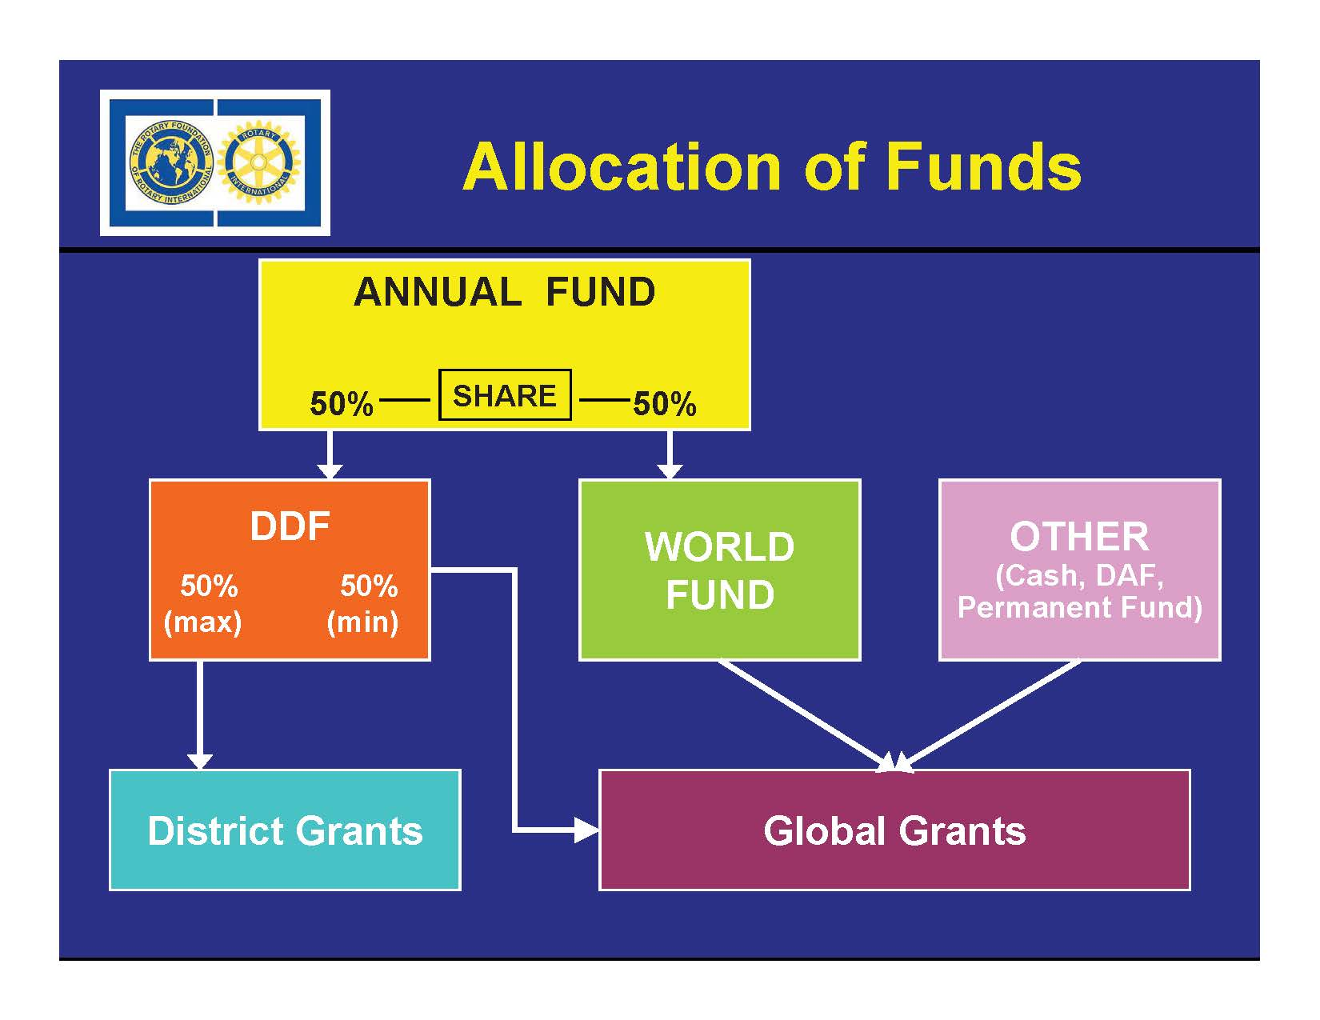
How Rotary Foundation Money Comes to Global Grants
DDF=District Designated Funds
DAF=Donor Advised Funds
Notes:
Where does the money come from for Global Grants and District Designated Funds? Much of it comes from your donations. Most of our club members contribute each month with their dues payments. This money goes into the Annual Fund, which in turn allocates 50% to DDF and another 50% to the World Fund. Districts may use up to 50% of the DDF for District Grants; the remainder may be used for Global Grants. Our District bases the eligibility for DDF on how much each club gave to the Annual Fund over a 2 ½ year period. The Rotary Foundation determines each District's share of DDF on that District’s donations to the Annual Fund over a 3-year period.

Slide 14



WHAT CAN I DO?
Sign Up To Donate Each Month with Your Dues Payment
$10/mo. Qualifies as a Sustaining Member
Your Contributions will be Matched for Paul Harris Fellow Recognitions
Our Club will be Eligible for Additional District Grants for our Projects
Our Club will be Eligible for Sustaining Club Status
Our Club will be Eligible for District Awards and “Best Club” Recognition
PHF Pins
EREY Banner
Sustaining Club Banner
Notes:
We have provided just one example of a project funded by a Rotary Foundation Global Grant. The voluntary nature of Rotary service tends to make The Rotary Foundation one of the most effective uses of your humanitarian giving. If you are not contributing every month to the Rotary Foundation, please ask our Treasurer Bill Kersten to add it to your dues billing. If everyone could give at least $10 month, each Rotarian would qualify as a “Sustaining Member,” and our club would achieve Sustaining Club status. We match all monthly donations with matching credits towards successive levels of Paul Harris Fellow recognition. Because a few members did not donate this year, our club was ineligible to compete for the 2014-15 Best Club recognition.

Slide 15

Mission Statement of The Rotary Foundation
The mission of The Rotary Foundation is to enable Rotarians to advance world understanding, goodwill, and peace through the improvement of health, the support of education, and the alleviation of poverty.
Notes:
I want to close with the Mission Statement of The Rotary Foundation. To paraphrase, Rotary during its 110-year history has discovered that improving health, education, and alleviating poverty across national boundaries is the best way to advance world understanding, goodwill and peace.

