Slide 1
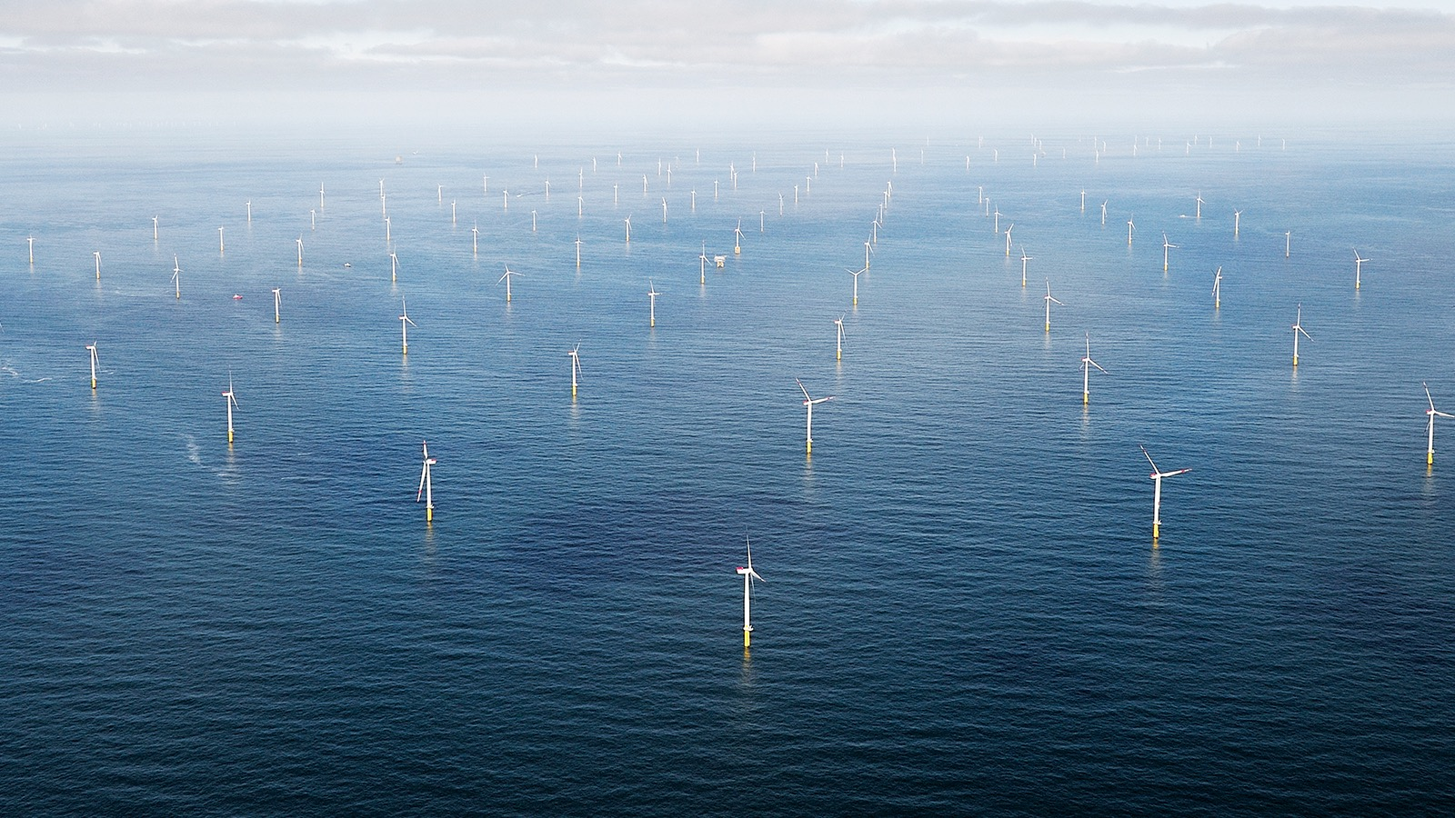
Walney Extension Wind Farm
Irish Sea, England
Largest Wind Farm in the World
Went Online September 2018
More Area than San Francisco
Notes:
Largest Wind Farm in world
Walney Extension Just went online Sept 2018
Area Larger than San Francisco
659 MW - powers nearly 600,000 homes!
87 Turbines - 640 feet tall
Est - by 2026 2.3 GW of offshore wind will be running in the US-enough to power more than 1m US homes.
Dutch are proposing a 30GW farm with it’s own artificial island built in the ocean between the Netherlands and Norway by

Slide 2
Globally, wind could supply
worldwide electricity consumption
40 times over
Notes:
ID #2802 - Can be used in noncommercial online and TV broadcasts of your presentation, but not modified.
Buckminster Fuller:
I have summarized my discovery of the option of humanity to become omnieconomically and sustainably successful on our planet while phasing out forever all use of fossil fuels and atomic energy generation other than the Sun. I have presented my plan for using our increasing technical ability to construct high-voltage, superconductive transmission lines and implement an around-the-world electrical energy grid integrating the daytime and nighttime hemispheres, thus swiftly increasing the operating capacity of the world's electrical energy system and, concomitantly, living standard in an unprecedented feat of international cooperation.
DESCRIPTION: Text stating that wind could supply worldwide electricity consumption 40 times over
ADDITIONAL TALKING POINTS: There is general consensus that global wind power potential is enormous, even under conservative estimates. For example, a 2009 study found that a network of land-based 2.5-megawatt wind turbines restricted to non-forested, ice-free, non-urban areas and operating at as little as 20 percent of their rated capacity could supply more than 40 times current worldwide electricity consumption, and more than five times total global use of energy in all forms.*
REFERENCES:
* Xi Lua, Michael B. McElroya, and Juha Kiviluoma, “Global Potential for Wind-Generated Electricity,” Proceedings of the National Academy of Sciences of the United States of America 106, No. 27 (July 7, 2009): 10933-10938. http://www.pnas.org/content/106/27/10933.full.pdf

Slide 3


Enough solar energy reaches Earth every hour
to fill all the world’s energy needs for a full year
Notes:
ID #3781 - Can be used in noncommercial online and TV broadcasts of your presentation, but not modified.
DESCRIPTION: Image of the Sun’s rays striking the Earth and text stating that enough solar energy reaches the Earth every hour to meet the world’s power needs for a full year
ADDITIONAL TALKING POINTS: Although solar energy is not evenly distributed across the Earth, significant resources are found on every continent. Moreover, while coal, oil, and natural gas resources are finite, the Sun will continue to shine for at least 5 billion years.*
REFERENCES:
* Dan Chiras, “Can Solar Power the World?," Mother Earth News, March 12, 2010. http://www.motherearthnews.com/renewable-energy/can-solar-power-the-world.aspx#axzz32CGVnRHY

Slide 4
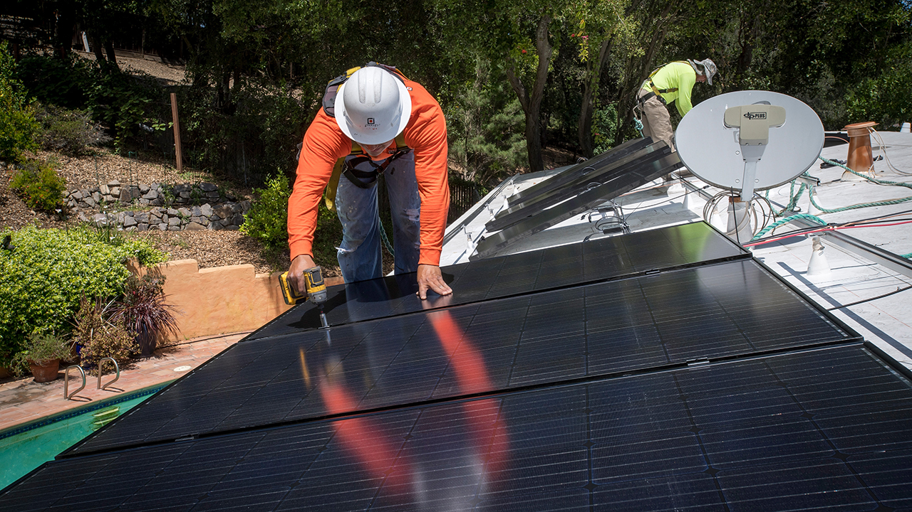
Lafayette, California
May 15, 2018
The price of solar in California has declined 53% over the past five years.
The Average Rooftop Solar
Installation Payback Period
is 7.5 Years.
© 2017 David Paul Morris/Bloomberg via Getty Images
Notes:
Current Solar panel technology is capable of around 30% efficiency
NovaSolix is a silicon valley startup developing a process to manufacture solar panels that use carbon nanotubes as antennas – combined with nanoscale rectifiers – to generate power from a much broader swath of the solar energy spectrum than conventional PV cells. The company claims that 80-90% efficiency may be possible. They are also working to develop a process to manufacture the panels on a substrate of glass, thus dramatically reducing the cost compared with silicon-based PV technology.
DESCRIPTION: Text stating that the price of solar has declined 53 percent in California over the last five years (2012-2017) and photo of technicians installing solar panels on a roof in Lafayette, California, May 15, 2018
ADDITIONAL TALKING POINTS: Solar prices are falling in California. According to the Solar Energy Industries Association, the cost of solar fell 53 percent in California between 2012-2017.*
Meanwhile, according to the International Renewable Energy Agency, average total installed costs for residential solar photovoltaic (PV) systems (0-10 kW) in California fell 47 percent between Q2 2007-Q1 2017. For commercial PV (up to 500 kW), total installed costs fell 53 percent between Q2 2009-Q2 2017.**
REFERENCES:
* Solar Energy Industries Association, "Solar Spotlight-California" (June 2018). https://www.seia.org/sites/default/files/2018-06/Web2018Q1_California.pdf
** IRENA, "Renewable Energy Power Generation Costs 2017" (2018). https://www.irena.org/-/media/Files/IRENA/Agency/Publication/2018/Jan/IRENA_2017_Power_Costs_2018.pdf

Slide 5
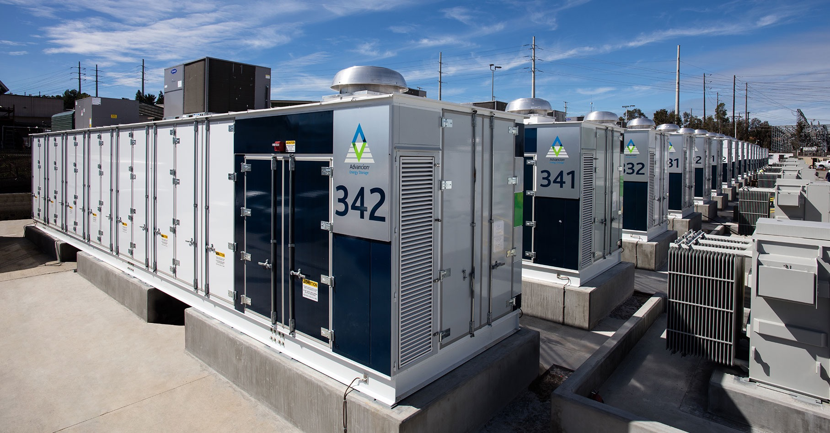
World’s Largest Lithium Battery
February 2017 - Escondido, California
In 2013, California enacted the world's first energy storage mandate, requiring its utilities to adopt 1,325 megawatts of energy storage by 2020.
30 MW Storage Facility
Capable of providing 120 Mwh of Energy
Serving 20,000 customers for 4 hours
400,000 Batteries installed in 20,000 Modules
Notes:
30 MW Storage Facility
Capable of providing 120 Mwh of Energy
Serving 20,000 customers for 4 hours
400,000 Batteries installed in 20,000 Modules
Today, SDG&E is showcasing the world’s largest lithium-ion battery energy storage facility in partnership with AES Energy Storage, which will enhance regional energy reliability while maximizing renewable energy use. The 30 megawatt (MW) energy storage facility is capable of storing up to 120 megawatt hours of energy, the energy equivalent of serving 20,000 customers for four hours.
The 400,000 batteries, similar to those in electric vehicles, were installed in nearly 20,000 modules and placed in 24 containers. The batteries will act like a sponge, soaking up and storing energy when it is abundant – when the sun is shining, the wind is blowing and energy use is low – and releasing it when energy resources are in high demand. This will provide reliable energy when customers need it most, and maximize the use of renewable resources such as solar and wind.

Slide 6
“Solar-plus-batteries
is set to begin
a dramatic transformation
of human civilization.”
Bloomberg View
  April 8, 2015
Notes:
ID #3511.C - Can be used in noncommercial online and TV broadcasts of your presentation, but not modified.
DESCRIPTION: Quote from Bloomberg View about solar power and energy storage technologies from April 8, 2015
ADDITIONAL TALKING POINTS: In a July 2014 Blue Paper, Morgan Stanley Research Global stated that “given the relatively high cost of the power grid, we think that customers in parts of the US and Europe may seek to avoid utility grid fees by going ‘off-grid’ through a combination of solar power and energy storage. We believe there is not sufficient appreciation of the magnitude of energy storage cost reduction that Tesla [an electric car manufacturer and advanced battery producer] has already achieved…While ‘off-grid’ applications are the most disruptive use of energy storage, we note that there are also less disruptive applications such as strengthening the grid to compensate for the variability of solar output.”*
REFERENCES:
* Stephen Byrd, et al., “Solar Power & Energy Storage: Policy Factors vs. Improving Economics,” Morgan Stanley Research Global, July 28, 2014. http://energystorage.org/system/files/resources/morgan_stanley_solar_power_energy_storage_blue_paper_july_29_2014.pdf

Slide 7
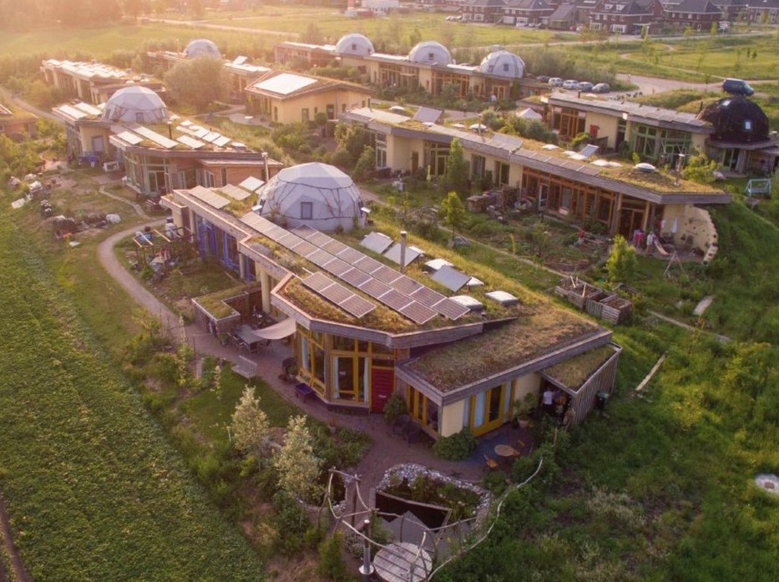
Microgrids
Localized grouping of distributed energy sources together with storage or backup generation including management tools
Multiple homes in a neighborhood share solar power and storage
Can include adjacent businesses or multi-use buildings
Use what you need, draw on larger grid as needed, sell excess into the grid
Advantages
Drawdown CO2
Electric Reliability - Avoid losses from utility blackouts
Lowers Energy Costs for Consumers and Businesses
Ardehuizen, Netherlands - A “near” self-sufficient eco-village consisting of 23 “Earthship” houses.
Improves Community Well Being
Notes:
A microgrid is a group of interconnected loads and distributed energy resources within clearly defined electrical boundaries that acts as a single controllable entity with respect to the grid. A microgrid can connect and disconnect from the grid to enable it to operate in both grid-connected or island-mode.
Benefits of Microgrids
• Provide efficient, low-cost, clean energy
• Improve the operation and stability of the regional electric grid
• Critical infrastructure that increases reliability and resilience
• Reduce grid “congestion” and peak loads
• Enable highly-efficient CHP, reducing fuel use, line losses, and carbon footprint
• Integrate CHP, renewables, thermal and electric storage, and advanced system and building controls
• Make RTO markets more competitive
• Offer grid services including: energy, capacity, and ancillary services
• Support places of refuge in regional crises and first responders
• Use local energy resources and jobs
• Diversified risk rather than concentrated risk
• Using electric and thermal storage capabilities, a microgrid can provide local management of variable renewable generation, particularly on-site solar
• When properly designed, a regional power grid that combines both large central plants and distributed microgrids can be built with: less total capital cost, less installed generation, higher capacity factor on all assets, and higher reliability.

Slide 8
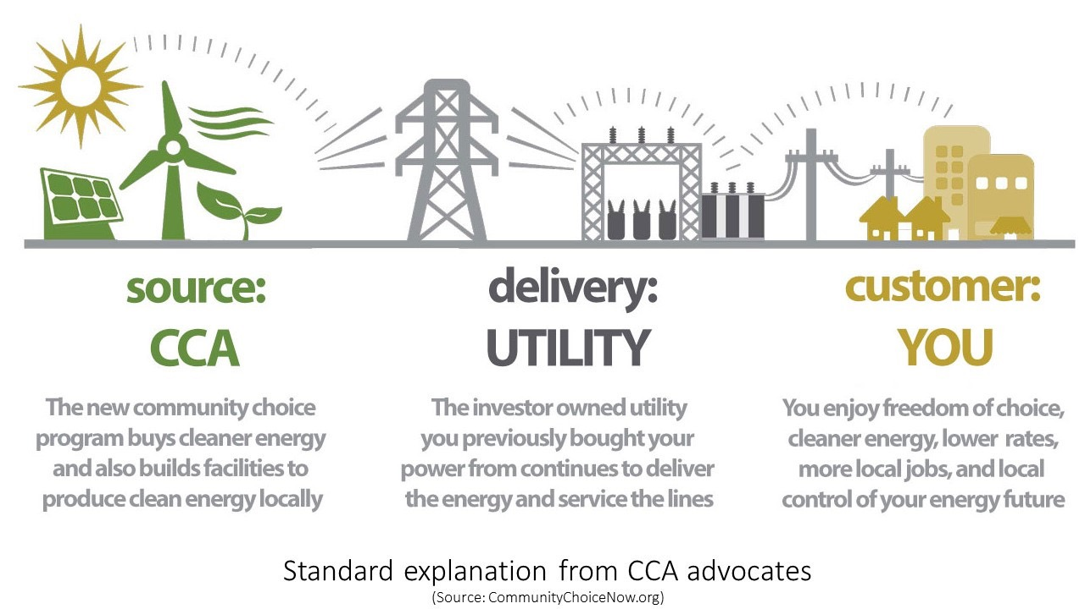
How Community Choice Aggregation Works
Notes:
19 CcA in Calif today
9 in various stages of investigation - including Del Mar, Encinitas, Carlsbad and Oceanside
Operational Community Choice agencies:
• MCE Clean Energy, launched 2010, Marin, Napa, and cities in Solano and Contra Costa counties
• Sonoma Clean Power, launched May 2014, Sonoma and Mendocino Counties
• Lancaster Choice Energy, launched May 2015, City of Lancaster in L.A. County
• CleanPowerSF, launched May 2016, City and County of San Francisco
• Peninsula Clean Energy, launched October 2016, San Mateo County
• Silicon Valley Clean Energy, launched April 2017, Santa Clara County
• Apple Valley Choice Energy, launched April 2017, City of Apple Valley
• Redwood Coast Energy Authority, launched May 2017, Humboldt County
• Pico Rivera Innovative Municipal Energy (PRIME), launched September 2017
• Pioneer Community Energy, launched February 2018, Placer County
• Clean Power Alliance of Southern California, launched February 2018, Los Angeles and Ventura Counties
• Monterey Bay Community Power, launched March 2018, Monterey, Santa Cruz, and San Benito counties
• San Jacinto Power, launched April 2018, City of San Jacinto
• Rancho Mirage Energy Authority Launched May 2018
• Solana Energy Alliance, launched June 2018, City of Solana Beach
• Valley Clean Energy, launched June 2018, Yolo County
• East Bay Community Energy, launched June 2018, Alameda County
• San Jose Clean Energy (Launched Sept. 2018)
• King City Community Power Launched July 2018, Monterey County
Emerging Community Choice agencies (CCAs):
• Desert Community Energy (Coachella Valley – Central and Eastern Riverside County)
• Western Community Energy (Western Riverside County Council of Governments)
• Butte County Community Choice
• Hanford Community Choice (Kings County)
• San Luis Obispo/Morro Bay Community Choice
• City of San Diego
• North Coast – San Diego County
• Central Coast Power (Santa Barbara County and cities)
• Who’s Next?

Slide 9
Energy Mobilization Actions
  Install solar on every available rooftop, including homes, businesses, government properties, schools, police, fire stations, community centers, transit depots, carports, parks, etc.
Lobby to Allow Microgrids
Move rapidly toward Community Choice Aggregation
Partner with surrounding cities to build Utility Scale Solar Plants and offshore Wind Farms
Notes:
Including smart thermostats and smart appliances
Overcome utility monopoly
Allow every government building to participate in a microgrid
Ensure backup for emergency services

Slide 10
Transportation
Auto Manufacturers Are Moving to Electric Vehicles
Companies with Electric Models in Production
Aixam
Aston Martin
Audi
BAIC
BMW
Bolloré
Buddy Electric
BYD
ChangAn
Chery
Chevy
Citroën
Citydom GmbH
CODA
Daimler
Exagon
Fiat
Fisker
Ford
Geely
GM
Goupil
Honda
Hyundai
JAC
Kandi
Kantanka
Kia
Kyburz
Mahindra
Mercedes-Benz
Mitsubishi
Mullen
NIO
Nissan
Opel
Peugeot
Qiantu
Rayttle
Renault
$mart
Subaru
Tata
Tesla
Toyota
Trumpchi
Venturi
Volkswagen
Zotye
Data: Bloomberg New Energy Finance, EVObsession
Notes:
All told, there will be over 100 new plug in models available by 2022
ID #4842.B - Can be used in noncommercial online and TV broadcasts of your presentation, but not modified.
DESCRIPTION: Text list of auto manufacturers with an electric model in production
ADDITIONAL TALKING POINTS: According to recent research by McKinsey & Company, about 30 percent of vehicle buyers in the US would consider an electric vehicle (EV) purchase today. In Germany, this number is closer to 45 percent. One of the factors behind this low percentage is that around half of the consumers in the US and Germany comprehend how electrified vehicles and the associated technology work, compared to almost 100 percent of consumers for an internal combustion engine (ICE). But less than 5 percent of potential buyers ultimately purchase an EV over an ICE (~3 percent in the US, ~4 percent in Germany, and ~22 percent in Norway).*
Although understanding and purchases of EVs may be low, the stage is set for a change as the average battery pack price has fallen almost 80 percent between 2010 and 2016. Additionally, significant range increases since 2013 of about 20 to 40 percent helped offset consumer concerns about mileage, one of the major deterrents to an EV purchase. Finally, projections indicate that global charging station deployments – both public and private – could grow from around two million in 2016 to over 12 million in 2020.**
In 2016, there were over two million electric vehicles on the road globally. Although they represented only a small portion — about 0.2 percent — of total passenger light-duty vehicles in circulation that year, carmakers estimate between 9 and 20 million electric vehicles could be deployed by 2020, and between 40 and 70 million by 2025.***
Perhaps as a sign of where investors believe the future of automobile sales lies, in April 2017, electric car manufacturer Tesla surpassed General Motors in market value.****
REFERENCES:
* McKinsey & Company, “Electrifying insights: How automakers can drive electrified vehicle sales and profitability,” Advanced Industries, January 2017. http://www.mckinsey.com/industries/automotive-and-assembly/our-insights/electrifying-insights-how-automakers-can-drive-electrified-vehicle-sales-and-profitability
** Katie Fehrenbacher, “5 Ways Automakers Can Make Electric Cars Profitable,” Greentech Media, February 7, 2017. https://www.greentechmedia.com/articles/read/5-ways-automakers-can-make-electric-cars-profitable
*** International Energy Agency, “Electric Vehicles Have Another Record Year, Reaching 2 Million Cars in 2016,” June 7, 2017. https://www.iea.org/newsroom/news/2017/june/electric-vehicles-have-another-record-year-reaching-2-million-cars-in-2016.html
**** The New York Times, “Tesla Hits a New Milestone, Passes G.M. in Market Valuation,” April 10, 2017. https://www.nytimes.com/2017/04/10/business/tesla-general-motors-stock-market.html

Slide 11
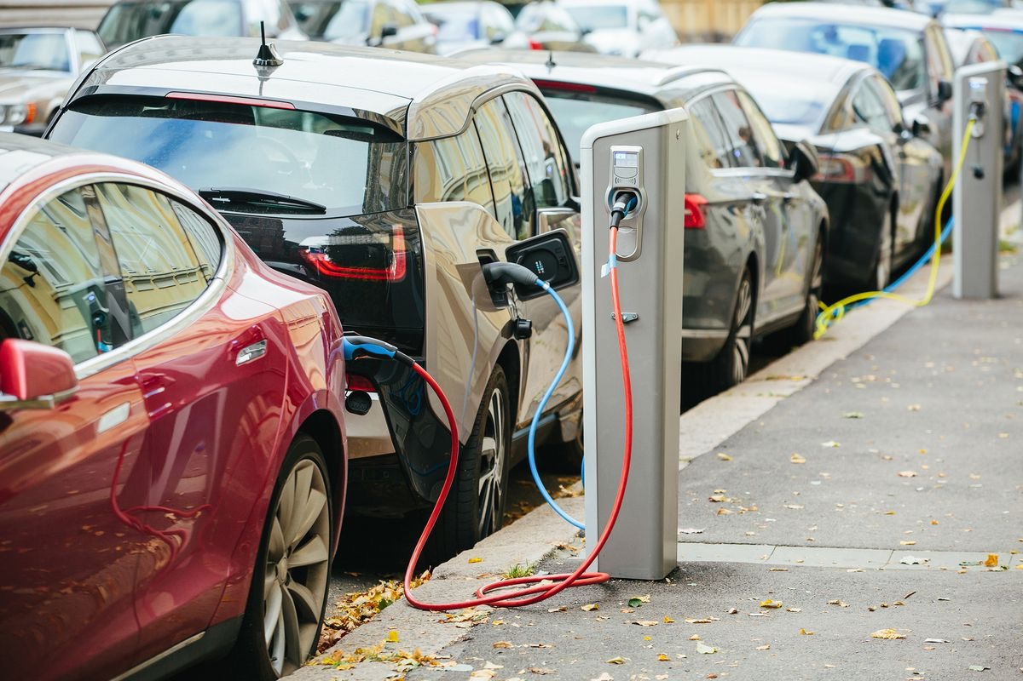
Benefits of Buying an Electric Vehicle
No Fossil Fuels
Simpler to Make
Fewer Moving Parts
Less Maintenance
Safer
Fun to Drive
Notes:
Bloomberg
“Our latest forecast shows sales of electric vehicles (EVs) increasing from a record 1.1 million worldwide in 2017, to 11 million in 2025 and then surging to 30 million in 2030 as they become cheaper to make than internal combustion engine (ICE) cars. China will lead this transition, with sales there accounting for almost 50% of the global EV market in 2025.The state legislature recently passed a bill that will make it easier for renters to install charging stations, according to Capitol Weekly (via ChargedEVs).
Apartment Dwellers can charge ahead!
Assembly Bill 2565 would give tenants the right to install an electric-car charging station at their residence, provided the tenant submits a written request to the landlord and pays for the installation costs.
Once the station is installed, the cost of charging will be added to an electric-car owner's rent, along with any costs associated with maintaining or repairing the hardware

Slide 12
13 cities have committed to buying only zero-emissions buses starting in 2025:
Auckland
Barcelona
Cape Town
Copenhagen
London
Los Angeles
Mexico City
Milan
Paris
Quito
Rome
Seattle
Vancouver
Shanghai and Shenzhen, China are already buying only electric buses.
Notes:
ID #5431.B.LA - Can be used in noncommercial online and TV broadcasts of your presentation, but not modified.
DESCRIPTION: Text slide listing 13 cities committed to only buying zero-emissions buses starting in 2025, that also notes Shanghai and Shenzen are already doing so
ADDITIONAL TALKING POINTS: The actions of the signatory cities listed on this slide represent 80 million people and 60,000 buses. Switching to e-buses will greatly reduce tailpipe and CO2 emissions even when the power is largely derived from coal and natural gas. There are some uncertainties in the bus market that will be a barrier to some of these cities – particularly around battery technology. It is unclear how fast and far the prices of batteries will fall and how long they will last. However, in a 2018 Bloomberg New Energy Finance Report, it says that electric buses have a much lower operating cost and can be cheaper over the lifetime of the vehicle. In addition, countries have made an effort to align national policy with the actions of these cities to help alleviate these market barriers *
The German car industry is the world’s largest investor in electric vehicles. In 2018, German manufacturers proposed contributing to a €500-million fund to reduce urban pollution, with proposed solutions including modernizing bus fleets and building bike paths.**
REFERENCES:
* Bloomberg New Energy Finance, “Electric Buses in Cities; Driving Towards Cleaner Air and Lower CO2,” (March 2018). https://c40-production-images.s3.amazonaws.com/other_uploads/images/1726_BNEF_C40_Electric_buses_in_cities_FINAL_APPROVED_%282%29.original.pdf?1523363881
** The Local De, “German automakers are biggest global spenders on electric cars: study,” March 12, 2018. https://www.thelocal.de/20180312/german-automakers-are-biggest-global-spenders-on-electric-cars-study

Slide 13

Mobility Alternatives
Bicycling
Inland Rail Trail
Walking
North San Diego County, CA
Notes:
The Inland Rail Trail is a (partially completed) 21-mile Class I bikeway through the cities of Oceanside, Vista, San Marcos, and Escondido, as well as a portion of the unincorporated County of San Diego. The Inland Rail Trail is an important element of the San Diego Regional Bike Plan and is considered a priority project. Completion of the Inland Rail Trail and other similar Class I bikeways will help create an interconnected regional bike network. A Class I bikeway is a bike path that is physically separate from motor vehicle traffic.

Slide 14
Transportation Mobilization Actions
Make Your Next Auto Purchase an EV
Use Clean Public Transportation Whenever Possible
Telecommute vs Driving or Flying
Lobby Your City to:
Build a network of bicycle and walking paths for non-motorized Vehicles
Build Pedestrian Friendly Streets
Expand Net-Zero Public Transport
Notes:
Consider bicycle sharing
Build a network of bicycle and walking paths for non-motorized vehicles
Improves health
Safe and away from auto traffic
Build pedestrian friendly streets
Well lit at night
Tree-lined and shaded
Walking “school bus”
Expand public transport. Encourage use
Develop a non-motorized area of the city
Demand to live in walkable places far outstrips supply
A single round trip flight from San Diego To Paris expends 15,000 kg of carbon - 75% of yearly average

Slide 15
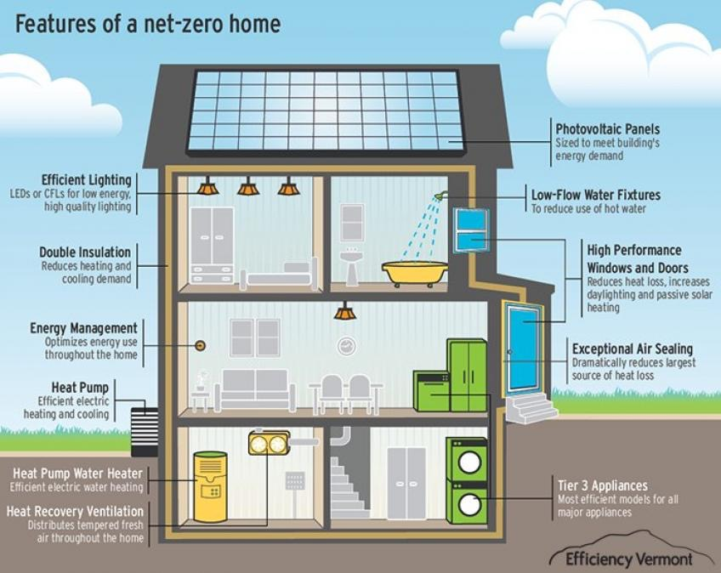
Features of a Net-Zero Home
Photo-Voltaic
Panels
LED
Lighting
Low-Flow
Water Fixtures
Double
Insulation
High Performance Windows & Doors
Energy
Management
Exceptional
Air Sealing
Heat
Pump
Heat Pump
Water Heater
Tier 3
Appliances
Heat Recovery
Ventilation
Notes:
Buildings Account for 39% of CO2 emissions in the United States
A typical building can cut energy use by up to 15% by implementing no and low cost measures and over 45% by implementing deeper retrofit measures. Such retrofit projects will reduce operating costs, and improve occupant comfort with a host of other benefits.
The commercial and residential building sector accounts for 39% of carbon dioxide (CO2) emissions in the United States per year, more than any other sector. U.S. buildings alone are responsible for more CO2 emissions annually than those of any other country except China. Most of these emissions come from the combustion of fossil fuels to provide heating, cooling and lighting, and to power appliances and electrical equipment. By transforming the built environment to be more energy-efficient and climate-friendly, the building sector can play a major role in reducing the threat of climate change.
What Are NET-ZERO HOMES?
Zero energy homes are just like any home—except better. They are regular grid-tied homes that are so air-tight, well insulated, and energy efficient that they produce as much renewable energy as they consume over the course of a year, leaving the occupants with a net zero energy bill, and a carbon-free home.
Have
zero net energy consumption
Passive Houses: US Standard at phius.org
Reduce energy consumption and need for lighting with daylight
Encourage people to walk between floors
Walls, windows, and ceilings have max insulation
Window overhangs encourage sunlight in winter, provide shade in summer
Use electrochromic glass
Changes opacity according to heat, sun, difference between indoor and outdoor temperature
Uses solar and energy storage
AC uses natural ventilation to create convection cooling breezes
Has green roof
Uses advanced automation

Slide 16
Net Zero Buildings Mobilization Actions
Install PV Solar
Install LED Lighting
Weatherize & Insulate
Install Energy Efficient Windows
Retrofit Water Fixtures to Low-Flow
Purchase Energy Efficient Appliances
Install Smart Thermostat/Home Automation System
Install High Efficiency HVAC Heat Pump/Whole House Fan
Demand that your City, State, and Fed Implement a Net Zero Building Policy for Homeowners, Businesses, and all Government Buildings!
Notes:
As much as 80% of generated energy is wasted
Empire State Building reduced energy consumption by 40%
Willis Tower in Chicago reduced energy consumption by 70%
“Net zero retrofits now exist for older buildings.” Drawdown p. 103
Payback in 5-7 years
California – all new buildings Net Zero Energy by 2025
50% of existing buildings will be NZE by 2025
Action: retrofit your home if you can
All new construction must be net zero
* Consider Passive Housing
Commercial buildings must also have net zero water and waste
In building codes and permitting
Offer priority permitting for NZE
All existing buildings must be retrofitted upon sale or major renovation
Offer incentives to every homeowner to retrofit
Set financing mechanisms, e.g., PACE
Ask schools to create training for advanced construction practices
Replace street lights with smart LEDs and networked control
For monitoring, on/off and dimming
Provide cyber security
Use streetlight network for additional
Sensors, cameras and intelligent automation of city services
Replace all in-building lights with LEDs
Commit to 100% renewable energy
See San Diego Strategic Conversion Project RFP
San Diego will save $2.4 million per year
60% energy savings
50% GHG emission reduction (vs.2010)
100% renewable energy All new construction must be net zero
* Consider Passive Housing
Commercial buildings must also have net zero water and waste
In building codes and permitting
Offer priority permitting for NZE
All existing buildings must be retrofitted upon sale or major renovation
Offer incentives to every homeowner to retrofit
Set financing mechanisms, e.g., PACE
Ask schools to create training for advanced construction practices

Slide 17



Food
Plant Based Diet
If 50% of the World’s Population Restricts Diet to 2500 Calories per Day and Reduces Meat Consumption, OVER 26.7 Gigatons of Greenhouse Gases can be avoided by 2050.
—Drawdown
“Vertumnus"
1591- Guiseppe Arcimboldo
Notes:
Giuseppe Arcimboldo (Italian: [dʒuˈzɛppe artʃimˈbɔldo]; also spelled Arcimboldi) (1526 or 1527 – July 11, 1593) was an Italian painter best known for creating imaginative portrait heads made entirely of objects such as fruits, vegetables, flowers, fish, and books.
Vertumnus is a painting by Mannerist painter Giuseppe Arcimboldo produced in Milan c. 1590–1591. The painting is Arcimboldo's most famous work and is a portrait of the Holy Roman Emperor Rudolf II re-imagined as Vertumnus, the Roman god of metamorphoses in nature and life. The fruits and vegetables symbolize the abundance of the Golden Age that has returned under the Emperor's rule.[1][2]
Methane accounts for about 16% of all GHG Emissions
44% of Methane Going into Atmosphere is from cows
Shift menus to include plant based diets
Action: Like LA, require 1-day a week plant based diets in schools
“Meatless Mondays”
eating chicken cuts INDIVIDUAL GHG by about 25%
Vegan cuts GHG BY over 50%
Yet even the most optimistic studies suggest that if every person on Earth switched to a plant-based diet, it would reduce agricultural emissions, which account for a quarter of global greenhouse gas emissions, by 30 to 70 percent. That’s a lot, but it’s not enough
Methane accounted for about 16% of global greenhouse gas emissions in 2015, according to the IPCC.
Methane is far more potent than CO2 as a greenhouse gas, capturing more of the sun’s radiative force, but it persists for less time in the atmosphere. Taking that into account, scientists calculate that over a 100-year period the “global-warming potential” of the gas is 28 times greater than for carbon dioxide.

Slide 18

Cadillac Urban Gardens
Detroit, MI
Food
Community Gardens
Notes:
During WW2 Victory Gardens supplied up to 40% of the produce Americans ate
Best known mechanism to address global warming:
Capture CO2 from the air via photosynthesis
Composting: there are more microbes in a teaspoon of healthy soil than there are people on the planet
Breakdown organic matter and put nutrients back in the soil
Averts methane emissions
San Francisco: composting city’s food waste is mandatory
Seattle: fines those who violate composting requirements
DETROIT – General Motors is unveiling Cadillac Urban Gardens on Merritt, a community project where 250 shipping crates from Orion Assembly – home of the Buick Verano and Chevrolet Sonic – are converted into raised garden beds.
The once-abandoned southwest Detroit parking lot will now benefit nearby residents, providing them nutritious and locally grown food.
“Instead of recycling this material, we found a direct reuse, which saves energy and resources,” said John Bradburn, GM’s manager of waste reduction efforts. “We seek opportunities for projects in our backyard that reduce environmental impact and strengthen communities.”
This project is a result of collaboration with eight-time GM Supplier of the Year Ideal Group, and composting company Detroit Dirt. The soil, supplied by Detroit Dirt, is sourced from local partners, including Detroit Zoo animal manure, Astro Café coffee grounds, and composted food scraps from the Marriott Hotel in GM’s world headquarters and GM’s Detroit-Hamtramck Assembly Plant, home of the Chevy Volt.
Several organizations helped make the project a reality. Detroit Dirt provided urban planning expertise, and Southwest Detroit Environmental Vision created the urban environmental plan; Rush Trucking delivered the GM-donated crates for volunteers from Ideal Group, Congress of Communities, Better Day Ministries and Southwest Detroit residents to begin planting.
“Our mission is to create a space that promotes the health and security of our community,” said Frank Venegas, Ideal Group chairman. “Cadillac Urban Gardens is producing vegetables, community health and growth. This vision came true with fast action on the part of our collaborative partners. In four short months, we are well on our way to linking sustainability with producing community growth.”

Slide 19

WATER
Conservation
Harvest and Recycle Rainwater
Install “Low-Flow” Toilets/Fixtures
Repair Water Leaks
Use Dry Cleanup
Replace Grass with Xeriscape
Use High Efficiency Washer
Wash Car at Carwash (They Recycle Water)
Notes:
Hot water consumes 25% of residential energy worldwide
Low flush toilets save 19%
Use water efficient washing machines
10% is lost to leaks
30% is used outdoors, mostly to water grass
Low flow fixtures would reduce use by 45%
Action: place restrictions on water use
Set polices requiring efficient plumb

Slide 20

WATER
DESALINATION
America’s Largest Seawater Desalination Plant
Carlsbad, CA
Notes:
The Claude "Bud" Lewis Carlsbad Desalination Plant is a desalination plant that opened on December 14, 2015 in Carlsbad, California, adjacent to the north end of the Encina Power Station
50 million Gallons of water per day
About 7% of San Diego County water needs
In this Sept. 4, 2015 photo is the Carlsbad, Calif. desalination plant. America’s largest seawater desalination plant, the $1 billion facility produces 50 million gallons of drinking water for the San Diego area each day, but at a cost double the price of other sources.

Slide 21
“Stuff” Reduction
Minimize Frivolous Purchases
Recycle / Resell Unwanted Items
Purchase Used When Possible
Repair It instead of Throwing Away
Eliminate “One Time Use” Plastics/Drinking Straws
Notes:
Craigslist - How much GHG has been averted by people getting bargains on pre-used items?

Slide 22

Net Zero
Waste
Composting
Reduces Landfill Waste
Reduces Greenhouse Gases
Positively Effects Air Quality
Averts Garden Pests
Neutralizes Soil
Increases Biodiversity
Cost Effective
Notes:
DRAWDOWN #3 70.53 GT REDUCED CO2
The pilot composting program at Ole Miss began in the fall of 2013 after receiving funding from the Green Fund. The project was awarded $3,000 to collect pre-consumer food waste from the Marketplace at the Residential Colleges. The compost program has since expanded to collect food waste from other campus dining facilities including the Marketplace at the Residential Colleges, Rebel Market, Freshii, the Grill at 1810, Einstein’s, Ole Miss Catering and Lenoir Dining. Since 2013, the program has diverted more than 90,ooo tons of food waste from landfill.
Focus on organics
Divert them away from landfills
Action: require composting to reduce greenhouse gases
And provide soil to gardens
Action: Set a zero waste goal
Develop a zero waste action plan
Ban organic waste from landfills
Landfill Methane
Releases 12% of world’s total
Equivalent to 800 million tons of CO2
Cities create 1.4 billion tons of CO2 each year
Better waste diversion: reduction, reuse, recycling and recovery
Most land fill is organic matter
Food scraps, yard trimmings, junk wood, waste paper
Decomposition release biogas: Co2, methane, etc.
Action: compost
Action: Use neighborhood & home composting and biogas systems

Slide 23

DRAWDOWN IS
“that point in time when the concentration of greenhouse gases in the atmosphere begins to decline on a year-to-year basis.”
Notes:
#5 Tropical forests 61.23 gt
#38 Forest protection 6.2 gt
#15 Afforestation 18.06 gt reduced co2
85.49 gt averted by 2050
Creating new forests where there were none before is the aim of afforestation. Degraded pasture and agricultural lands, or other lands corrupted from uses such as mining, are ripe for strategic planting of trees and perennial biomass.
Reforestation is the natural or intentional restocking of existing forests and woodlands that have been depleted, usually through deforestation. Wikipedia
Forest Protection
6.2 GT Reduced CO2
896,29 GT Protected CO2

Slide 24

“We see global warming not as inevitability but as an invitation to build, innovate and effect change, a pathway that awakens creativity, compassion, and genius. This is not a liberal agenda, nor is it a conservative one. This is the human agenda”
Paul Hawken, Drawdown
Notes:
So, do we have the tools to address the greatest threat ?
Not only do we have the solutions at hand, the technologies available right now are capable of transitioning the world from fossil fuels. What we don’t have is the political will on the national level. With so little time remaining to start the transition on the scale required to keep warming below 1.5℃, the burden is now on each and every one of us to mobilize. By making a personal commitment as individuals to make the difficult but necessary changes in every aspect of our lives from:
Driving, building, eating, consuming, and conserving,
to:
mobilizing to enact changeover in our:
Families
Communities
Schools
Local and State Governments
by getting involved with climate change organizations, voting, acts of civil disobedience, applying pressure to your city councils, divesting from fossil fuels and re-investing in clean technologies.

Slide 25
MOBILIZE!
“Our governments and institutions have failed to protect us. It's up to all of us to take matters into our own hands with a new approach that could actually work”
theclimatemobilization.org
Notes:
Our governments and institutions have failed to protect us. It's up to all of us to take matters into our own hands with a new approach that could actually wor
TRUTH-BASED
We can't solve a problem we refuse to look at. Climate change is outpacing official predictions, and accelerating due to feedback loops. Accepted targets and timelines that guided climate action for decades are based on bad data. The scary truth is if we don’t dramatically change course, Earth could become uninhabitable in a matter of decades.
EMERGENCY SPEED
There is no more time for multi-decade solutions. To have a fighting chance, we need to reach zero emissions and drawdown as fast as possible: and in under a decade. This will take massive, sustained reductions in carbon emissions, and concerted collaborative action on a speed and scale we haven’t seen since the home front mobilization during World War II.
WHOLE SOCIETY
A true solution to the climate and ecological emergency must account for all sources of greenhouse gases and overshoot. This means an all-hands-on-deck massive transformation of all sectors of our economy and society. In the process, we can build more resilient, compassionate, and just communities that work for everyone.

Slide 26
MOBILIZE!
S³
Notes:
Our governments and institutions have failed to protect us. It's up to all of us to take matters into our own hands with a new approach that could actually wor
TRUTH-BASED
We can't solve a problem we refuse to look at. Climate change is outpacing official predictions, and accelerating due to feedback loops. Accepted targets and timelines that guided climate action for decades are based on bad data. The scary truth is if we don’t dramatically change course, Earth could become uninhabitable in a matter of decades.
EMERGENCY SPEED
There is no more time for multi-decade solutions. To have a fighting chance, we need to reach zero emissions and drawdown as fast as possible: and in under a decade. This will take massive, sustained reductions in carbon emissions, and concerted collaborative action on a speed and scale we haven’t seen since the home front mobilization during World War II.
WHOLE SOCIETY
A true solution to the climate and ecological emergency must account for all sources of greenhouse gases and overshoot. This means an all-hands-on-deck massive transformation of all sectors of our economy and society. In the process, we can build more resilient, compassionate, and just communities that work for everyone.

Slide 27
Must We Change?
Can We Change?
Will We Change?

Slide 28

“It is not an exaggeration to say… by omission and commission, by unwillingness to do what we have to do, we are living out a mutual suicide pact planet-wide”
—John Kerry

Slide 29

Source: NASA
Notes:
ID #3 - Can be used in noncommercial online and TV broadcasts of your presentation.
DESCRIPTION: Photo of Earth from Apollo 17, taken as the crew was traveling toward the moon, December 7, 1972
ADDITIONAL TALKING POINTS: This picture is called the “Blue Marble,” taken during the last Apollo mission.
What makes the photograph so unique and powerful is that it captures the complete circle of the earth, helping us see the big picture of our planet – and our lives on it.* It was the first time the Apollo mission made it possible to capture almost the entire southern polar ice cap.**
REFERENCES:
* Ben Cosgrove, “Home, Sweet Home: In Praise of Apollo 17’s ‘Blue Marble’,” Time, April 11, 2014. http://time.com/3879555/blue-marble-apollo-17-photo-of-earth-from-space/
** NASA Visible Earth, “The Blue Marble from Apollo 17," December 7, 1972. http://visibleearth.nasa.gov/view.php?id=55418

