Slide 1
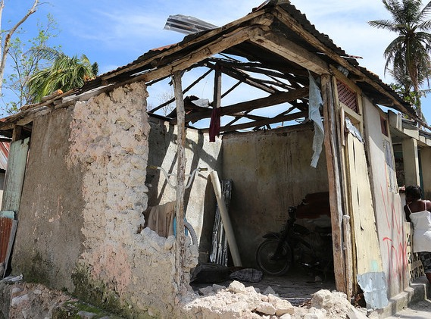

Notes:
Home is a word we use often and it can have different meanings – it can be:
A house, apartment, or other shelter that is the usual residence of a person, family, or household.
Or the other definition is: the place in which one's domestic affections are centered.
A home provides safety and warmth; it is the foundation for families and for communities. Whether a disaster is natural or manmade, it comes with little warning and it attacks people at the center of their life. It attacks them in their home.
At ShelterBox we look to give families back that stable place so that they can begin to rebuild their lives and their communities.

Slide 2
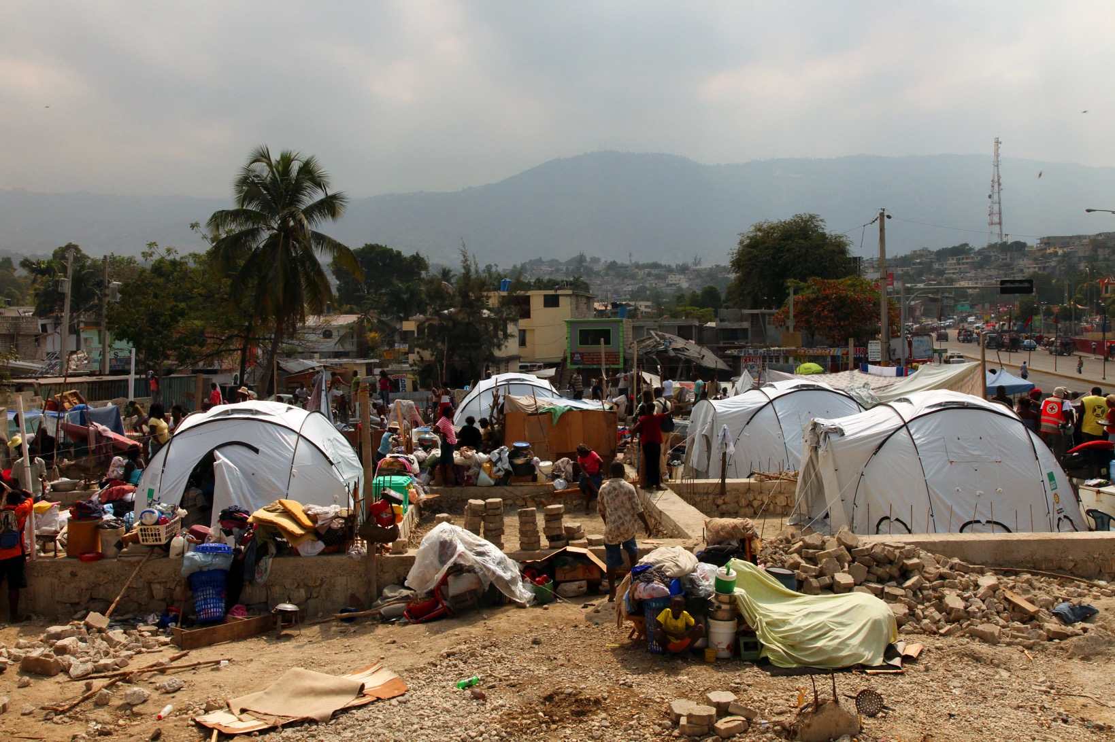
WHY DO WE EXIST?
Right now, around 85 million people around the world have been displaced by natural disaster and conflict – more than any other time since
World War II.
Notes:
Every day, landslides, hurricanes, earthquakes, floods and conflict tear homes and families apart. We often only hear about these families when something major happens, when the headlines are covering the destruction. But ShelterBox teams are working 365 days a year to ensure that no family is left without shelter.
Today, more than 60 million people are displaced by force and 25 million are displaced by natural disasters.

Slide 3
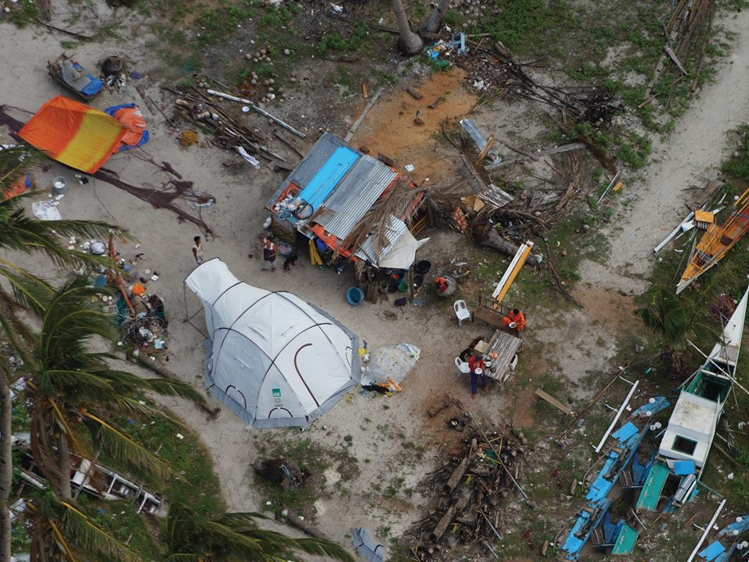
Notes:
Our mission is to provide emergency shelter and vital aid with urgency to serve families overwhelmed by disaster or humanitarian crisis.
Our vision is a world where no family is without shelter when disaster strikes.
Our mission is critical because today, more than 60 million people are displaced by force and 25 million are displaced by natural disasters. Our VISION is important because forecasts show the number of people displaced will grow to close to 200 million by 2050. Those people will need our help.

Slide 4
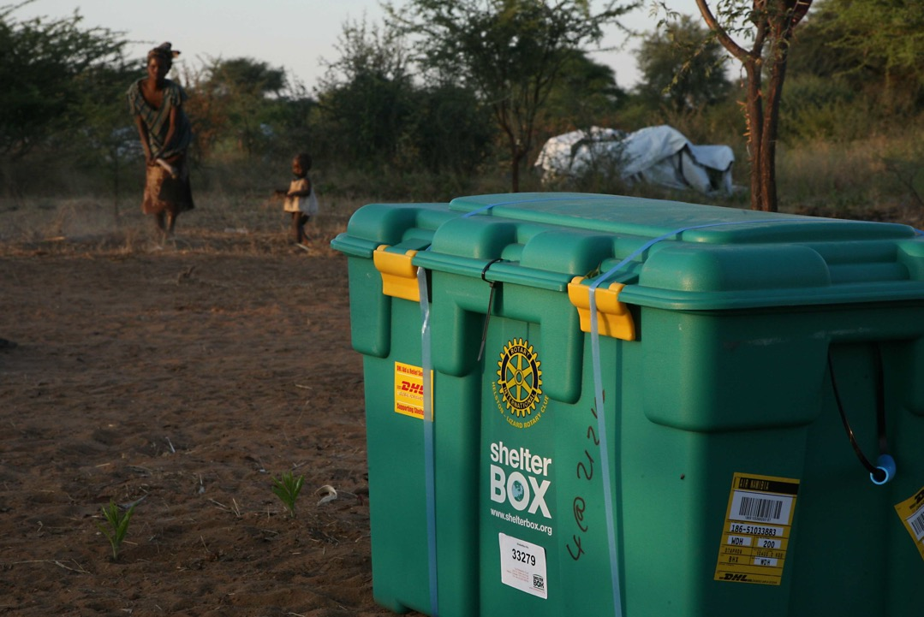
Notes:
The Box. In 1999 the founder of ShelterBox saw a hole in Disaster Relief. People were bringing medicine and food, but there was no one who specialized in shelter. A Rotary Club in Cornwall England made it it’s millennial project and the green box that we have all come to know and love was created.

Slide 5
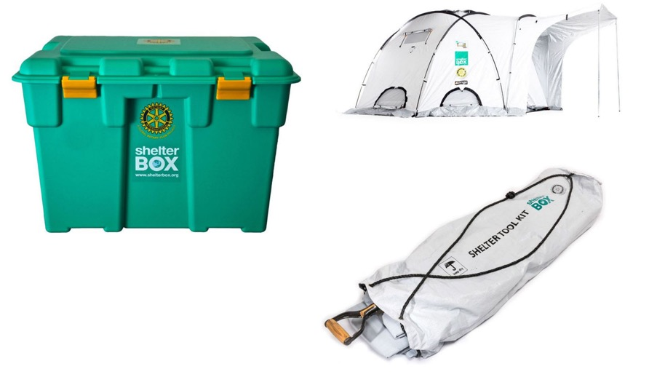
OUR AID
Notes:
Our signature ShelterBoxes and ShelterKits contain the tools to transform lives and rebuild communities.
After many years of working in disaster relief we have learned a thing or two. The biggest thing we have learned is that there is no one solution to every disaster. We now have a suite of solutions that we can provide. We still use the traditional ShelterBox, additionally we have what is called a ShelterKit, which provides people with the tools needed to build a temporary shelter out of found materials. We can also send palatized aid- that could be mosquito nets, LuminAID’s, water filtration units, anything that is needed in that particular disaster. We have worked tirelessly in the field both during our initial deployments and during our monitoring and evaluation deployments to find out what is working, what isn’t working, and how can we make ourselves more effective. And because of that, our aid is constantly evolving.

Slide 6
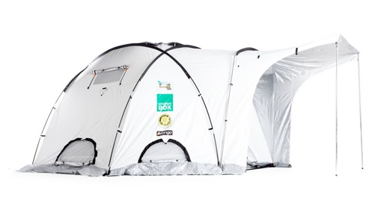
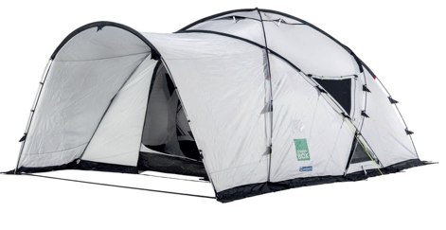
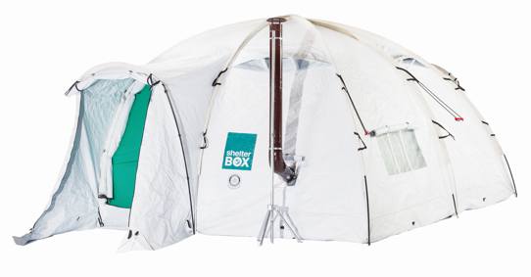
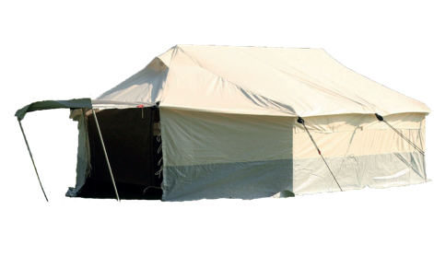
SHELTER
Standard Relief
OASE
Flex 3
UN Spec Tent
Notes:
As we repeatedly state, there is no one size fits all. Therefore we have a variety of shelter options.
Our standard relief tent is the main ShelterBox tent which we are constantly making improvements to, working with Vango – the manufacturers to incorporate feedback from the families living in them. This tent is not one you’d want to take camping for the weekend, as it weighs 75 lbs because it was made with special fabric that is UV coated and can withstand winds of up to 70 mph.
The Oase (Outwell) - A newer alternative to the Standard Relief tent. This lightweight dome tent is suited to ShelterBox’s work in warmer climates. Also it’s important not to be solely reliant on one supplier and to be able to meet needs of differing environments and people.
The Flex 3 (NRS) – This is an internationally accepted tent that can be used with a stove inside – a rarity. We sent them this year to North Korea and have them being delivered in Syria as we speak.
The UN spec – Been around for 30 years in the wider NGO world, but used by us only for specific aid requests such as high security deployments. More demand recently to be used with countries such as Syria and Iraq due to the incognito appearance – no branding or logo’s found on it – thus avoiding making any group of people a target. The UN Spec tent is relatively heavy and expensive so we avoid using it when possible but necessary when needed to blend in with other aid agencies and for security and safety.

Slide 7
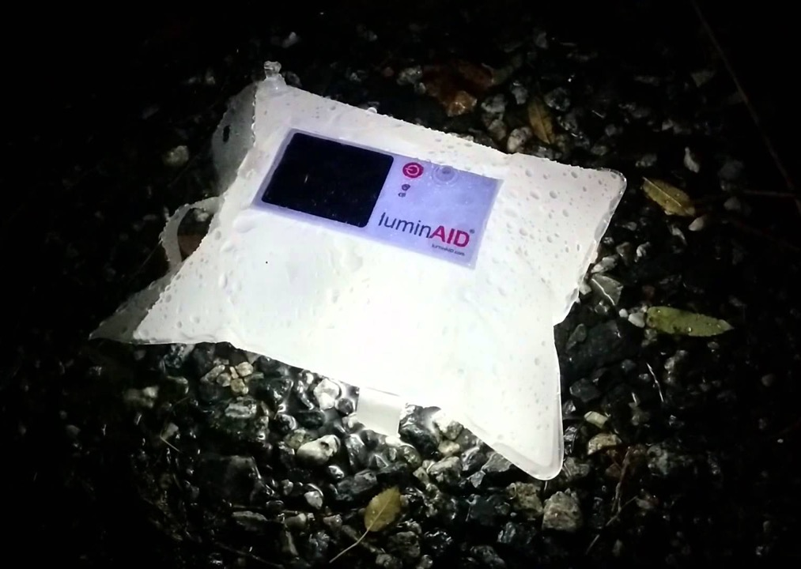
LuminAID SOLAR LIGHT
Notes:
In looking at other contents of our ShelterBox, this LuminAID L.E.D. solar light is a powerful tool. It folds up to the size of a wallet and weighs less than 3 ounces. It is waterproof up to 3 feet, made up of durable plastic to prevent punctures and after 7 hours of charging, it will provide 8 hours on its highest setting and 16 hours on it’s dim setting. But more than that, this solar light is…

Slide 8
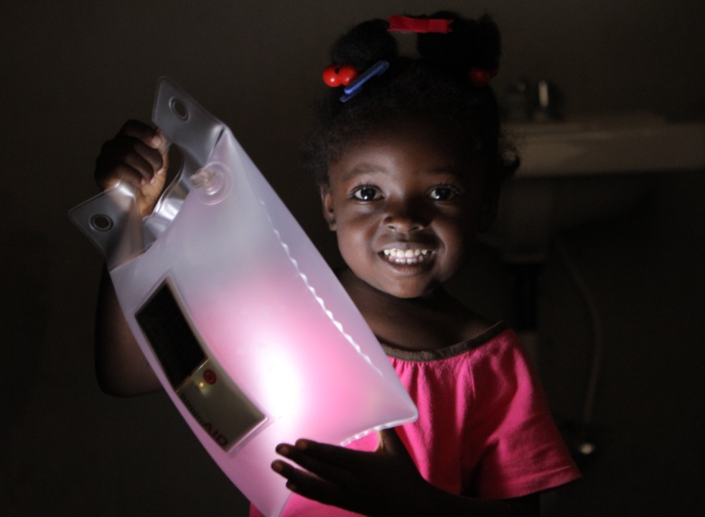
A LIGHT IN THE DARKNESS
Notes:
A Light in the Darkness:
It is safety at night as women and girls travel to the latrines and can be at risk of attack in the darkness.
It is protection from wild animals; in tropical countries, for example, snakes can lurk in the latrines.
And it is a way to cook and work or to do homework and have the normalcy of study, when a students way of life had been turned upside down.

Slide 9
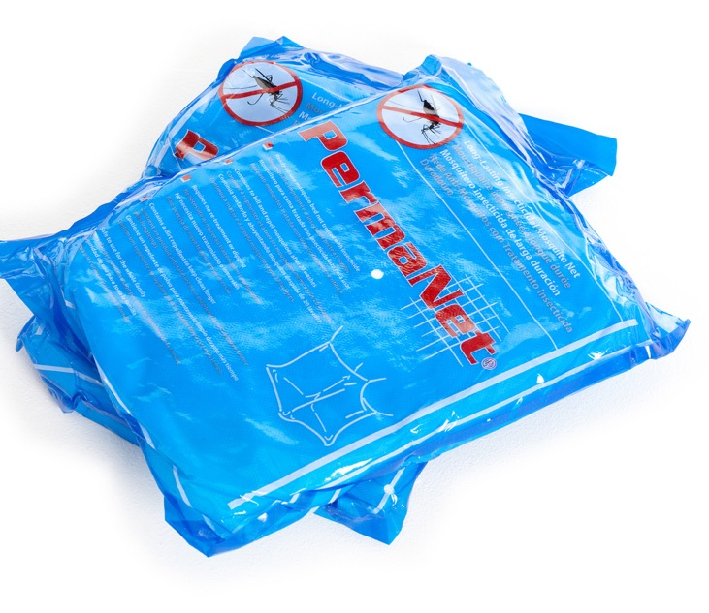
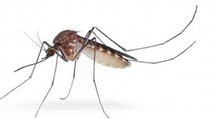
Notes:
Similarly, our mosquito nets prevent malaria, which is a leading cause of death among children in Africa and Zika virus, which can cause birth defects…

Slide 10
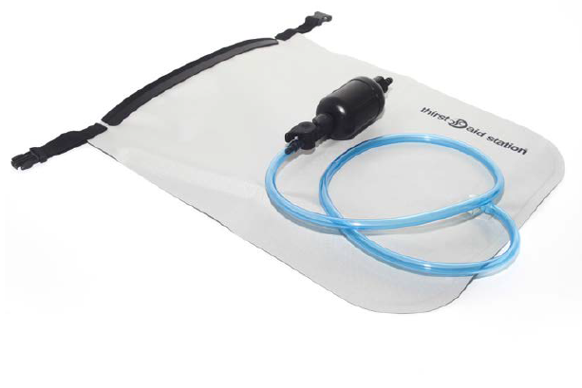
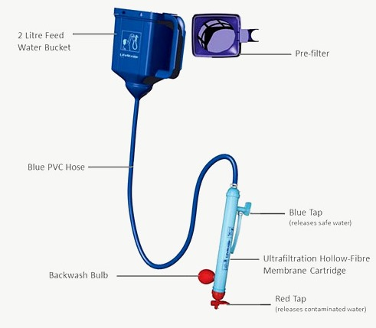
Notes:
And our Thirst Aid stations ward off cholera and other waterborne disease. Water supplies often become contaminated after a major disaster, as infrastructure and sanitation systems are destroyed. This presents a secondary but no less dangerous threat to survivors than the initial disaster.
The Thirst Aid Station, there on the right, is a bag-based water filter, which converts diseased and dirty water into pure, clean and safe drinking water quickly and easily. The dirty water is poured in at the top and clean water emerges from the bottom instantly. The thing I love about this is that it has been jointly pioneered by British company Pure Hydration and ShelterBox, based on feedback we received from multiple deployments of volunteers in the field. We used to use the product on the left, that required a lot of training for beneficiaries to use and because there were multiple valves, users ran the risk of drinking untreated water. This streamlined design on the right is our solution and an important example of how our aid has evolved to better serve our beneficiaries.

Slide 11
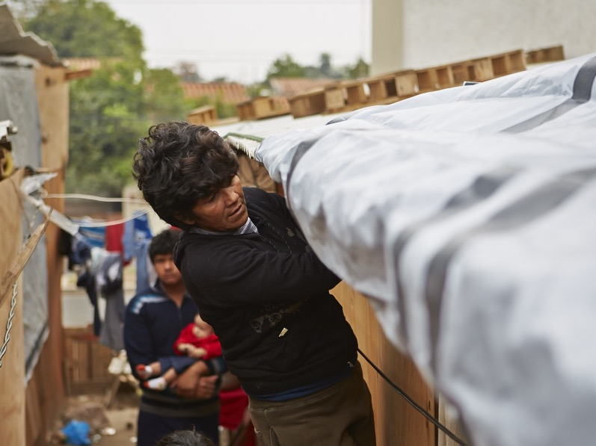
Paraguay
Flooding, July 2014
Notes:
In looking at how our organization has (and will continue to) evolve, one of the most recent additions to the ShelterBox Solution is the Shelter Repair Kit.
Sometimes people haven’t lost their whole home – maybe walls or the roof are damaged, as was the case in Nepal in 2015. Sometimes people have been able to scavenge materials from the wreckage but need additional help to waterproof and windproof them. Sometimes there simply isn’t room for tents in urban areas. Tarps and tools are a great provision.
Here you can see how close the houses are to each other and why there was no room for a tent.

Slide 12

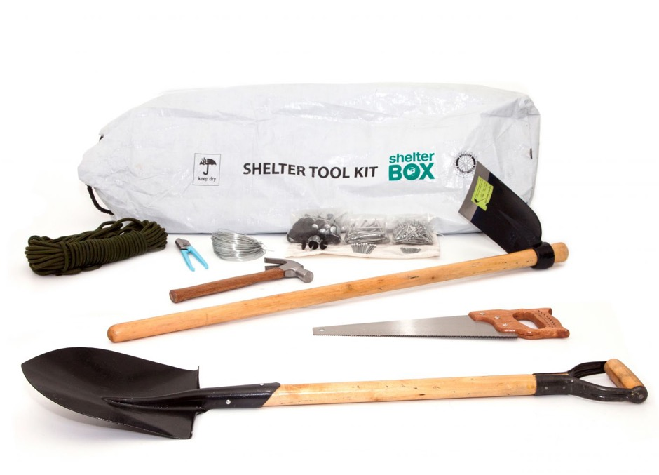
Notes:
ShelterKits contain plastic sheeting, basic tools, rope and fixings that enable families to rapidly provide their own shelter or make repairs to their damaged houses in the aftermath of a disaster.
These items enable people to improve their immediate environment by cutting firewood or digging a latrine, for example. Then, when it is possible, they are able to start repairing or rebuilding the home they were forced to leave. Our ShelterKits allow people to remain on their homesite, secure their possessions, and repair what’s theirs. Allowing people to remain in their community positively impacts their social, economic and mental welfare.

Slide 13
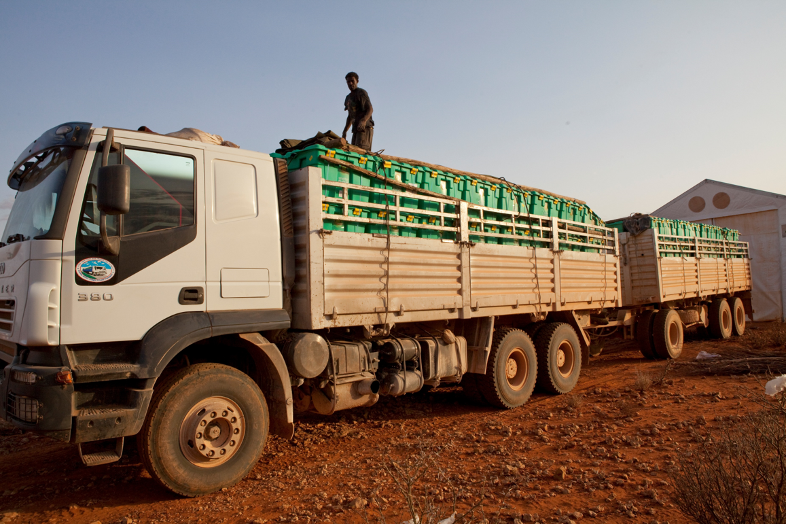
TRANSPORTATION
Notes:
After seeing our gear and these 120 lb boxes, something most people wonder is how we get it there, and the answer is really by any means possible.

Slide 14
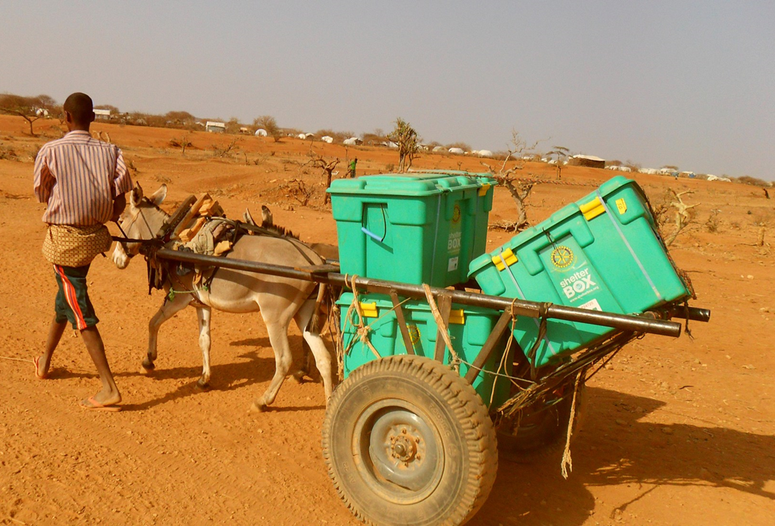
Notes:
As you can see here…

Slide 15
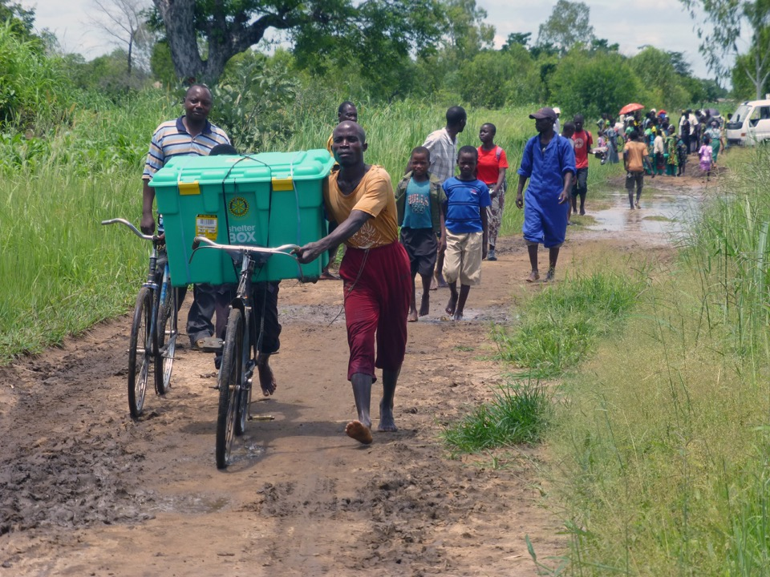
Notes:
And here

Slide 16
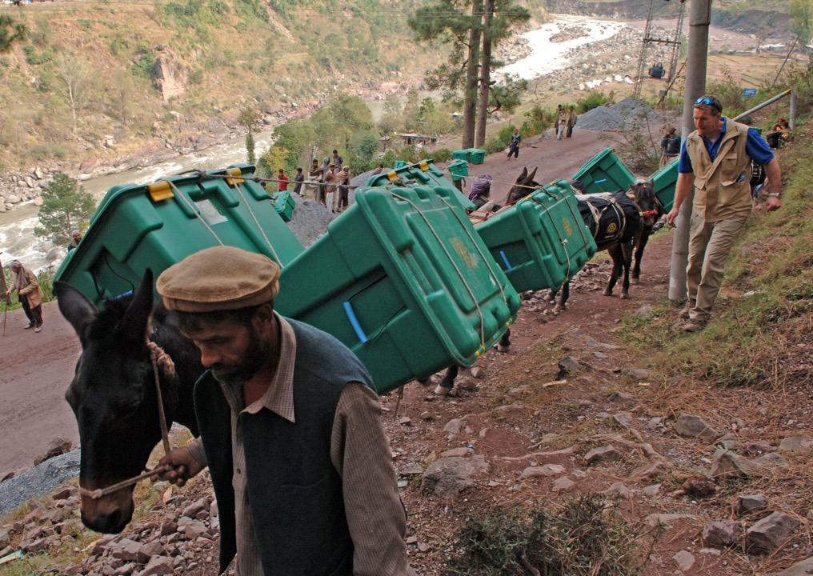

Slide 17
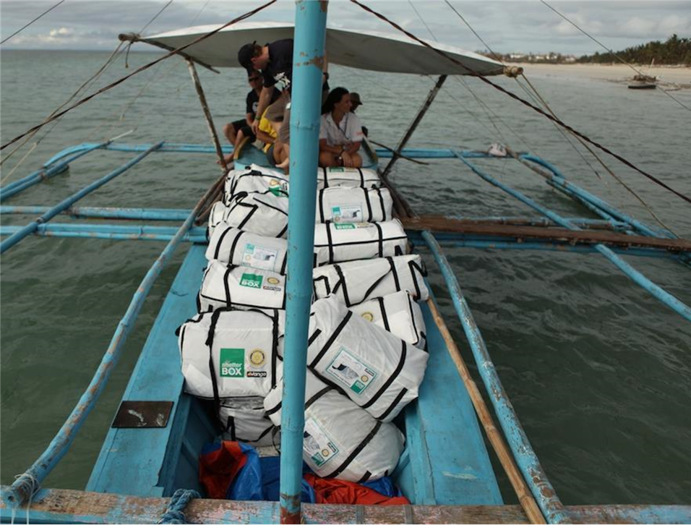
Notes:
And here…

Slide 18
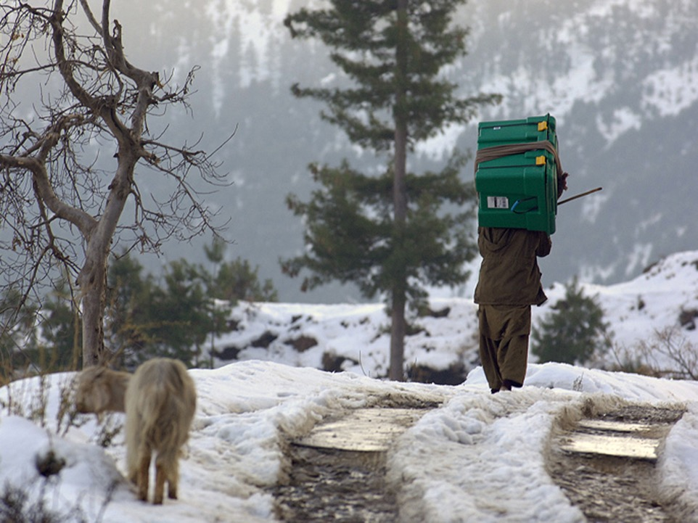
Notes:
And here…because our volunteer teams are small and well trained and our aid is nimble, we are able to provide last mile aid – in hard to reach areas or in populations that are traditionally underserved.

Slide 19
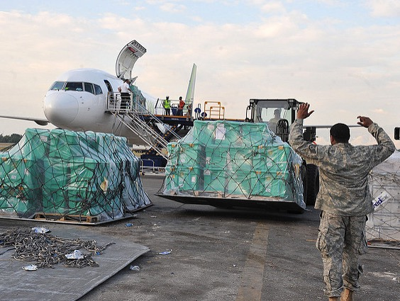
HOW IT’S POSSIBLE
Notes:
ShelterBox aid is sponsored by generous donors from around the world, including within the United States. Individuals, Rotary Clubs, businesses and foundations make monetary contributions to help sponsor aid.
There are also three types of volunteer opportunities with ShelterBox:
Volunteer Ambassadors that raise awareness and funds by giving presentations or organizing initiatives in their community
Rotary Club Liaisons who are people who have an interest in disaster relief and would like to be the representative for their Club. They receive deployment updates and access to pertinent disaster relief information to share with their Rotary club.
The final volunteer type are those that actually deliver our aid.

Slide 20
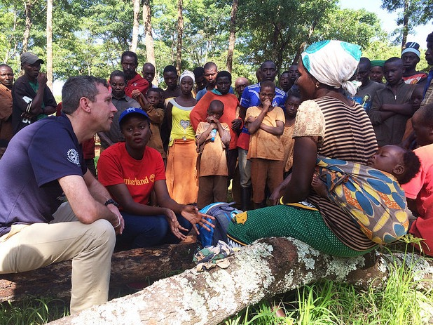
VOLUNTEERS
Notes:
We have a group of around 200 volunteers worldwide who are available at a moments notice to deliver aid in the wake of a disaster. These highly trained people are called ShelterBox Response Team members or SRT for short. They go through a rigorous year long training to make sure they are both physically and mentally ready to deploy.
Since 2000, our determination has led us to provide shelter to more than 1.1 million people all over the world who have been robbed of their homes by disaster.
This determination is driving our evolution into an organization that will soon reach more than a million people every year. Our volunteers are a key part of our success.

Slide 21
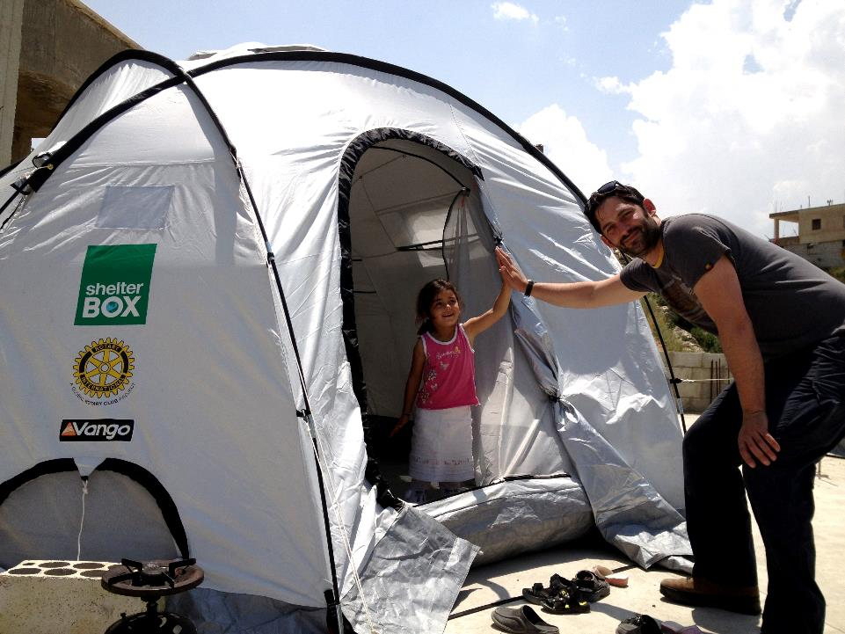

PARTNERS
Notes:
Rotary has been instrumental in our growth. Since we were founded, we grew from one club’s adopted project to the largest global Rotary club project in the over 100-year history of the organization. In 2012, we became Rotary International's first Project Partner. This agreement enables both of us to collaborate more closely to bring relief and temporary shelter to survivors of disasters worldwide. The partnership builds on both our strengths in responding to disasters all over the world. The fundraising efforts by Rotarians make up a significant proportion of donations received by ShelterBox. Alongside this, Rotary Clubs provide invaluable logistical support to our field operations. Rotarians are often the first point of contact for the ShelterBox Response Team members when they arrive in country. They provide everything from translators, local knowledge, to a bed to sleep in, in our recent deployment to Haiti a Rotarian provided the warehouse our team needed to store our aid while we distributed it.

Slide 22
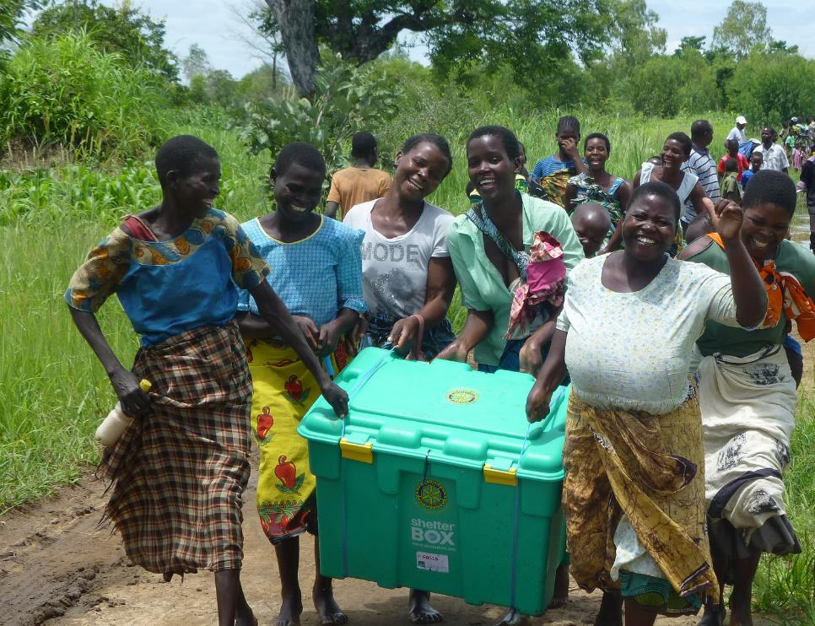
NOTABLE DEPLOYMENTS
Malawi - Flooding - 2015
Notes:
Here are the highlights of a few of ShelterBox’s notable deployments…

Slide 23
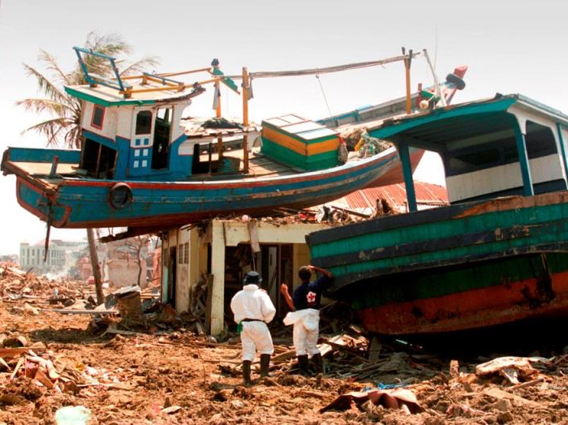
Indian Ocean Tsunami
Indonesia- Tsunami - 2004
Notes:
On Boxing Day in 2004, a massive undersea earthquake off the west coast of Sumatra was among the most powerful ever recorded, and was the longest-lasting quake in history.
The energy released was 1,500 times greater than the Hiroshima atomic bomb, triggering other earthquakes as far away as Alaska. The shifting of underwater plates caused the entire globe to move by 1 centimeter, coastlines changed forever, and smaller islands to the south-west of Sumatra were moved or submerged permanently.
The ensuing Tsunami engulfed coastal communities from Sri Lanka, to India, to Thailand and Indonesia. 230,000 people lost their lives, and when the waters receded, at least as many survivors were in desperate need of shelter.

Slide 24
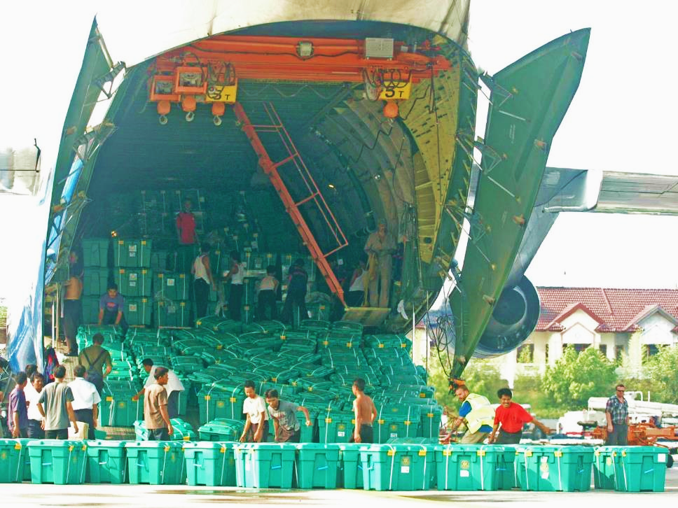
Indian Ocean Tsunami
Indonesia- Tsunami - 2004
Notes:
The Indian Ocean Tsunami was ShelterBox’s first large-scale deployment and to give you an idea of the scope of that response, the plane you see here is the Antanov An 124- the largest aircraft in the world
In the aftermath of the tsunami, we were able to provide more than 22,000 boxes in 4 different countries and set the organization on the world stage as a major player in disaster relief.

Slide 25
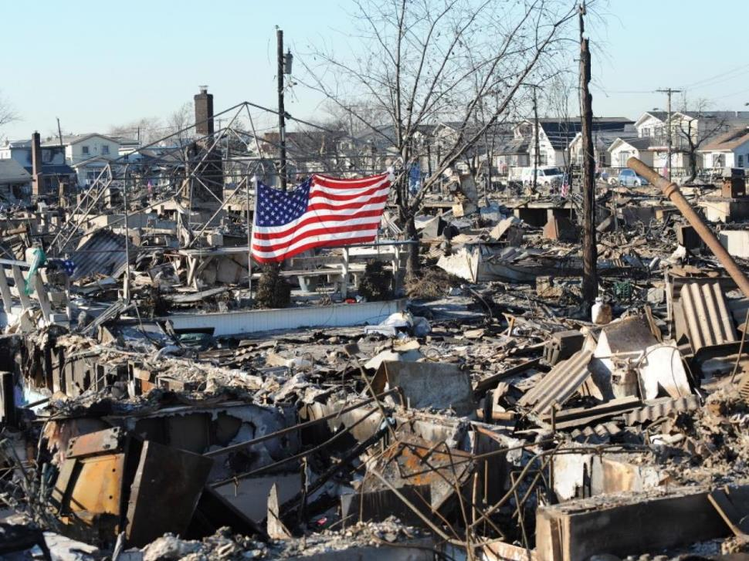
United States Response
USA- Hurricane Sandy - 2012
Notes:
We responded to Hurricane Sandy in November 2012
The United States bore the full force of Hurricane Sandy, where it expanded into a huge storm with winds covering a distance of about 1,000 miles.
ShelterBox provided aid for more than 6,000 people following Super Storm Sandy in the fall of 2012. Though tented shelter was not needed, ShelterBox distributed blankets, warmth items including scarves and knit hats as well as children’s activity packs.
Teams worked closely with Rotarians in the area, including the NJ District 7500, whose District Governor said, “I am very pleased to see that in our time of need, ShelterBox responded immediately. To make a call to ShelterBox on Tuesday and to have a team on the ground on Thursday with a significant order placed by Friday is amazing.”

Slide 26
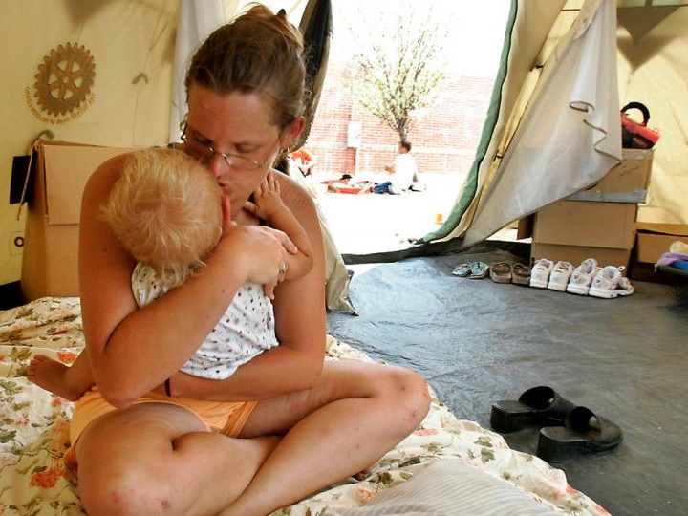
United States Response
USA- Hurricane Katrina – 2005
Notes:
Here in the US, we have also provided aid along the Gulf Coast, following Hurricane Katrina and in Arkansas in 2011 and in Oklahoma in 2013 following tornadoes there. During Hurricane Katrina, the storm struck land August 29th and we were distributing aid September 1st, days before the USA Army arrived with aid.
This is Karen Davis and following Hurricane Katrina, she and her husband and their three children lived in the tent for weeks after their home in Mississippi was destroyed. One of the other recipients in the area told us, “the tents came through when nobody else did.”

Slide 27
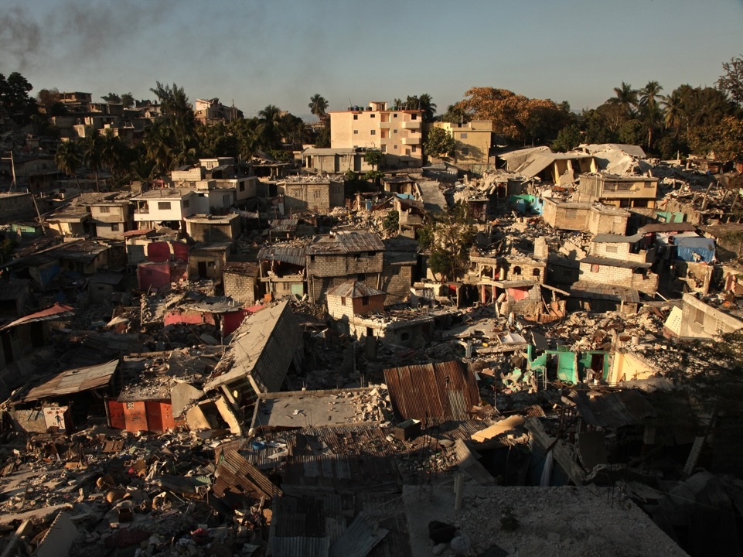
Haiti
Haiti - Earthquake – 2010
Notes:
When the severe Earthquake struck Haiti in January 2010, ShelterBox mobilized and had sent boxes within hours.
The 7.0 magnitude earthquake left 1 million people homeless and took the lives of more than 300,000.

Slide 28
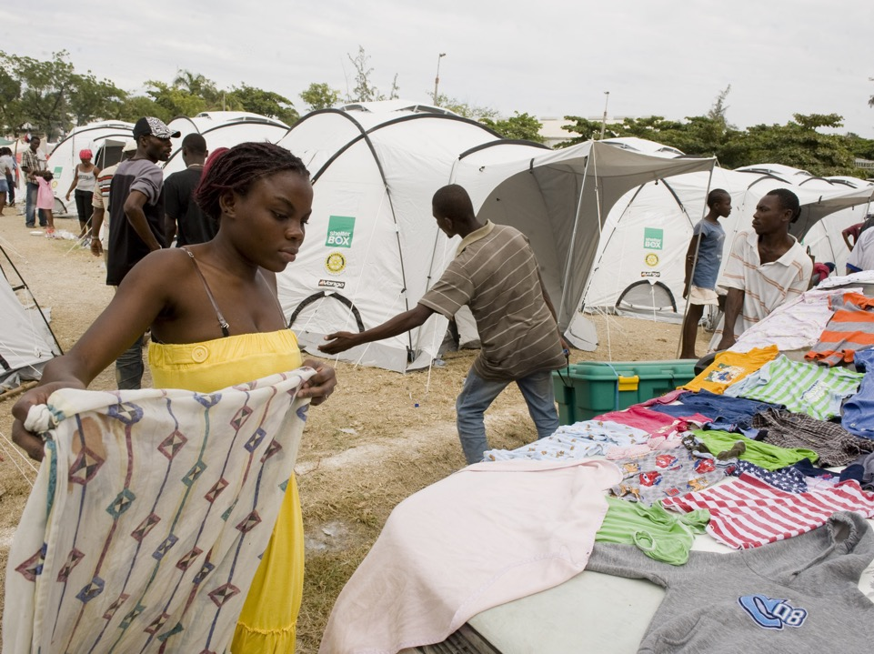
Haiti
Haiti - Earthquake – 2010
Notes:
More than 27,000 ShelterBoxes, including 35,000 tents were delivered, meaning that ShelterBox provided more than 1/3 of all of the tented shelter in Haiti.
On October 7, 2016 we deployed again to Haiti, this time to help with the aftermath of Hurricane Matthew, but this time with ShelterKits, as 100,000 who were living in tents had not yet returned home to their communities.

Slide 29
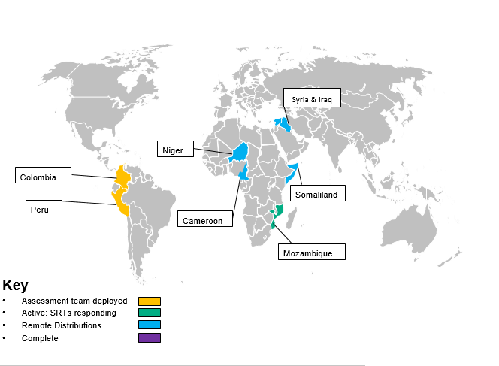
CURRENT DEPLOYMENTS

Slide 30
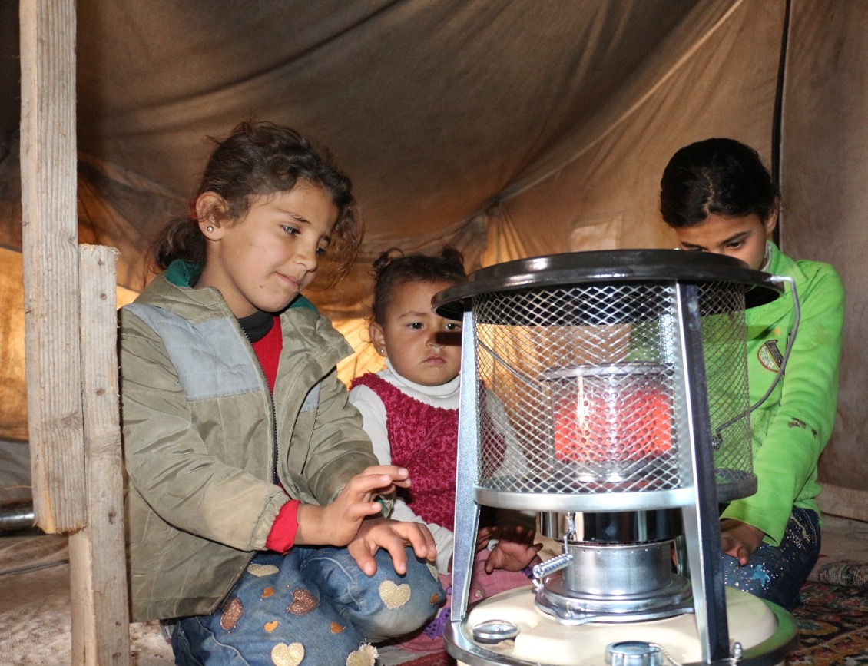
SYRIAN CRISIS
Syria - Conflict – 2011 - Present
Notes:
When most people hear “Disaster Relief” they think of earthquakes, tsunamis, hurricanes, natural disasters, not manmade disasters. Yet so many of our current deployments are conflict based. From Syria and Iraq where we are helping those displaced by ISIS to Cameroon and Niger where we are helping those fleeing from Boko Haram.
7 years on, there is no sign of the Syrian refugee crisis easing. In the last year, the number of people who have fled starvation, fear and death has more than tripled.
ShelterBox has ensured distribution of aid through implementing partners. Current distributions are focusing on supporting displaced people with protection from winter conditions.

Slide 31
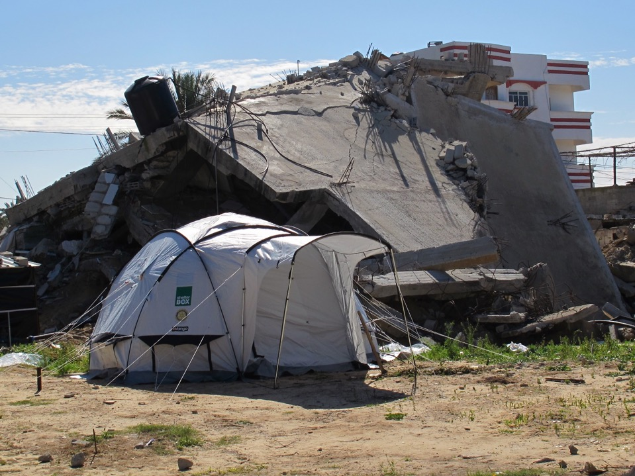
HOW YOU CAN HELP
Notes:
So, how can YOU help?
Make a donation. Give to ShelterBox USA
Give of your time by spreading the word about ShelterBox in your community. You could become a ShelterBox Ambassador and raise support for the mission by connecting with civic groups, schools, businesses and individuals in your community

Slide 32
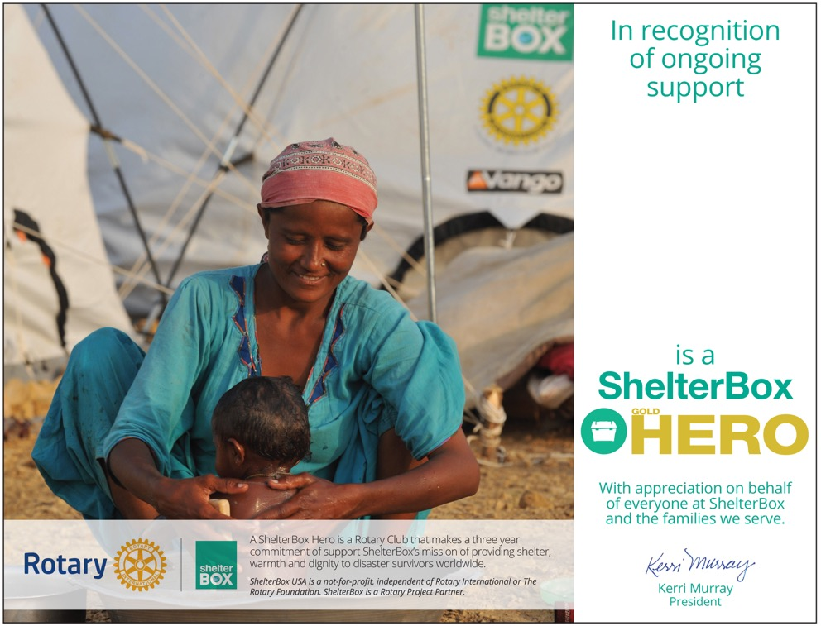
HERO PROGRAM
Rotary
Club
Name
Here
Notes:
Your Club can also help ShelterBox through your ongoing donation to our HERO Program.
A ShelterBox HERO is a Rotary Club who has committed to making an ongoing impact in worldwide disaster response by pledging to support ShelterBox annually for three consecutive years.
By making a 3 year pledge of $1,000, $3,000 or $5,000, you can help us prepare for and immediately respond to the worst day ever and make sure we have a consistent funding stream, should disaster strike.

Slide 33
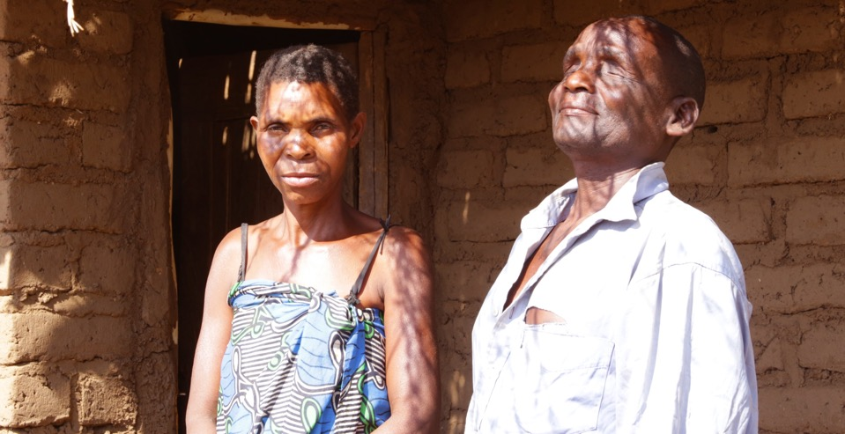
‘Staying in the tent felt like I was staying in a house with a roof of iron sheets.”
-Enoch Masiye from Kadawere, Malawi
Notes:
As tangible as our aid is, it’s important to remember that shelter means more than simply a product – we provide tools for self recovery.
As families transition from emergency shelter to a permanent home, they are able to pick up the threads of everyday life - a safe space to call home, light to do homework by, an active role in the community.
An example of this comes from Enoch and Mary in Malawi.
Enoch and his family lived in a ShelterBox tent until they were able to build a new house.
When asked about the ShelterBox tent Enoch said - “Staying in the tent felt like I was staying in a house with a roof of iron sheets”.
The shelter we provide protects a family from burning heat, bitter cold, dangerous animals and disease, but it means so much more:
A shelter creates a space where families can have privacy from the rest of the world, where they can feel safety and security in being together.
For Enoch and Mary, it provided them with safe shelter until they could build their new home, which you can see in the background of the picture. When our team went to meet them, they were just added the finishing touches to the floor!
This is an example of what we mean by looking at shelter as a process and not one product – the shelterbox tent started them on the process of rebuilding.

Slide 34
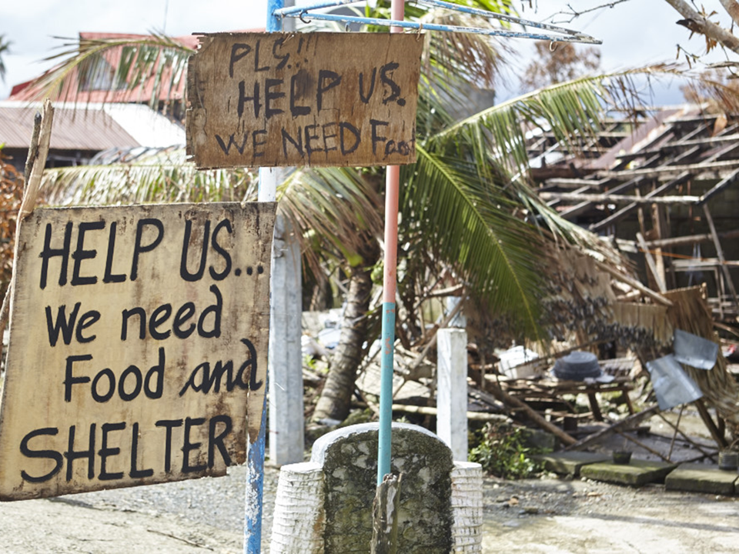

Notes:
We will never stop. And we will do whatever it takes to ensure that no family goes without shelter. With your help we can make sure that no family is forgotten or left behind. Thank you for letting me come speak with you today. Do you have any questions?

