Slide 1
Solana Energy Alliance (SEA)
Eco-Rotary Meeting
7/10/18

Slide 2
What is a CCA?
Community Choice Aggregation is a local, not-for-profit governmental program that buys and may generate electrical power on behalf of its residents, businesses, and governmental entities.

Slide 3
CCA Benefits
Choice – Historically, customers had no choice but to use SDG&E
Local Control – CCA’s are run by a Board of Directors (City Council)
Rate setting process is held locally and with transparency/public involvement
Not in San Francisco or Sacramento
City Council is beholden to the rate payers, not shareholders
Higher % of Renewable Energy Content
Investor owned utilities (IOUs) respond to mandates (RPS), CCAs respond to local needs/desires.
One of the top mitigation measures in the City’s Climate Action Plan. Without a higher renewable energy content, City will not meet CAP goals

Slide 4
Statewide CCAs
To date, there are eighteen (18) operational CCA programs in California:
Solana Energy Alliance (June 2018)
East Bay Community Energy (June 2018)
King City Community Power (June 2018)
San Jacinto Power (June 2018)
Rancho Mirage Energy Authority (June 2018)
Valley Clean Energy Alliance (June 2018)
MCE Clean Energy
Sonoma Clean Power
Lancaster Choice Energy
CleanPowerSF
Peninsula Clean Energy
Redwood Coast Energy Authority
Silicon Valley Clean Energy
Apple Valley Choice Energy
Clean Power Alliance (formerly Los Angeles Community Choice Energy)
Monterey Bay Community Power
Pioneer Community Energy
Pico Rivera Innovative Municipal Energy (PRIME)
There are another two (2) emerging CCA programs that are scheduled to launch later in 2018:
San Jose Clean Energy (Spring 2018)
Desert Community Energy (Summer 2018)
Projected that CCA’s will account for approximately 70% of total energy load in entire State by 2020

Slide 5
Current Operational Member* Overview
Member | Customer Accounts | Peak Load MW | Minimum RPS | Unbundled RECs | Annual Load 2017 GWh
Apple Valley Clean Energy** | 29,000 | 70 | 35% | 8% | 235
CleanPowerSF** | 76,000 | 95 | 40% | 0 | 535
Lancaster Choice Energy | 52,000 | 198 | 35% | 8% | 590
Los Angeles County Community Energy*** | 285,000 | 877 | 50% | 0 | 3,470
MCE** | 260,000 | 520 | 55% | 0 - 3% | 2,900
Monterey Bay Community Power*** | 307,000 | 680 | TBD | TBD | 3,800
Peninsula Clean Energy | 300,000 | 660 | 50% | 0 | 3,800
Pico Rivera Innovative Municipal Energy | 17,000 | 50 | 50% | 0 | 215
Silicon Valley Clean Energy | 240,000 | 680 | 50% | 0 | 3,700
Redwood Coast Energy Authority** | 60,000 | 140 | 40% | 0 | 730
Sonoma Clean Power | 227,000 | 510 | 43% | 0 | 2,434
CalCCA Member Totals | 1,853,000 | 4,480 MW | 45% (avg) | 1.8% (avg) | 22,409 GWh
* East Bay Clean Energy and Pioneer Clean Energy are also Operational Members of CalCCA with data forthcoming in 2017/18
** Represents partial enrollment with additional phases planned for 2018
*** Represents estimates for program launching in 2018

Slide 6
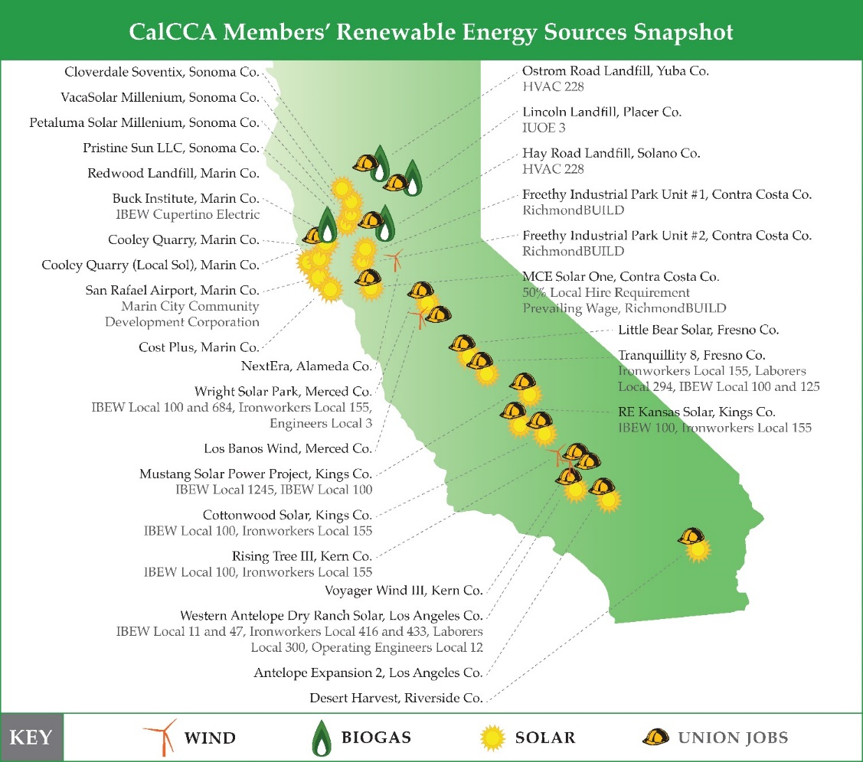
Current CCA state resources…

Slide 7
Why Solana Beach?
For Solana Beach, the #1 priority has always been environmental
Quickest way to reduce Greenhouse (GHG) gas emissions
Only way to meet Climate Action Plan targets
100% renewable energy is the #2 mitigation measure in the entire CAP
Local control
SDG&E serves a large geographic area with varying climatic zones
CCA can be rapidly responsive to needs of our community
Provide programs that are wanted by community and best fit our CAP goals
EV incentives
Solar incentives

Slide 8
CAP Reduction Targets
Year | 2010 | 2020 | 2035
 | Metric tons of carbon dioxide equivalent
2010 Baseline | 139,216
Reduction Target (Percent below 2010) |  | 15% | 50%
Target Emissions |  | 118,334 | 69,608
Legislative-Adjusted Emissions Forecast |  | 116,837 | 115,683
Reductions from CAP Measures |  |  | 46,026
Emissions with CAP Measures |  |  | 69,659
Additional Reductions Needed to meet Target |  |  | 51

Slide 9
CAP Mitigation Measures
Table 3-4 Summary of Electricity and Natural Gas Measures
Measure Number | Measure Description | GHG Reductions (MTCO₂e)
 |  | 2035
E-1 | Implement a Community Choice Aggregation program, subject to City Council approval | 10,466
E-2 | Achieve 10.8 MW residential rooftop solar photovoltaic systems | 5,858
E-3 | Achieve 2 MW commercial rooftop solar photovoltaic systems | 1,085
E-4 | Solar hot water heating at 20% of existing commercial spaces | 2,811
E-5 | Solar hot water heating at 25% of new homes and home retrofits | 539
E-6 | Reduction in non-space/water heating residential natural gas use by 15% | 359
E-7 | Residential energy efficiency retrofits to achieve 15% reduction | 59
E-8 | Commercial energy efficiency retrofits to achieve 15% reduction | 37
TOTAL |  | 21,214
Notes: Columns may not add to totals due to rounding. MTCO₂e = metric tons of carbon dioxide equivalent; MW = megawatts Source: EPIC 2017.
Table 3-3 Summary of Transportation Measures
Measure Number | Measure Description | GHG Reductions (MTCO₂e)
 |  | 2035
T-1 | Increase EVs and AFVs VMT to 30% of total VMT | 17,495
T-2 | Increase commuting by vanpools to 20% of labor force | 608
T-3 | Reduce average commuter trip distance by 1 mile | 464
T-4 | Increase commuting by mass transit to 10% of labor force | 429
T-5 | Increase preferred parking for EVs and AFVs to 20% of eligible parking spots | 325
T-6 | Retime four traffic signals | 144
T-7 | Promote telecommuting to achieve 10% participation | 86
T-8 | Convert municipal gasoline fueled vehicle fleet to EVs to achieve 50% gasoline reduction | 56
T-9 | Increase commuting by walking to 5% of labor force | 16
T-10 | Increase commuting by bicycling by achieving approximately 17 bike lane miles | 11
T-11 | Promote alternative work schedule to achieve participation from 1% of labor force | 9
TOTAL |  | 19,643
Notes: Columns may not add to totals due to rounding. AFV = alternative fuel vehicle; EV = electric vehicle; GHG = greenhouse gas; VMT = vehicle miles traveled MTCO₂e = metric tons of carbon dioxide equivalent Source: EPIC 2017.

Slide 10
Background
2012 – CCAs placed in the City Council Work Plan as an “Unprioritized” Environmental Sustainability Issue
2013 – Elevated to a “Priority” Environmental Sustainability Issue in the City Council Work Plan
January 2015 – City became first jurisdiction in San Diego to adopt a Resolution of Support to continue studying the feasibility of CCA
May 2016 –CCA Technical/Feasibility Study presented to Council
June 2016 – Council authorized the release of a RFQ/P to solicit proposals for consultant assistance in the development, financing and ongoing administration of a CCA program
November 2016 – Council authorized City Manager to initiate negotiations with TEA/Noble to provide CCA-related services to the City.

Slide 11
SEA Recent Actions
November 15, 2017 – Council approved the Implementation Plan and Statement of Intent
December 13, 2017 – Council adopted Ordinance 483 Establishing a Community Choice Aggregation Program
February 16, 2018 – City received certification of IP from the CPUC
February 28, 2018 – Council took the following actions:
Authorized the launch of the SBCCA
Introduced the Risk Management Policy
Approved the Energy Procurement Strategy
Base level – 50% renewable, 75% GHG-free
Opt-Up – 100% renewable
Approved the rate discount of 3% (on energy cost)
Approved the program name Solana Energy Alliance (SEA)
March14, 2018 – Council adopted rates
May 9, 2018 – Council approved SEA Budget
June 1, 2018 – SEA launched!

Slide 12
Residential Rates

Slide 13
Residential Rates - CARE

Slide 14
Commercial Rates

Slide 15
SEA Budget

Slide 16
SEA Power Sources
 | Total Retail Load (MW)
Portfolio Content | 36,520 | 100%
Wind | 10,500 | 29%
Geothermal | 8,000 | 22%
Hydro - CF | 10,500 | 29%
Unspecified | 7,520 | 21%

Slide 18
Questions?
Dan King
Assistant City Manager
City of Solana Beach
dking@cosb.org
858-720-2477

