Slide 1


  Zone 8
  Regionalisation
  Pilot
  Update July 2023
  Jyoti, Rotarian since 2016.
Notes:
Introduction with country specific welcome
Introduction of presenter(s)
This webinar is a follow up to the email that went out to all members recently.
Its purpose is to..
give you an update on the work that has been happening since we received the go ahead from the RI Board 3 months ago
provide a picture of what is coming over the next several months
Give you the opportunity to ask questions
After 4 years of planning and preparing we are now into the establishment phase and implementation will begin from 1 Jan 2024.
I plan to give you an overview of what is being worked on - it is rather like constructing a large and complex building – before you can see what the shape of the building is going to actually look like there is a whole lot of groundwork that has to happen, often out of sight, in order to create the foundations that are critical to the future structure. So although you may not have seen a lot, that foundational work is happening.
We have been given the opportunity to be forward thinking and innovative as we seek to grow Rotary and help us become even more relevant and attractive in a world that needs us.
And we are putting the RI Action Plan into action, especially our ability to adapt to a changing world!

Slide 2
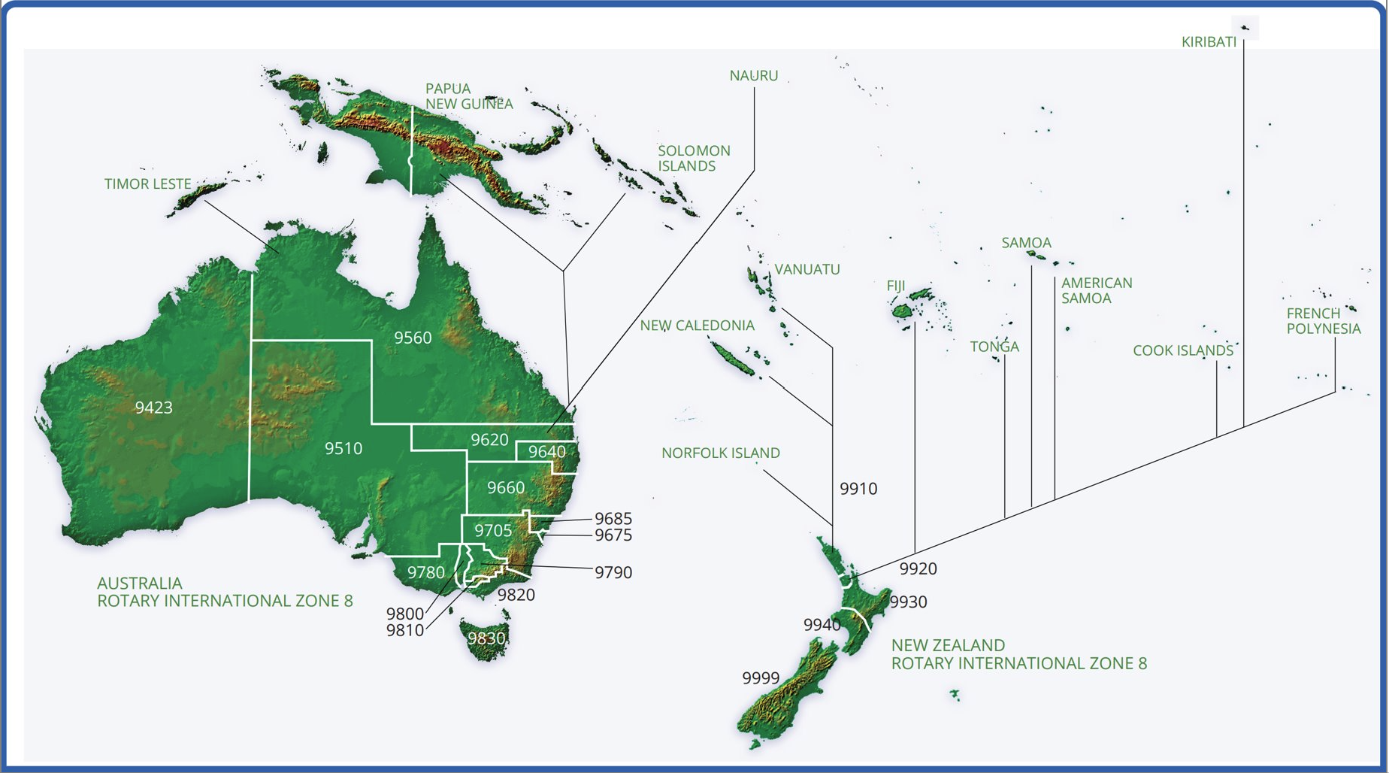

  Purpose and objectives of the pilot
Our Purpose
To establish a Regional Governance structure to transform Rotary and Rotaract in our region to better support Clubs to provide relevant and engaging experiences to serve our communities and enable us to grow.
5 key objectives
One voice
Partnerships and presence
Consistent strategy
Support to clubs and efficiencies
Doable and attractive leadership roles
Notes:
So, let’s keep in the fore front what are we focused on delivering
In the beginning, we developed a clear vison and purpose – transformation with our clubs and members heart and center
And 5 key objectives - we aim to …
⁃ take a planned and coordinated approach to speak with 'one voice' in marketing and public relations, regionally, nationally and locally.
⁃ focus on identifying and implementing partnerships that will bring profile, opportunities for projects, and funding to benefit communities. These will enable clubs to connect and collaborate in new ways that will engage members with each other and their communities and deliver more impact.
⁃ have a longer term strategy and the capacity and capabilities to adapt to meet the particular needs, circumstances and cultural aspects of our part of the world as well as catering for recent changes in volunteering trends. We believe tailoring programs, support and resources in a more coordinated way will ensure local clubs not only remain viable but thrive, and they will be able to acess expertise from across the zone
⁃ move away from a ‘one size fits all Rotary’ to a Rotary where we take the very best aspects and adapt them to suit our region, especially improving efficiencies, reducing unnecessary duplication and costs, automating many processes
⁃ make leadership roles more attractive and doable, reducing admin and focusing on leading and mentoring

Slide 3

  Regionalisation - WHAT does it mean to us?
A chance to think about how we can:
support clubs differently to grow Rotary
collaborate nationally/regionally
enhance Rotary’s profile and reputation
adapt for local needs
better access expertise
Notes:
Regionalisation isn’t a quick fix answer to the several challenges we are facing in the zone - but we cannot just hope that what we have been doing to date might give different results, nor can we do nothing.
At its heart, regionalisation is about enabling us to take more responsibility for the way Rotary operates in our region. It’s about focusing on supporting clubs and members in areas that they currently find challenging
It gives us the opportunity to think about:
How Rotary can work differently to support clubs and members and grow, e.g. attracting new members, retaining new members especially in the first 2-3 years
How we can collaborate for more impact
How we can more effectively and often let the public know what we do
We are also looking at
What might be better coordinated or delivered nationally and/or regionally?
What we could adapt and do for ourselves
How we can enable better access to specialist expertise to support clubs

Slide 4

What has happened recently?
Today
Club vote – September 2022
Financial support from the Rotary International Board – April 2023
Memorandum of Understanding signed with RI
11 Regionalisation Establishment Teams addressing key elements of the pilot – 100+ volunteers
Governor summits monthly
Communication plan
Updated website
109 days
100%
20 days
100%
699 days
0%
92 days
0%
365 days
0%
426 days
0%
120 days
0%
365 days
0%
122 days
0%
91 days
0%
912 days
0%
912 days
0%
Approval to Proceed
212 days
0%
Notes:
In 2019 we started to develop a plan and project structure. If we think back to the building metaphor, that was the design and planning phase.
Key to getting us to this point of beginning the actual pilot was the club vote last year and in April the RI Board gave us their final approval and some financial support so that we can move to implementation.
We are now laying down the foundations:
we have an MoU with RI detailing key deliverables and check in points.
We have well over 100 volunteers contributing their expertise as we develop detailed implementation plans and activities through 11 different establishment teams
And there are over 1000 members in the Reference Group - a group we connect with regularly and get input from, through for example surveys (about what kind of specialist support clubs want.)
Current priorities are RCL role, groupings and selection; Regional Council roles and selection process; identifying areas for the specialist network, identifying which functions will transfer over time from districts to the RC; establishing a legal entity to enable contracts for services etc; delivering comms, really focusing on how change will impact districts and clubs.
The full group of governors, current and future, meet monthly to have input into significant steps, like the CL role and how that will work.
You will continue to receive regular updates, monthly via Presidents and secretaries and every other month to all members. Look out for these, especially over the next couple of months as the community leader and how it will work will be explained more.
And the website has been updated to make it much easier to navigate. This is where you can also find latest updates.

Slide 5
Members at the heart of the regional model
Rotary International
Members
Clubs
Projects
Programs
Regional Council
Rotary Community Leaders
Specialist Support
Notes:
I am sure you are keen to understand what the model looks like.
Conceptually the new model recognises the central role of Members, Clubs, Projects, and Programs in Rotary having impact in communities.
The 3 roles shown here are all new, to be piloted:
The Regional Council provides the governance, strategy and representation for the region.
To support our clubs and help them engage their members and grow we have 2 key roles:
firstly, Rotary Community Leaders who will be elected from the clubs they support. We are anticipating about 100 Rotary Community Leaders, each with around 10-15 clubs to support, but this is likely to vary according to local/district needs.
and, specialist Rotarians and Rotaractors who are the best of the best in their field who will be available to all clubs, through a database.
Then we will of course continue to work very closely with RI and with our local office based in Sydney. They have been integrally involved in the project providing valuable direct support and will continue to do so.
This member centric model is designed to help clubs focus on delivering to their communities and providing an engaging experience for members.

Slide 6
Proposed regional structure
  Regional pilot period Club support arrangements
Rotary International (and The Rotary Foundation)
Regional Council (RC) Chair
RI Office
(Sydney)
RC Chair Elect
Rotaract Nominee
Rotary Specialist Network
Multi-National Advisory Committee
Country representatives
Rotary Communities Nominee
Corporate and Admin
(Non-elected)
Functional Committees (Legal entities, Financial Assets, Insurance…)
Zone Strategic Planning
Liaison for Incorporated Entities
Rotary Community Leaders
Portfolio Leads x 6
Portfolio Committees
Regional Council
(elected voting positions x 10)
District
Governors
Portfolios:
Service projects and programs;
Relationships, public image and partnerships;
Membership;
Leadership,Learning and Development, Events;
Major fundraising and Grants, including the Rotary Foundation;
Diversity, Equity and Inclusion
Notes:
This is our initial proposed governance model.
I will talk through the Regional Council structure and then explain the other new roles subsequently.
The Regional Council will be led by a Chair, supported by a Chair Elect, with each role being for 2 years. These 2 roles will work closely with the portfolio leads and will also be a key liaison with RI, globally and local, and with governors.
The proposed 6 Portfolio Chairs will have an important role leading their committee to deliver outcomes to support clubs and members in their area of expertise. The 6 areas are ones which are relevant for clubs, like membership, public image, leadership and development – you can see these on the slide.
Rotaract and community leaders will also have nominees representing their interests on the Regional Council.
And given the nature of our zone, there is special representation for our diverse countries in a committee of country representatives, working with the Chair Elect.
All roles will be open to any Rotarian or Rotaractor who meets the skills and experience requirements for the role.
For the duration of the pilot, districts will remain and governors will continue to provide support to clubs but many district functions will gradually transfer to the regional structure.
It is really important that we continue to support The Rotary Foundation. The support committees etc will remain with districts or at least the duration of the pilot. A dedicated working group is looking at what changes may be needed to operate effectively within a regional model, while ensuring that there is no negative impact on giving, grants and projects.

Slide 7

New roles - Community Leaders
Today
Elected from their group of clubs to….
Support and mentor
Assist clubs to collaborate
Help clubs deliver on their and Rotary’s priorities and goals
Facilitate access to channels of support
Show leadership acumen with cultural sensitivity
It is not….
A reporting relationship
A management role
A governor
109 days
100%
20 days
100%
699 days
0%
92 days
0%
365 days
0%
426 days
0%
120 days
0%
365 days
0%
122 days
0%
91 days
0%
912 days
0%
912 days
0%
Approval to Proceed
212 days
0%
Notes:
Community leaders are a very important role in the pilot
They will be elected from their group of clubs to ..
Support and mentor club leaders and members
Assist clubs to collaborate as they provide service
Lead the execution of engagement strategy with their community of clubs on behalf of the region, focusing on providing service
Support and assist clubs to deliver on their and Rotary’s priorities and goals – growing Rotary, enhancing our image and reputation, and supporting the Rotary Foundation.
Facilitate access to channels of support available through the Region, Rotary International and the Rotary Foundation
Show a high level of leadership acumen while also being sensitively aware of the diversity of clubs within the community and each club’s autonomy
Each district’s Governors, current and future, are currently considering how they will make the transition from AGs to RCLs and how clubs will be supported to decide groupings/communities. This is likely to vary according to local/district needs.

Slide 8
New roles – Specialist Network
Today
Selected as the best of the best in their field to…
Help clubs access expertise and support in specific areas relevant for clubs
Provide timely and relevant advice to clubs as they need it
Stay up to date in their field
Show cultural sensitivity and a commitment to being inclusive
Some examples….
New club development
Learning and development
Event management
Grant applications
Strategic planning
Conflict resolution
Environmental projects
109 days
100%
20 days
100%
699 days
0%
92 days
0%
365 days
0%
426 days
0%
120 days
0%
365 days
0%
122 days
0%
91 days
0%
912 days
0%
912 days
0%
Approval to Proceed
212 days
0%
Notes:
The specialist network is another important role in the pilot
Any one will be able to self nominate or be nominated. They will be expected to be able to demonstrate their expertise and experience
There will not be a fixed term.
Specialists will..
Help clubs access expertise and support in specific areas relevant for clubs
Provide timely and relevant advice to clubs as they need it
Stay up to date in their field
Show cultural sensitivity and a commitment to being inclusive
The establishment team is about to undertake a survey through the reference group to determine which areas will be most important for clubs.
These are some possible examples.

Slide 9
Zone 8 Regional pilot milestones
July 2023 (1)
Consultation and Final Definition of:
RCL role & Community Groups
Specialist Role
Plan to establish RC as a legal Ent.
August 2023 (1)
Consultation and Final Definition of Regional Structure & Election process
Call for Expressions of Interest in RC roles
August 2023 (3)
Consultation and Final Definition of Election/ selection process for RCL roles
October 2023 (2)
RI Board update
Election of RC members
Beginning of Rotary Specialists selection Process
July 2023 (2)
Identification of Functions to Transfer to RC & timeline (1st Tr)
Training of new club dev Specs.
Signing MOU
August 2023 (2)
Processes to support functions Transfer
Consultation and Final Definition of Rotary Specialist Selection Process
September 2023
Review of Expressions of Interest in RC roles
November (1)
Community Groups identification/ formation
Beginning RCL Elections processes
October 2023 (1)
SG Approval of Transfer of Functions Schedule
Notes:
I am sure you are interested in what the time line is for all these key activities
There is a lot of detail in here but we will be recording the final webinar and putting this presentation on the website.
Talk through by month

Slide 10
Zone 8 Regional pilot milestones
November 2023 (2)
Identification of Rotary Specialists (1st Group)
Submission for Registration of RC as a Legal Entity - with Directors IDs
December 2023
RC established as a Legal Entity
February 2024
RCLs training programs and materials developed
RCLs Elected
April 2024
Beginning the training for RCLs
June 2024
Concluding the training for RCLs
Concluding the training for the members of the Regional Council
November 2023 (3)
RC Training Material Developed
Beginning the Training for RC members
January 2024
Regional Council formed
March 2024
Beginning of Transfer of First Tranche of Functions to RC
May 2024
Completion of Transfer of First Tranche of Functions to RC
July 2024
Rotary Community Leader & Specialist roles commence (1st Group)

Slide 11
What can you do in your club?
Today
Think about the grouping you could be part of
Consider members who would be effective community leaders
Consider members who could be nominees for the Regional Council
Consider members who could be nominees for specialist roles
Keep up to date via the website - https://creatingtomorrowrotary.org/
Have a conversation about regionalisation, request someone to speak about it
Seek opportunities to collaborate and share thinking with other clubs
Join the Reference Group – click Subscribe on the website
109 days
100%
20 days
100%
699 days
0%
92 days
0%
365 days
0%
426 days
0%
120 days
0%
365 days
0%
122 days
0%
91 days
0%
912 days
0%
912 days
0%
Approval to Proceed
212 days
0%
Notes:
So what can you do as we progress with regionalisation?
Clubs will be asked to consider the grouping they choose to be part of- you will get further information over the next 2 months
Consider members who would be effective community leaders
Consider members who could be nominees for the Regional Council
Consider members who could be nominees for specialist roles
Keep up to date via the website
Have a conversation about regionalisation, request someone to speak about it – most districts have a team.
Seek opportunities to collaborate and share thinking with other clubs
Join the Reference Group – click Subscribe on the website

Slide 12
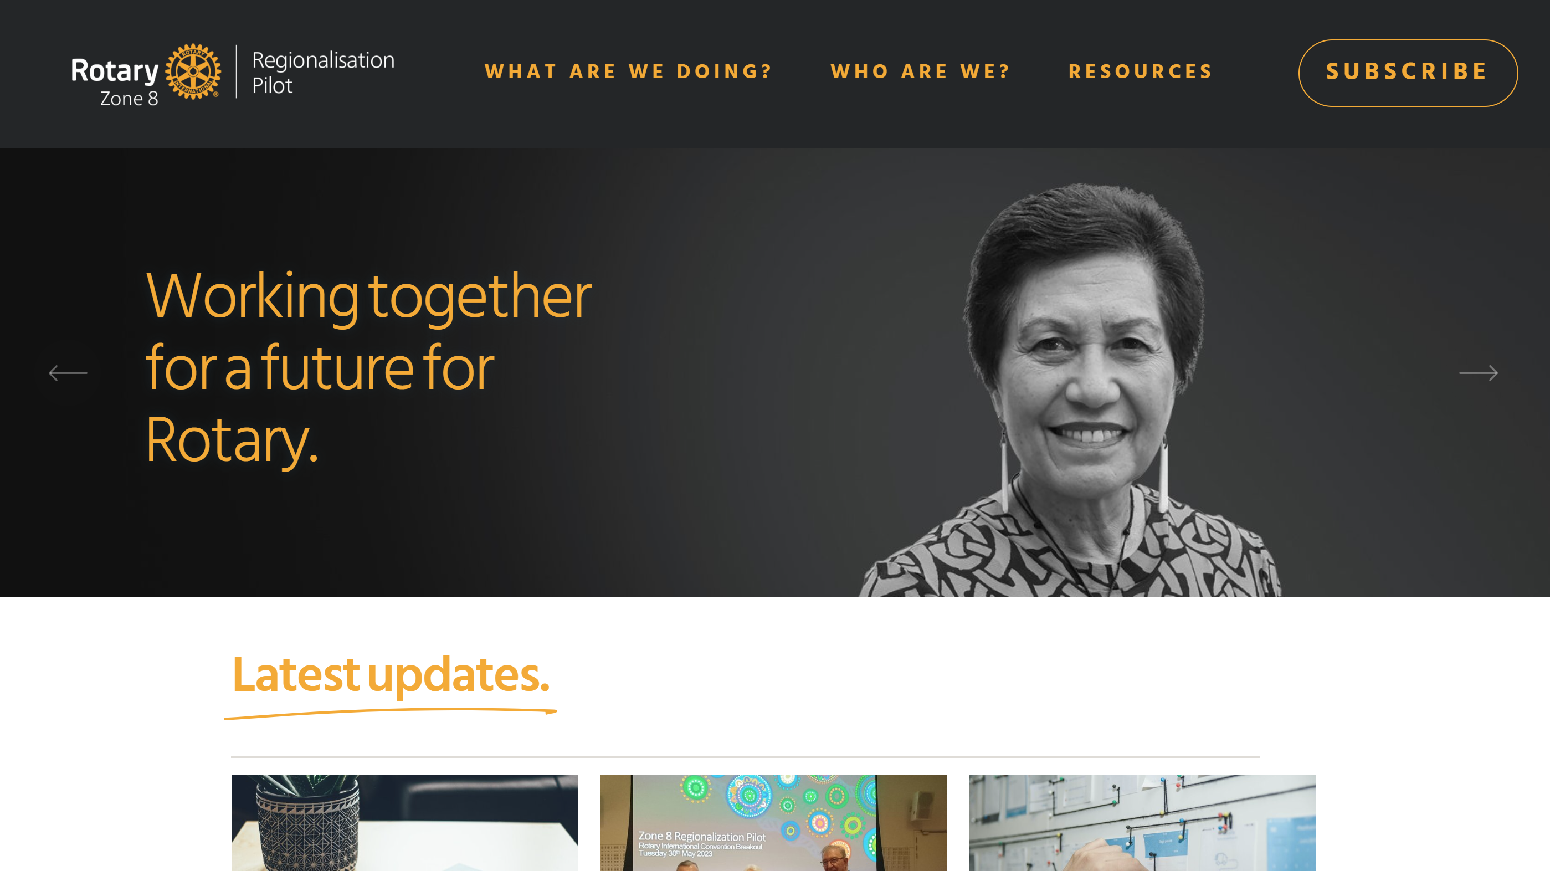
Notes:
This is a view of the updated website front page.
If you would like to have your say, become part of our reference group or simply keep up to date, the website is our primary source of information. Or you can email directly and you will get an answer- rotaryregionalpilot@gmail.com
And, as mentioned, there will be regular update emails sent to Presidents and Secretaries for you to share with your club members.

Slide 13

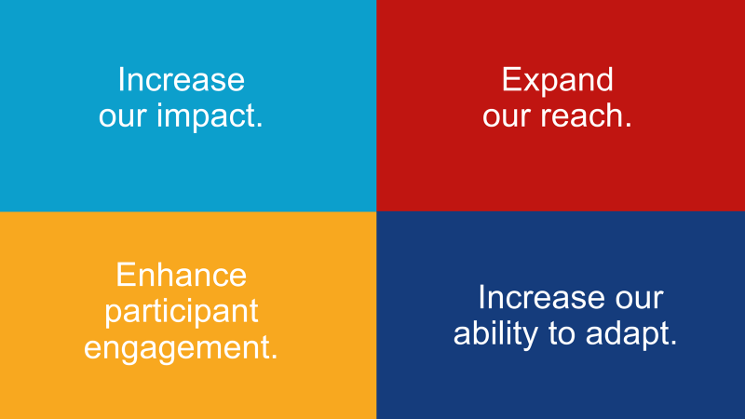
Together, we see a world where people unite and take action to create lasting change across the globe, in our communities, and in ourselves.
Notes:
We believe that this pilot represents an opportunity for Rotary globally, as well as in zone 8, to demonstrate that we are committed to change.
It will be our ability to adapt to a changing world that will enable us to deliver to the promise of our RI action plan and vision statement and grow Rotary in our zone.
We know we must do something.
We want to hear your thoughts
Open now for questions
END

