Slide 1


CATARACT PROJECT
Restoring Sight and Self-confidence
enabling Belgian medical specialists to perform cataract surgeries annually to significantly alleviate the backlog on surgery waiting lists in the Paarl region
Title Page Option

Slide 2
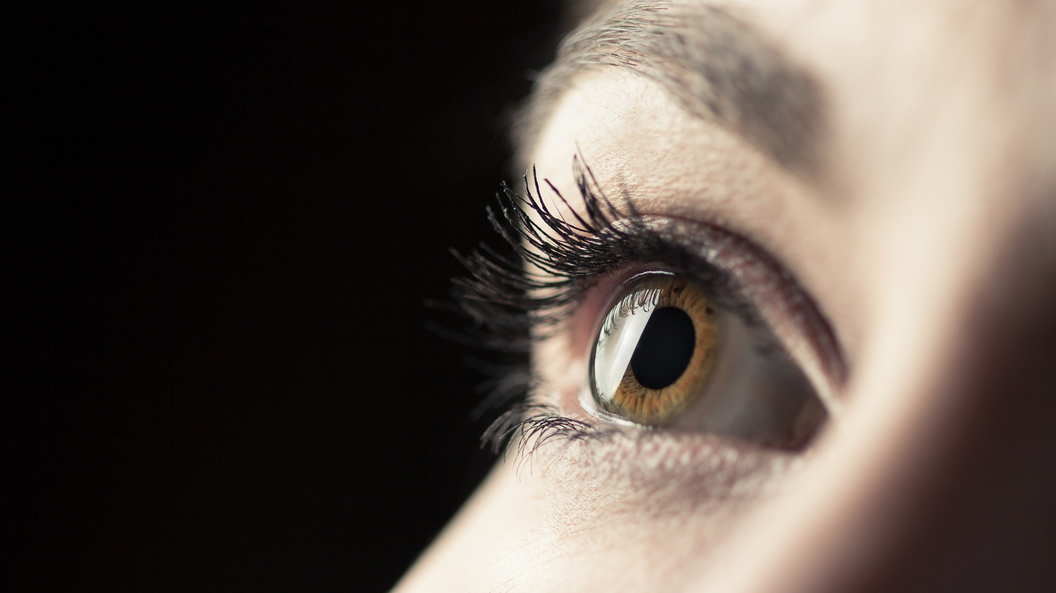
subhead
Drakenstein Valley
The Gift of
Eyesight
- 250,000 individuals affected
by Cataracts in South Africa
- Resource constraints
- Thousands of patients on hold
- 6 European medical specialists
- 100 to 250 operations annually

Slide 3
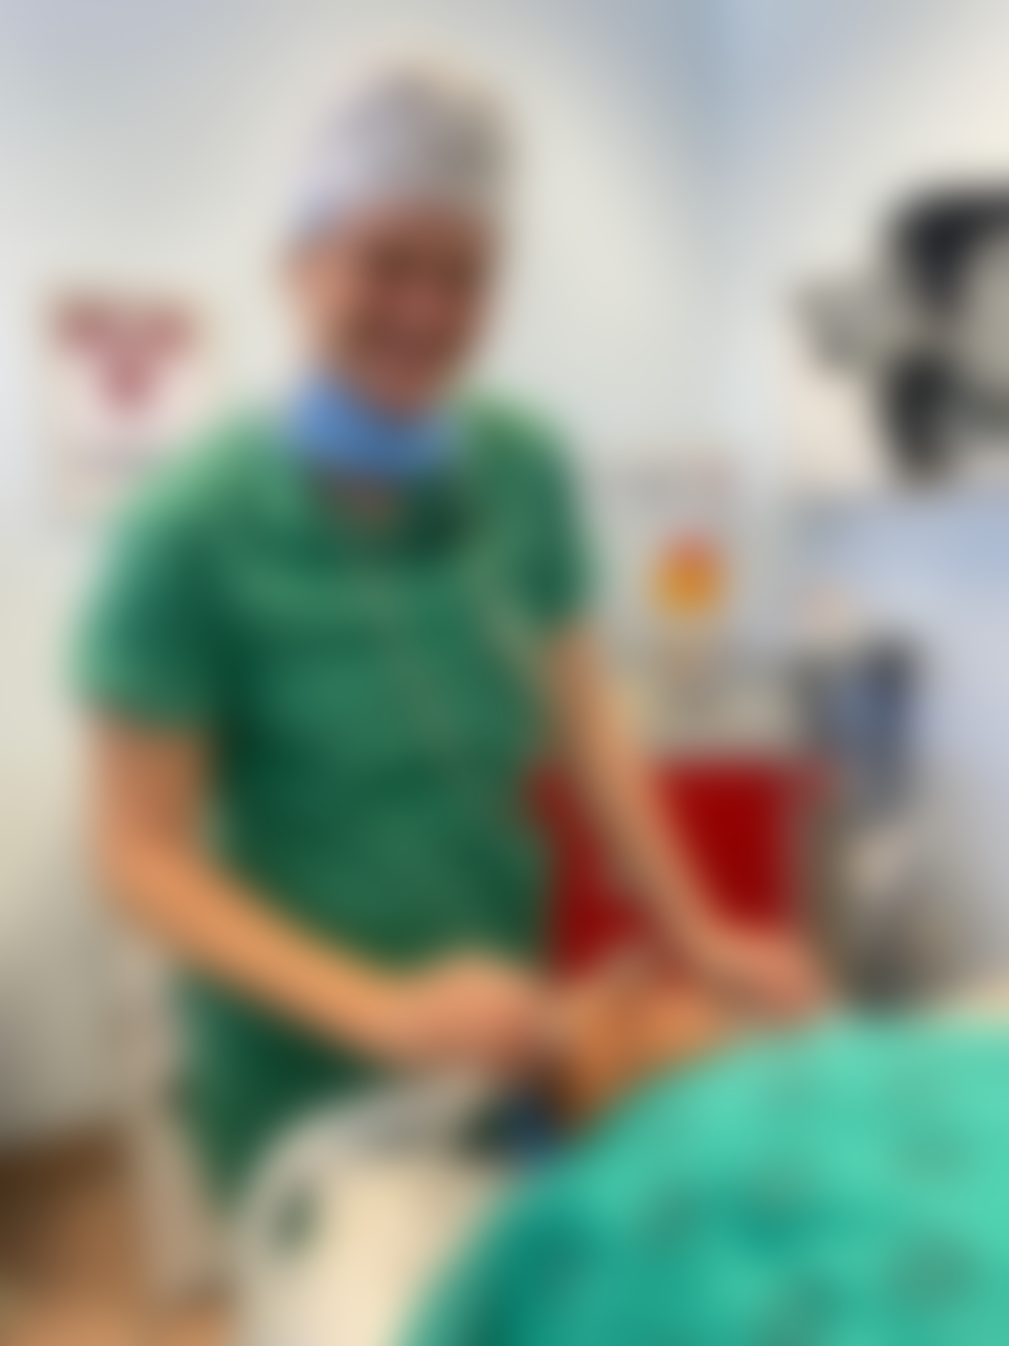
Global Problem
As the world's population ages, Cataract-induced visual dysfunction and blindness is on the increase
Both genetic and environmental factors contribute to Cataract formation. Deterioration is exacerbated by our harsh sunlight
Some of the patients were on the verge of losing their jobs, due to poor eyesight. Many are the only breadwinners
Cataract impaired patients lose income, become economically isolated, become dependent on caregivers and ultimately lose self-confidence leading to many other health problems
Cataract vision

Slide 4

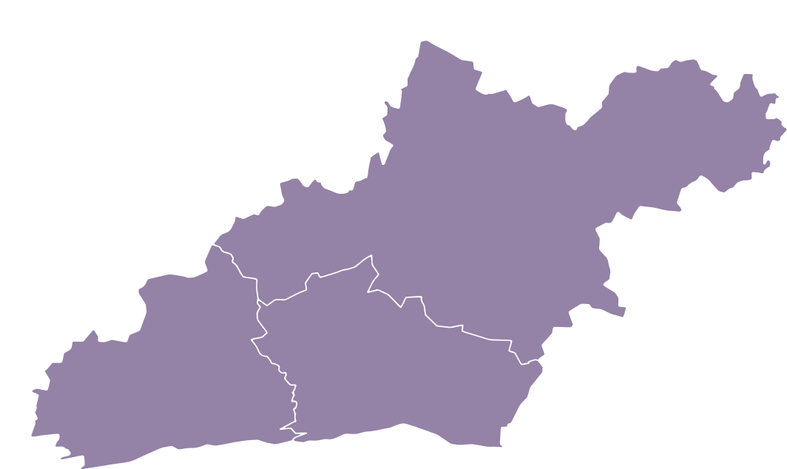



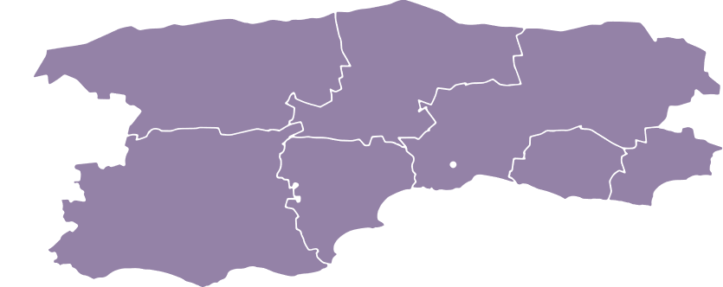



Western Cape surgery Waiting Lists
Rural Central
Ecosystem
V
Cataract surgery waiting list: 1500 patients
Vredendal
Hospital
Rural West
Ecosystem
Worcester
Hospital
Rural East
Ecosystem
Cataract surgery waiting list: 1500 - 2000 patients
P
W
G
Cataract surgery waiting list: 600 patients
Paarl
Hospital
George
Hospital

Slide 5

RESOURCE CONSTRAINTS
20
Only 20 – 40 Cataract Operations are currently
performed every month at Vredendal Hospital
More than 1,500 patients on hold in
the Rural West Ecosystem
The backlog is growing every day
Staff shortages
Consumable shortages
COVID-19 had significant impact
Too few Ophthalmologists in South Africa

Slide 6


Partnership solution
Together, we can achieve so much more
Paarl Rotary Club organized and managed the Cataract project that enabled Belgian medical specialists to perform surgeries
See and Smile, an NGO from Belgium, provided all the medical specialists as well as the cost for flights to and from South Africa
Paarl Rotary Club also provided transport, meals and accommodation for the team during their full stay in South Africa
The Department of Health (Western Cape) wholeheartedly supported the Cataract project
They provided the facilities where the cataract surgeries were performed
They provided consultation during planning of the Cataract project
They also provided leadership and mentoring during the Cataract project execution

Slide 7
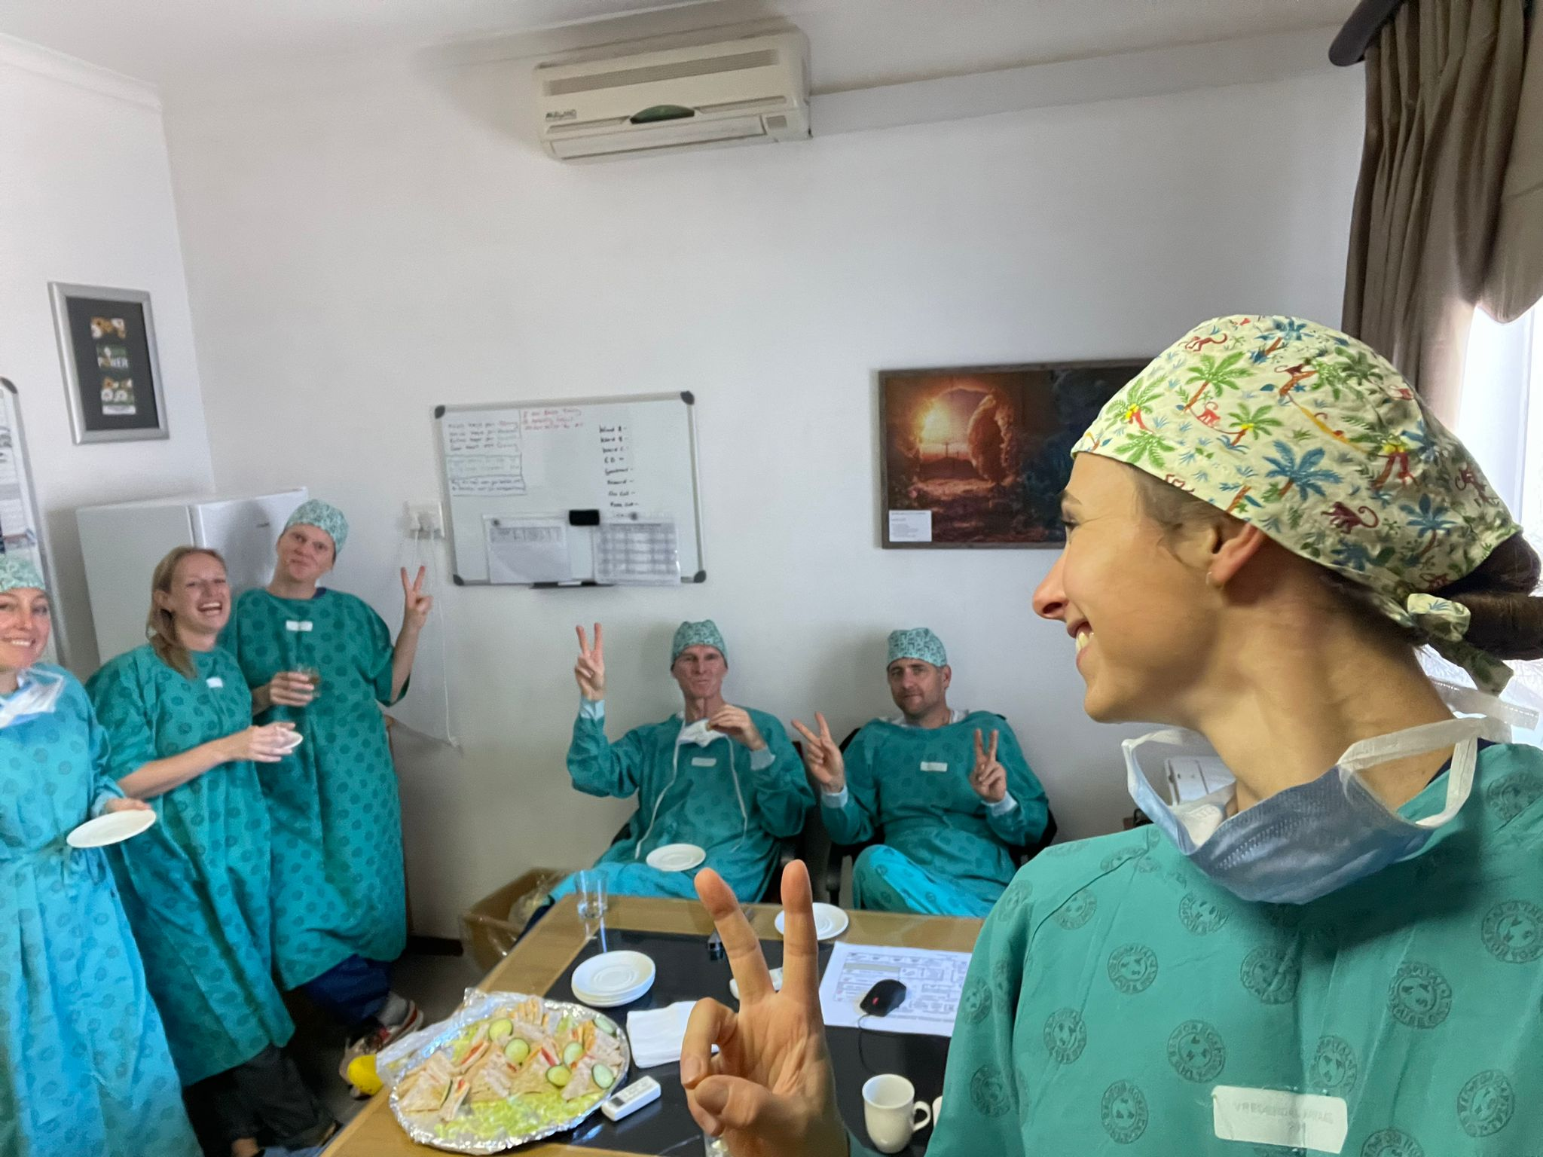
International MEDICAL specialists
Paarl Rotary Club has spearheaded a life-changing Cataract project in Vredendal, partnering with Belgian ophthalmologists sponsored by the Belgian NGO, See & Smile
The Belgian medical team comprised of three surgeons, an optician and theatre assistants who brought ten suitcases of equipment

Slide 8
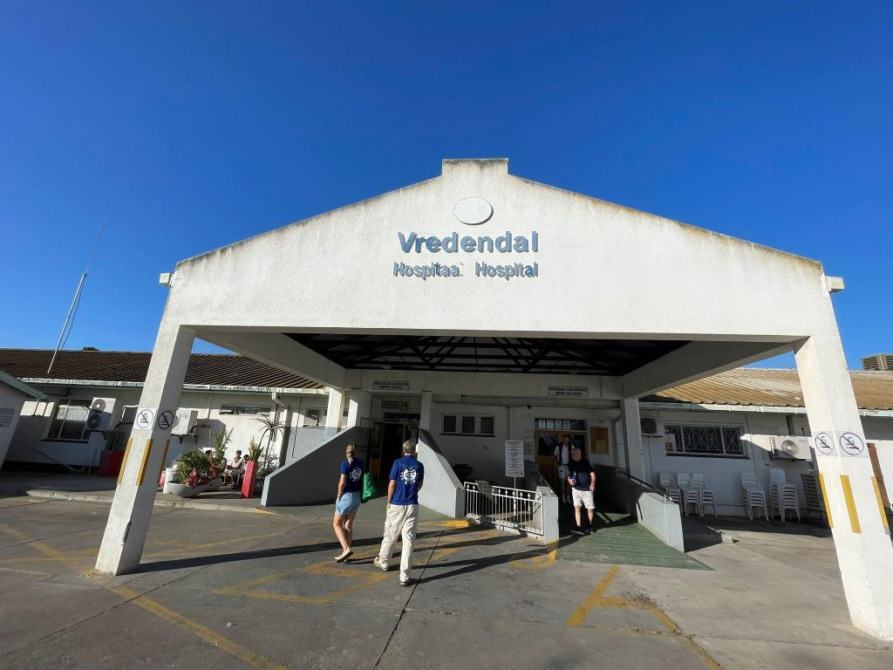
Availability of Facilities
A critical success factor of the Cataract project was the planning of operating theatres to perform safe surgery
The Department of Health (Western Cape), and more specifically, the Paarl Provincial Hospital management, assist in arranging alternative facilities when local operating theatres are considered unavailable
Vredendal Provincial Hospital was used
More than 100 Cataract surgeries were performed in a week

Slide 9
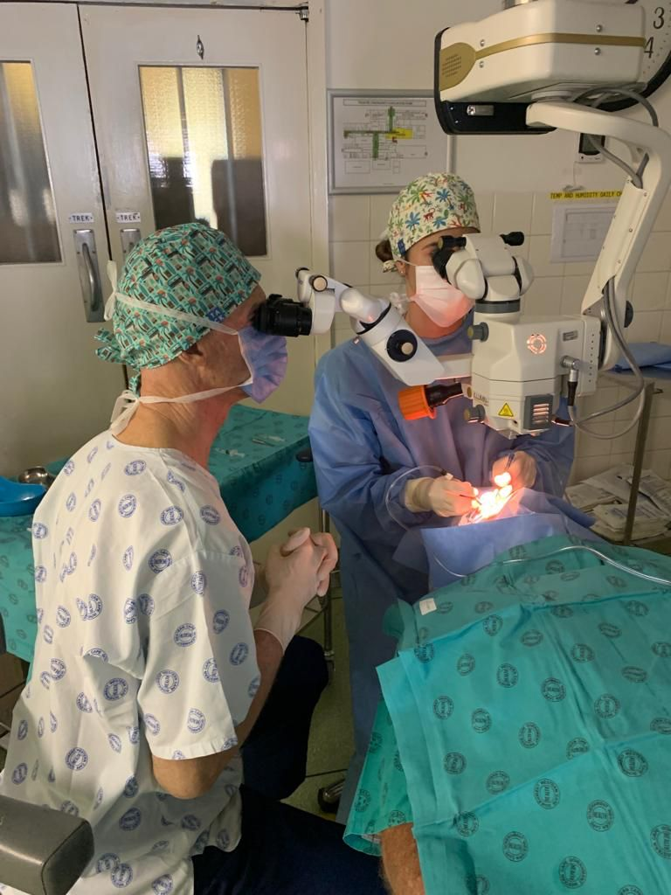
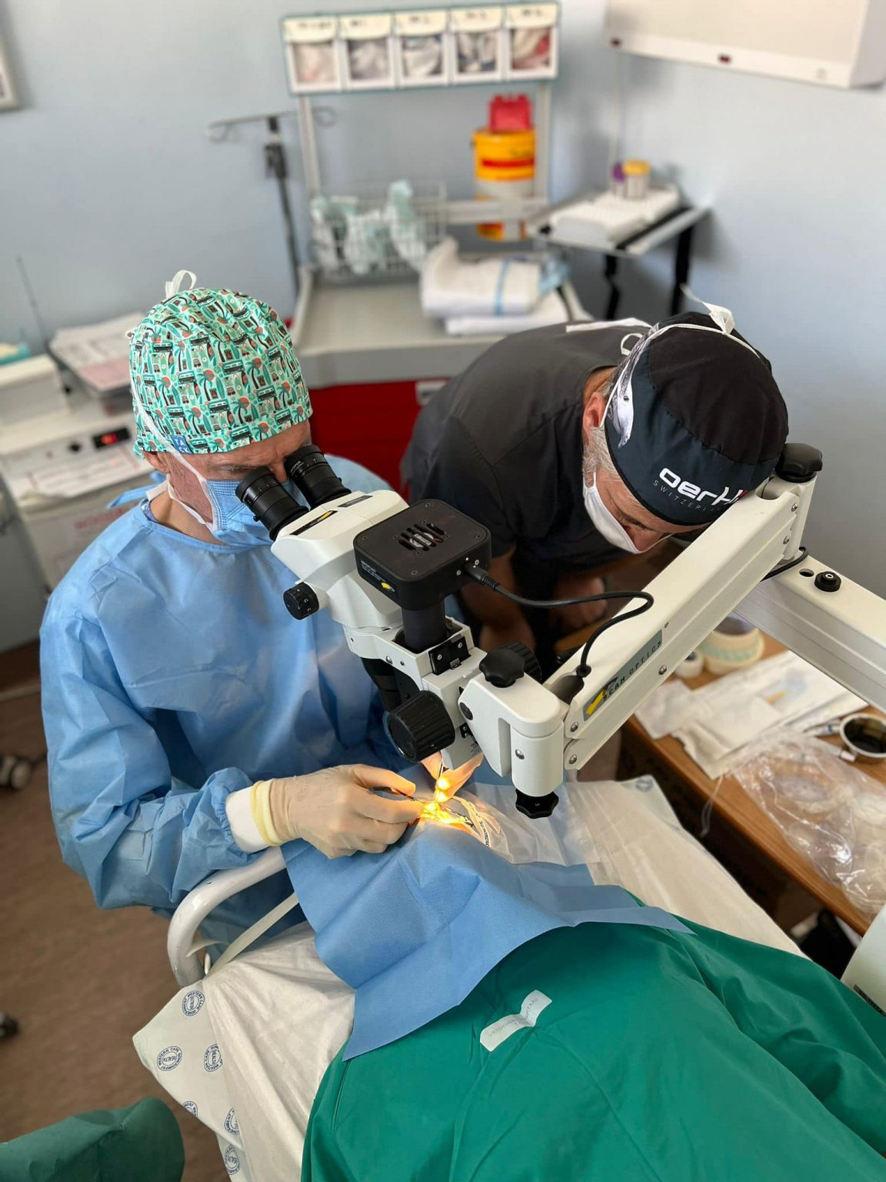
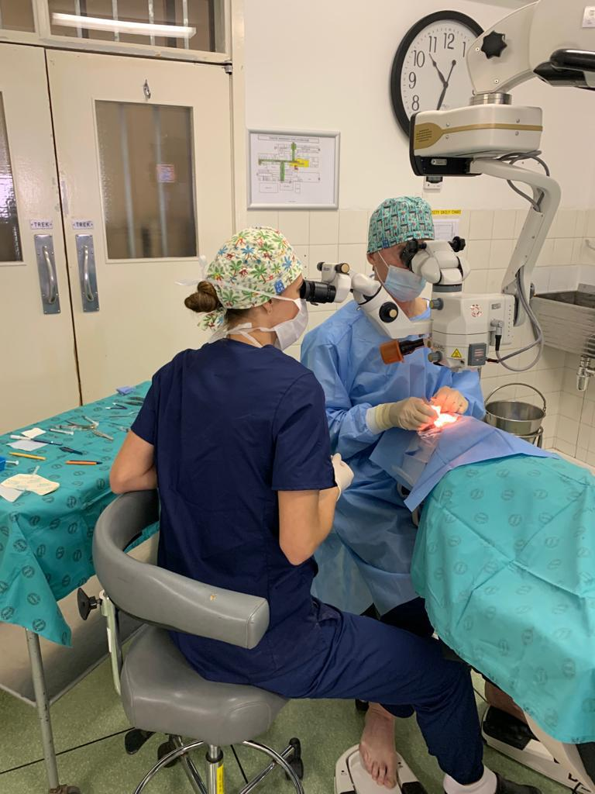

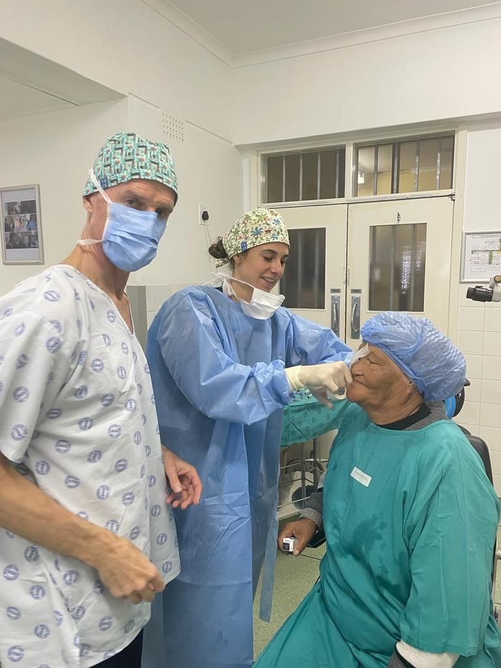
People of action
Over five days, the team conducted more than 100 Cataract surgeries, restoring eyesight to needy patients from the Namaqualand area
State-of-the-art equipment used
Highly specialized skills
Long, hard days
Intense focus
Great collaboration and success

Slide 10
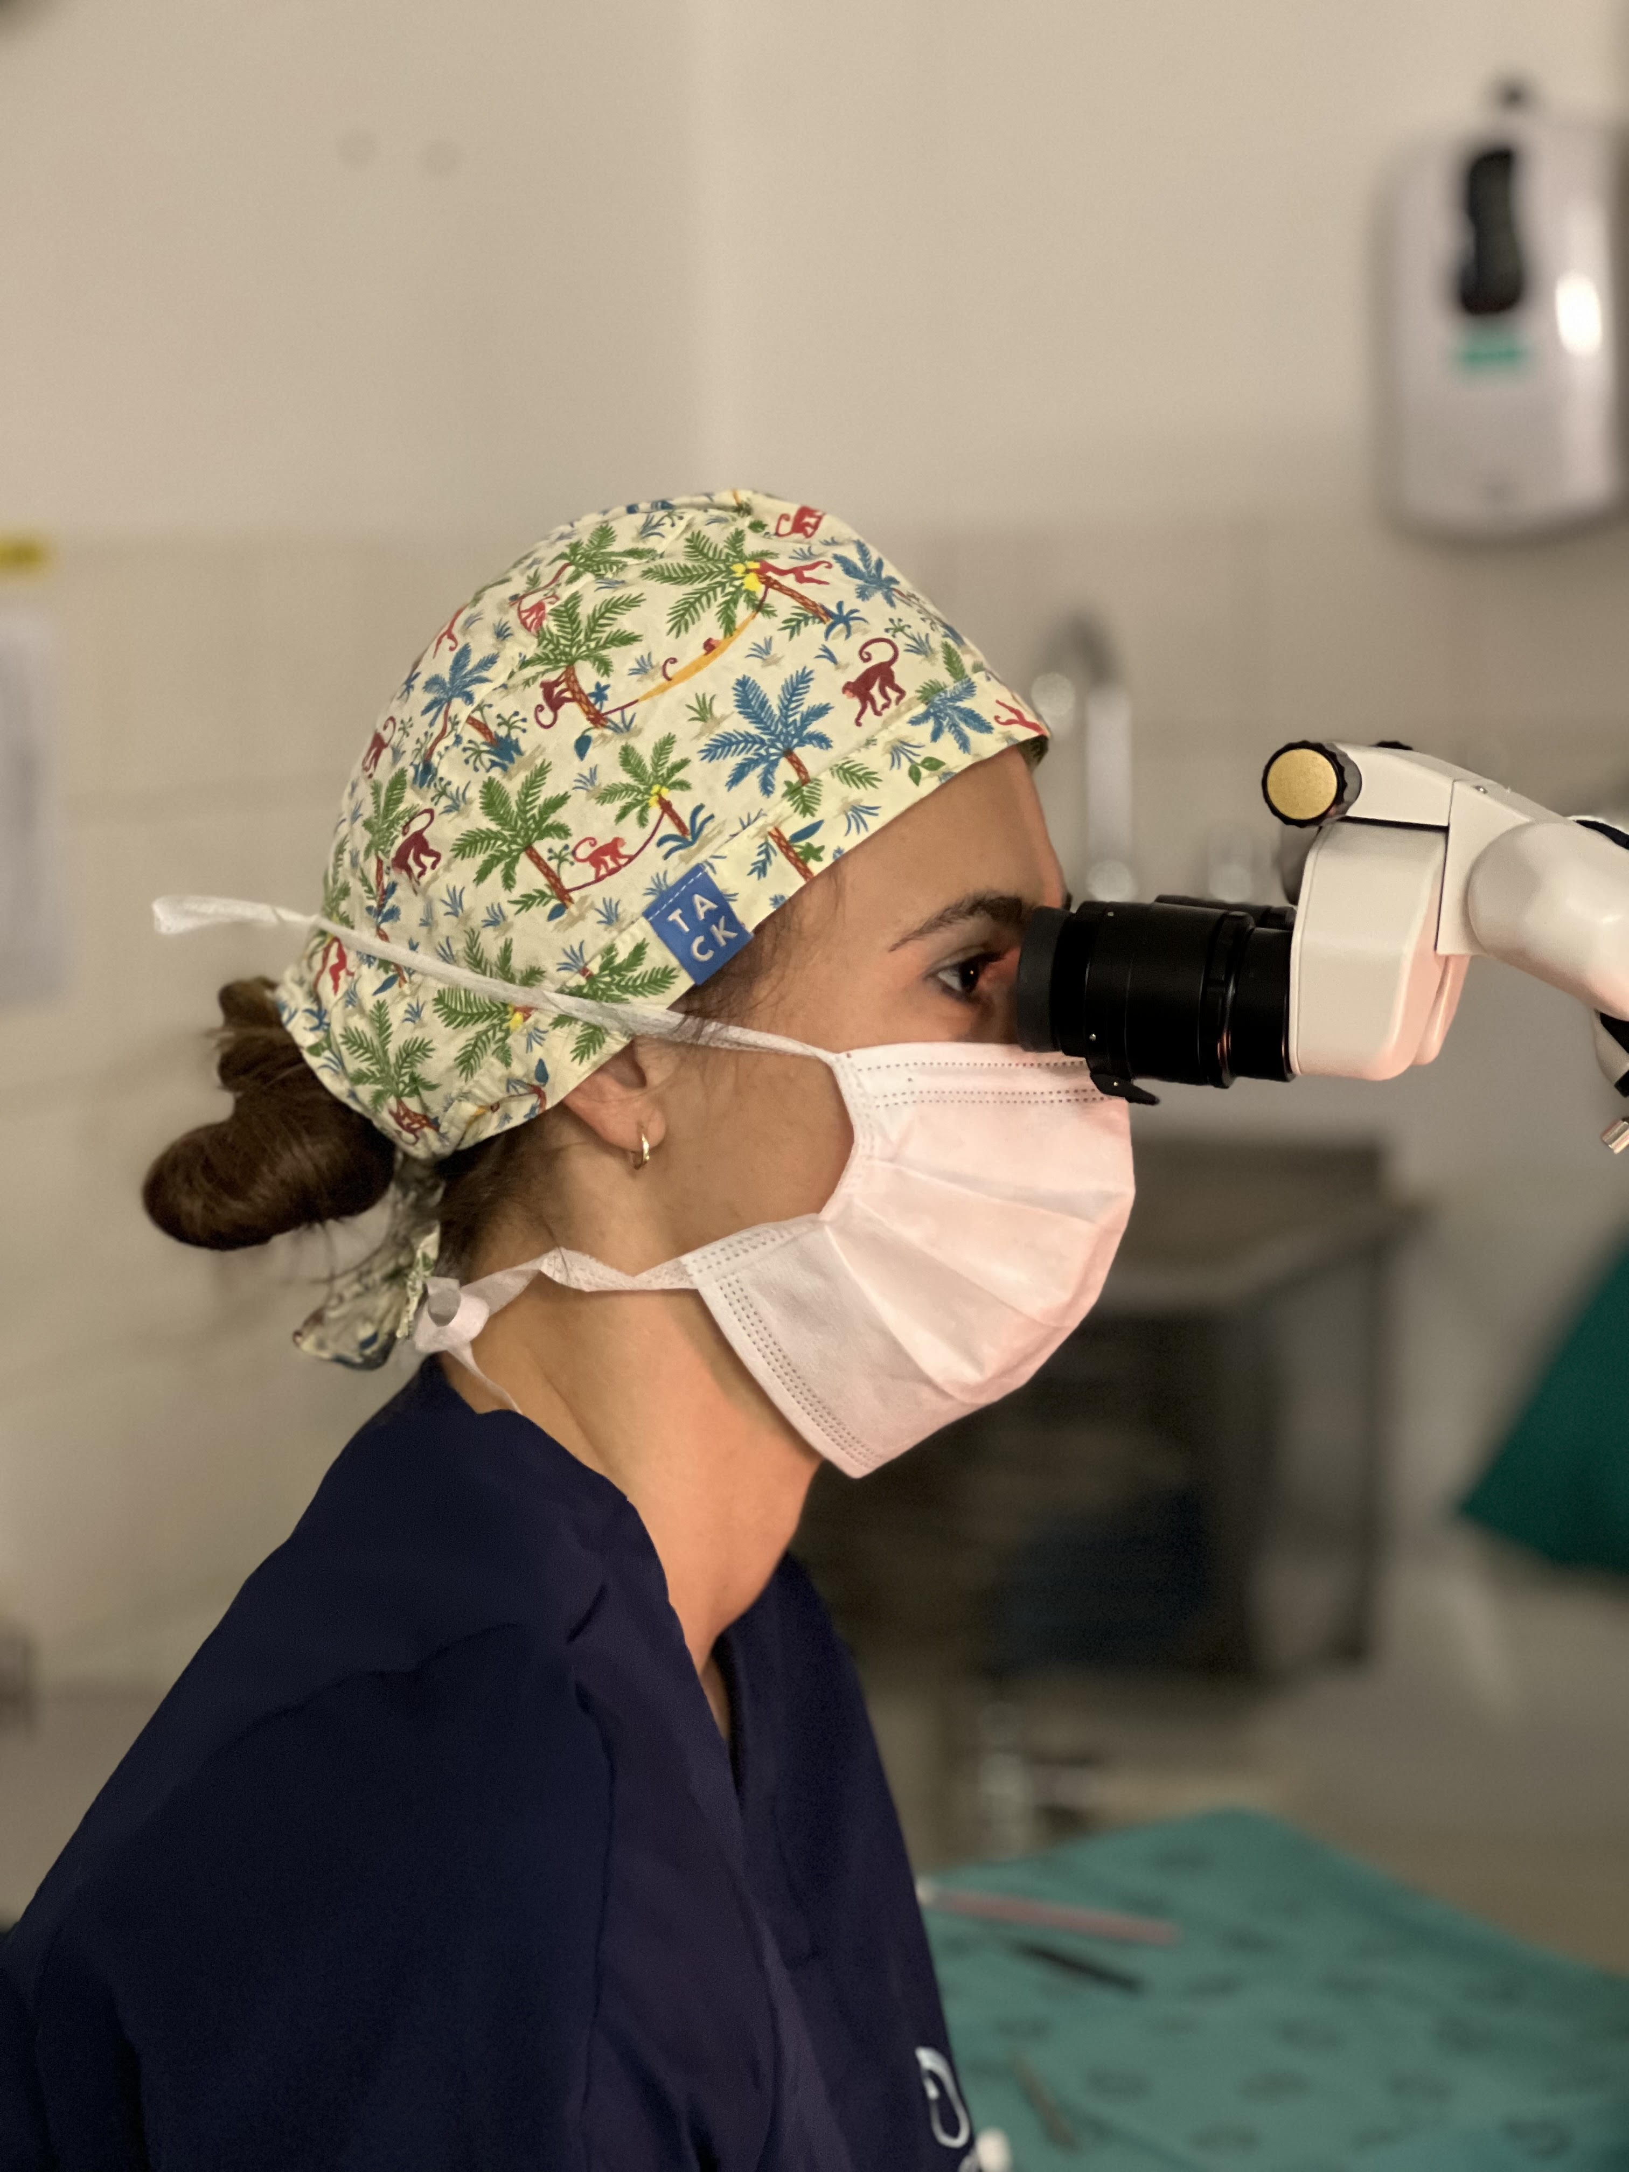
Quality of life
The Cataract surgeries not only restored vision but also improved the patients’ quality of life, enabling many to regain economic independence and alleviate the burden on their caregivers
This effort highlights the persistent challenges in rural healthcare, with over 1,000 patients awaiting cataract surgeries in the Vredendal area due to resource constraints
The Cataract project builds on Rotary’s longstanding tradition of supporting vision care, including providing spectacles to learners with impaired sight
It underscores the transformative power of collaboration in restoring sight and hope to those in need

Slide 11
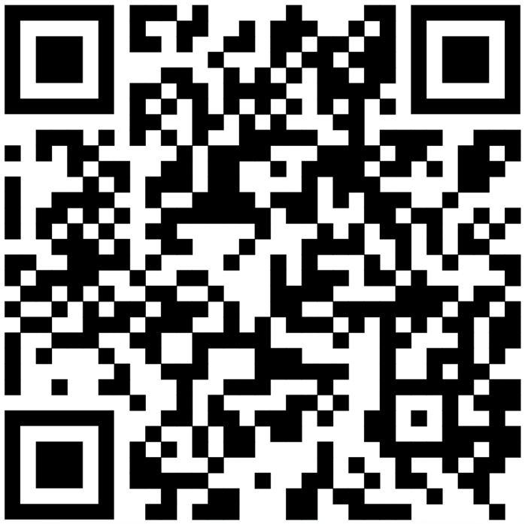
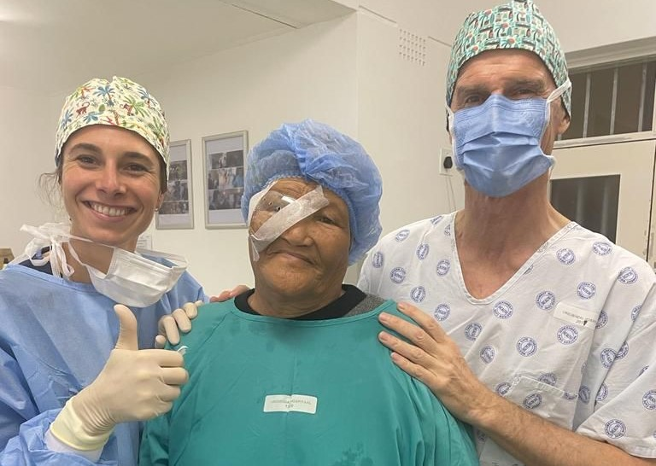
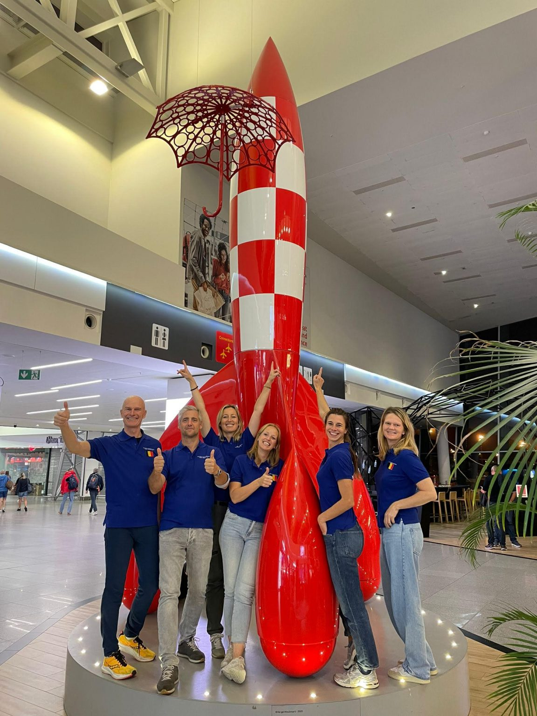
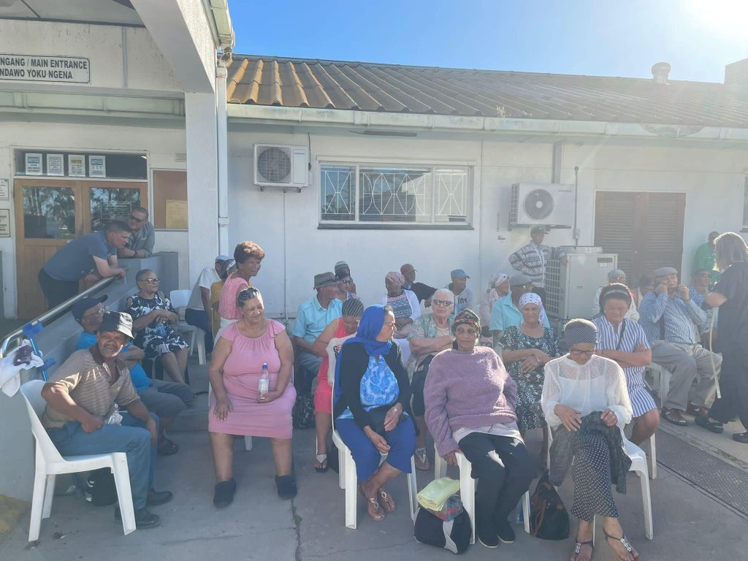


supporting cataract surgery
Restoring sight
Restoring self-confidence
We are creating HOPE
To donate or get involved, please contact:
Club President: Rudy Dupont
Contact +32 49 850 6334
Secretary: June Kroukamp
Contact +27 82 492 0423
paarlrotary
people_of_action1940

