Slide 1


ITHEMBA PROGRAMME
Saving Children in Africa
a programme focused on creating hope by breaking the circle of poverty amongst our youth
Title Page Option

Slide 2
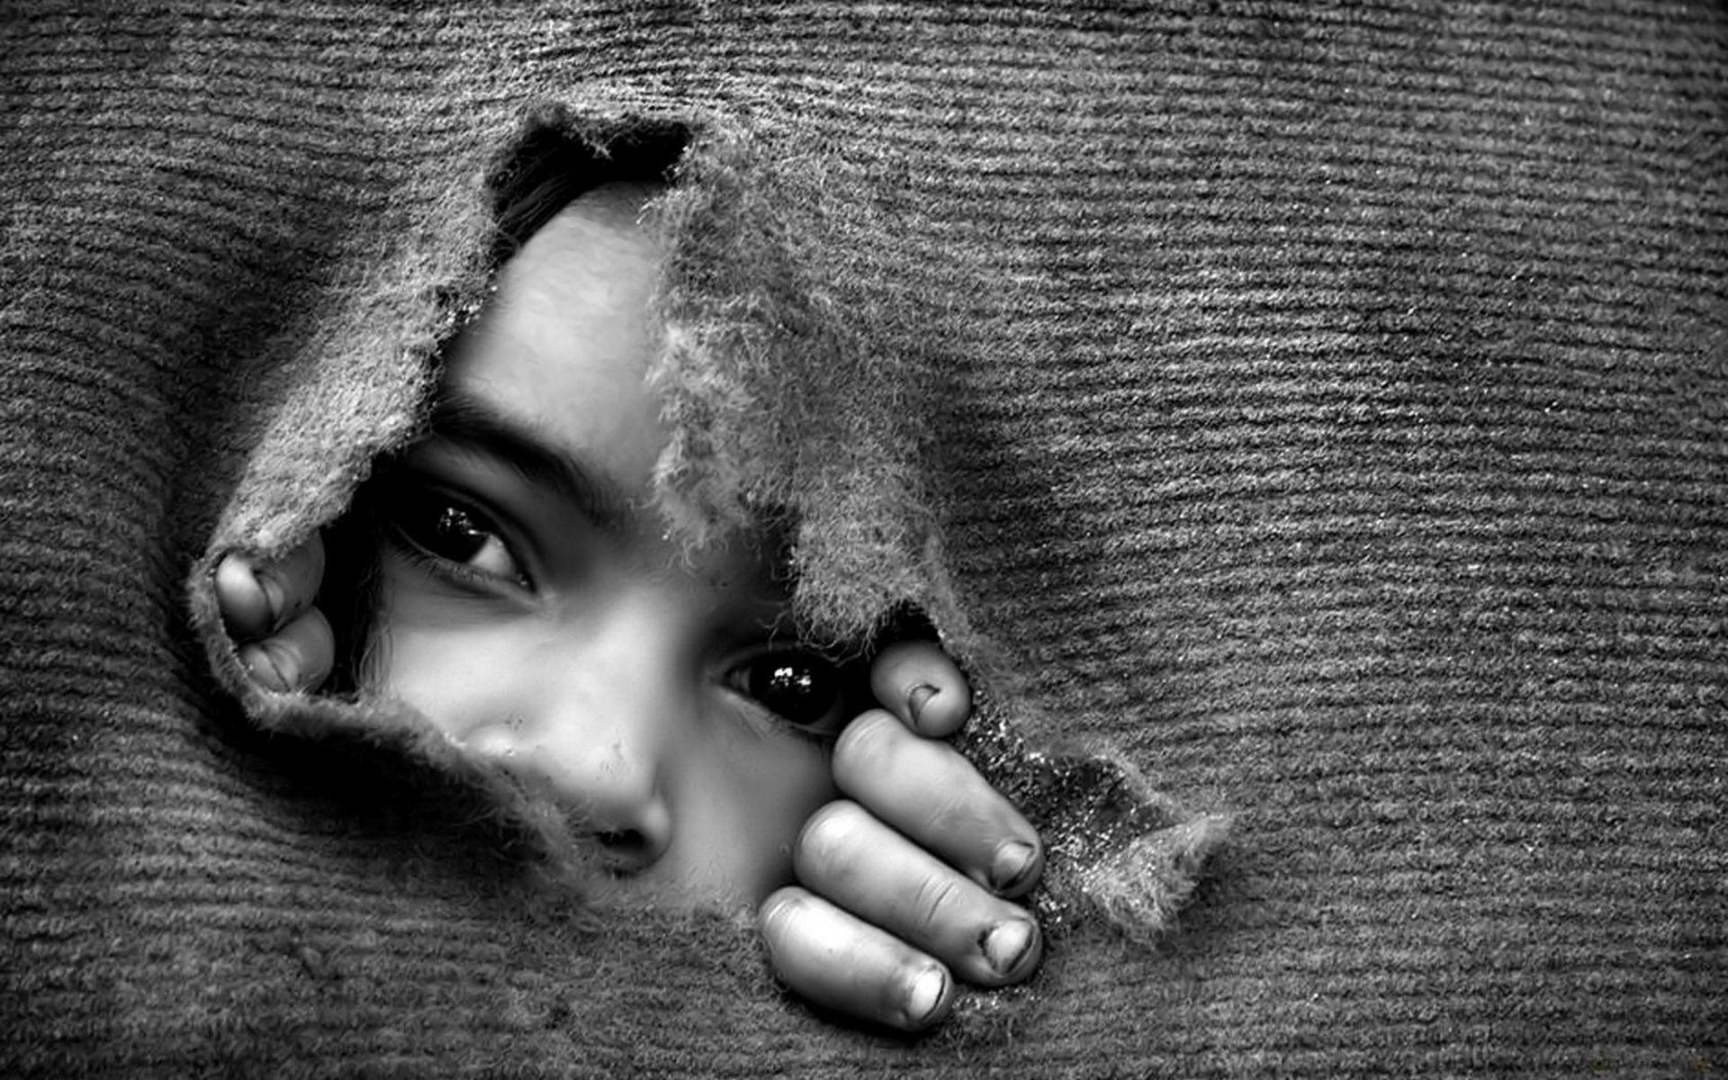
subhead
Drakenstein Valley
A Community
Locked in
Poverty
- 41 Informal Settlements
- 11755 Households without Income

Slide 3
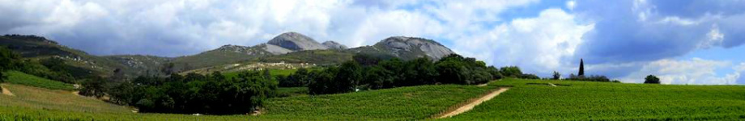
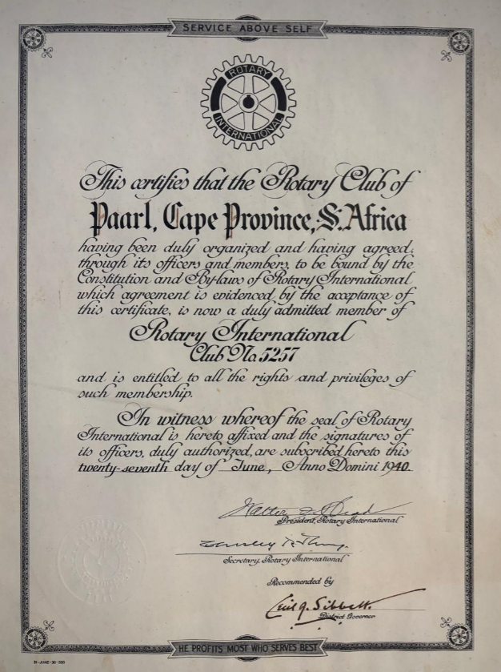
Drakenstein Valley
Our Community and our club
PAARL is located 60km from Cape Town. Paarl has a population of 332,715 and according to the Dept of Health, 82% of our people have no medical insurance
DRAKENSTEIN municipal borders cover 1538 km² and due to the growth of the Mbekweni township it is now a de facto urban unit with Wellington
The town is known for its SCENIC environment, viticulture and fruit-growing heritage
Paarl is however a TOUGH ENVIRONMENT for the poor
Paarl Rotary Club was already chartered in 1940
Paarl Rotary Club supports 6 Interact Clubs and 1 EarlyAct Club
Paarl Rotary Club also supports Rotary Youth Exchange, Adventure into Citizenship as well as Rotary Youth Leadership Awards programmes
Paarl / Wellington / Saron / Gouda

Slide 4
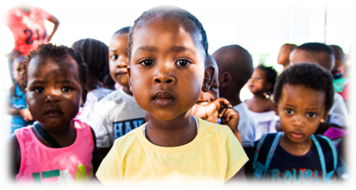
Unemployment challenges
Food and Nutrition
Health clinic facilities
Abandoned babies
Violence against women and children
Youth pregnancies
Drug and Alcohol abuse
Need for educational aids
Bullying
32%

Slide 5
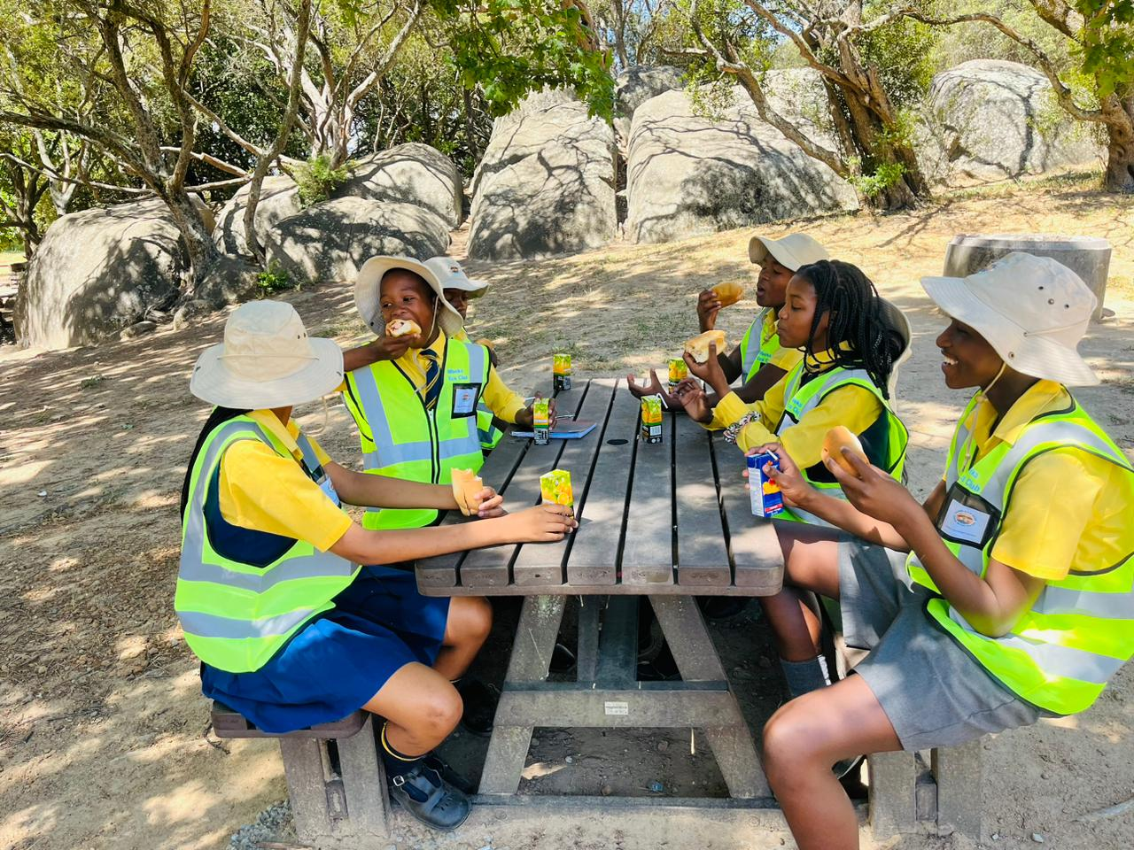
iThemba – Creating hope for our youth
We do however know that throughout history, Paarlites who have managed to overcome these challenges have excelled in becoming some of the continent’s top leaders in business as well as on the sports field
Paarl Rotary acts as Steward for your investment towards creating HOPE for the youth

Slide 6

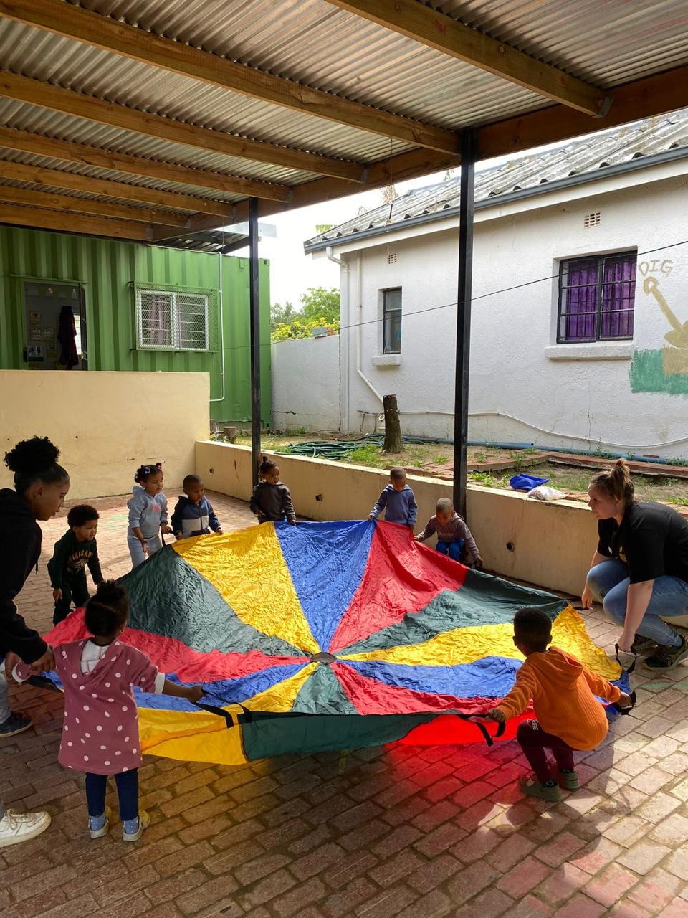
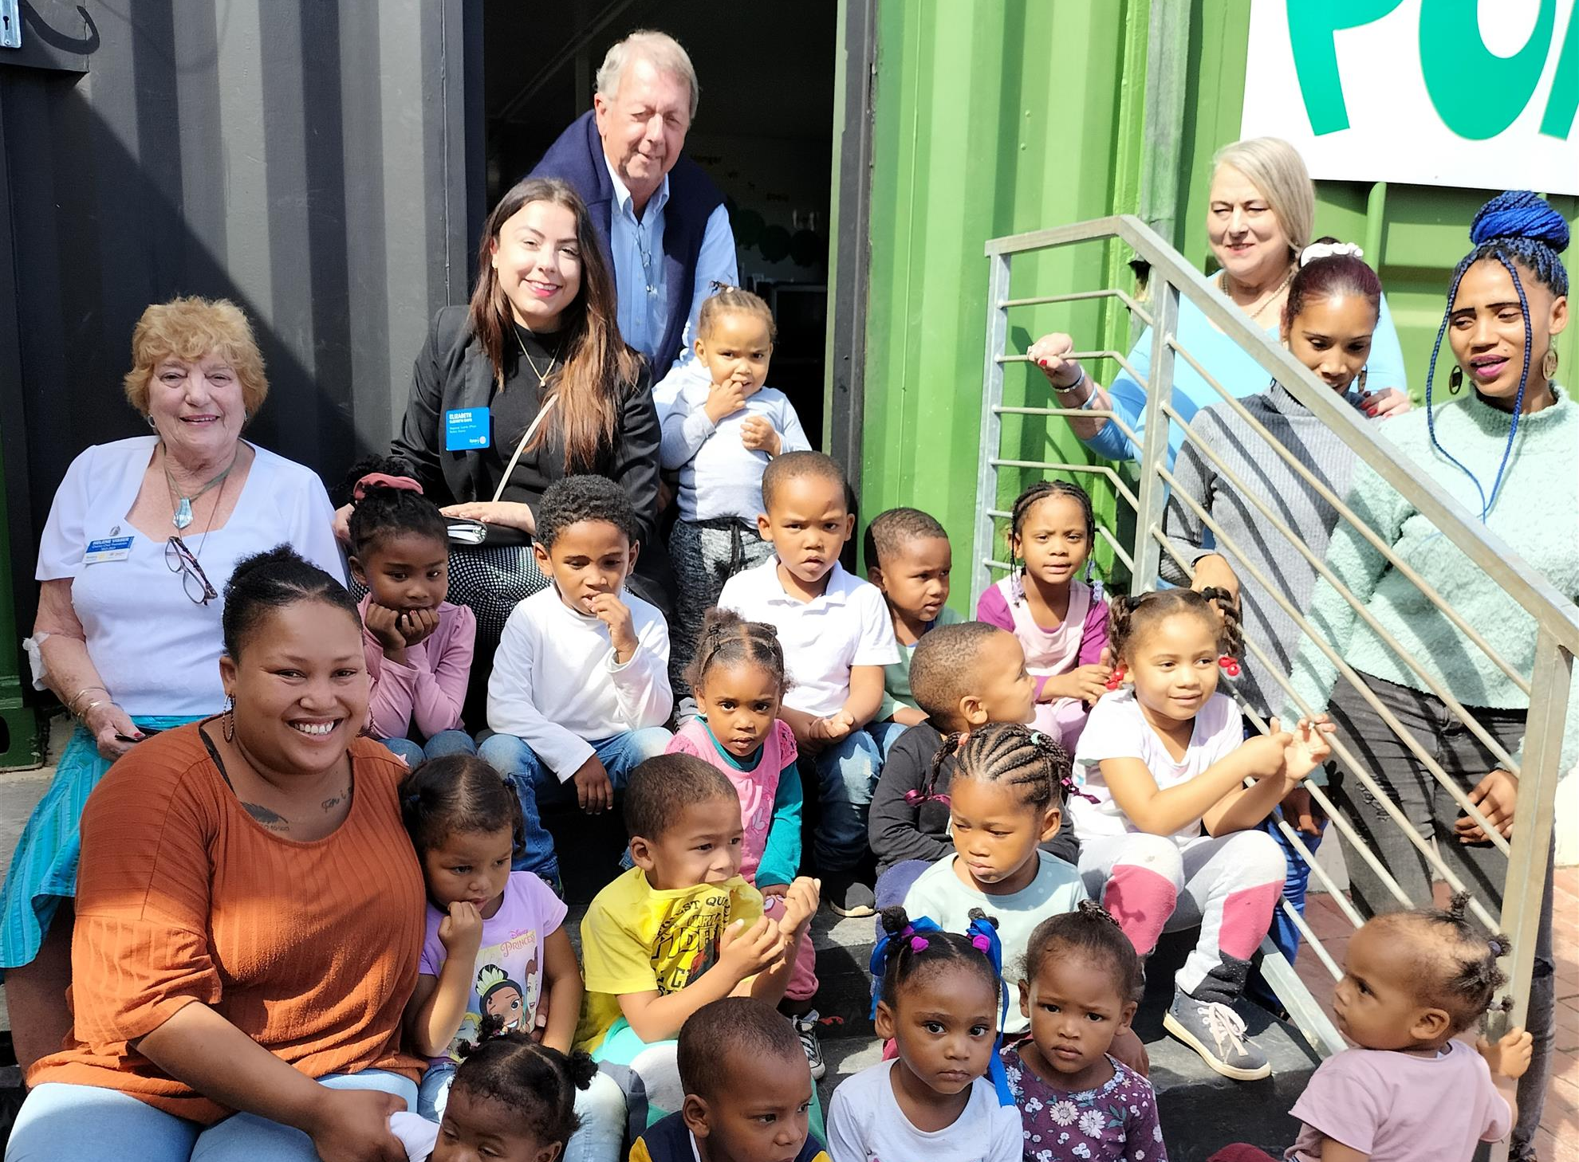
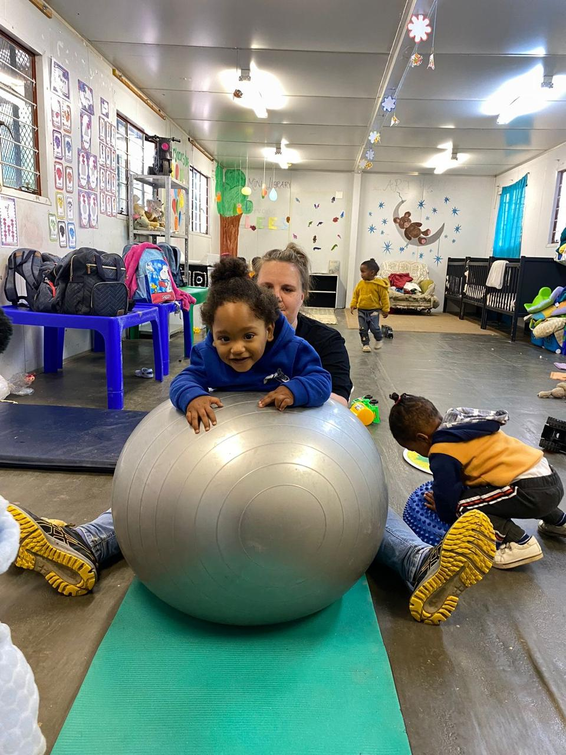
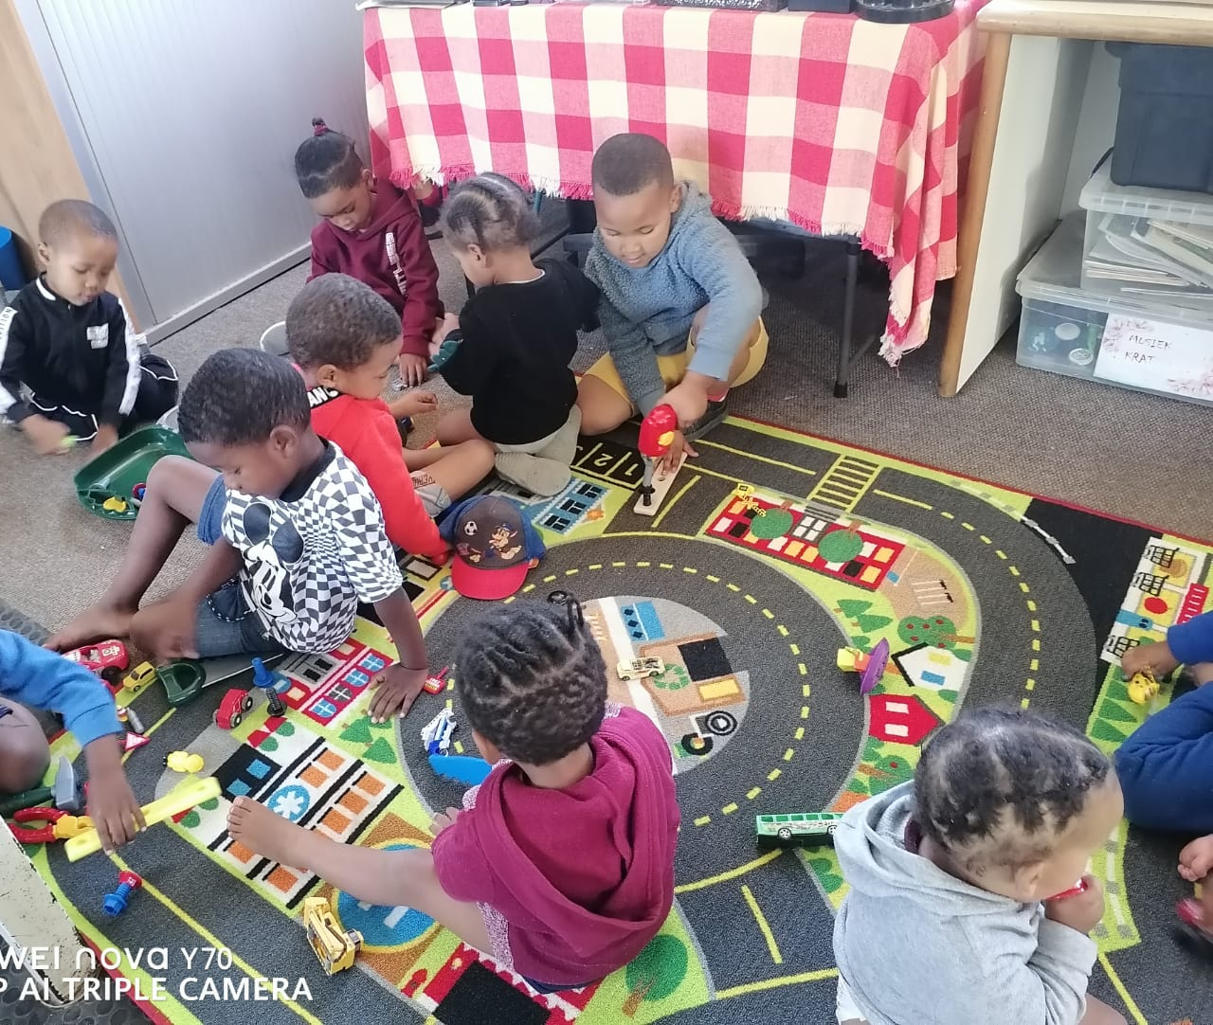
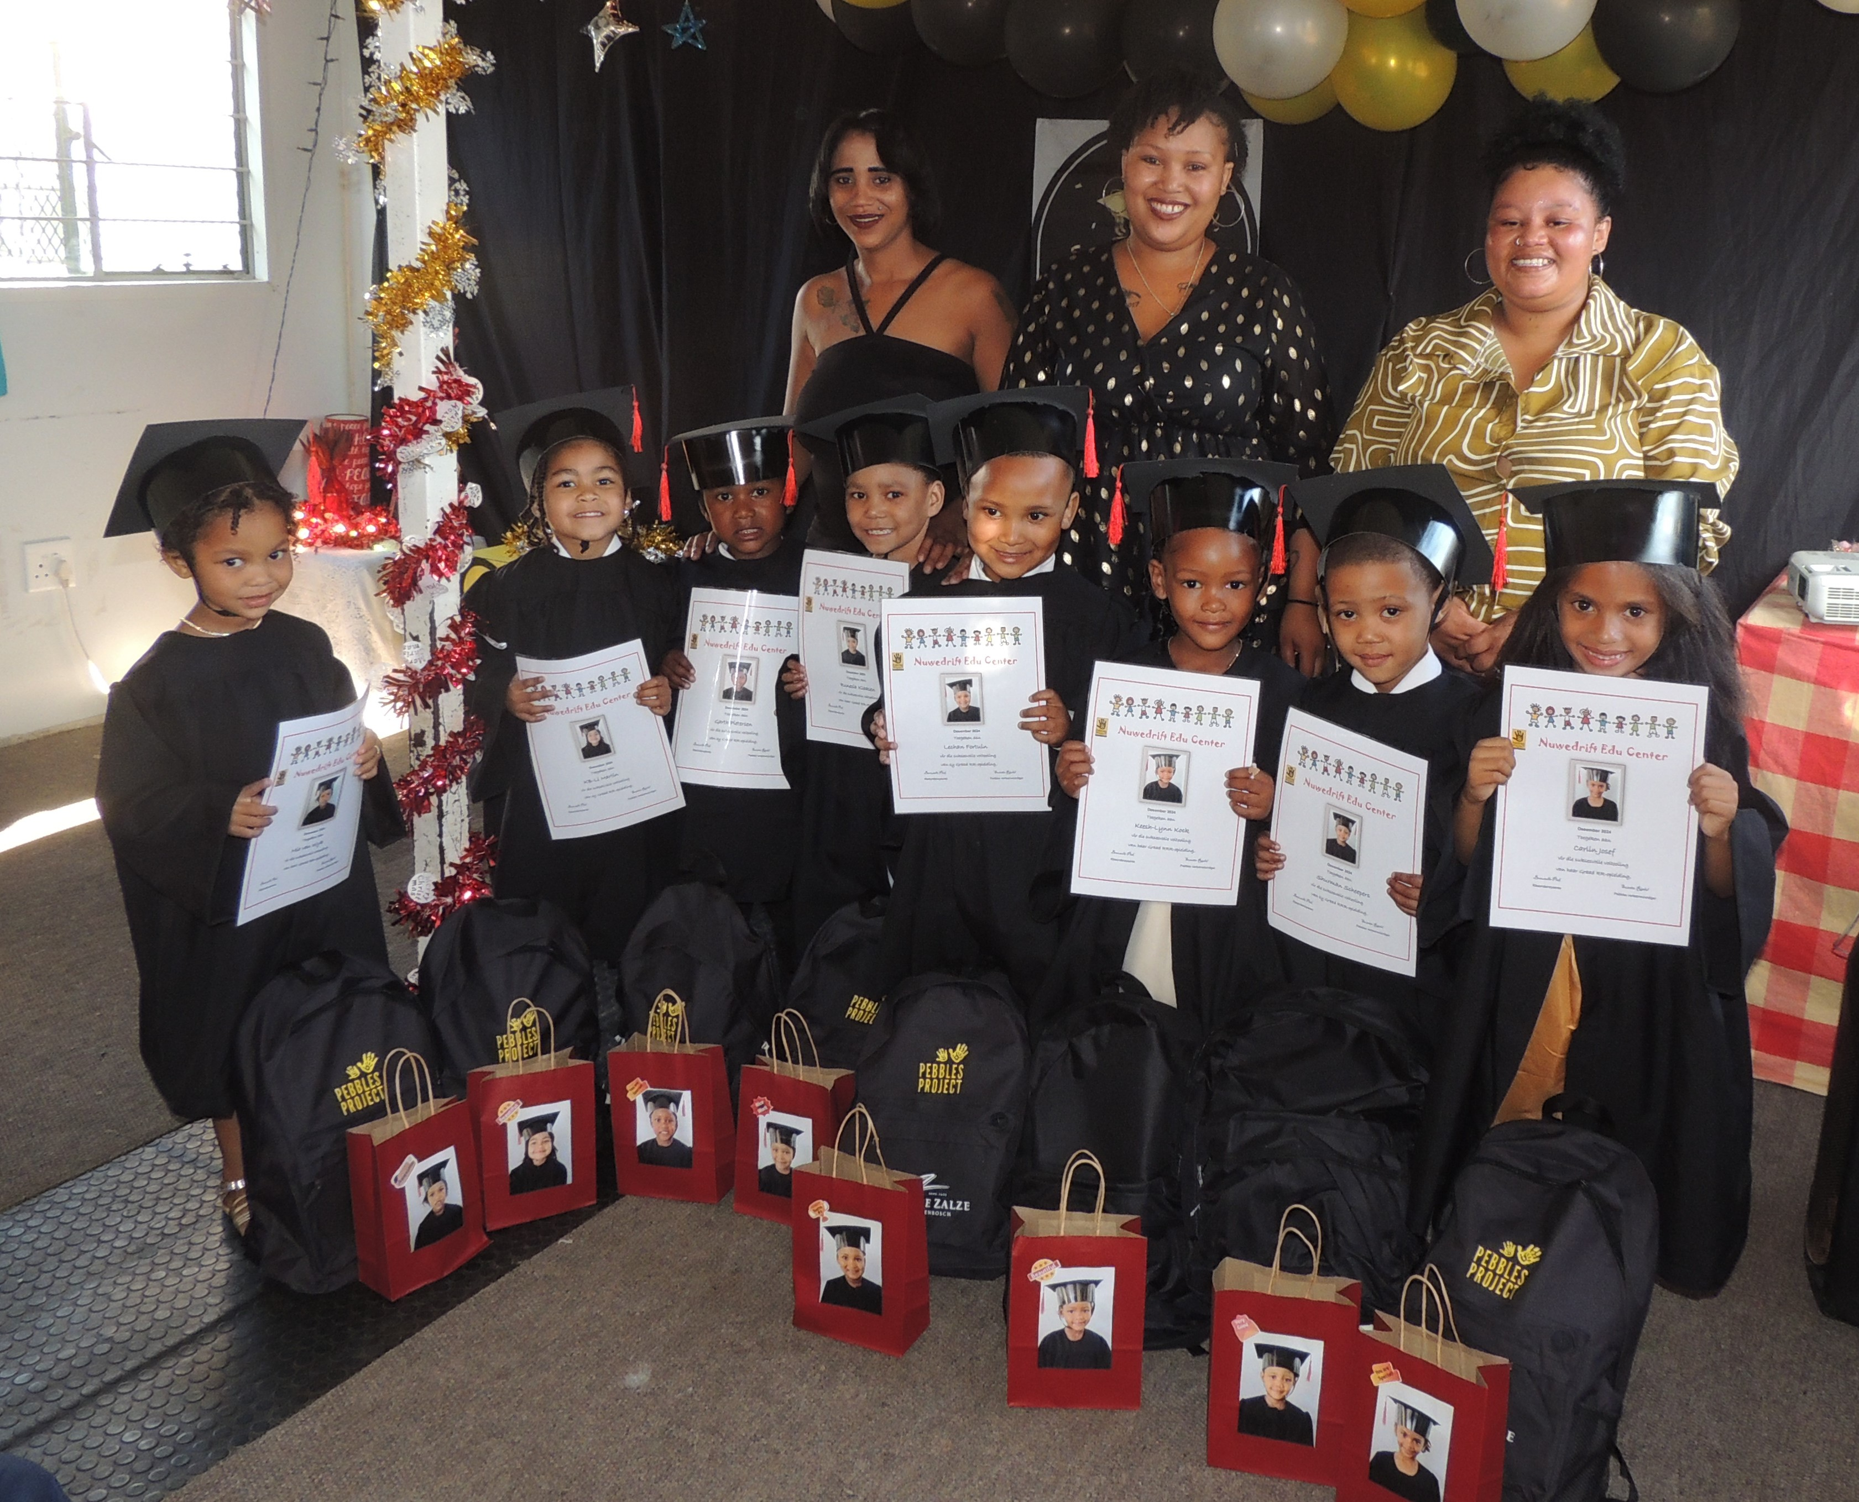
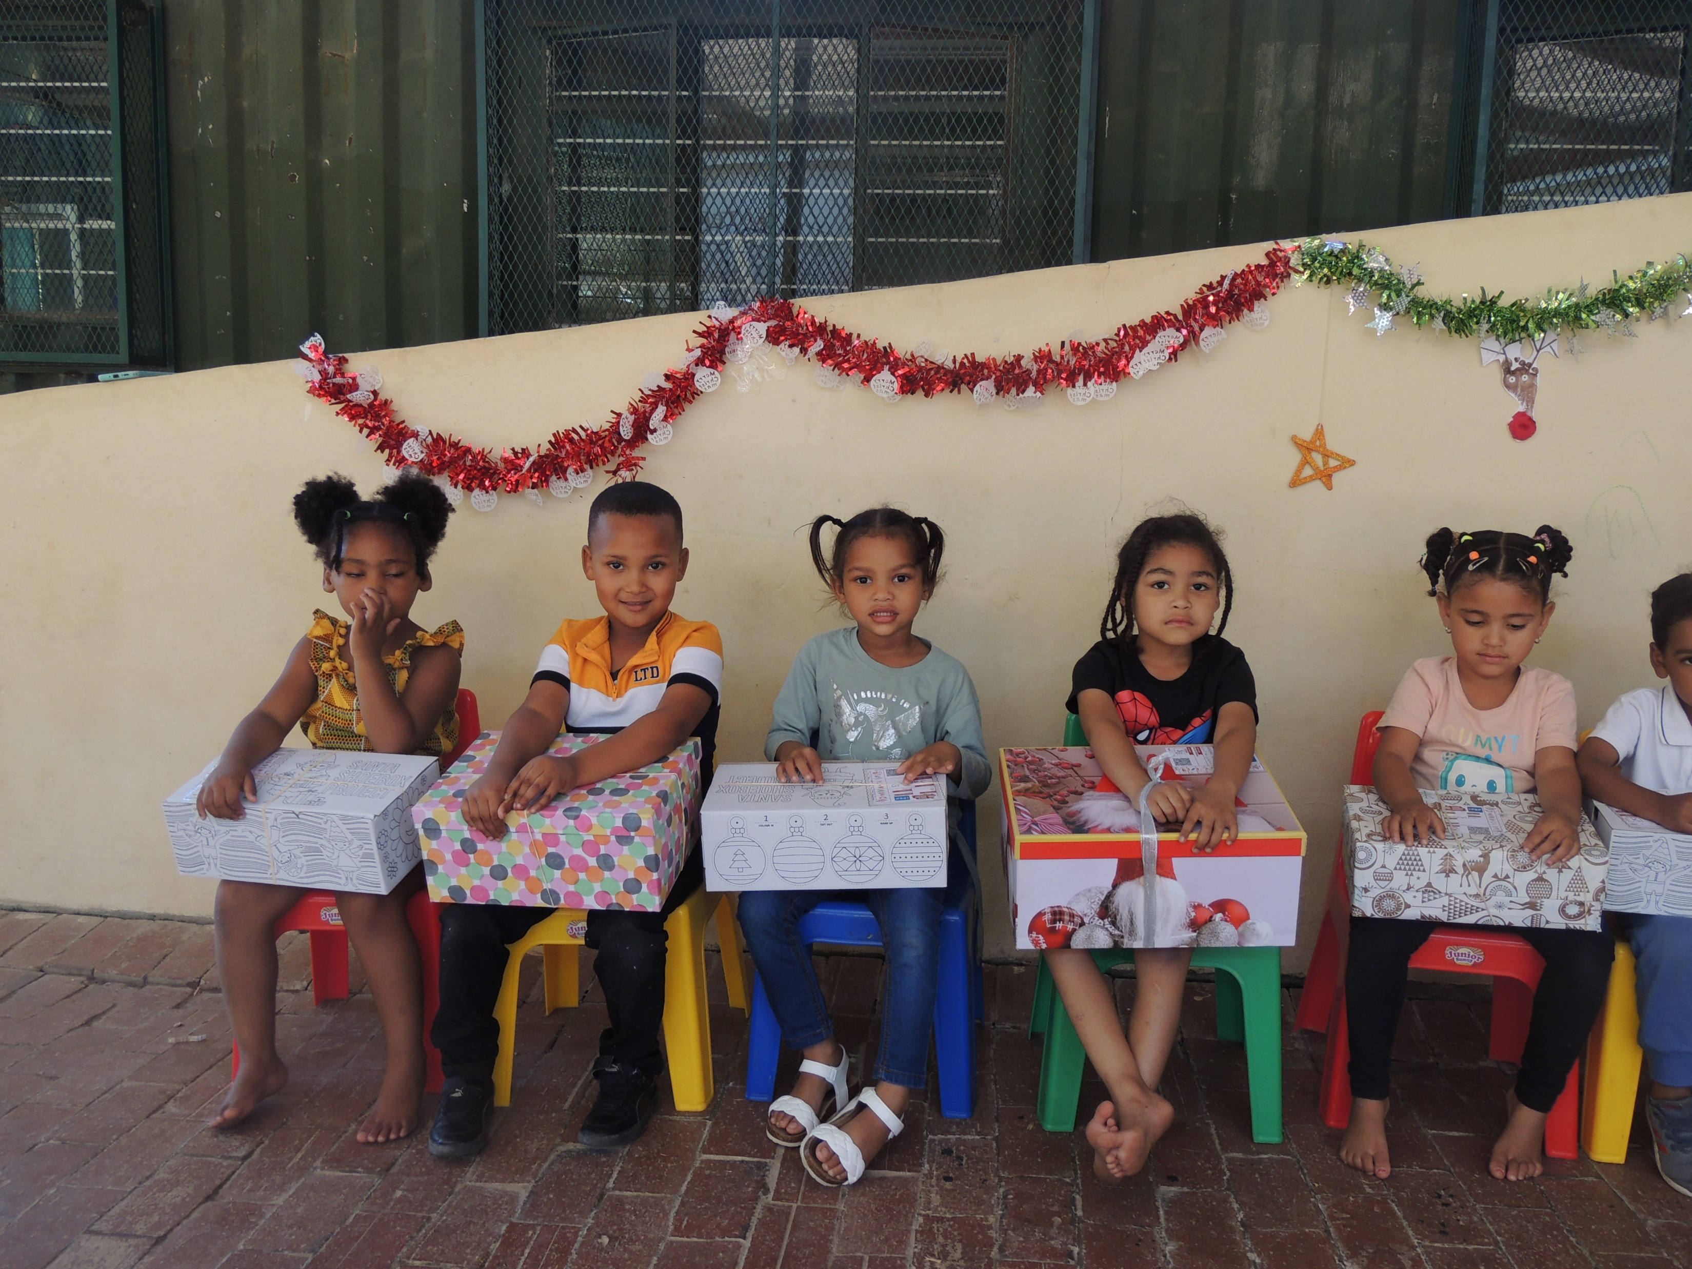
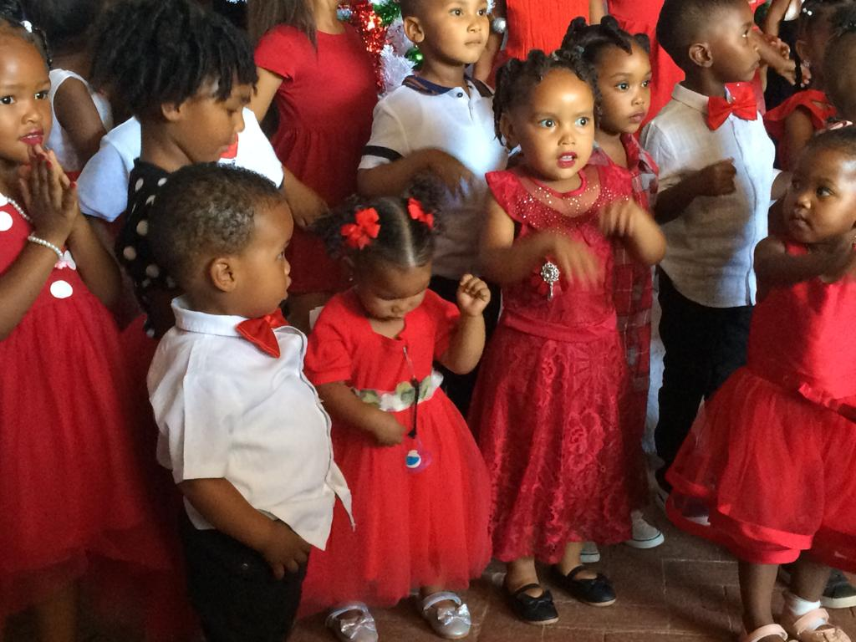
Educational trust for farmworkers
At Nieuwedrift, we support an educational facility for early childhood development for the children of farmworkers – in this wine producing community
The drop-out rate among these children is exceptionally high, and the programme is focused to break this cycle of poverty

Slide 7
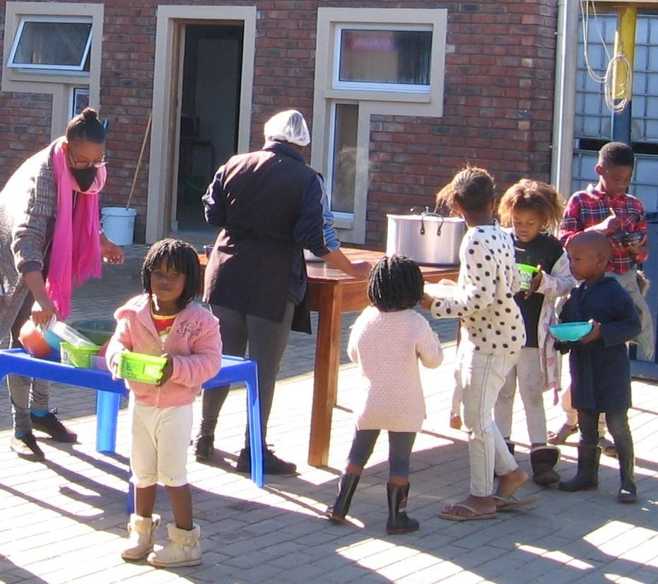
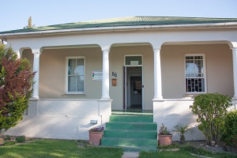
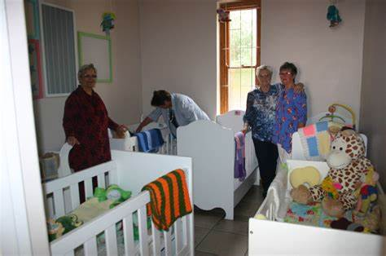
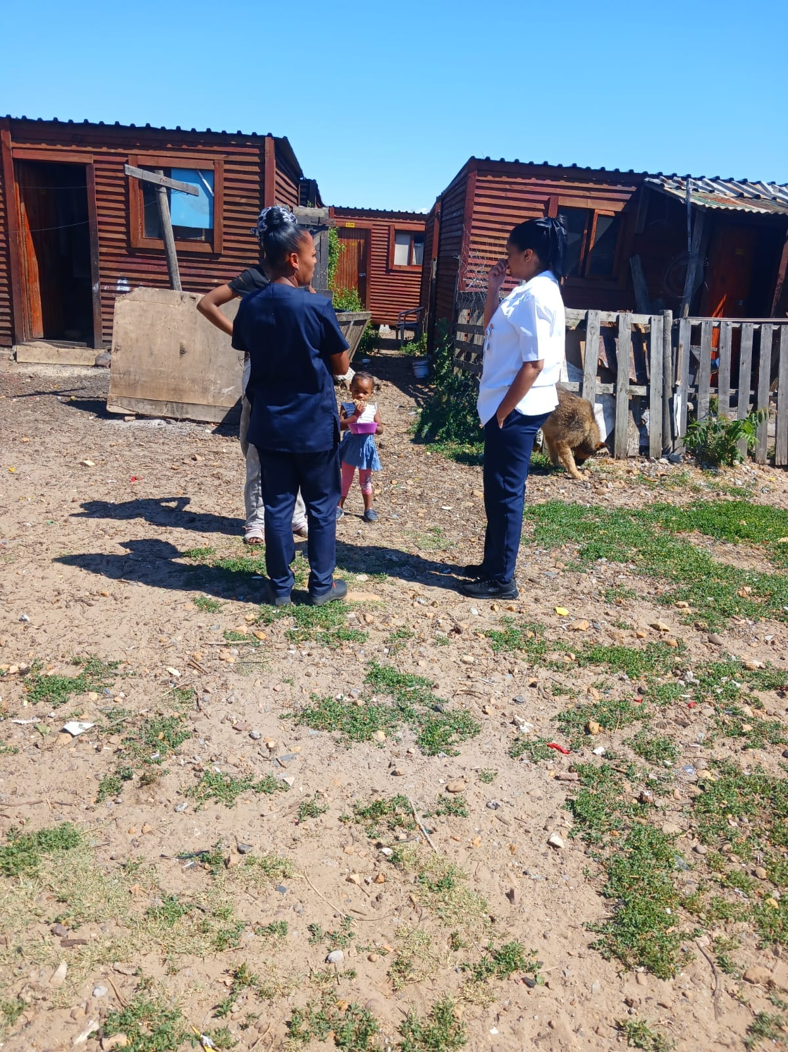
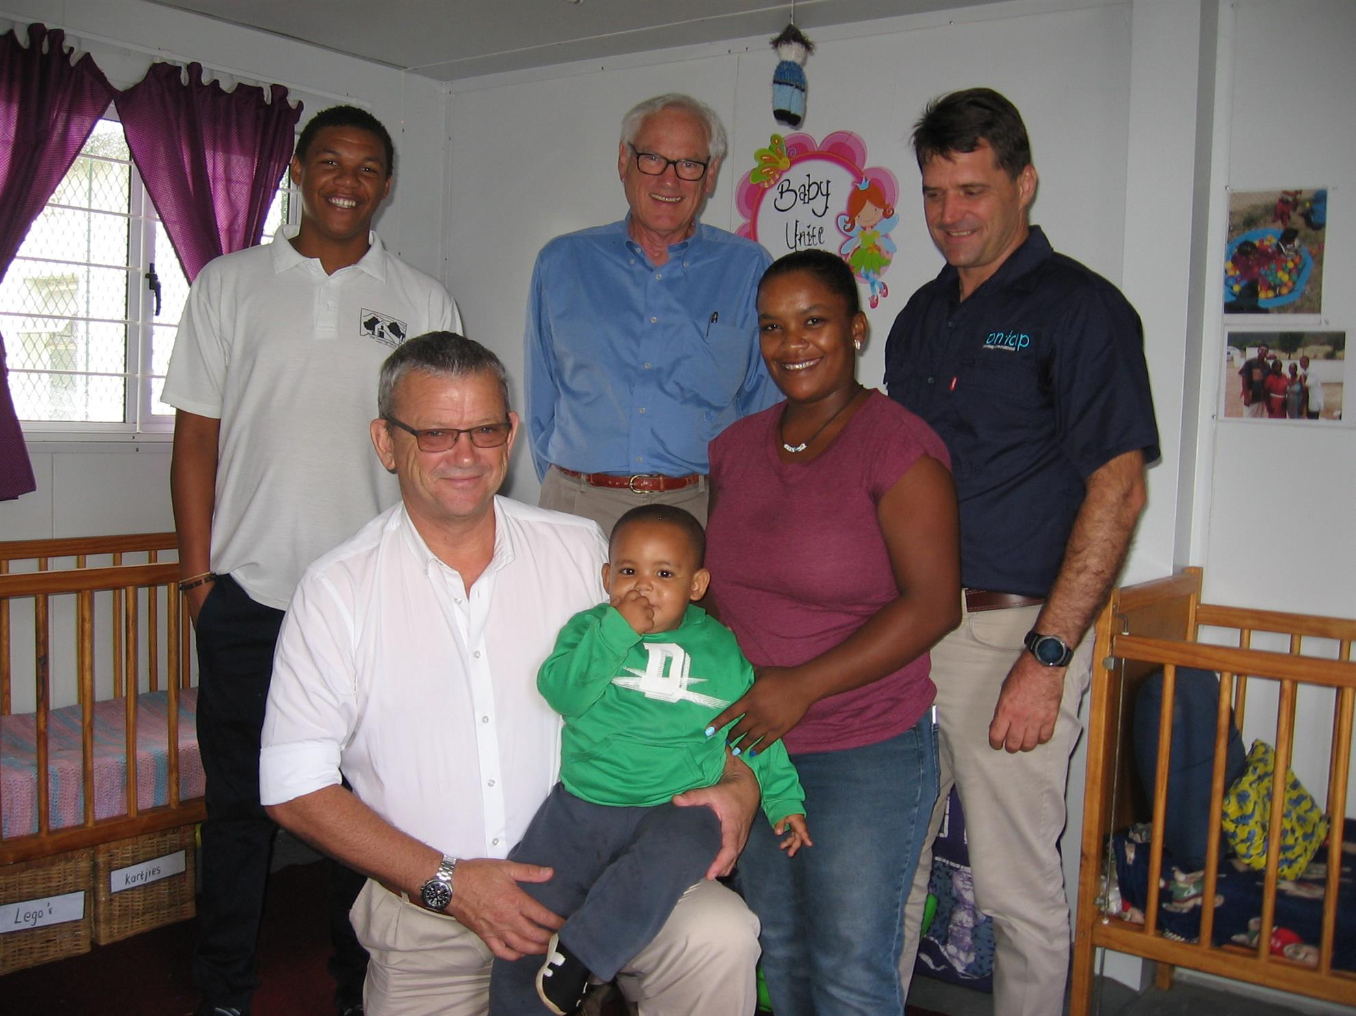
Abandoned babies and foster care
In Wellington and Mbekweni, we provide nutritional support, educational support, psycho-social support, foster care, early childhood development as well as offering an after-school training service
Through this initiative we reach out to more than 4000 families

Slide 8
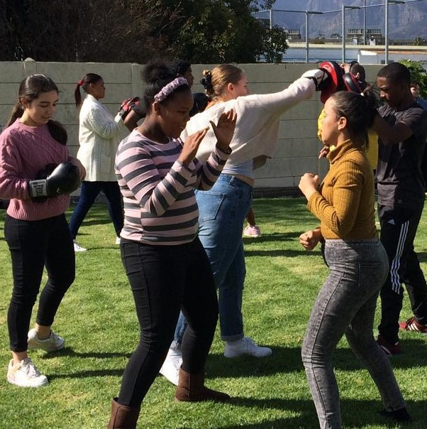
Anti-Bullying initiatives
In Paarl, we support locally organised sports clubs to keep youth off the streets
We have had great success with a kickboxing club that presents ant-bullying courses at schools
Wrestling, martial arts, cricket clubs and athletics clubs also prove to be effective in motivating vulnerable youth

Slide 9
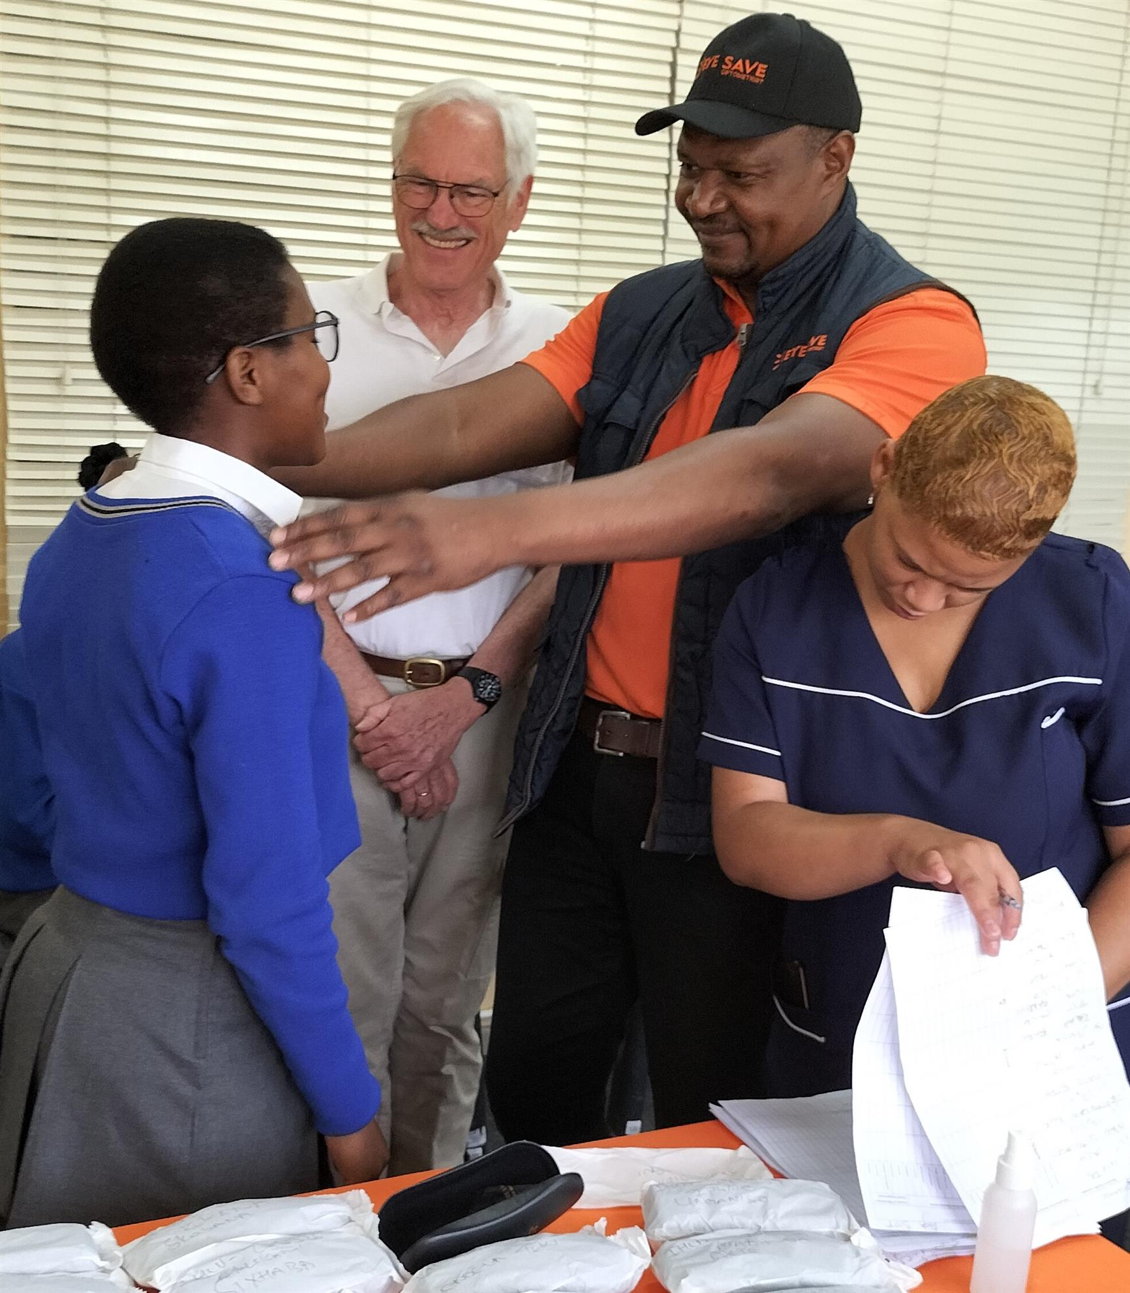
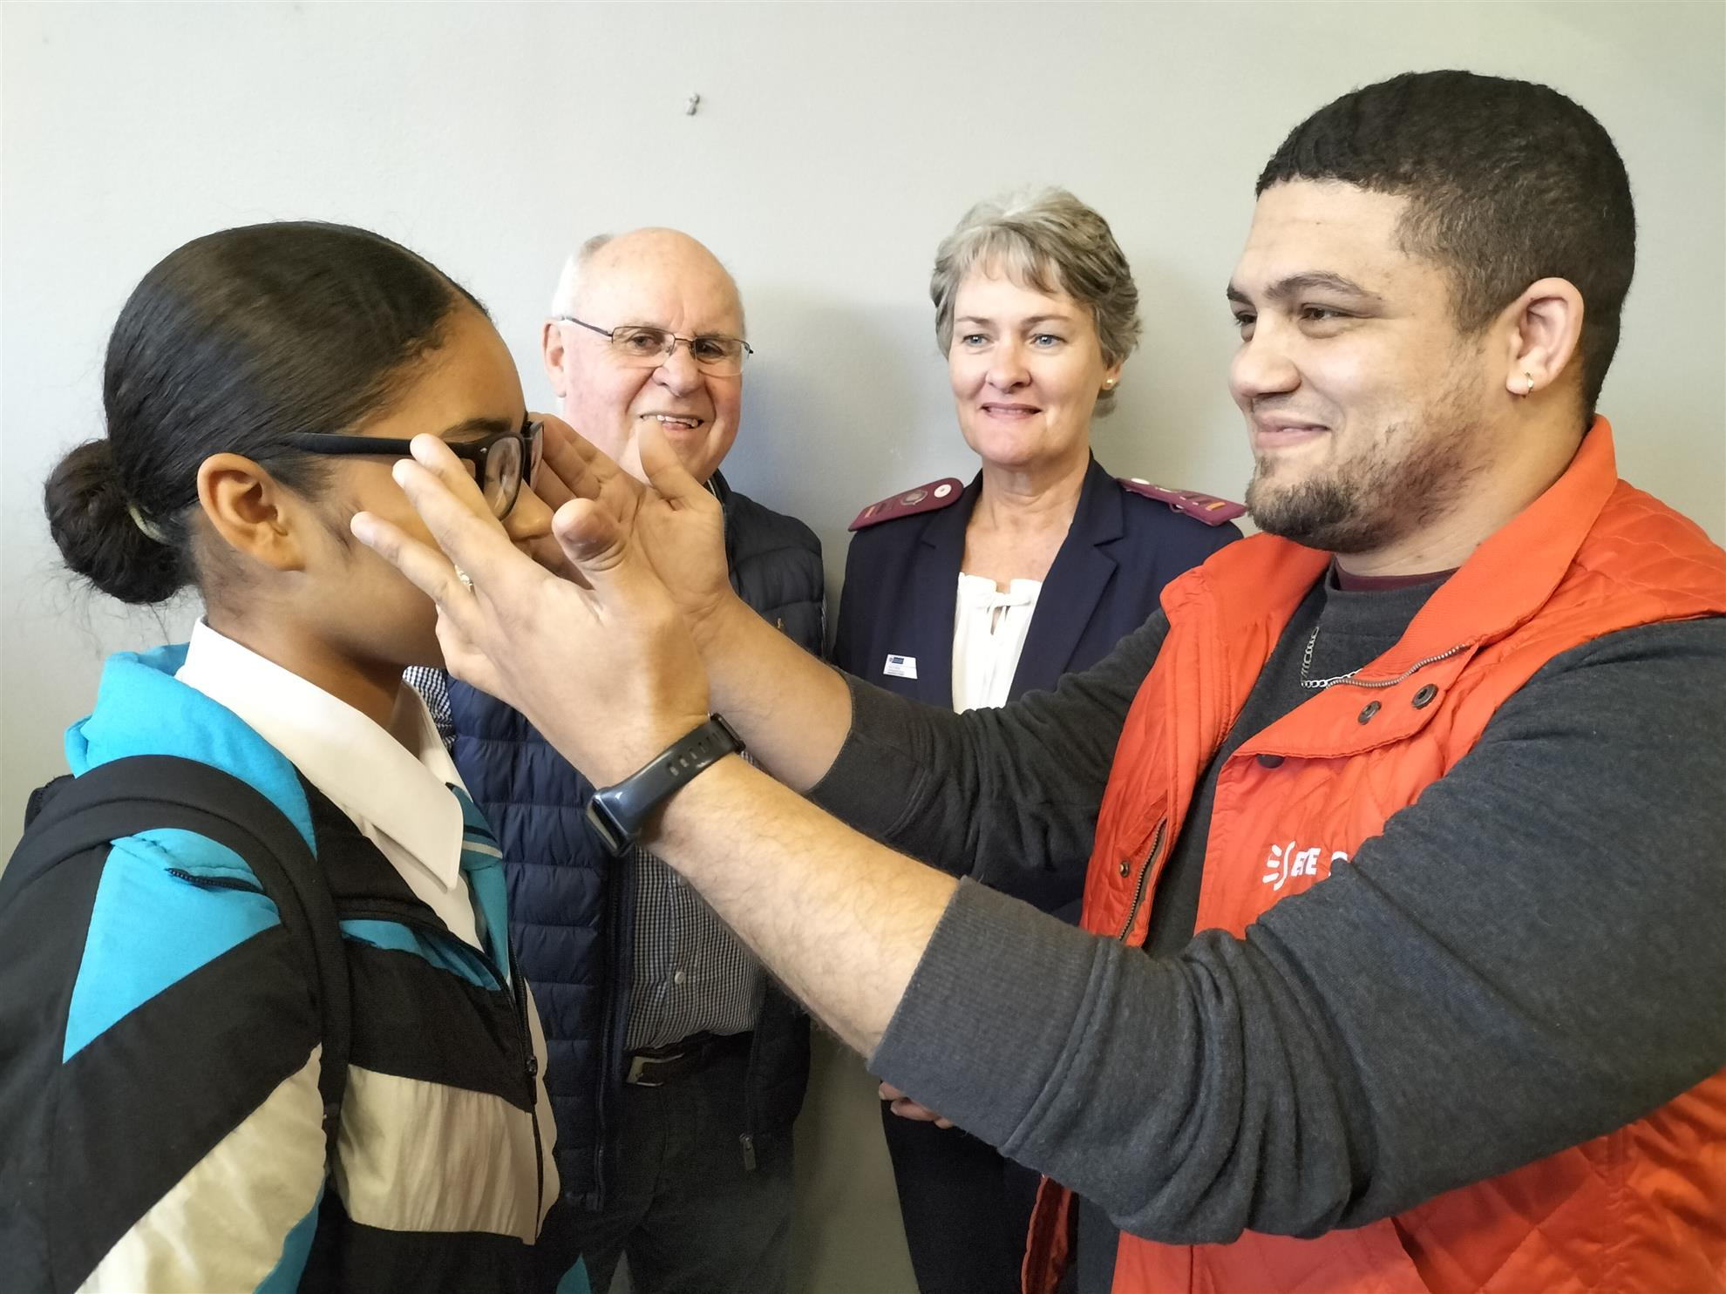
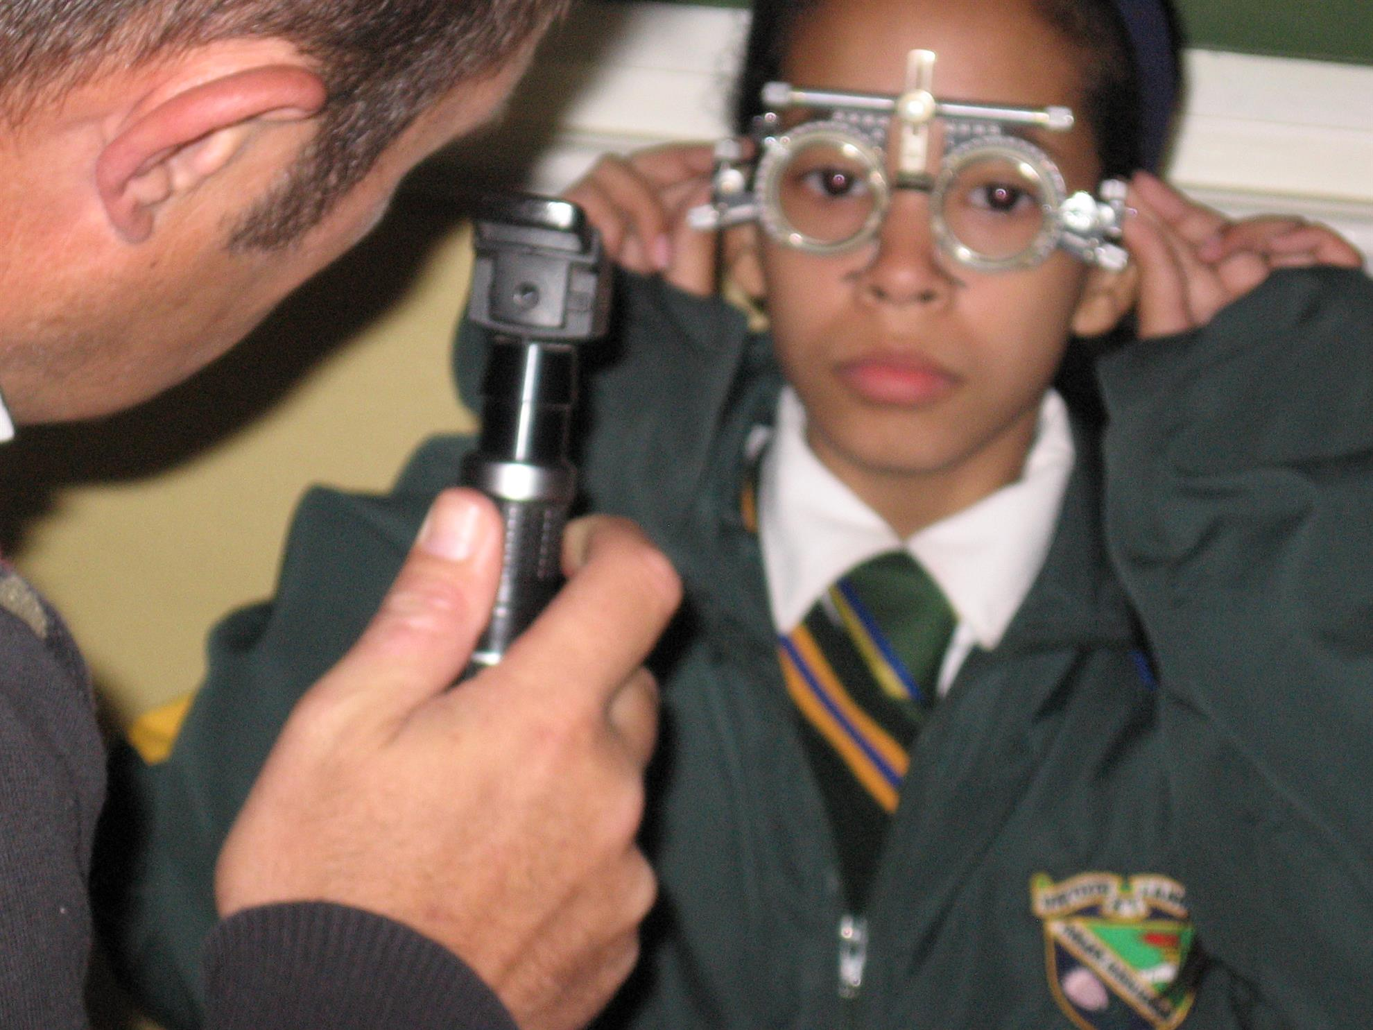
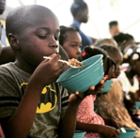
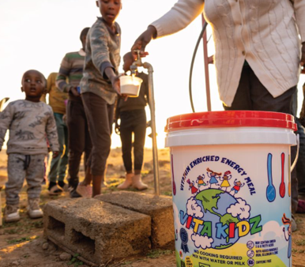
Feeding schemes
We have established and support numerous soup kitchens and other feeding schemes with organisations who continue to support the needs of the community on a daily basis
Eyecare
We regularly organise free eye tests at multiple facilities and hundreds of spectacles have been supplied to children in need. This ongoing work has proven to be a great success in improving children’s learning abilities

Slide 10
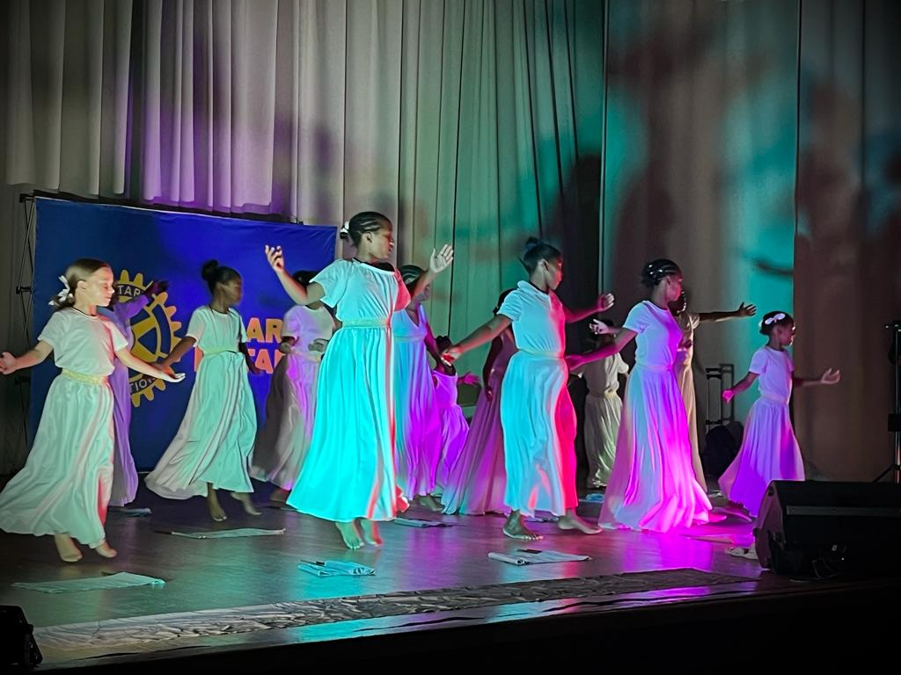
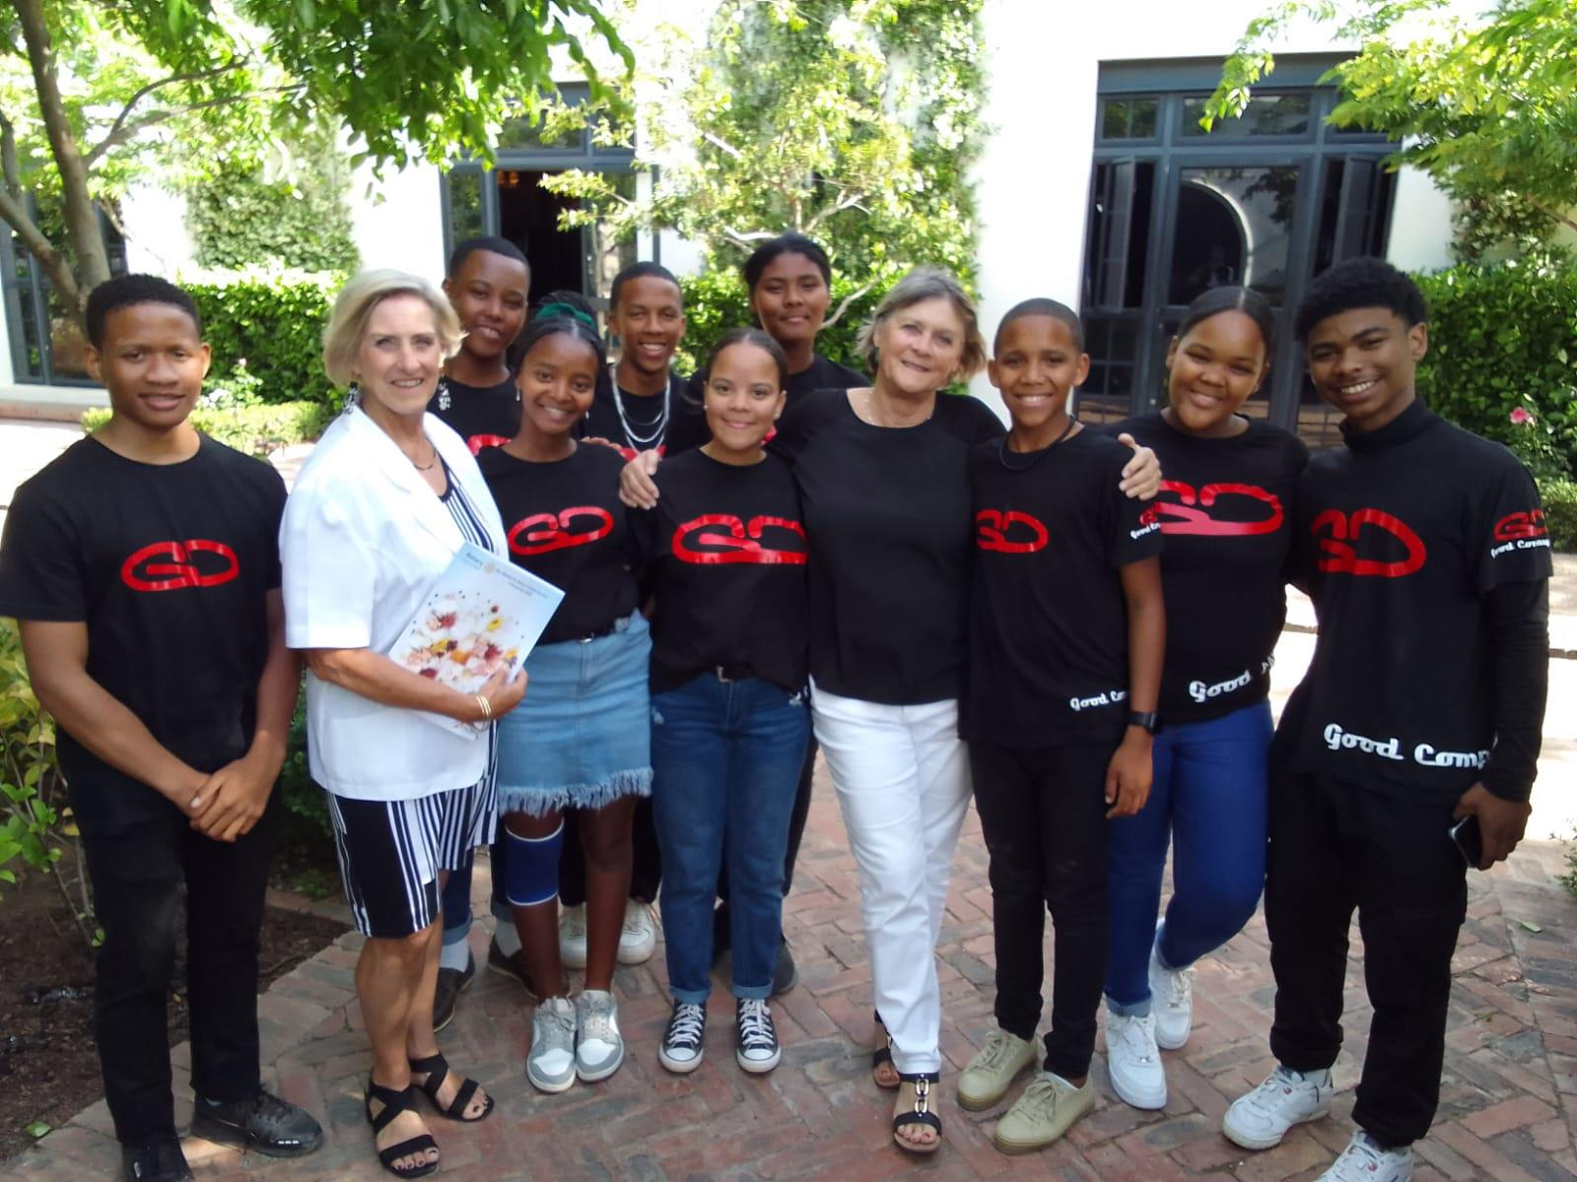
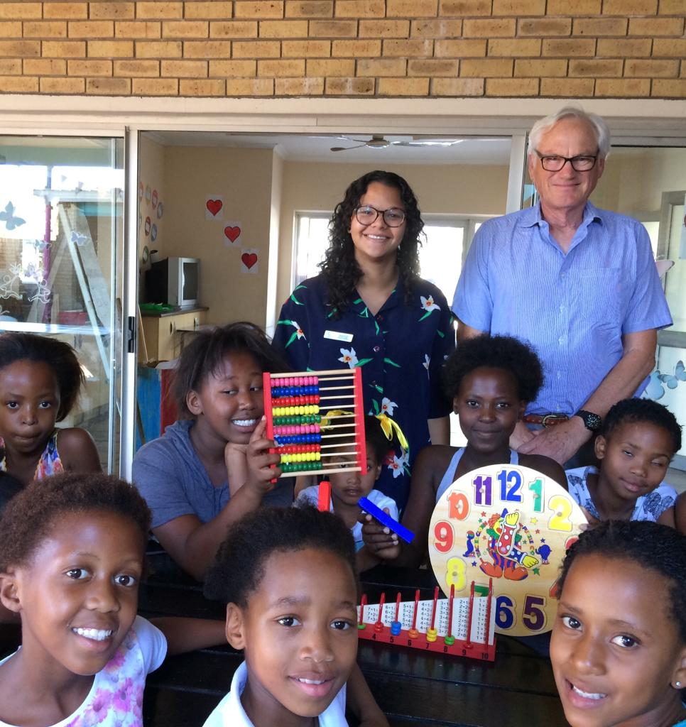
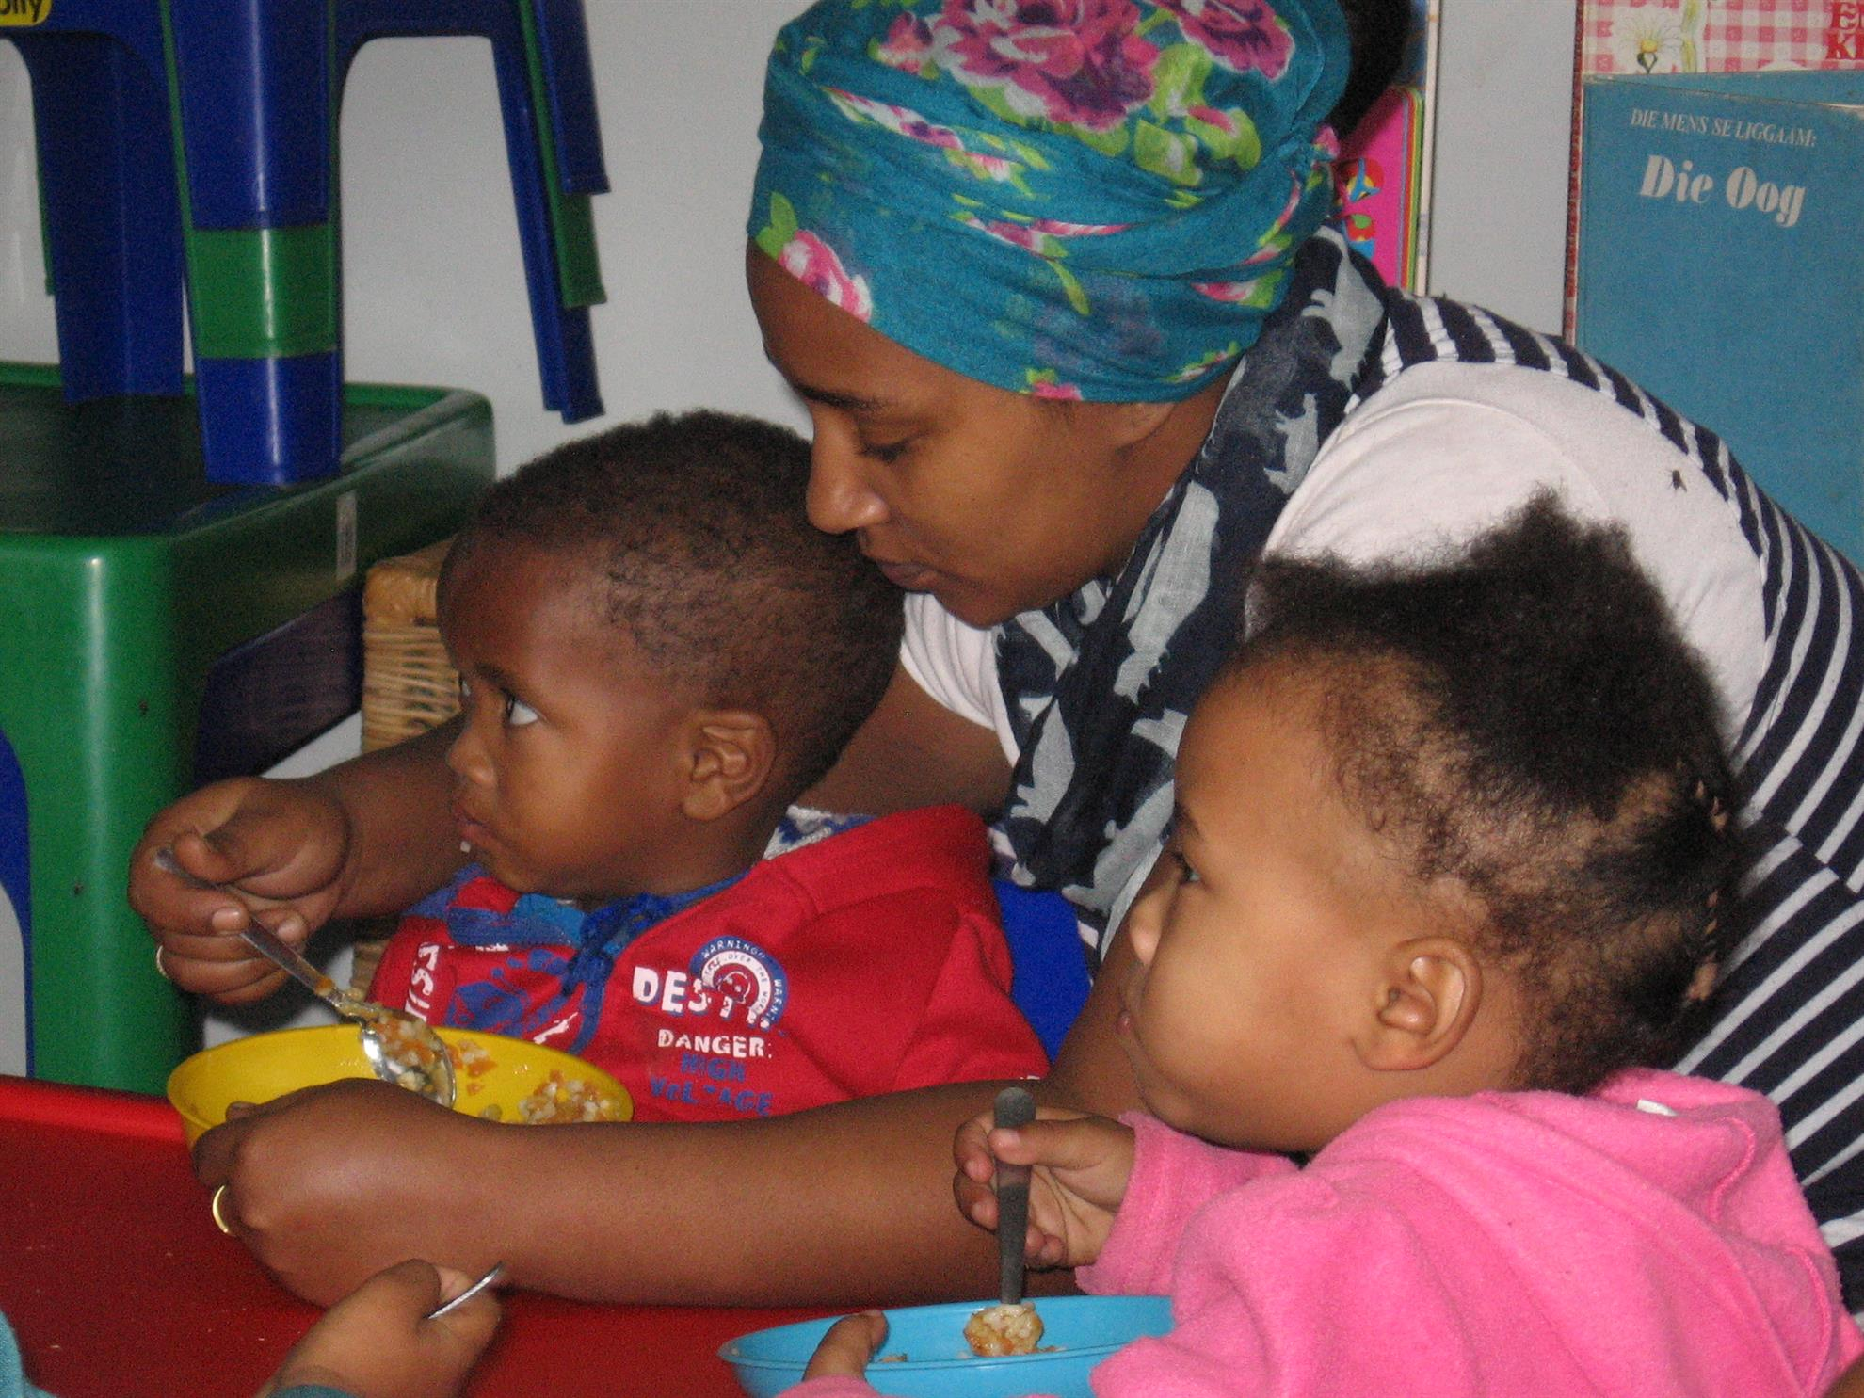
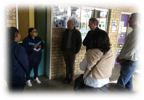
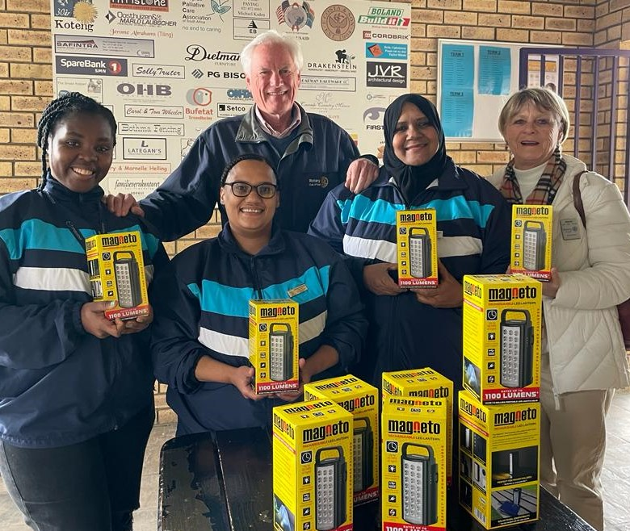
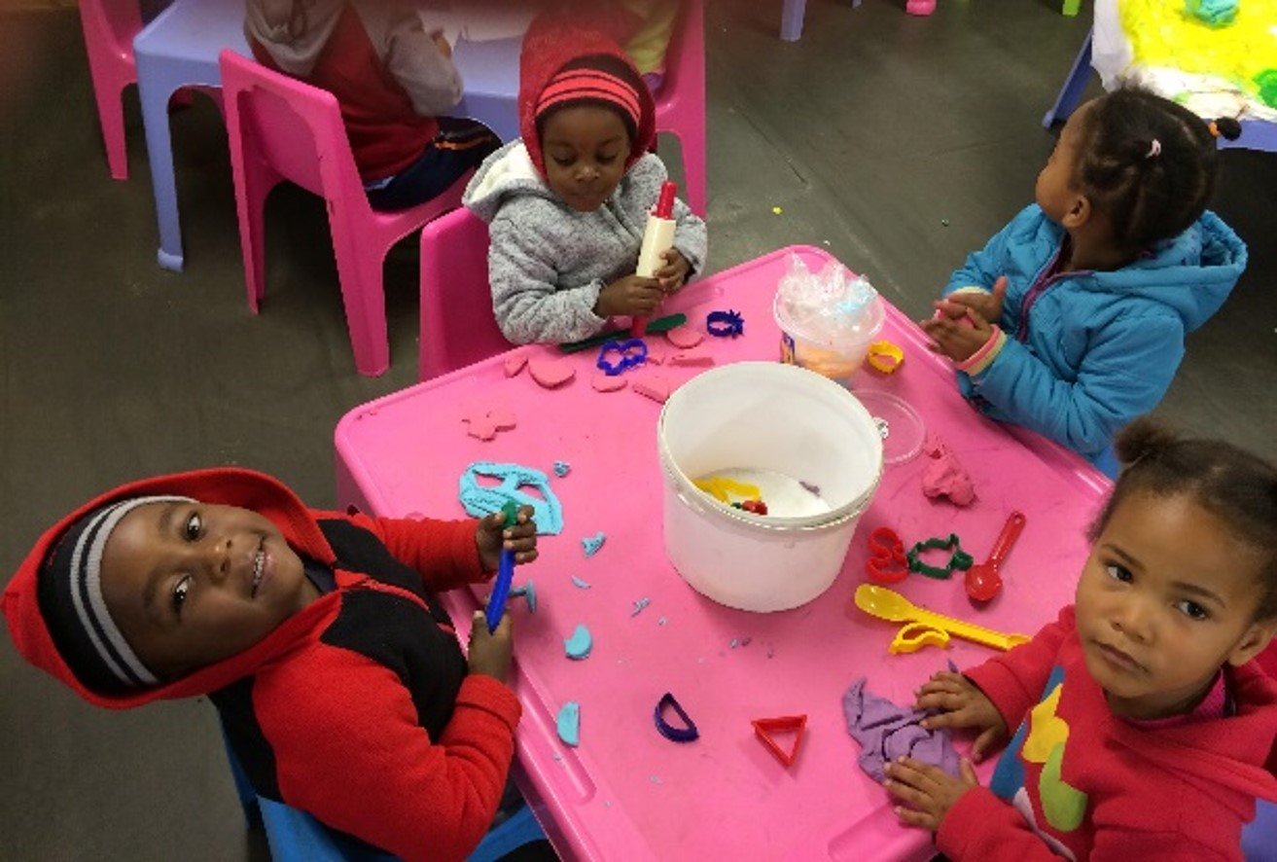
Township
Pre-school
We support a pre-school and after school care centre for children from the poverty and violence stricken informal settlement of Fairyland
Leadership Training
Every year a large group of youth leaders from the local schools are sponsored to attend a week’s course in leadership training at an offsite venue in our area
We would like to extend this to more youth candidates from within our municipal borders

Slide 11
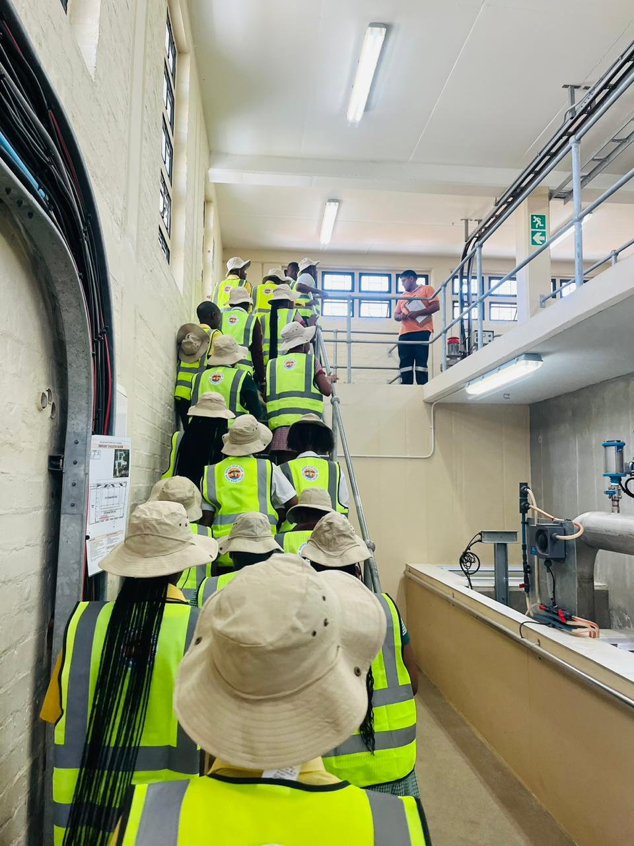
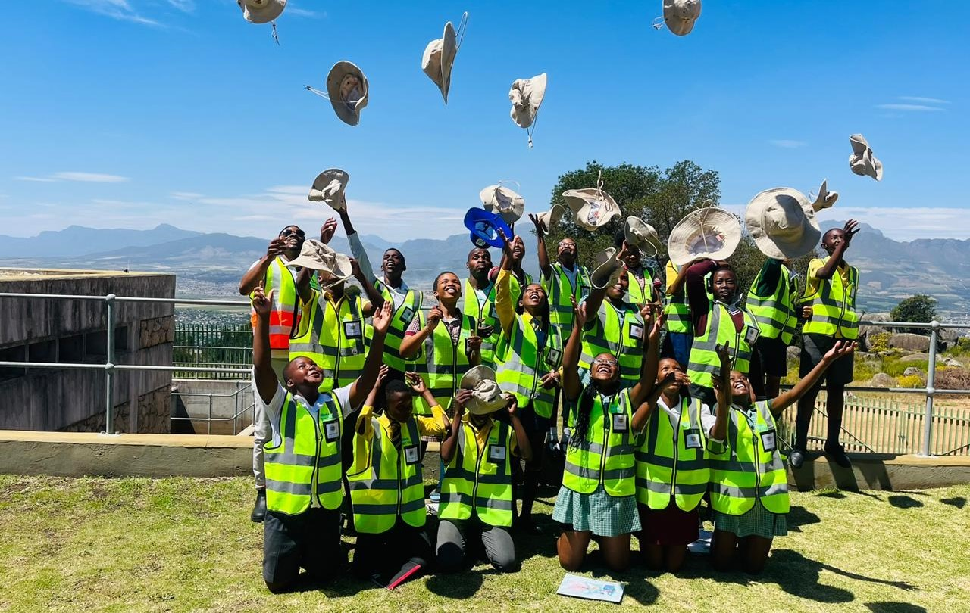
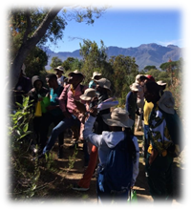
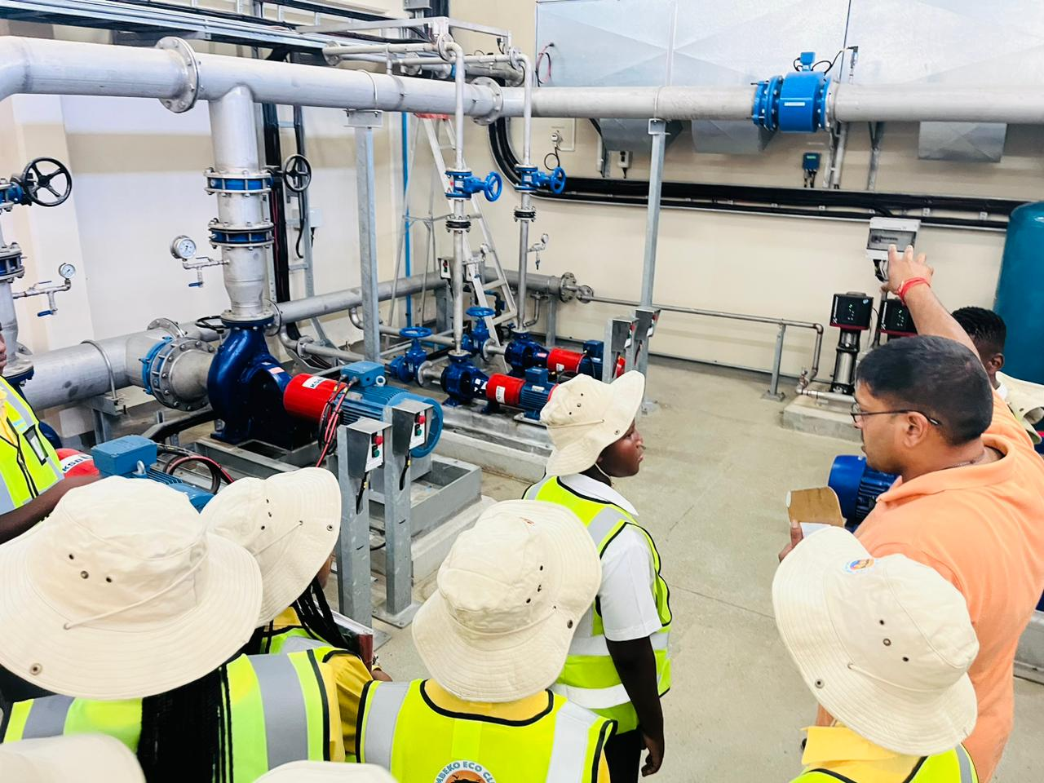
ECO-Clubs
In partnership with Paarl Mountain Nature Reserve personnel and youth from the Mbekweni community, we have embarked on an environment programme to harvest seeds and re-establish indigenous trees on Paarl Mountain
Food gardens are established to teach children how to grow food sustainably
The Wet Wednesdays initiative educates groups of learners on the importance of water conservation. In partnership with Drakenstein Municipality, learners from various township schools visit the water purification plant and engage in river cleanups

Slide 12
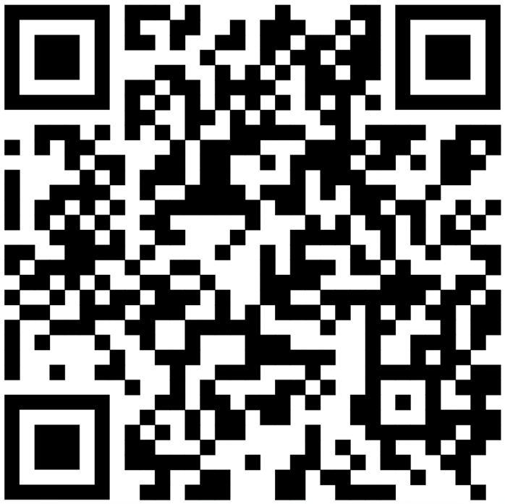
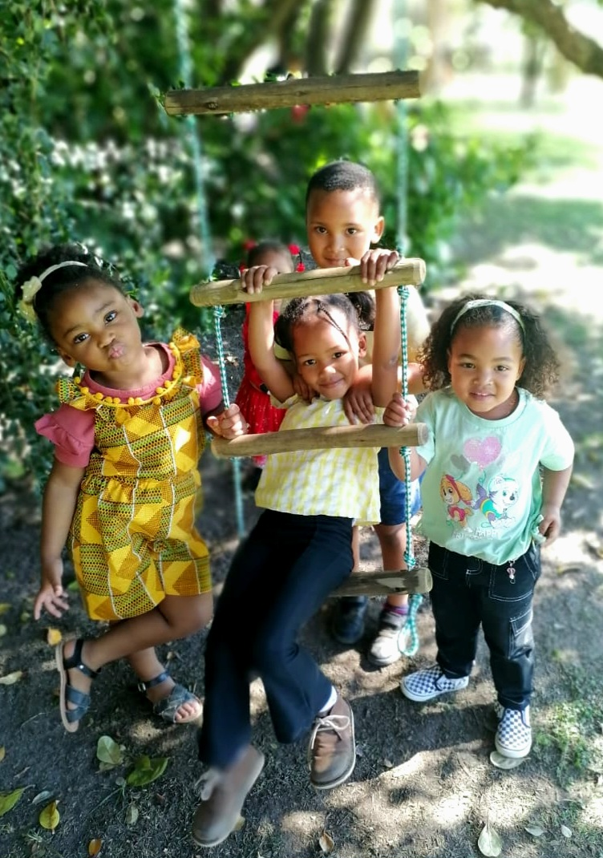
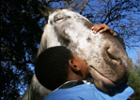


Join us in supporting iThemba
Together, we are creating HOPE
All work is made possible through focused donations and partner trusts
To donate towards a specific initiative, please contact:
Club President: Rudy Dupont
Contact +32 49 850 6334
Secretary: June Kroukamp
Contact +27 82 492 0423
paarlrotary
people_of_action1940

