Slide 1
Rotary year
2015-2016
Pam Hoesman

Slide 2
Youth
Strive – Served 19 students, awarded 4 scholarships totaling $2,350, including new Del Schulz scholarship of $100
Continued Students of the Month and Students of the year, granting $4,000 in scholarships
Second year of 4 Way Test Speech Contest, $600 in prizes
Literacy – Reading to 475 students at 3 schools, 160 books donated

Slide 3
MEMBERSHIP
Added two new members: Ron Parisi and David Yonke
Membership at year end is 58

Slide 4
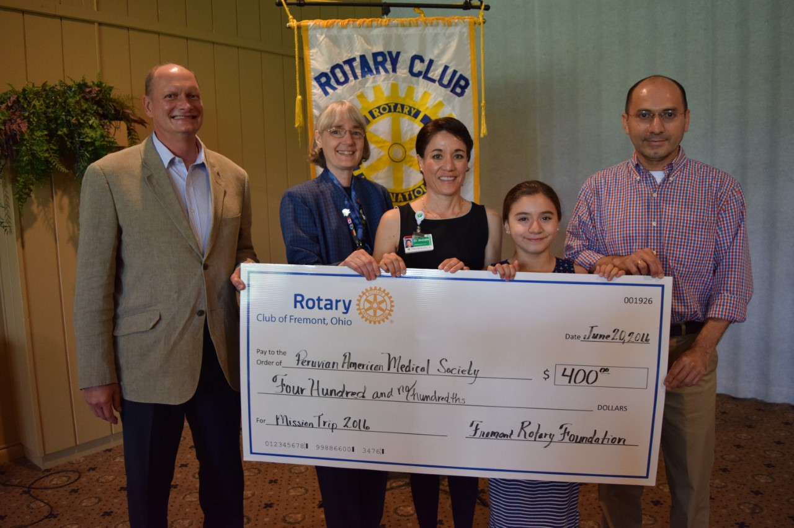
PUBLIC RELATIONS
Many news articles and photos published in the News Messenger
Active on social media – facebook, website, and weekly email
Rotary tent at Fremont Farmer's Market – Sept. 2015
Rotarians in Holiday Parade – Dec. 2015

Slide 5
COMMUNITY SERVICE
Salvation Army bell ringing - $1368
Community Christmas – 3 families and 2 senior citizens
Partnered with Sand. Co. Parks to donate $2216 and 20 boxes of food
Supported T-Ball League - $500
Donation to Wreckers Boxing Club - $200
Sponsored a day at Liberty Center - $225
School of Hope Egg Hunt and gifts
Painted restrooms at Hayes Museum
JEFF Service Club project – helped move Share and Care to a new building

Slide 6
FREMONT ROTARY FOUNDATION
SCHOLARSHIPS
Boy Scouts - $100
Hayes Library and Museums 4th of July Celebration - $100
SCORTA – Dictionary Project - $225
Tyler Aldrich Autism Run - $400
Peruvian American Medical Society Mission Project - $400

Slide 7
INTERNATIONAL
MESA – Members donated computers, medical supplies, clothing, and cash
MESA Bike Ride – Angelica Rinehart
World Community Workshop – Four students participated
Polio Eradication – 23 club members contributed
Donations to Rotary International from the Fremont Club - $4855
Donated "skipped lunch" money to the World Food Program - $1313.53

Slide 8
DISTRICT EVENTS
Two members attended the District Grant Seminar
President attended District Annual Conference
President Elect attended PE training
Case of 100th Anniversary (The Rotary Foundation) wine purchased
Contributed recipes to district healthy recipe cookbook

Slide 9
CLUB ADMINISTRATION & SPECIAL EVENTS
90TH Anniversary Celebration at Down Thyme Restaurant
Established Centennial Fund in the foundation to raise $100,000 by the 100th anniversary for a local community project
New fundraiser initiated: Blues, Brews and Brats
Foundation chairman and Past Presidents chairman invited to attend all club board meetings to improve communication

Slide 10
2016-2017 New Officers
President Doug Beck
President Elect Scott Lang
2nd Vice Pres Angelica Rinehart
3rd Vice Pres Tim Ellenberger
4th Vice Pres Christie Weininger
5th Vice Pres Roger Kuns
Secretary Treasurer Angelica Rinehart
Sergeant-at-arms CJ Szymanowski
Rotary Foundation Coordinator Cheryl Cotter (The Rotary Foundation)

