Slide 1
The Rotary Club of Cedar Rapids
New Member Orientation

Slide 2
Meeting Objectives
Welcome / Introductions
Rotary International
The Rotary Foundation
Our Cedar Rapids Downtown Rotary Club
Expectations of our Rotary members
How to get more involved
Information about our committees
Questions

Slide 3
The World’s First Service Club
Rotary was Formed:
In Chicago, IL on
February 23, 1905
by Paul P. Harris, Attorney
Where did Paul Harris attend Law School?
“Whatever Rotary may mean to us, to the world it will be known by the results it achieves.”
Paul P. Harris

Slide 4
The Rotary Organization
Rotary is made up of:
Rotary International
The Rotary Foundation
The Rotary Clubs

Slide 5
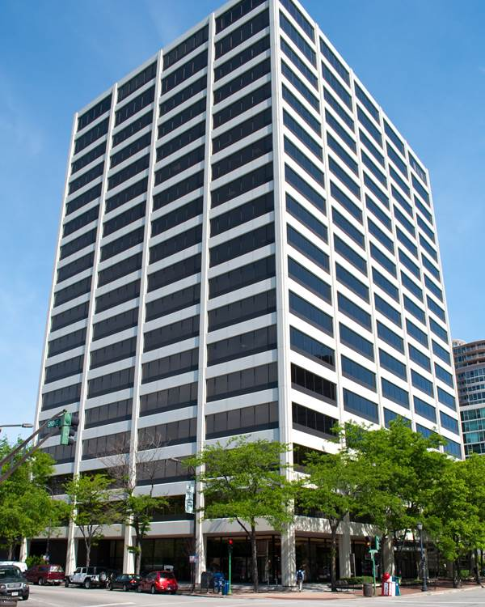
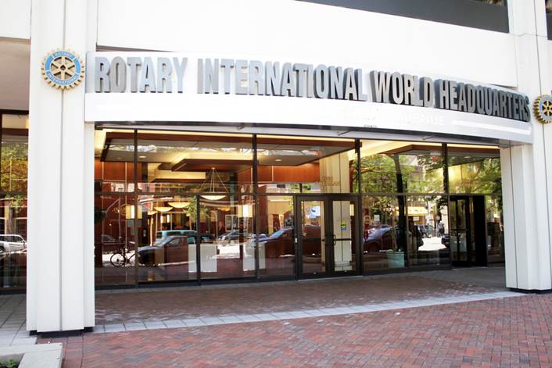
Rotary International Headquarters
Located In Evanston, IL

Slide 6
Rotary International
Rotary International has more than 1.2 million members
Rotary has more than $1 billion dollars in assets and manages its assets in 29 different currencies
Rotary has invested $3 billion in thousands of projects over the past 100 years
There are over 35,000 Rotary clubs in 200 countries around the world

Slide 7
Rotary International
Rotary International is divided into 534 districts.
The Cedar Rapids Downtown Rotary Club is in district #5970, which covers the northern half of Iowa and includes a total of 50 clubs.
The Cedar Rapids Downtown Rotary Club is:
The largest club in our district
In the top 25 largest Rotary clubs in the United States

Slide 8
Rotary.org

Slide 9
Rotary Mission
Provide service to others
Promote high ethical standards
Advance world understanding, goodwill and peace through fellowship of business, professional and community leaders.

Slide 10
Rotary - Guiding Principles
The Four-Way Test was created in 1932 by Rotarian Herbert J. Taylor when he was asked to take charge of a company that was facing bankruptcy.
Our Rotary motto, the Four-Way Test, has become one of the world's most widely printed and quoted statements of business ethics.

Slide 11
Rotary - Motto

Slide 12
The Rotary Logo
The evolution of the Rotary logo:

Slide 13
Affiliated Rotary Programs
Interact Clubs: (Jefferson High School)
For Youth - Ages 12 to 18
Students develop leadership skills while working on projects designed to help their local community and also build international understanding.
More than 468,500 Interactors in 20,372 Interact clubs in over 150 countries
Rotaract Clubs: (no local rotaract clubs are sponsored at this time)
For adults - ages 18 to 30
Promote leadership, professional development and community service
203,000 Rotaractors in 10,904 clubs in 180 countries

Slide 14
Affiliated Rotary Programs
Rotary Youth Exchange:
Historically, around 9,000 students ages 15 to 19 from more than 100 countries
Opportunity for students to live and attend school in other countries
Rotary Youth Leadership Awards (RYLA & YRYLA):
Leadership development seminars and events that are organized by Rotary for 500,000 students and young professionals ages 12 to 30
Rotary Community Corps:
Rotary Community Corps members support local Rotary club projects but are not members of a Rotary club. There are more than 8,500 corps in over 90 countries.

Slide 15
Rotary International Conventions
Past/Future Rotary International Conventions:
June 12 to 16, 2021 in Taipei, Taiwan (went virtual)
June 4 to 8, 2022 in Houston, Texas, USA
May 27 – 31, 2023 in Melbourne, Australia
June 8 – 12, 2024 in Singapore, Asia
Attendance at a Rotary International Convention is 40,000.
(Future Convention dates and locations are tentative.)

Slide 16
The Rotary Foundation Mission:
Advance the world understanding, goodwill, and peace through the improvement of health, the support of education, and the alleviation of poverty.

Slide 17
The Rotary Foundation
The Rotary Foundation transforms your financial gifts into service projects that change lives both close to home and around the world.
Last year Rotary provided $87 million dollars in grants for more than 1,306 projects worldwide.
During the past 100 years, the Rotary Foundation has spent $3 billion dollars on life-changing, sustainable projects.
95 percent of donations to the Foundation go directly to support Rotary service projects around the world.

Slide 18
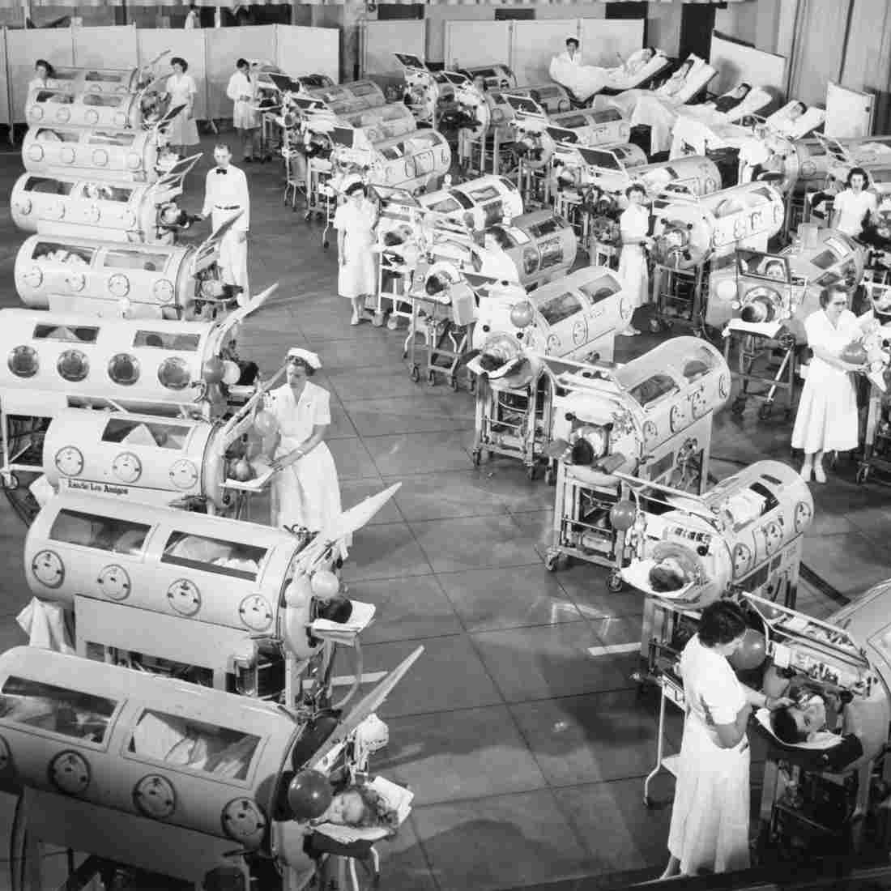
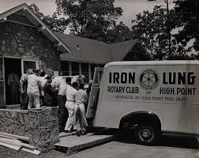
The Rotary Foundation - Polio
The Iron Lung

Slide 19
The Rotary Foundation - Polio
Rotary has helped fund the fight to end Polio since 1988: (350,000 people around the world contracted Polio in 1988)
Polio is 99.9% of the way to being eradicated. Polio will become only the second human disease in history to be eradicated worldwide, the first was smallpox.
This year, the African region was certified free of wild polio virus
As of 2021, there were less than 100 new cases of wild poliovirus worldwide
The cost to immunize a child against Polio is less than $1.

Slide 20
Funding the Rotary Foundation
Funding for the Rotary Foundation comes primarily from voluntary contributions from Rotarians and friends of Rotary.
There are 1.1 million Paul Harris Fellows (individuals who have donated $1,000 or more to the Rotary Foundation).
Every new member in our Rotary club is encouraged to donate $100 for an initial contribution to the Rotary Foundation.
Our Rotary club encourages members to continue to make an annual contribution of $100 toward achieving PHF.
Annually, the CR Downtown Rotary club members donate approximately $25,000 to the Rotary Foundation.

Slide 21
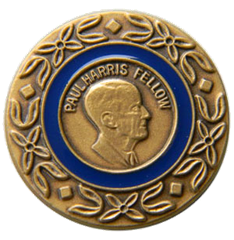
Our Club Foundation Giving Paul Harris Fellow Designation
Club all-time giving = $1,025,324
Since our club began, over 550 Downtown Rotarians have become Paul Harris Fellows
128 current Downtown Rotarians are PHFs
Over 45% of our current PHFs hold multiple designations
How? $1,000 – Cumulative donations/points to Foundation over any time period

Slide 22
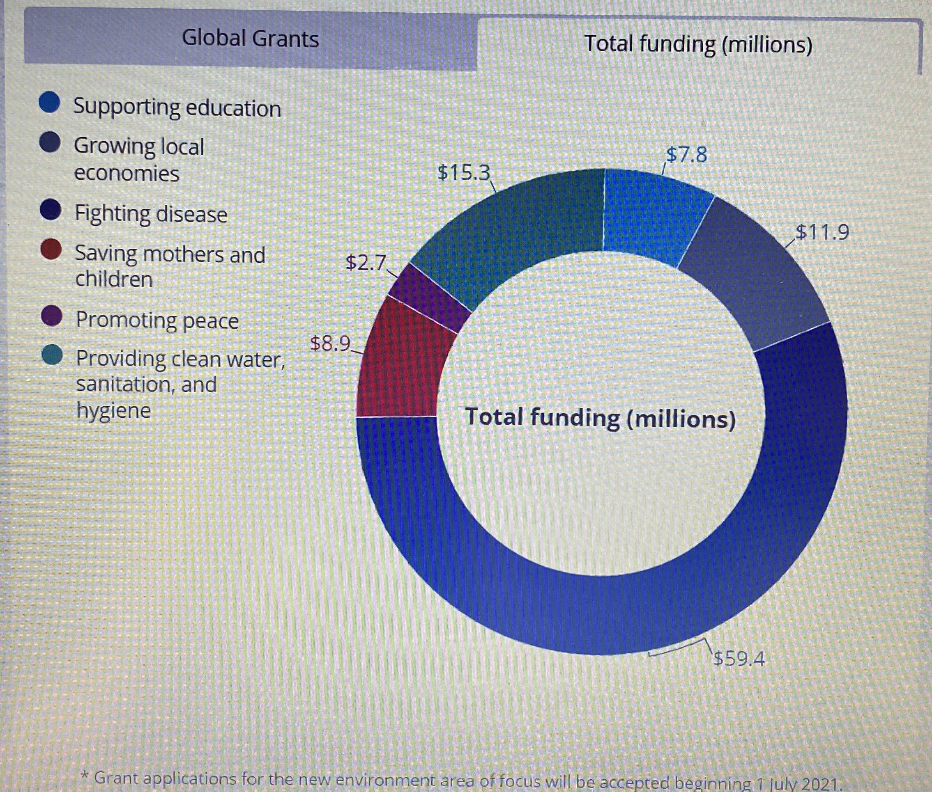
Rotary Foundation Global Grant Funding

Slide 23
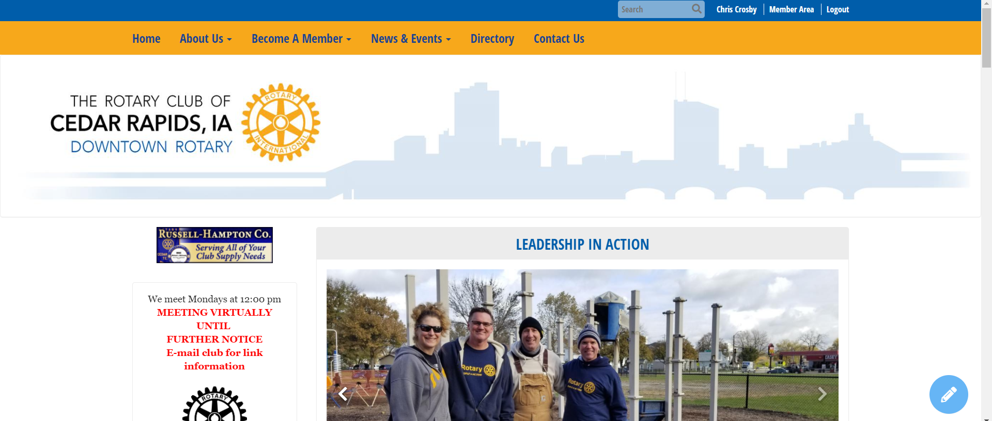
RotaryClubofCedarRapids.org

Slide 24
CR Downtown Rotary Club
Chartered on June 1, 1914 in Cedar Rapids, Iowa
Club ID Number is 2185
The 4th oldest Rotary club in Iowa
In the top 25 largest Rotary clubs in the United States
Over 210 members (Active and Honorary)
Average age of our members is 55 years
Gender diversity is 36% Female and 64% Male
The average tenure in our Club is 14 years

Slide 25
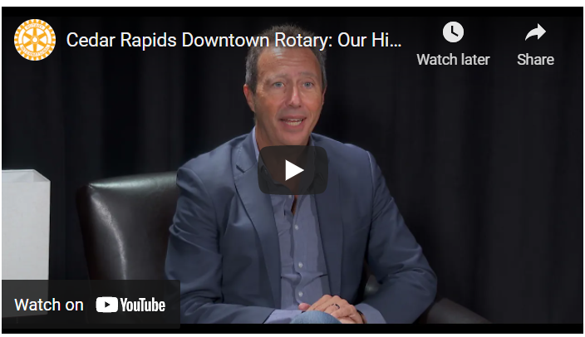
Club History
Notes:
https://www.youtube.com/watch?v=3EtKh_5GAlE

Slide 26
CR Rotary Club Leadership
Barb Randall, President from July 2022 thru June 2023
Jim Koch, Past-President from July 2021 thru June 2022
Joe Lock, President-elect 2023-24 & International CMTE Chair
Brooke Fitzgerald, President-elect 2024-25 & Membership CMTE Co-chair
Robb Loftsgard, President-elect 2025-26 & Membership CMTE Co-chair
Cydney Lovell, President-elect 2026-27 & Youth Exchange CMTE Chair
Additional Current Board Members include:
Brooke Fitzgerald & Robb Loftsgard Membership Committee Co-Chair
Adam Moore Communications Committee Chair
Michelle Owens Program Committee Chair
Jen Welton Past Program Committee Chair
Susan Koch Service / Social Committee Chair
Sandy Sublett Foundation Committee Chair
Jenny Bosking Youth Leadership Committee Chair
Cydney Lovell Youth Exchange Committee Chair
_____________ International Committee Chair
Additional Members include:
Shannon Banks - Executive Director
Christine Crosby – Treasurer
Nick Gearhart - Sergeant-at-Arms

Slide 27
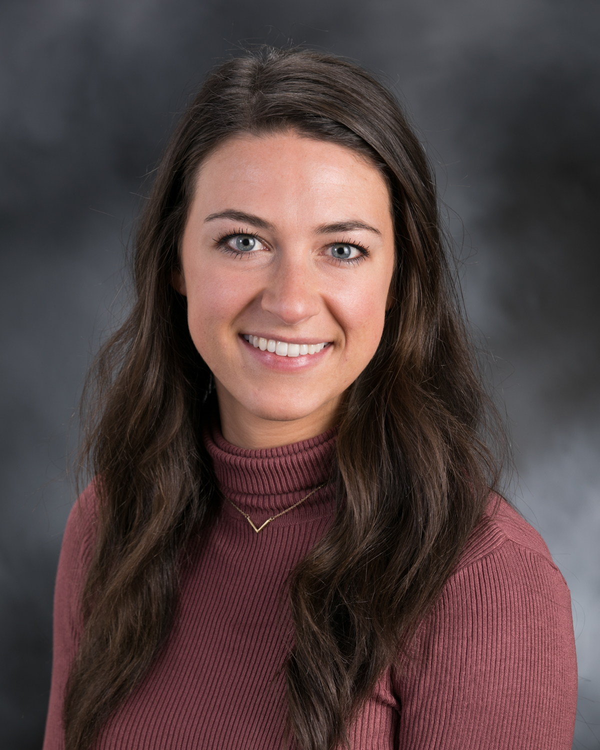
Executive Director
Shannon Banks is the Executive Director for the CR Downtown Rotary Club.
Email: CRdowntownRotary@gmail.com
Phone Number: 319-491-4411
Cedar Rapids Downtown Rotary Club Website: www.rotaryclubofcedarrapids.org

Slide 28
CR Rotary Club Strategic Initiatives
“Building Connections and Enriching Lives”
Three-Year Vision
Sustain the impact and legacy of Downtown Rotary by focusing on four pillars:
Relevance – adapt to remain relevant to members
Influential – support and create a better local and worldwide community
Networking – encourage members to connect, share fellowship, and learn from each other/programs
Growth – retain and recruit members to continue/increase our impact

Slide 29
Rotary Club Membership Dues
The membership dues are used to fund the club’s operations and charitable initiatives:
The annual membership dues for our club are $475.00
Approximately $83.00 goes to pay Rotary International dues
Approximately $36.00 goes to pay Rotary District dues
Approximately $175.00 goes toward community grants and contributions on behalf of our Club
The remaining $181.00 funds the operation of our club
The suggested $100.00 annual donation to the Rotary Foundation is in addition to the club membership dues
In addition, the suggested $15.00 helps cover credit card fees that we incur for online payments

Slide 30
Charitable Contribution Initiatives
A portion of your annual membership fee is used to fund the club’s charitable initiatives:
The club budgets annually for charitable contributions of approximately $50,000
Budgeting charitable contributions enables our club to stay true to the Rotary mission to help give back to our community
Think of Rotary as being made up of committed Individuals versus being a representative from a company or an organization

Slide 31
Charitable Contributions
The $50,000 in annual charitable contributions is allocated to the following awards and programs:
Club Appreciation Award
Community Service Award
Larry Christy Award
International Projects (Ponsetti Project)
Metro Rotary Council Projects
Rotary Youth Leadership Awards (RYLA) Program
Youth Exchange Program
Interact Club at Jefferson High School
Various Community Projects
Major Community Projects (Future Reserves)

Slide 32
Local Service Projects
Collaborated with other Rotary clubs in the area to provide playground equipment for 13 Cedar Rapids and Marion elementary schools. (Gearing up for Kids)
Supported education projects at local schools
Cash donation for the NewBo City Market - Rotary Hall
Rejuvenation of the Czech Village Bandstand Plaza
Supported Art in the Parks with sculptures in city parks
Taylor Elementary playground upgrade
HACAP Operation Backpack grant and support
Prospect Meadows - Baseball / Softball Complex
Recognition Wall – Metro-wide project
Miracle Field Pavilion & Memorial Garden – District Grant
Indian Creek Nature Center trail clean up

Slide 33
International Service Projects
Sustainable Farming Project:
Donations to help create the means for people to feed themselves while creating income for their families and communities in Liberia
Clean Water Projects:
Collaborated with First Lutheran Church to help fund a well that provides clean drinking water for 26,000 residents in the town of Same, Tanzania
Worked with Haiti Community Health Initiative and other area Rotary clubs. Roughly 30,000 citizens of Haiti will be positively impacted by the clean water systems built via this project.
Ponseti / RAG4Clubfoot Project:
Doctors around the world are trained in the highly effective Ponseti method to treat / correct clubfoot.

Slide 34
Expectations of Rotary Members
Strive to attend 60% of weekly Rotary meetings
Our Monday meetings start at noon and end by 1:00 pm
You can stay plugged into Rotary by:
Visiting other Rotary Clubs
Attending a Rotary Fun Group Meeting
Participating in Special Events
Attending Committee Meetings
Online @ rotaryeclubone.org (max. 6 make-ups per year)
Support Rotary sponsored events when possible
Bring a guest to a meeting; encourage new members

Slide 35
How To Get Involved
Serve on a committee
Consider volunteering to serve on the Board of Directors
Host a Breakout Session
Attend a club social event
Volunteer to work on a project - grants, youth golf tournaments, etc.
Participate in a Rotary Fun Group
Sit at a different table each week
Attend First Friday – lunch on the first Friday of each month hosted at Matthew 25

Slide 36
CR Rotary Club Committees
Brooke Fitzgerald & Robb Loftsgard Membership Committee Co-Chairs
Adam Moore Communications Committee Chair
Michelle Owens Program Committee Chair
Jen Welton Past Program Committee Chair
Susan Koch Service / Social Committee Chair
Sandy Sublett Foundation Committee Chair
Jenny Bosking Youth Leadership Committee Chair
Cydney Lovell Youth Exchange Committee Chair
_____________ International Committee Chair

Slide 37
Jim Koch Information
What a good Rotarian looks like

Slide 38
e-Newsletter-Ripples

Slide 39
Get Social!
Follow us on Facebook, Twitter & LinkedIn!

Slide 40
Attending Other Area Clubs
Tuesday @ 12:00 pm - Marion/East Cedar Rapids
Indian Creek Country Club
Wednesday @ 12:00 pm - Cedar Rapids West’
National Czech & Slovak Library & Museum
Wednesday @ 5:30 pm - Linn County
Shores Event Center
Thursday @ 7:00 am - Cedar Rapids Sunrise
Matthew 25 Groundswell Café
Thursday @ 11:30 am – Cedar Rapids / Hiawatha Metro North
Biaggi’s Restaurant
Friday @ 7:00 am - Cedar Rapids Daybreak
Cedar Rapids Country Club
Friday @ 7:00 am (1st and 3rd Fridays of the Month) - Gateway
Four Oaks Campus

Slide 41
Thank You for being a Rotarian!
Questions?

