Slide 1
The Rotary Club of Cedar Rapids
New Member Orientation

Slide 2
Meeting Objectives
Welcome / Introductions
History of Rotary
Rotary International
The Rotary Foundation
Our Cedar Rapids Downtown Rotary Club
Expectations of our Rotary members
How to get more involved
Information about our committees
Questions

Slide 3
The World’s First Service Club
Rotary was formed
in Chicago, IL on
February 23, 1905
by Paul P. Harris, Attorney
Where did Paul Harris attend Law School?
“Whatever Rotary may mean to us, to the world it will be known by the results it achieves.”
Paul P. Harris

Slide 4
Rotary Mission
Provide service to others
Promote high ethical standards
Advance world understanding, goodwill and peace through fellowship of business, professional and community leaders.

Slide 5
Rotary - Guiding Principles
The Four-Way Test was created in 1932 by Rotarian Herbert J. Taylor when he was asked to take charge of a company that was facing bankruptcy.
Our Rotary motto, the Four-Way Test, has become one of the world's most widely printed and quoted statements of business ethics.

Slide 6
Rotary - Motto

Slide 7
The Rotary Organization
Rotary is made up of:
Rotary International
The Rotary Foundation
The Rotary Clubs

Slide 8
Rotary International
Rotary International has more than 1.2 million members
Rotary has more than $1 billion dollars in assets and manages its assets in 29 different currencies
Rotary has invested $3 billion in thousands of projects over the past 100 years
There are over 35,000 Rotary clubs in 200 countries around the world

Slide 9
Rotary International
Rotary International is divided into 534 districts.
The Cedar Rapids Downtown Rotary Club is in district #5970, which covers the northern half of Iowa and includes a total of 50 clubs.
The Cedar Rapids Downtown Rotary Club is:
The largest club in our district
In the top 25 largest Rotary clubs in the United States

Slide 10
Past International Service Projects
Sustainable Farming Project:
Donations to help create the means for people to feed themselves while creating income for their families and communities in Liberia
Clean Water Projects:
Collaborated with First Lutheran Church to help fund a well that provides clean drinking water for 26,000 residents in the town of Same, Tanzania
Worked with Haiti Community Health Initiative and other area Rotary clubs. Roughly 30,000 citizens of Haiti will be positively impacted by the clean water systems built via this project.
Ponseti / RAG4Clubfoot Project:
Doctors around the world are trained in the highly effective Ponseti method to treat / correct clubfoot.

Slide 11
Rotary.org

Slide 12
Affiliated Rotary Programs
Interact Clubs: (Jefferson High School)
For Youth - Ages 12 to 18
Students develop leadership skills while working on projects designed to help their local community and also build international understanding.
More than 468,500 Interactors in 20,372 Interact clubs in over 150 countries
Rotaract Clubs: (no local rotaract clubs are sponsored at this time)
For adults - ages 18 to 30
Promote leadership, professional development and community service
203,000 Rotaractors in 10,904 clubs in 180 countries

Slide 13
Affiliated Rotary Programs
Rotary Youth Exchange:
Historically, around 9,000 students ages 15 to 19 from more than 100 countries
Opportunity for students to live and attend school in other countries
Rotary Youth Leadership Awards (RYLA & YRYLA):
Leadership development seminars and events that are organized by Rotary for 500,000 students and young professionals ages 12 to 30
Rotary Community Corps:
Rotary Community Corps members support local Rotary club projects but are not members of a Rotary club. There are more than 8,500 corps in over 90 countries.

Slide 14
Rotary International Conventions
Past/Future Rotary International Conventions:
June 12 to 16, 2021 in Taipei, Taiwan (went virtual)
June 4 to 8, 2022 in Houston, Texas, USA
May 27 – 31, 2023 in Melbourne, Australia
June 8 – 12, 2024 in Singapore, Asia
Attendance at a Rotary International Convention is 40,000.
(Future Convention dates and locations are tentative.)

Slide 15
Why Downtown Rotary?
Use to be a “check-writing club, now flexing our muscles with service projects
Quality and diversity of the membership
Broad cross-section of business and professional members
Opportunity to network
Quality and educational value of programming
Even most informed members learn something new about Cedar Rapids or the world at large
Credentials of our speakers
Rich history and established traditions
Rotary itself, was only nine years old when Downtown Rotary was established in 1914.
Choice of membership involvement level
Strong commitment to education and children
Strong support of our Interact Club, Rotary Active mentoring program and our Service Above Self awards
Stability of membership

Slide 16
CR Downtown Rotary Club
Chartered on June 1, 1914 in Cedar Rapids, Iowa
Club ID Number is 2185
The 4th oldest Rotary club in Iowa
In the top 25 largest Rotary clubs in the United States
Currently the 53rd largest club in the world (excluding Asia)
Over 210 members (Active and Honorary)
Average age of our members is 55 years
Gender diversity is 36% Female and 64% Male
The average tenure in our Club is 14 years

Slide 17
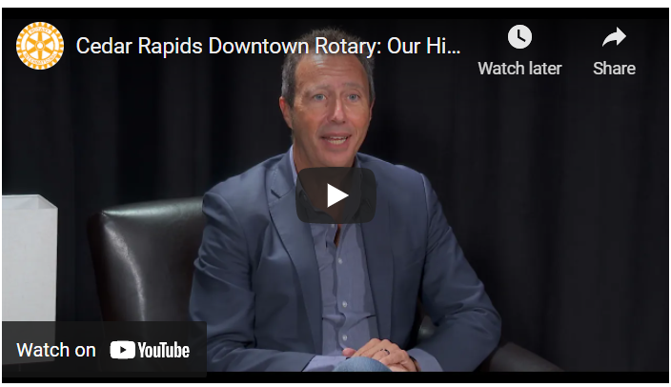
Club History
I will email out video
Notes:
https://www.youtube.com/watch?v=3EtKh_5GAlE

Slide 18
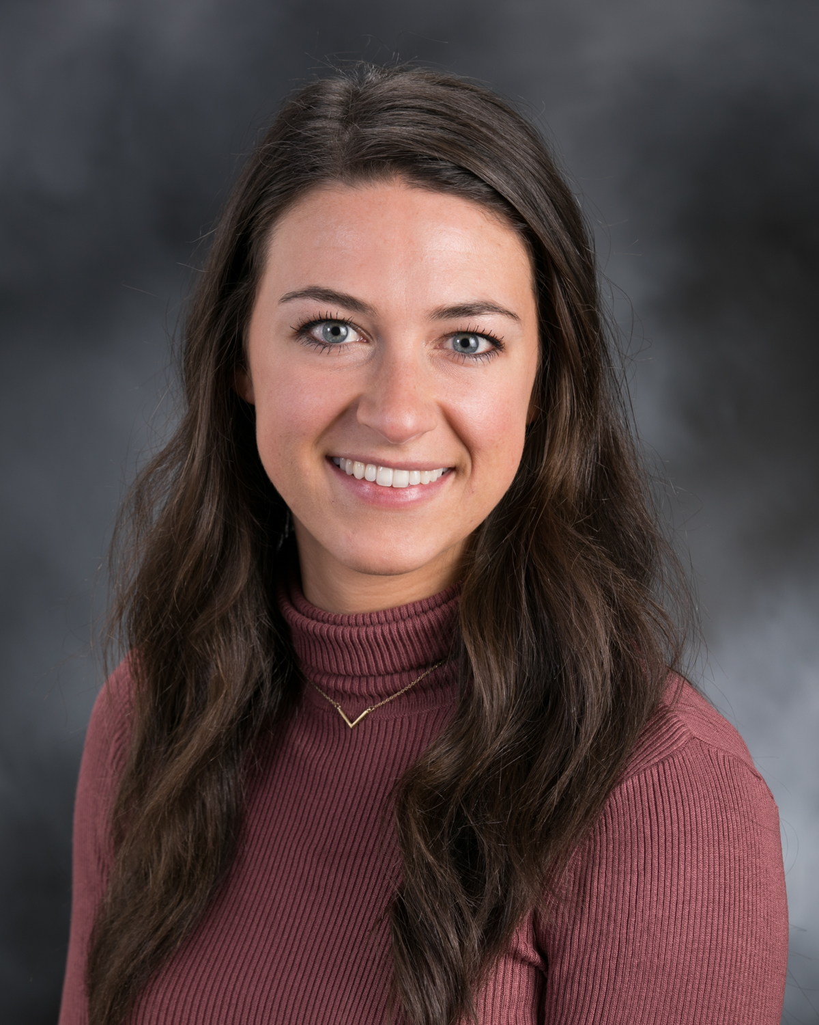
Executive Director
Shannon Banks is the Executive Director for the CR Downtown Rotary Club.
Email: CRdowntownRotary@gmail.com
Phone Number: 319-491-4411
Cedar Rapids Downtown Rotary Club Website: www.rotaryclubofcedarrapids.org

Slide 19
CR Rotary Club Leadership
Shannon Banks, Executive Director
Brooke Fitzgerald, President (2024-25)
Robb Loftsgard, President-elect (2025-26)
Cydney Lovell, President –elect elect (2026-27)
Joe Lock, Past-President (2023-24)
Nick Gearhart, Sargent-at-Arms
Current Board Members include:
Robb Loftsgard & Shannon Hanson Membership Committee Co-Chair
Becky Lutgen Gardner Communications Committee Chair
Michelle Owens Program Committee Chair
Jen Welton Past Program Committee Chair
Susan Koch Service / Social Committee Chair
Jared Jirak Foundation Committee Chair
Jenny Bosking Youth Leadership Committee Chair
Cydney Lovell Youth Exchange Committee Chair
Ben Gander Treasurer

Slide 20
CR Rotary Club Strategic Initiatives
“Building Connections and Enriching Lives”
Three-Year Vision
Sustain the impact and legacy of Downtown Rotary by focusing on four pillars:
Relevance – adapt to remain relevant to members
Influential – support and create a better local and worldwide community
Networking – encourage members to connect, share fellowship, and learn from each other/programs
Growth – retain and recruit members to continue/increase our impact

Slide 21
What goes into being a good rotarian for Downtown Rotary?

Slide 22
1. Be present. Good attendance.
Strive to attend 60% of weekly Rotary meetings
Our Monday meetings start at noon and end by 1:00 pm
You can stay plugged into Rotary by:
Visiting other Rotary Clubs
Attending a Rotary Fun Group Meeting
Participating in Special Events
Attending Committee Meetings
Online @ rotaryeclubone.org (max. 6 make-ups per year)
Bring a guest to a meeting; encourage new members

Slide 23
2. Get Involved
Consider volunteering to serve on the Board of Directors
Shannon Banks, Executive Director
Brooke Fitzgerald, President (2024-25)
Robb Loftsgard, President-elect (2025-26)
Cydney Lovell, President –elect elect (2026-27)
Joe Lock, Past-President (2023-24)
Nick Gearhart, Sargent-at-Arms
Current Board Members include:
Robb Loftsgard & Shannon Hanson Membership Committee Co-Chair
Becky Lutgen Gardner Communications Committee Chair
Michelle Owens Program Committee Chair
Jen Welton Past Program Committee Chair
Susan Koch Service / Social Committee Chair
Jared Jirak Foundation Committee Chair
Jenny Bosking Youth Leadership Committee Chair
Cydney Lovell Youth Exchange Committee Chair
Ben Gander Treasurer
Host a Breakout Session
Attend a club social event
Volunteer to work on a project - grants, youth golf tournaments, etc.
Participate in a Rotary Fun Group
Sit at a different table each week
Attend First Friday – lunch on the first Friday of each month hosted at Matthew 25
Serve on a committee
Get involved with one of our fundraisers

Slide 24
“Get Involved” continued
Serve on a Committee…
Robb Loftsgard & Shannon Hanson Membership Committee Co-Chairs
Becky Lutgen Gardner Communications Committee Chair
Michelle Owens Program Committee Chair
Jen Welton Past Program Committee Chair
Susan Koch Service / Social Committee Chair
Jared Jirak Foundation Committee Chair
Jenny Bosking Youth Leadership Committee Chair
Cydney Lovell Youth Exchange Committee Chair
I will email out video of Service Committee Chairs
Notes:
https://www.youtube.com/watch?v=4r5LR6hX0tw [youtube.com] video

Slide 25
“Get Involved” continued
Get involved with our fundraisers
The Grand Impact – Monday, April 1, 2024
This will be conducted during a 2 hour Rotary meeting instead of at night
50 companies donate $2,000 each and one lucky non-profit gets one impactful infusion of $100,000
2nd place is awarded funds from District Grant; typically, around $10,000
3rd place is awarded proceeds raised from Four Way Taste and Toast
Golf Fundraiser – Monday, June 10, 2024
Organize a foursome. Rotarians from other clubs or even non-rotarians are invited
at Hunters Ridge Golf Course
In 2024 the Club raised over $10,000 for Foundation 2
Four Way Taste and Toast – conducted at last meeting of the year
Raised over $3,000 for Mission of Hope in 2023
2024 beneficiary will be the 3rd place winner of The Grand Impact

Slide 26
“Get Involved” continued
Volunteer at Service Projects…
Pribyl Golf Tournament
Helped get a garden ready for Feed Iowa First
Collaborated with other Rotary clubs in the area to provide playground equipment for 13 Cedar Rapids and Marion elementary schools. (Gearing up for Kids)
Supported education projects at local schools
Cash donation for the NewBo City Market - Rotary Hall
Rejuvenation of the Czech Village Bandstand Plaza
Supported Art in the Parks with sculptures in city parks
Taylor Elementary playground upgrade
HACAP Operation Backpack grant and support
Prospect Meadows - Baseball / Softball Complex
Recognition Wall – Metro-wide project
Miracle Field Pavilion & Memorial Garden – District Grant
Indian Creek Nature Center trail clean up
United Way Reading Into Success Program

Slide 27
“Get Involved” continued
Host a Breakout Session
Attend a club social event
Sit at a different table each week
Attend First Friday – lunch on the first Friday of each month hosted at Matthew 25

Slide 28
3. Achieve Paul Harris status with Rotary Foundation
You become a Paul Harris fellow when you contribute $1,000 to the foundation
For every $1,000 after the initial $1,000 you become a “Paul Harris Fellow +1” so on and so forth
Your annual bill for dues does include a request for a contribution of at least $100.

Slide 29
The Rotary Foundation Mission:
Advance the world understanding, goodwill, and peace through the improvement of health, the support of education, and the alleviation of poverty.

Slide 30
The Rotary Foundation
The Rotary Foundation transforms your financial gifts into service projects that change lives both close to home and around the world.
Last year Rotary provided $87 million dollars in grants for more than 1,306 projects worldwide.
During the past 100 years, the Rotary Foundation has spent $3 billion dollars on life-changing, sustainable projects.
95 percent of donations to the Foundation go directly to support Rotary service projects around the world.

Slide 31
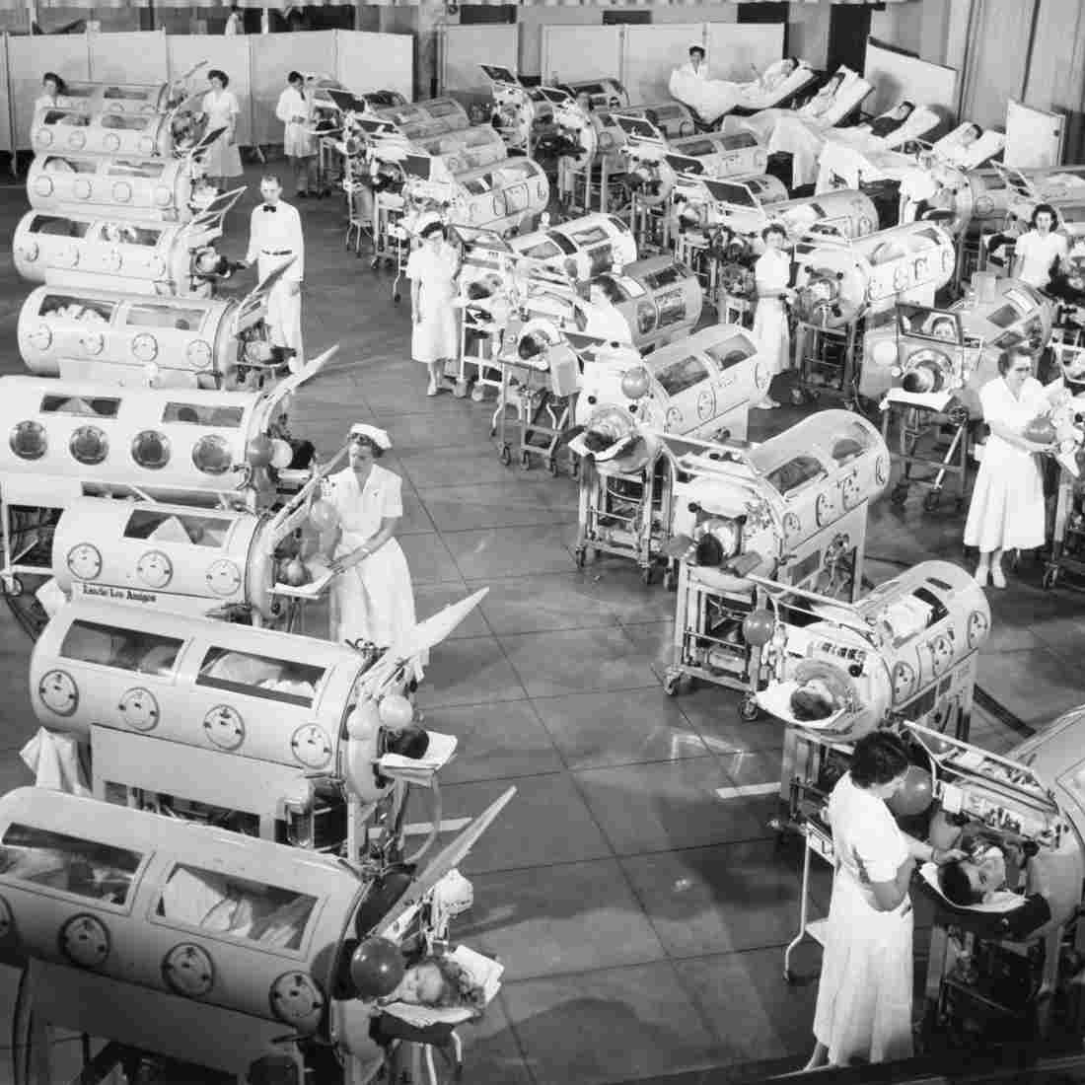
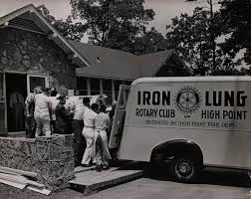
The Rotary Foundation - Polio
The Iron Lung

Slide 32
The Rotary Foundation - Polio
Rotary has helped fund the fight to end Polio since 1988: (350,000 people around the world contracted Polio in 1988)
Polio is 99.9% of the way to being eradicated. Polio will become only the second human disease in history to be eradicated worldwide, the first was smallpox.
This year, the African region was certified free of wild polio virus
As of 2021, there were less than 100 new cases of wild poliovirus worldwide
The cost to immunize a child against Polio is less than $1.

Slide 33
Funding the Rotary Foundation
Funding for the Rotary Foundation comes primarily from voluntary contributions from Rotarians and friends of Rotary.
There are 1.1 million Paul Harris Fellows (individuals who have donated $1,000 or more to the Rotary Foundation).
Every new member in our Rotary club is encouraged to donate $100 for an initial contribution to the Rotary Foundation.
Our Rotary club encourages members to continue to make an annual contribution of $100 toward achieving PHF.
Annually, the CR Downtown Rotary club members donate approximately $25,000 to the Rotary Foundation.

Slide 34
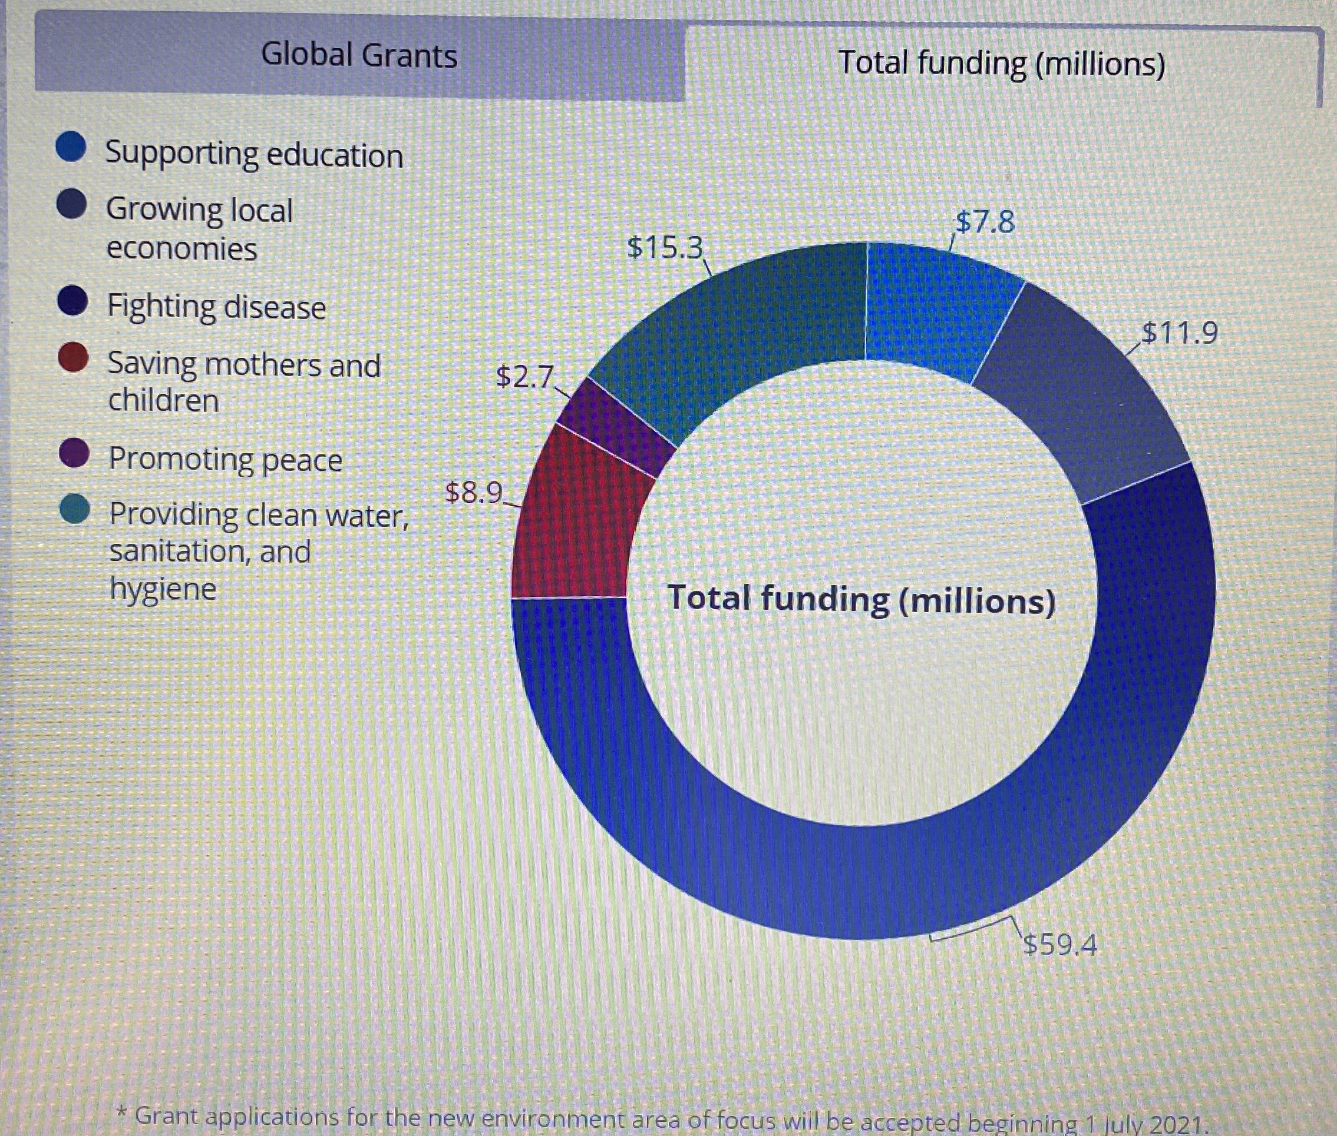
Rotary Foundation Global Grant Funding

Slide 35
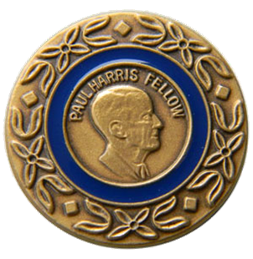
Our Club Foundation Giving Paul Harris Fellow Designation
Club all-time giving = $1,031,835
Since our club began, over 550 Downtown Rotarians have become Paul Harris Fellows
121 current Downtown Rotarians are PHFs
Over 45% of our current PHFs hold multiple designations
How? $1,000 – Cumulative donations/points to Foundation over any time period

Slide 36
4. Pay your Rotary Club Membership Dues
The membership dues are used to fund the club’s operations and charitable initiatives:
The annual membership dues for our club are $475.00
Approximately $83.00 goes to pay Rotary International dues
Approximately $36.00 goes to pay Rotary District dues
Approximately $175.00 goes toward community grants and contributions on behalf of our Club
The remaining $181.00 funds the operation of our club
The suggested $100.00 annual donation to the Rotary Foundation is in addition to the club membership dues
In addition, the suggested $15.00 helps cover credit card fees that we incur for online payments

Slide 37
“Dues” continued…
Charitable Contribution Initiatives:
A portion of your annual membership fee is used to fund the club’s charitable initiatives:
The club budgets annually for charitable contributions of approximately $40,000
Budgeting charitable contributions enables our club to stay true to the Rotary mission to help give back to our community
Think of Rotary as being made up of committed Individuals versus being a representative from a company or an organization

Slide 38
“Dues” continued…
The $40,000 in annual charitable contributions is allocated to the following awards and programs:
Club Appreciation Award
Community Service Award
Larry Christy Award
Metro Rotary Council Projects
Rotary Youth Leadership Awards (RYLA) Program
Youth Exchange Program
Interact Club at Jefferson High School
Various Community Projects
Major Community Projects (Future Reserves)

Slide 39
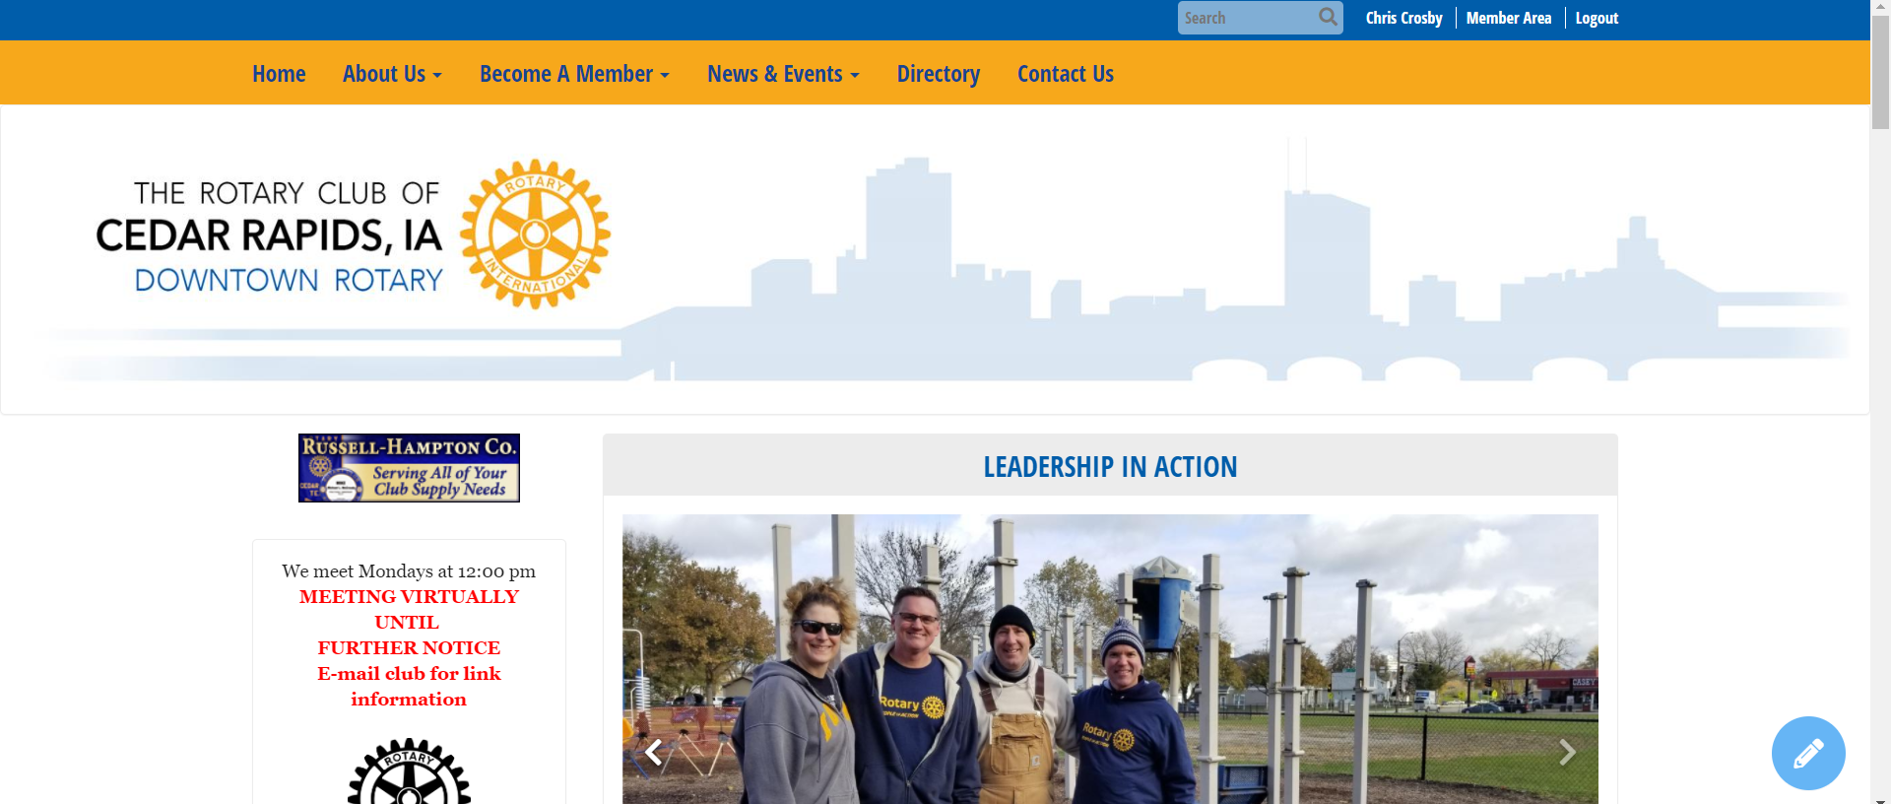
4. Stay connected…
Periodically look at website…www.rotarycluborcedarrapids.org

Slide 40
“Stay connected” continued…
e-Newsletter-Ripples

Slide 41
“Stay connected” continued…
Engage in our social media…
Follow us on Facebook, Twitter & LinkedIn!

Slide 42
5. Recruit new members
Membership is around 200 members; used to be over 300 members
We need to return Downtown Rotary to its glory days of being a Networking Hub for the movers and shakers of the Cedar Rapids area.
Young, Middle-aged and Seasoned

Slide 43
Thank You for being a Rotarian!
Questions?

Slide 44
Other Area Clubs
Tuesday @ 12:00 pm - Marion/East Cedar Rapids
Indian Creek Country Club
Wednesday @ 12:00 pm - Cedar Rapids West’
National Czech & Slovak Library & Museum
Wednesday @ 5:30 pm - Linn County
Shores Event Center
Thursday @ 7:00 am - Cedar Rapids Sunrise
Matthew 25 Groundswell Café
Thursday @ 11:30 am – Cedar Rapids / Hiawatha Metro North
Biaggi’s Restaurant
Friday @ 7:00 am - Cedar Rapids Daybreak
Cedar Rapids Country Club
Friday @ 7:00 am (1st and 3rd Fridays of the Month) - Gateway
Four Oaks Campus

