Slide 1
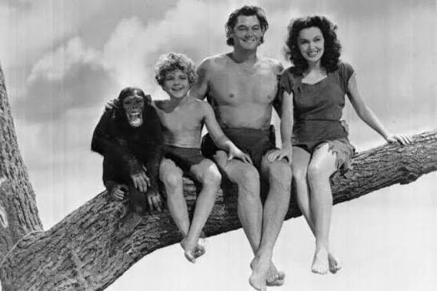
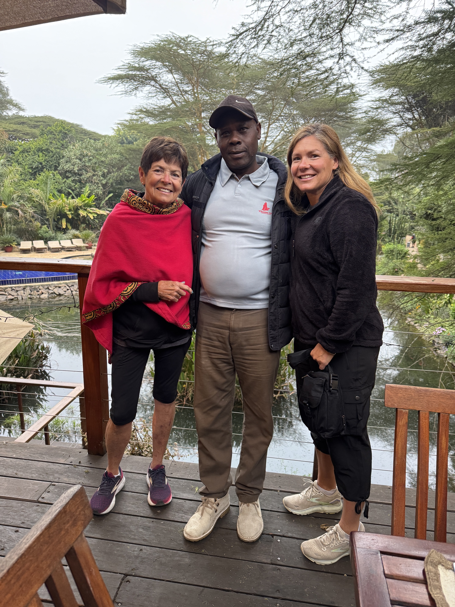
1997 First trip to
Kenya
We were Hooked!
Multiple trips to
Volunteer
And bring supplies
2006-07 school year
Christopher Mutuku
1 project!
2007-08
10 school projects!
Now- 1300+ projects
1 million US kids

Slide 2
H2oforlifeschools.org

Slide 3


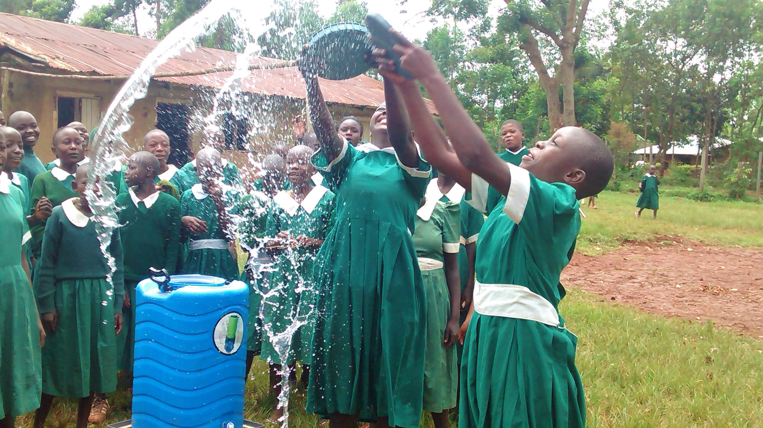
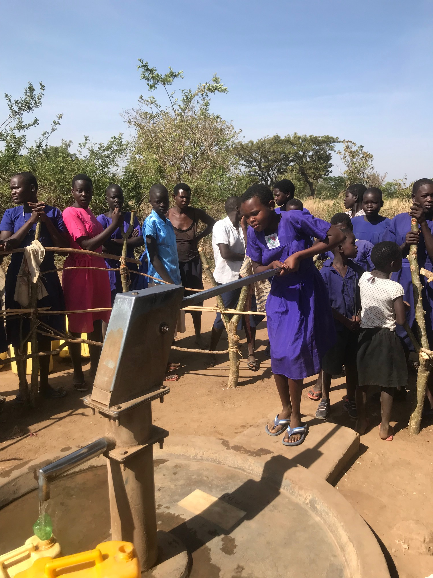
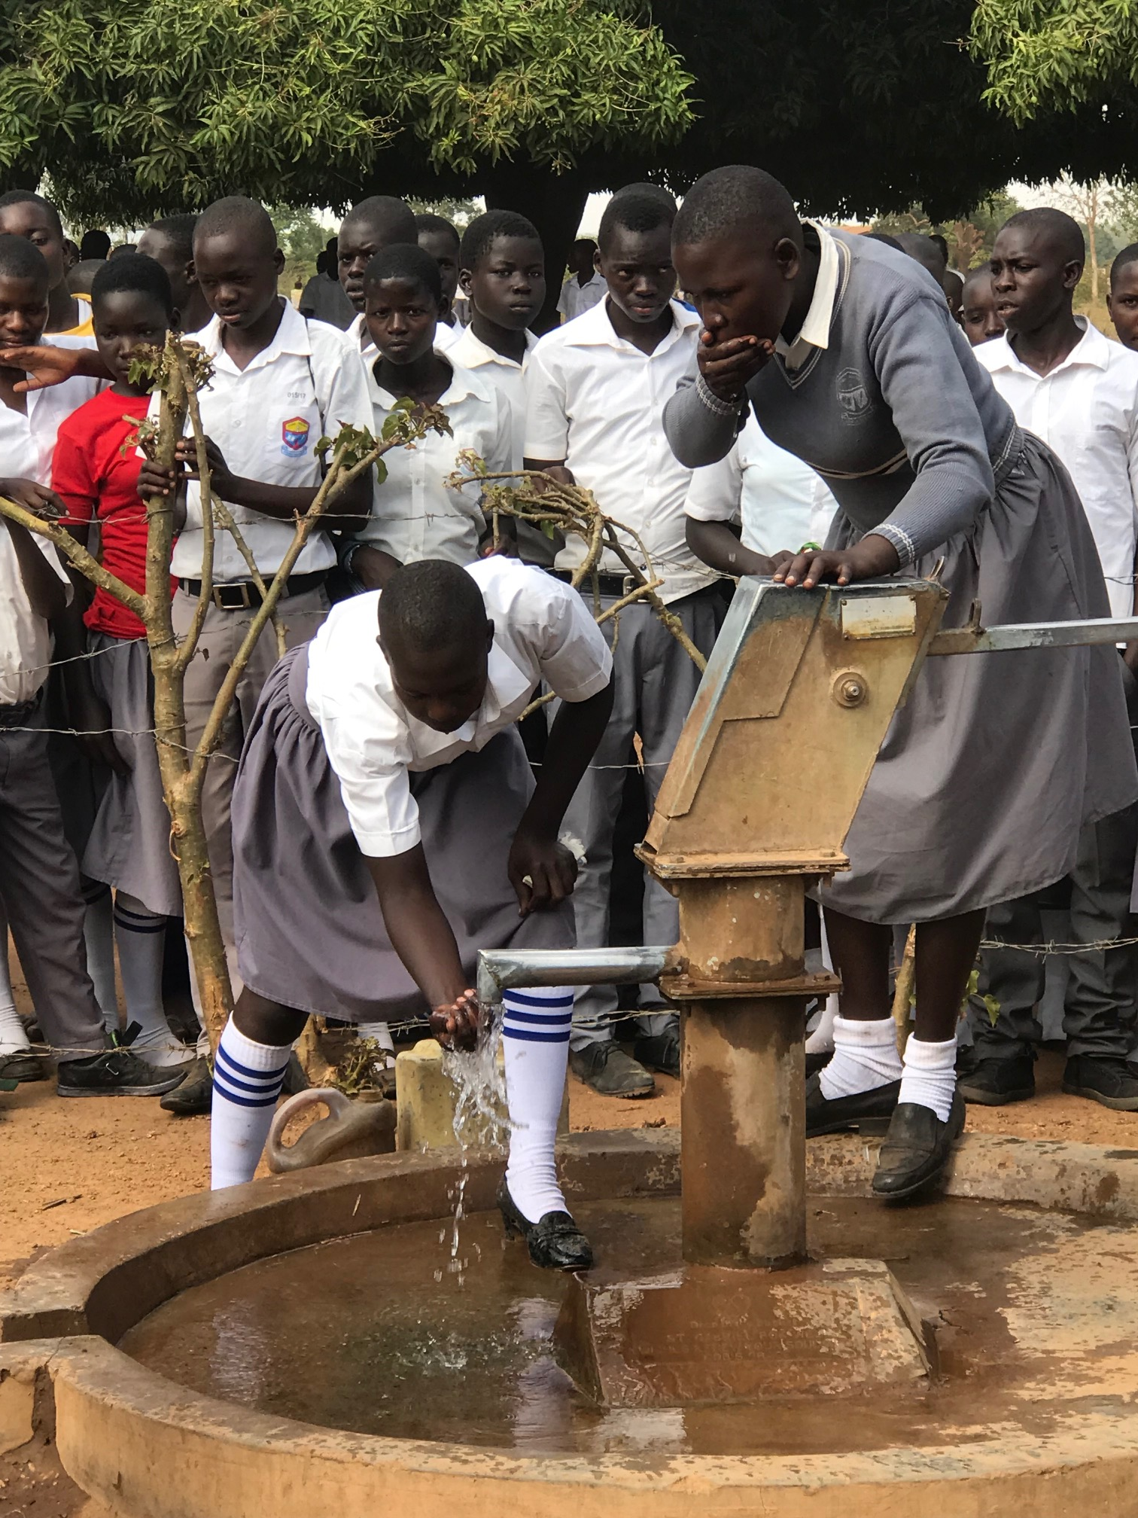
Global Grant 5960 2026-27
Providing Water, Hygiene Training for
6 schools
White Bear Lake Rotary Club, MN, Kitgum Rotary Club, Uganda and Implementing partner Drop in the Bucket
Providing Water and Hygiene Education
Training local community Water Committee Teams
Development of a pay structure with the community to ensure sustainability
Training 2 pump mechanics
Hygiene education training for community/school

Slide 4
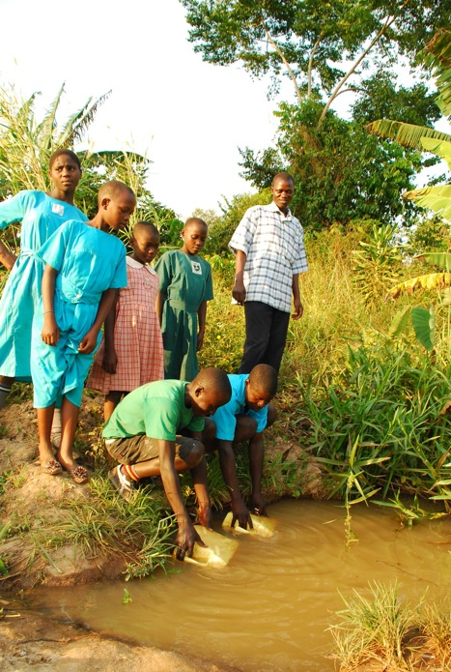
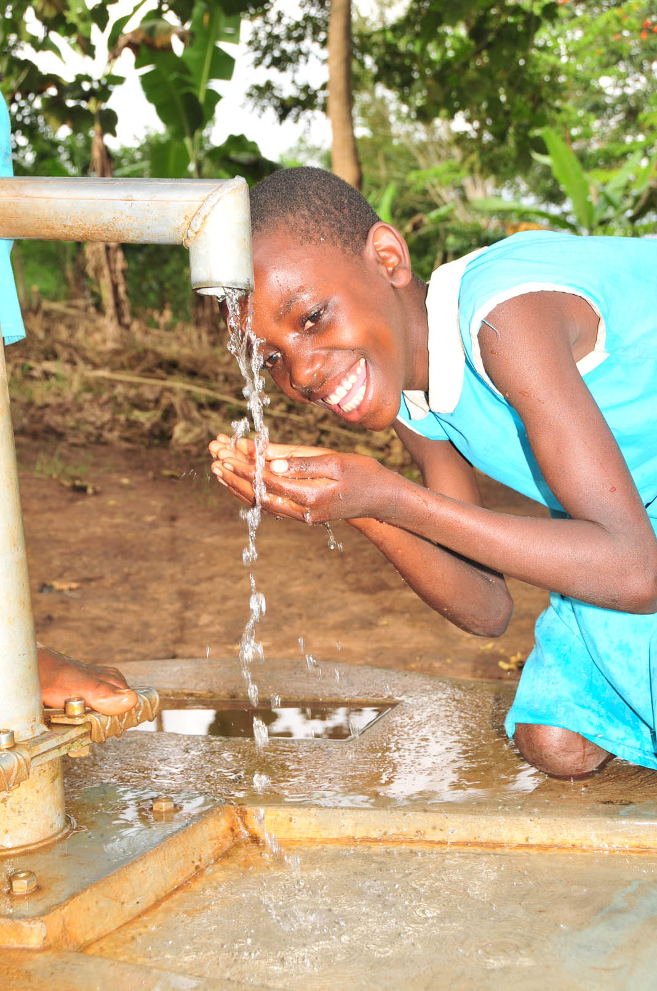
Before WATER
After WATER
WASH in Schools Changes schools and Communities

Slide 5
Without Access to Water:
Students walk long distances to gather water, typically from unsafe water sources.
Unsafe water leads to water borne illness leading to many days of absence
Handwashing decreases illnesses in schools.
Hygiene training is provided for all students. School teams are elected to keep facilities clean.(Yes- it is an honor to be elected to the hygiene team)
Providing a bore hole well on school property or adjacent to property provides plentiful access to water for the school and surrounding community.

Slide 6
Sustainability is Key for all projects
Active and Engaged Local Community-Human Centered Design
Committed to providing locally sourced materials and a sustainable funding plan
Training and providing technical support for local water management team
Vetted and Reliable Implementing Partner “Drop in the Bucket”
Recognized by the Ugandan Government as a highly respected NGO
Track record of projects and sustainability reports (Hundreds of WASH Projects)
Recognized by peers as a top performer

Slide 7
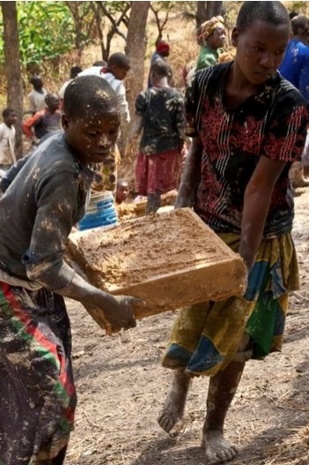
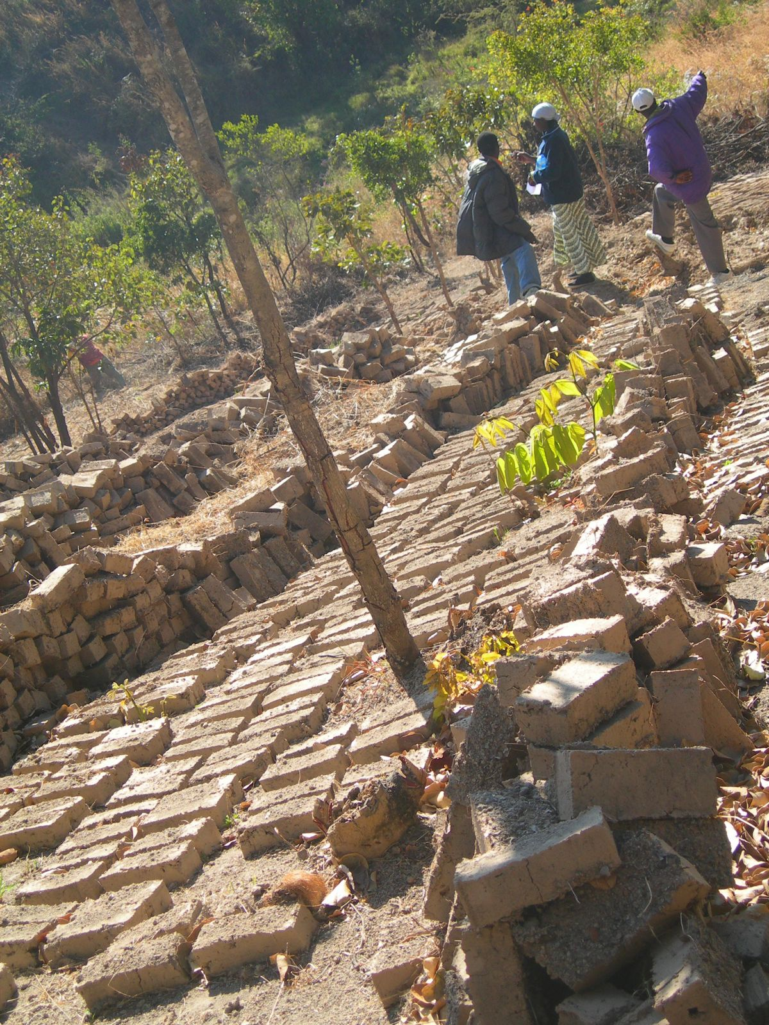
Community Meetings
Drop in the Bucket hosts meetings prior to any work within a community. Each community creates a school savings program. Kitgum Rotary Club, District 9213 is involved!
Locally sourced materials are provided by the community.
Local community members are hired and trained to assist with the implementation
Local community members and school leaders are identified by the community and are trained in borehole maintenance. (The Water Community Team)
Drop in the Bucket maintains staff within easy access to the communities for consultation.

Slide 8
What is the Impact?
6 schools in Uganda, each school has approximately 500 students. The wells also provide water to the local community members impacting a minimum of 5-6000 people across 6 projects- EVERY DAY
Student attendance rises as overall health improves.
Students spend more years in school- particularly girls
Economic development rises as more youth graduate and statistics show that educated women bring more dollars back into their communities.

Slide 9
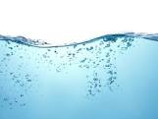
Total Cost of the GRANT: $66,891
Hoping to raise funds by the end of September 2026
I hope your clubs may wish to donate- I’d love to visit your club!
EXPECTATION:
Water and Hand Washing available prior to February-March
2027 for the beginning of a new Ugandan School Year

Slide 10
Thank you to all the clubs for your consideration of this grant!

Slide 11

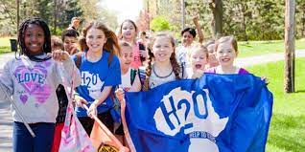
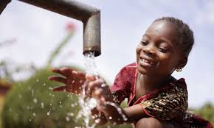
Do you have an InterAct Club?
If so, please consider learning more about H2O for Life. We provide a service learning program to educate, engage and inspire youth!
www.H2OforLifeSchools.org
Students choose an International or US project focused on water for all
Students raise awareness in your community and raise funds to support implementation of water, sanitation and hygiene education projects for partner schools.

Slide 12
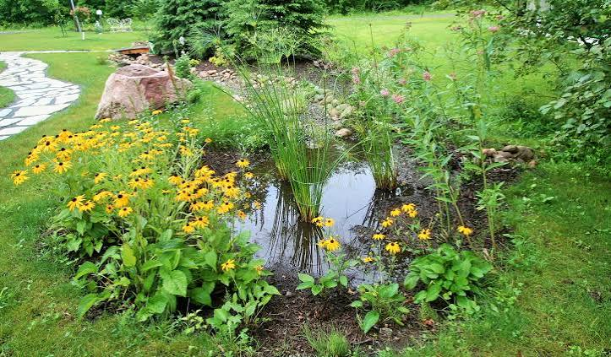

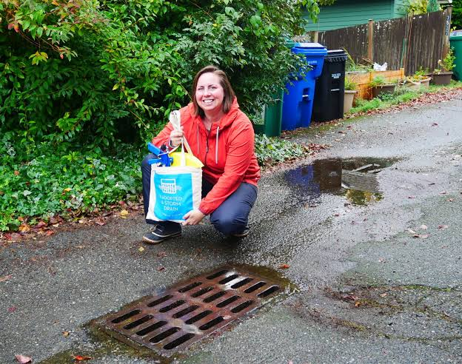
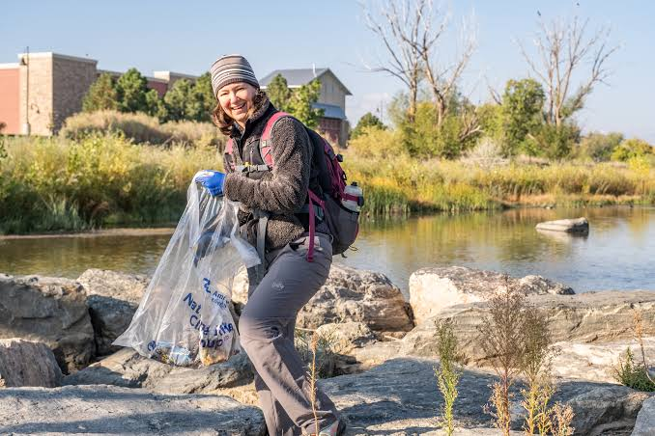
3 Year Initiative
Rotary’s coordinated service Activities to Unite for Water will:
Transform communities
Create a public image blitz across social media, news outlets,
and community channels.
Provide clubs with opportunities to share their impact stories.
Rain Garden
What Can Your Club Do?
River and lake clean-ups.
Adopt-a-Drain.
Adopt-a-River.
Work with your Watershed.
Promote public awareness of water issues.
Be creative. Your choice!

Slide 13

Your CLUB can initiate a Global Water Project for WASH
We can help you find implementing partners, provide resources and review grants!
We can also add: $2000 to your grant!
WASH-RAG.ORG

