Slide 1



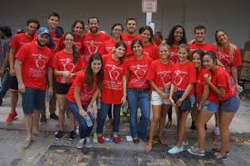
Rotary and Peace

Slide 2
You belong to the largest non-governmental peace organization in the world.

Slide 3
Rotary And Peace
Proclaimed in 1917, Rotary's goal of worldwide peace and tolerance has been an unwavering pursuit: conducting global forums, hosting international peace symposiums, advancing peace through its 60-year collaboration with the UN, as well as grassroots initiatives such as the Rotarian Action Group for Peace.

Slide 4
True or False?
For the last 50 years, the casualty rate from armed conflicts worldwide has been steadily increasing.

Slide 5


Slide 6
Rotary Values
Fighting Disease
Supporting Education
Peace Building
Saving Mothers and Children
Rotary Values all Support Peace Building
Clean Water
Growing Local Economies

Slide 7
Rotary Peace Centers
Rotary's most significant effort to wage peace is the Rotary Peace Centers program, established in 2002. Each year, the program trains some of the world's most dedicated and brightest professionals, preparing them to promote national and international cooperation and to resolve conflict.

Slide 8
Rotary Peace Centres
Bangkok
Duke/UNC
Tokyo
Bradford
Brisbane
Uppsala

Slide 9
UW Graduate Program in Integrated Peace
Health & Health Systems
Development Practice
CORE
Peace and Conflict Studies
Global Governance
Climate Change
Technology

Slide 10
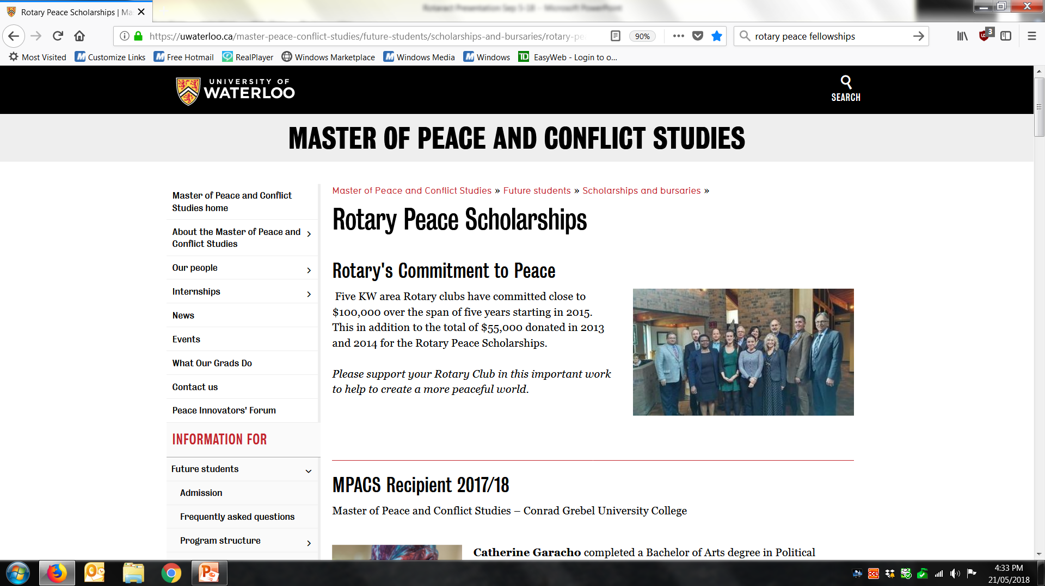

Slide 11
Rotaract and Peace

Slide 12
The Rotaract Club of the University of Moratuwa, Sri Lanka, built a library, science lab, and bridges, and launched a weaving cooperative in a rural village. Rotary has honored the club with the 2017 Rotaract Outstanding Project Award.

Slide 13
More than 25 organizations and businesses supported the Rotaract Club of Pau dos Ferros in its efforts to boost the rural community of Varzea Nova. Over 13 months, the club helped establish Internet connectivity in the town, provided medical exams and services, led childhood education sessions for infants and parents, organized vocational training for adults, and hosted a cultural festival.

Slide 14
The Rotaract Club of Cotonou Phare undertook a multiphase project to bring clean water and improved sanitation facilities to a local orphanage. The first phase involved drilling a well for the facility’s kitchen and bathrooms. In the second, club members worked with their sponsor Rotary club and other service organizations to refurbish the toilets.

Slide 15
Rotaractors from the University of Lethbridge in Alberta raised $36,500 to update kindergarten facilities in the community of Mazatlan, Mexico. By collaborating with the local government and Rotary clubs, Rotaractors ensured that the funds were used for teachers’ salaries and for buying new plumbing and classroom spaces for about 70 students.

Slide 16
Local Resources You Can Draw On

Slide 17


Slide 18

The Rotary Club of Stratford Charitable Foundation provides more than $45,000 annually in a variety of scholarships and bursaries to local secondary school and University of Waterloo students.

Slide 19
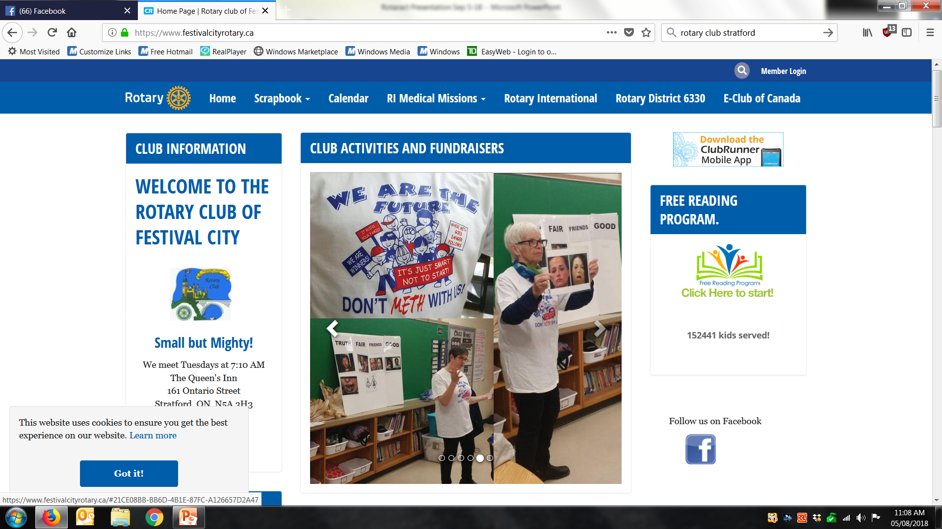

Slide 20
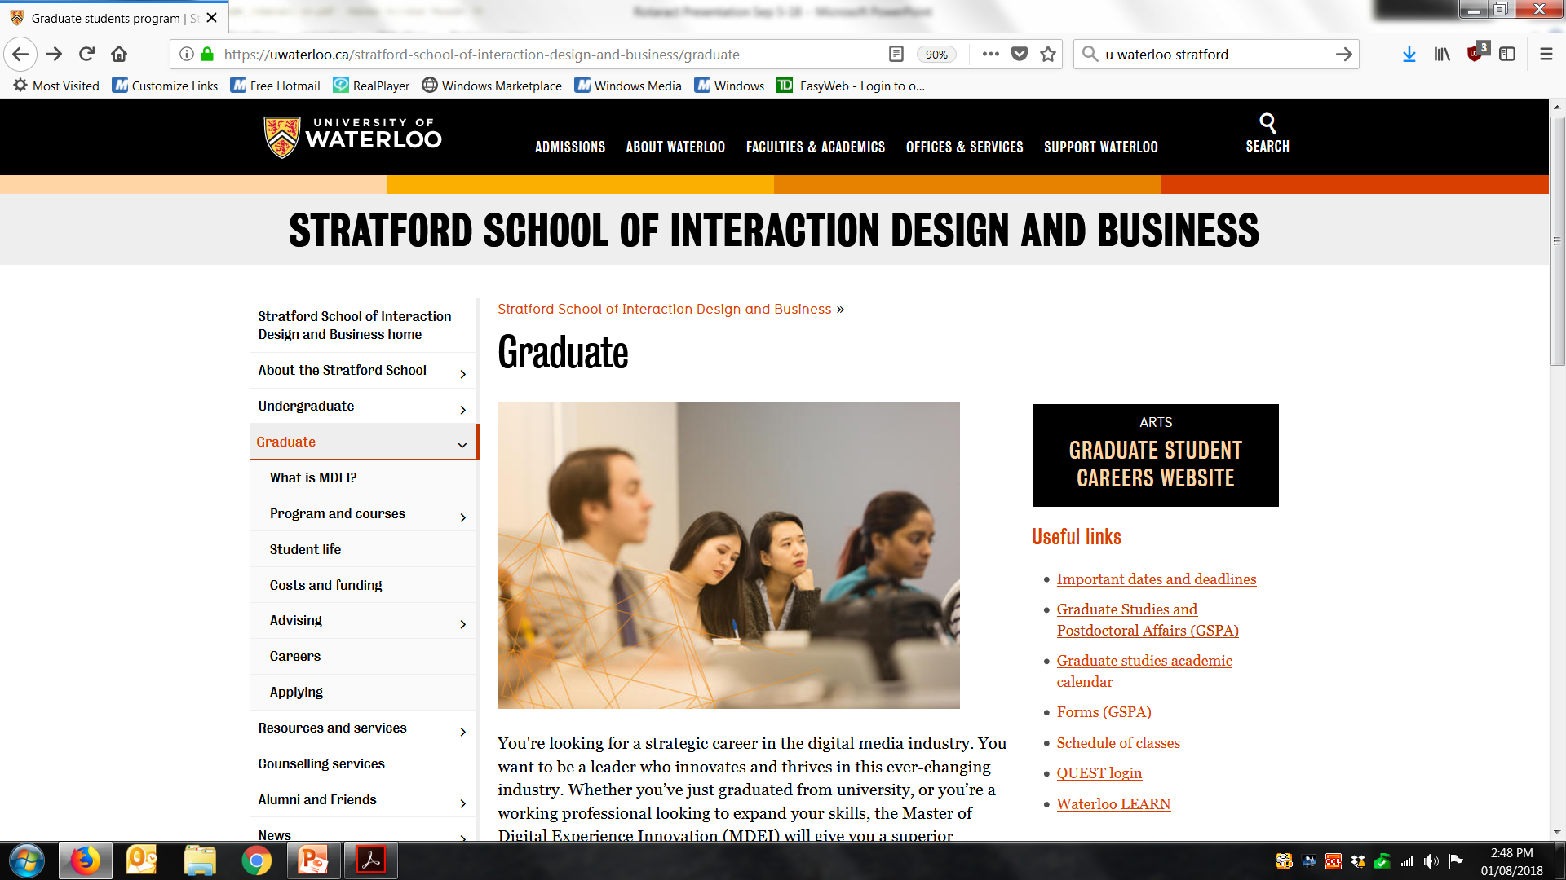

Slide 21
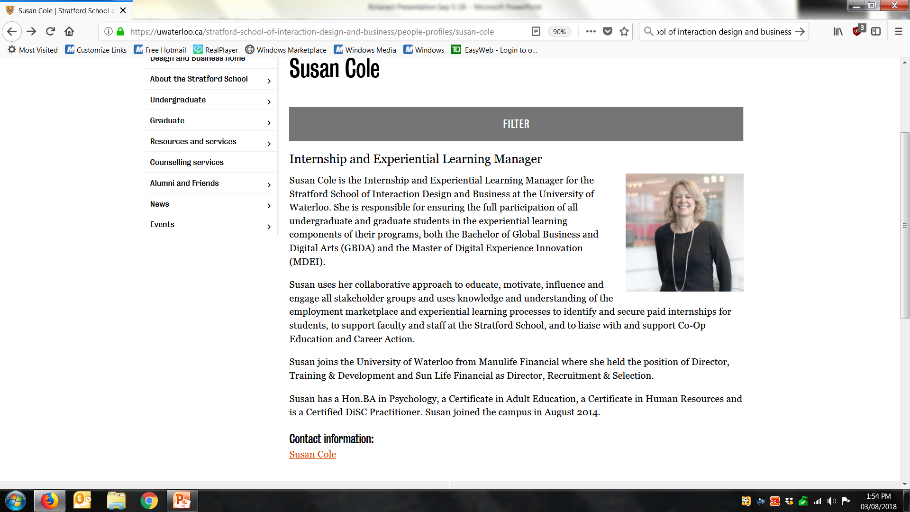

Slide 22
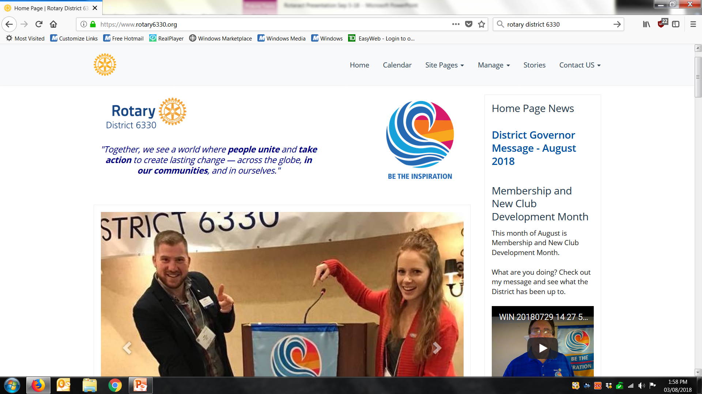

Slide 23
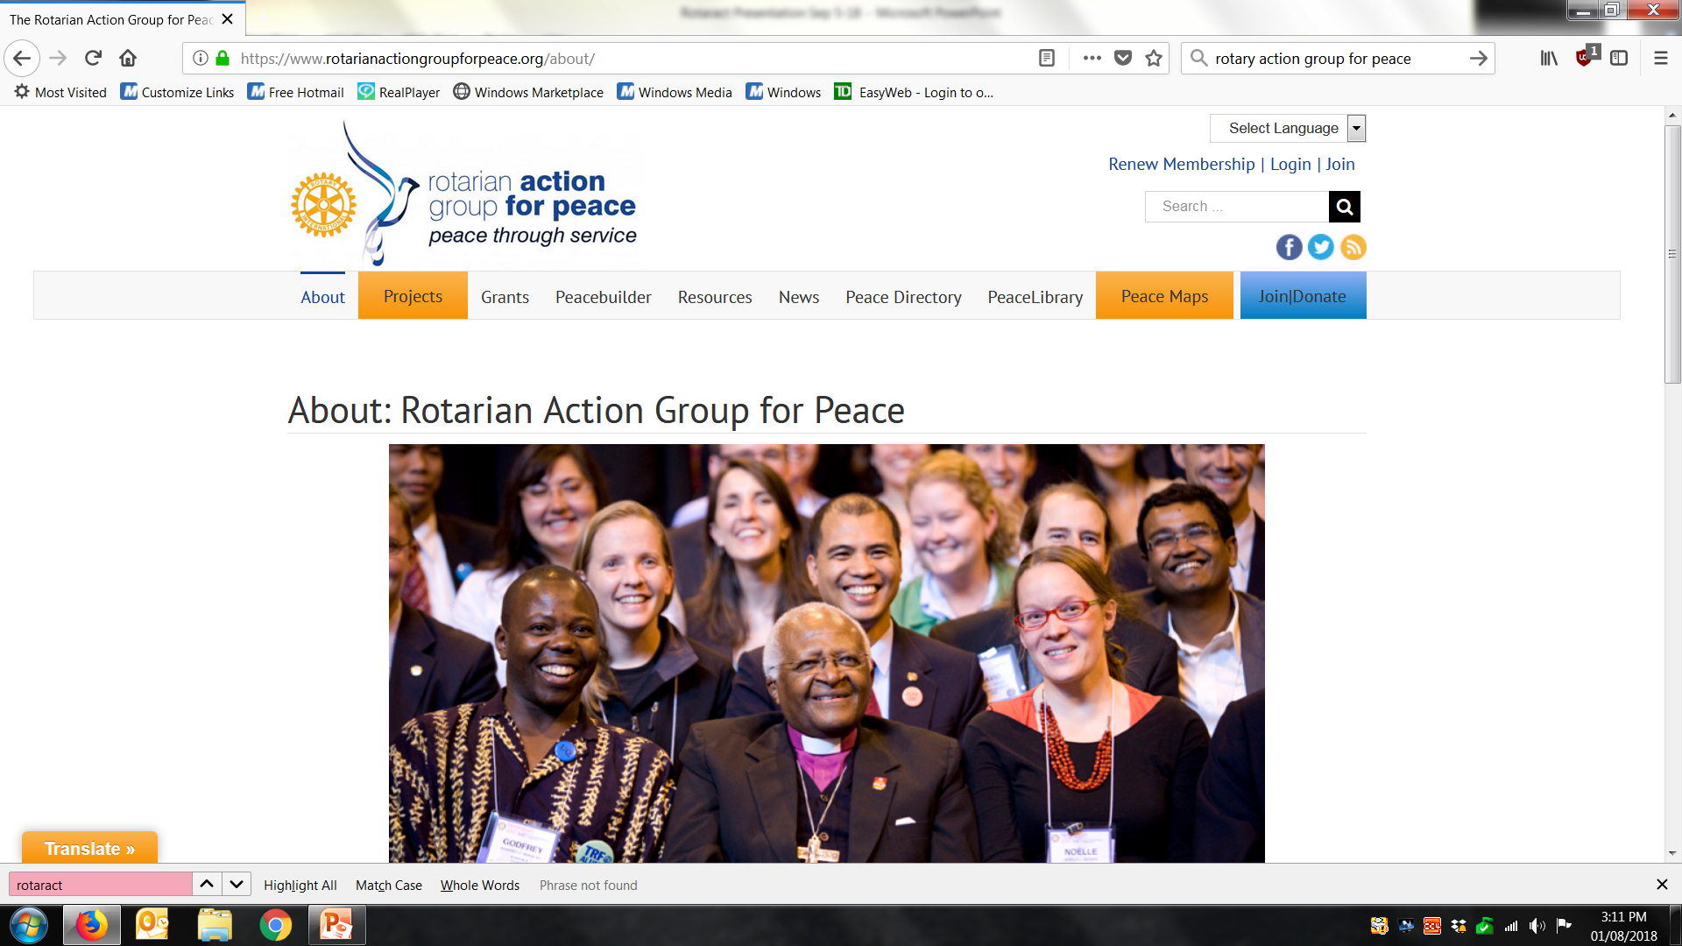

Slide 24
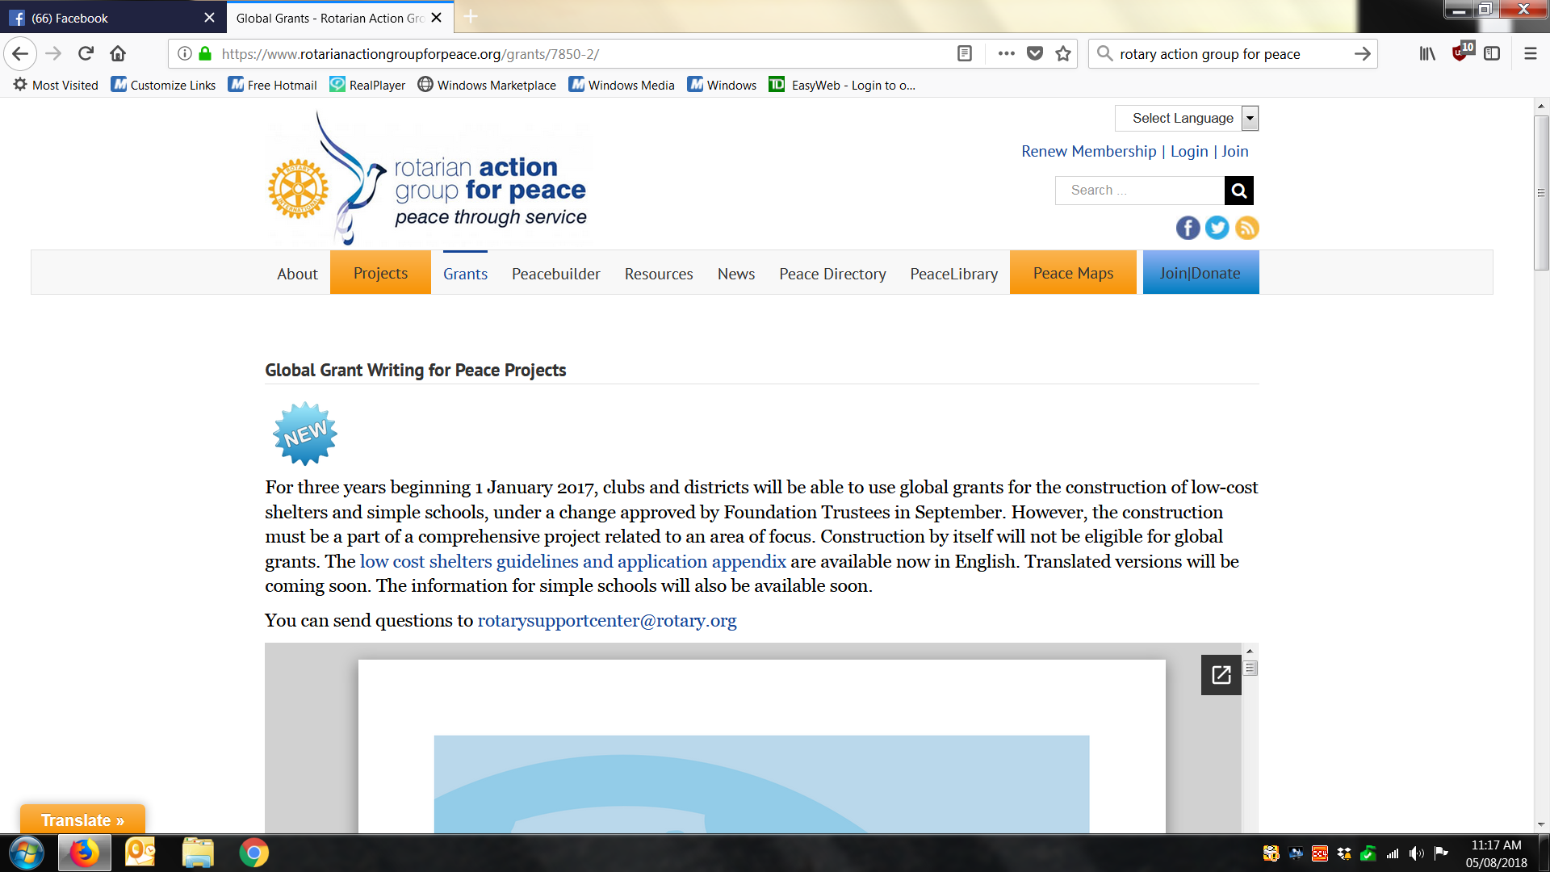

Slide 25
Questions?

