Slide 1
Sunrise Market
A great way to thank your clients while supporting the community…
Sell Rotary Gift or Port Packs…
Sunrise Market
A great way to thank your clients….
And support our community

Slide 2
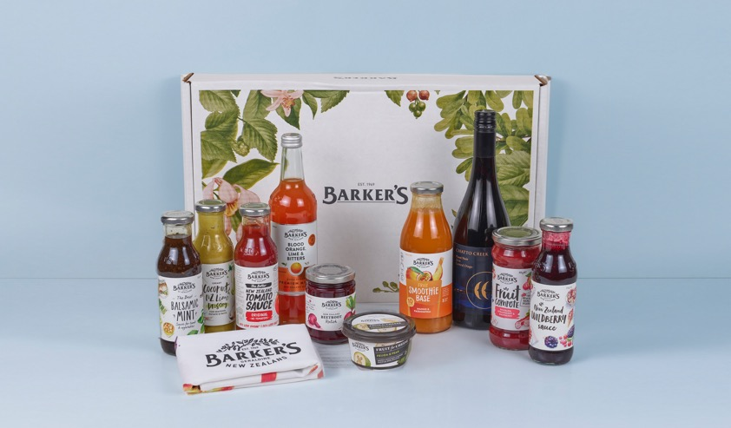
Rotary Gift Pack
$135 including GST, plus shipping

Slide 3
Rotary Port Pack
$120 including GST, plus shipping

Slide 4
What’s in it for your club?
Every box that you sell makes your club money:
$20 for each Rotary gift pack
$15 for each Port gift pack
Sunrise Market
A great way to thank your clients….
And support our community

Slide 5
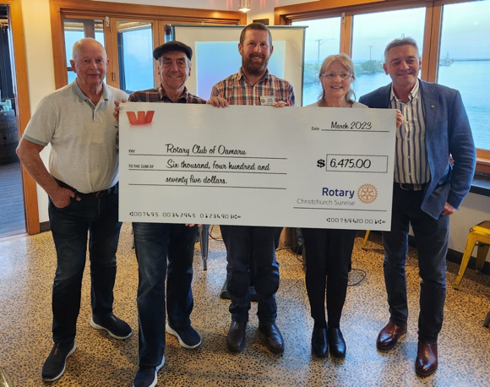
What’s in it for your club?
The Rotary Club of Oamaru participated in this program last year earning $6,475

Slide 6
What do you have to do?
Network within your local community to find companies that wish to provide a quality gift box to their clients as a thank you
Sunrise Market
A great way to thank your clients….
And support our community

Slide 7
What marketing assistance do you get?
A pack is provided containing all the material you need to run this project. This will include printed copies of the promotion as well as all necessary instructions
Sunrise Market
A great way to thank your clients….
And support our community

Slide 8
What is the deadline for orders?
The cutoff is for all orders and payment is 20 November the 2023.
Sunrise Market
A great way to thank your clients….
And support our community

Slide 9
When are they delivered and how?
Your club does no work at all. All deliveries are handled by ourselves as part of the process. This can be either bulk delivery or dispatched by courier directly to the customers to arrive before Christmas
Sunrise Market
A great way to thank your clients….
And support our community

Slide 10
Where from here?
Nominate one member from your club to manage this project. One of our club members will be assigned to your club to work with you to ensure this is a successful project.
Sunrise Market
A great way to thank your clients….
And support our community

Slide 11
How do you order and pay?
We will provide the process to you to enable this to be done as a bulk transaction or, for single orders being processed through our website www.sunrisemarket.co.nz
Sunrise Market
A great way to thank your clients….
And support our community

Slide 12
Frequently asked questions?
There is alcohol in the pack. Who needs the liquor license?
We have the liquor license so this is all covered.
Sunrise Market
A great way to thank your clients….
And support our community

Slide 13
Sunrise Market
A great way to thank your clients while supporting the community…
The proceeds generated by the Rotary Club of Christchurch share will assist in their support of the Cancer Society
Sunrise Market
A great way to thank your clients….
And support our community

