Slide 1


The Rotary Club of Oamaru did

Slide 2
Rotary Christmas Gift Packs
A great way to thank your clients while supporting the community…
Sunrise Market
A great way to thank your clients….
And support our community

Slide 3
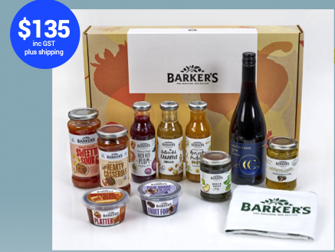
Rotary Christmas Gift Pack

Slide 4
What’s in it for Bayleys Real Estate Christchurch?
For every box that you buy, the profit generated goes to support a charity or cause within our local community.
Sunrise Market
A great way to thank your clients….
And support our community

Slide 5
Are these gift packs only available at Christmas time?
Our current program is for the forthcoming festive season. However these will be available after this on an ongoing basis.
Sunrise Market
A great way to thank your clients….
And support our community

Slide 6


Slide 9
What is the deadline for orders?
The cutoff for all orders and payments is November 1 the 2024.
Sunrise Market
A great way to thank your clients….
And support our community

Slide 10
When are they delivered and how?
All deliveries are handled by The Rotary Club of Christchurch Sunrise as part of the process. This can be either a bulk delivery or dispatched by courier directly to customers.
Sunrise Market
A great way to thank your clients….
And support our community

Slide 11
Where to from here?
Bayleys need to nominate one staff member to manage this project. We have a mentor assigned to work with you to answer any questions and to help at all stages.
Sunrise Market
A great way to thank your clients….
And support our community

Slide 12
How do we order and pay?
We will be provided the process to enable orders to be placed either in bulk or as single orders through the www.sunrisemarket.co.nz website.
Sunrise Market
A great way to thank your clients….
And support our community

Slide 13
Frequently asked questions?
There is alcohol in the pack. Do we need a liquor license?
No we don’t as The Rotary Club of Christchurch Sunrise has the liquor license, so this is all covered.
Sunrise Market
A great way to thank your clients….
And support our community

Slide 14
Rotary Christmas Gift Packs
A great way to thank your clients while supporting the community…
The Rotary Club of Christchurch Sunrise share of the profits will assist in their support of their partner charities in 2024/25
Sunrise Market
A great way to thank your clients….
And support our community

