Slide 1

Making money is easy!
How would you like to make $6475!
Sunrise Market
A great way to thank your clients,
and support our community

Slide 2
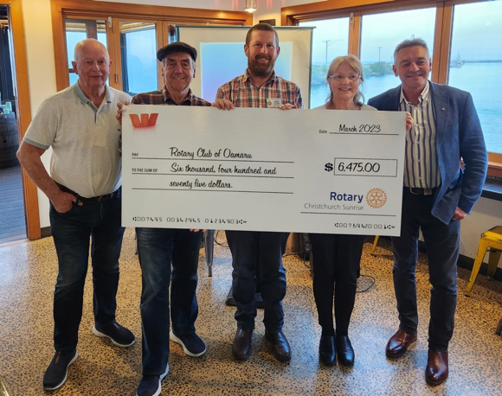
The Rotary Club of Oamaru did !

Slide 3
Rotary Christmas Gift Packs
A great way to thank your clients while supporting your community…
Sunrise Market
A great way to thank your clients,
and support our community

Slide 4
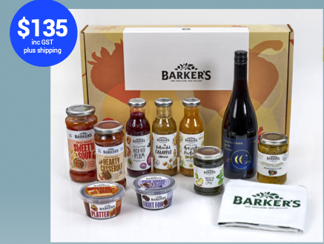
Rotary Christmas Gift Pack

Slide 5
What’s in it for your club?
Every gift box that you sell your club makes money:
$20 for each Rotary gift pack sold.
Note that the $20 excludes GST.
Sunrise Market
A great way to thank your clients,
and support our community

Slide 6
What do you have to do?
Network within your local community to find companies who wish to provide a quality gift pack to thank their clients.
Sunrise Market
A great way to thank your clients,
and support our community

Slide 7
What assistance do you get?
A sales pack providing all material you will need to run this project. This includes printed copies of the promotion as well as all necessary instructions.
Sunrise Market
A great way to thank your clients,
and support our community

Slide 8
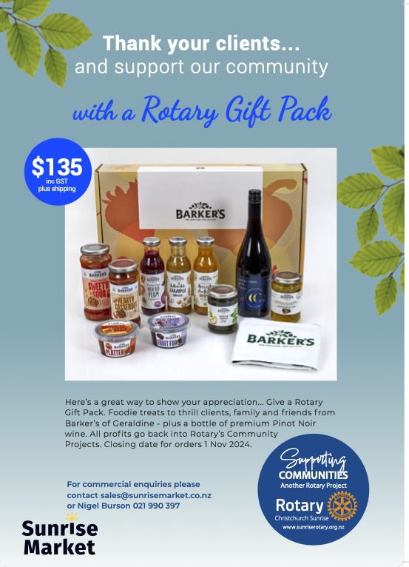

Slide 11
What is the deadline for orders?
The cutoff date for all orders and payments is November 1 the 2024.
Sunrise Market
A great way to thank your clients,
and support our community

Slide 12
The delivery of the gift boxes?
Your club does no work at all. All deliveries are handled by ourselves as part of the process. This can be either bulk delivery or individual orders, dispatched by courier directly to the customer.
Sunrise Market
A great way to thank your clients,
and support our community

Slide 13
Where to from here?
Simply nominate one member from your club to manage this project. One of our club members will be assigned to work with you to answer any questions that you have and to help your club at all stages.
Sunrise Market
A great way to thank your clients,
and support our community

Slide 14
How do you order and pay?
We will provide the process to enable orders to be placed either in bulk or as single orders through the www.sunrisemarket.co.nz website.
Sunrise Market
A great way to thank your clients,
and support our community

Slide 15
Frequently asked questions?
There is alcohol in the pack. Do you need a the liquor license?
No you don’t as we have the liquor license so this is all covered.
Sunrise Market
A great way to thank your clients,
and support our community

Slide 16
The Rotary Club of Oamaru made
$6475

Slide 17
Rotary Christmas Gift Packs
A great way to thank your clients while supporting the community…
The Rotary Club of Christchurch Sunrise share of the profits will assist in their support of their partner charities in the 2024/25 year.
Sunrise Market
A great way to thank your clients,
and support our community

