Slide 1

Making money is easy!
Oamaru Club made
$6,475!
Why can’t we!
Sunrise Market
A great way to thank your clients,
and support our community

Slide 2
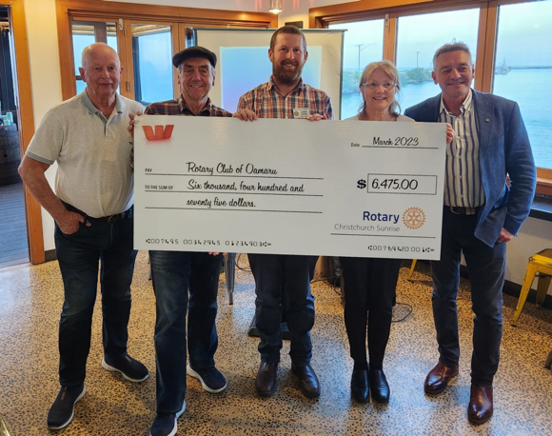
The Rotary Club of Oamaru did !

Slide 3
Rotary Christmas Gift Packs
A great way to thank your clients while supporting your community…
Sunrise Market
A great way to thank your clients….
And support our community

Slide 4
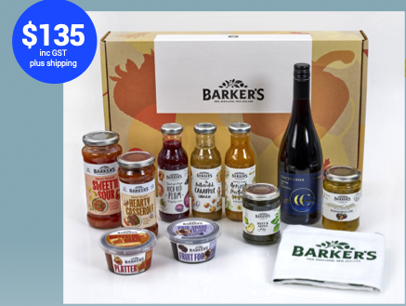
Rotary Christmas Gift Pack

Slide 5
What’s in it for our club?
Every gift box that we sell makes our club money:
$20 for each Rotary gift pack.
Note that the $20 excludes GST
Sunrise Market
A great way to thank your clients,
and support our community

Slide 6
What do we have to do?
Network within our local community to find companies that wish to provide a quality gift box to thank their clients.
Sunrise Market
A great way to thank your clients,
and support our community

Slide 7
What support do we get to make this happen?
A sales pack providing all the material we need to run this project. This includes printed copies of the promotion as well as all necessary instructions
Sunrise Market
A great way to thank your clients,
and support our community

Slide 8
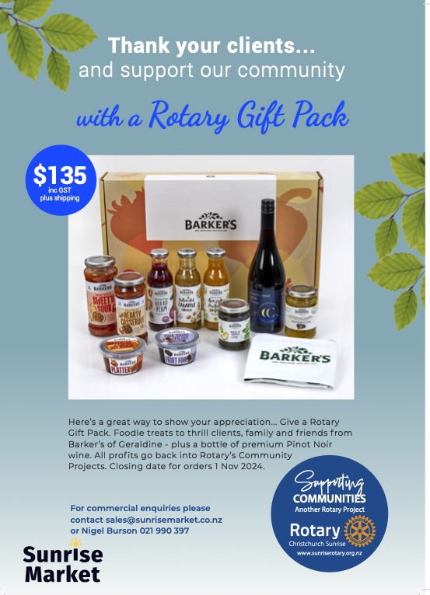

Slide 11
What is the deadline for orders?
The cutoff for all orders and payments is November 1 the 2024.
Sunrise Market
A great way to thank your clients,
and support our community

Slide 12
When are they delivered and how?
Our club does no work at all. All deliveries are handled by The Rotary Club of Christchurch Sunrise as part of the process. This can be either bulk delivery or individual orders, dispatched by courier directly to the customer.
Sunrise Market
A great way to thank your clients
and support our community

Slide 13
Where to from here?
We need to nominate one member from our club to manage this project. We have a mentor assigned to work with us to answer any questions and to help at all stages.
Sunrise Market
A great way to thank your clients,
and support our community

Slide 14
How do we order and pay?
We will be provided the process to enable orders to be placed either in bulk or as single orders through the www.sunrisemarket.co.nz website.
Sunrise Market
A great way to thank your clients,
and support our community

Slide 15
Frequently asked questions?
There is alcohol in the pack. Do we need a liquor license?
No we don’t as The Rotary Club of Christchurch Sunrise has the liquor license, so this is all covered.
Sunrise Market
A great way to thank your clients,
and support our community

Slide 16
The Rotary Club of Oamaru made
$6475 !

Slide 17
Rotary Christmas Gift Packs
A great way to thank your clients while supporting the community…
The Rotary Club of Christchurch Sunrise share of the profits will assist in their support of their partner charities in 2024/25.
Sunrise Market
A great way to thank your clients,
and support our community

