Slide 1
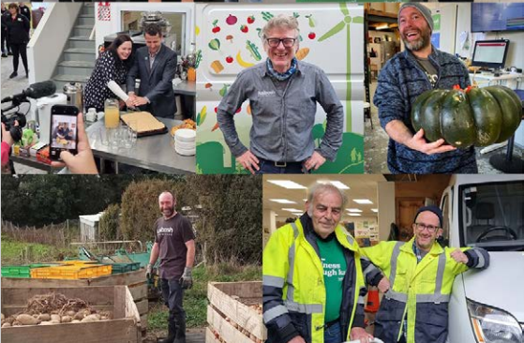

Presentation to:
Rotary
July 2025
Susie Robertson – Chief Executive
Notes:
Well if you were listening then good news for you – quiz which you may get 10 out of 10 on.

Slide 2
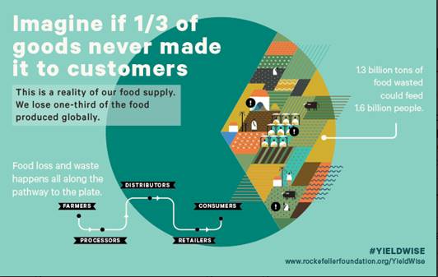
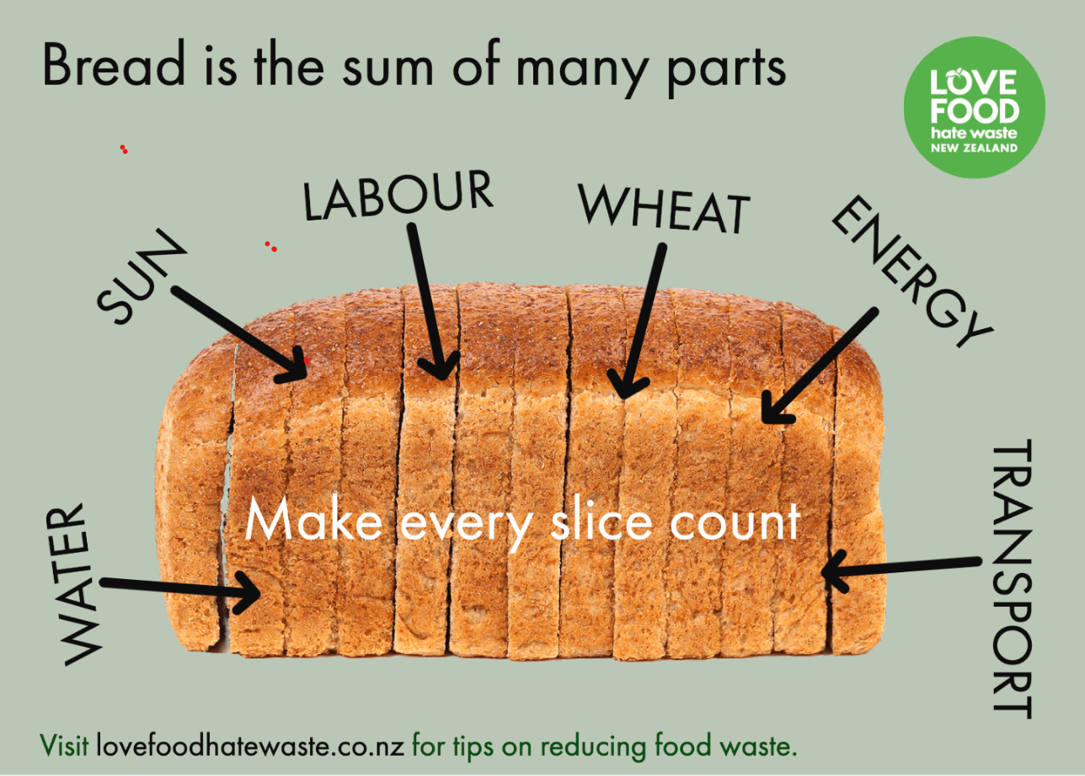
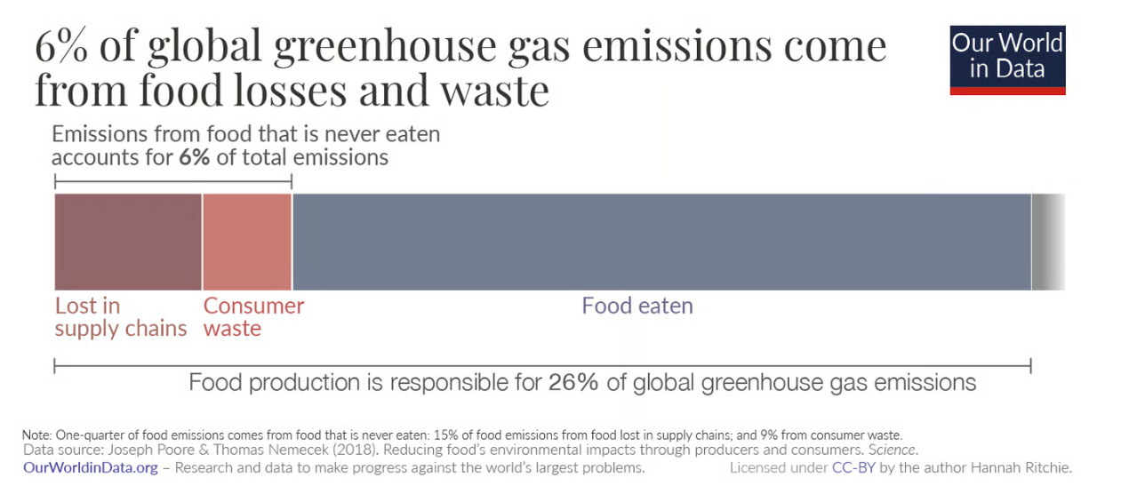
The Waste
Notes:
An estimated 1/3 of food produced is lost or wasted from farm to fork. It is lost all along the food chain from framers, processors, distributors, retailers and consumers.
When good food is wasted, all the water, raw ingredients, energy, transport and labour is also wasted.
Food waste ending up in traditional landfill is a problem, because it doesn’t get enough air and therefore releases methane. Methane is 20 times more efficient at trapping heats in the atmosphere than Co2. So in the short term it is much more damaging, but it dissipates more quickly than Co2.
A study in 2018 found that food waste made up 6% of global greenhouse gas emissions. The study by Poore and Nemecek (2018) found that almost one-quarter – 24% – of food’s emissions come from food that is lost in supply chains or wasted by consumers. Almost two-thirds of this (15% of food emissions) comes from losses in the supply chain which result from poor storage and handling techniques; lack of refrigeration; and spoilage in transport and processing. The other 9% comes from food thrown away by retailers and consumers.

Slide 3
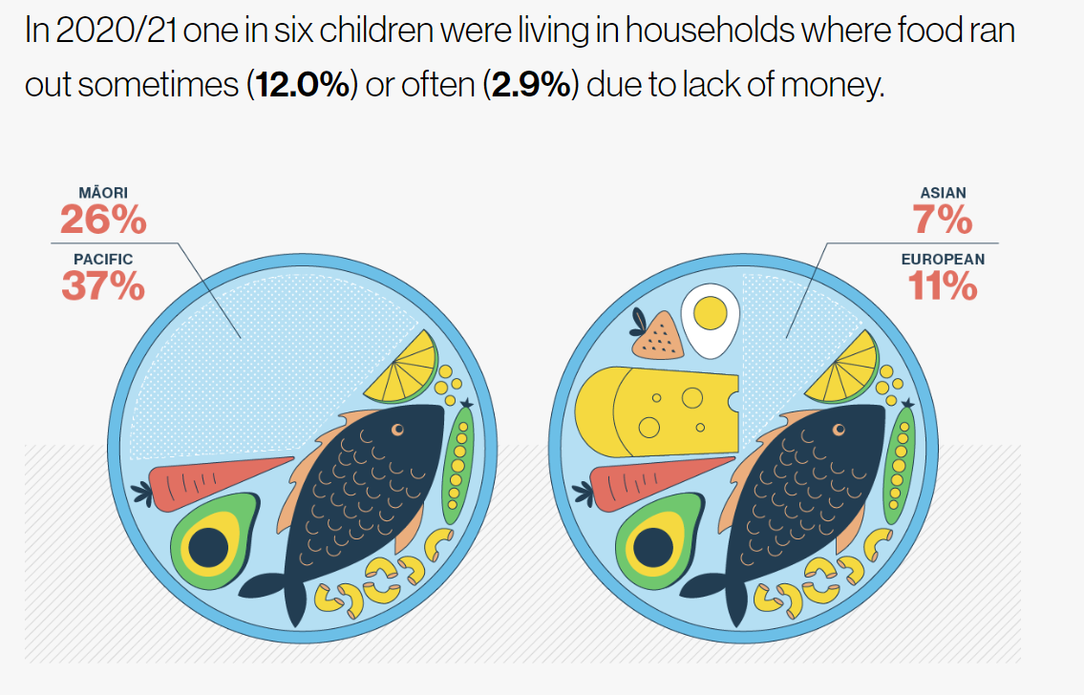
The issues
Food Insecurity
What do you think it was in the same survey conducted in 2022/2023?
The issues
Notes:
Food Security - All people at all times have access to sufficient, safe, and nutritious food to maintain a healthy and active life".
Child Poverty Report 2023 - Currently between 15-20% of our people in Aotearoa New Zealand experience moderate to severe food insecurity in an ongoing way. This means they cannot access enough food to feed their whānau or themselves in a way that enables them to carry out their daily activities.
The cost of food increases – Department of Human Nutrition (2023), Information Package for Users of the New Zealand Estimated Food Costs 2023. (C. Smith, Ed.). University of Otago. Mean cost of grocery shop has increased 24% from 2021. A much higher percentage of the budget is having to be spent on dairy, vegetables, meat and poultry, fruit, fish and eggs, due to increase in price of these foods compared to others.
Food Parcels given out from Lower Hutt Food Bank – 4 years ago a slow day was less than 10 people, a busy day was 20 people. Now a quiet day is 70-80 and a busy day is 120-135. People queue up from 7am in the morning and they don’t open til 9am.

Slide 4

Food Production
5.25 million people
How many people could we feed in New Zealand with the food we produce here?
40 million people!
• 39 million people - dairy
• 11.5 million people - meat, seafood and other protein
• 2 million people - vegetables (mainly onions and potatoes)
• 10 million people - fruit (kiwifruit and apples)
Notes:
Pacific Islands Families Study: Household Food Security during Pregnancy and Secondary School Educational Achievement
Who's eating New Zealand? | RNZ News

Slide 5
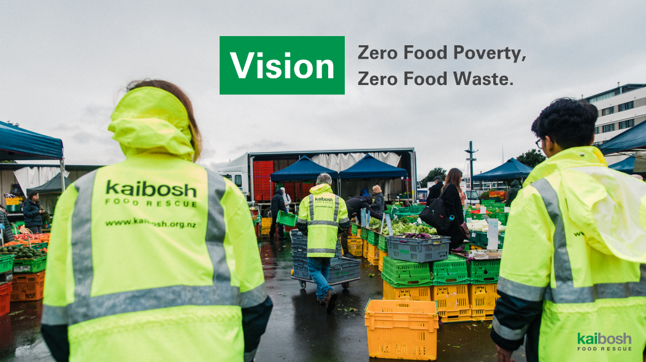
Vision
Zero Food Poverty,
Zero Food Waste.
Kaibosh
Food
Rescue
Notes:
Kaibosh Food Rescue
Founded 2008 in Wellington City
by Robyn & George Langlands
The first food rescue in Aotearoa
Charitable Trust with Board of Trustees

Slide 6
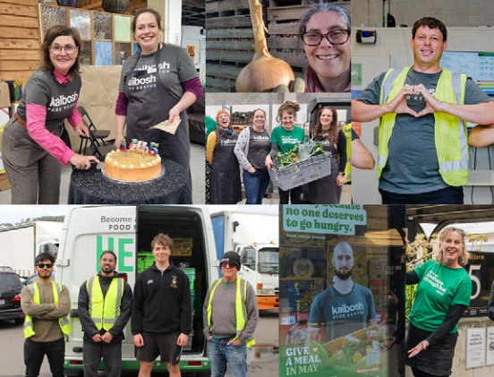
Staff and Volunteers
35 staff -12.1 FTE
4 staff work 30+ hours
40% started at volunteers
250+ volunteers
3 Branches
Pōneke
Petone
Paraparaumu
Notes:
12.6 Full Time Equivalnet - most staff are part time. They range from full-time (only me) to 4 hours per week. Everyone is paid living wage or above. Volunteers outnumber us 6 ½ :1. Voulnteers dinated 6000 hours last year.

Slide 7
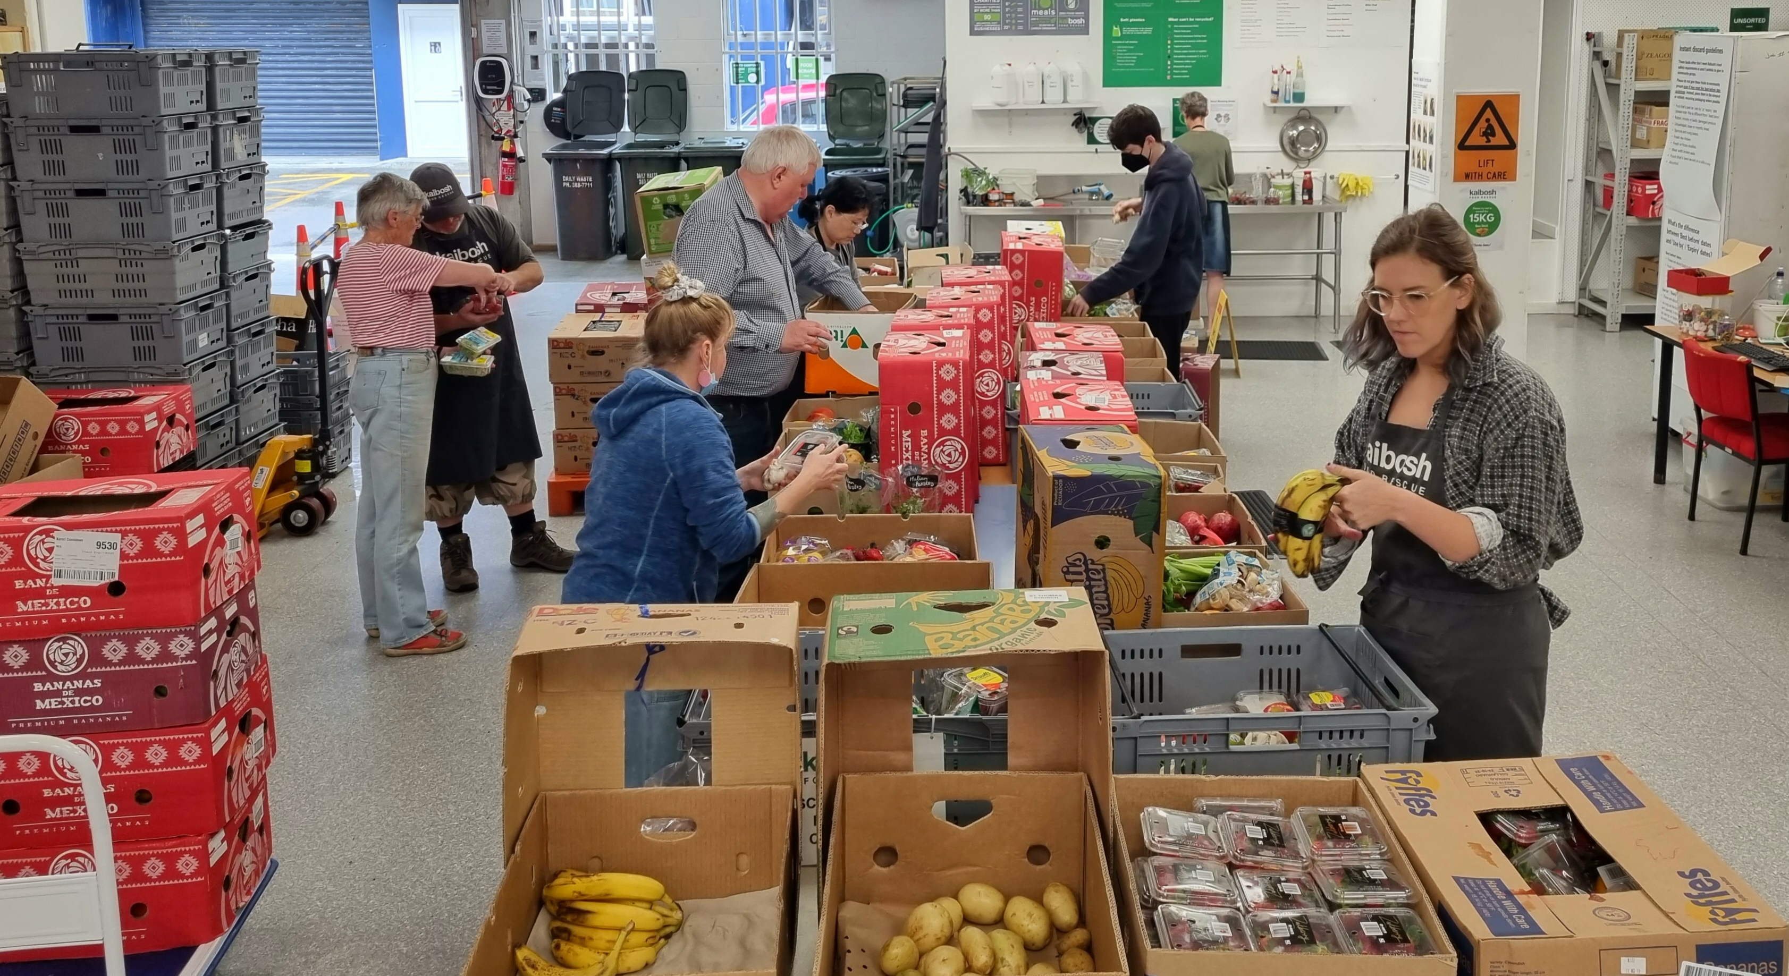
Hopper St Wellington in action – midday food sort

Slide 8
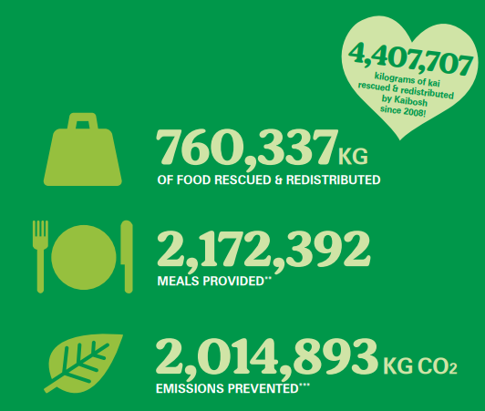
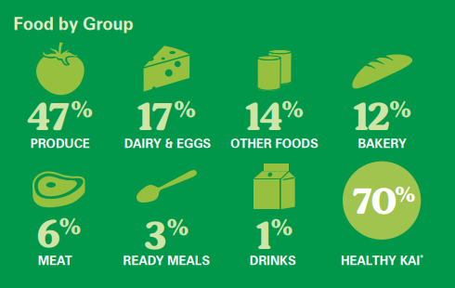
2024 Food volumes
Notes:
I can actually tell you what the totals for this financial year from July 1 2024-June 30 2025 are
853,000kgs, Goal of 70% Fresh Prodcue, dairy, meat and eggs - 77%

Slide 9

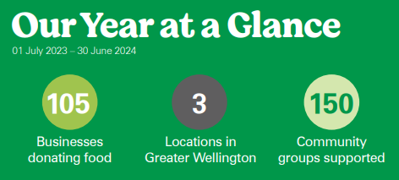
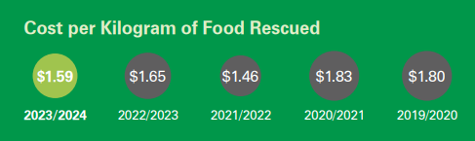
Notes:
12,000 people a week
Who donates: Supermarkets, farmers markets, logistic/food manufacturers/farms/individuals/freight companies.
Why they donate food – cosmetic damage, best before day, use by date, surplus, something slightly wrong, incorrect labelling (recalls) the wrong size or shape or prettiness factor.
How is the food used: food banks/parcels/cooked meals for elderly, homeless or new moms/homework clubs/cooking classes (Well Fed)/Emergency food assistance.
For every $1.00 spent on food rescue - $4.50 worth of social value – study by Otago University Food Innovation Department.

Slide 10
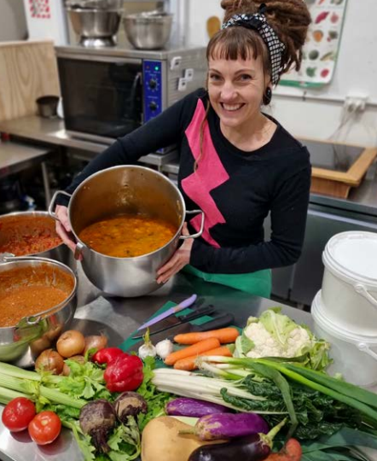
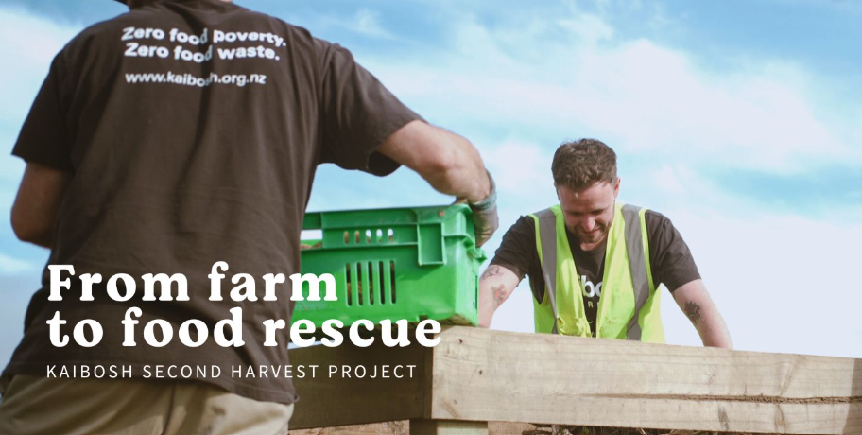
New Work Streams – The Kaibosh Kitchen Petone
Second Harvest – From Farm to Food Rescue
Local Harvest – Co-op model with chioce
Notes:
Need to supplement produce by going directly to farms.

Slide 11
Notes:
Central Government - Was 25% in 2020, this year it is 6.25% and next financial year who knows?

Slide 12

How you can help Kaibosh?
Donate
Connect us to others who might be able to help us.
Run an event
Sponsor a project/vehicle
Advocate for NZ to have a Food Strategy (less food waste/people fed)
Notes:
Make a Meal In May
Funding – Small Grant - John Ilott Fund – for trolleys 2.5K.

Slide 13

Pātai/
Questions
?????

