Slide 1
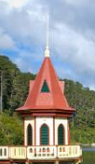
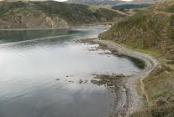
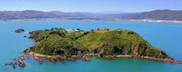
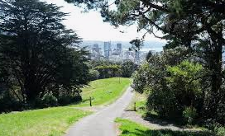
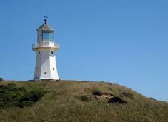
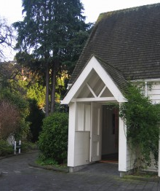
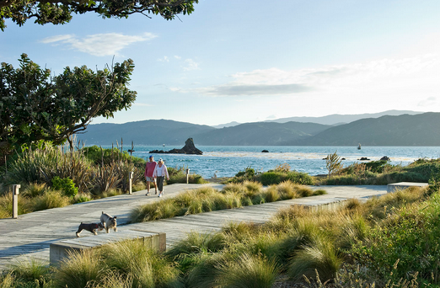
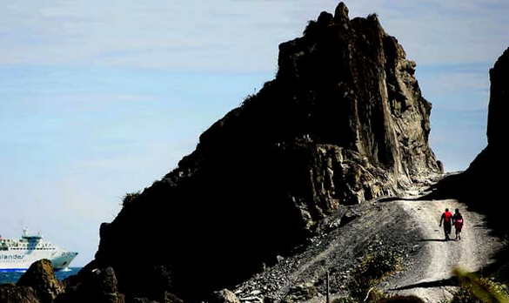
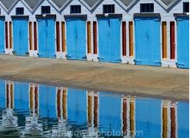
Wellington Places
1 Island Bay
2 Makara
3 Zealandia
4 Mt Kau Kau transmission mast
5 Somes/Matiu Island
6 Pencarrow Lighthouse
7 Central Park, Brooklyn
8 Seatoun
9 Red Rocks
10 Oriental Bay boatsheds
Wildcard Bolton Street Chapel Museum
1
2
3
4
Close up on Wellington
5
7
6
Wildcard
8
9
10
Page 1
Table Quiz Instructions
Using the input from all those at your table, decide on a name, handle the pages around and complete the quiz.

Slide 2
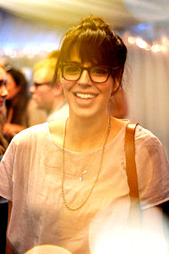
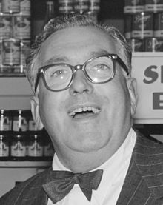
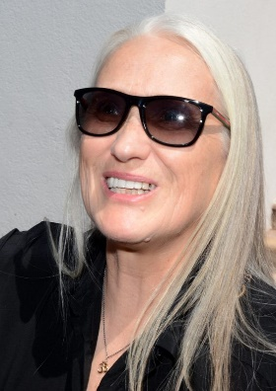
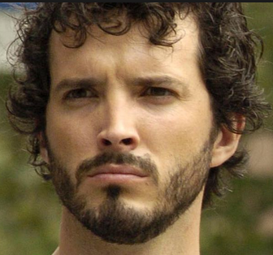
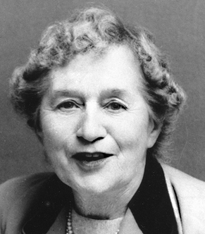
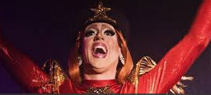
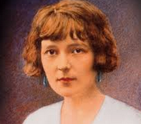
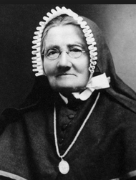
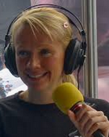
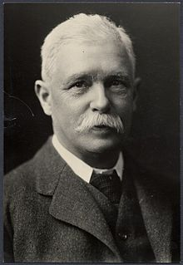
Wellington Locals
1 Selwyn Toogood
2 Jane Campion
3 Brook Fraser
4 Bret Mackenzie (Flight of the Concords)
5 Colin McLean (aka Polyfilla)
6 Maud Basham – Aunt Daisy
7 Katherine Mansfield
8 Melissa Moon
9 Grant Batty
10 Sister Susan Aubert
Wildcard: Alfred Brandon (Mayor of Wellington 1894)
1
2
3
4
5
6
7
8
9
10
Wildcard
Page 2

Slide 3
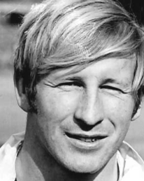
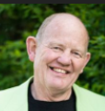
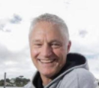
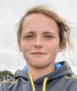
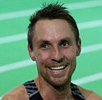
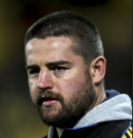
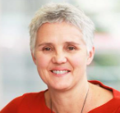
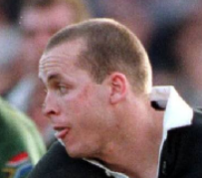
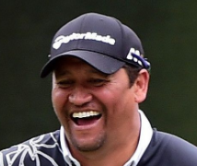
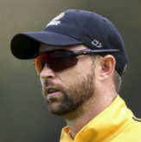
Wellington Sport Celebrities
1 Chris Laidlaw - Rugby
2 Billy Graham - Boxing
3 Gavin Larsen - Cricket
4 Amelia Kerr - Cricket
5 Nick Willis - Athletics
6 Dane Coles - Rugby
7 Anne Hare- Athletics
8 Christin Cullen - Rugby
9 Michael Campbell - Golf
10 Devon Conway - Cricket
Wildcard Bruce Murray - Cricket
Provide both name and sport
1
2
3
4
5
6
7
8
9
10
Wildcard

