Slide 1
New Zealand’s National Flags
Gregor Macaulay
The Rotary Club of Dunedin
12 June 2025

Slide 3
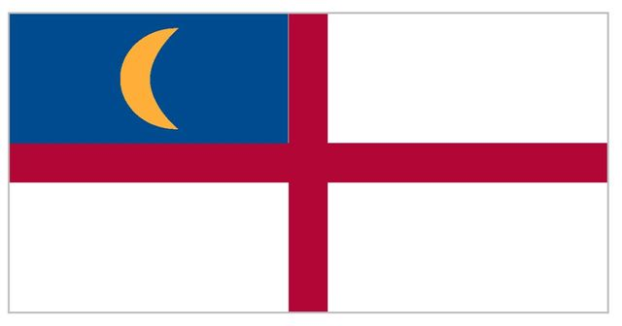

Slide 10
