Slide 1
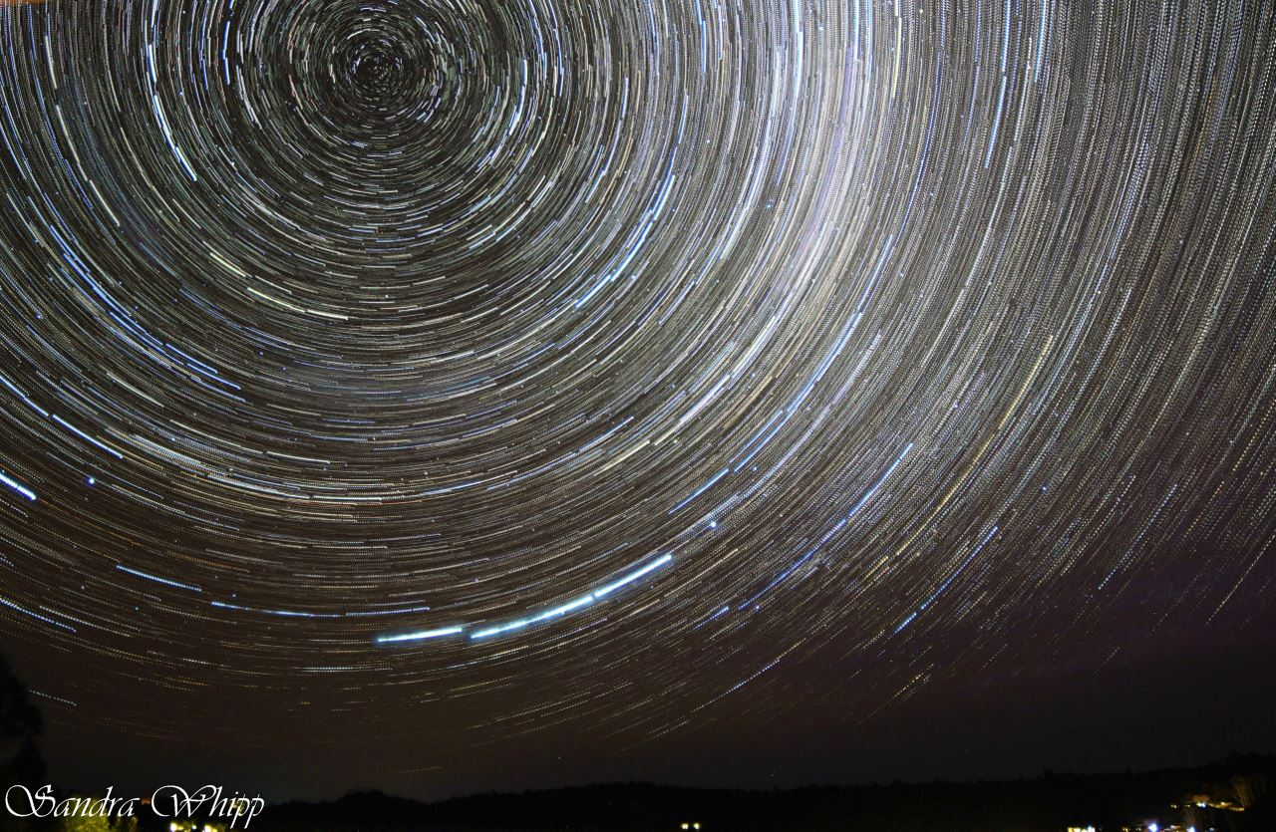
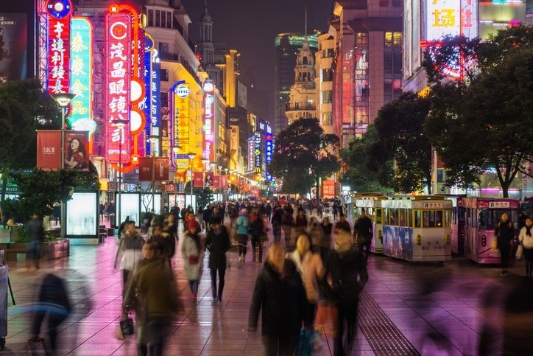


Market Insights – Greater China
Invercargill Rotary Club
19 October 2021

Slide 2
Today's presentation
Great South
The growing importance of China
Economic situation in China
Chinese Culture and Social Phenomenon
Five key trends shaping the Chinese Economy
Challenges of diversification & Opportunities
Q & A

Slide 3

Southland Regional
Development Agency
Notes:
Great South is Southland’s regional development agency.
We are funded by Four different councils and
The koru
An integral symbol in Maori art, the koru represents new life, growth, strength and peace.
For Great South, it represents a new chapter in regional development.
The two tones of blue represent water, highlighting Southland being home to New Zealand largest coastline

Slide 4
Our Goals
1
Grow the population
2
Diversify the economy
3
Grow innovative business
4
Build a skilled workforce
Notes:
Support the development of a diverse and resilient economy
Identify opportunities that encourage new investment, extend sector capability and support economic growth
Strengthen local business
Build capability and capacity in the sector, increase business confidence and position Southland as a preferred place to live and work
Put Southland on the map
Leverage the potential of tourism by profiling Southland as a preferred place to live, work, visit and play

Slide 5
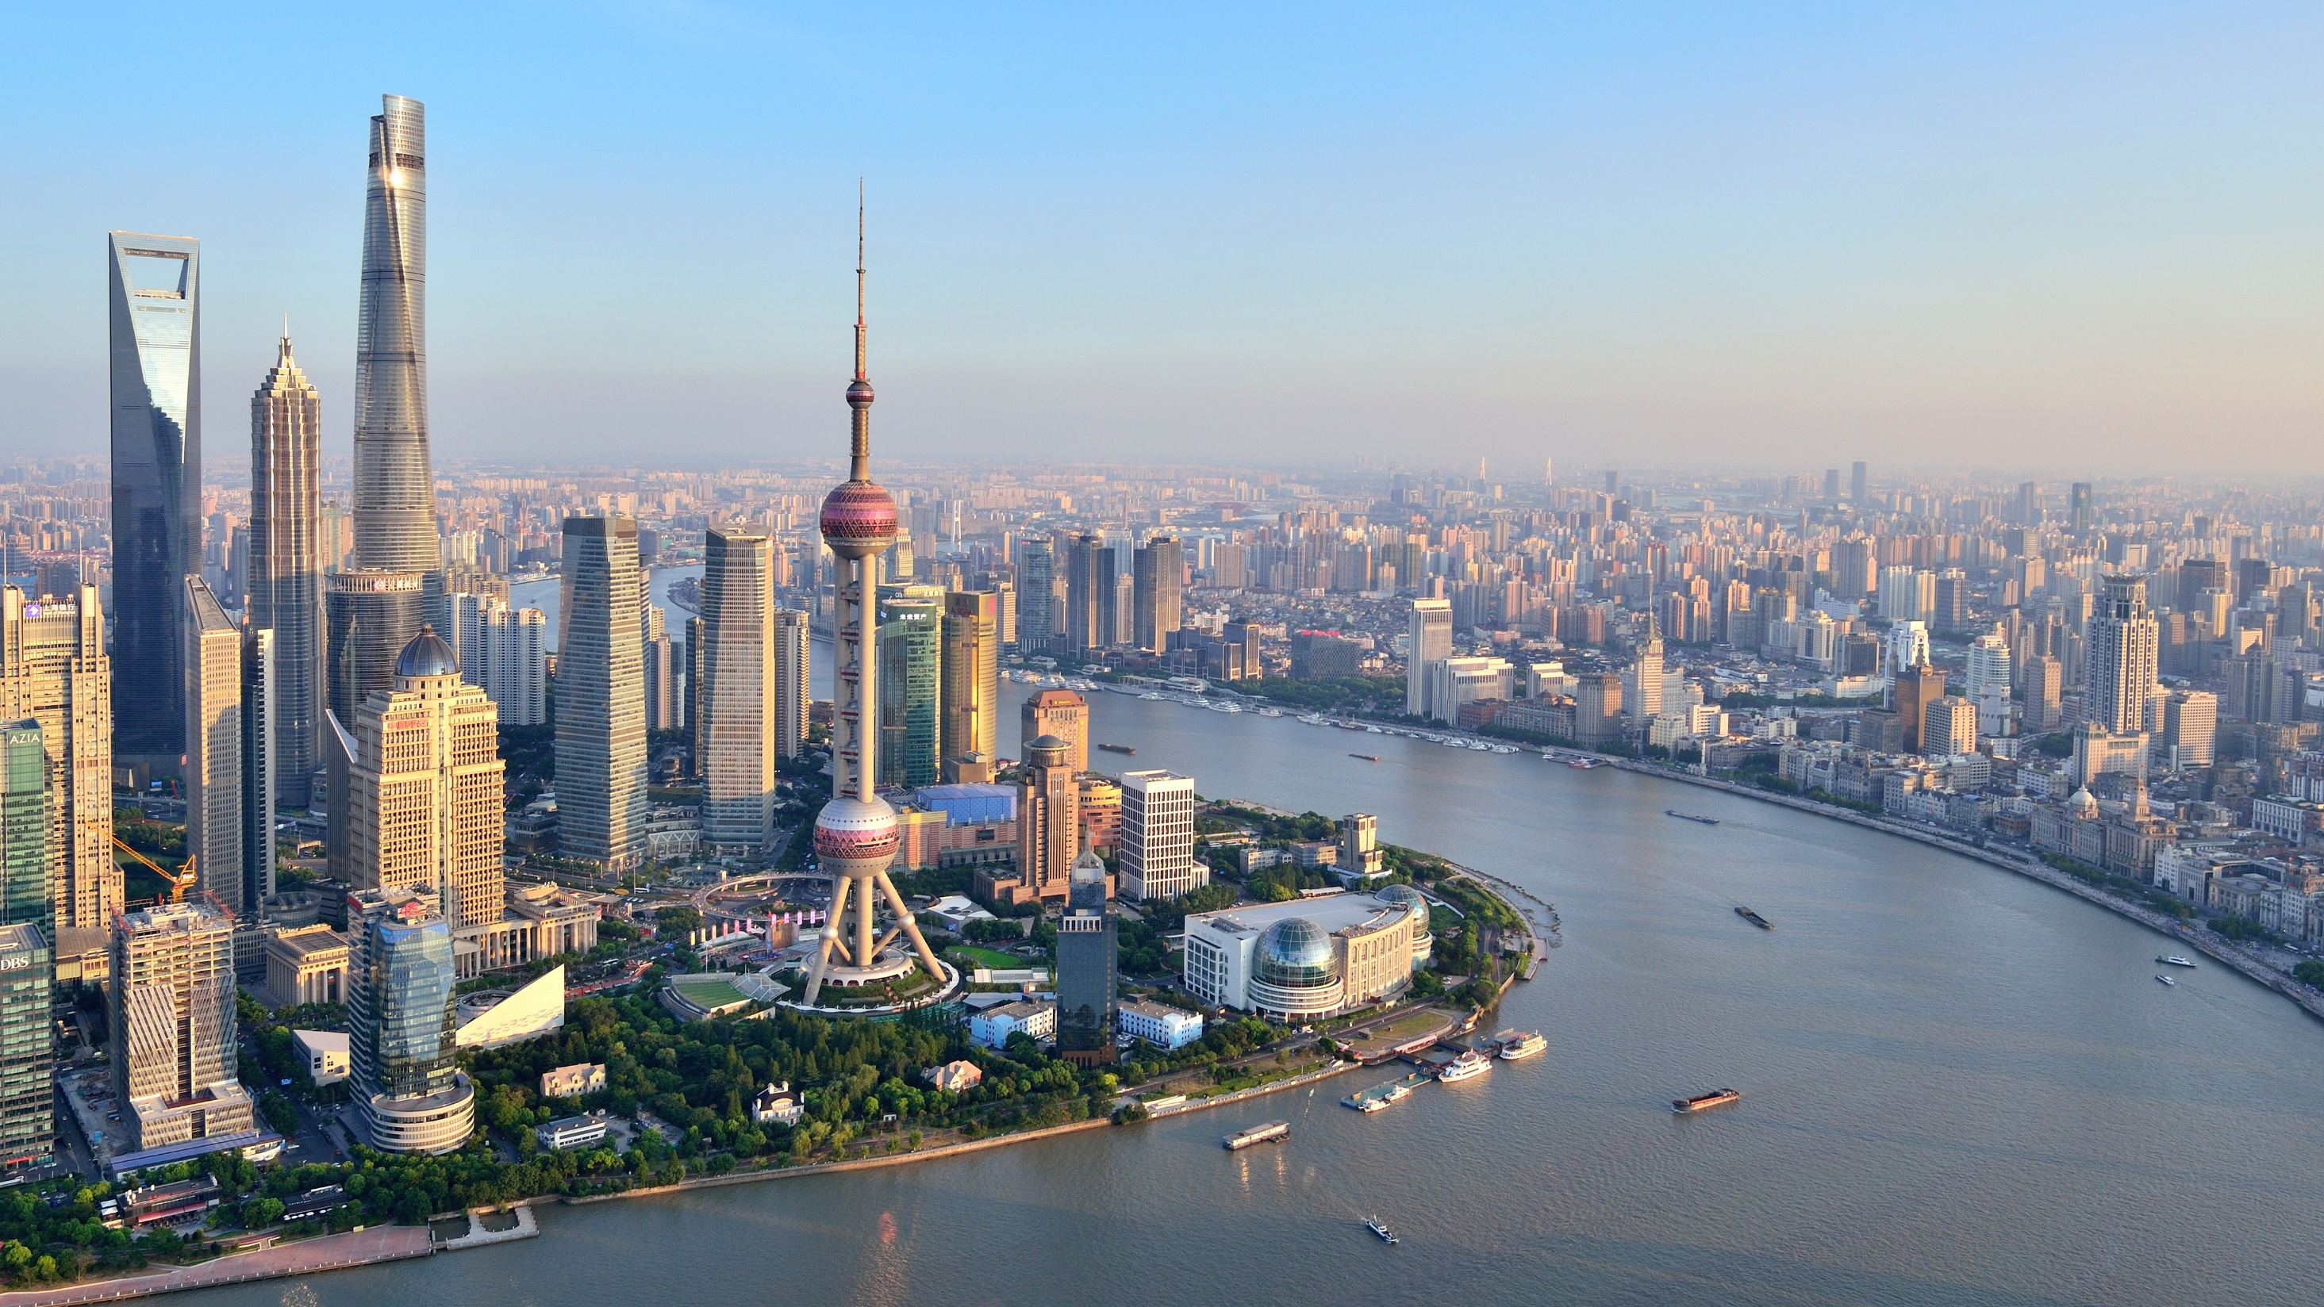
The growing importance of China

Slide 6
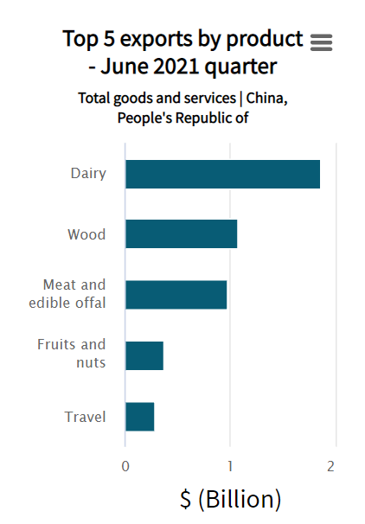
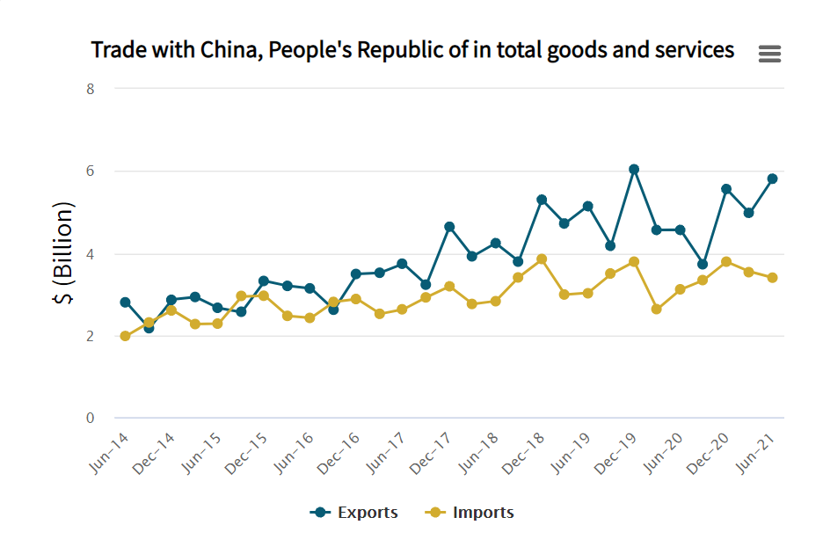

Slide 7
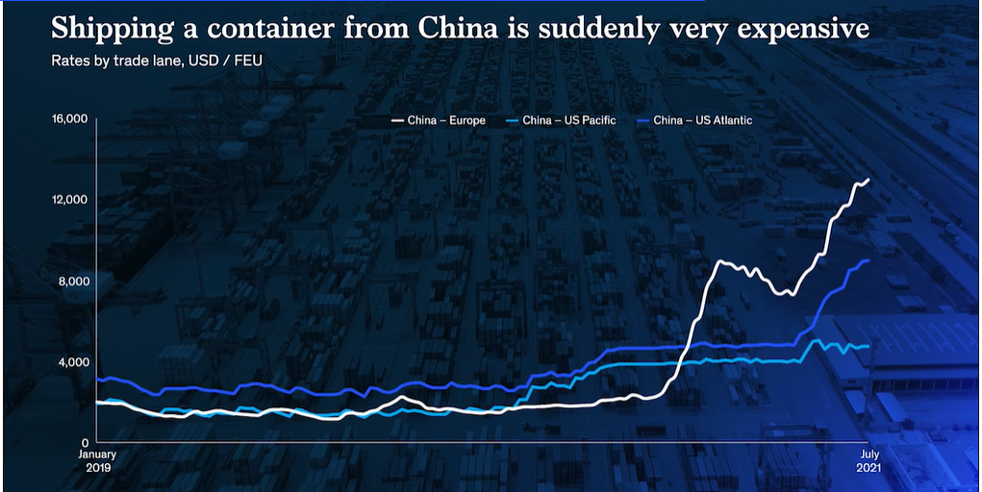
Covid Impact

Slide 8
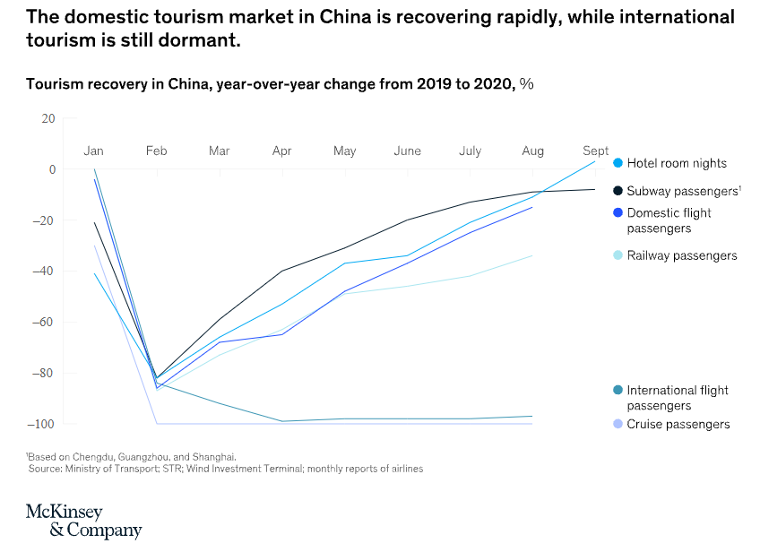
Economic Recovery

Slide 9



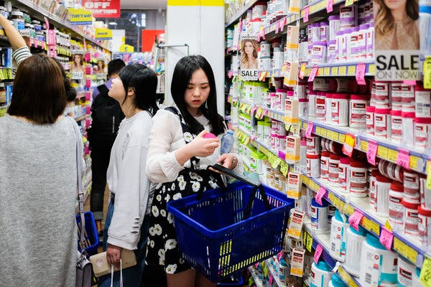

Chinese Culture and Social Phenomenon

Slide 10
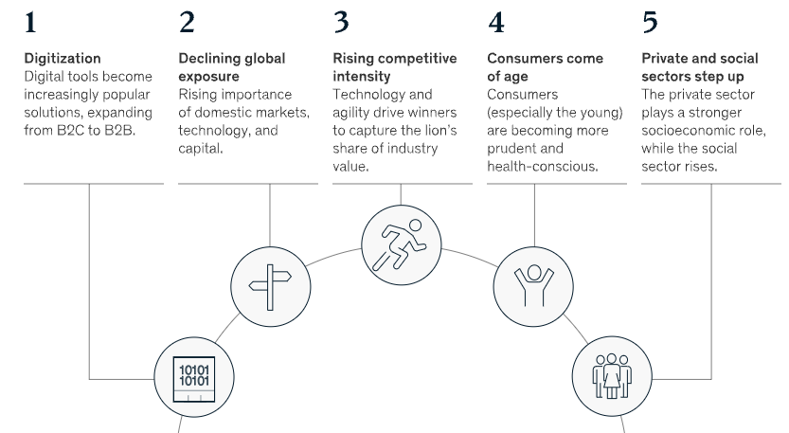
Five key trends shaping the Chinese economy

Slide 11
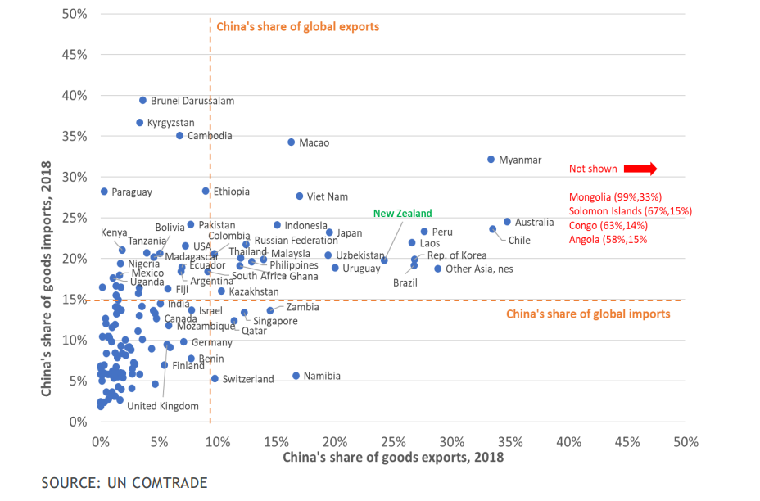
All eggs in one basket ?

Slide 12
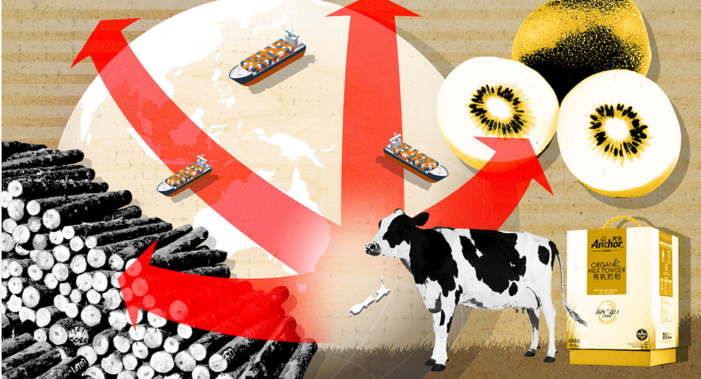
The Challenge of diversification

Slide 13
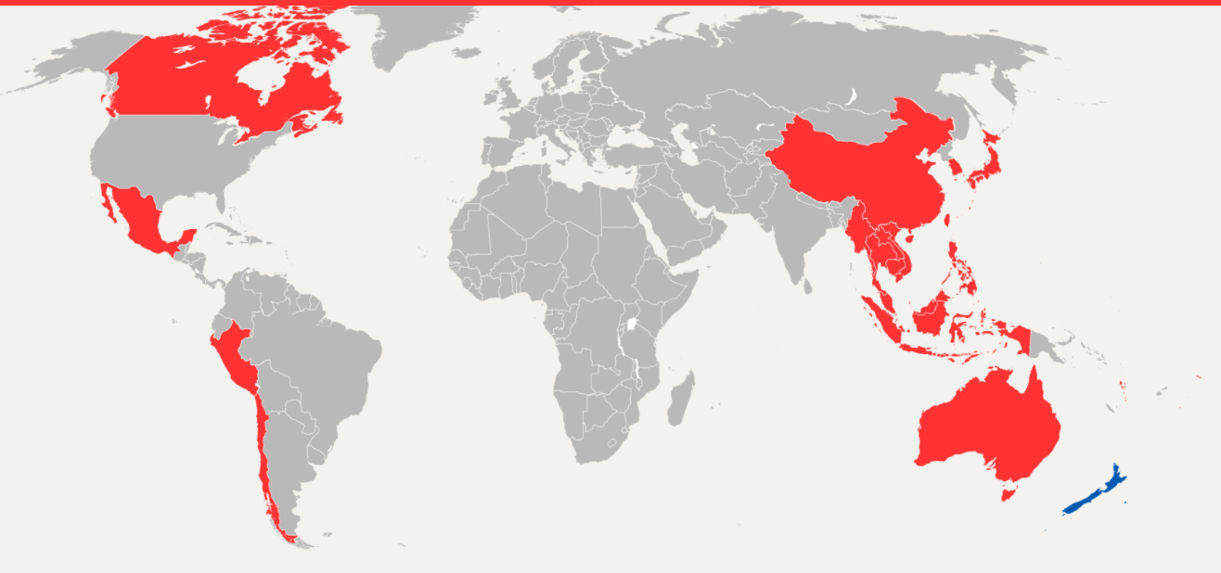
FTAs and trade barriers

Slide 14


Geopolitics

Slide 15
Opportunities for Southland
Technology
Renewable energy such as hydrogen
Value added exports
Film industry
China has agreed to further expand its sectors, including aviation, education, finance, elderly care, and passenger transport as the latest FTA upgrade

Slide 16

Any Questions?

