Slide 1
ROTARY CLUB OF METRO PROVIDENCE
An Introduction to Our Club and Rotary International
Title Page Option

Slide 2
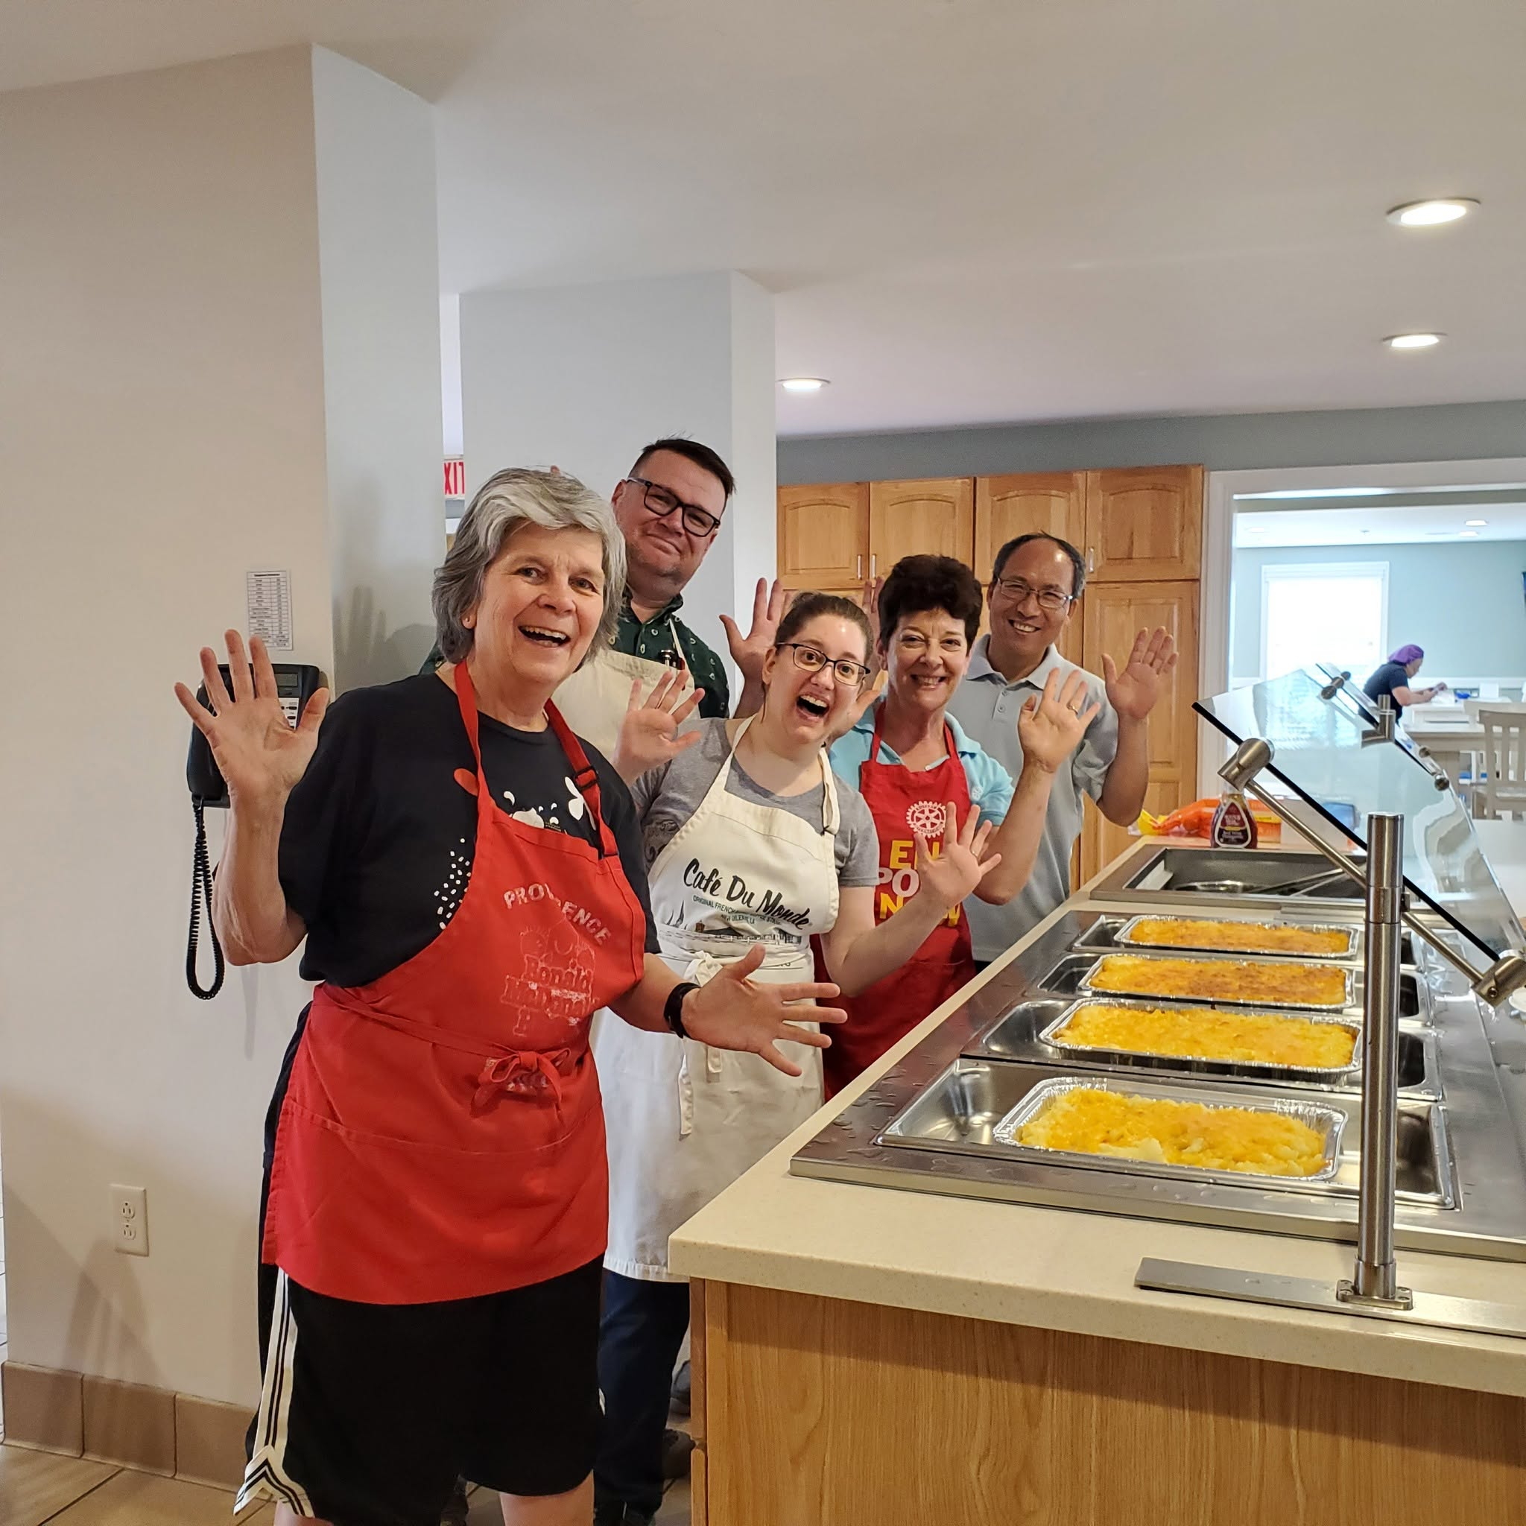
Overview
Introducing Rotary International
About Rotary Club of Metro Providence
Rotary Projects
The Rotary Foundation, including End Polio Now
You and Rotary

Slide 3
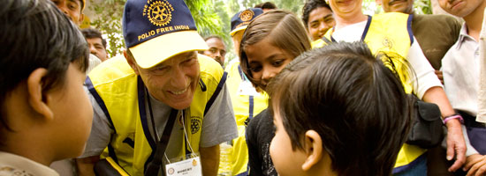
Rotary International
Neighbors, friends, leaders, and problem-solvers who see a world where people unite and take action to create lasting change⎯across the globe, in our communities, and in ourselves.

Slide 4

ROTARY INTERNATIONAL
Started in 1905 in Chicago by Paul Harris
Worldwide organization with 1.2 million
members in over 45,000 clubs
Membership is open to all races, creeds,
genders, and ethnic backgrounds
Organization is nonpolitical
Rotary motto: “Service Above Self”
Local clubs are the backbone of the worldwide organization
Service projects are limited only by the imagination of members

Slide 5


Slide 6

Rotary Areas of Focus

Slide 7
A Highly Ethical Organization
Is it the truth?
Is it fair to all concerned?
Will it build goodwill and better friendships?
Will it be beneficial to all concerned?

Slide 8

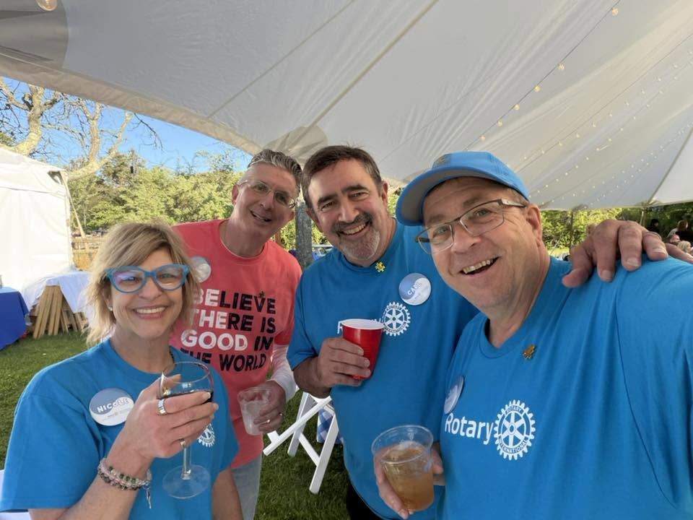
Organizational Structure
YOU!
Club and its
Board of Directors
District (group of clubs)
Zone (group of districts)
Rotary International

Slide 9
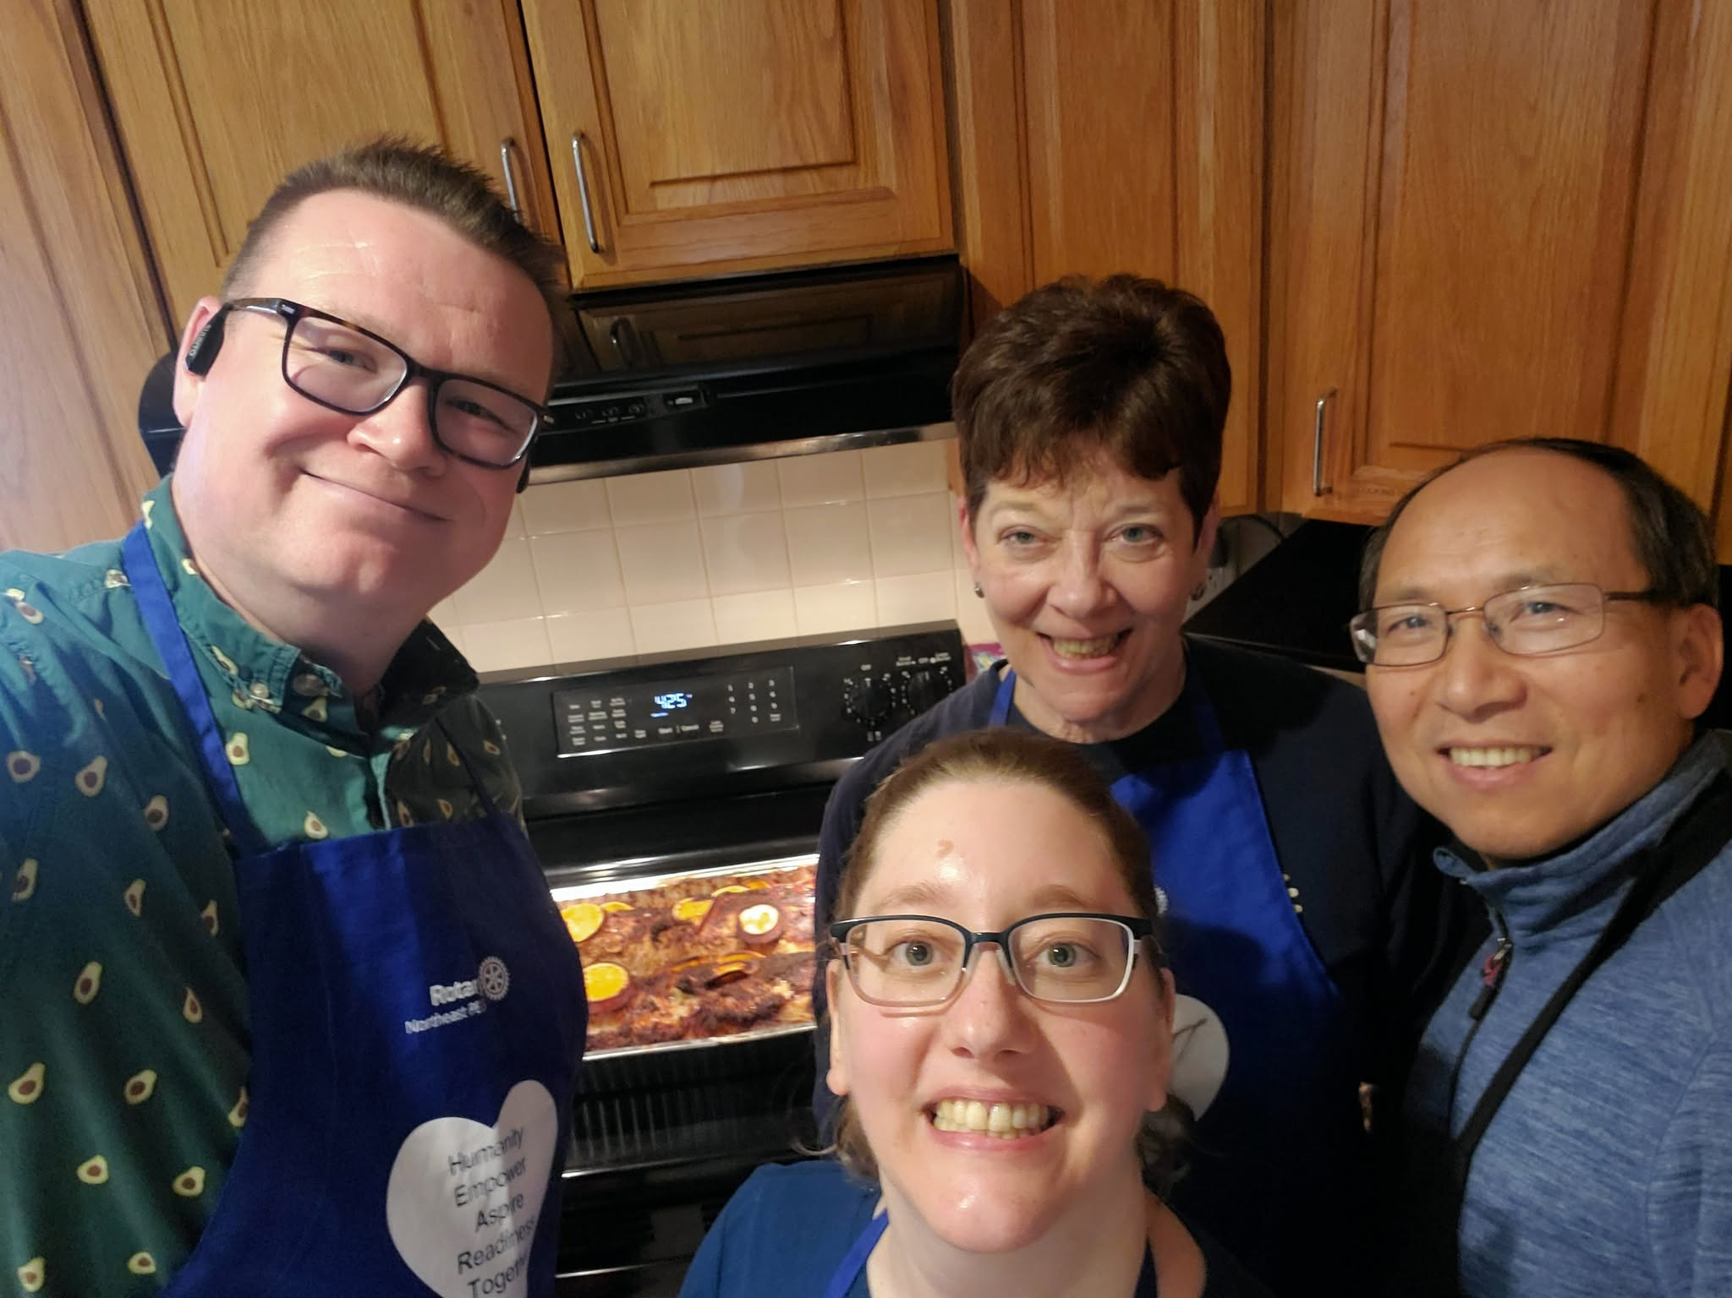
Local Rotary Club Objectives
Club service:
Develop friendship and fellowship and support the club
Vocational service:
Use professional skills to serve others
Community service:
Address local needs
International service:
Meet humanitarian needs around the globe
YOUTH service:
Develop the next generation of leaders

Slide 10
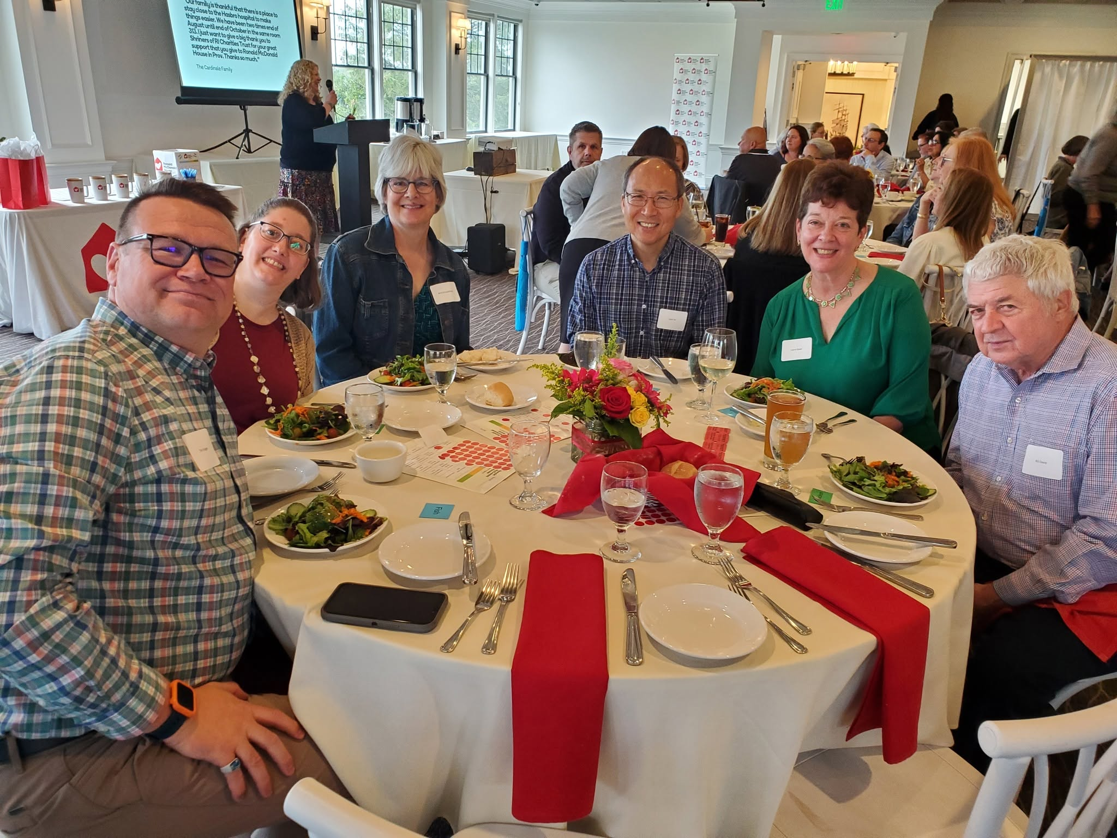
Rotary Club of METRO PROVIDENCE
Meetings: First and third Wednesdays
5:30 PM
Knight Memorial Library
Providence, RI 02903
Social and service events as scheduled

Slide 11
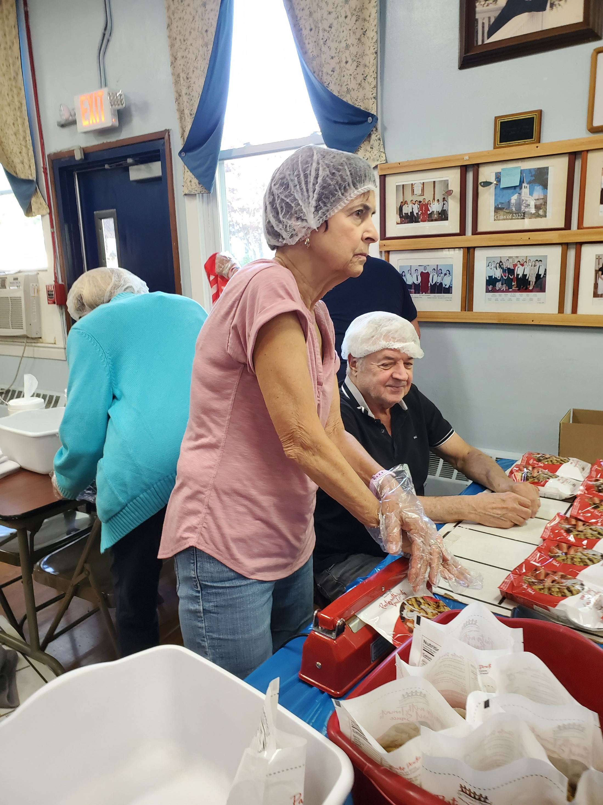
Local Community Service
Meals with Love and kitchen supplies for Ronald McDonald House of Providence
“Pop tops” for Ronald McDonald House of Providence
End Hunger New England food packaging for local schools and food banks
Welcome Home Kits, supplies. and care kits for Crossroads Rhode Island
Children’s Friend spirit of Giving Holiday Presents
Color a Smile
Cards for Hospitalized Kids
Community clean ups
And more…

Slide 12
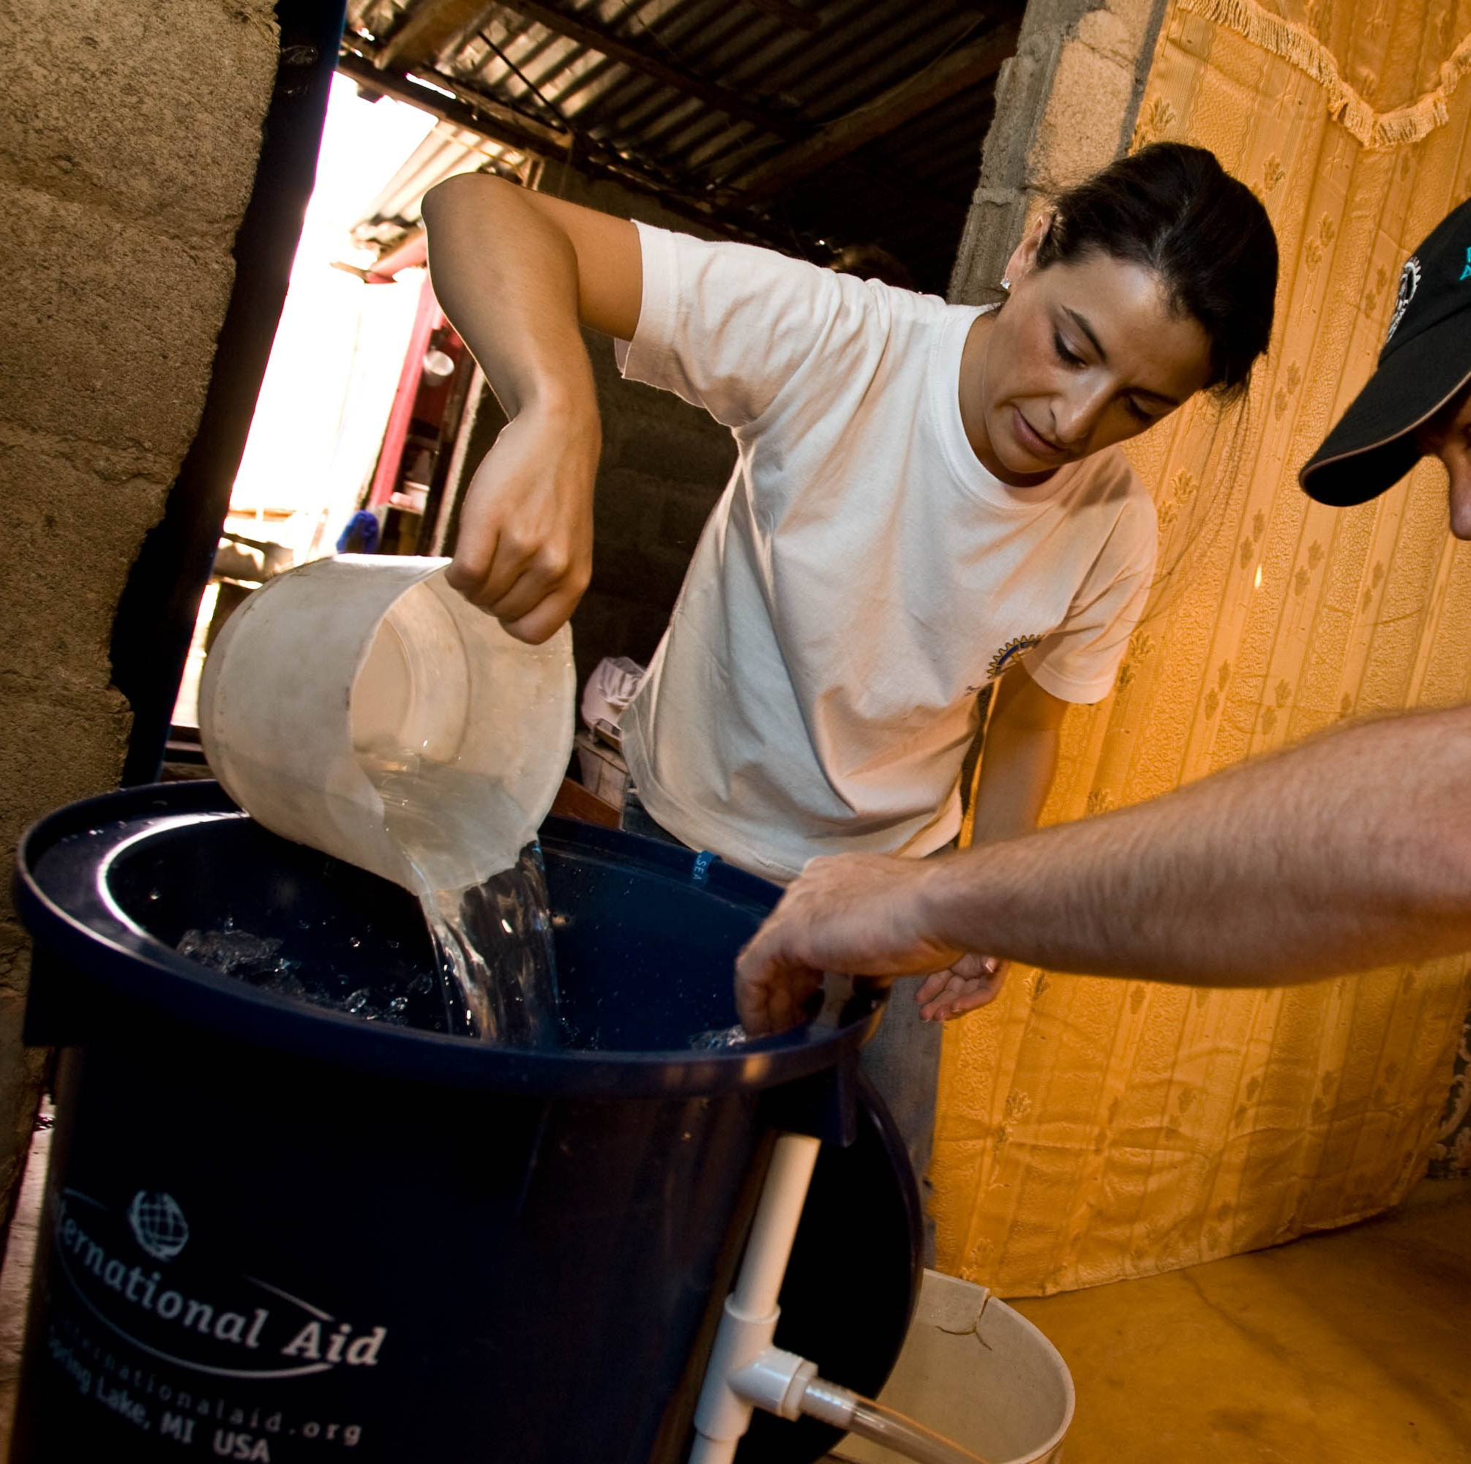
Rotary Service Projects: Supporting Rotary Goals
Rotarians are generous with their time and resources
Rotarians contribute to local club projects and The Rotary Foundation
The Rotary Foundation redirects some funds back to districts for local or international projects
District grants for clubs can fund one major project each year
Global grants support major international projects ($30K-$400K), spearheaded by local clubs
Projects can be sponsored by individual or many clubs
International projects are done with clubs in the project country

Slide 13
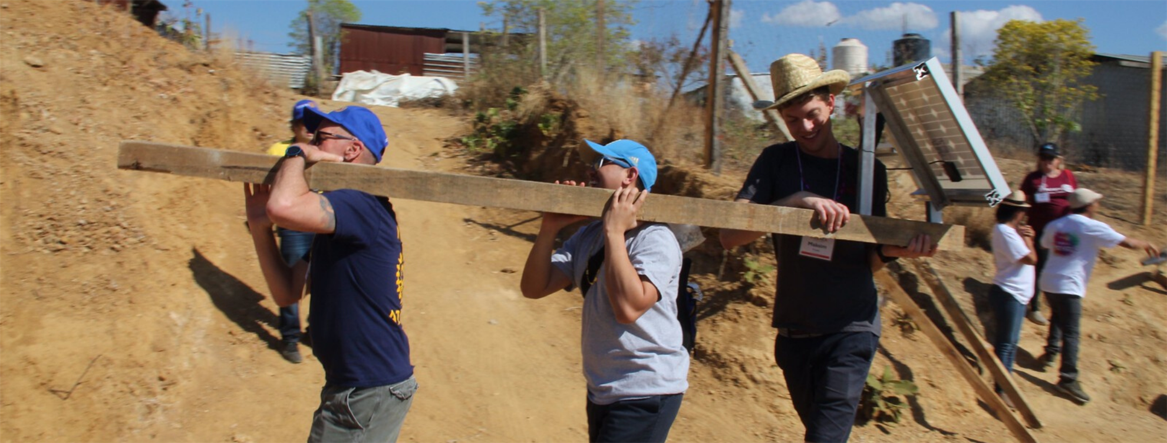
The Rotary Foundation

Slide 14
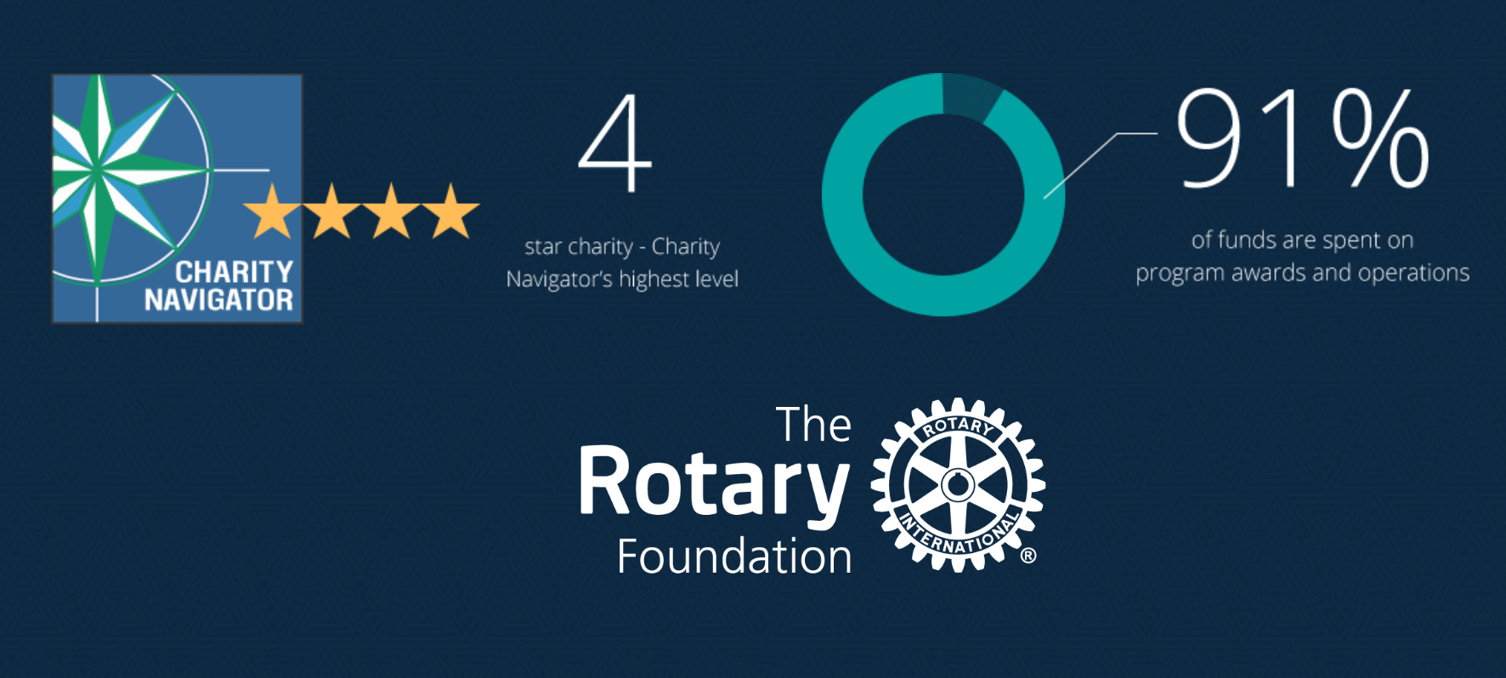
The Rotary Foundation
Mission: Help Rotary members advance world understanding, goodwill, and peace by improving health, providing quality education, improving the environment, and alleviating poverty

Slide 15
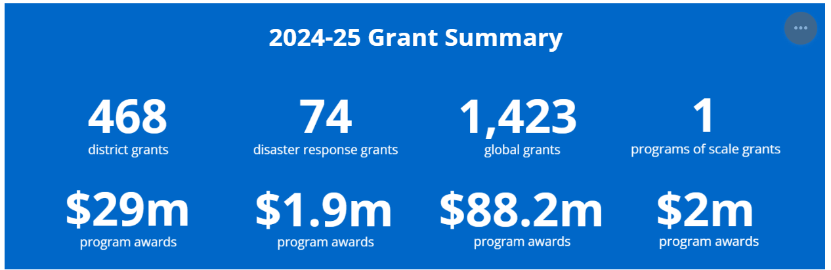
The Rotary FoundAtion funds Matching grants

Slide 16

ROTARY END POLIO NOW

Slide 17
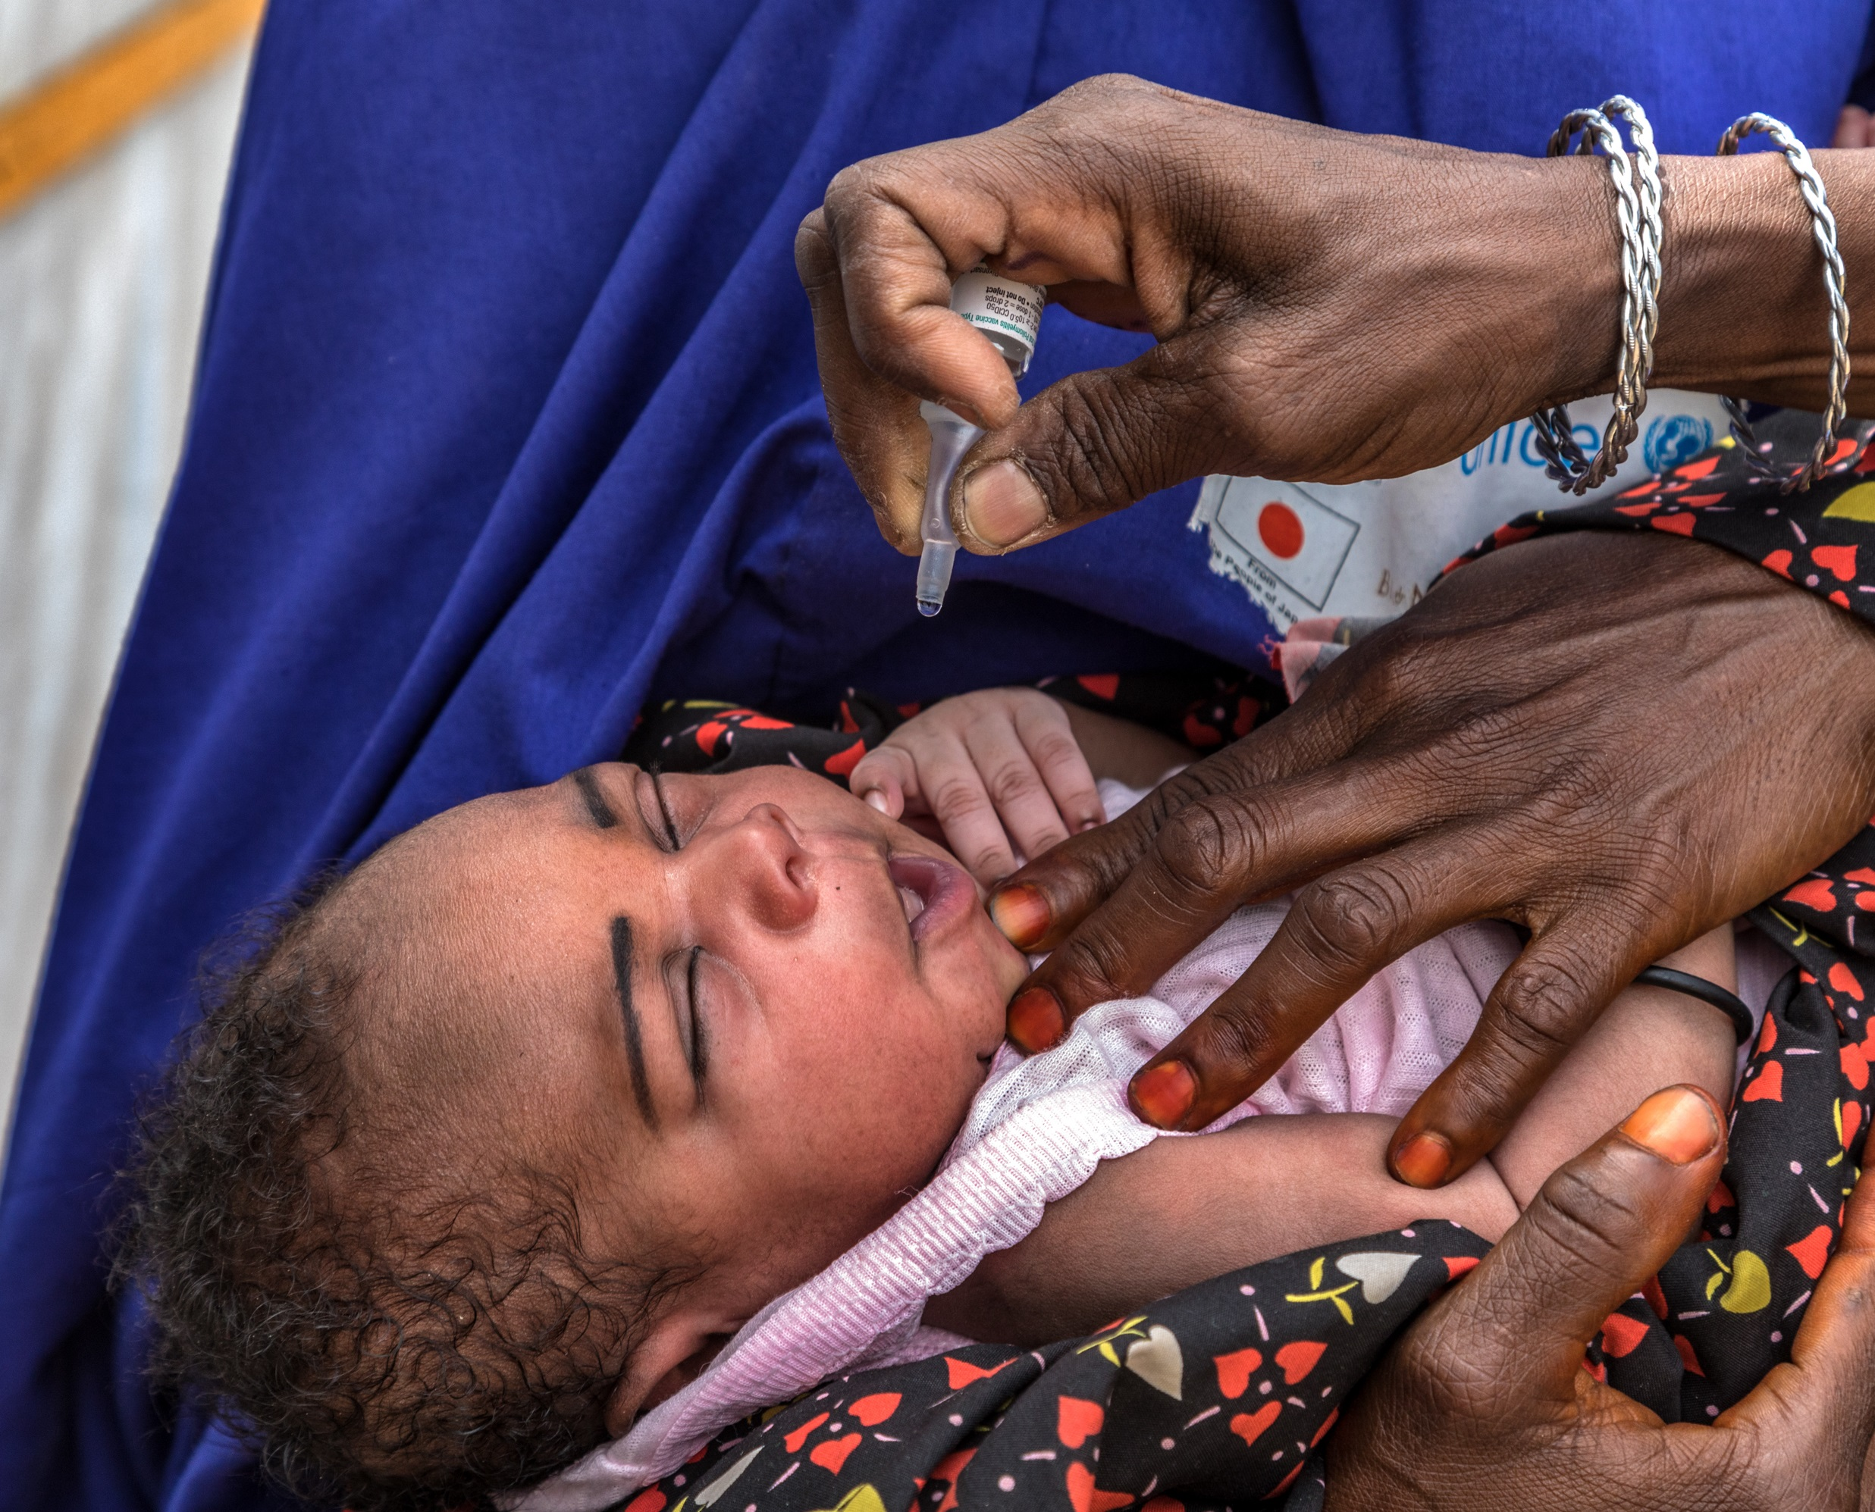

ROTARY END POLIO NOW
1985 Rotary objective: Eradicate polio worldwide!
Started by one Rotarian in the Philippines
Project launched with the World Health Organization and the UN Children’s Fund
Gates Foundation matches donations 2:1
Over 3B children immunized worldwide in 122 countries
Polio cases reduced 99.9% around the world
2025: Wild polio virus detected in Pakistan and Afghanistan

Slide 18

Rotary and…

Slide 19
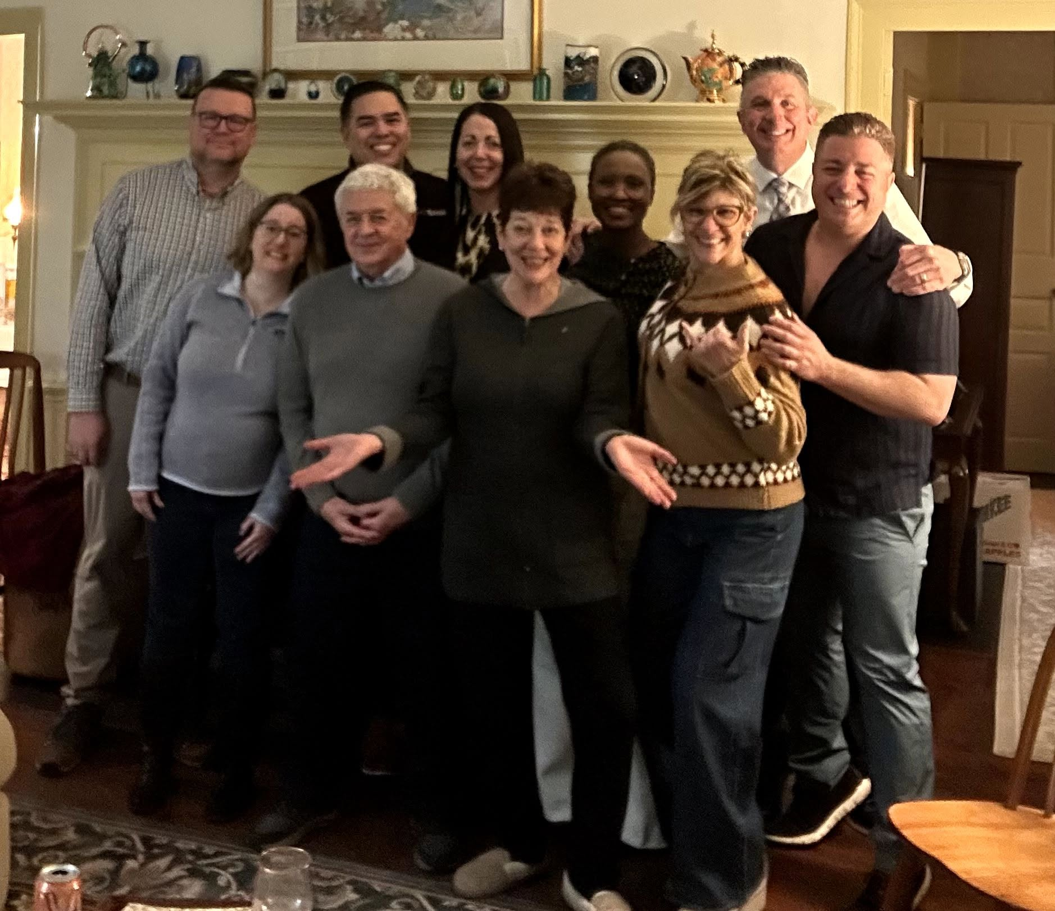
Why Join
Opportunity to help others and be a better world citizen
Personal growth, leadership development, continuing education, public speaking, social and vocational skill development
Fellowship, fun, friendship, acquaintances, entertainment, nice people
Ethics development, cultural awareness, prestige, and pride
Great contacts throughout the country and the world—Rotarians are welcome everywhere!

Slide 20
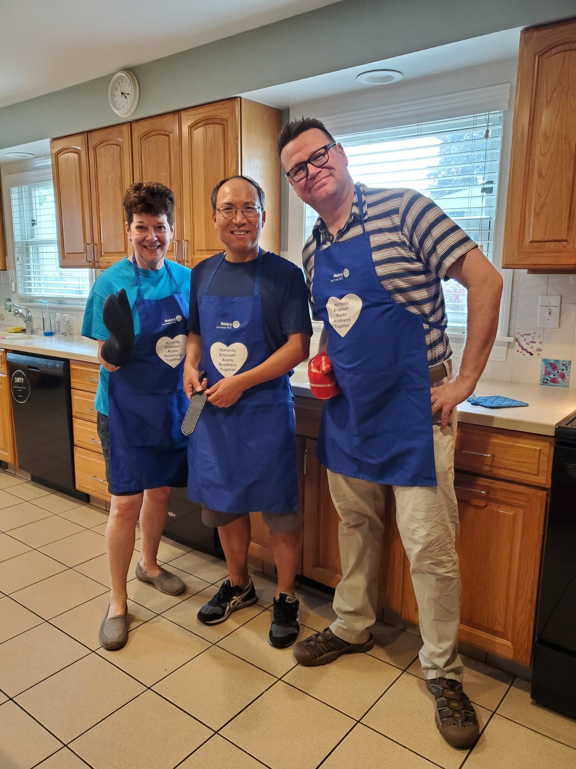
Opportunities
Support or sponsor a service project
Attend social events
Attend meetings
Be a speaker
Serve on the club board or as a committee leader
Attend district meetings, forums, training, and/or conferences
Promote Rotary International

Slide 21
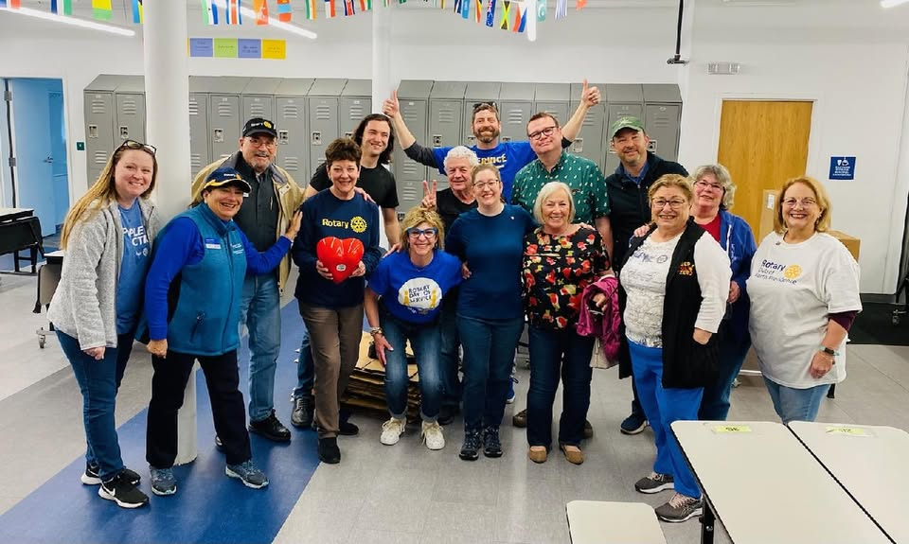
Whatever You Choose… Feel Fulfilled As a Rotarian!

Slide 22
For More Information
Rotary Club of METRO PROVIDENCE
www.rotarymetropvd.org
www.facebook.com/RotaryMetroPVD
www.instagram.com/rotarymetropvd
info@rotarymetropvd.org

Slide 23
QUESTIONS

