Slide 1
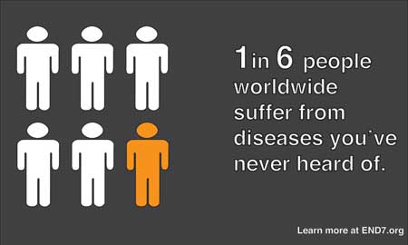
Neglected Tropical Disease

Slide 2
What is a Neglected Tropical Disease?
NTD’s are widespread in the world’s poorest regions, and together they impact approximately 1 billion people – 1/6 of the world’s population
They earn their title because they are not public health problems in wealthier nations, where water and sanitation are up to standard, and thus are the focus of little attention and research
100% of low income countries are affected by at least five neglected tropical diseases simultaneously
These diseases kill over 530,000 people every year

Slide 3
What are classified as NTD’s?
Buruli ulcer
Chagas disease
Cysticercosis
Dengue fever
Dracunculiasis (Guinea Worm)*
Echinococcosis
Fascioliasis
Trypanosomiasis (Sleeping Sickness)
Leishmaniasis
Leprosy
Lymphatic Filariasis* **
Onchocerciasis (River Blindness)*
Rabies
Schisotomiasis* **
Hookworm* **
Trachoma*
Yaws

Slide 4
Who?
The poorest people from the poorest countries on earth are the majority of those afflicted with NTD’s
Individuals living in conflict zones are disproportionately impacted by NTD’s
South Sudan has had conflict-related outbreaks of at least 3 NTD’s, particularly Leishmaniasis
Afghanistan suffered an outbreak of cutaneous leishmaniasis due to long-standing conflict
Syria is the most recent location to develop a widespread outbreak of NTD’s, also including leishmaniasis

Slide 5
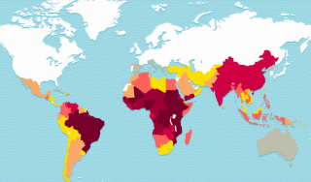

Slide 6
The Medical Effects of NTD’s
NTD’s can often cause extreme disability and/or disfigurement, more often than death
Many involve parasitic or viral infection, especially the water-borne or mosquito/tsetse fly-borne NTD’s
Some effects include ulcers, fever, cysts, CNS trauma, chronic cough, chest pain, liver failure, skin and bone infection, sleep disorder, seizures, coma, lymphedema of the limbs, kidney damage, skin disfigurement, blindness, intenstinal symptonms, anaemia, malnutrition, epilepsy, death

Slide 7
Social & Economic Effects
Those afflicted suffer from isolation, social stigma, inability to work
Social impacts on child rearing, independence, reduced productivity of caregivers
Morbidity causes decades of lost productivity per person, with up to $3 billion in productivity lost per disease, per year
No studies investigating impact of co-morbidity (presence of more than one disease per individual) which is likely significantly higher

Slide 8
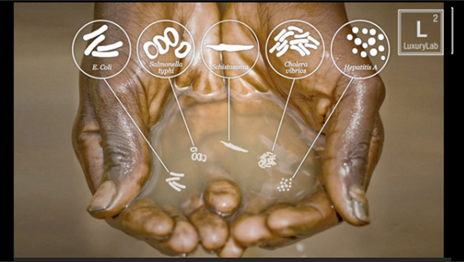
What Causes NTD’s?
Most are caused by parasites and viruses spread by contact with contaminated water, human or animal waste, or insects such as the mosquito or tsetse fly
Mainly occur in areas with poor water and sanitation – extremely rural areas or urban slums

Slide 9
Treating NTD’s
Drug development is slow and outdated
Medications are available to treat many of the more prevalent NTD’s, although they do not always reach the populations who need them most
Medications are often extremely affordable ($0.25-$0.50 per person, per year) due to donations of drug treatments
Efforts to promote clean water, sanitation and hygiene (WASH programs) also address underlying causes

Slide 10
Ways to Help:
Support/undertake a water & sanitation project
Donate funds to organizations focused on NTD treatment/prevention, campaigns against individual diseases, or to public health organizations working in conflict zones/refugee camps

