Slide 1
Leadership
Dieter Dratwa @ Rotary Club Patong Beach
Title Page Option

Slide 2
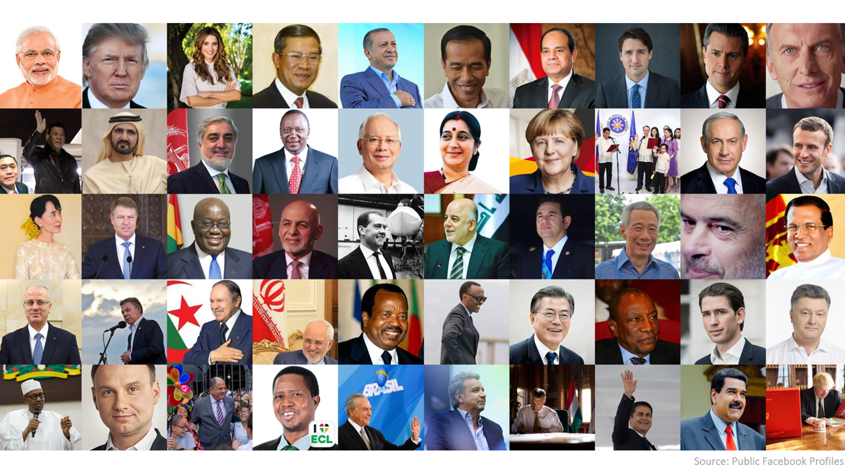
Known leaders

Slide 3
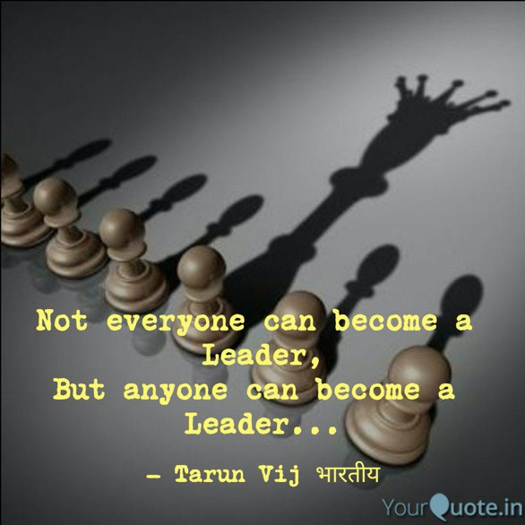

Slide 4
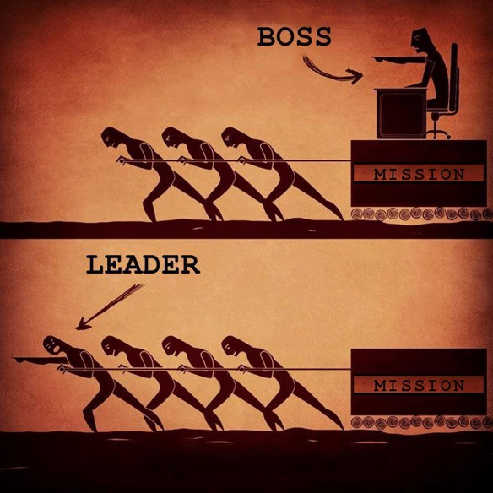

Slide 5
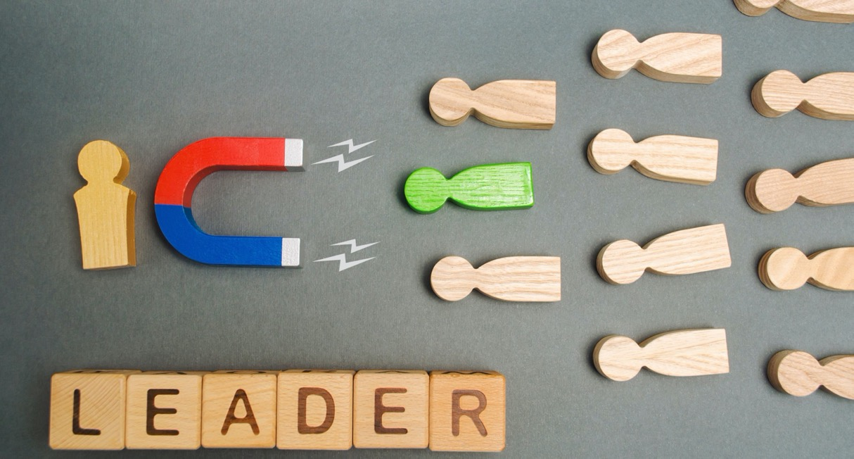

Slide 6
Being a leader
DO’s
Learning quickly what motivates team members
Asking your team for their view on the situation
Thinking beyond what happened in the short term
Knowing how to train and develop your team
Setting standards to build a team you can rely on
DONT’s
Thinking yesterday‘s result will still count tomorrow
Being out of touch with your own emotions
Not noticing what is going on around you
Not asking for feedback on your leadership and ideas
Not keeping physically fit and thinking positively

Slide 7
Leader vs. Manager
Leader
Focus on people
Risk tolerant
Innovative
Visionary
Emphasize product/service, not financial results
Think long-term
Rely on charm and influence
Can be dictatorial and authoritative
Work for winning, not for money
Manager
Focus on processes
Risk averse
Formulistic
Objective
Emphasize the bottom line
Think short-term
Rely on authority and formal position
Are democratic and engaging
Work for rewards – money, fame, or ego.

Slide 8
Leader AND Manager
Leader
Manager

Slide 9
Leadership styles
Coercive | Authoritative | Affiliative | Democratic | Pacesetting | Coaching
Demands that people comply Drive to achieve, self-control Key phrase: “Do what I tell you” | Leads with a clear vision Self-confidence, empathy Key phrase: “Come with me” | Creates harmany, builds bonds Empathy, good relationships, and communication skills Key phrase: “People come first” | Consensus through participation Collaboration, team spirit, and communication skills Key phrase: “What do you think?” | Seys high performance standards Drive to achieve, conciousness Key phrase: “Do as I do” | Develop skills in other people Developing others, self-awareness Key phrase: “Try this”

Slide 10
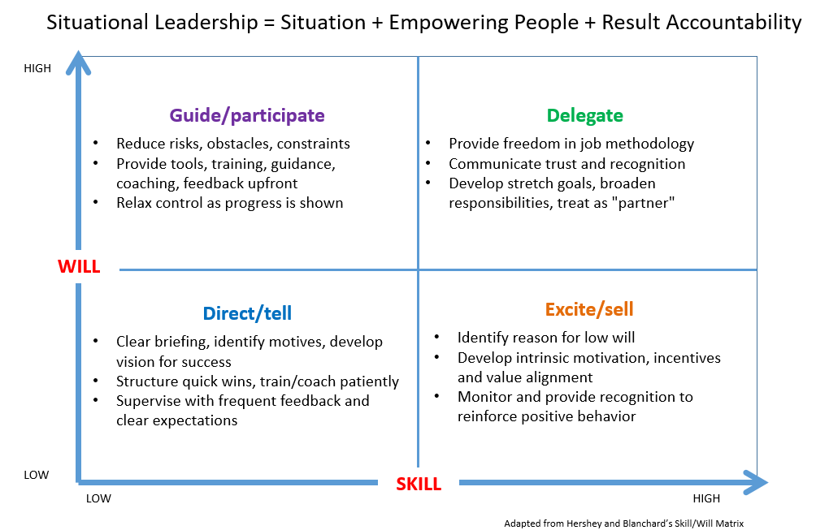

SITUATIONAL Leadership MOPEL

Slide 11
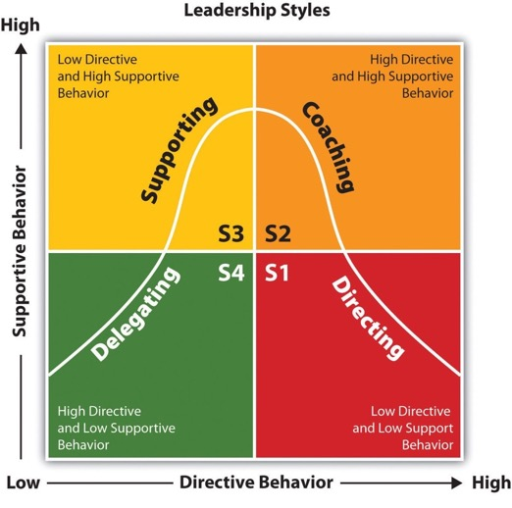
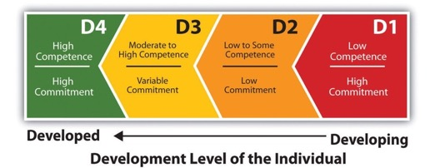
SITUATIONAL Leadership MOPEL

Slide 12
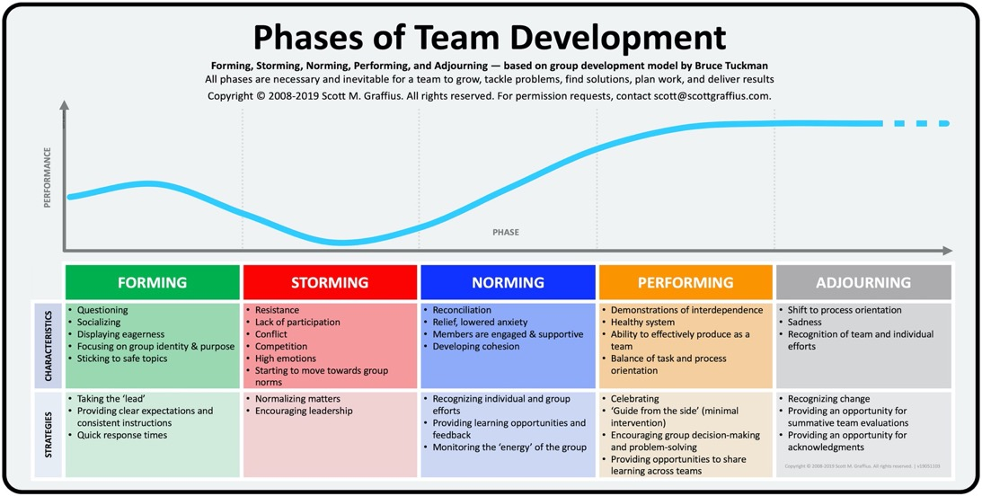
Forming a team

Slide 13
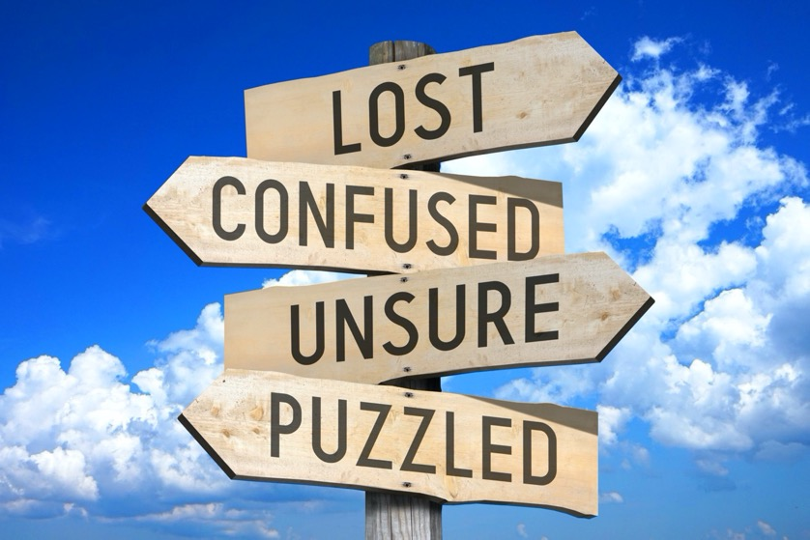


Leading through a crisis

Slide 14

Leading through a crisis
Leading through crisis:
Adapt instead of react to the new situation
Lead with confidence
Any direction going is better than running in circles (no panic!)
Admit mistakes and fine-tune later

Slide 15
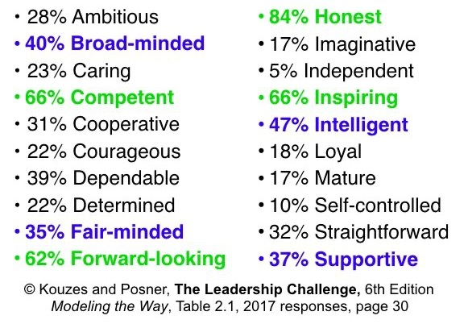
Characteristics of a leader

Slide 16
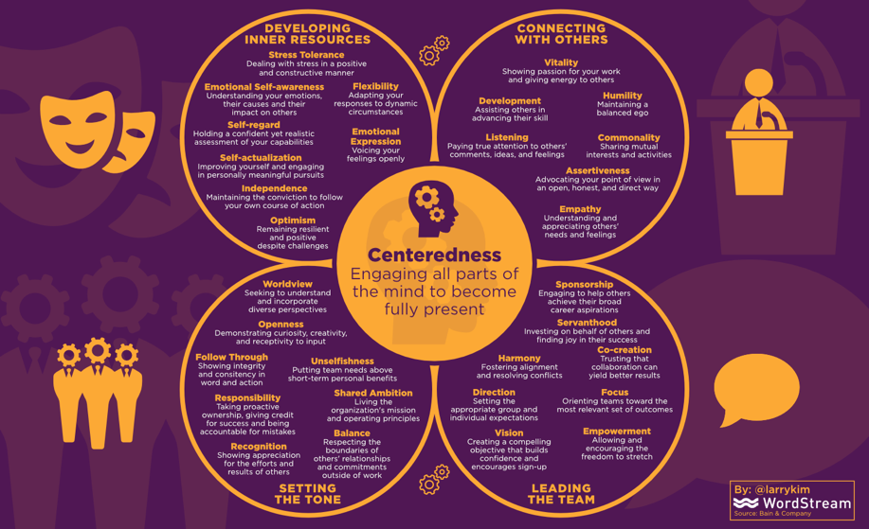
How to become a great leader
Become a great leader:
Get inspired by other leaders e.g, TED talks
Continous learning
Form a well-rounded personality
Seek opportunites to lead
Get a coach e.g., Dieter Dratwa

Slide 17
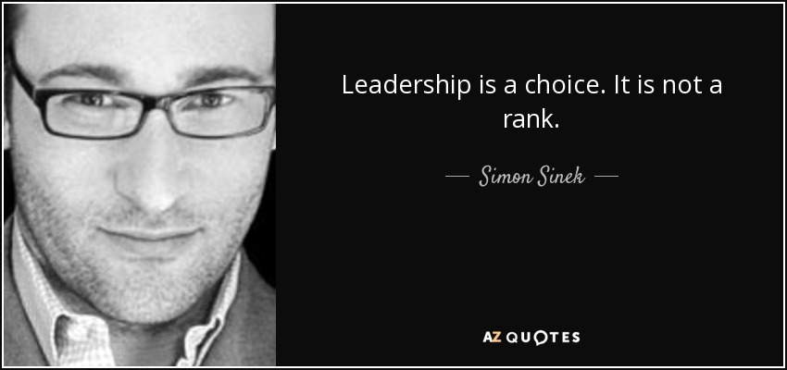

Closing the circle

Slide 18
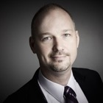
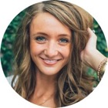
Q&A
What is leadership for you?
Is leadership in Phuket different?

Slide 19
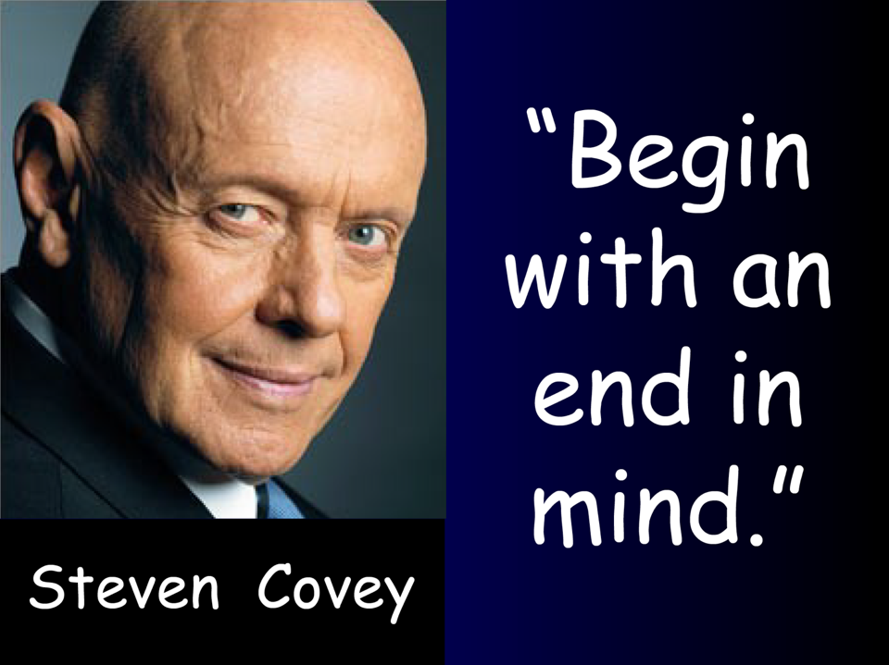


Slide 20
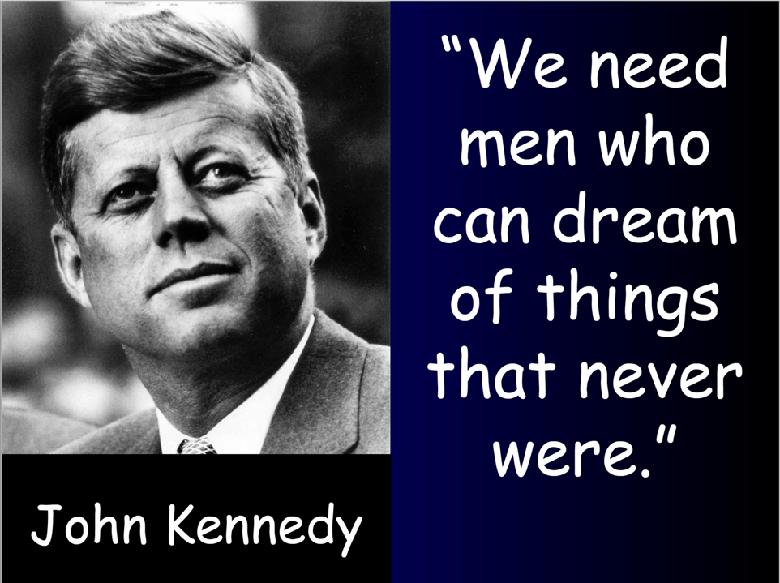

Slide 21
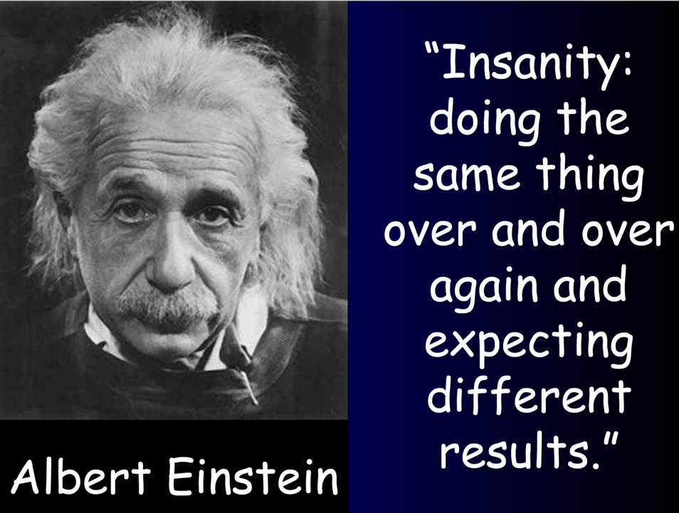

Slide 22
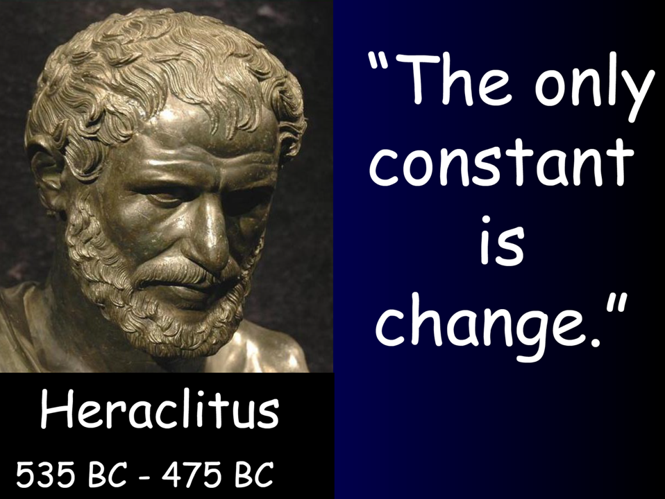

Slide 23
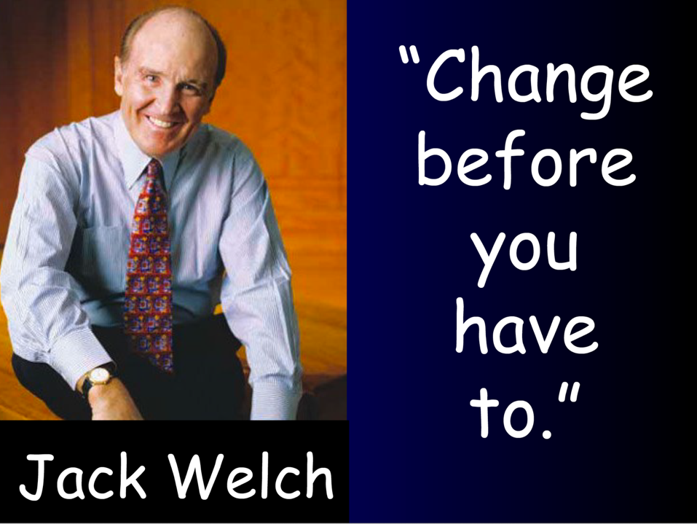

Slide 24
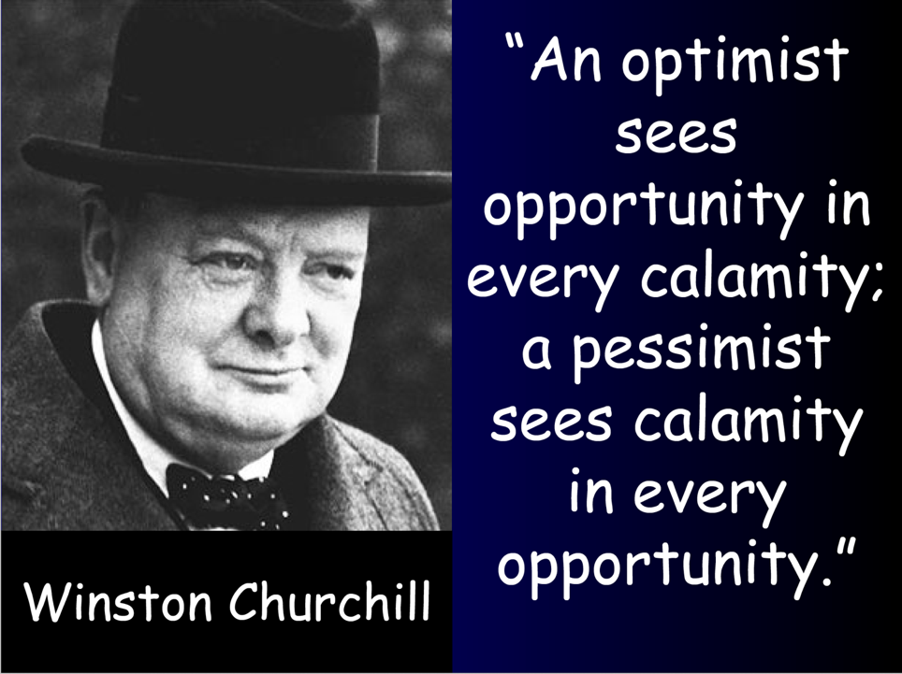

Slide 25
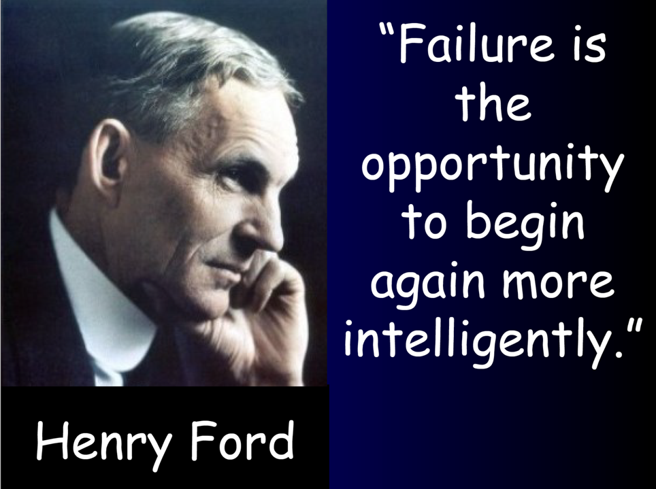

Slide 26
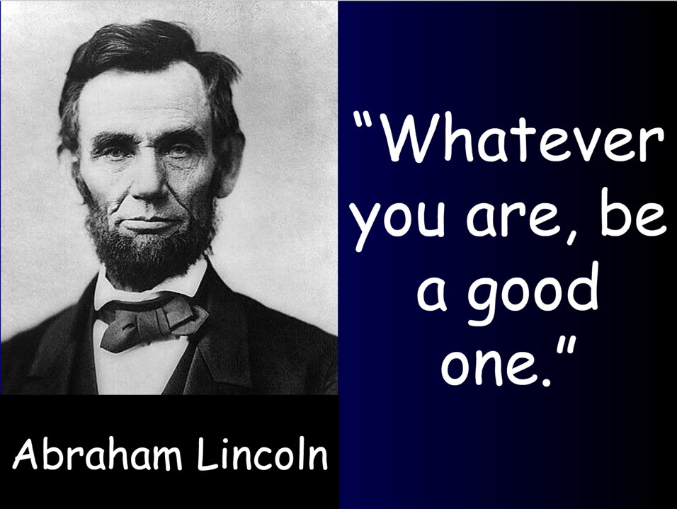

Slide 27
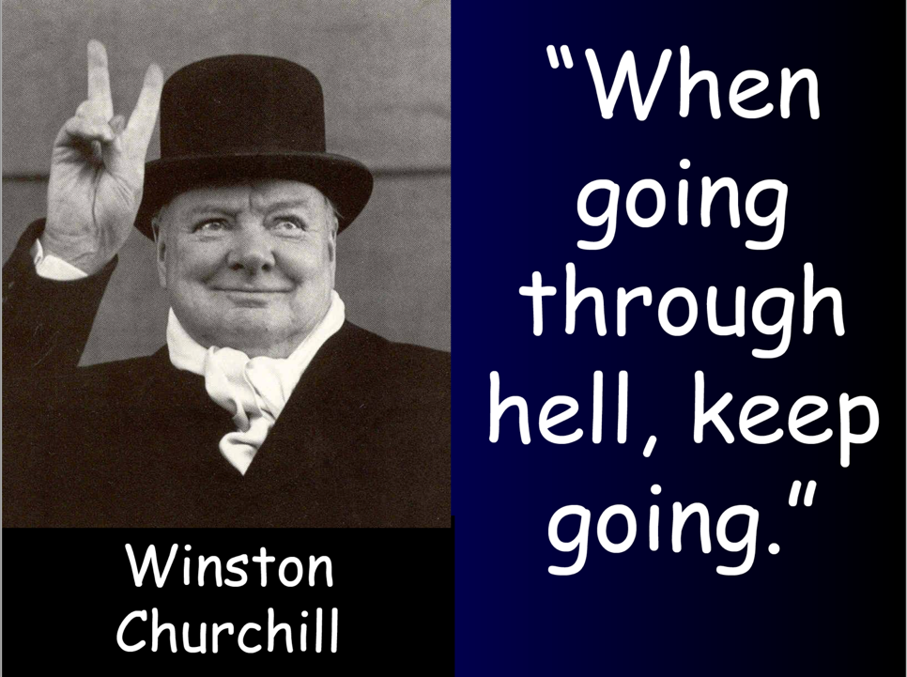

Slide 28
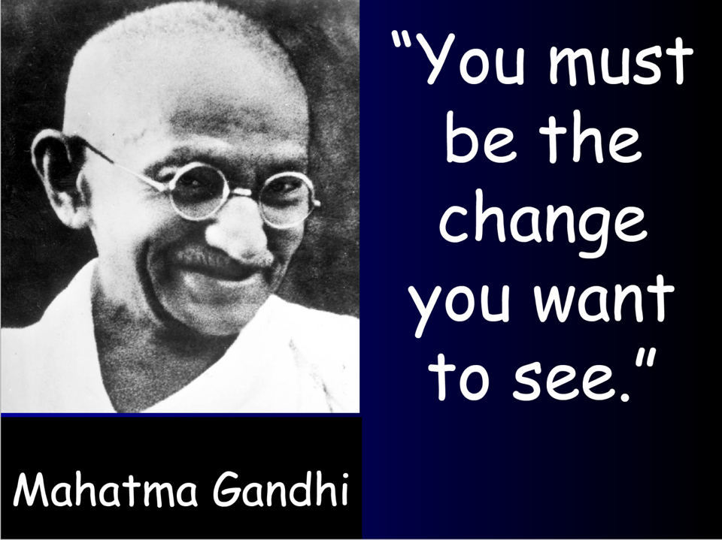

Slide 29
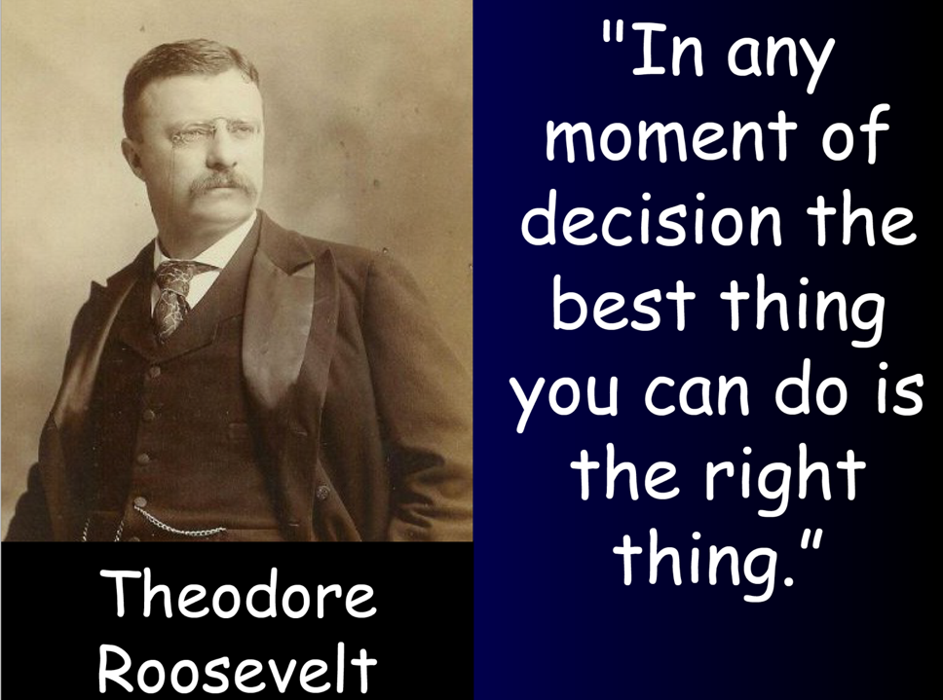

Slide 30

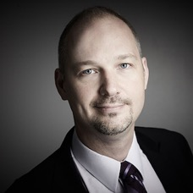


Thank you
Thanks for watching! Stay in touch with us!
facebook.com/dratwadieter
Linkedin.com//in/dieterdratwa
Dieter.Dratwa@Gmail.com
+66 99 501 8013

