Slide 1
Rotary Club of Caloundra Inc
10 years of:
FAIM / RAWCS Projects
2005 - 2015

Slide 2
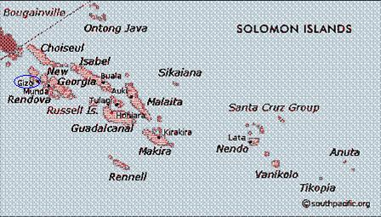
Gizo ~ Solomon Islands
Gizo has interesting WWII history in that it was where John F Kennedy’s (later President of USA) patrol boat PT109 was sunk by Japanese destroyer Amagiri.

Slide 3
Gizo – February 2005
Upgrade Outpatients at old Gizo hospital - renovating outpatients’ area including pharmacy supplies and birthing kits & school supplies at Ngari school
Project Value : $20k.
Participants: Mr Ian Belcher, Mr Mark Ward, Ms Juliana Neill, Ms Genevieve Neill, Mr Merv Paddison, Mr Lyn Roberts

Slide 4
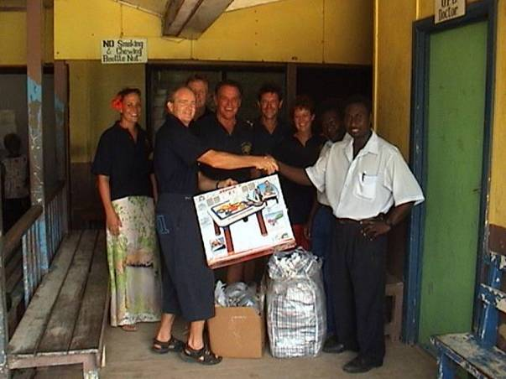
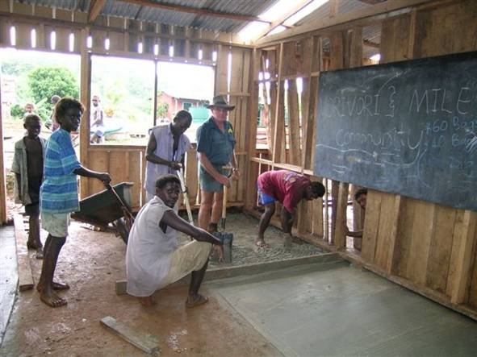
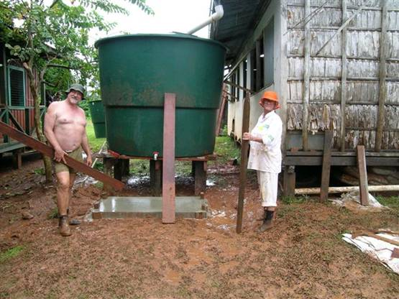
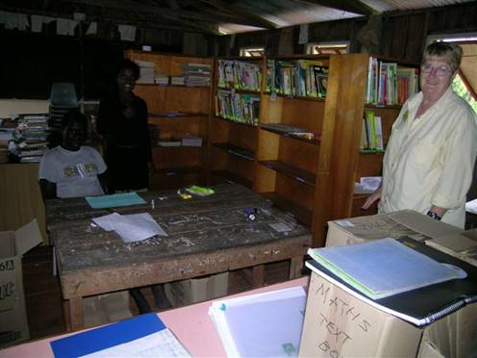
Gizo – February 2005

Slide 5
Gizo – February 2006
Ngari school - provide a water system, sanitation and library and temporary medical support for the surrounding villages
Project Value : $60k.
Participants: Anne & Merv Paddison, Alan Bethune

Slide 6
Gizo – Oct/Nov 2007
Install 8 Tanks. Five of them to be installed on School Teachers Houses in Gizo itself, the other three to go to Schools in Villages on the islands of Rannonga and Vella La Vella.
Gizo Primary and High Schools Libraries and cleaning and painting Home Economics area of the School and putting in two new cook tops complete with gas tanks.
Project Value : $40k.
Participants: Norm Bourguignon, Ron Strong, Jim Adam

Slide 7
Gizo –2008-2009
October 2008
Build two classrooms at Goldie School Munda Island
Norm donated a water tank for project
June 2009
Julianna arranged stationery for DIK container

Slide 8
Gizo – April 2010
Nurses Aid Station~Ngari, Gizo Island, sponsored by SC Rotary (Trevor Taylor) & RC of Sydney Cove (Mike Austin).
This project will allow a Nurse to be stationed at Ngari and provides a much improved environment, especially for childbirth.
Project Value : $25k.
Participants: Julianna, Paul Hartigan and daughters Jessica & Stephanie

Slide 9
Gizo – June 2011
Trevor Taylor update: 15 trips to Gizo in the last 6.5 years and undertaken 13 projects. Project funding has averaged $18k per project with 8 volunteers per trip. We have helped 20 villages on 5 islands and improved the lives of 1000’s of people.
Project Value to Date: ~$230k.

Slide 10
Gizo – October 2011
Ngari School Water and Sanitation
Project Value : $2k.
Participants: Jim Adam (Died during project)

Slide 11
Gizo –2012
Vocational Training Team Komaki to Gizo
Project Value : $2k.
Participants: Genta Tsukimori

Slide 12
Gizo – September 2015
Sassamunga Water and Sanitation Choisoul province
Part of Global Grant, see next sllide
Project Value : $5k.
Participants: Genta Tsukimori, Darryl Laing, Jim Lombard, Merv Paddison Bill Lavery

Slide 13
Gizo –2015-2016
Western Province Water, Sanitation: Sassamunga, Pienuna, Mburi, Vonunu, Suparto & Bibolo schools, Vori Vori community and Pienuna nurse aid station
As per Global Grant by Gordon Watson GG1417603
Project Value : $57k.

Slide 14
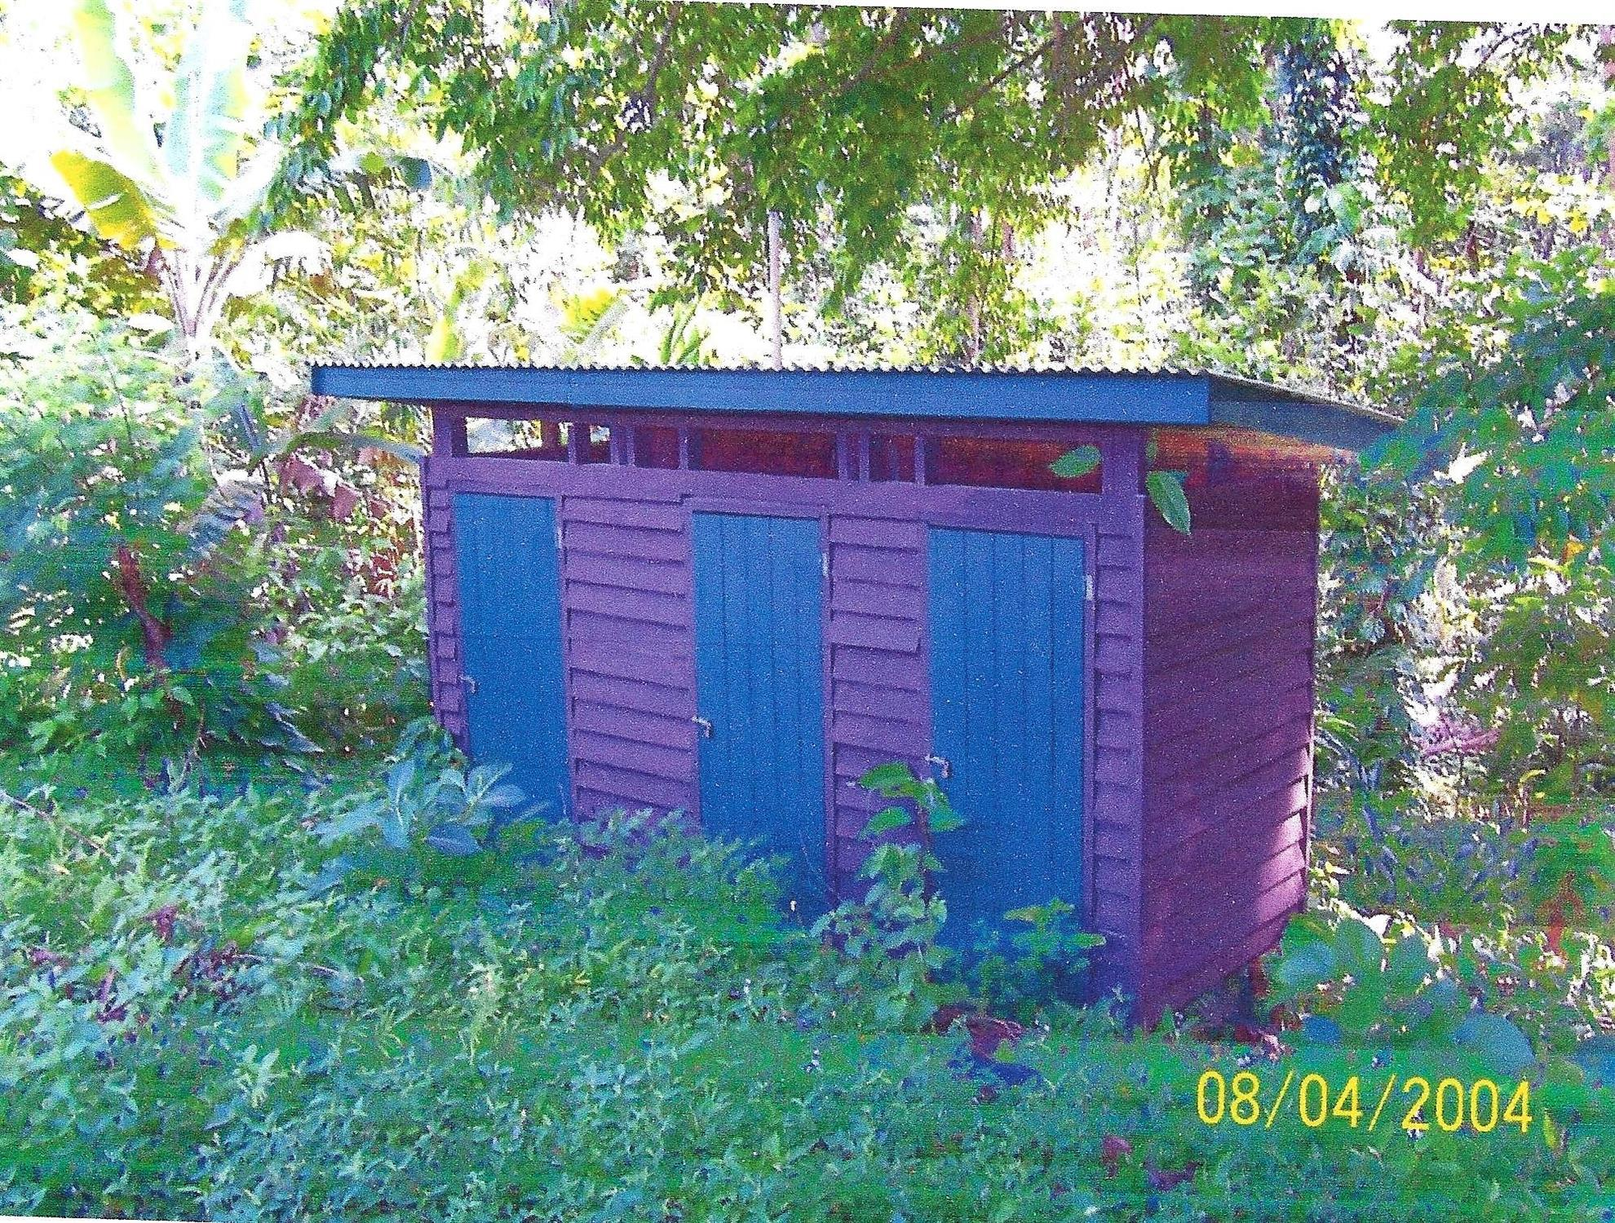
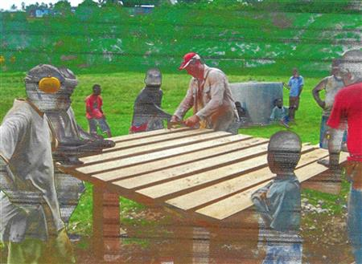
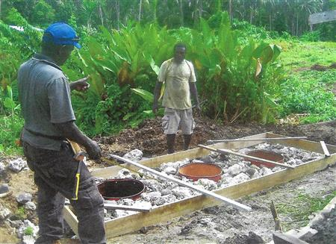
Pienuna Primary School, Ranongga Island

Slide 15
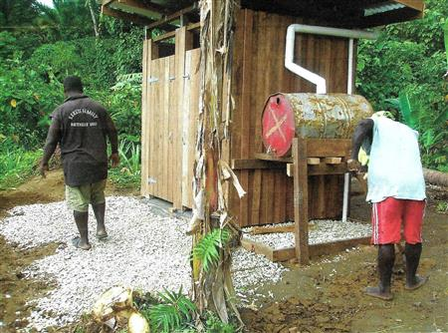
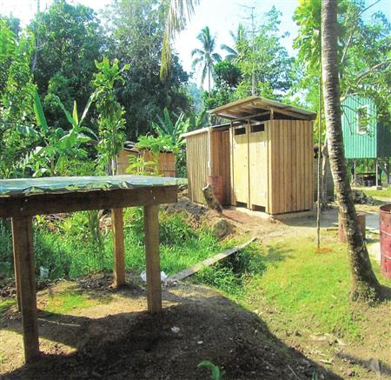
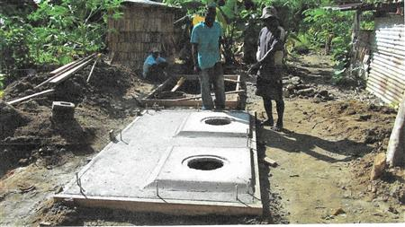
Mburi Schools, Ranongga Island

