Slide 1

Saving landfill, delivering joy!
PP Lesley McCarthy, Flemington Kensington Rotary

Slide 2
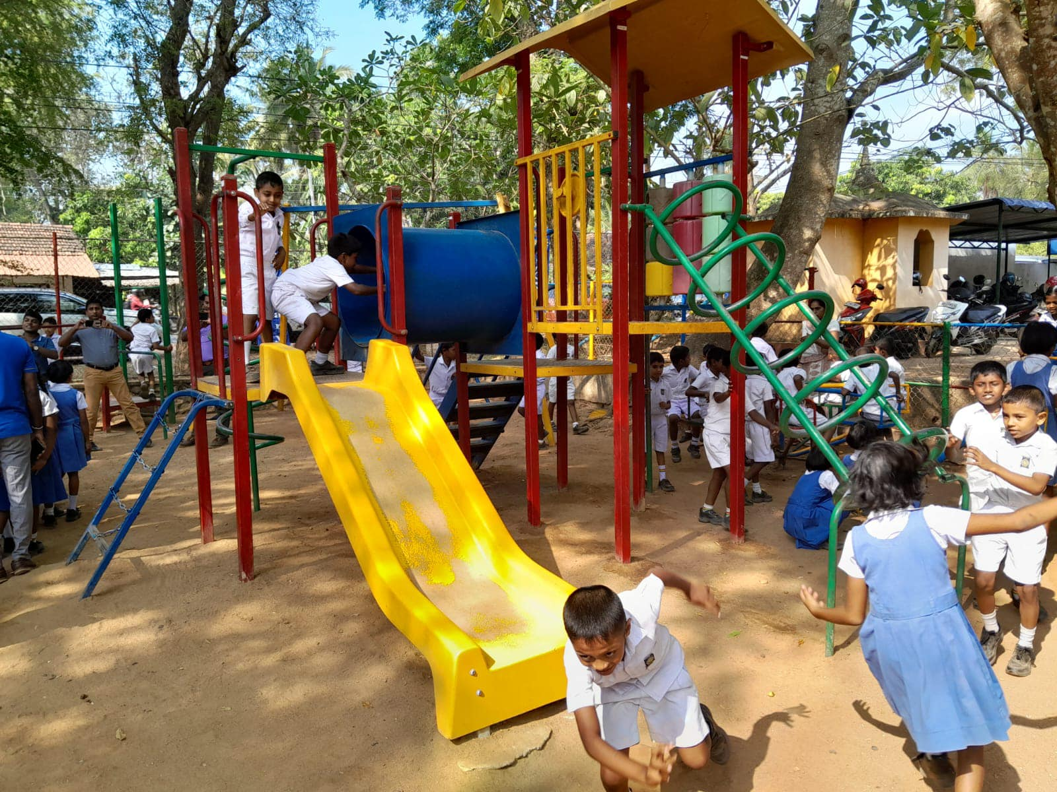
RORP grew out of a project that sent a container of educational goods to a Girl’s Home in Sri Lanka.
The “wish item” was for a children’s playground.
There are over 20,000 playgrounds in Victoria.
Approximately 2000 are replaced each year.
Due to legal liability they cannot be reused in Australia.
Playgrounds like this are sent to landfill or scrap.

Slide 3
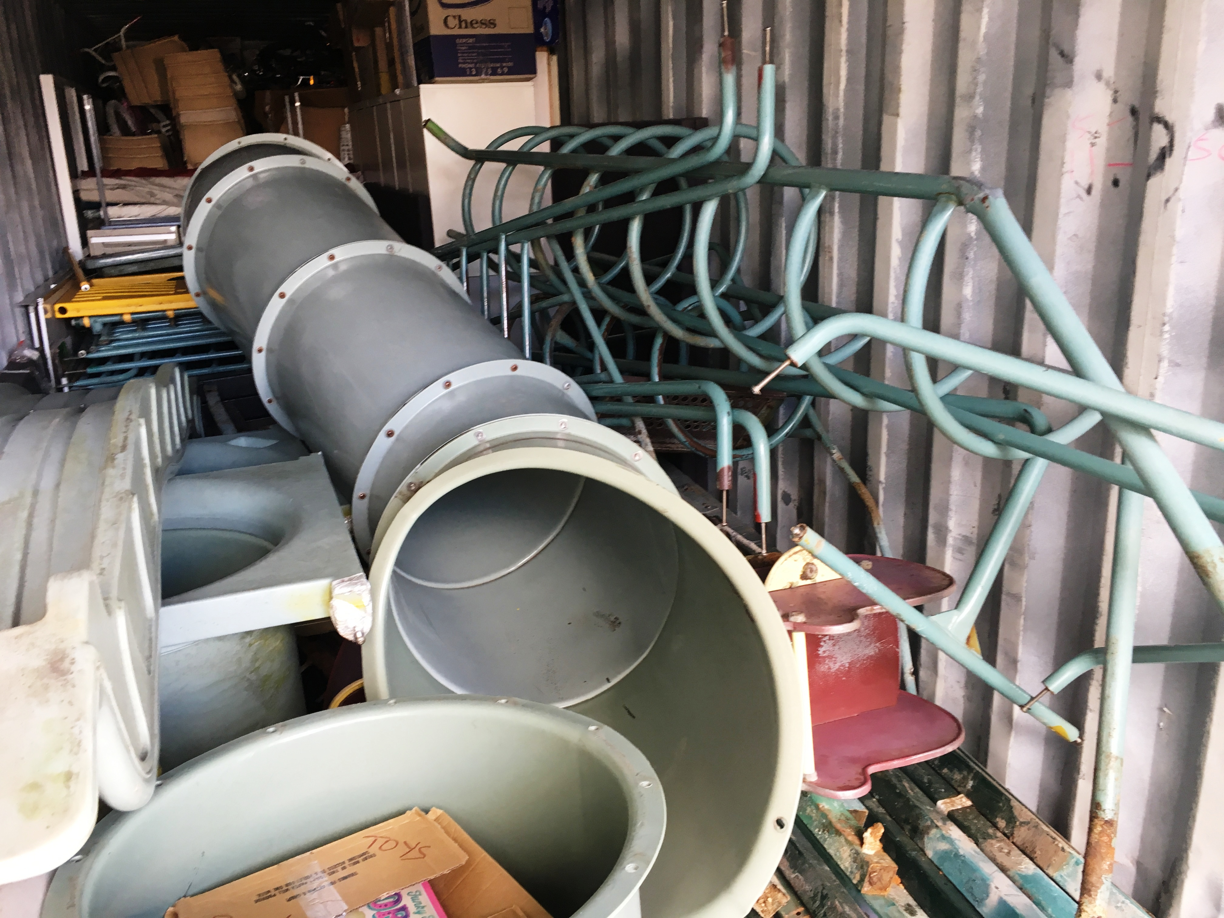
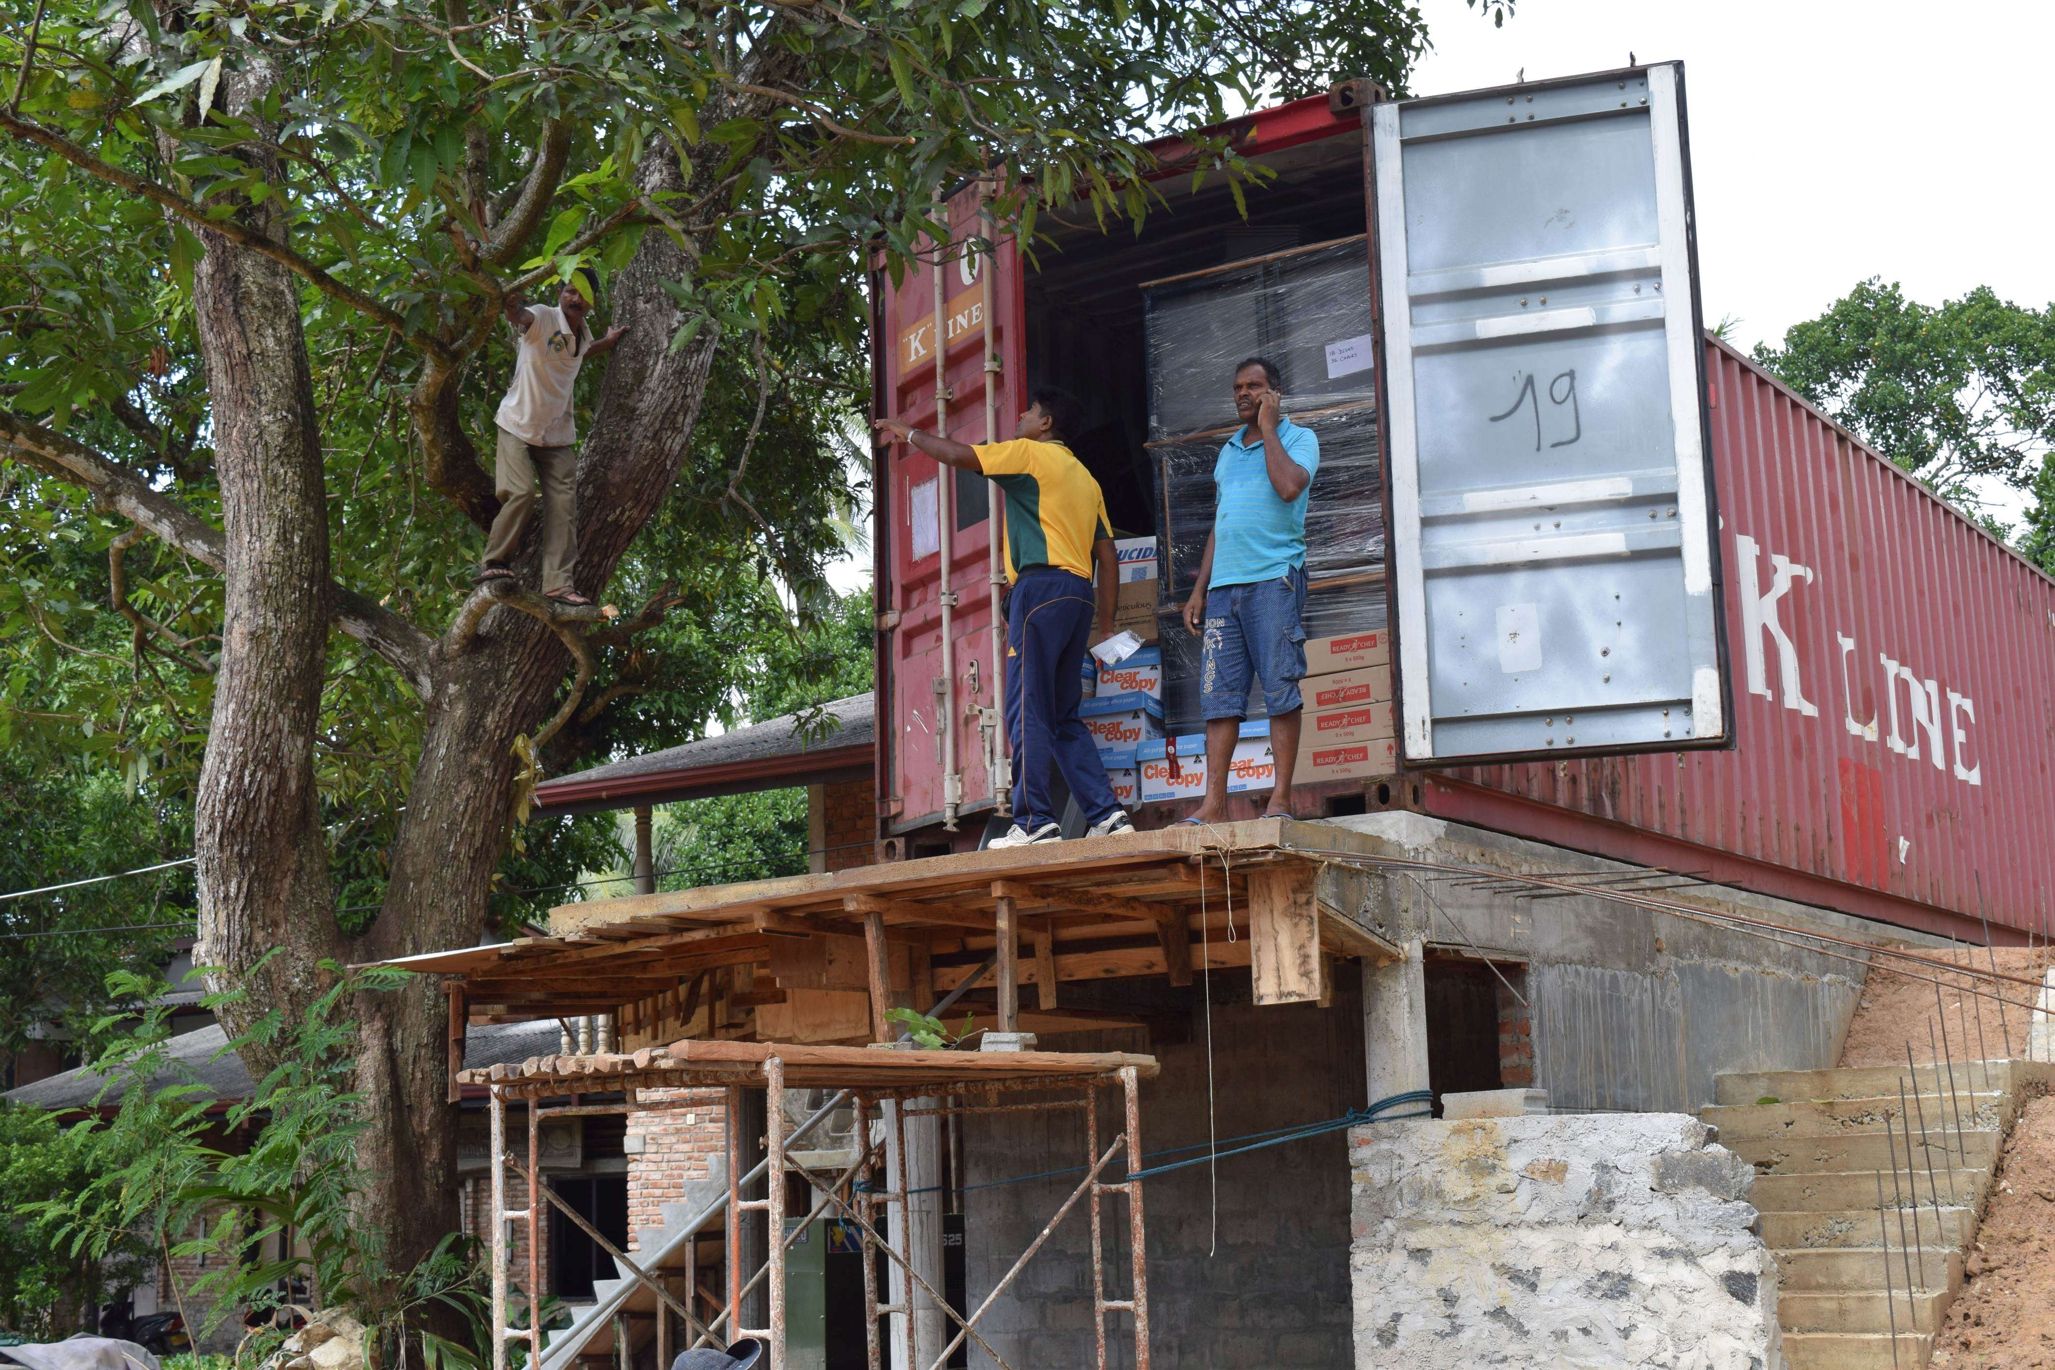
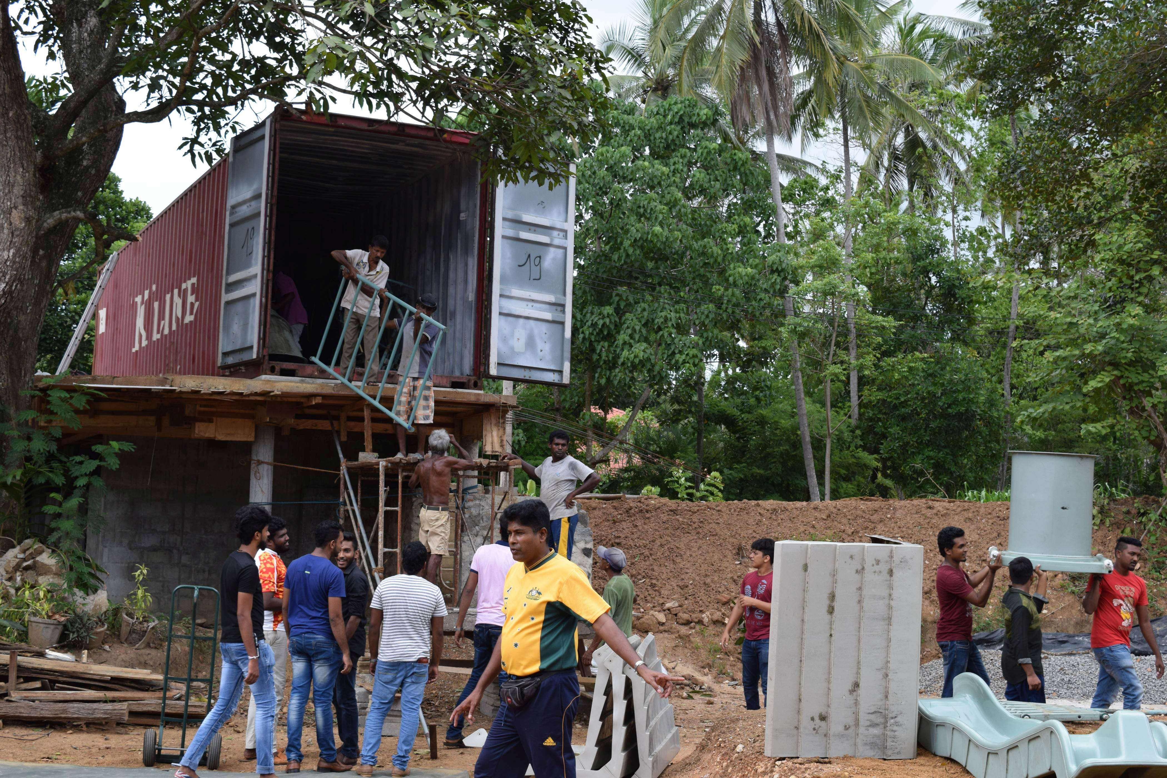
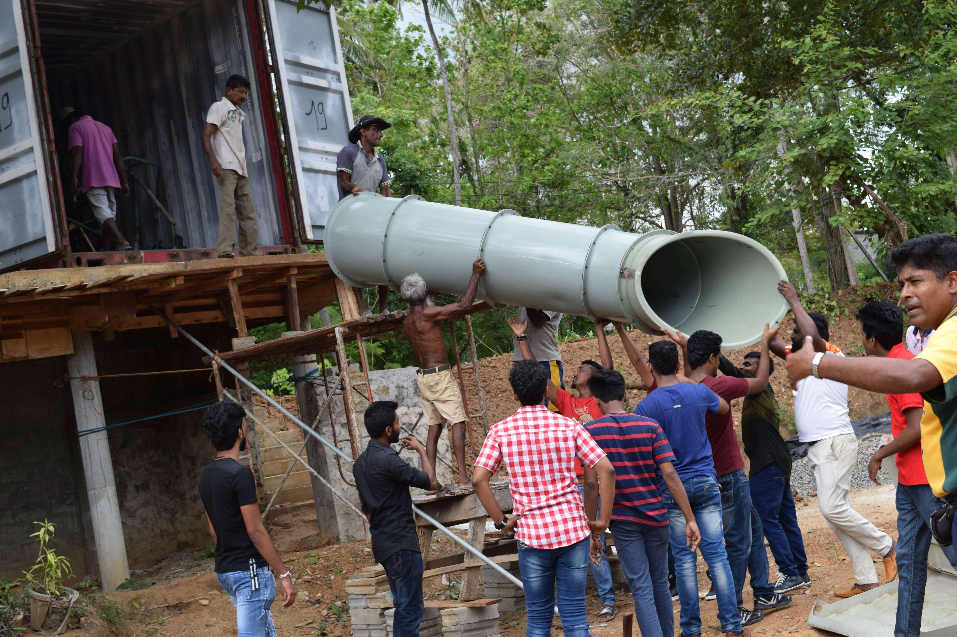
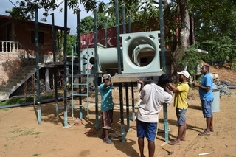
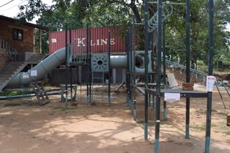
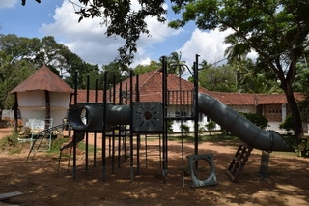
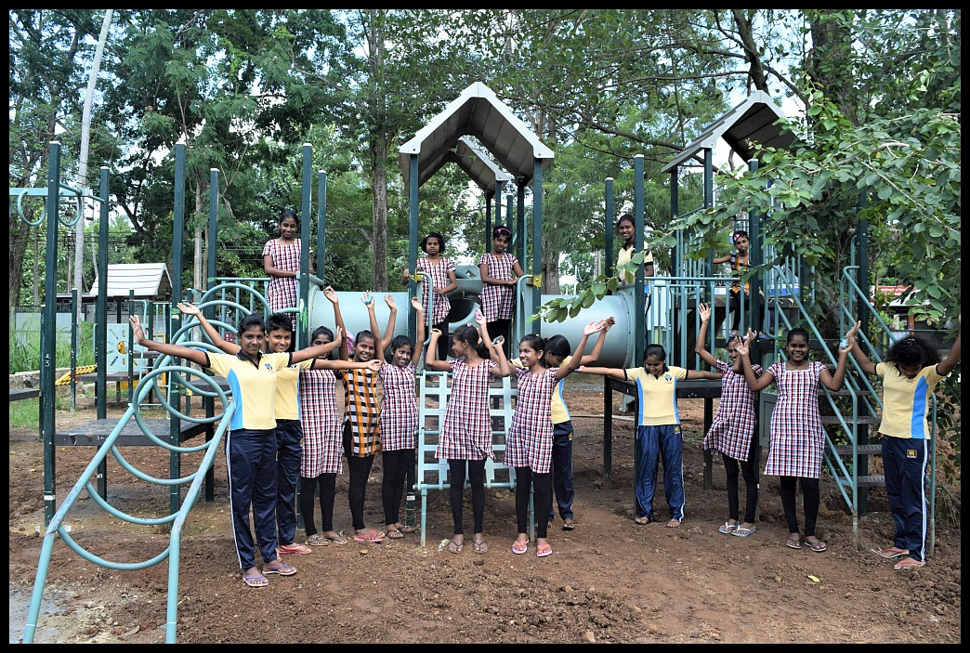
Sputnik Girls Home, Sri Lanka - #1

Slide 4
How does RORP operate?
There are 4 RORP cells operating in Victoria, with others in Mount Barker, SA
and Forbes, NSW.
The Victorian cells are:
District 9815 – Nunawading and Mt Martha clubs
District 9780 – Geelong Central
District 9800 - Flemington Kensington
Each cell operates in their geographic area but uses the same model and costings.

Slide 5
How do we find playgrounds?
Councils send out a tender for a playground removal; and usually a new installation.
Most councils now require contractors to work with Rotary to harvest the playground.
When a likely playground is identified, the RORP Team works with the contractor to submit a cost and discuss timelines.
Then, prior to dismantling:
  Photos are taken of each element/join.
  A detailed plan is prepared.
  Individual elements are then marked with a code and a colour paint spot.

Slide 6
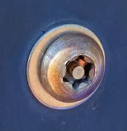
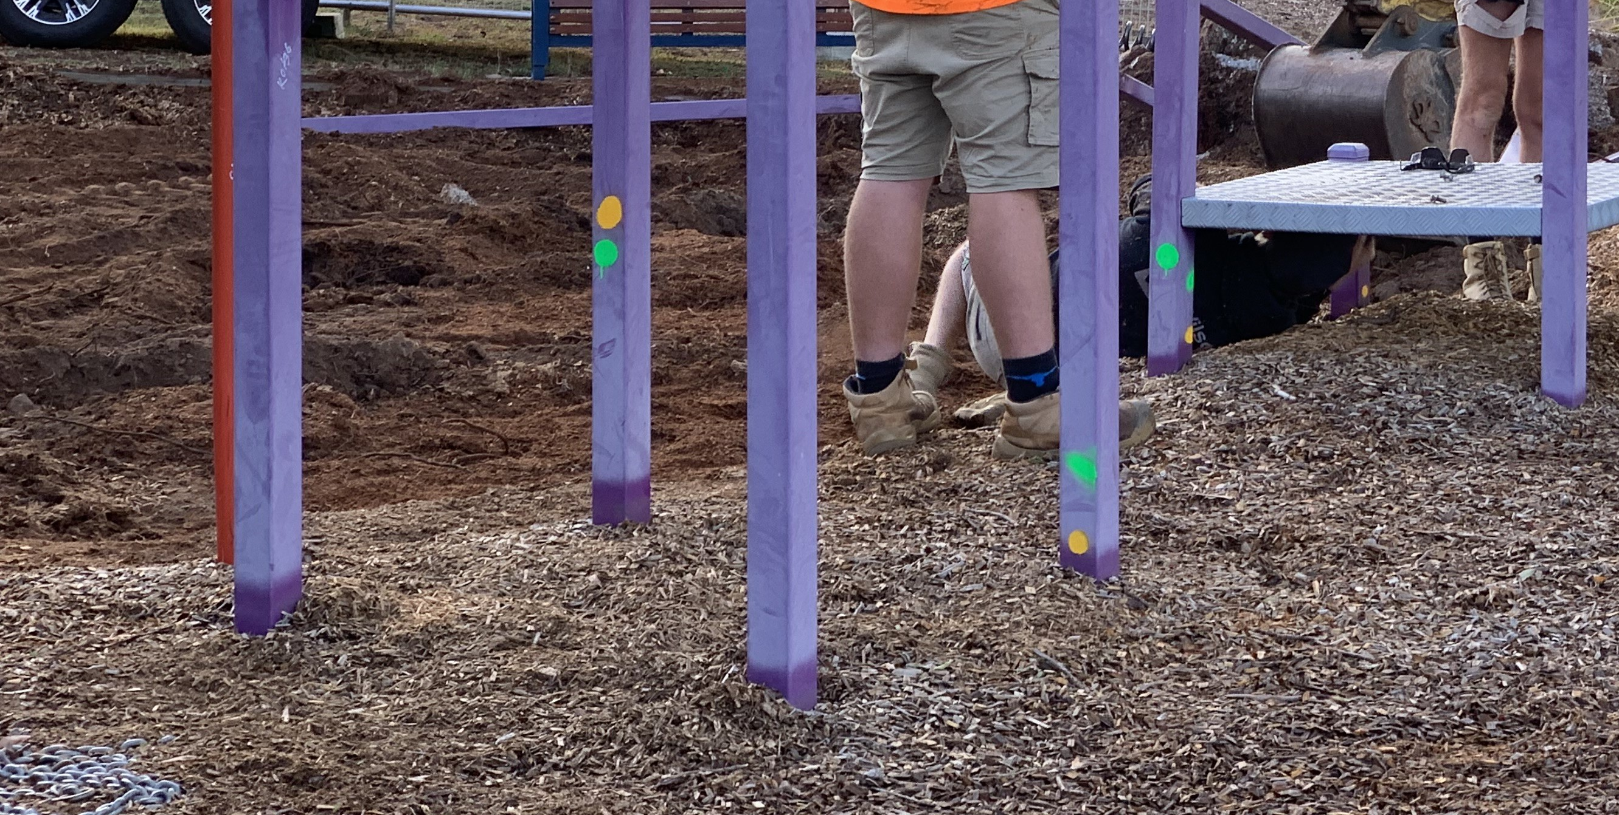
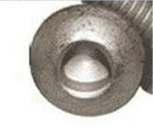
The special vandal proof bolts which require a specific tool.
Paint spots to identify pieces of the same playground set.

Slide 7
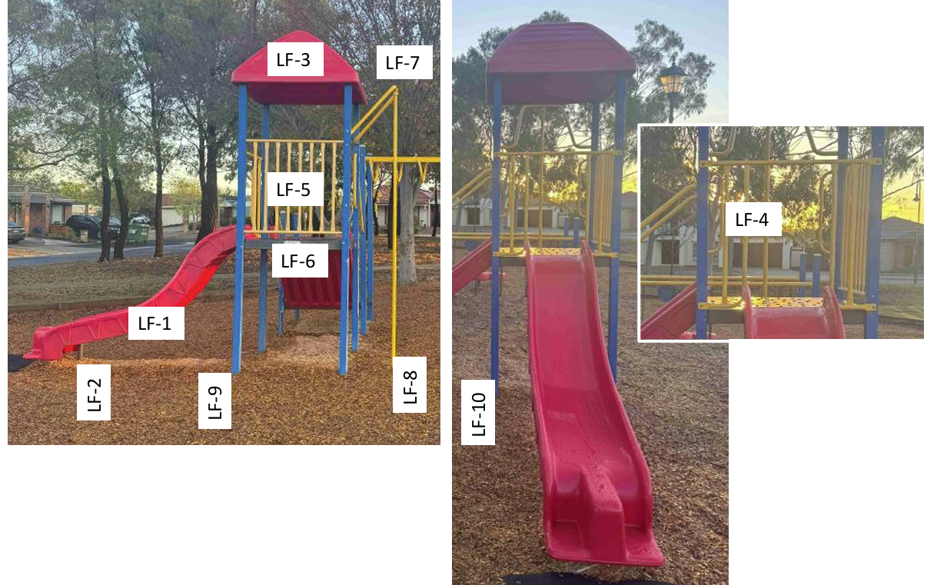
Each individual pole, element and post is coded according to the plans and by playground location harvest. This is why great photos are so important.

Slide 8
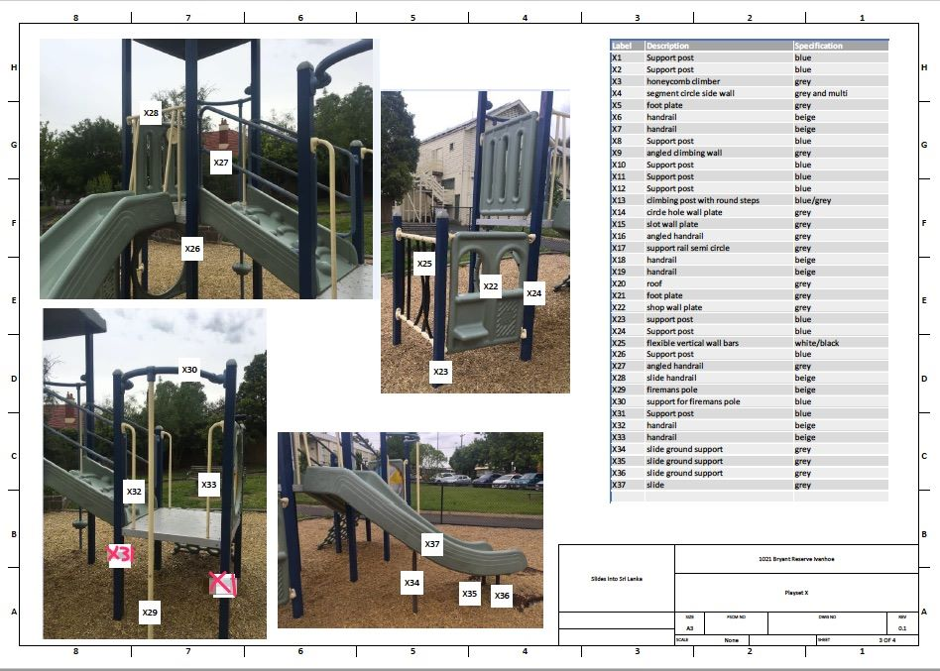
Detailed specifications and plans are compiled for reassembly.
John Farmery, Engineer, uses photographs and plans supplied to create a sequence of parts and joins which are listed and labelled.
Individual elements are identified with a permanent marker:
It’s like a meccano set.

Slide 9
How is RORP Funded?
The fee per playground is itemized per post and major element eg a slide.
$750 plus $25 per post/pole.
With 10 playgrounds per 40ft container the shipping fee is covered.
A playground fits into a DiK Truck, or on a medium sized trailer. The only cost to a Rotary Club is fuel.
The heavy work in the removal of a playground is undertaken by the playground contractor.
They dig out footings and poles, remove any element concreted in eg rocking horse.
For you this means - no digging, no heavy lifting and no cost.
This is a great hands-on project for your club on their own or though your partnership with the local Men’s Shed or Sports Club.
RORP is largely self funded – all that is missing is YOU.

Slide 10
How could you be involved?
Identify 4-6 people who could be available
once every 6 weeks for about 3 hours.
Volunteer to assist with taking photos, marking up playgrounds, driving the truck, assisting with plans.
RORP District 9800 and District 9815 north/ north-west is currently managed by:
Rotary Flemington Kensington PP Peter Cribb Mob: 0410 548 543
John Farmery - plans
Jean Turnbull – logistics and procedures
Shraddha Sharma and Lesley McCarthy
District 9790 – Don Shields, Rotary Geelong Central

Slide 11
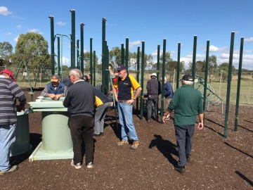
No. #1:
Playground from Leopold near Geelong which was removed by the Rotary Clubs of Flemington and Highton and the Geelong MG Car Club now installed for community use near the Sputnik Girl’s home in Kurunegala, Sri Lanka

Slide 12
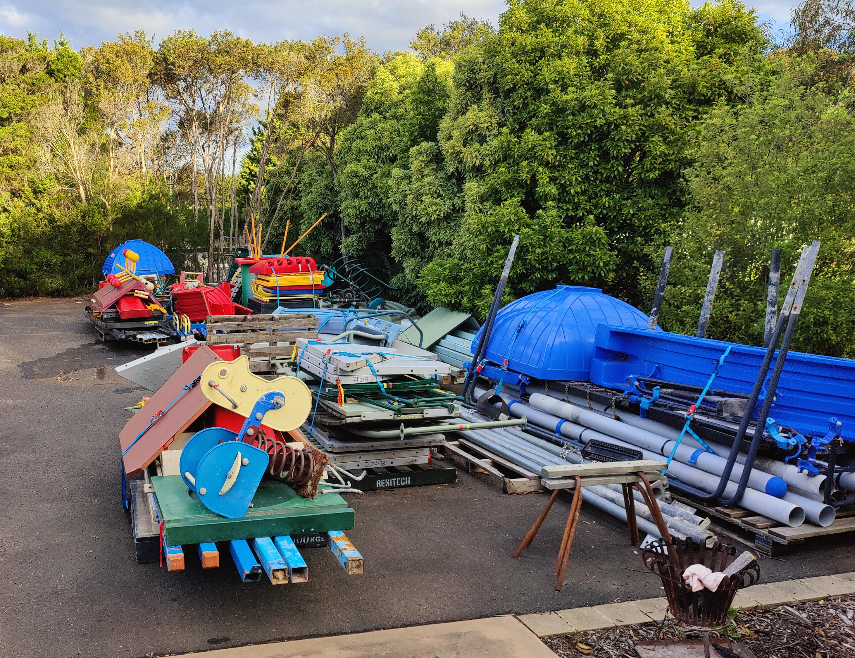
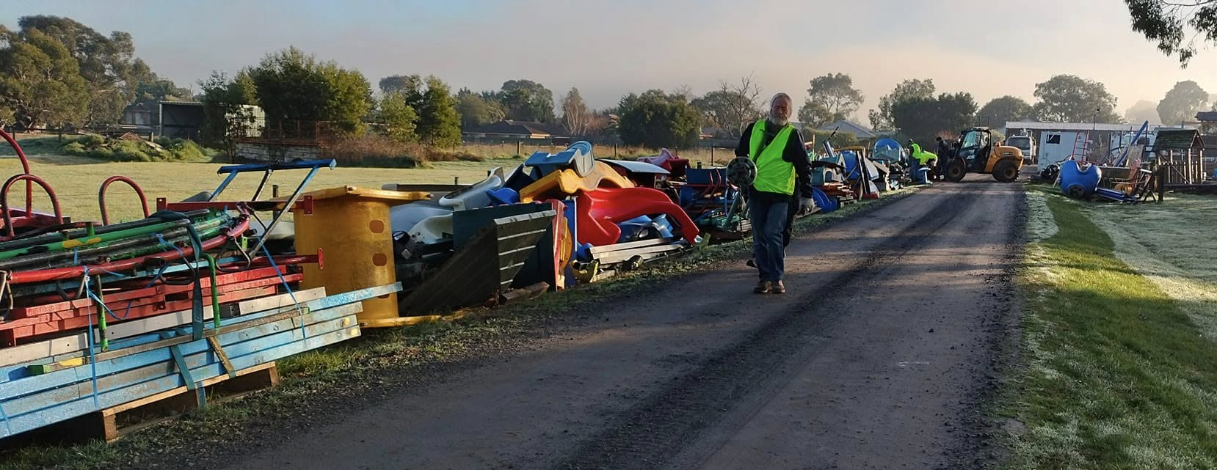
Storage site
A site has been obtained at the Rabitha Centre in Rockbank where playgrounds can be safely and securely stored until we have sufficient for a container.
The Mosque has signed an MoU with us.
At the current site for District 9815 in Kilsyth, playgrounds are laid in separate bundles, organised to facilitate ease of loading.

Slide 13
Where have playgrounds been sent?
Sri Lanka – the first partner country with Rotary Colombo – 166
https://www.facebook.com/share/p/17riSVhEHu/
Timor Leste - second destination, now installed in 10 schools
Cambodia in partnership with Heartprint and Rotary Peninsula https://www.facebook.com/share/r/1EzoxamAKK/
El Salvador, Fiji, India, Nepal, Mongolia, the Philippines, Papua New Guinea, Sierra Leone, South Africa, Uganda, Zimbabwe.
Anywhere that a Rotary Club has a connection and is willing to facilitate.

Slide 14
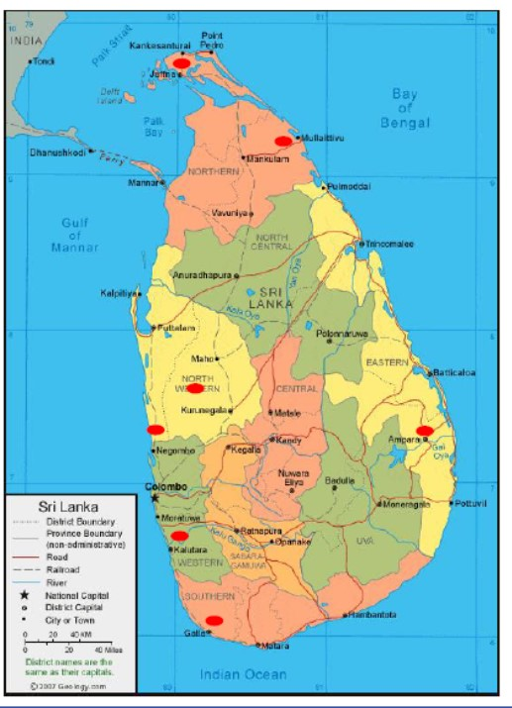
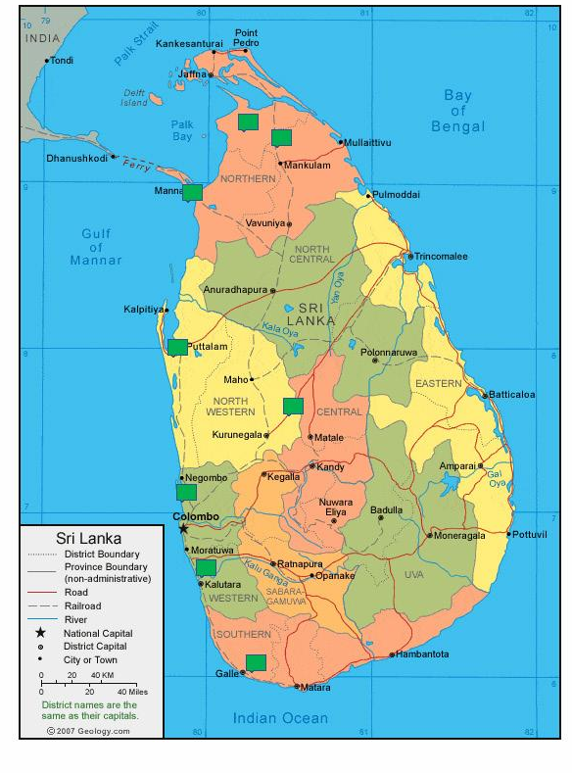

Sri Lanka – the flagship

Slide 15
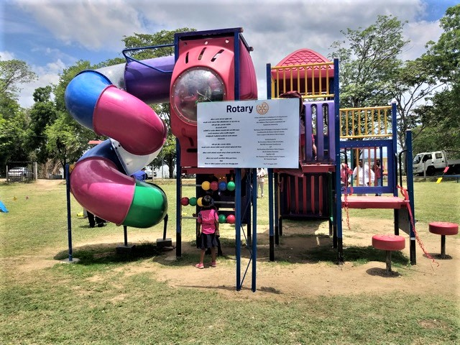
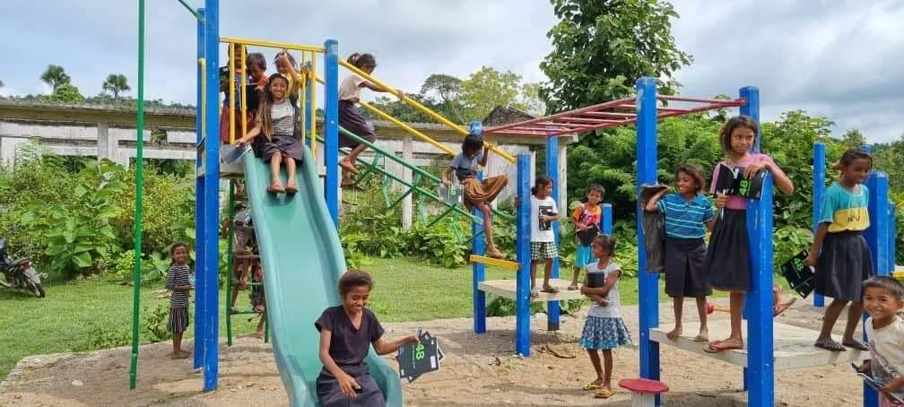
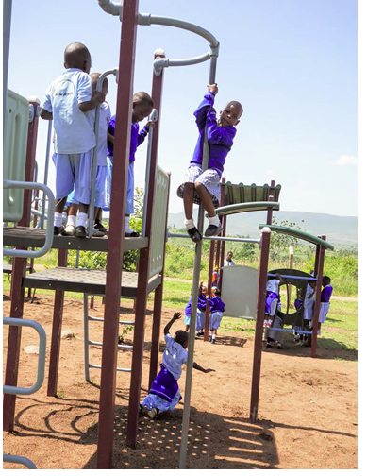
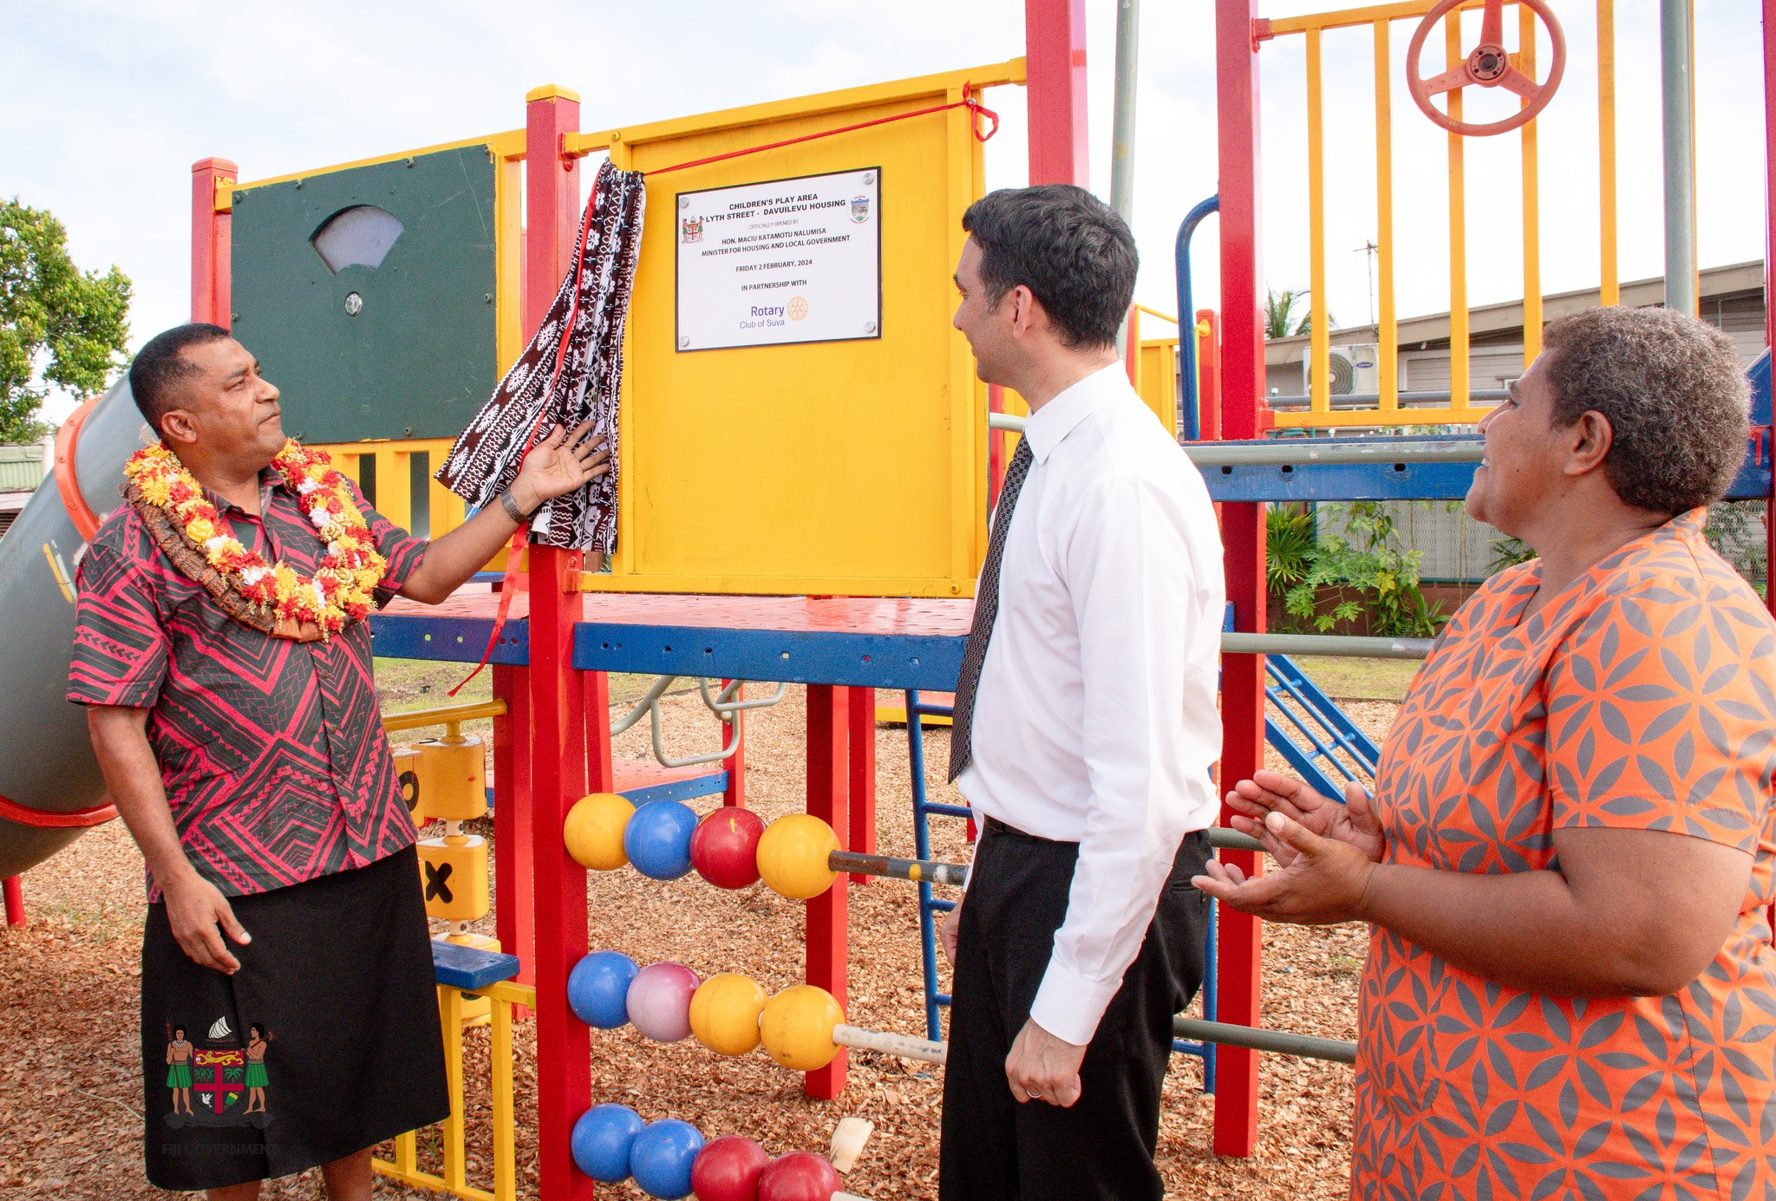
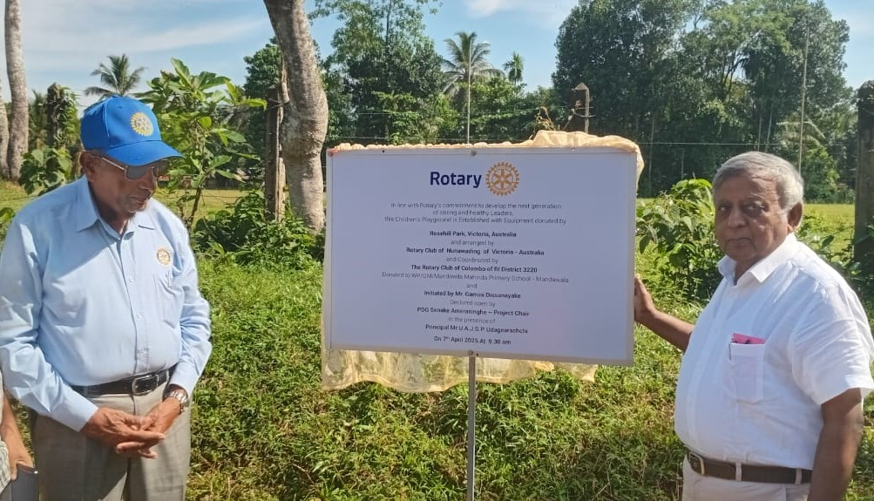

Slide 16
Publicity
Recycling PlayGrounds | District 9800
Rotary to send Port Lincoln playground boat overseas to bring joy to underprivileged children - ABC News
Wayne Jenkins: Harvesting joy for generations to come • Rotary Down Under
Rotary Overseas Relocated Playgrounds |
Leopold tennis pavilion redevelopment underway as new playground is installed - City of Greater Geelong
ROTARY OVERSEAS RECYCLED PLAYGR
New life overseas for Lions Park playground | Forbes Shire Council OUNDS (RORP) Port Pirie Regional Council
International Projects – Rotary Club of Regency Park
What's making news in PLAY today

Slide 17
Supporting documents
LEVY:
https://docs.google.com/document/d/12DSMKyFIFn8160V4NJTmaq9l2TOofv2h/edit?usp=sharing&ouid=116957478042048914794&rtpof=true&sd=true
Information for donors:
https://docs.google.com/document/d/1xEXNv5zQ0xAtF9EZHhjgJWmMuYN6Zwzd/edit?usp=sharing&ouid=116957478042048914794&rtpof=true&sd=true
Guide to taking great photos:
https://docs.google.com/document/d/1-wlbvCHO-9k-VT1LM3r3l9ynZvo_3ZLB/edit?usp=sharing&ouid=116957478042048914794&rtpof=true&sd=true
Tools:
https://docs.google.com/document/d/1cgDuqdp7wsctgB4gwiGUGSJUOSrjBjdx/edit?usp=sharing&ouid=116957478042048914794&rtpof=true&sd=true

Slide 18
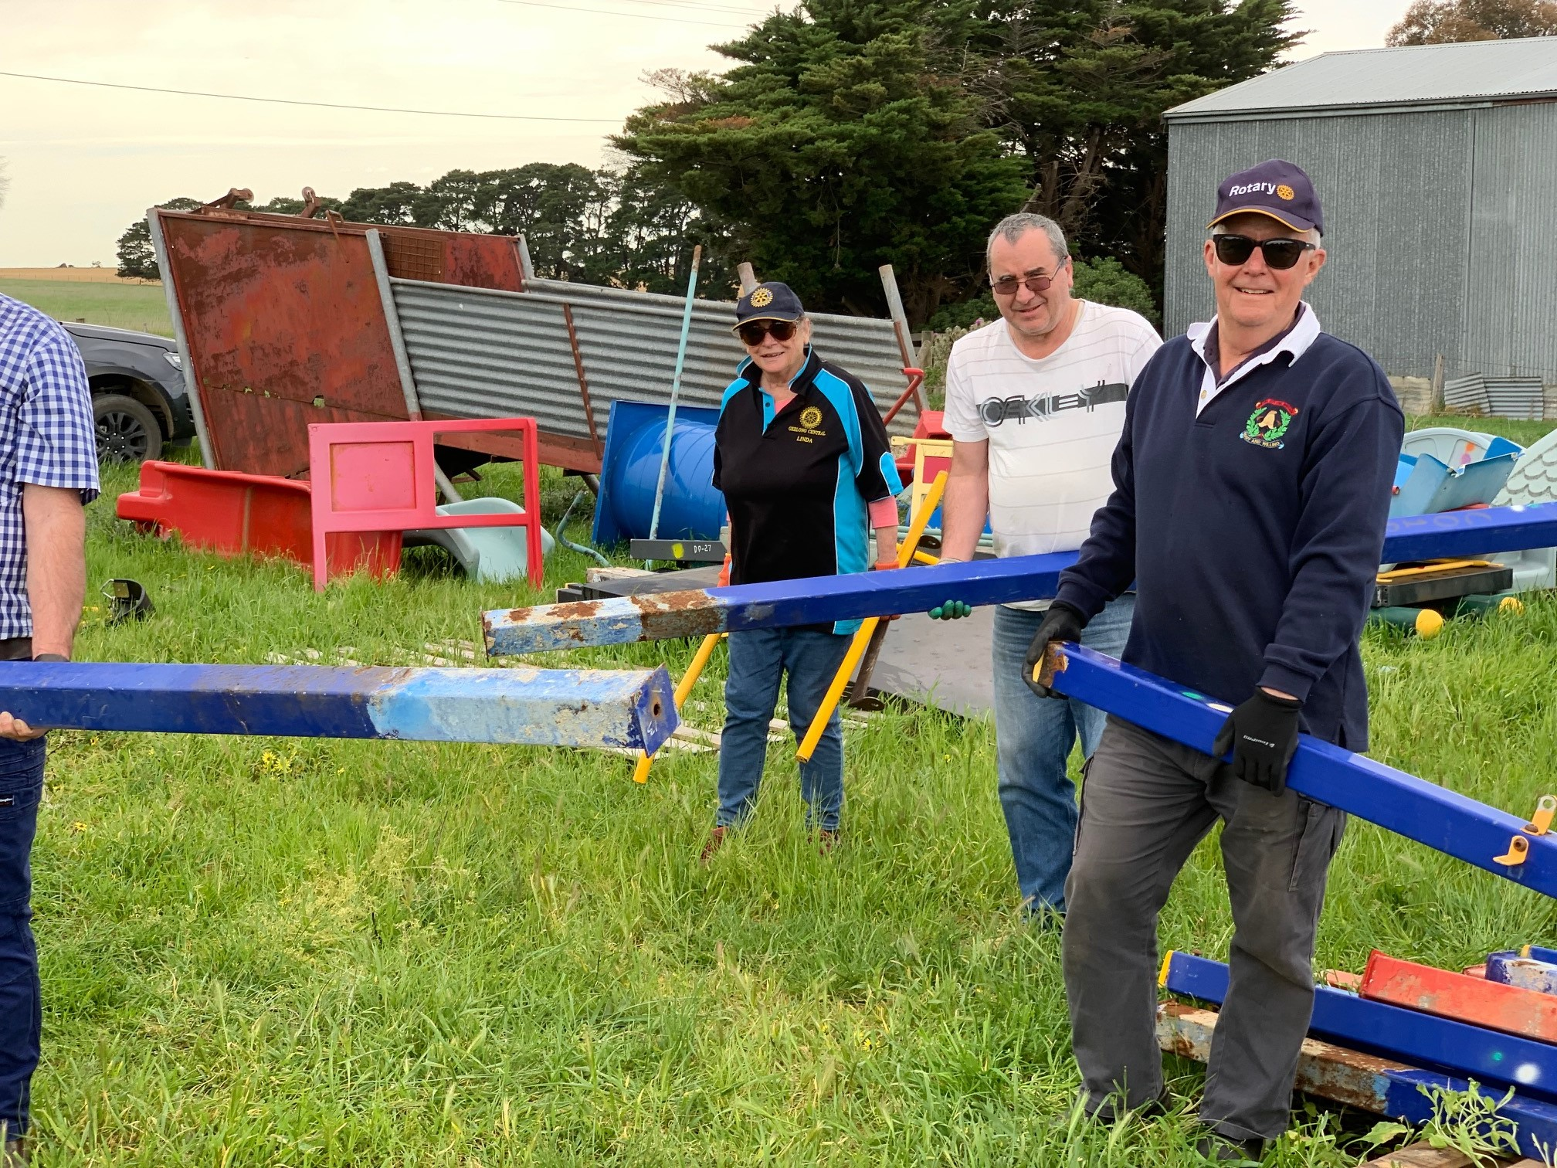
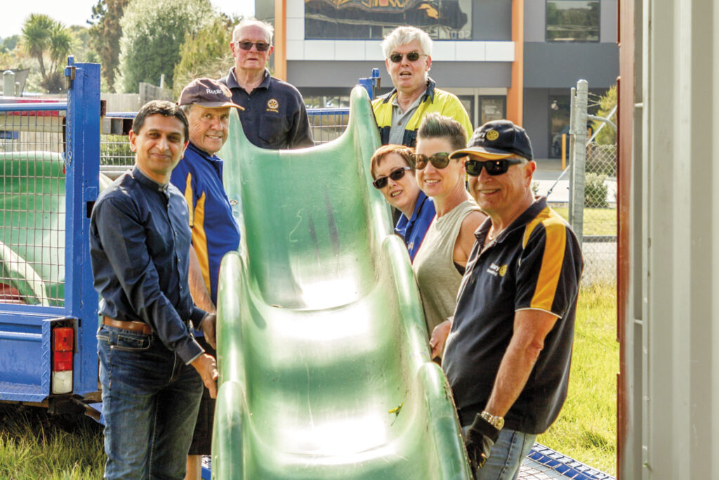
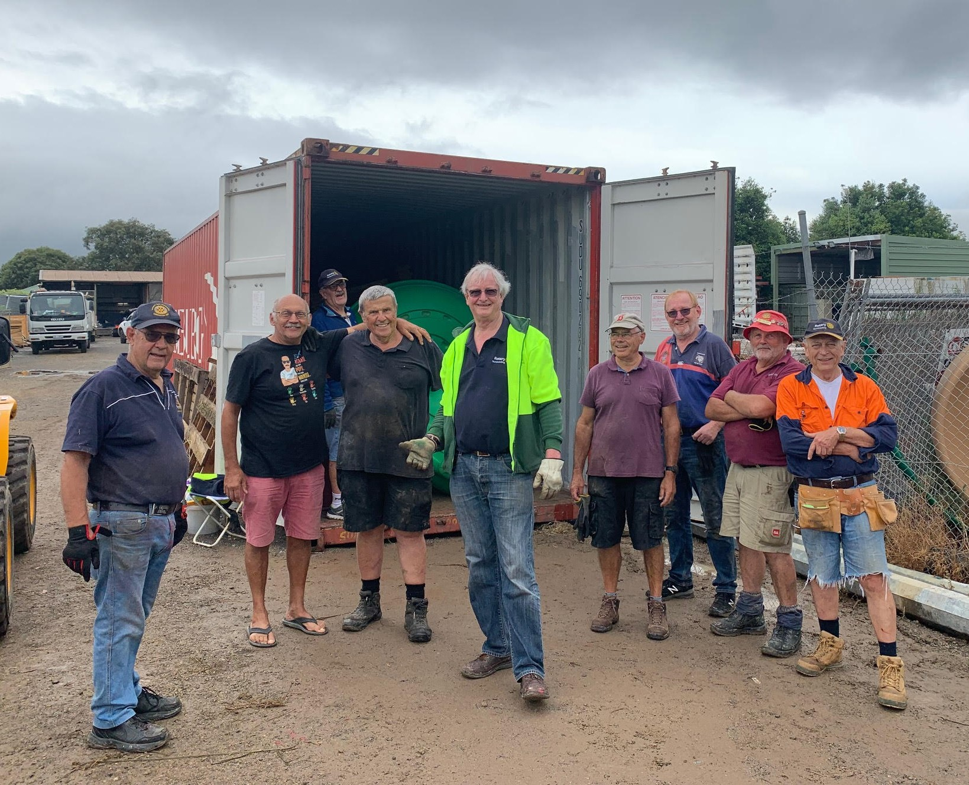
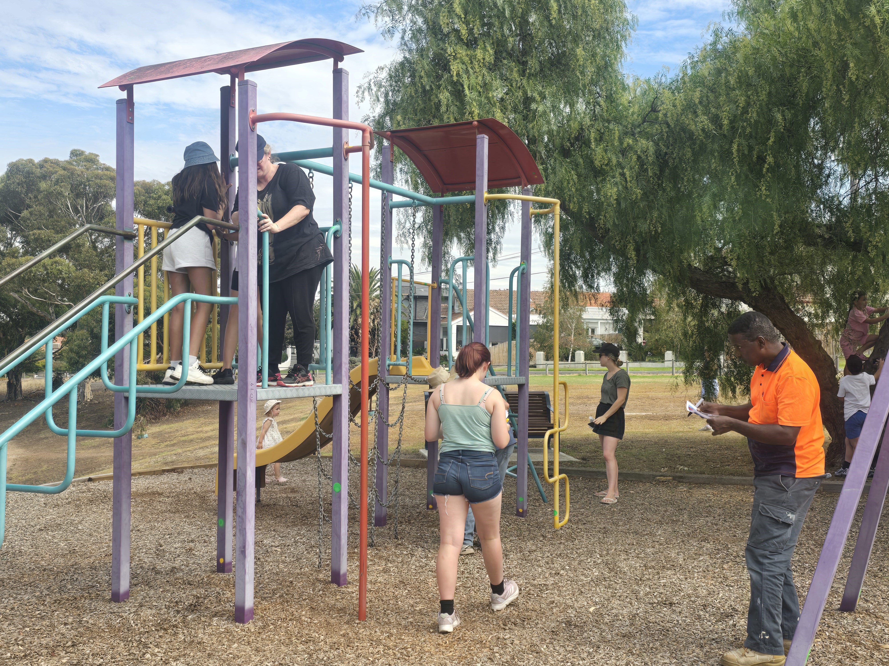
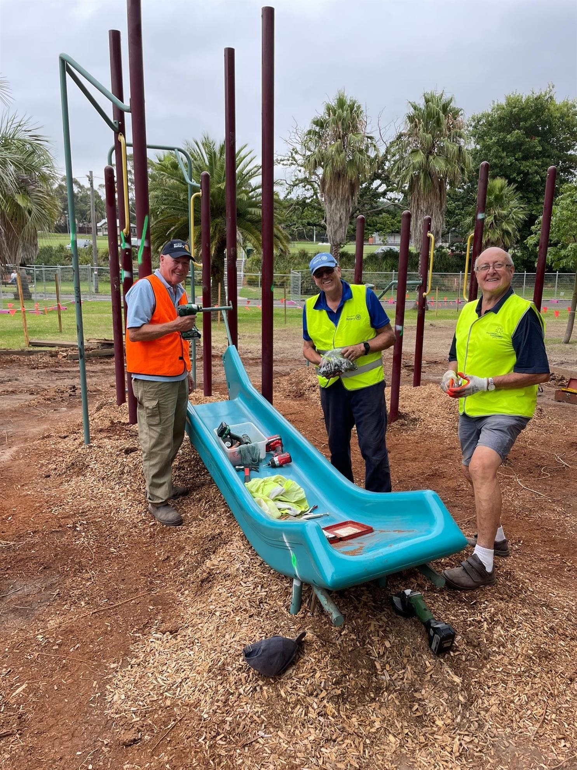
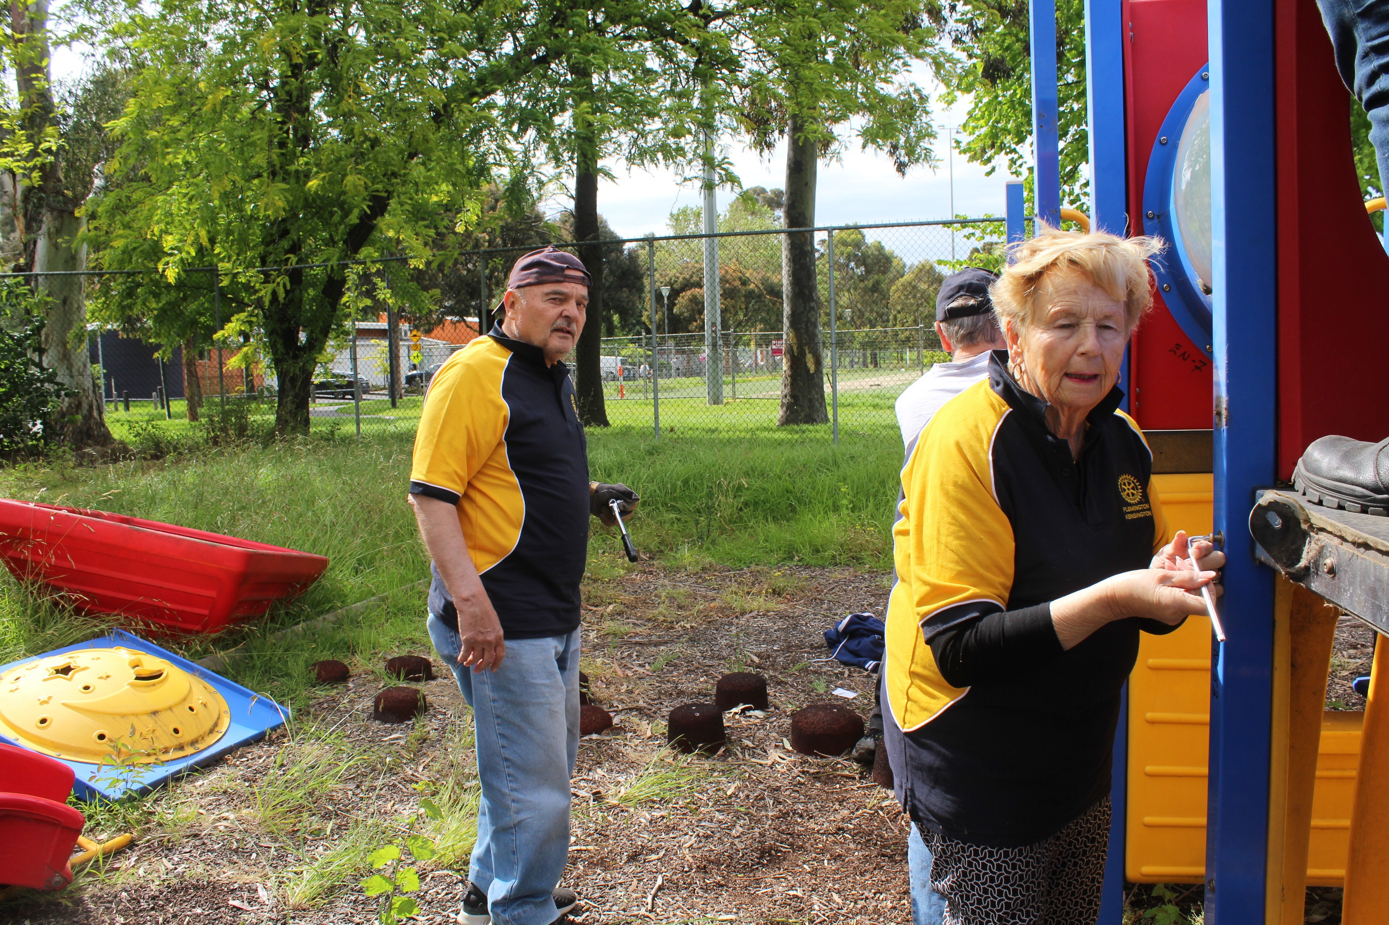
Collecting is easy – our women and kids help too!

