Slide 1

Rotary Themes
HOT AIR
5 September 2019
Brad’s Broadcast
St James College & Rotary Breakfast
For those over fifty Rotary members, guests, teachers who were able to attend the St James College breakfast, we were lucky to experience something special to be entertained by the amazing talents, professionalism and genuine friendliness and smiles of the St James students. Not only did the students prepare a full menu breakfast the quality even the Marriot Hotel would be proud of, . we were entertained by the award winning school choir and high quality students artwork. The senior students passionately spoke about what they have proudly achieved at the school and how keen they are to be given job and life experience opportunities, simply inspiring!!
Considering the huge life challenges of many of the St James school students coming from refugee, indigenous, and ethnic backgrounds. their achievements were even more impressive.
A great Rotary moment was to see our city Rotary club members working together, using our business and community networks to identify potential work experience opportunities for the St James students. Our Rotary Brisbane High-Rise club is also in discussions with a major local business in an attempt to form relationships with the St James school. We will follow examples of programs and students who hopefully have gained a career start from this breakfast over the coming months.
Thanks to Councillor Vicki Howard of Brisbane City Council Central Ward, and fellow Rotarian from New Farm, again for her support of the local community and the St James school. Qld Government Member, Grace Grace, could not attend. However, Grace will be a speaker guest at our Rotary breakfast meetings soon and St James Principal Ann Rebgetz will attend the breakfast.
Rotary Brisbane High Rise Key Note Speaker: New Brisbane Runway Project
Continuing our great Brisbane High-Rise breakfast and speaker programs at the Marriot, we have secured Paul Coughlan, the Brisbane Airport Project Director, to deliver a great presentation on our successful new runway project at Brisbane Airport. Invite family, friends, work mates.
Hamilin High Tea Reminder
Please support and invite friends to Margot’s famous high tea this Saturday from 2-4pm Kangaroo Point. As well as a great event, proceeds go to the Catherine Hamlin charity that supports eradicating obstetric fistula in villages overseas.
Warm regards
President Brad
Date | DIARY DATES
7 September | Hamlin Afternoon Tea
8 September | The Scandinavian Festival at Perry Park, Bowen Hills (34 Folkstone Street)
15 September | Working Bee – Forceful QMM
28 September | River Fire – QMM
12 October | Hamilton Swimathon
26 October | FashionAble fashion parade
Rob | Greg | Russell | Wendy | Kit | John M
Sergeants 17/18
Barbara Leddy
Mark Molesworth
John Arvier
Phil Breene
Rob O'Donovan
John Mills
Kit Bennetts
Excused from roster
Kit – he does sergeant
Tom – he is always away
Bill L – on leave
Elizabeth – on leave
John M – does sergeant
Rob O – does sergeant
Sarah – obvious reason
Greg – higher duties
Wendy –pre-DG duties / still does sergeant
1st - Rob O
2nd – John A
3^{rd – PHIL}
4th – BARBARA
5th –
INTERNATIONAL TOAST
This week we toast the Rotary Club of 29 in Oklahoma City, with a membership of 615 members. They credit their success to their inclusive organization with a shared vision of strengthening their community through service to others.
PROGRAM / GUEST SPEAKER
5 Sept | Member Induction & Interview – Helen Fox
12 Sept | Dr Tim Baker – Winners at Work
19 Sept | Fellowship
3 Oct | Great Guest Speaker – Paul Coughlan Project Director Brisbane Airport Runway
ROSTER | 5 Sept | 12 Sept | 19 Sept
Chair | Stephen F | James | John K
Set Up and Close | James | John K | Steve K
Greeter | John K | Steve K | Deb
Sergeant | Phil | Rob | Phil
July
August | Membership
September | Basic Education and Literacy
October | Economic and Community Development
November | The Rotary Foundation
December | Disease Prevention and Treatment
January | Vocational Service
February | Peace and Conflict Prevention / Resolution
March | Water and Sanitation
April | Maternal and Child Health
May | Youth Service
June | Rotary Fellowships
RECOGNITION of TRADITIONAL OWNERS I acknowledge the traditional owners of the land on which we meet today, the Turrbal and Yugara people, and pay my respect to their elders, past, present and emerging | APOLOGIES / GUESTS and MAKEUPS NOTIFY OUR CLUB BY 7.00 am TUESDAY PRIOR TO THAT WEEK’S MEETING AT: apologies@rotarybrisbanehighrise.com HOT AIR EDITOR angela@razconsulting.com.au | DIRECT DEBIT PREPAY FOR OUR MEETINGS, EVENTS, SUBSCRIPTIONS AT: BSB 084 -034 Account Number 559347857 | ROTARY GRACE For friends, service, good fun and fellowship, especially the Fellowship of Rotary we Give our thanks
APOLOGIES / GUESTS and MAKEUPS NOTIFY OUR CLUB BY 1700 TUESDAY PRIOR TO THAT WEEK’S MEETING AT: apologies@rotarybrisbanehighrise.com make-ups@rotarybrisbanehighrise.com | DIRECT DEBIT PREPAY FOR OUR MEETINGS, EVENTS, SUBSCRIPTIONS AT: BSB 084 -034 Account Number 559347857 | ROTARY GRACE O Lord and giver of all good, we thank you for our daily food. May Rotary friends and Rotary ways help us to serve you all our days.

Slide 2
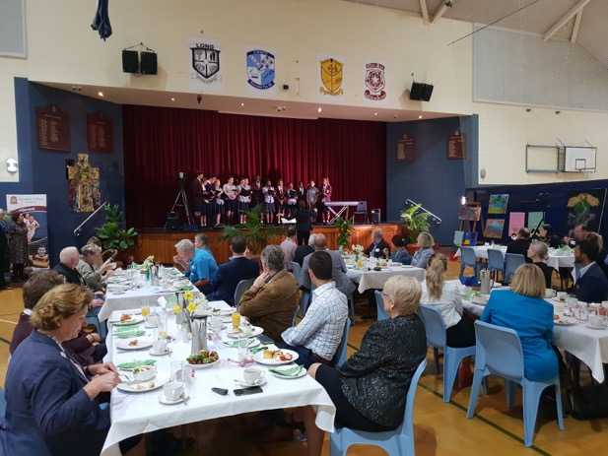
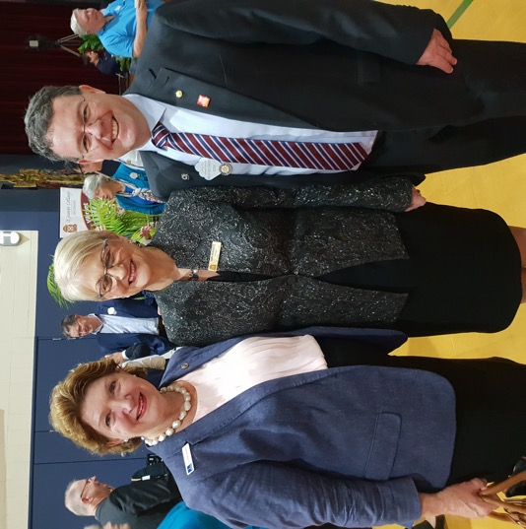
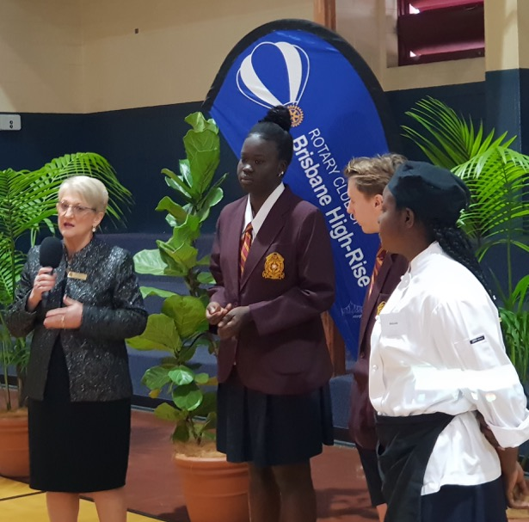
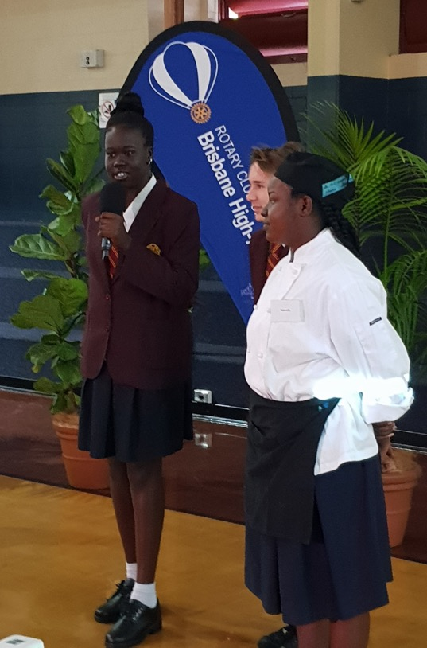
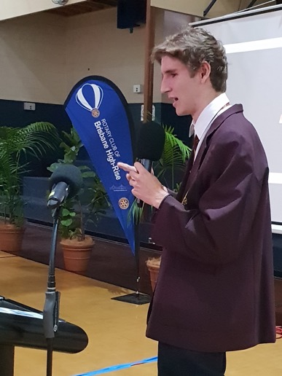
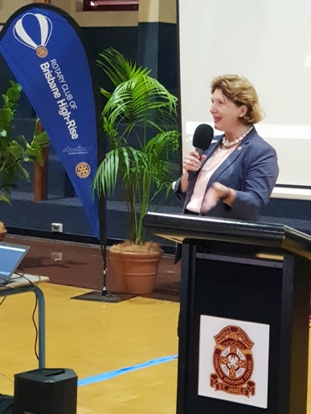
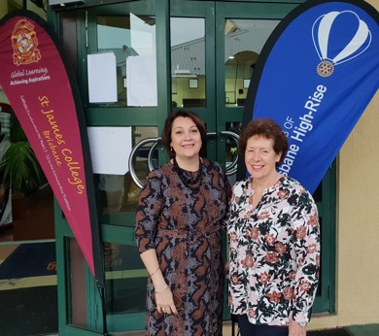
LAST WEEK’S MEETING
Wow, what a successful breakfast meeting, thanks to the students and teachers of St James college. Will go down as a highlight of our BHR club history and the start of a special partnership between St James, Brisbane High-Rise and other city Rotary clubs and local businesses.

Slide 3
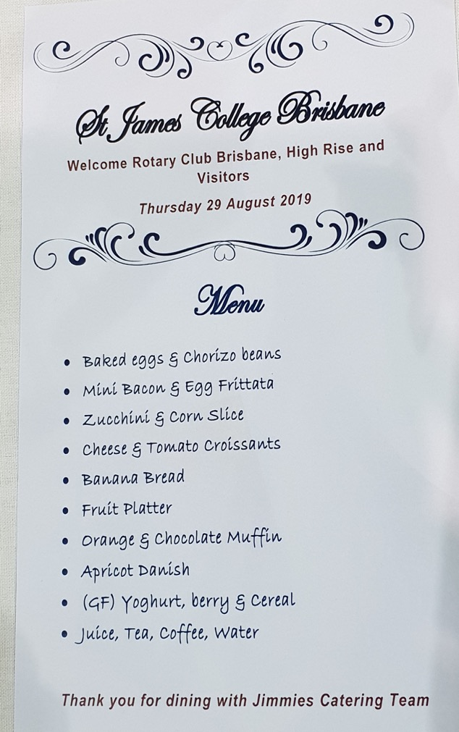
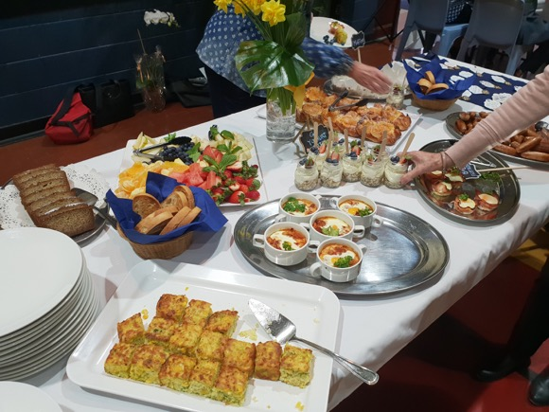
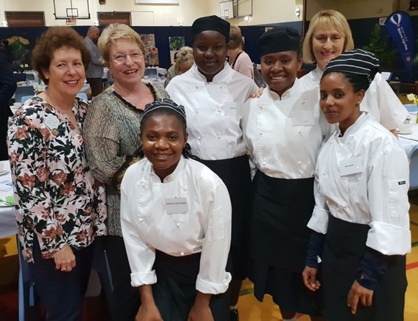
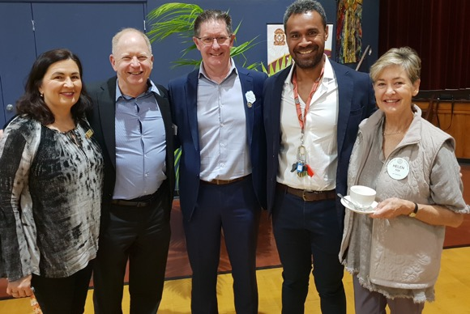
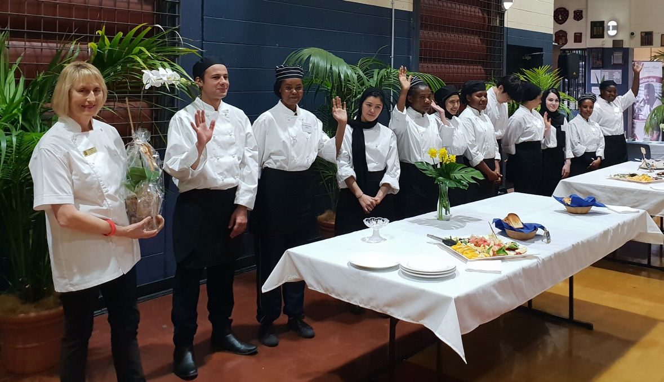

Slide 4
NEED TO ACT NOW
HIGH TEA FOR HAMLIN – ON THIS SATURDAY
Please let Margot know if you can come so that Dennis can have the Aperol Spritzers ready. Even if you can’t make the high team please support the cause with a donation via the link below.
ACT NOW

Slide 5


Great Opportunity for
2 hours of Service and Fun
BRISBANE'S SCANDINAVIAN FESTIVAL 2019
The Scandinavian Festival offers an exciting range of culture, food & beverage, music and live entertainment and they need our help doing tasks like selling raffle ticket sales, making flower crown, bump out assistance and gate control.
Expect a smorgasbord of traditional Scandinavian food and drinks while taking part in an historic tale or two. There will be performances on stage all day with traditional music and dancing, including Folk-dancers and fiddle groups. Saga Vikings will also be onsite to share stories and entertain the crowd.
Details
Date: Sunday 8th September 2019
Location: Perry Park (34 Folkstone Street, Bowen Hills)
3 Time slots : 10.00am – Noon; Noon – 2.00pm and
2.00 to 4.00pm
If you can help let Roly Wells know
E: rwells@projectcreations.net
T: 0427 191 446
JOIN THE BHR WALKING TEAM
or
BECOME A SPONSOR
Sunday 6 October
Start time 8.00am
Margot Baillie has invited you to join Rotary Club of Brisbane High Rise and take part in Walk For Awareness 2019. You can join by clicking the ''Join Team'' button below. It only takes a few minutes to complete your registration and get started. Thanks! Click here to Join Rotary Club of Brisbane High Rise

Slide 6


RFDS BALL – LONGREACH
12 October 2019
Accommodation
We have arranged a discounted arrangement at the Saltbush Retreat which is as good as next door to the Stockman’s – an easy walk on flat cement path. Quoted rate – Friday & Saturday nights $380 per double room; Thursday, Friday & Saturday nights $390 per double room.
Dress Code – Black Tie for the Ball
RSVP – Russell Postle
Important information
Russell has sent an email to all those who have indicated that they are coming to Longreach. If you have not received a confirmation email you do not have accommodation booked and will need to make your own arrangements.
OPPORTUNITY FOR SERVICE
SUNDAY 15 SEPT
RIVERFIRE
2019
BOOK YOUR TICKETS NOW
DATE : Saturday 28 September
TIME : 4.30 to 8.00 pm
LOCATION : QLD Maritime Museum
COST : $35 per person OR $75 Family ( 2 Adults and 3 children)
Buffet dinner, reserved tables and chairs provided. Soft drinks, wine, beer, ice creams and nibbles for sale or BYO by special arrangement.
An amazing location without the crowds, to view the Fireworks. Limited tickets for sale – RSVP Angela Tillmanns at angela@razconsulting.com.au OR text Name and numbers to 0437 636 499 and pay Lindsay at the front desk. Need numbers for catering purposes.

Slide 7
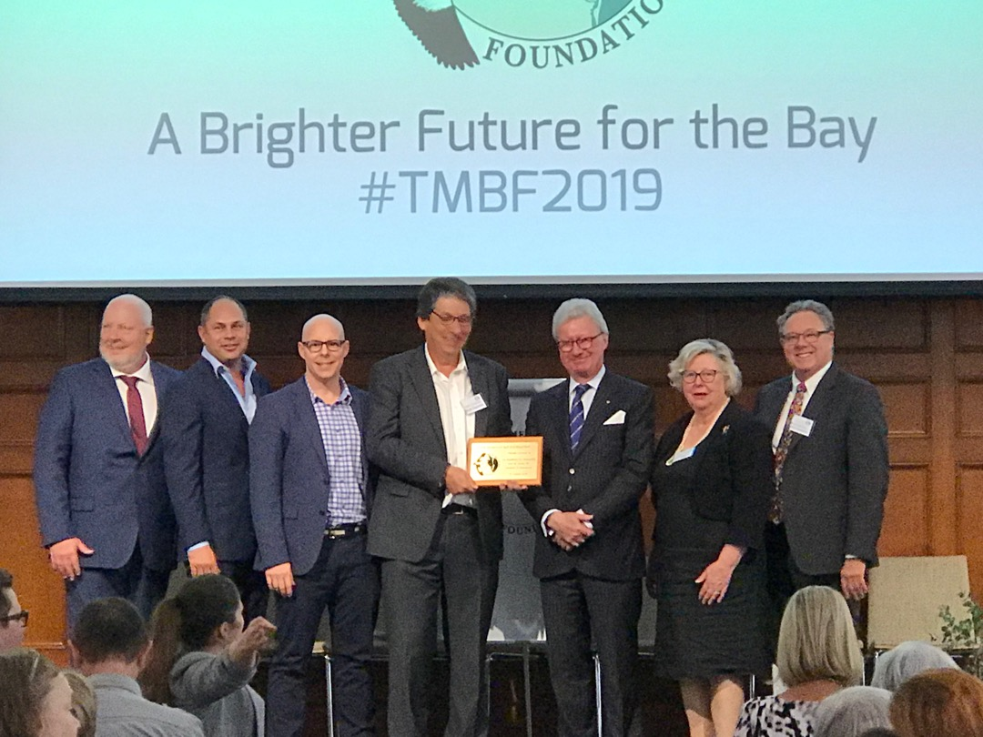
Update on Moreton Bay Foundation
On Friday 30 August 2019 the Moreton Bay Foundation was officially launched by the Governor. In the picture below is our very own James Goodman who is on the Board of the Foundation. You may recall that he and John Goodman addressed the Club about the Foundation a few months back.
Get Ready for Some Great Guest Speakers
Please take note of the dates and invite your friends, family and work colleagues along to hear these great guest speakers.
12 September – Dr Tim Baker (past member) Tim is a master trainer, executive coach, published author and keynote speaker. He has conducted major consulting projects throughout the world. His clients include IBM, Unilever, Nokia, Boeing, Singapore Airlines, Warner Brothers, Volvo and SAP.
3 October – Paul Couglan, Project Director for Brisbane Airport Runway. Hear about one of the largest infrastructure projects in Brisbane and the successful journey to build the new runway on schedule and under budget.
21 November – Grace Grace Minister for Education and Minister for Industrial Relations in the Queensland Government

Slide 8

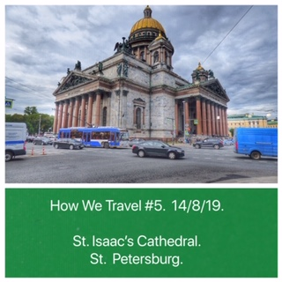
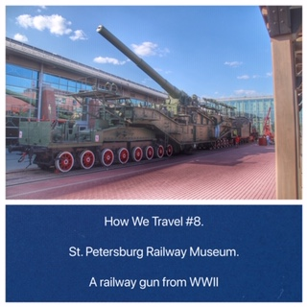

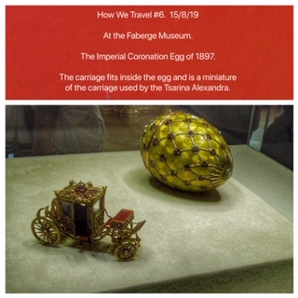
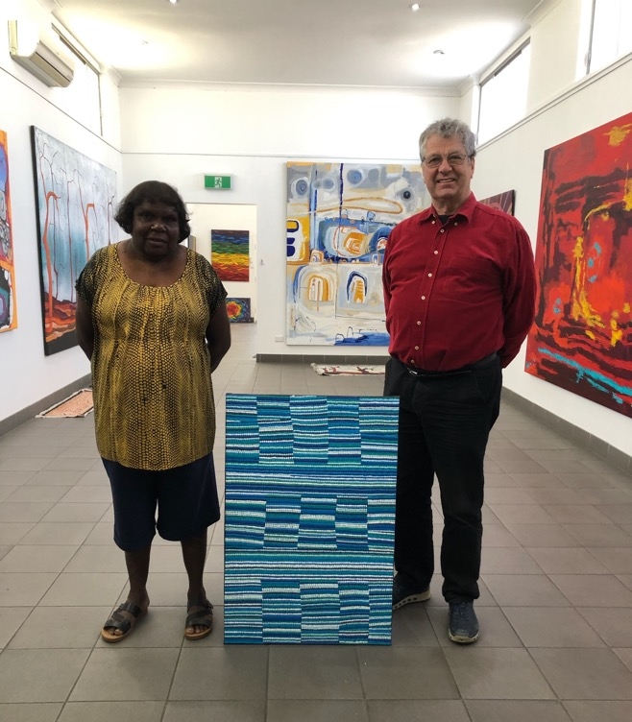
TRAVELLING CLUB MEMBERS
BILL AND ELENOR LEVERITT
UNEXPECTANTLY BACK HOME
Here are some photos of our few days in St Petersburg. We spent 4 days there, visiting the well known sites such as the Hermitage, but also some lesser known ones, including the city tramway museum and the Railway Museum (which was an excellent museum, clean, well laid out, good signage in both English and Russian). Unfortunately, we’ve had to return early to Australia. Our daughter in Bundaberg is in hospital, and her ex husband has just died suddenly, of a heart attack at age 50. Our two grandsons are understandably upset so we’ve come back to look after the family. We will be trying for travel insurance to cover it but, we’re not sure it will.
FRANK IN ALICE SPRINGS
Frank captured while looking to add to his art exhibition through a quick trip to Central Australia.

Slide 9
ANNUAL CALENDAR
The calendar will appear in every edition with new events being bolded in purple. This will give you a long range planning tool. The calendar is being maintained by Margot, so if you have an event that you want listed, please advise Margot. This calendar will also be available on our website.
July 2020 |  | August 2020 |  | September 2019
 |  |  |  | 7 | Hamlin High Tea
 |  |  |  | 8 | The Scandinavian Festival
 |  |  |  | 15 | Working Bee at QMM Restoring the Forceful
 |  |  |  | 26 | Club Assembly
 |  |  |  | 28 | Riverfire Maritime museum
October 2019 |  | November 2019 |  | December 2019
6 | Walk for Awareness | 4 | Calcutta Night Stones Corner | 5 | Club Assembly
12 | Swimathon, Hamilton Club RFDS Ball Longreach | 9 | Party Maritime Museum | 19 | Christmas Meeting
18 | Fellowship Dinner | 21 | Theatre Night – Chicago
26 | FashionAble – Multicap Mercure Hotel, North Quay | 29 | Christmas Party
Jan 2020 |  | Feb 2020 |  | March 2020
TBC | Hosting NYSF students |  |  | 1 | Clean Up Australia
 |  | 29 | RI Million Dollar Dinner Westin Hotel | 13 – 15 | District Conference
April 2020 |  | May 2020 |  | June 2020
23 - 26 | Anzac Day at Fraser | 11 | Art Show opening night
 |  | 9 - 16 | Art Show
BARB’S JOKE CORNER
The parents were very disappointed in the grades that their son brought home. "The only consolation I can find in these awful grades," lamented the father, "is that I know he's not cheating on his exams."
She texted me: Your adorable!
I replied: No. You're adorable. Now she likes me a lot. All I did was point out her typo.

