Slide 1
Planning a healthy new year
Cristina Anez de Gomez MD, FACP, Dip ACLM
Internal Medicine

Slide 2
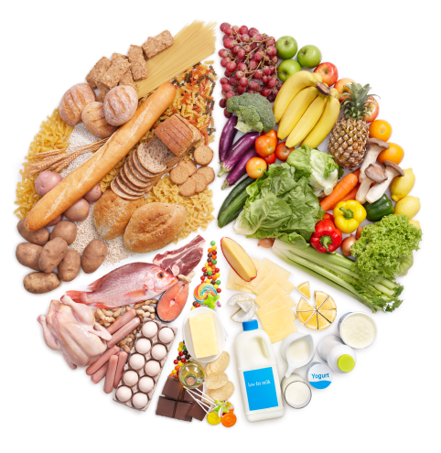
Health Triangle
How is your mind
Stress, sleep, relationships
What and How you eat
How you move

Slide 3
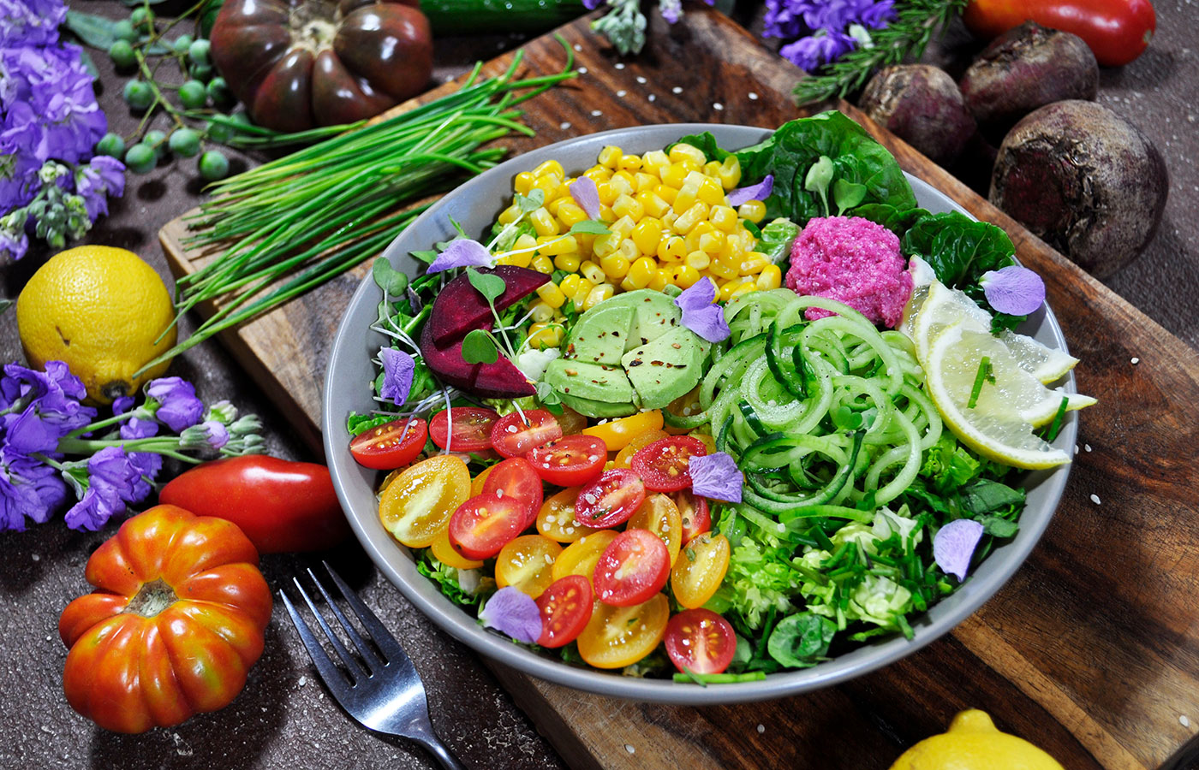
Add more fiber to meals you need 30-40 gr of fiber a day
BENEFITS
Give more energy
Improve blood flow
more neurotransmitters
Decrease inflammation
Improve bowel movement
Boost immune system
More
natural
food
Have a Plant Predominant diet

Slide 4
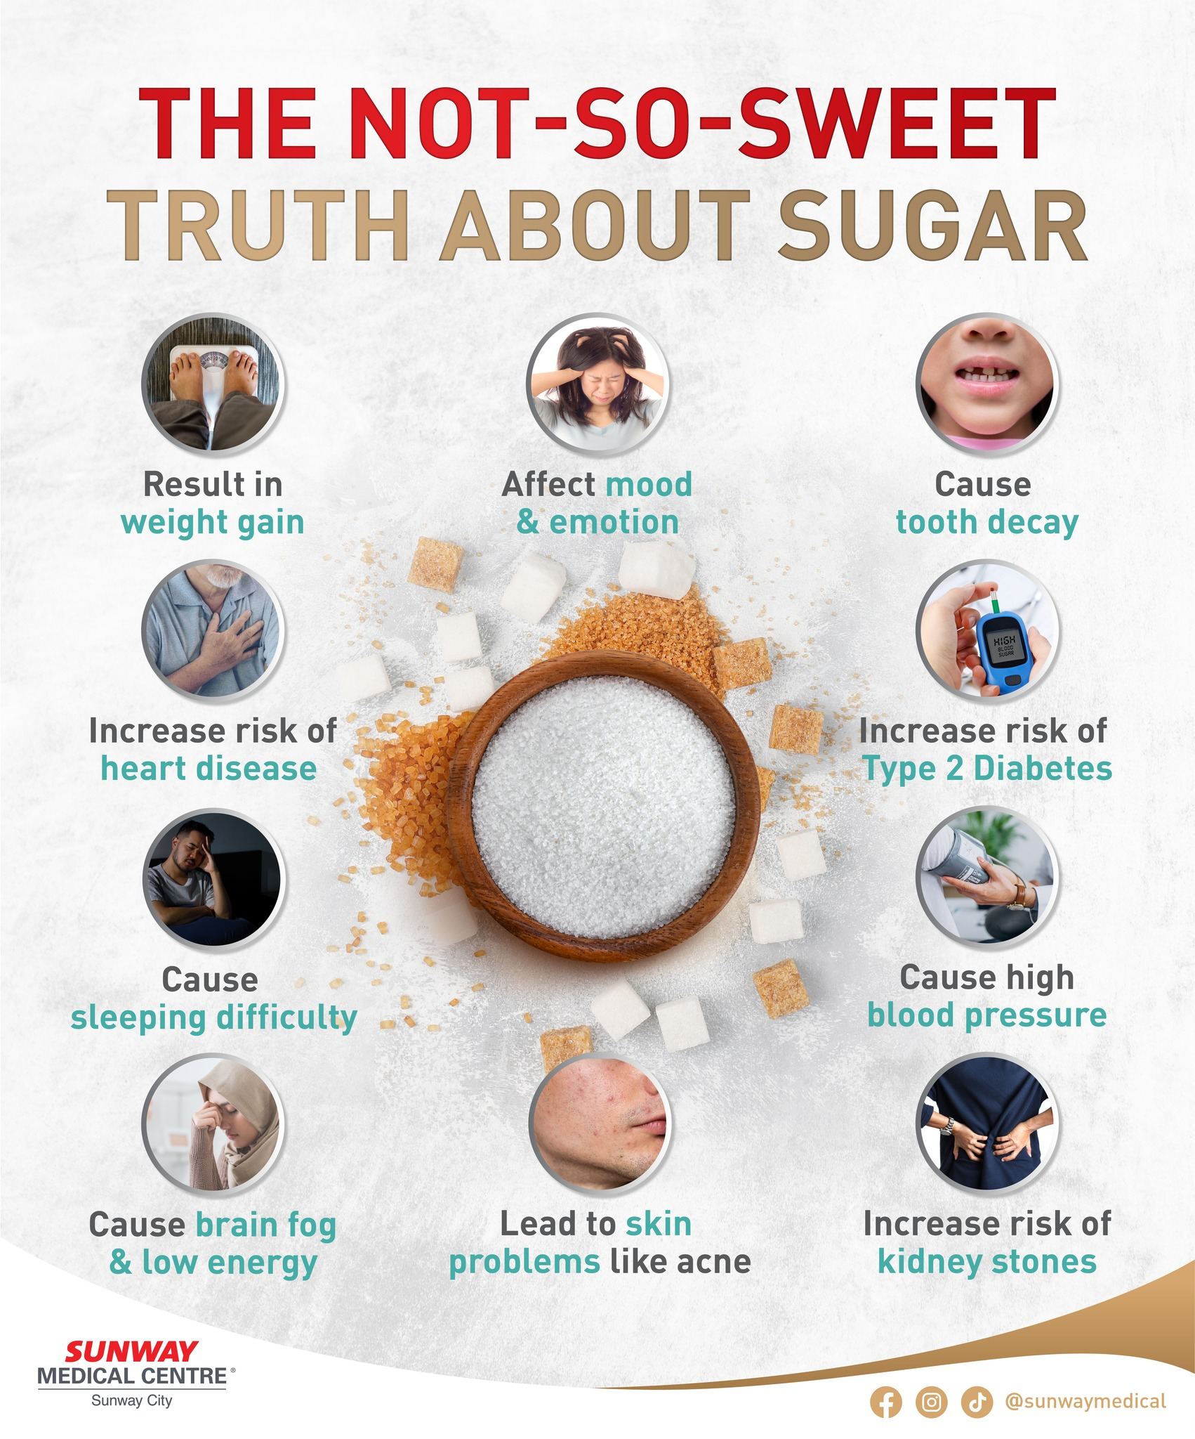

Slide 5
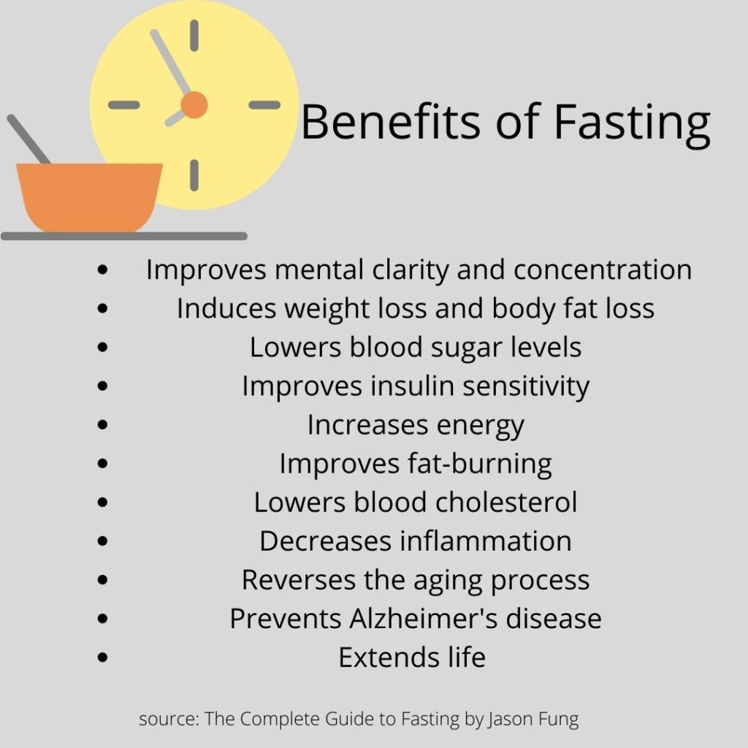
Overnight 12 h FASTING

Slide 6
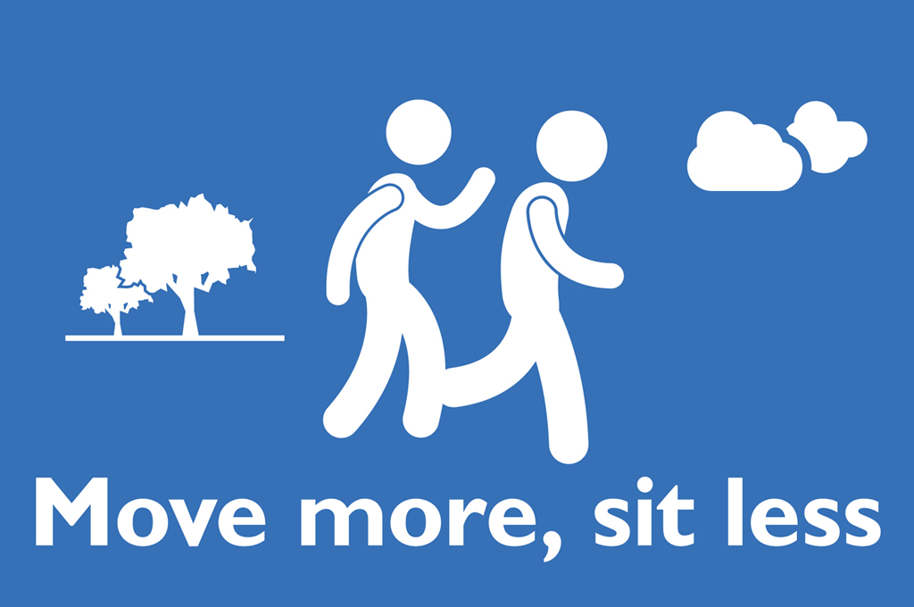
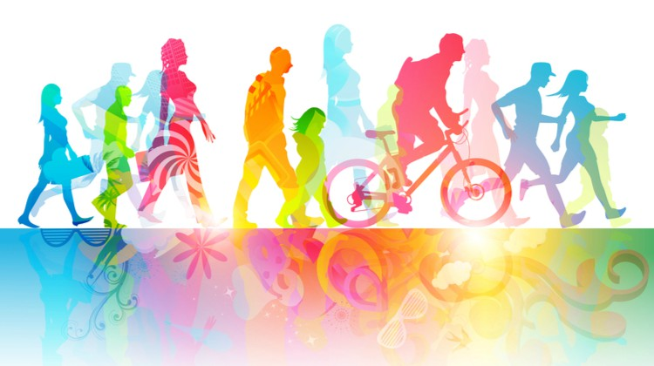
Move more! goal cumulative 150 min moderate exercise throughout the week moderate means able to talk but not sing 20 seconds going upstairs counts also sitting exercises

Slide 7
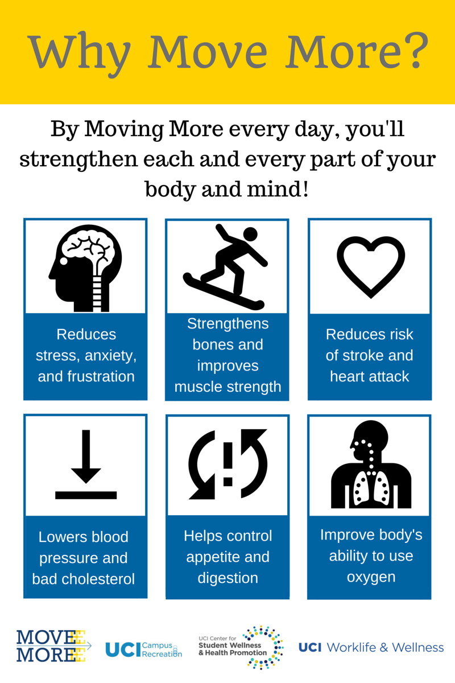

Slide 8
Impact of stress in performance
Control your stress

Slide 9
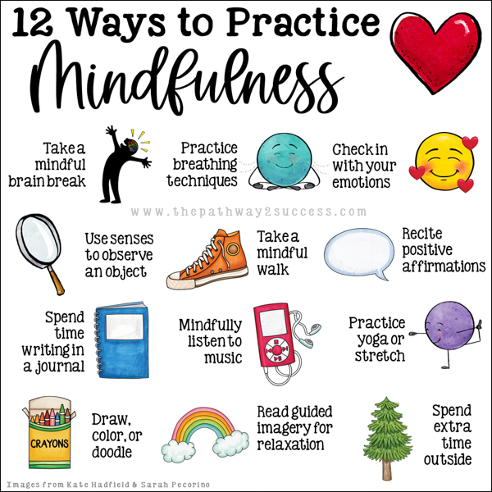

Slide 10
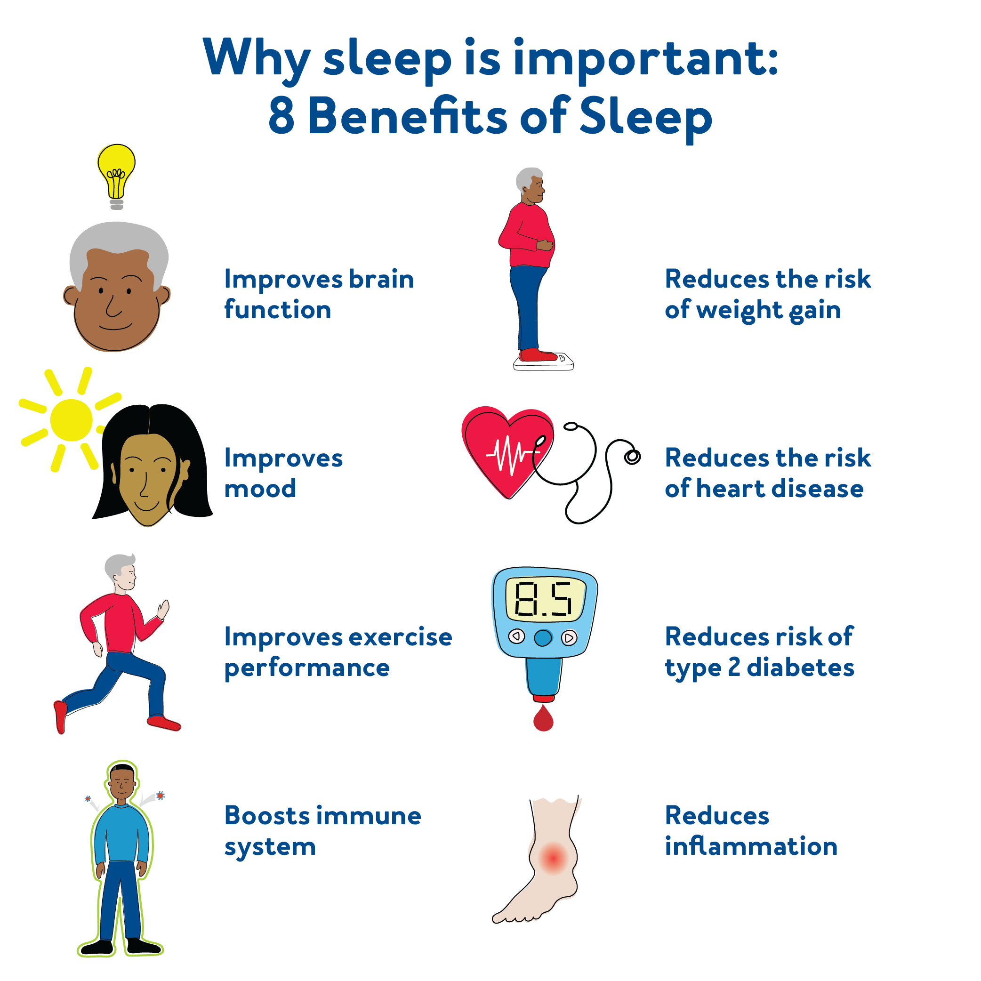
Sleep 7-9 hours a day

Slide 11
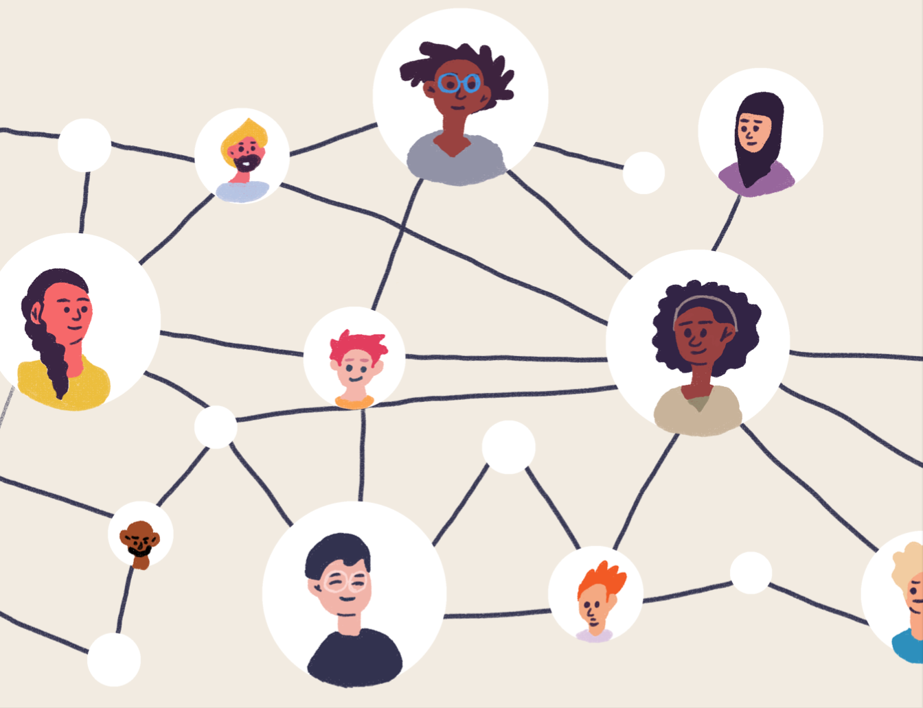
Socialization
Benefits
Better overall health
Improve memory
Reduce stress, anxiety and depression
Increase self esteem and confidence
Better sleep

Slide 12
Questions?
Cretanez@gmail.com
Instagram
@drcristips

