Slide 1
Rotary Club Saigon International Appeal for Emergency Support in Ho Chi Minh City
Title Page Option

Slide 2
subhead
Hospitals across Ho Chi Minh City are struggling to treat COVID-19 patients due to a severe shortage of equipment

Slide 3
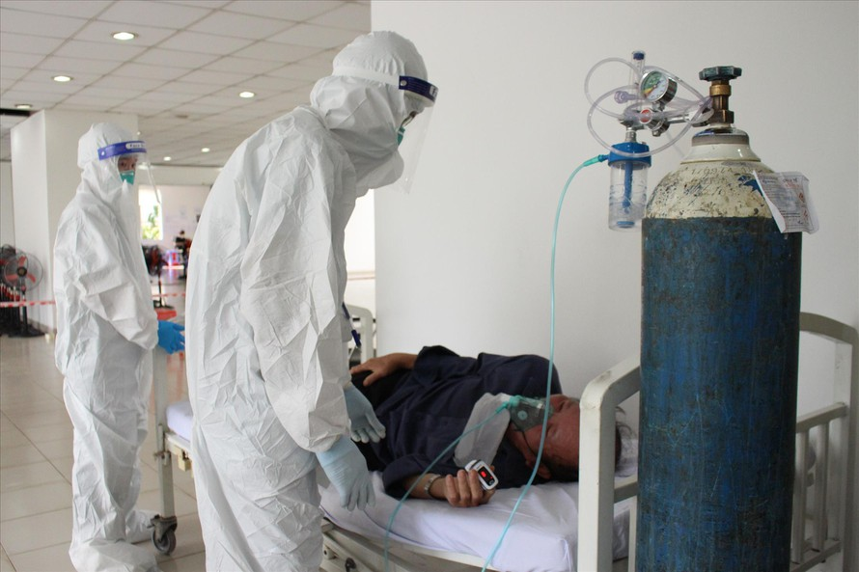
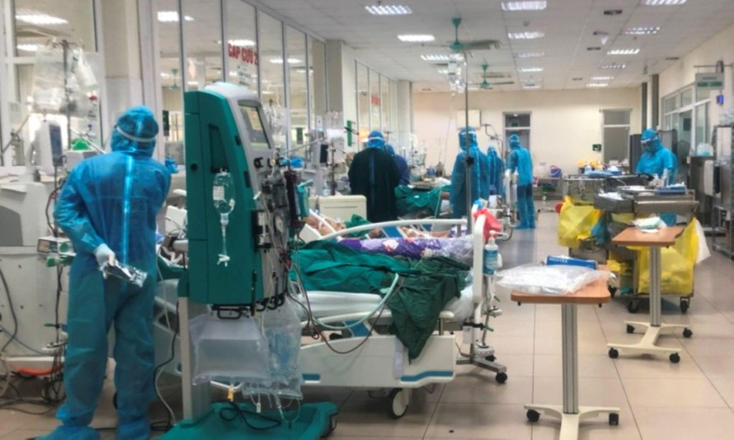
Field hospitals have opened across the city, and will open in neighbouring provinces as the need arises. Our club have conducted in-depth assessments with frontline doctors and administrators to see what the most urgent needs are.

Slide 4
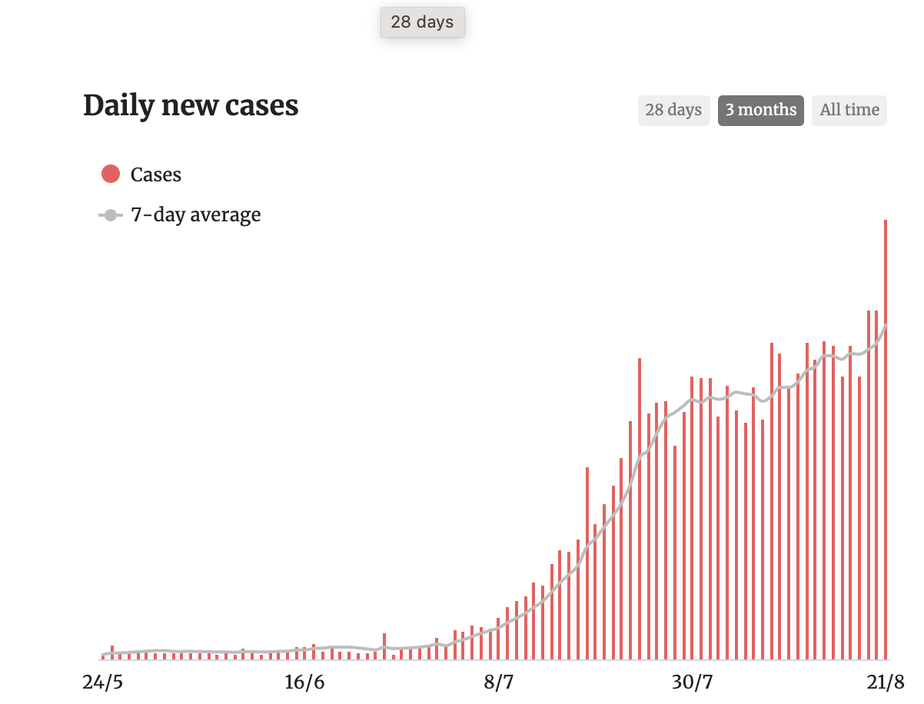
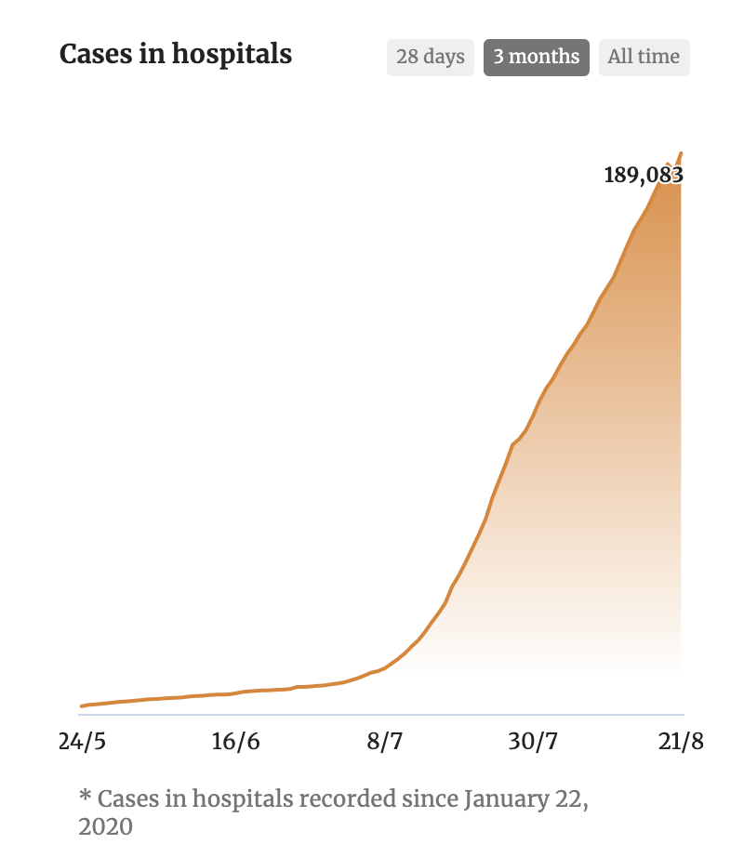
Vietnam largely avoided outbreaks of Covid 19 for many months, and was recognized as a leader in implementing aggressive track-and-trace policies and quarantine to control the spread of the virus.
As this graph illustrates, infections have grown exponentially since the end of June 2021 and as a result hospitalizations have risen sharply to the point where there is immense pressure the healthcare system.

Slide 5
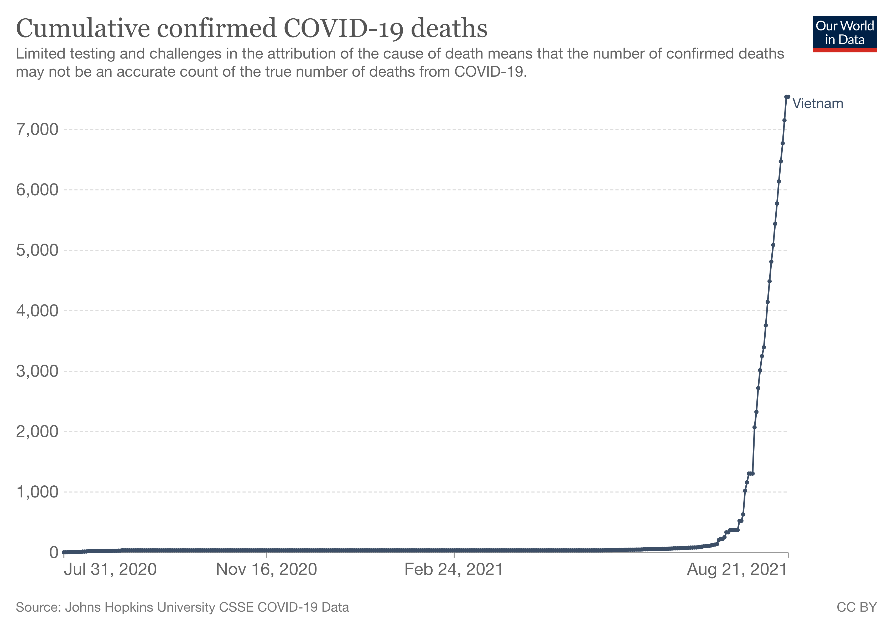
DAILY COVID MORTALITY REPORT IN VIETNAM

Slide 6
COVID HAS BECOME ONE OF THE TOP MORTAL CAUSES IN VIETNAM
Stroke
Myocardial
infarction
COVID
Chronic
obstructive
pulmonary
disease
Diabetes
Traffic
accidents
Alzheimer
& dementia
Respiratory
tract infection
Kidney
disease
Liver cancer
Cirrhosis
*National Death Report from 7/7-7/8/2021

Slide 7
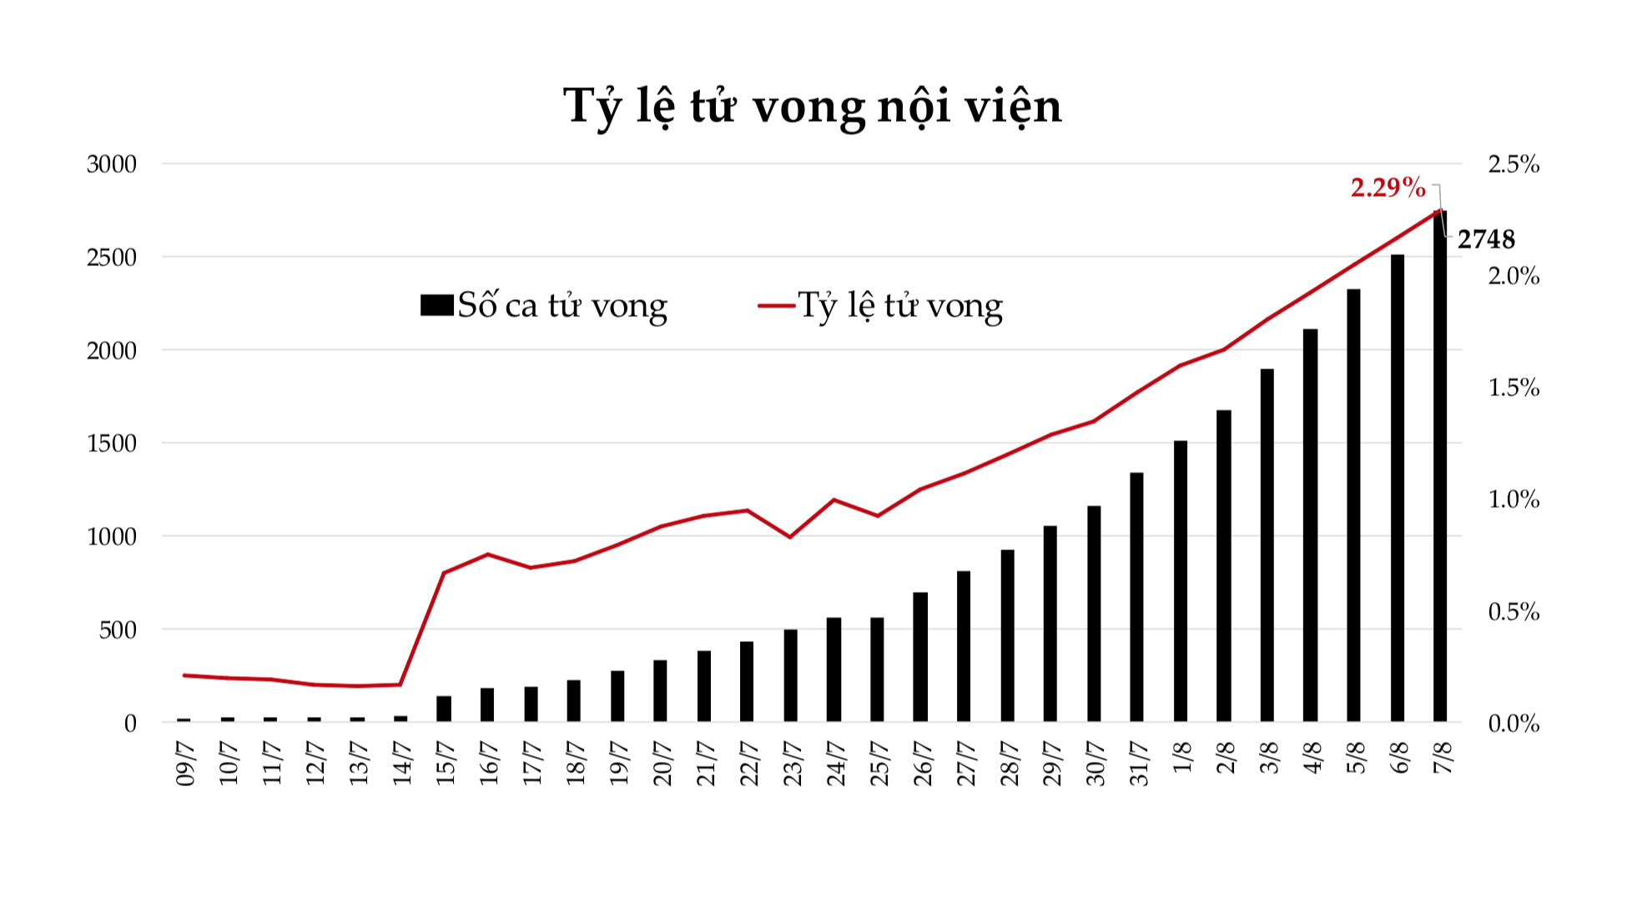
MORTALITY RATE OF COVID IN THE HOSPITALS

Slide 8
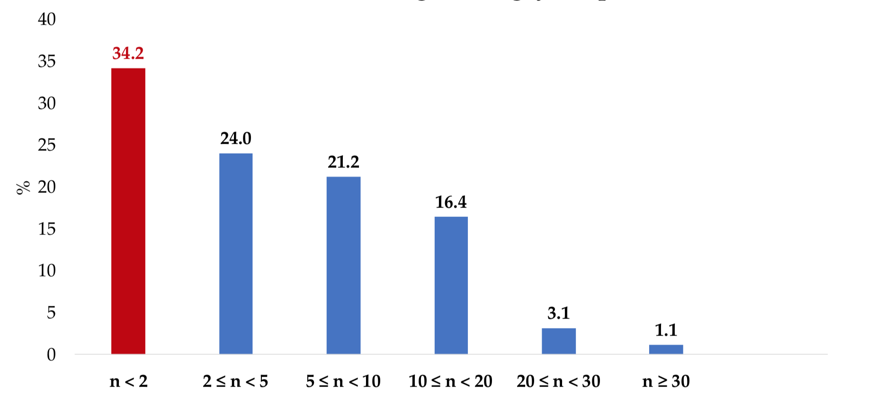
MORE THAN 1/3 OF COVID PATIENTS DIE AFTER 2 DAYS IN THE HOSPITAL
n = day in the hospital

Slide 9
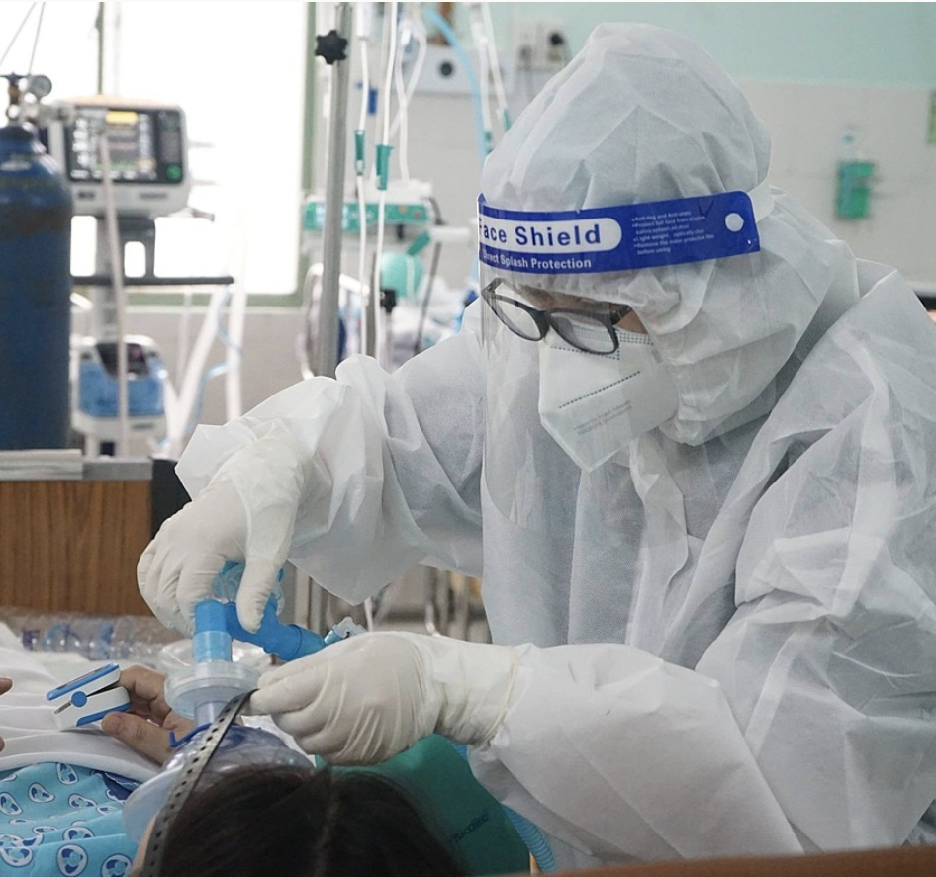
Many hospitals are short of equipment
As an example, The COVID-19 Resuscitation Hospital in Thu Duc City has issued an appeal for: 10 portable X-ray machines
5 bedside ultrasound machines
5 echocardiogram machines
10 arterial blood gas machines
30 CRT dialysis machines
50 non-compressed air high-function ventilators
200 high flow oxygen ventilators (HFNC)
Similar requests for support are echoed in hospitals across the country, but particularly in Ho Chi Minh City, which is the epicentre of the current outbreak.
The number of people requiring mechanical ventilation has doubled in the past ten days, from more than 700 people (July 28) to more than 1,300 people (August 5).

Slide 10
OUR APPEAL FOR HELP
To tackle with the urgent situation in the hospital and try to help lower the mortality rate due to lack of equipment, Rotary Club Saigon International will raise funds to join forces with Rotary International Club and purchase 100 oxygen concentrators to support the field hospitals in Vietnam.
Each Oxygen concentrator costs around USD800 (we have negotiated supply at cost price from local distributors and have compared pricing from 5 different suppliers as well as checking with several senior doctors in field hospitals as to suitability of the chosen units).
Our chosen unit delivers 10L/minute of oxygen at approx. 94% concentration. It is designed to support patients at level2-3 of progression of Covid to increase o2 Saturation in the bloodstream.

Slide 11
OUR APPEAL FOR HELP
Why Oxygen concentrators?
We spoke to many doctors and asked them what the most pressing need is in their hospitals and field hospitals right now and most identified Oxygen concentrators.
One unit can treat up to 6 patients a day in the early stages of the disease by keeping their blood saturation levels up and reducing the number of patients who will need mechanical ventilation.
These units are mobile, require no systemic change in hospital infrastructure or operations, can be passed on to other facilities or areas as the need arises and are relatively affordable.
We are sourcing units that are already approved for use by the Ministry of Health and our doctors have agreed are fit for purpose.

Slide 12
About Our clubs
Rotary Club Saigon International was chartered in June 2021. The club was founded by a group of international and Vietnamese entrepreneurs, businesspeople and NGO workers. The club is currently about 20 strong and recruiting new members with an aim to build to 50 or so by the end of 2021.
RCSI was chartered just as the current spike in Covid cases began in Vietnam and so far we have already completed 2 projects in the community supporting vulnerable people hit hard by the effects of strict lockdown and the disabled community with the distribution of almost 400 wheelchairs.
Also Chartered in June 2021 was Rotary Club Saigon. We are working together on this project and others as well as with Rotary Clubs in our supporting districts in Thailand and China.

Slide 13
If you are able to help our emergency fundraiser, please contact:
Chi Lan Nguyen – Chair, Projects and Services Committee chilan@m-group.com.vn
(whatsapp +84 96 694293)
Or Matt Millard matt@purpleasia.com
(whatsapp +84 90 30 29898)
Thank You

