Slide 2
District 5010 Grants Management Seminar
Notes:
JULY 2012

Slide 3
Areas of Focus
Basic Literacy
Child and Maternal Health
Disease Prevention and Treatment
Water and Sanitation
Economic/Community Development
Peace/Conflict Resolution

Slide 4
District 5010 Qualification Requirements
Attend a grants management seminar annually
Submit Memorandum of Understanding (MOU)
Complete Financial Management Plan
Submit Project Proposal for use of
District Designated Funds (DDF) by April 20
Submit District Dues, RI Dues and reports on time
Be current on all outstanding grant reports
Support the Annual Program Fund

Slide 5
Additional Requirement
Club Goals must be entered into Club Central by the end of the day on April 20.

Slide 6
Purpose
Understand how to manage a Rotary Foundation grant
Learn stewardship expectations
Prepare clubs to implement the MOU
Qualify clubs to receive grant funds

Slide 7
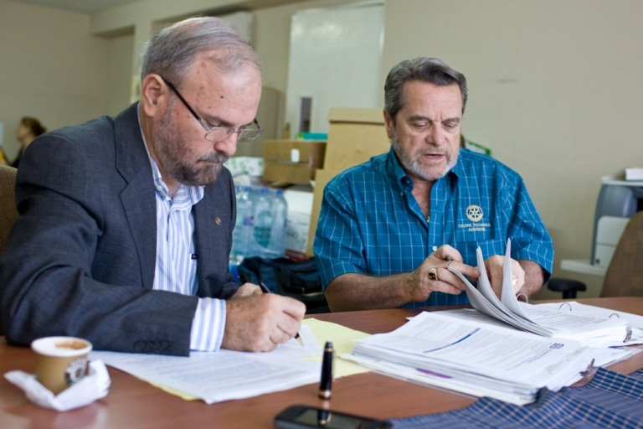
Grants Management
Ensures that projects:
Have proper financial control
Adhere to technical standards
Meet the needs of the beneficiaries
Fulfill their objectives
Safeguard funds

Slide 8
Successful Grant Projects
Meet community needs
Include frequent partner communication
Have implementation plan
Are sustainable
Maintain proper stewardship of funds
Impact many people
Involve Rotarians

Slide 9
Project Planning
Form a three-person grant committee
Assign roles
Implementation plan
Budget
Contingency plan
Document retention plan

Slide 10
Share System – short version
$358,000 D5010 contributions
from third prior year
$179,000 to the World Fund
$89,500 for Global Grants
$89,500 for District Grants

Slide 11
The Rotary Foundation
District grants
http://www.matchinggrants.org/District
Global grants
http://www.rotary.org

Slide 12
District Grants
Community based programs (some international)
Scholarships and Vocational Training Teams (VTT)
Rotarian cash contributions matched 100% with District Designated Funds (DDF)

Slide 13
Global Grants
Large scale international sustainable programs – partnerships desirable, $30,000 minimum.
Scholarships and Vocational Training Teams (VTT)
DDF matched 100% with World Fund
Rotarian cash contributions matched 50% with World Fund
Non-Rotarian cash contributions

Slide 14
Resource Leaders
Denise Ringhand– District Grants
George Elgee – Global Grants/Juneau
Bonnie Venton Ross – Whitehorse
Mary Kowalczyk – Ketchikan/Sitka/Petersburg
Karl Schroeder – ANC International
Jodi Stuart– Kenai Peninsula/Kodiak
Lisa Roberts – Kenai Peninsula
Alex Slivka – Anchorage
Stacie Stigar– The Valley
Vicki Kennebec – Fairbanks/Barrow
Denice Gilroy - Nome
Alex Slivka– Grants Chair

Slide 15
Thank you!
Remember!
The most important office
in Rotary is
PRESIDENT

