Slide 1
Preventing and Addressing Abuse and Harassment in Rotary
RYLA Planning Committee
April 12, 2021

Slide 2
Session Outcomes
Know Rotary’s Policy on harassment for Youth Programs
Develop a greater awareness and understanding of Abuse and Harassment using examples of harassment
Know the steps for creating a harassment-free environment
Know what to do if a youth reports (or you observe) harassment or abuse

Slide 3
Rotary Code of Policies
Article 26.120.
Harassment-free Environment at
Meetings, Events, or Activities
Rotary is committed to maintaining an environment that is free of harassment.
Harassment is broadly defined as any conduct, verbal or physical, that denigrates, insults, or offends a person or group based on any characteristic (age, ethnicity, race, color, abilities, religion, socioeconomic status, culture, sex, sexual orientation, or gender identity).

Slide 4
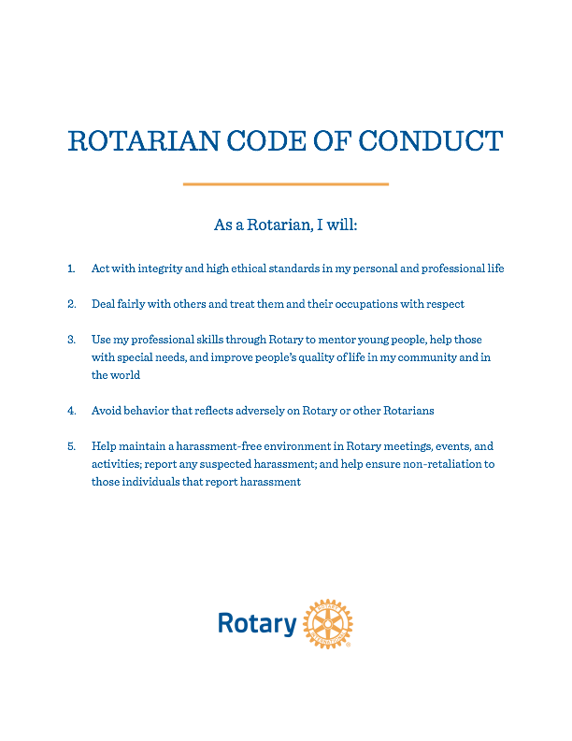

Slide 5
D5010 Youth Protection Policy
District 5010 strives to create and maintain a safe environment for all youth who participate in Rotary activities. To the best of their ability, Rotarians, Rotarians’ spouses and partners, and other volunteers must safeguard the children and young people they come into contact with and protect them from physical, sexual, and emotional abuse.
All Rotarian and non-Rotarian volunteers interested in working with youth program participants must meet RI and district eligibility requirements.
RI prohibits the membership and participation of any volunteer who has admitted to, been convicted of, or otherwise been found to have engaged in sexual abuse or harassment.

Slide 6
All Rotarian and non-Rotarian volunteers that have direct supervised contact with program participants must:
• Complete a volunteer agreement form
• Be interviewed at the club level, preferably in person
• Comply with RI and district guidelines
RI further states that anyone that has direct, unsupervised contact with program participants must complete a background check.

Slide 7
Adults who work with youth are subject to policies outlined in the Rotary Code of Policies 26.120.
All allegations of criminal activity should be referred to appropriate local law enforcement authorities. If in doubt, it is better to report than not report.

Slide 8
Is it Harassment or Abuse?
Harassment is broadly defined as any conduct, verbal or physical, that denigrates, insults, or offends a person or group based on any characteristic
Sexual Abuse is mainly used to describe behavior toward children, not adults.
Sexual Abuse of a child is a criminal act. All 50 states have laws that recognize that children are not capable of giving informed consent to any sex act.
Sexual Abuse can include many different things, from touching a victim in a sexual manner to forcing a victim to touch the perpetrator in a sexual way to making a victim look at sexual body parts or watch sexual activity.
Sexual Assault can describe a range of criminal acts that are sexual in nature, from unwanted touching and kissing, to rubbing, groping or forcing the victim to touch the perpetrator in sexual ways. Sexual assault is a criminal act.

Slide 9
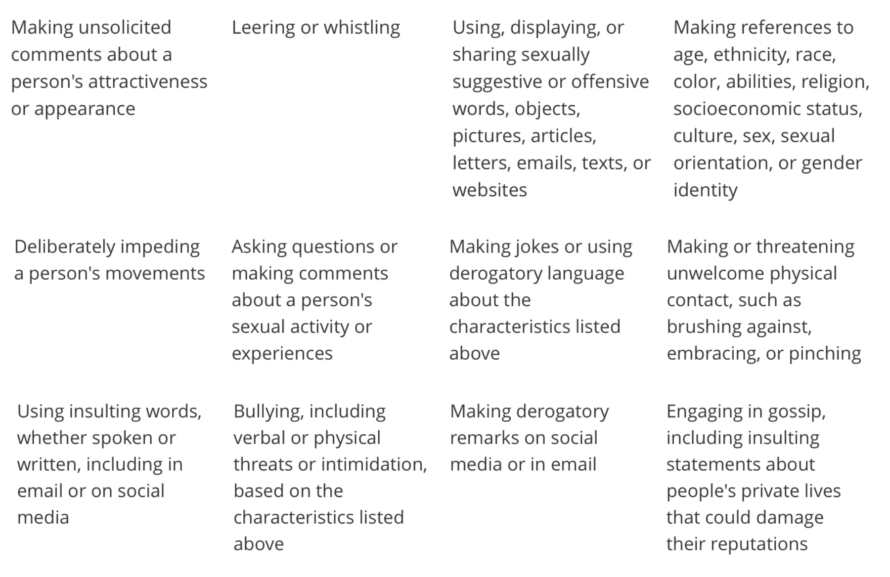
Examples of Harassment
Harassment can take many forms. When a behavior becomes pervasive or extreme, it is harassment.

Slide 10
Addressing an allegation of Harassment
* Take all allegations of harassment seriously and address the situation.
* Program Leaders must promptly address any allegation of harassment and must not retaliate against the person who made it.
* This is where completing the D50910 Report Form begins.
* It is recommended that RYLA form an Event committee to address these kinds of allegations.
* District 5010 has established a code of conduct and policies for preventing and addressing harassment within clubs, among members, and with other Rotary participants. It is part of the D5010 Manual of Procedure.
* If harassment is found, but does not constitute criminal activity, D5010 can specify when contact with young people by the alleged perpetrator should be restricted.
* If sexual harassment is found, contact with youth in D5010 Programs may be prohibited.

Slide 11
Receiving an Allegation Report
Any adult to whom a program participant reports abuse or harassment must:
Listen attentively and stay calm. Acknowledge that it takes courage to report abuse or harassment. Be encouraging, but remain neutral; do not express shock, horror, or disbelief.
Assure privacy but not confidentiality. Explain that you will have to tell someone about the abuse or harassment to make it stop and ensure that it doesn’t happen to others.
Get the facts, but don’t interrogate. Ask questions that establish facts: who, what, when, where, and how. Reassure the young person that he or she did the right thing in telling you. Avoid asking “why” questions, which may be interpreted as questioning the young person’s motives. Remember that your responsibility is to report this information to the proper authorities.
Be nonjudgmental and reassure. Avoid criticizing anything that has happened or anyone who may be involved. It’s especially important not to blame or criticize the young person. Emphasize that it was not his or her fault and that it was brave and mature to come to you.
Document the allegation. Record the conversation, including the date and time, as soon after the report as you can. Try to record the young person’s exact words.

