Slide 1

District Rotary Foundation Forum – Improving our Performance

Slide 2
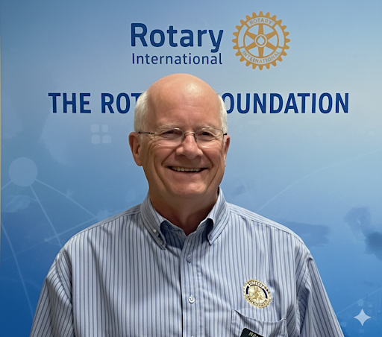
Presenter – Ian Grant District Rotary Foundation Chair

Slide 3

Looking for New Ideas

Slide 4


Slide 5





The Rotary Foundation – Where do Your Donations Go?
Global Grants $81 Million
District Grants $27.8 Million
Polio Plus $151 Million
Disaster Relief $1.8 Million
Peace Scholarships $5.2 Million
2024-25 Figures

Slide 6
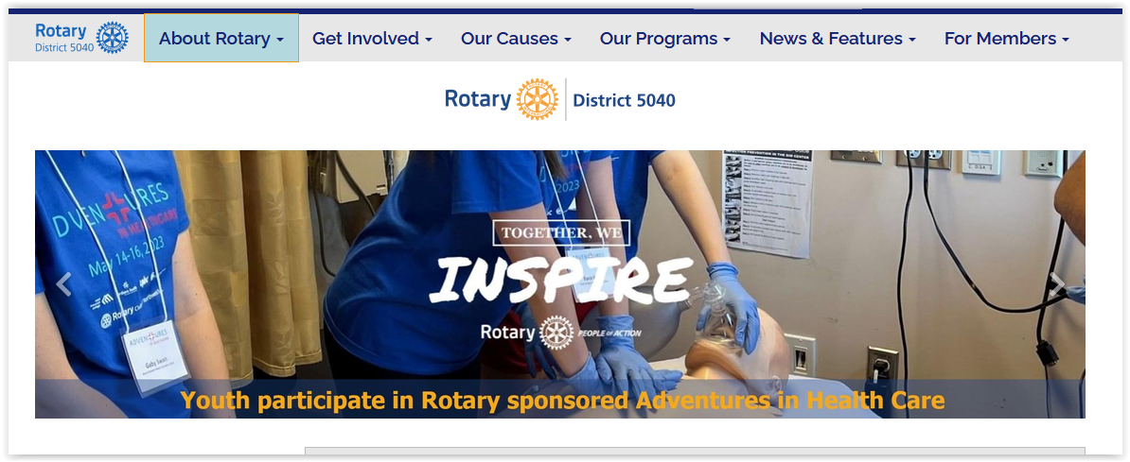
Global and District Grants in our District
Click on About Rotary on the 5040 Home Page
Then click on Showcase of Club Projects

Slide 7

Stories about Grants
On the district 5040 website this symbol identifies a story about a project funded by a grant.
Use these stories to show where grant funds go and the impact they can have.
Stories can be impactful and highlight why we give

Slide 8
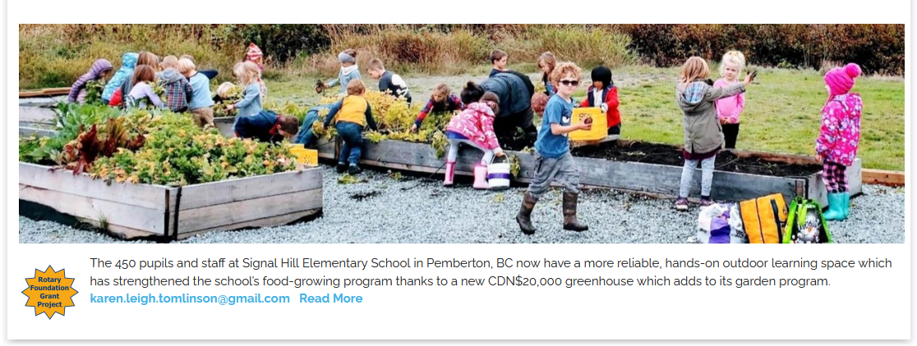
School food-growing program expands with new greenhouse

Slide 9
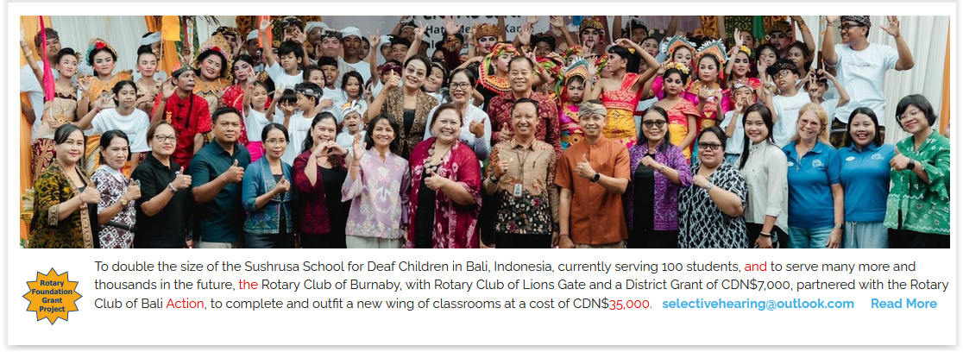

School for Deaf in Bali doubles in size

Slide 10
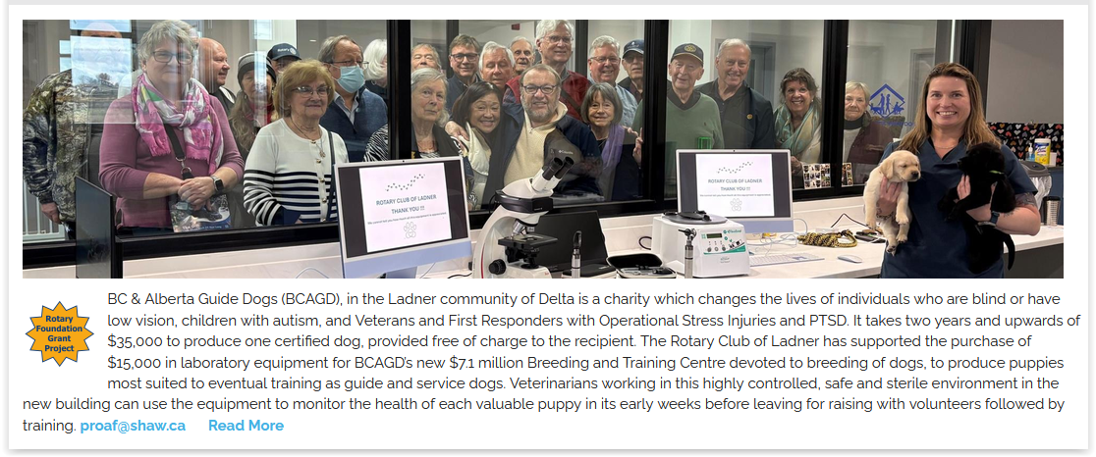
Newborn future guide dogs get a good start with Rotary-sponsored lab equipment

Slide 11

Dental clinic, education for low income children and adults in the Philippines

Slide 12
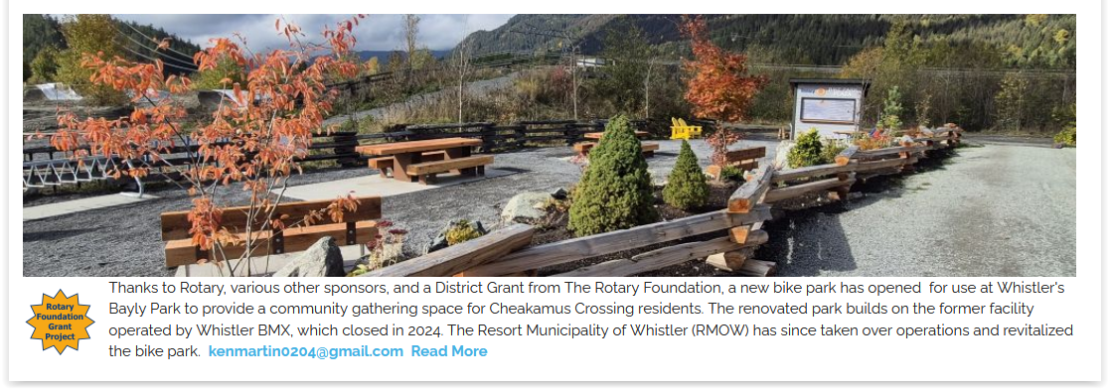
Bike park in Whistler's Bayly Park now in use

Slide 13
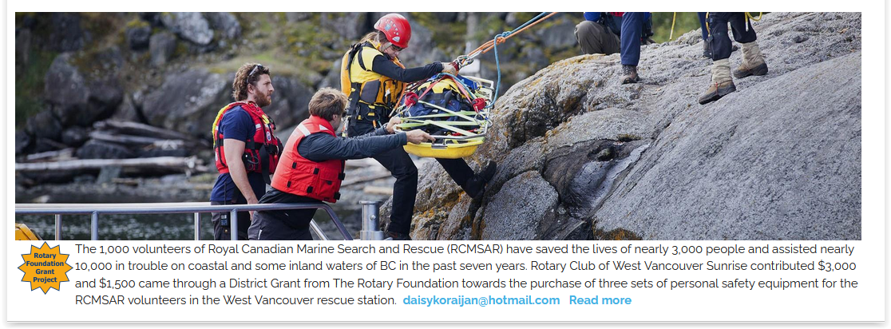
Equipment for Royal Canadian Marine Search and Rescue in West Vancouver

Slide 14
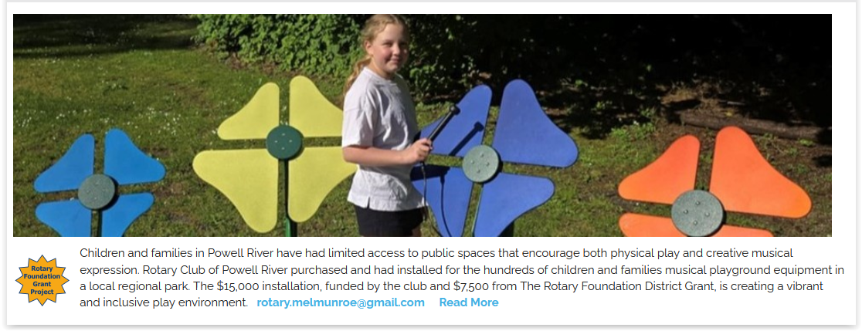
Music to play in the park

Slide 15
Building Blocks to Impact
IMPACT
OUTCOME
The positive, longterm change resulting
from our actions.
These are measurable
improvements
that wouldn’t have
occurred otherwise.
OUTPUT
The intermediate
results of our actions,
such as changes in
attitude or behavior
in the target
population.
INPUT
The immediate
results of activities
that have taken place, such as the number of people trained or the amount of materials delivered.
The funding, time, training, or other materials that we invest in a project.

Slide 16
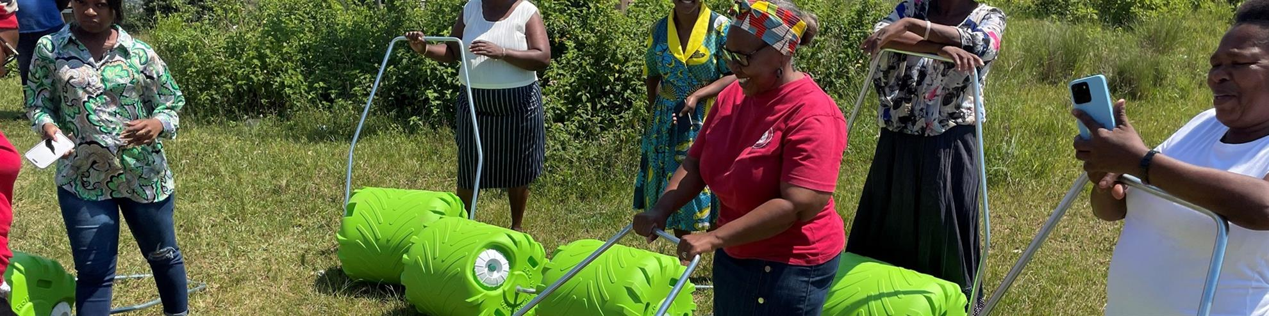
ECOrollers smaller, cheaper to help bring water to South African villages
In rural communities across South Africa, limited access to water affects health, education, household income, and daily dignity. Women and children often spend hours each day carrying heavy containers over long distances, reducing time available for school, work, food production, and community life. The ECOroller Scaling Project addresses that burden with a practical 70-litre rolling water container that allows families to move significantly more water with far less physical strain. The Rotary Club of Prince Rupert donated $2,100 which, with the help of the Rotary Club of Gibsons, received an additional District Grant of $1,050 from The Rotary Foundation to add to this project

Slide 17
The Hippo Roller Impact
IMPACT
OUTCOME
Saves time, reduces injury, boosts education, improves health and livelihoods. Improves food security. The growth in gardens has been seen from space.
OUTPUT
Women are making fewer trips to collect water and now have water for gardens
INPUT
Hippo Rollers are in the hands of women in villages
Rotary Funding, manufacturing and distribution of Hippo Rollers

Slide 18
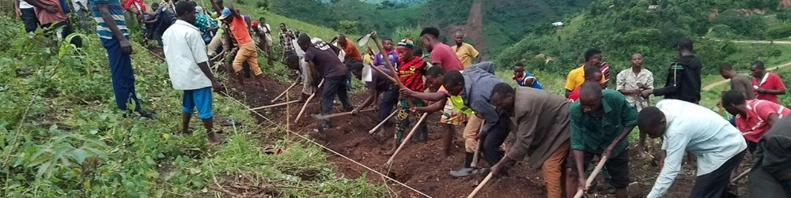
Clean water and good health come to 7,000 villagers in rural Uganda
In Uganda’s Ibanda District Parish of Irimya people in some remote villages have had to walk over 3 km to fetch water from distant sources demanding time and energy away from any school or daily routines. Waterborne disease continued to make villagers of all ages sick. Rotary District 5040 clubs and The Rotary Foundation sponsored installation of a Gravity Flow System (GFS) of clean water flowing down in pipes from nearby hills to the seven villages in the valley below, considerably leading to a higher level of education among children and productivity and well being among the adults

Slide 19
Water Project Impact
IMPACT
OUTCOME
93.3% drop in diarrheal diseases
72.2% drop in intestinal worms
99% of women feel safer when collecting water
Extreme poverty dropped by 30.3% and savings increased by 66%
OUTPUT
Handwashing with soap is the new normal
11 villages entirely eliminated practices that cause cholera and typhoid
70% decline in menstruation-related school absences
95.5% of families walk less than 30 minutes for water
INPUT
Schools have clean water taps and handwashing stations
A health center has running water and sanitation infrastructure serving 20,000+ patients + staff
Taps in each village providing clean water
Fund and construct a Gravity Flow Scheme (GFS) to deliver clean water through taps.
Provide sanitation and hygiene training to households, schools, and institutions.
Provide entrepreneurship training for selling hygiene products (soap and sanitary pads).

Slide 20
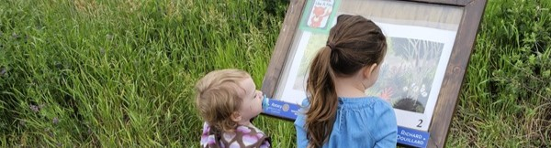
StoryWalk trail for young readers outdoors in Williams Lake
StoryWalks, of children’s book two-page reading stations, exchanged every two weeks or so year round, along a one kilometre trail provides an outdoor experience and an opportunity for children to read with adults, learn new words, describe things and events, enjoy and tell stories. The Rotary Club of Williams Lake Daybreak’s Satellite division has added another StoryWalk in the community along the RC Cotton trail off of Scout Island Nature Centre and bird sanctuary in the Williams Lake, BC community with $3,668 from the club and $1,386 in a Rotary District Grant from The Rotary Foundation

Slide 21
Storywalk Impact
IMPACT
OUTCOME
OUTPUT
Young children build early literacy, increase physical activity, and spark a love for nature by combining reading with outdoor play
Parents and grand parents walk the trail with their children and grandchildren reading the stories
INPUT
Storybook pedestals installed along a one kilometre trail
Stories updated regularly
Fund, plan construct and install storybook pedestals
Choose and update books

Slide 22

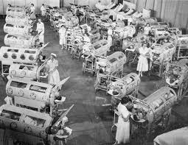

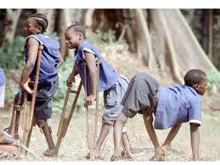
POLIO

Slide 23
Polio
IMPACT
OUTCOME
OUTPUT
Global polio cases have been reduced by 99.9% since 1988
Wild poliovirus remains endemic in only two countries: Afghanistan and Pakistan.
INPUT
More than 3 billion children across 122 countries have been immunized
Raised over $2.9 billion through PolioPlus.
Secured billions more through high-level government advocacy.
Partnered with the Bill & Melinda Gates Foundation, which matches Rotary donations
millions of volunteer hours for door-to-door immunizations and local tracking.
Championed polio eradication and engaged clubs in funding the initiative
Created global awareness through events like World Polio Day
Built cross-cultural and political support in countries with active conflict or fragile health systems.

Slide 24
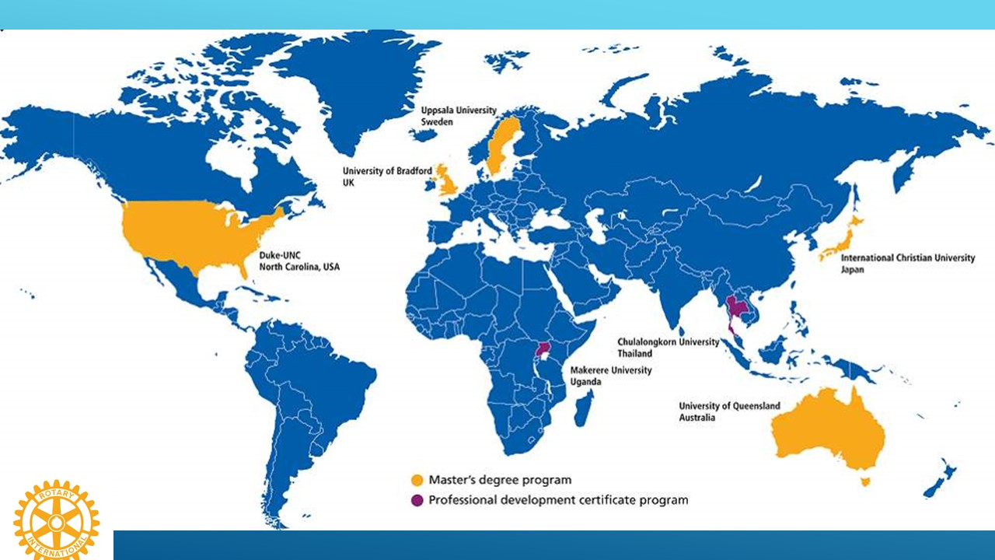

Peace and Conflict Resolution Rotary Peace Centers

Slide 25
Rotary Peace Centers
IMPACT
OUTCOME
OUTPUT
Key Beneficiaries:
Refugees and displaced persons
Young people
Conflict affected areas
Women and children
Impoverished communities
INPUT
93% of alumni have a job connected to Peace and Development
904 Masters level and 572 Certificate Level Alumni with skills in:
Research and Conflict Analysis
Conflict Resolution
Communication and presentation
Project Planning
Leadership
Funding of Peace Centres
Selection of candidates to receive scholarships

Slide 26
Foundation Participation Trends District 5040

Slide 27
OUR DISTRICT – How are we Doing Compared to Last Year?
    Total Giving from District 5040 Rotary Clubs in 2025–26 was $628,882 $190,482
    Annual Fund $432,042 $9,557
    Polio Plus $92,455 $11,150
    Endowment Fund $72,104 $164,967
    Avg. Per capita to Annual Fund $370.22 $16.08
    41.22% of members were EREY 4%
Note: One donor has contributed $230,000 to the Annual Fund and an additional $20,000 to Polio each year
All $US

Slide 28

Clubs Meeting RI Targets
The Target for AF/per capita is $100US
60% of clubs made the target
The Target for Polioplus is $1,500 per club
40% of clubs made the target

Slide 29
District Designated Funds (DDF)
Contribution Year | Total Annual Fund | Annual Fund Share | 47.50% | Endowment | Total | District Grants | Global Grants | Can $ | Year Available
2023-24 | $ 226,539.06 | $ 216,936.67 | $ 103,044.92 | $ 9,202.00 | $ 112,246.92 | $ 56,123.46 | $ 56,123.46 | $ 78,572.84 | 2026-27
2024-25 | $ 422,485.00 | $ 183,926.00 | $ 87,364.85 | $ 9,202.00 | $ 96,566.85 | $ 48,283.43 | $ 48,283.43 | $ 67,596.80 | 2027-28
2025-26 | $ 433,311.00 | $ 175,078.00 | $ 83,162.05 | $ 9,202.00 | $ 92,364.05 | $ 46,182.03 | $ 46,182.03 | $ 64,654.84 | 2028-29
Well total AF figures have been much higher the last two years a significant portion was allocated to AF areas of focus and hence not available for share. DDF available for grants is going down each year.
Note: Exchange rates and endowment fund earnings may change these numbers

Slide 30
Unallocated DDF
We have not done well in using all our DDF in support of grants
  Clubs with approved district grants have had to return the funds when their project could not be completed on time
  Clubs have overstated their budget and had to return funds not used
  We have not had enough global grant applications to utilize all our DDF
Members who donate funds to the Annual Fund expect them to be used for grants

Slide 31
District Grant Timeline Opportunity
We have the opportunity to submit our District Grant Spending Plan before the end of June and receive our block grant in July, the start of the Rotary year
Block Grant received and funds distributed
Clubs submit final reports
Clubs work on and complete projects
July
January
May
June
July
District Grant Training, Clubs submit Signed MOU’s
Grant applications reviewed and approved by district
Spending plan and final report submitted and approved by RI

Slide 32
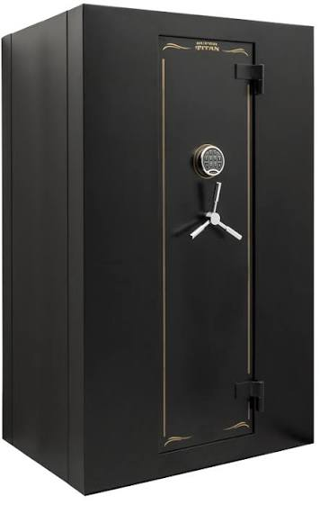
The Combination Required for us to Access our District Grant Funds from RI
1) We must have submitted a final report showing all the grant projects and the disposition of funds for the previous year
2) We must submit a spending plan, a list of all the projects and the funds each requires. The plan must add up to at least 80% of our available DDF
District Block Grant Funds (DDF)

Slide 33
District Grant Timeline Challenge
We have two challenges:
  We cannot submit the final report to RI for the years spending until we have received and approved the District grant reports from each club which received a grant. Some clubs are not completing their reports until as late as August, September.
  We are not receiving enough applications to reach our 80% threshold for applying for the block grant until often September or October.

Slide 34

POLIO
We do not want to go back to this:

Slide 35
There are Three Serotypes of Wild Poliovirus: type 1, type2 and type 3
Type 2 wild poliovirus was declared eradicated in September 2015 with the last virus detected in India in 1999
Type 3 wild poliovirus was declared eradicated in October 2019. It was last detected in November 2012.
Only type 1 wild poliovirus remains

Slide 36
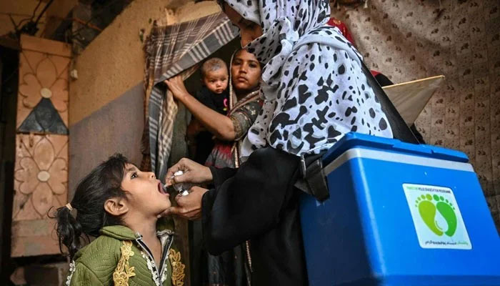
The fight to end Polio Continues
Compared with the same period in 2025, the geographical spread of wild poliovirus has narrowed and transmission has become increasingly concentrated in a small number of high-risk areas.
There are three critical hotspots requiring intensified focus: Afghanistan’s South Region, Pakistan’s southern Khyber Pakhtunkhwa (KP), and the Karachi Bloc.
Together, these areas remain the principal reservoirs of wild poliovirus transmission and sources of onward spread. Population movement, insecurity, misinformation and operational challenges continue to complicate efforts to consistently reach every child with lifesaving vaccines.
Cases as of October 5th
Afghanistan 35
Pakistan 5
Notes:
Bans on House-to-House Vaccination
Restrictions on Female Health Workers:. Female workers are absolutely critical to the program, as they are often the only ones culturally permitted to enter homes and interact with mothers and young children. [1]
🗺️ Geopolitical and Population Movements
Mass Repatriation and Mobile Populations:
Remote and Inaccessible Geography: A large percentage of the Afghan population lives in highly rural, rugged, and isolated regions. Delivering temperature-sensitive vaccines across these terrains with fragile infrastructure remains a massive logistical hurdle. [1, 2]
🤝 Social Resistance and Community Fatigue
Vaccination Fatigue and Boycotts: Some communities have grown weary of constant health workers knocking on doors exclusively for polio while they lack basic human rights, clean drinking water, and food safety. In some areas, villages intentionally boycott the vaccine as a bargaining chip to demand broader infrastructure and humanitarian aid from local leaders. [1, 2, 3]
Misinformation and Refusal Pockets: Pockets of adamant refusal persist due to deep-seated rumors, myths, and misinformed religious beliefs regarding vaccine safety, which are continuously combated by UNICEF community mobilizers

Slide 37
WPV1 Case Breakdown (2024–2026)
Country | 2024 Cases | 2025 Cases | 2026 Cases to date
Afghanistan | 25 | 21 | 35
Pakistan | 74 | 31 | 5

Slide 38
Why we must not give up
Wild polio virus (WPV1) was detected in a sewage sample in Hamburg, Germany, in October 2025, linked to the virus circulating in Afghanistan.
Notes:
24 November 2025, Islamabad, Pakistan – International and national experts convened by the World Health Organization (WHO) and the Aga Khan University in Karachi on Friday unanimously concluded that all available science and evidence indicate that, despite challenges, ending polio in Pakistan and globally is within reach. Experts underlined that, over the last 3 decades, the Pakistan Polio Eradication Initiative has reduced polio cases by 99.6% in Pakistan – from 20 000 annual cases to 74 in 2024, and 30 so far in 2025 –, demonstrating that vaccines work and save lives.
“Eradicating polio forever, and for every child, is not just the right thing to do. It is also the smartest. The recent detection of the poliovirus in Germany is a stark reminder that the poliovirus knows no borders and the future of millions of children is at stake. Science tells us that eradicating polio forever in Pakistan and across the globe is within reach. Science tells us that it is not time to quit,” said WHO Representative in Pakistan Dr Luo Dapeng.

Slide 39
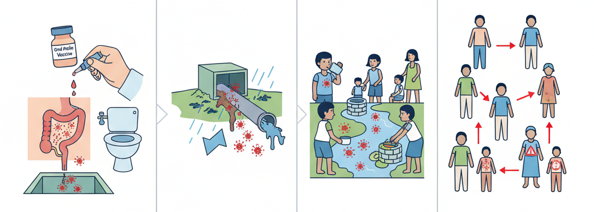
Circulating Vaccine-Derived Polioviruses
Vaccination
Contamination
Ingestion
Community Spread
Weakened Vaccine is excreted
Feces contaminate water sources
Virus is ingested through unsafe water/food
Virus spreads potentially mutating causing CVDP
Notes:
The oral polio vaccine (OPV) that has brought the wild poliovirus to the brink of eradication has many benefits: the live attenuated (weakened) vaccine virus provides better immunity in the gut, which is where polio replicates. The vaccine virus is also excreted in the stool, and in communities with low-quality sanitation, this means that it can be spread from person to person and actually help protect the community.
However, in communities with low immunization rates, as the virus is spread from one unvaccinated child to another over a long period of time (12 -18months) it can mutate and take on a form that can cause paralysis just like the wild poliovirus. This mutated poliovirus can then spread in communities, leading to cVDPVs.
the cause of cVDPV is low immunization rates. So, the best way to prevent them and stop them when there is an outbreak is to vaccinate children. The polio vaccine protects children whether the kind of polio is wild poliovirus or vaccine-derived poliovirus. Outbreaks (whether WPV or cVDPV) are usually rapidly stopped with 2–3 rounds of high-quality supplementary immunization activities (immunization campaigns).
A new vaccine is being used which is less likely to mutate

Slide 40
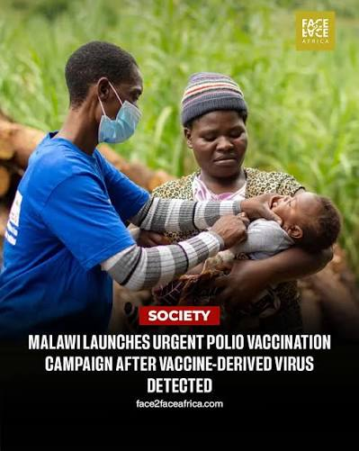
Immunization Campaigns Address the Problem of Vaccine Derived Polio
Novel Oral Polio Vaccine (nOPV2): Scientists developed the novel oral polio vaccine type 2 (nOPV2), which is "super-engineered" to be far more genetically stable and significantly less likely to mutate back into a form that causes paralysis compared to older oral vaccines
Supplementary Immunization Campaigns: Outbreaks of circulating vaccine-derived poliovirus (cVDPV) are stopped quickly with multi-round vaccination campaigns in affected regions to boost community immunity and close immunity gaps

Slide 41
Percentage of Leaders Donating to the Foundation (2025-26)
Assistant Governors 70%
Club Presidents 57%
Club Foundation Chairs 49%
Club Treasurers 55%
Club Secretaries 60%

Slide 42
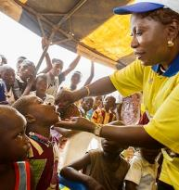
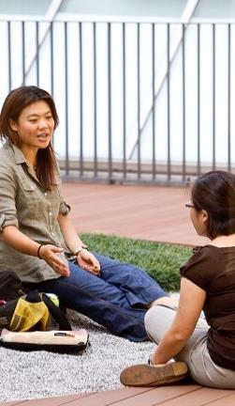
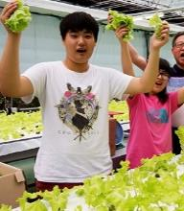
The Rotary Foundation’s Mission
The Rotary Foundation helps Rotary members to advance world understanding, goodwill, and peace by improving health, providing quality education, improving the environment, and alleviating poverty.
Since it was founded more than 100 years ago, the Foundation has spent more than $4 billion on life-changing, sustainable projects.
109YEARS OF DOING GOOD IN THE WORLD
The Rotary Foundation was started by Arch Klumph in 1917
Notes:
Have attendee read the Mission:
Did you know Rotarians are the ENGINE The Rotary Foundation for Rotary’s humanitarian activities, from clubs’ and districts’ local service projects to global initiatives. Rotary also leads the ongoing international effort to eradicate polio worldwide.
Our Foundation is able to achieve its mission through the generous contributions and active participation of Rotarians and friends of Rotary.

Slide 43
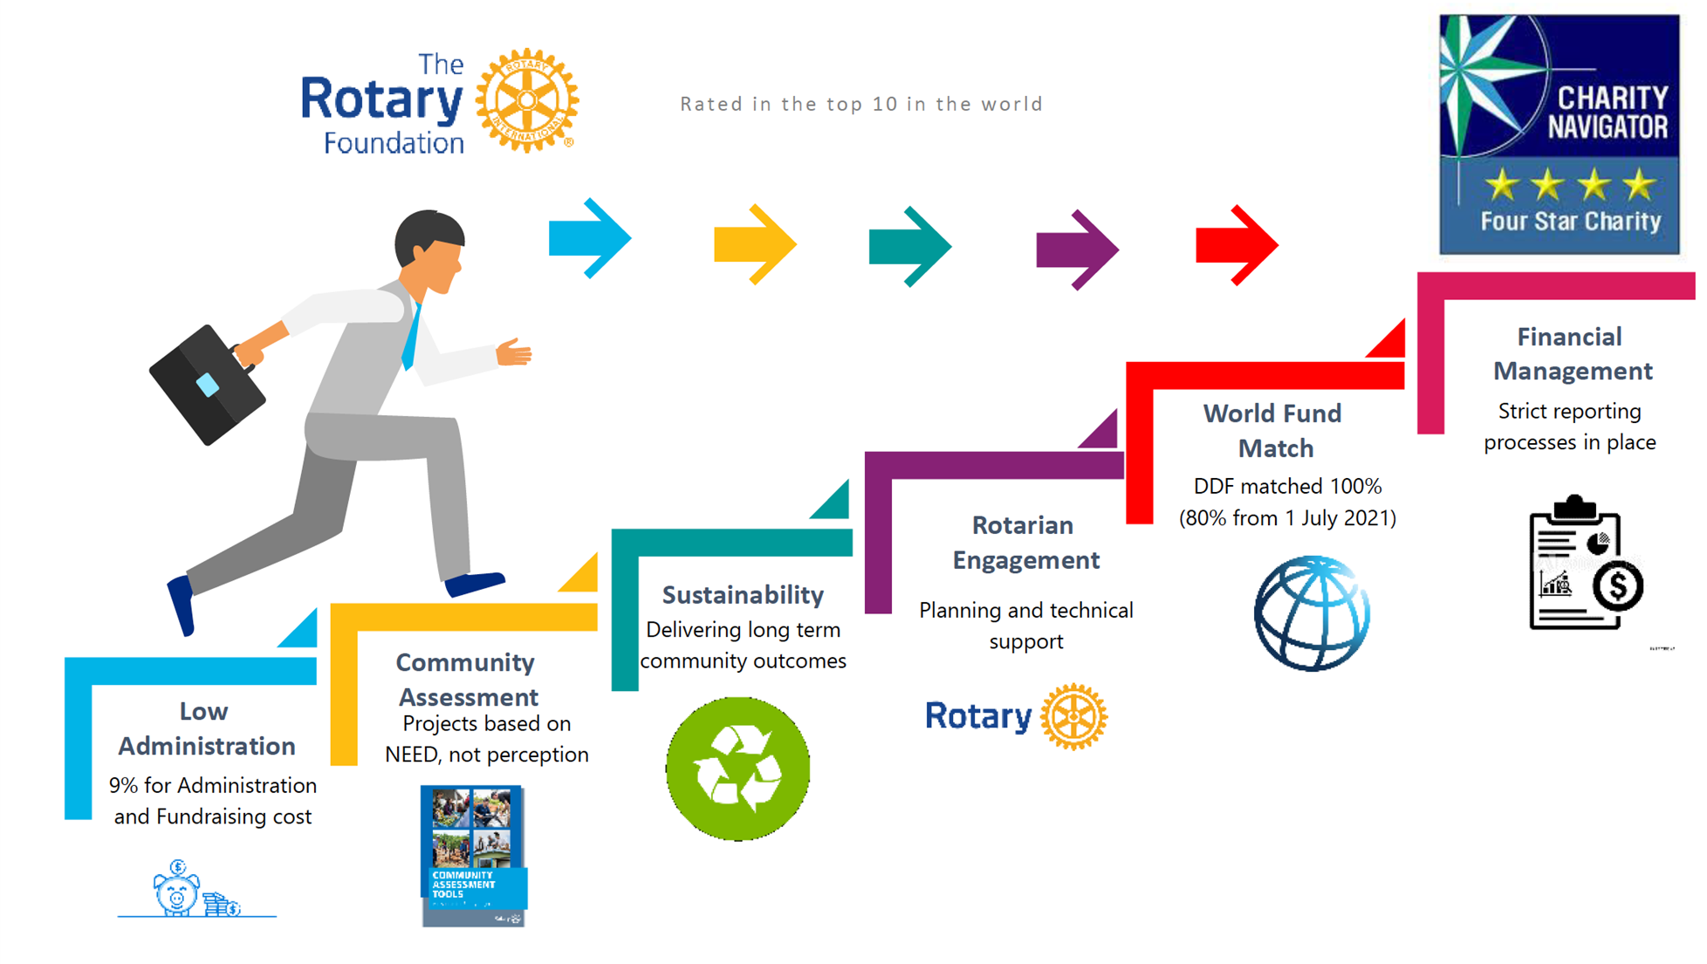
A Trusted Charity
80%

Slide 44


Did You Know This?
Do you realize that Rotarians ALONE are the source of funds to the Annual Fund that come back to the district to support our Community and Global grants.
Only 1% of the charities evaluated by Charity Navigator have received at least ten consecutive four-star evaluations.
Our efficiency is recognized 16 years consecutively by Charity Navigator.

Slide 45
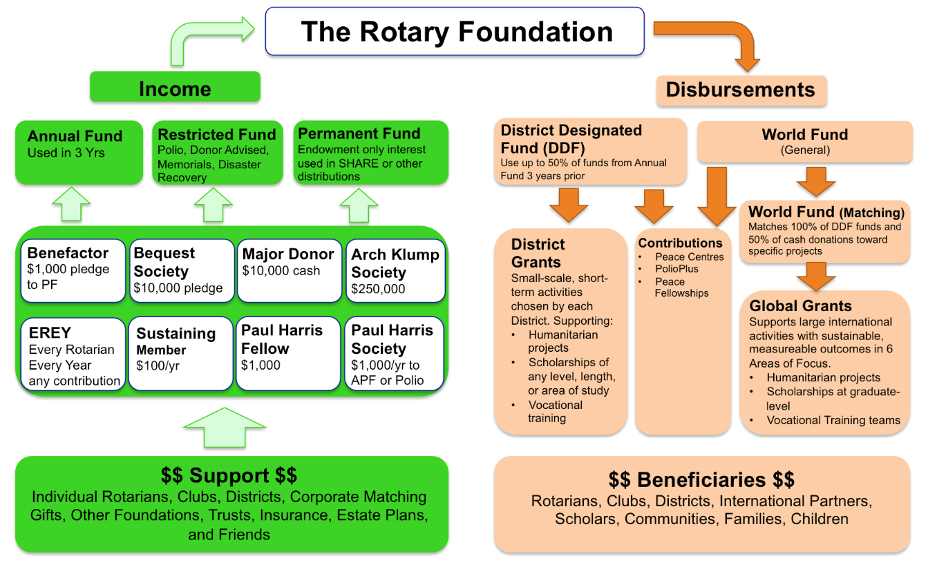
How the Money Flows
Matches 80% of District Designated Funds (DDF)

Slide 46


Our Rotary Foundation
Programs
- Polio
- Peace
Centers
- Grants
District
& Global
- Other Programs
Contributions
from
-Rotarians
- Rotary
Clubs
- Others
-Investments
PolioPlus
Annual Fund
DDF
47.5%
~ $100 M +
Held 3 years
World
Fund
47.5%
Operating Expense
5%
Endowment Fund
Earnings

Slide 47

Notes:
Global Grants are designed to focus the majority of the Foundation resources on larger, more sustainable projects that fall within the 7 areas of focus
Global grants are administered by the Rotary Foundation. You apply online through MyRotary. You must have a partner club in another district in another country. The minimum project budget is $30,000 and the maximum grant is $400,000.
Multiple clubs and districts may be involved. Clubs put up funds for a project, their district matches those funds from their District Designated Funds and then the Foundation matches 80% of the DDF.

Slide 48

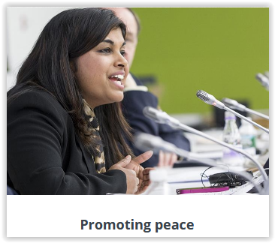
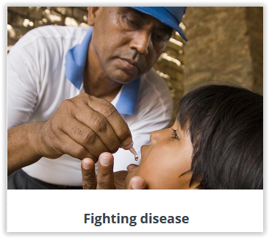
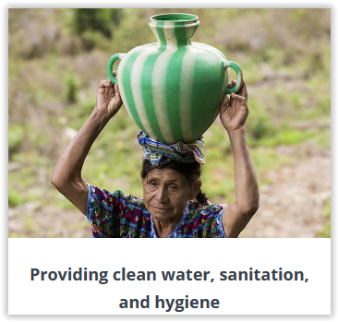
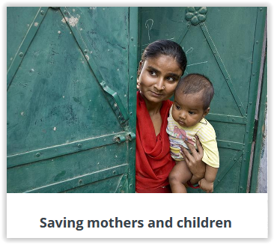

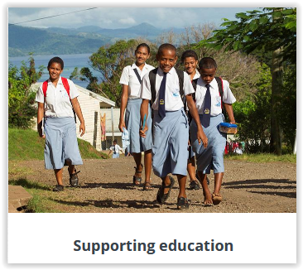
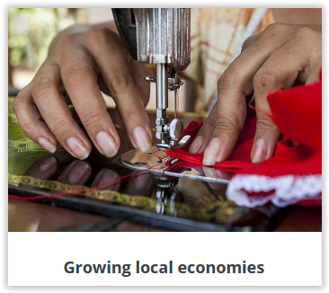
AREAS OF FOCUS
Global Grants can support projects in any of Rotary’s seven areas of focus
Supporting the Environment
Notes:
Global grants support large-scale international activities with sustainable, measurable outcomes in one or more of Rotary’s seven areas of focus. Grant sponsors form international partnerships and work together to develop projects that respond to real community needs.
Global grants can fund:
Humanitarian projects
Scholarships for graduate-level academic studies
Vocational training teams
Global Grants must be sustainable, which means they are designed and implemented so that the benefiting community can maintain long-term solutions to community needs after the grant funding ends.

Slide 49
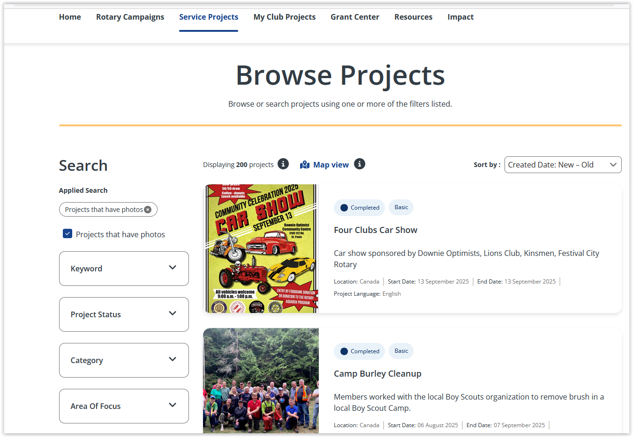
Check out the Service Projects Center on MyRotary
See what other clubs have done for projects and find partners for global grants

Slide 50

Notes:
District grants fund small-scale, short-term projects that address needs in local communities and communities abroad. Each district chooses which projects it will fund with these grants. Some districts choose to allocate smaller grants to support several club projects.
Applications for district grants are done online through our district 5040 website
Any member applying for a district grant must participate in a district grant training session

Slide 51
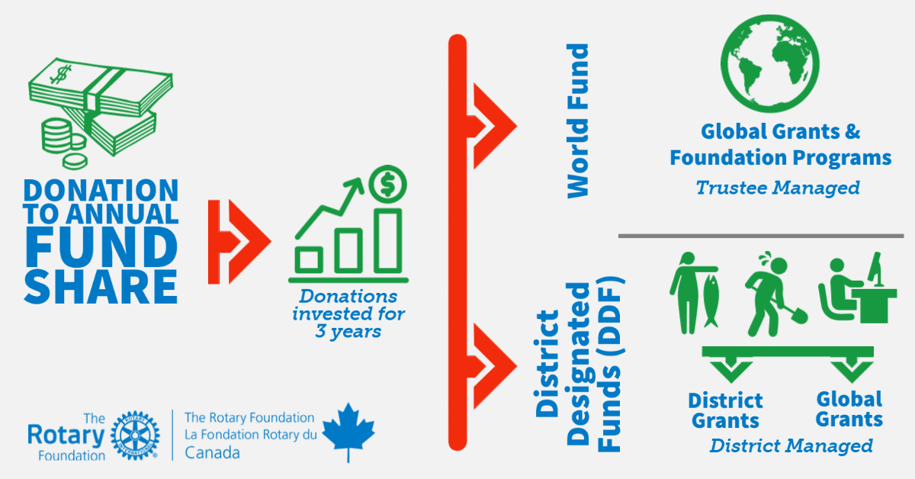
Who Manages the Grant Funds

Slide 52
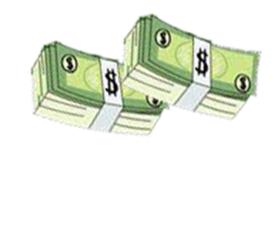
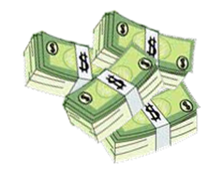
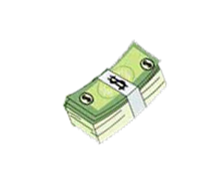
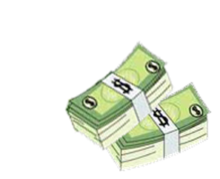
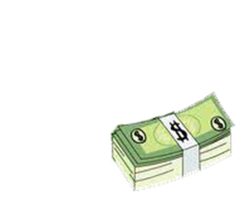
District Grant Funds available for 2026-27 ~ C$74,290
2023-2024
2026-2027
District Designated Funds (DDF) used for matching in Global Grants
3 years later
$56,024
47.5% Retained by
The Rotary Foundation The World Fund
(For Global Grants)
3 years later
$102,847
District Designated Funds (DDF) available
for District Grants
US$56,024
C$74,290*
Total Amount contributed
By D5040 clubs & individuals to the annual fund share
District Designated Funds are evenly split
$216,520
47.5% District Designated Funds, Global + District
Endowment Earnings add $9,202 for total $112,049
$102,847
Notes:
The District Designated Funds are held by the foundation and are available to spend 50% on Global Grants and 50% on district grants.
When we have enough approved District Grants to use at least 80% of the available funds, we create a spending plan showing all the district grant approved requests which we submit to the foundation. If approved we receive a block grant, the money is transferred to a district held grant account and we then disburse the funds.
Global Grant DDF are held by the foundation and distributed to approved projects
In 2020-21 we had $76,130 USD or $97,457 CAN
In 2021-22 we had $62,076 USD or $79,457 CAN
In 2022-23 we had $55,138USD or $74,436 CAN
It is only through your contributions to the Annual Fund that we have money for grants.

Slide 53



ROTARY FOUNDATION GRANTS
These two guides, both available on the District 5040 website, member area, Grants, Documents. Reviewing these should be your first step in applying for a grant
Notes:
A must read for someone considering a Grant.

Slide 54
Ways to Support the Foundation
Annual Fund
Endowment Fund - Named Endowment
Polio Plus Fund
The Rotary Foundation
Restricted Giving – approved Global Grant
Planned Giving Benefactor / Bequest
Restricted Giving – Disaster Response Fund

Slide 55
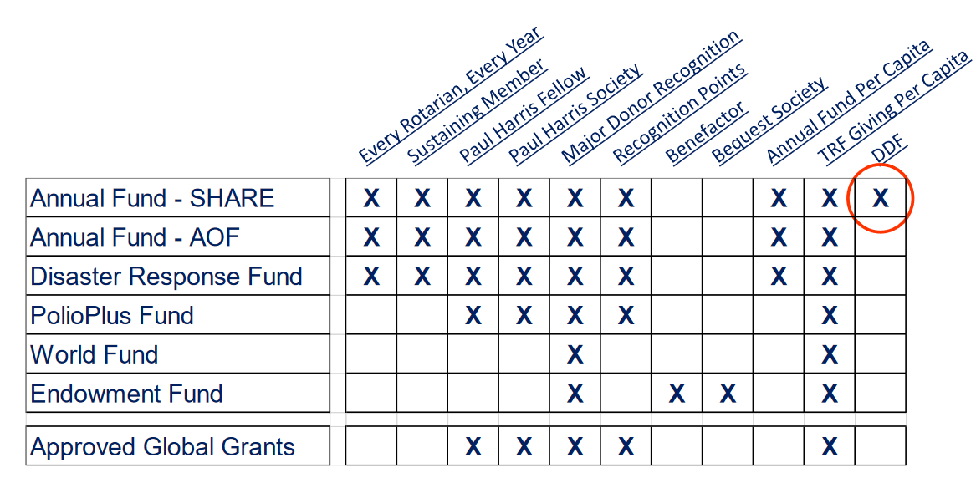
What Counts for What
Notes:
Note that only funds contributed to the Annual Fund Share result in district designated funds which come back to the district after three years

Slide 56
Meaningful Ways to Give
Rotary Foundation Sustaining Member
When you give $100 or more per year to the Annual Fund.
Paul Harris Fellow
Become a Paul Harris Fellow when your cumulative donation level hits $1,000
When you give additional gifts of $1,000 or more to the Annual Fund, PolioPlus, or an approved Foundation grant.
Benefactor
When you include the Endowment Fund as a beneficiary in your estate plans or when you donate over $1,000 and less than $10,000 to the fund outright.

Slide 57
As Your Giving Accelerates
Bequest Society
When you make a commitment for future gifts of $10,000 or more to The Rotary Foundation, you’ll be invited to join the Bequest Society.
Major Donor
When your cumulative donations reach $10,000.
Level 1: $10,000 to $24,999
Level 2: $25,000 to $49,999
Level 3: $50,000 to $99,999
Level 4: $100,000 to $249,999

Slide 58
Substantial Commitments to the Rotary Foundation
Arch Klumph Society
When your cumulative donations reach $250,000. Recognition includes an induction ceremony and your picture and biography in the Arch Klumph Society interactive gallery at the Rotary International headquarters in Evanston, Illinois, USA.
  Trustees Circle: $250,000 to $499,999
  Chair’s Circle: $500,000 to $999,999
  Foundation Circle: $1,000,000 to $2,499,999
  Platinum Trustees Circle: $2,500,000 to $4,999,999
  Platinum Chair’s Circle: $5,000,000 to $9,999,999
  Platinum Foundation Circle: $10,000,000 and above
Legacy Society
When you promise a gift of $1 million or more to the Endowment, you’ll be listed in Rotary’s annual report and invited to exclusive Rotary International and Foundation events.

Slide 59
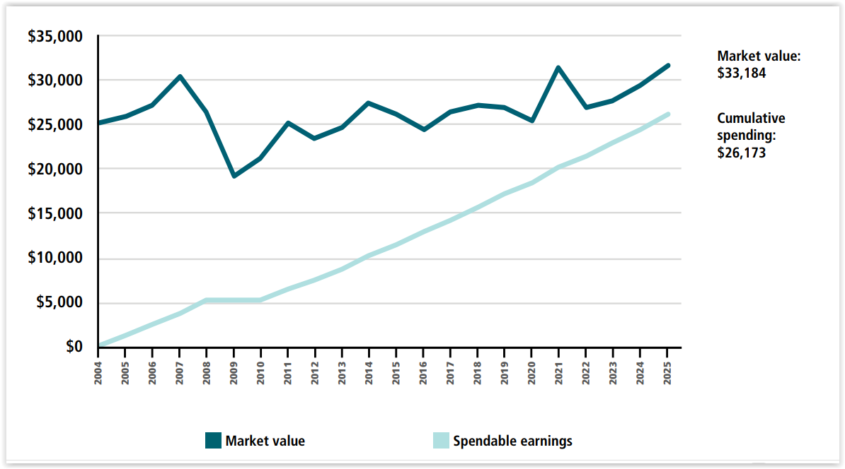
NAMED ENDOWED FUNDS TO AF SHARE CONTRIBUTE TO OUR DDF EVERY YEAR
Annual earnings are shared between the world fund and district DDF every year
An endowed fund may be directed at any of Rotary’s causes including areas of focus, the world fund, polio or share.
Note only the earnings from funds contributed to share come back as DDF to our district each year.

Slide 60

Estate Plans

Slide 61
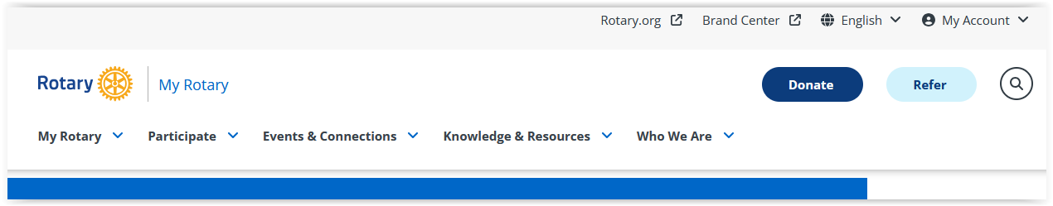
Log into MyRotary
Click on the Donate Button

Slide 62
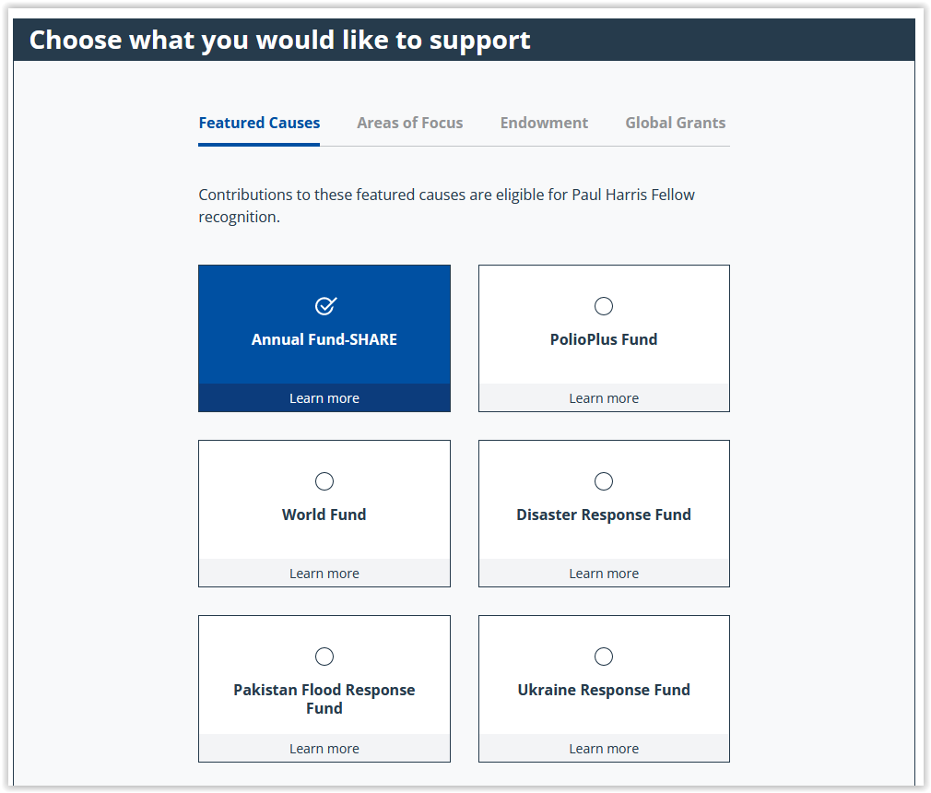
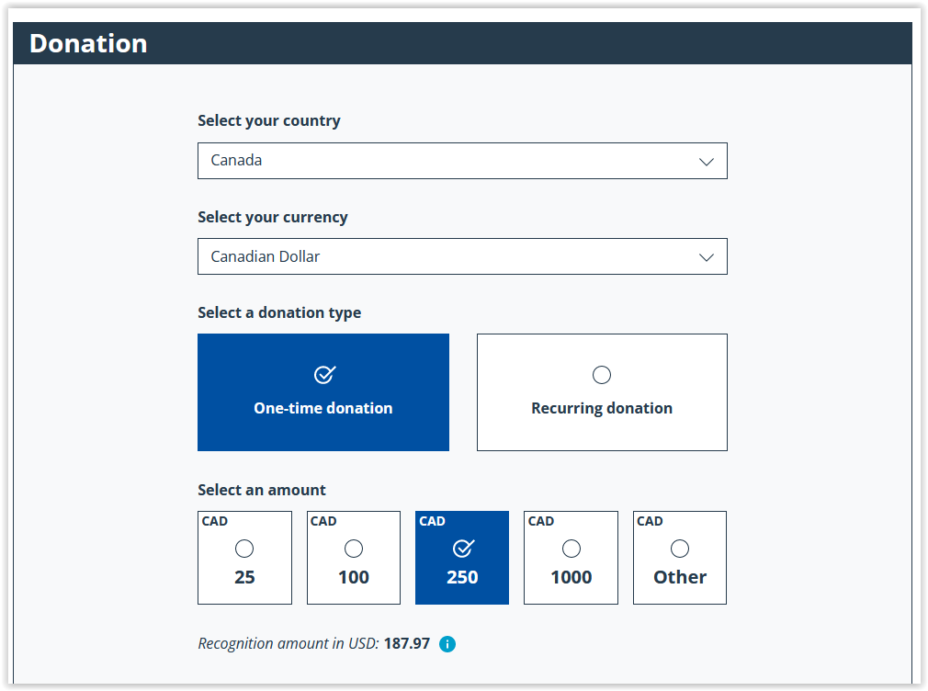
Donate on-line through MyRotary

Slide 63
How to Donate on Behalf of Members
If members donate at club meetings or events you can enter their contributions for them ensuring they get the recognition and tax receipts.

Slide 64
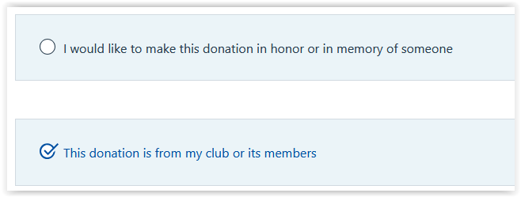
Donate on-line through MyRotary

Slide 65
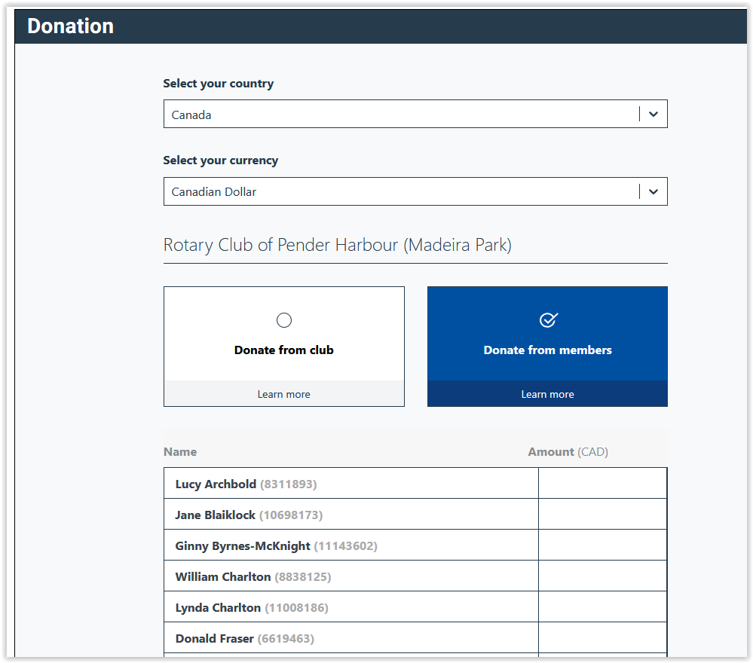
Enter Contributions for any or all Members

Slide 66
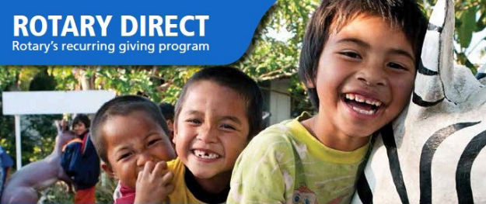
Rotary Direct
Regular and automatic giving to The Rotary Foundation
You subscribe to Netflix and Prime, why not subscribe to Humanity
with Rotary Direct?
Reasons for using TRF’s recurring giving program:
  Donor is connected directly to their giving (Deductions through dues are not always understood.)
  Club convenience! Club leadership work is minimized.
  Signing up once ensures continuous support.
  Signing up is simple. Recurring payments can be through a credit card. Set up online, on the phone, or by mail.
  It’s easier to give smaller amounts in more frequency.
  It’s efficient! It reduces TRF administration and marketing costs.
  Its secure! It’s the safest and most secure way to contribute.
  Making changes is easy! It’s easy to changes right on the RI website.
  Increasing the recurring amount gradually is less of a burden.
  Tracking the history by the giver giving is easy on the RI website.

Slide 67
Setup Payments in Rotary Direct – Tax Receipts at year end
Every Rotarian Every Year - $25 US $2.80 CA per month ($16.80 twice a year, minimum Rotary Direct is $10US)
Sustaining Member - $100US $12.50 CA per month
Paul Harris - $1,000US $112.50CA per month
Paul Harris Society - $1,000US every year
Polio Plus Society - $100US every year

Slide 68
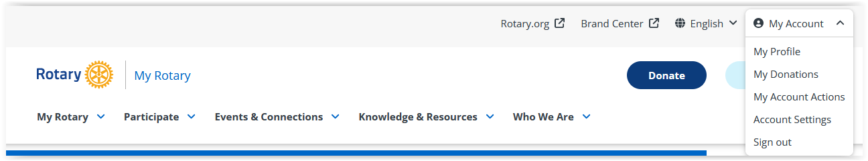
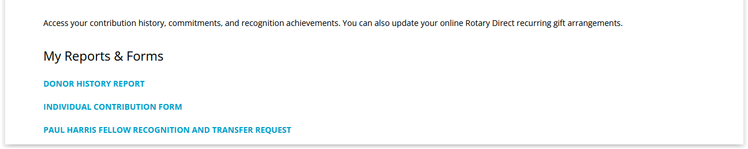
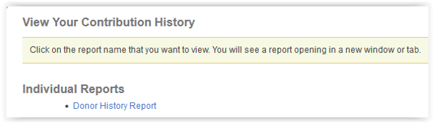
How to View Your Donor History
1
2
3
4

Slide 69
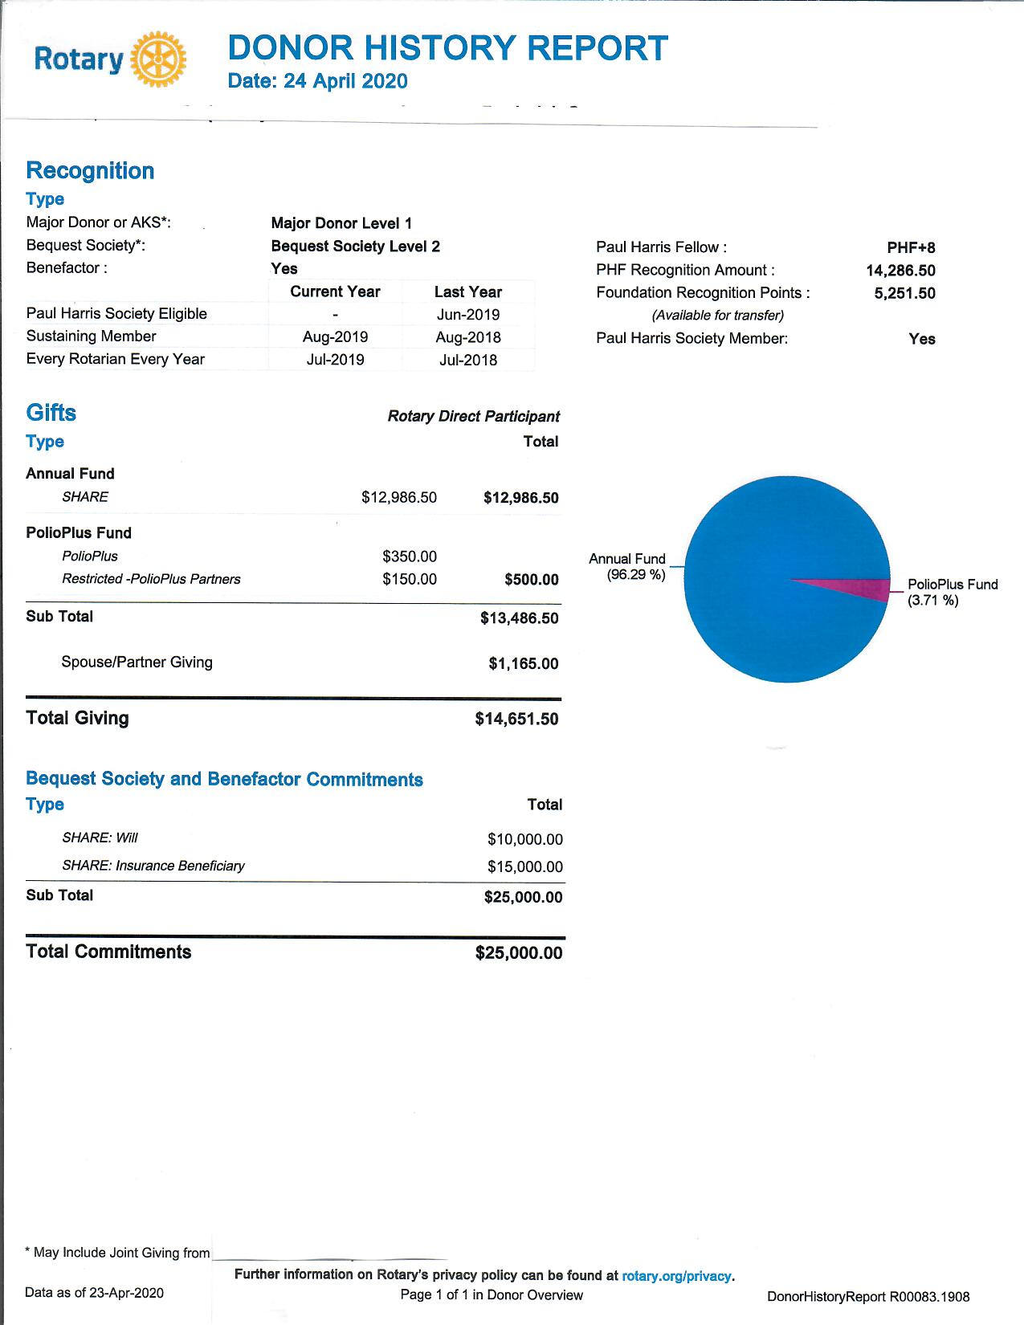

Slide 70
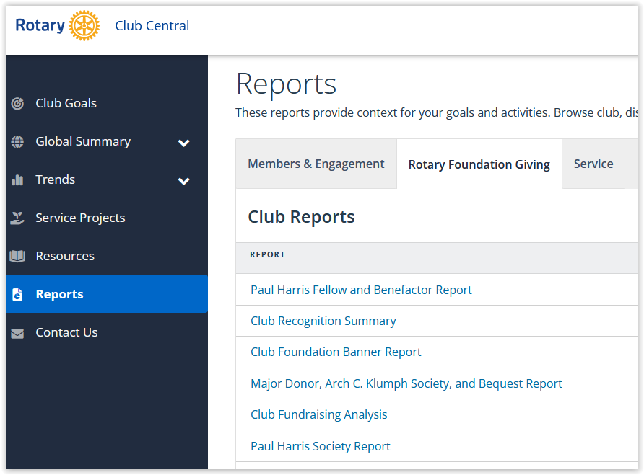
As Foundation Chair or President you can access these reports

Slide 71
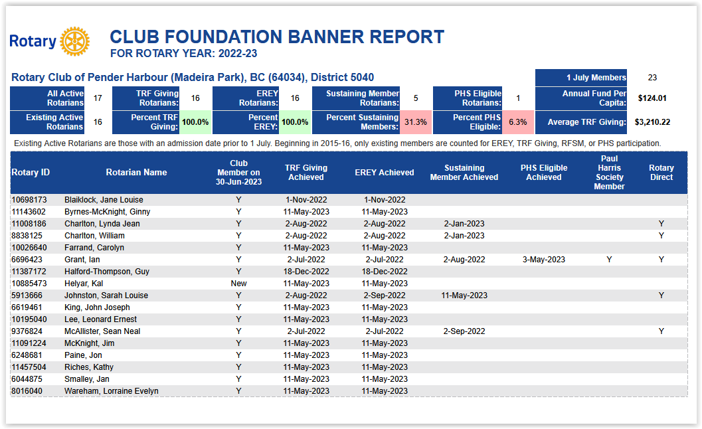
This report shows member participation

Slide 72

This report shows your club’s donations over 5 years

Slide 73


  District website
The 5040 District website has information on applying for grants. It is also the place to apply for and report on district grants.
Global Grants must be applied for through MyRotary

Slide 74
Stories about Grants
On the district 5040 website this symbol identifies a story about a project funded by a grant.
Use these stories to show where grant funds go and the impact they can have.
Stories can be impactful and highlight why we give

Slide 75




Think about how you can use these stories to promote donations to the Foundation

Slide 76
Foundation minute
Take a minute at the beginning of each meeting to highlight something about the Foundation
The current status of Polio
How to donate on-line
A story about a local district grant
A story about a global grant
How the Foundation got started
Where the club stands against it’s Foundation goals
Be creative

Slide 77
Presentation Materials
Powerpoint Presentations you can use and adapt:
The History of the Foundation
The Mechanics of the Foundation – How it works
Why Give to the Foundation
These can be found on the district 5040 site
Our Programs
Foundation/Grants
Foundation

Slide 78
How to do it
Set Goals
Talk about the foundation
Give presentations on the foundation
Have a foundation moment at each meeting
Challenge your club to apply for grants
Use stories showing the impact of grants
Show members how to contribute on-line
Show members how to set up Rotary Direct payments
Help members set up their MyRotary account
Lead by example
Hold foundation fundraising events
Have district foundation team members present at your club

Slide 79





The District Foundation Committee
Support for AG’s Presidents and Foundation Chairs
Ian Grant
Chair
Matt Caparas
Polio
Dave Taylor
International Services Chair
Paul Harris Society
Lorne Calder
Vice-chair
Liz Scroggins
District Grants
Bill Hellyer
Global Grants

Slide 80
Any New Ideas to Increase Giving and have Clubs Apply for Grants

Slide 81

Questions

