Slide 1

District Rotary Foundation Forum – Improving our Performance

Slide 2
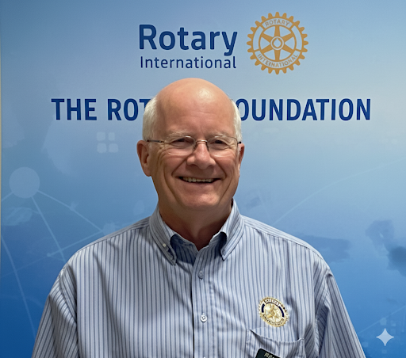
Presenter – Ian Grant District Rotary Foundation Chair

Slide 3

The Rotary Foundation reached several major milestones in 2024-25 that will expand our reach and increase our impact
Together, we raised more than $569 million (unaudited) in gifts and commitments, surpassing our ambitious $500 million goal. Donors strengthened our future by contributing to the Endowment resulting in net assets and commitments of $2.050 billion as of 30 June 2025, exceeding our $2.025 billion by 2025 campaign goal! This generosity ensures that we will keep Doing Good in the World for generations to come.
Thanks to you, we’ve been achieving meaningful change. In 2024-25, The Rotary Foundation was able to: Award 1,424 global grants, 468 district grants, and 74 disaster response grants
Renew our agreement with the Gates Foundation, recommitting to the fight to end polio
Award the Programs of Scale grant to an initiative that works to build peace in Colombia
Partner with Symbiosis International University to create a Rotary Peace Center in India

Slide 4
Foundation Participation Trends District 5040
47% Drop
37% Drop
29% Drop
28% Drop
6% Drop

Slide 5
AGENDA
The Role of Club Foundation Chairs
Foundation Basics
Tools for Foundation Chairs
Reports available
Presentation materials
Foundation minute
District website
Support for Foundation Chairs
EREY
Rotary Direct

Slide 6
The Role of Club Foundation Chairs
Your chief responsibility as chair of your club’s Rotary Foundation committee is to inspire your club’s members to give to the Foundation and participate in its activities
Promote Foundation grants and activities and help members participate in them.
Attend the grant management seminar to ensure that your club qualifies for Rotary Foundation district and global grants.
Work with your president to set Foundation Goals and monitor progress to achieving them
Conduct inspirational, Foundation-focused club programs

Slide 7


Slide 8
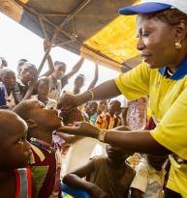

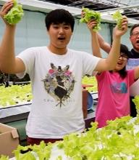
The Rotary Foundation’s Mission
The mission of The Rotary Foundation is to enable Rotarians to advance world understanding, goodwill, and peace through the improvement of health, the support of education, and the alleviation of poverty.
108 YEARS OF DOING GOOD IN THE WORLD
The Rotary Foundation was started by Arch Klumph in 1917
Notes:
Have attendee read the Mission:
Did you know Rotarians are the ENGINE The Rotary Foundation for Rotary’s humanitarian activities, from clubs’ and districts’ local service projects to global initiatives. Rotary also leads the ongoing international effort to eradicate polio worldwide.
Our Foundation is able to achieve its mission through the generous contributions and active participation of Rotarians and friends of Rotary.

Slide 9
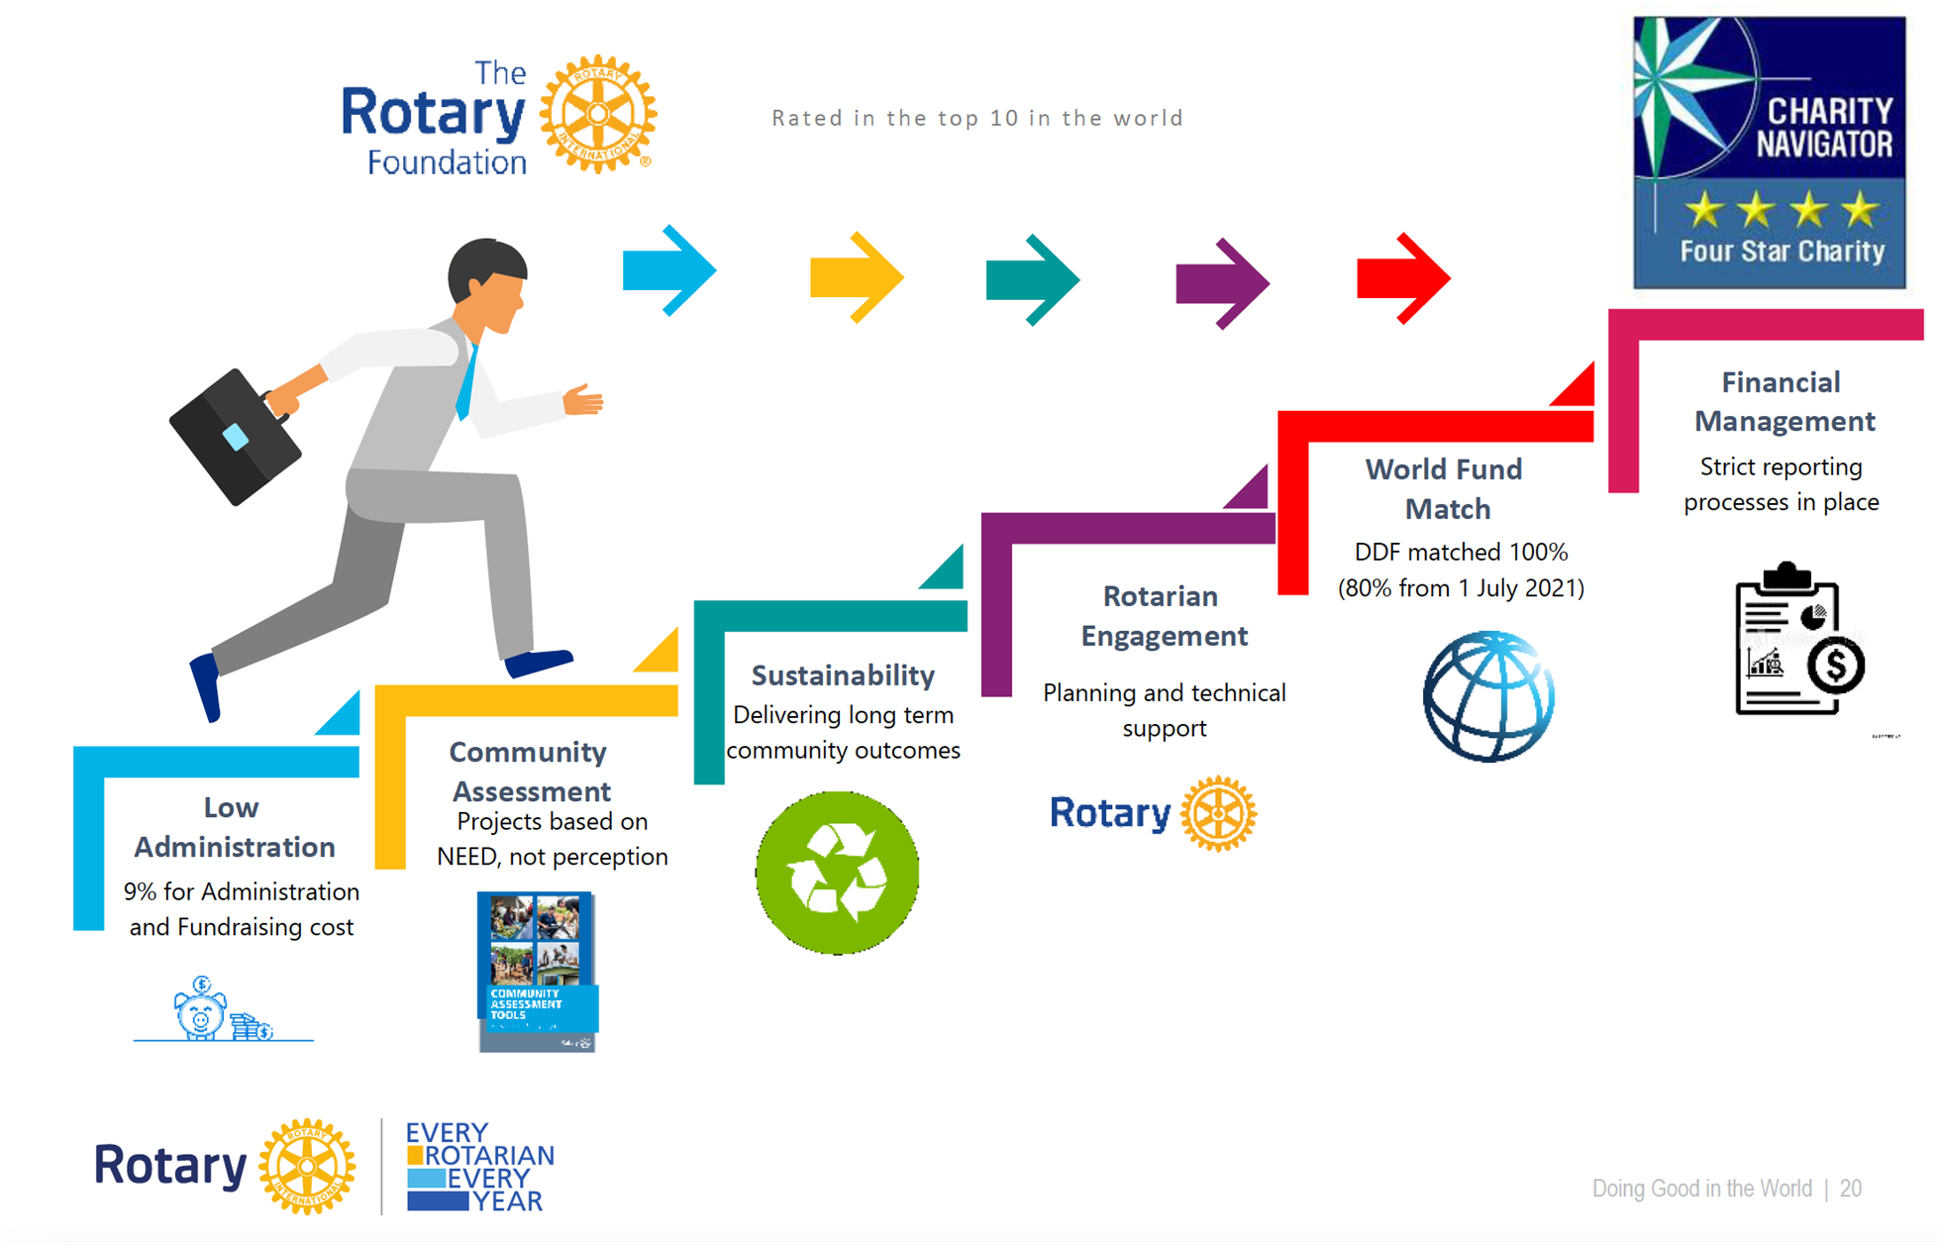
A Trusted Charity

Slide 10


Did You Know This?
Do you realize that Rotarians ALONE are the source of funds to the Annual Fund that come back to the district to support our Community and Global grants.
Only 1% of the charities evaluated by Charity Navigator have received at least ten consecutive four-star evaluations.
Our efficiency is recognized 16 years consecutively by Charity Navigator.
108 YEARS OF DOING GOOD IN THE WORLD

Slide 11
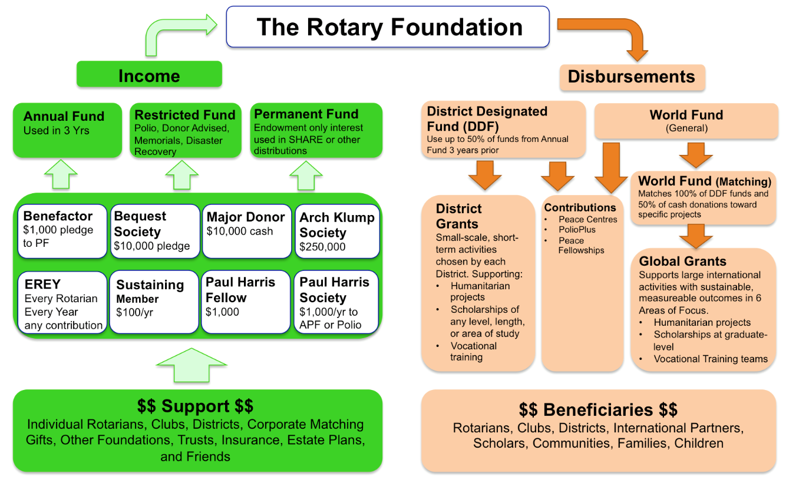
How the Money Flows
Matches 80% of District Designated Funds (DDF)

Slide 12



Our Rotary Foundation
Programs
- Polio
- Peace Centers
- Grants District & Global
- Other Programs
Contributions from
-Rotarians
- Rotary Clubs
- Others
-Investments
PolioPlus
Annual Fund
DDF
47.5%
~ $100 M +
Held 3 years
World
Fund
47.5%
Operating Expense
5%
Endowment Fund
Earnings

Slide 13

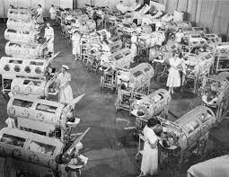
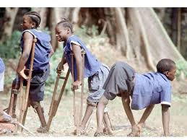
Establish a fundraiser for PolioPlus: Hold a dinner or a concert Make a donation directly to Polio Plus
We do not want to go back to this:

Slide 14
There are three serotypes of wild poliovirus: type 1, type2 and type 3
Type 2 wild poliovirus was declared eradicated in September 2015 with the last virus detected in India in 1999
Type 3 wild poliovirus was declared eradicated in October 2019. It was last detected in November 2012.
Only type 1 wild poliovirus remains

Slide 15
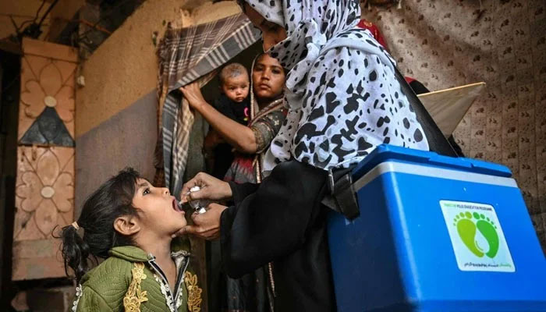
The fight to end Polio Continues
From 21 to 23 April 2025, Afghanistan carried out its first nationwide polio vaccination campaign of the year, immunizing over 11 million children under five. The effort was synchronized with a similar campaign in neighbouring Pakistan—a vital strategy in what remains a race against time to stop poliovirus transmission in the last two endemic countries on earth.
Just four weeks later, Afghanistan implemented a second nationwide campaign in May, again synchronized with Pakistan. This back-to-back coordination is helping to close immunity gaps and intensify the fight against the virus ahead of the high transmission season.
Cases as of September 20th
Afghanistan 4
Pakistan 26
Notes:
The Gates foundation announced in June they are continuing their 2 to 1 match with an overall target of contributing $450million. Rotary $50million/year, plus $100 million from the Gates Foundation is $150 million each year for three years is $450million. The Kingdom of Saudi Arabia has committed $500 million.
Now is the time to help Rotary make our $50million this year.

Slide 16
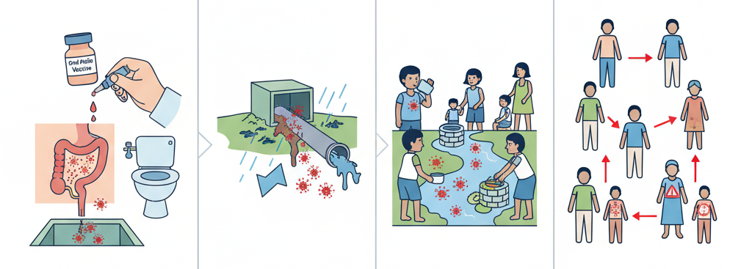
Circulating Vaccine-Derived Polioviruses
Vaccination
Contamination
Ingestion
Community Spread
Weakened Vaccine is excreted
Feces contaminate water sources
Virus is ingested through unsafe water/food
Virus spreads potentially mutating causing CVDP
Notes:
The oral polio vaccine (OPV) that has brought the wild poliovirus to the brink of eradication has many benefits: the live attenuated (weakened) vaccine virus provides better immunity in the gut, which is where polio replicates. The vaccine virus is also excreted in the stool, and in communities with low-quality sanitation, this means that it can be spread from person to person and actually help protect the community.
However, in communities with low immunization rates, as the virus is spread from one unvaccinated child to another over a long period of it can mutate and take on a form that can cause paralysis just like the wild poliovirus. This mutated poliovirus can then spread in communities, leading to cVDPVs.
the cause of cVDPV is low immunization rates. So, the best way to prevent them and stop them when there is an outbreak is to vaccinate children. The polio vaccine protects children whether the kind of polio is wild poliovirus or vaccine-derived poliovirus. Outbreaks (whether WPV or cVDPV) are usually rapidly stopped with 2–3 rounds of high-quality supplementary immunization activities (immunization campaigns).
A new vaccine is being used which is less likely to mutate

Slide 17

World Polio Day October 24th
Notes:
What will your club do to help finish the fight?

Slide 18

Notes:
Global Grants are designed to focus the majority of the Foundation resources on larger, more sustainable projects that fall within the 7 areas of focus
Global grants are administered by the Rotary Foundation. You apply online through MyRotary. You must have a partner club in another district in another country. The minimum project budget is $30,000 and the maximum grant is $400,000.
Multiple clubs and districts may be involved. Clubs put up funds for a project, their district matches those funds from their District Designated Funds and then the Foundation matches 80% of the DDF.

Slide 19

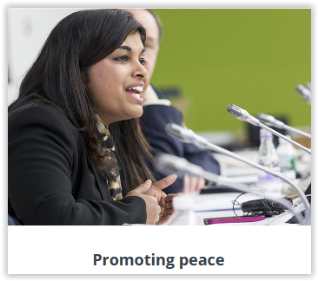
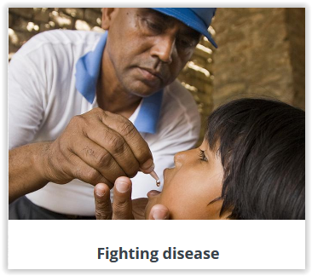
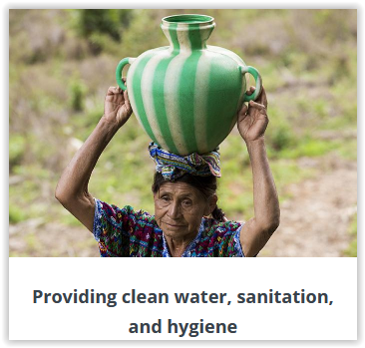
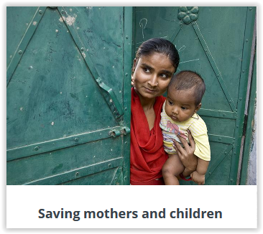

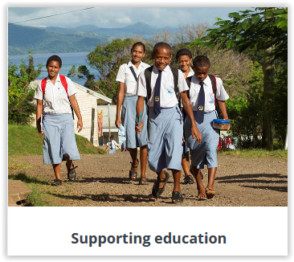
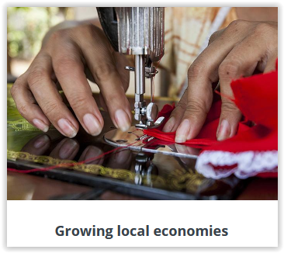
AREAS OF FOCUS
Global Grants can support projects in any of Rotary’s seven areas of focus
Supporting the Environment
Notes:
Global grants support large-scale international activities with sustainable, measurable outcomes in one or more of Rotary’s seven areas of focus. Grant sponsors form international partnerships and work together to develop projects that respond to real community needs.
Global grants can fund:
Humanitarian projects
Scholarships for graduate-level academic studies
Vocational training teams
Global Grants must be sustainable, which means they are designed and implemented so that the benefiting community can maintain long-term solutions to community needs after the grant funding ends.

Slide 20

Notes:
District grants fund small-scale, short-term projects that address needs in local communities and communities abroad. Each district chooses which projects it will fund with these grants. Some districts choose to allocate smaller grants to support several club projects.
Applications for district grants are done online through our district 5040 website
Any member applying for a district grant must participate in a district grant training session

Slide 21
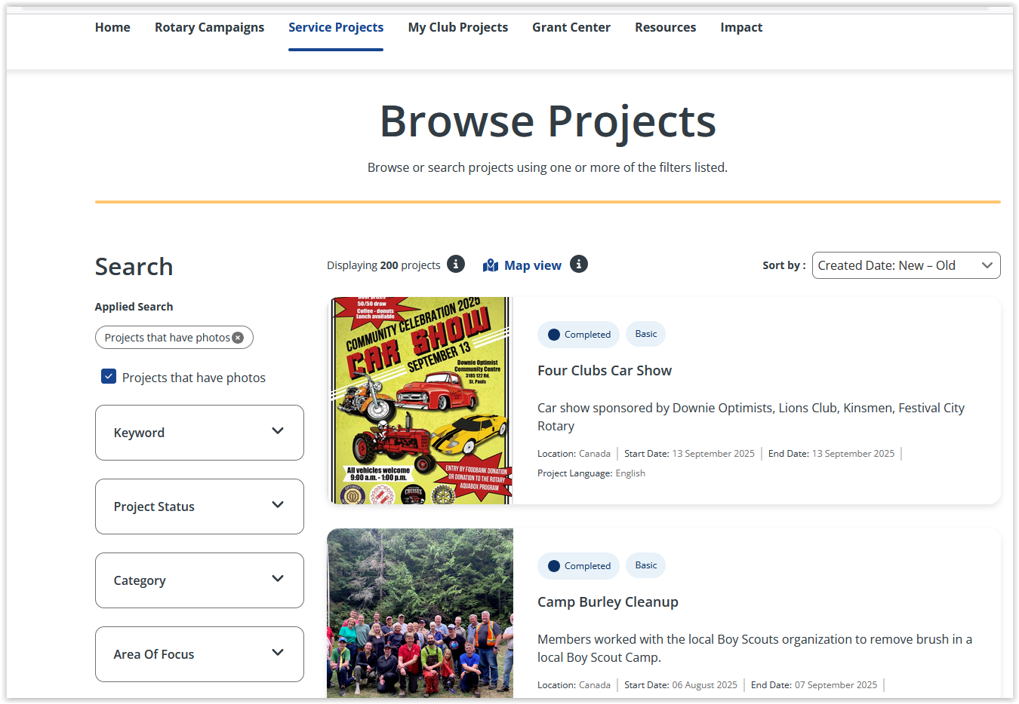
Check out the Service Projects Center on MyRotary
See what other clubs have done for projects and find partners for global grants

Slide 22
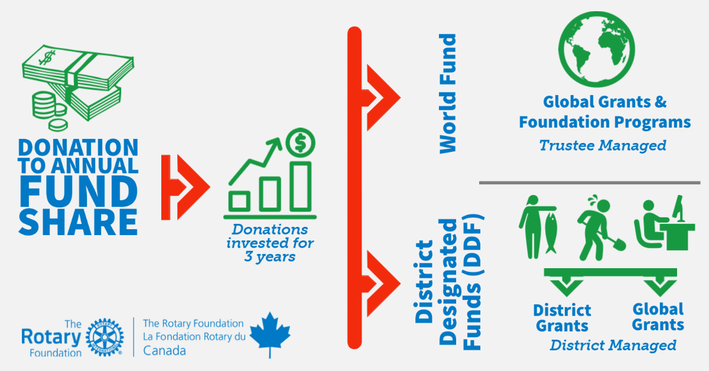
Who Manages the Grant Funds

Slide 23
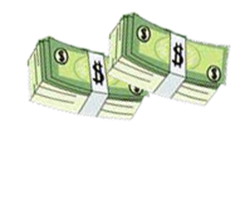
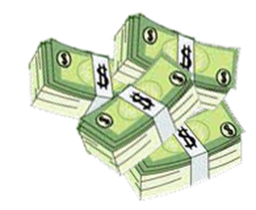
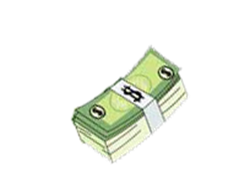
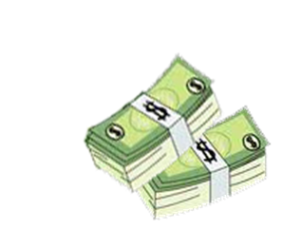
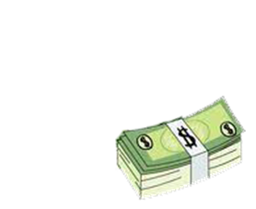
District Grant Funds available for 2025-26 ~ C$86,596
2022-2023
2025-2026
District Designated Funds (DDF) used for matching in Global Grants
3 years later
$63,209
47.5% Retained by
The Rotary Foundation The World Fund
(For Global Grants)
3 years later
$120,369
District Designated Funds (DDF) available
for District Grants
US$63,209
C$86,596*
Total Amount contributed
By D5040 clubs & individuals to the annual fund share
District Designated Funds are evenly split
$256,105
47.5% District Designated Funds, Global + District
Endowment Earnings add $6,050 for total $126,419
$120,369
Notes:
The District Designated Funds are held by the foundation and are available to spend 50% on Global Grants and 50% on district grants.
When we have enough approved District Grants to use at least 80% of the available funds, we create a spending plan showing all the district grant approved requests which we submit to the foundation. If approved we receive a block grant, the money is transferred to a district held grant account and we then disburse the funds.
Global Grant DDF are held by the foundation and distributed to approved projects
In 2020-21 we had $76,130 USD or $97,457 CAN
In 2021-22 we had $62,076 USD or $79,457 CAN
In 2022-23 we had $55,138USD or $74,436 CAN
It is only through your contributions to the Annual Fund that we have money for grants.

Slide 24



ROTARY FOUNDATION GRANTS
These two guides, both available on the District 5040 website, member area, Grants, Documents. Reviewing these should be your first step in applying for a grant
Notes:
A must read for someone considering a Grant.

Slide 25
Ways to Support the Foundation
Annual Fund
Endowment Fund - Named Endowment
Polio Plus Fund
The Rotary Foundation
Restricted Giving – approved Global Grant
Planned Giving Benefactor / Bequest
Restricted Giving – Disaster Response Fund

Slide 26
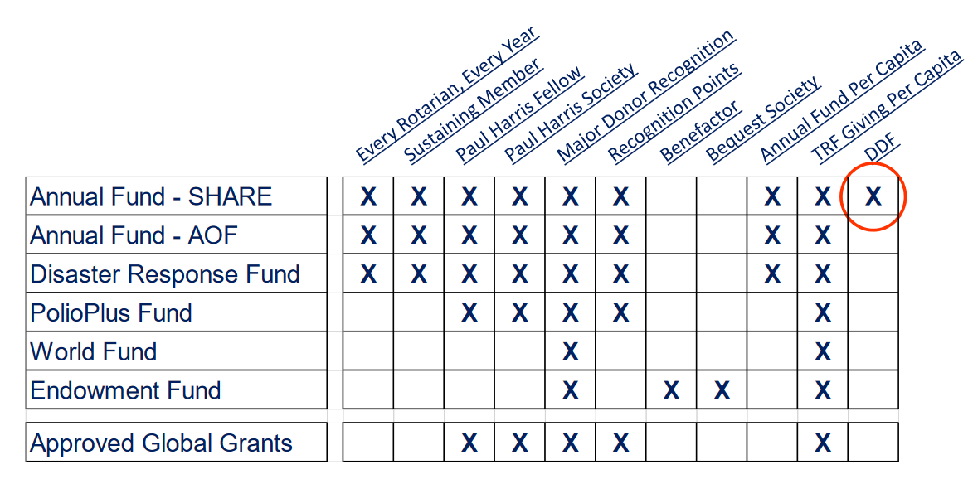
What Counts for What
Notes:
Note that only funds contributed to the Annual Fund Share result in district designated funds which come back to the district after three years

Slide 27
MEANINGFUL WAYS TO GIVE
Rotary Foundation Sustaining Member
When you give $100 or more per year to the Annual Fund.
Paul Harris Fellow
Become a Paul Harris Fellow when your cumulative donation level hits $1,000
When you give additional gifts of $1,000 or more to the Annual Fund, PolioPlus, or an approved Foundation grant.
Benefactor
When you include the Endowment Fund as a beneficiary in your estate plans or when you donate over $1,000 and less than $10,000 to the fund outright.

Slide 28
AS YOUR GIVING ACCELERATES
Bequest Society
When you make a commitment for future gifts of $10,000 or more to The Rotary Foundation, you’ll be invited to join the Bequest Society.
Major Donor
When your cumulative donations reach $10,000.
Level 1: $10,000 to $24,999
Level 2: $25,000 to $49,999
Level 3: $50,000 to $99,999
Level 4: $100,000 to $249,999

Slide 29
Substantial Commitment’s to The Rotary Foundation
Arch Klumph Society
When your cumulative donations reach $250,000. Recognition includes an induction ceremony and your picture and biography in the Arch Klumph Society interactive gallery at the Rotary International headquarters in Evanston, Illinois, USA.
Trustees Circle: $250,000 to $499,999
Chair’s Circle: $500,000 to $999,999
Foundation Circle: $1,000,000 to $2,499,999
Platinum Trustees Circle: $2,500,000 to $4,999,999
Platinum Chair’s Circle: $5,000,000 to $9,999,999
Platinum Foundation Circle: $10,000,000 and above
Legacy Society
When you promise a gift of $1 million or more to the Endowment, you’ll be listed in Rotary’s annual report and invited to exclusive Rotary International and Foundation events.

Slide 30
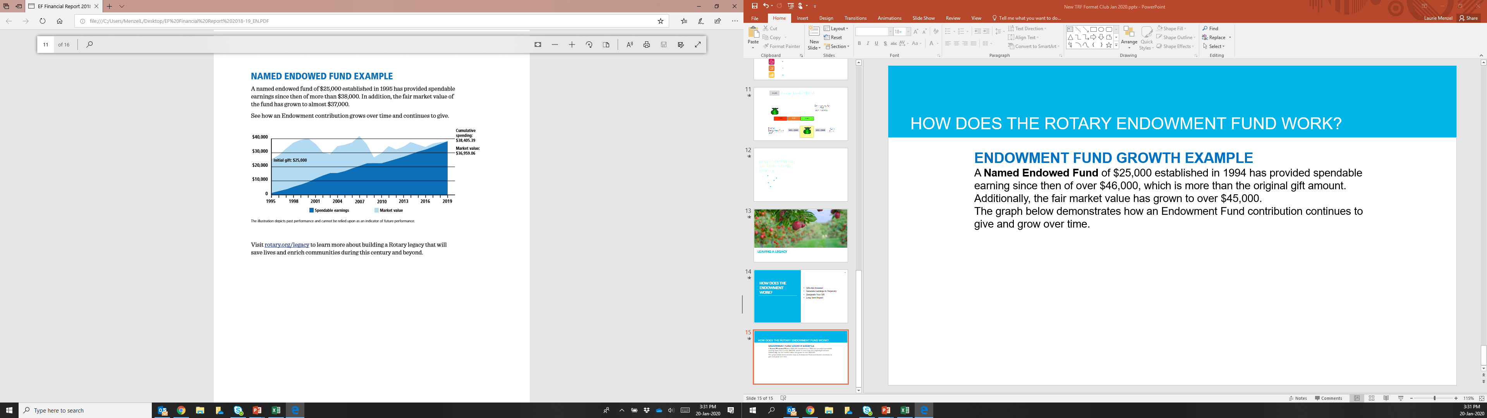
Named Endowed Fund
A Named Endowed Fund of $25,000 established in 1994 has provided spendable earning since then of over $38,000, which is more than the original gift amount. Additionally, the fair market value has grown to over $36,000.The graph demonstrates how an Endowment Fund contribution continues to give and grow over time.
Notes:
) Rotary strives to increase the value of your gift to the Endowment by preserving and investing your initial contribution and spending only a portion of the earnings. This strategy supports Rotary's causes today while generating funds that will further the work of future Rotarians committed to Doing Good in the World.
As with the Annual Fund, there are a number of ways to designate a gift within the Endowment Fund.
Earnings from gifts to EF-SHARE are split, with 50% going to World Fund and 50% going to District Designated Funds for the donor’s district. The difference is that with Annual Fund, the DDF portion of the gift will be applied one time. With Endowment Fund Share, the earnings from the gift are split each year. This means that although that yearly DDF amount is smaller than it would be with an AF gift, the DDF will continue to be given to the district every year as long as The Rotary Foundation exists. This like being a Paul Harris Society member forever. Donors may also choose to designate their Endowment Fund earnings to the World Fund, for Trustees to choose how to spend it. There are also options for the Rotary Peace Centers and for the Areas of Focus

Slide 31

Consider Including a Bequest to Rotary in your Estate Plans
Notes:
We can help with the process. Del Paterson is our major gifts officer

Slide 32
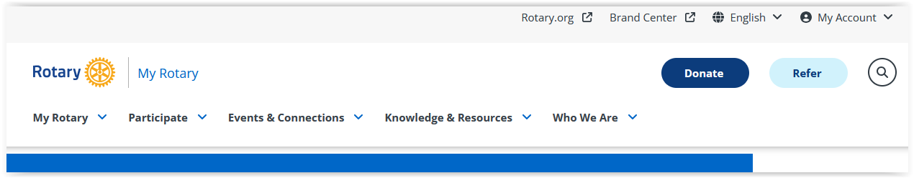
Log into MyRotary
Click on the Donate Button

Slide 33
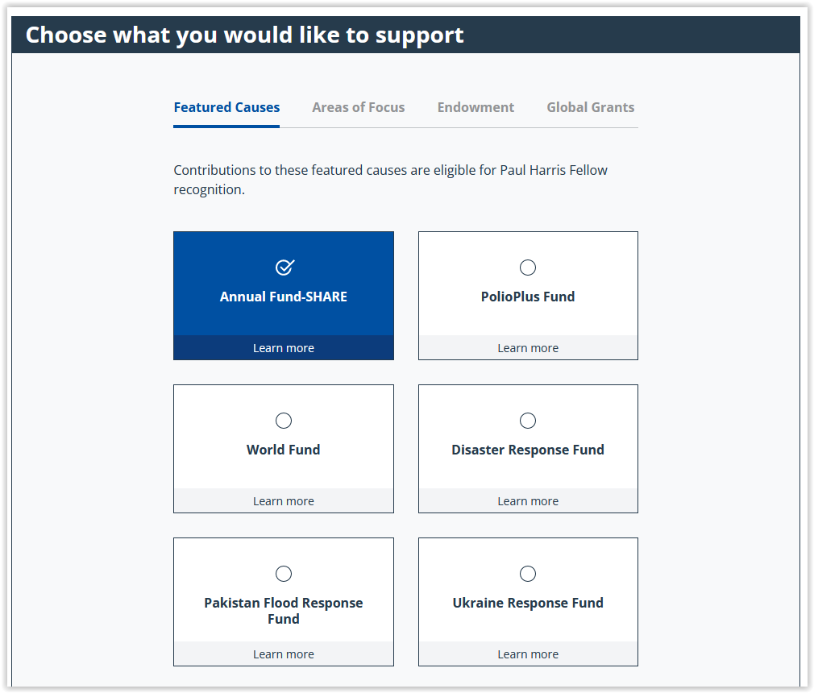
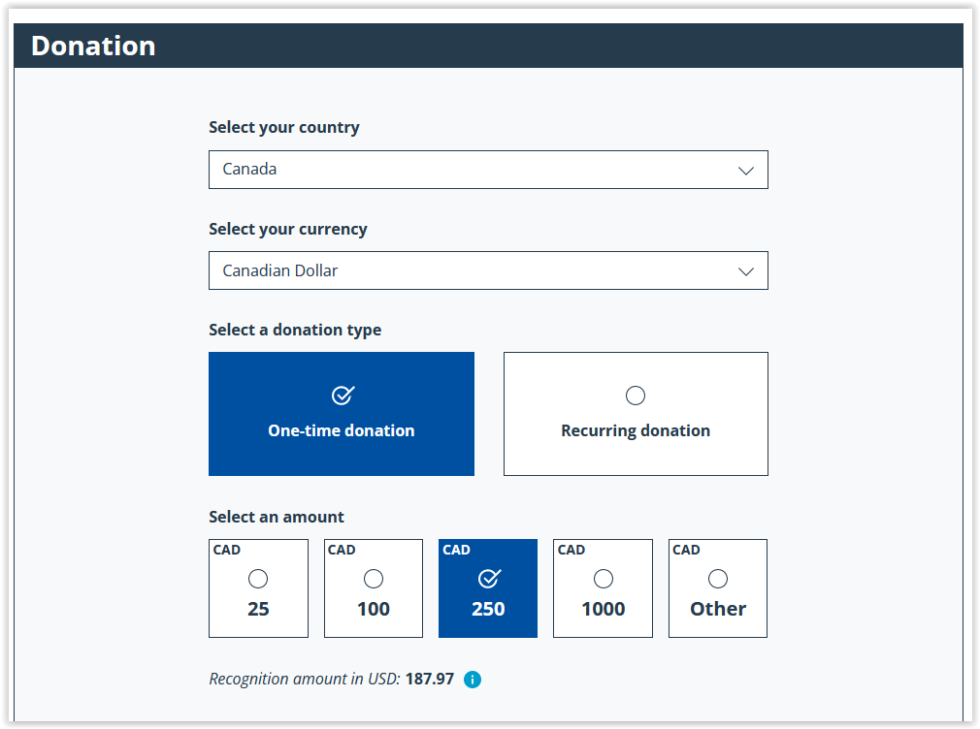
Donate on-line through MyRotary

Slide 34
How to Donate on Behalf of Members
If members donate at club meetings or events you can enter their contributions for them ensuring they get the recognition and tax receipts.

Slide 35
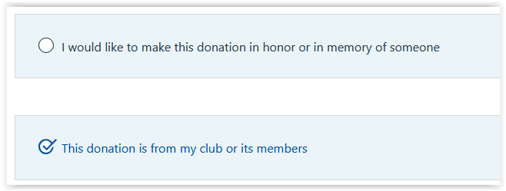
Donate on-line through MyRotary

Slide 36
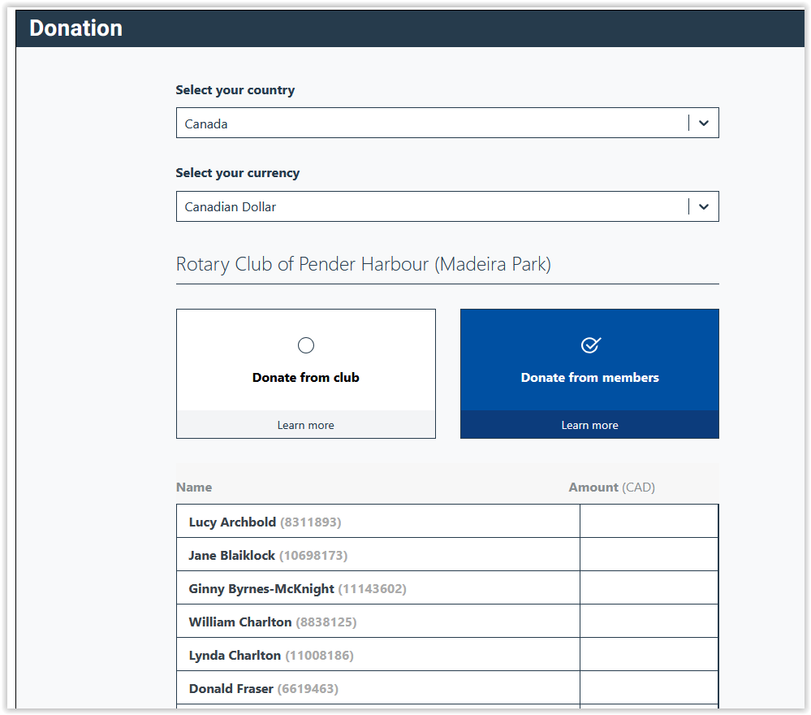

Slide 37
Rotary Direct
Regular and automatic giving to The Rotary Foundation
You subscribe to Netflix and Prime, why not subscribe to Humanity
with Rotary Direct?
Reasons for using TRF’s recurring giving program:
Donor is connected directly to their giving (Deductions through dues are not always understood.)
Club convenience! Club leadership work is minimized.
Signing up once ensures continuous support.
Signing up is simple. Recurring payments can be through a credit card. Set up online, on the phone, or by mail.
It’s easier to give smaller amounts in more frequency.
It’s efficient! It reduces TRF administration and marketing costs.
Its secure! It’s the safest and most secure way to contribute.
Making changes is easy! It’s easy to changes right on the RI website.
Increasing the recurring amount gradually is less of a burden.
Tracking the history by the giver giving is easy on the RI website.

Slide 38
Setup Payments in Rotary Direct – Tax Receipts at year end
Every Rotarian Every Year - $25 US $2.80 CA per month ($16.80 twice a year, minimum Rotary Direct is $10US)
Sustaining Member - $100US $12.50 CA per month
Paul Harris - $1,000US $112.50CA per month
Paul Harris Society - $1,000US every year
Polio Plus Society - $100US every year

Slide 39
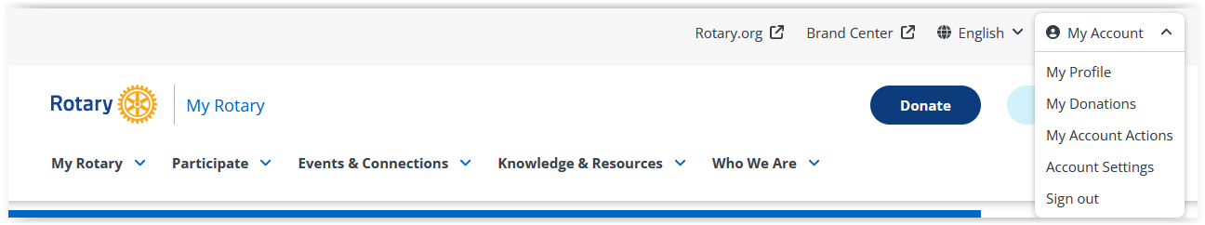
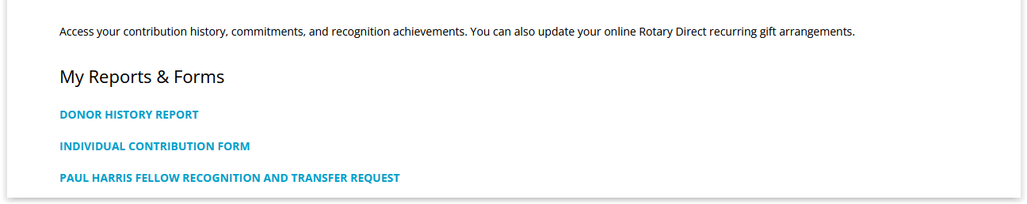
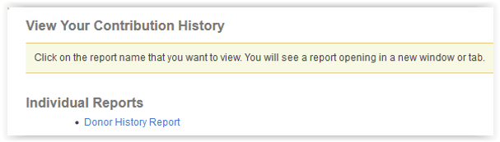
How to View Your Donor History
1
2
3
4

Slide 40
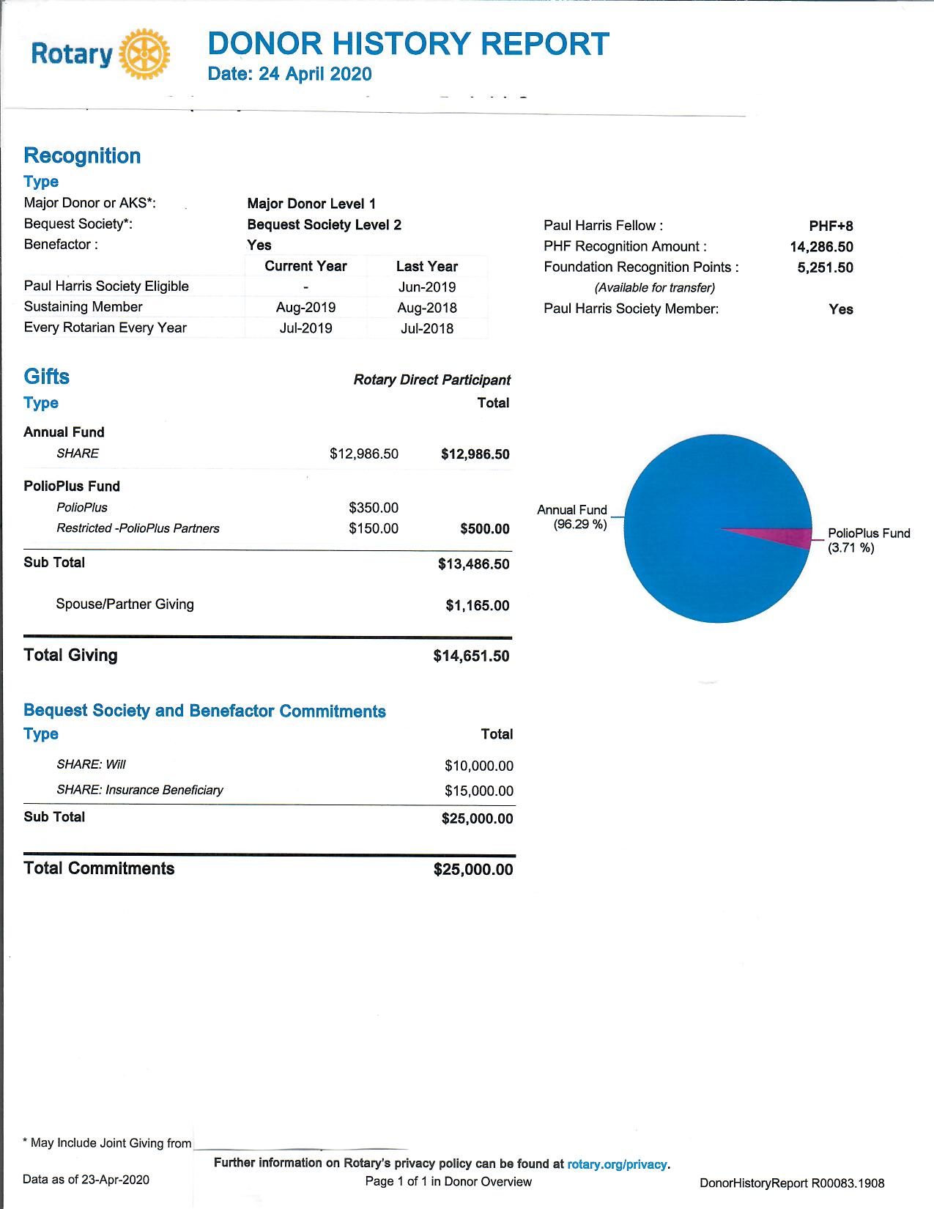

Slide 41
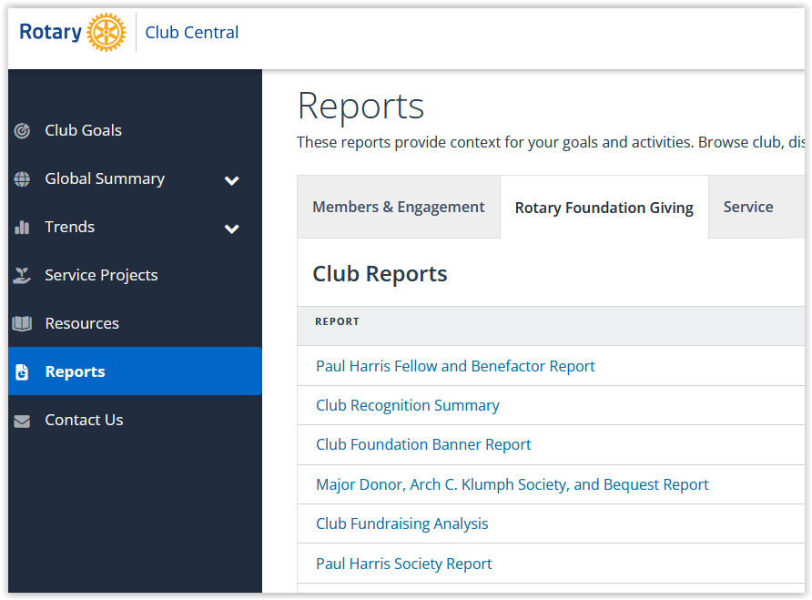
As Foundation Chair or President you can access these reports

Slide 42
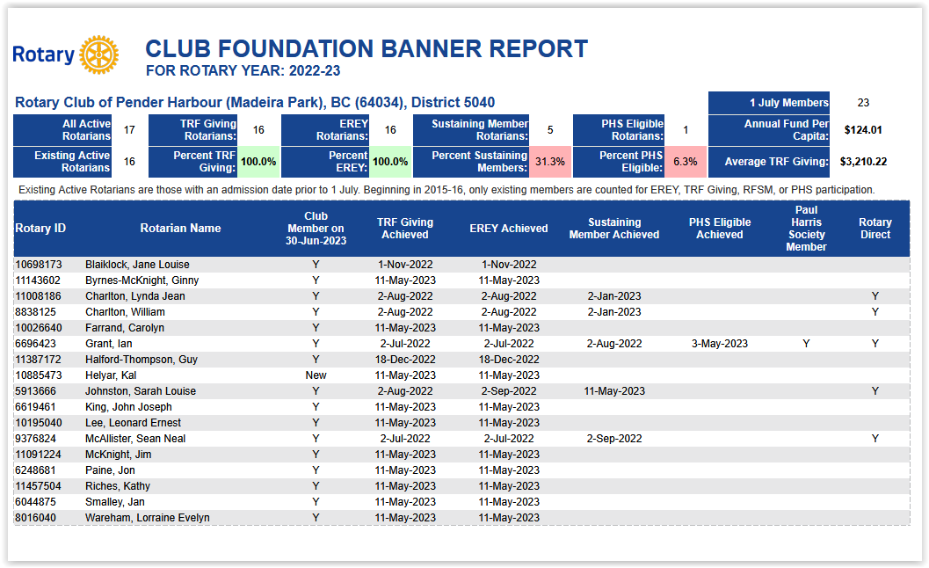
This report shows member participation

Slide 43
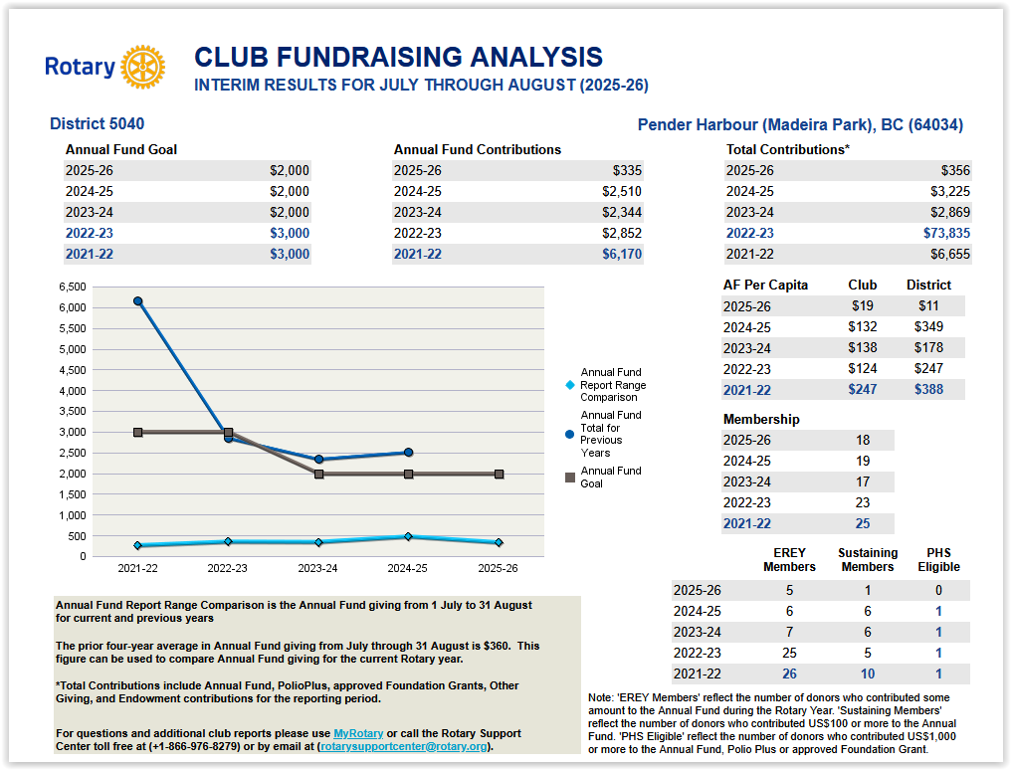
This report shows your club’s donations over 5 years

Slide 44
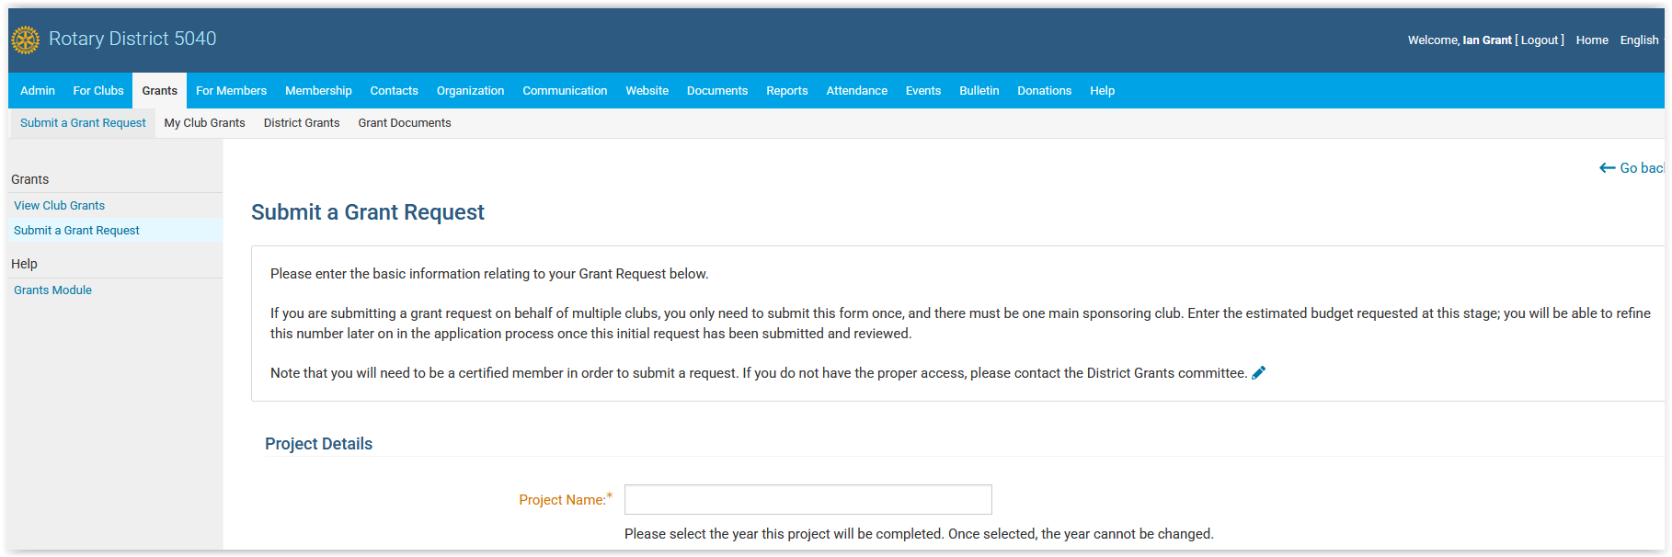

District website
The 5040 District website has information on applying for grants. It is also the place to apply for and report on district grants.
Global Grants must be applied for through MyRotary

Slide 45

Stories about Grants
On the district 5040 website this symbol identifies a story about a project funded by a grant.
Use these stories to show where grant funds go and the impact they can have.
Stories can be impactful and highlight why we give

Slide 46
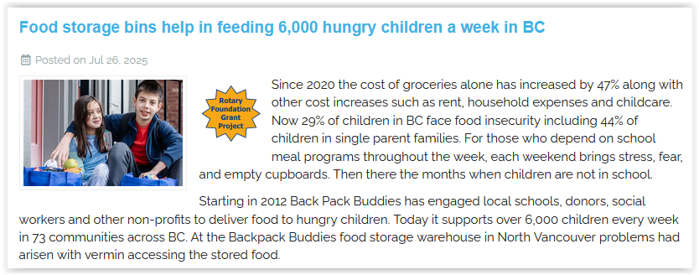
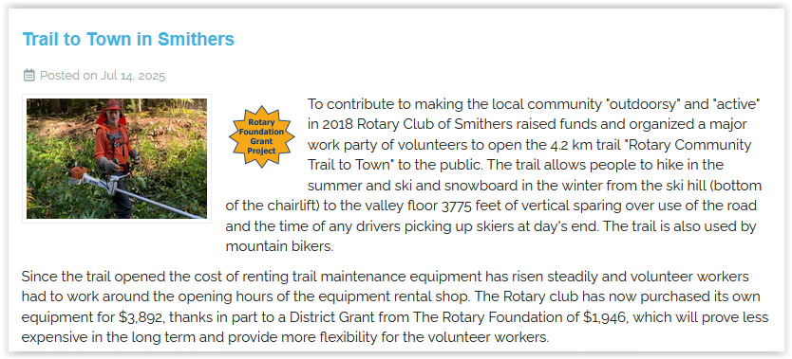
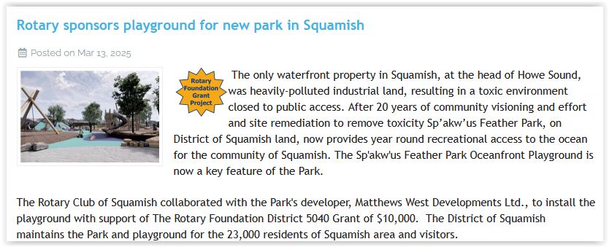
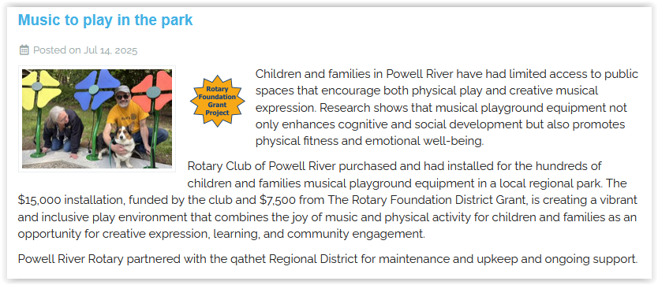
Think about how you can use these stories to promote donations to the Foundation

Slide 47
Foundation minute
Take a minute at the beginning of each meeting to highlight something about the Foundation
The current status of Polio
How to donate on-line
A story about a local district grant
A story about a global grant
How the Foundation got started
Where the club stands against it’s Foundation goals
Be creative

Slide 48
Presentation Materials
Powerpoint Presentations you can use and adapt:
The History of the Foundation
The Mechanics of the Foundation – How it works
Why Give to the Foundation
These can be found on the district 5040 site
Our Programs
Foundation/Grants
Foundation

Slide 49
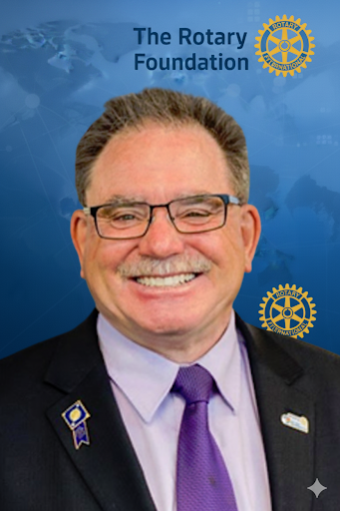
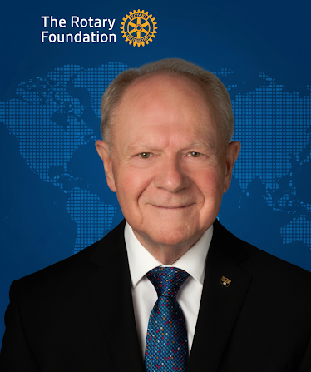
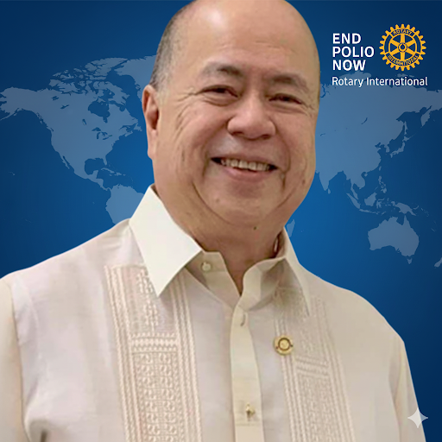
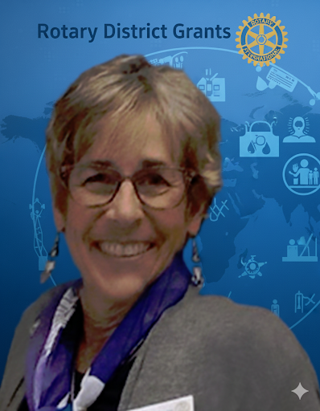
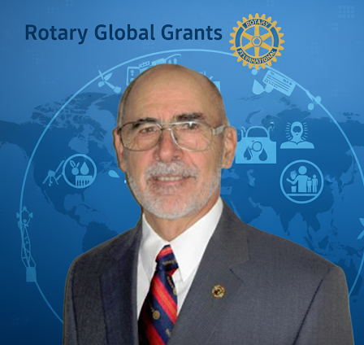
The District Foundation Committee
Support for Foundation Chairs and Presidents
Ian Grant
Chair
Lorne Calder
Vice-chair
Del Patersen
Major Gifts
Matt Caparas
Polio
Liz Scroggins
District Grants
Bill Hellyer
Global Grants

Slide 50
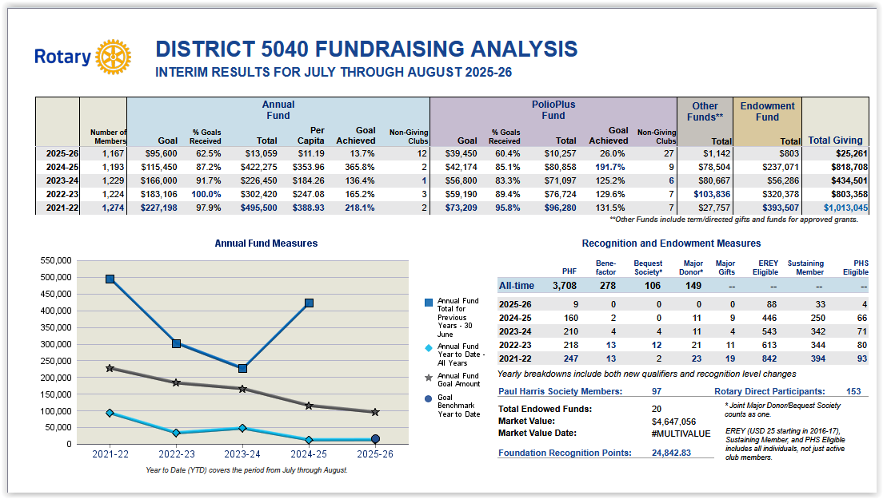

Slide 51
Foundation Participation Trends District 5040
47% Drop
37% Drop
29% Drop
28% Drop
6% Drop

Slide 52
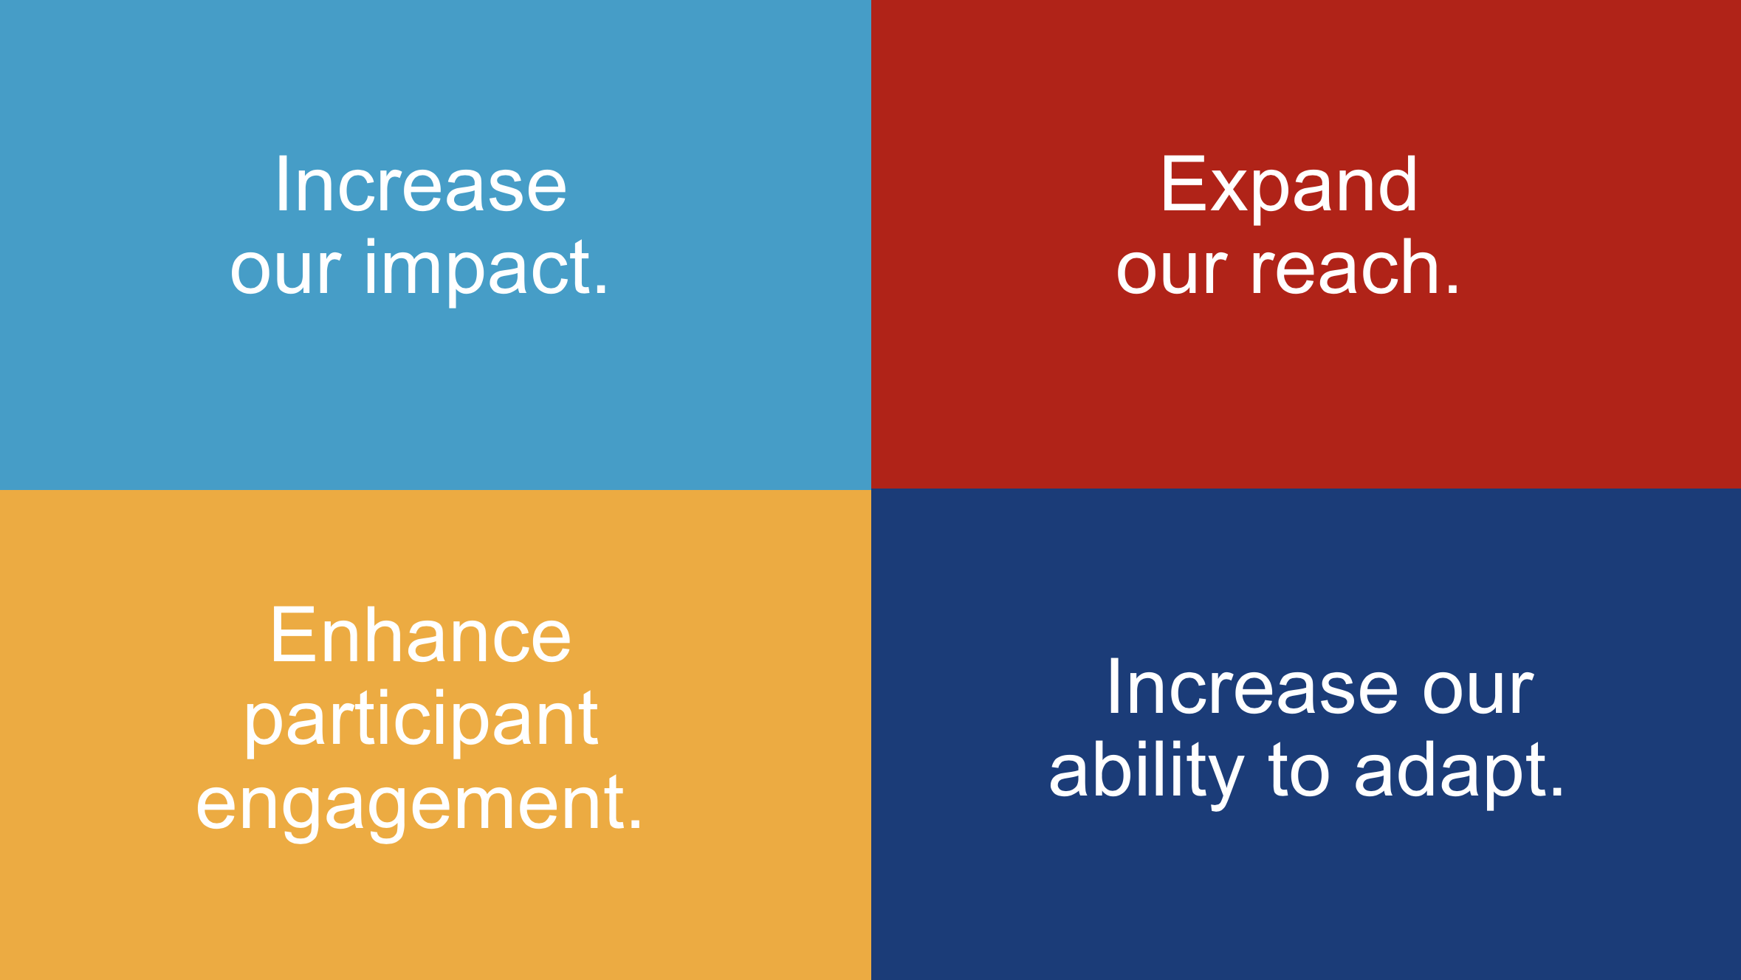

Slide 53
The Challenge – Improve your club’s numbers
EREY
Annual Fund Donations
Sustaining Members
Polio Fund Donations
PHS Eligible
Rotary Direct Members
Endowments
Bequests
District Grant Applications
Global Grant Applications

Slide 54
How to do it
Set Goals
Talk about the foundation
Give presentations on the foundation
Have a foundation moment at each meeting
Challenge your club to apply for grants
Use stories showing the impact of grants
Show members how to contribute on-line
Show members how to set up Rotary Direct payments
Help members set up their MyRotary account
Lead by example
Hold foundation fundraising events
Have district foundation team members present at your club

Slide 55

Questions

