Slide 1


Slide 2
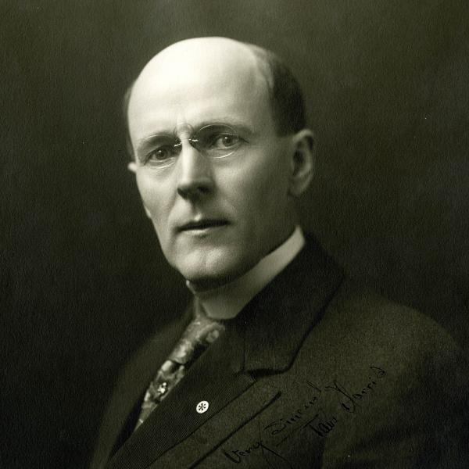
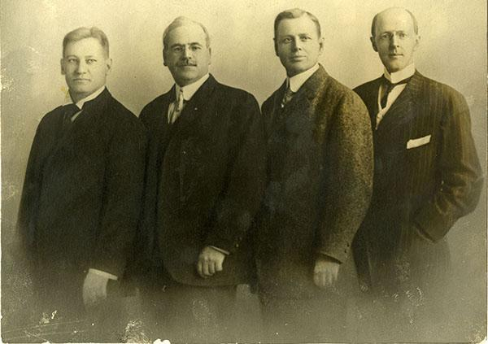
1905: Rotary begins
Attorney Paul P. Harris convenes the first Rotary meeting on 23 February in Chicago, Illinois, USA. Harris envisions a professional club that brings together local men from a variety of vocations.
The first four Rotarians: Gustavus Loehr, Silvester Schiele, Hiram Shorey, and Paul P. Harris
Rotary started with the vision of one man — Paul Harris
Notes:
After setting up his law practice in Chicago, Harris gathered several business associates to discuss the idea of forming an organization for local professionals. He envisioned a place where professionals of diverse backgrounds could exchange ideas and form meaningful, lifelong friendships.
On 23 February 1905, Harris, Gustavus Loehr, Silvester Schiele, and Hiram Shorey gathered at Loehr’s office in Room 711 of the Unity Building in downtown Chicago. This was the first Rotary club meeting.
“I was sure that there must be many other young men who had come from farms and small villages to establish themselves in Chicago ... Why not bring them together? If others were longing for fellowship as I was, something would come of it.”
In February 1907, Harris was elected the third president of the Rotary Club of Chicago, a position he held until the fall of 1908. Toward the end of his club presidency, Harris worked to expand Rotary beyond Chicago. Some club members resisted, not wanting to take on the additional financial burden. But Harris persisted and by 1910 Rotary had expanded to several other major U.S. cities.

Slide 3
1907: Early service project
The Rotary Club of Chicago meets with civic organizations to discuss the need for comfort stations (public toilets) to improve sanitation in the city.
1908: Rotary's second city
San Francisco, California, USA, becomes the second city to have a Rotary club in November.

Slide 4
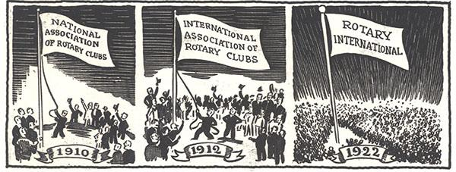
Evolving Beyond the Club Recognizing the Benefits of Working Together
1910: Clubs form an association
Members representing 16 Rotary clubs gather at the first Rotary Convention, in Chicago in 1910. They create the National Association of Rotary Clubs of America, adopt a constitution and bylaws for the organization, and elect a board of directors. As members of the association, Rotary clubs remain autonomous but share core values.
1912: Rotary becomes International
Rotary becomes an international organization with the chartering of the Rotary Club of Winnipeg, Manitoba, Canada, in April 1912. To reflect this, the organization changes its name to the International Association of Rotary Clubs. The name Rotary International is adopted in 1922.
Notes:
1907: Early service project
The Rotary Club of Chicago meets with civic organizations to discuss the need for comfort stations (public toilets) to improve sanitation in the city.
1908: Rotary's second city
San Francisco, California, USA, becomes the second city to have a Rotary club in November.
By 1910 there were 16 Rotary Clubs
The Rotary Club of Vancouver was chartered in April 1913 with 98 members
The Rotary Club of Victoria was chartered in November 1913

Slide 5
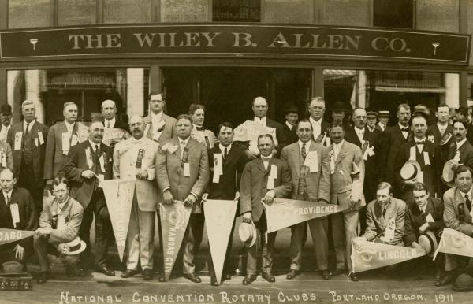
Rotary Convention 1911

Slide 6
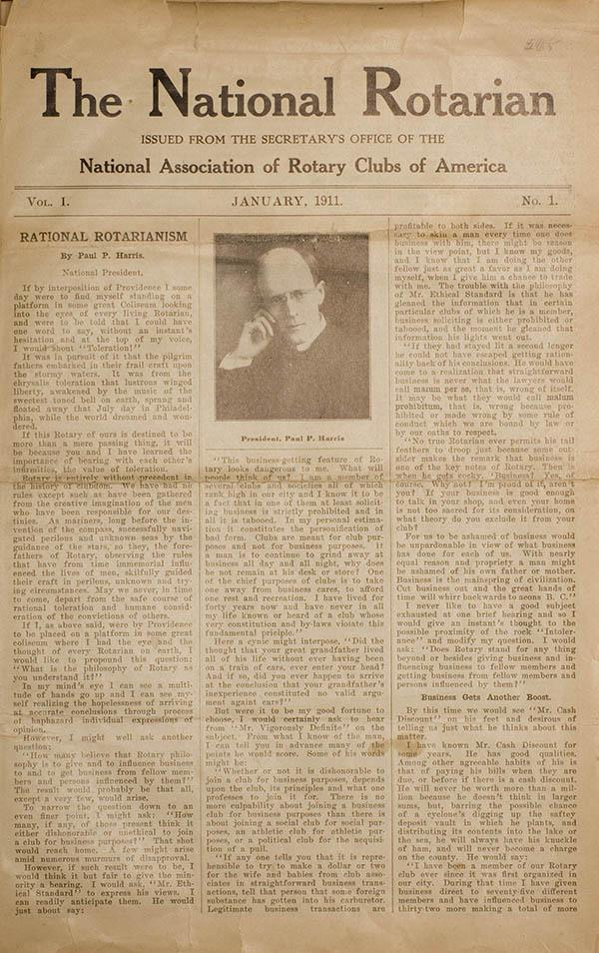
1911: The Rotarian magazine
Rotary publishes the first issue of The Rotarian magazine in January 1911, with the purpose of delivering standard messages to all clubs and sharing news from clubs and members. The magazine's name changes to Rotary in 2020.

Slide 7
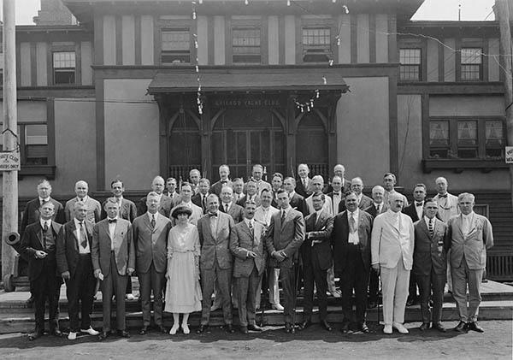
Rapid Expansion
1912: Rotary expands to Europe
The chartering of a club in London, U.K. in August puts Rotary in Europe. Although the Rotary Club of Dublin, Ireland, had been organized earlier, it wasn't charted until May 1913. Rotary's presence spreads to continental Europe with the chartering of a club in Madrid, Spain, in January 1921
1919: First International Assembly
Rotary holds its first International Assembly in Chicago, an annual training event for incoming leaders. The practice would continue yearly, building connections between incoming leaders worldwide.
1919: Rotary extends to South America
Rotary expands to South America with the chartering of a club in Montevideo, Uruguay, in February 1919. In 1920, a club is chartered in Argentina. Brazil becomes the third country on the continent to have Rotary clubs in 1923.
1919: Rotary arrives in Asia
A Rotary club is chartered in Manila, Philippines, in June 1919, and in Shanghai, China, four months later. ​The Rotary Club of Calcutta becomes the first club in India in January 1920.
Attendees at the 1920 International Assembly in Chicago

Slide 8
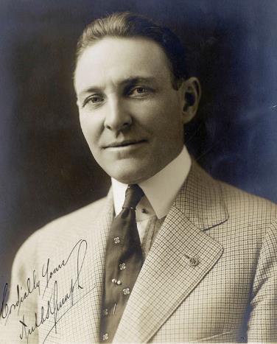
Arch Klumph’s Vision — 1917
It seems eminently proper that we should accept endowments for the purpose of doing good in the world, in charitable, educational or other avenues of community progress …
— Arch Klumph, 1917
106 YEARS OF DOING GOOD IN THE WORLD
Notes:
* One of many historical quotes from Arch Klumph. < READ > This is why he is recognized as the “Father of the Foundation” because he had the vision of a Rotary endowment fund and the dedication to bring this dream to life.
* As President of the Rotary Club of Cleveland, Ohio, USA, in 1913, he advocated for the club to build a reserve that would ensure its means to do future good work.
* As our 6th Rotary International President in 1916-17, he proposed this idea to a larger audience.
In his speech to the 1917 convention in Atlanta, he made this statement to the convention attendees.
* Arch’s vision of an endowment would eventually become The Rotary Foundation, and his call for “doing good in the world” was to become the Foundation’s motto. But it would take some time, however, for all of that to happen.

Slide 9
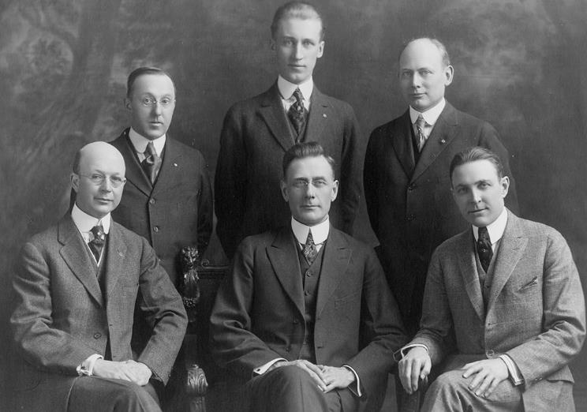
Arch Klumph’s Vision — 1917
Rotary’s 1917-18 Board of Directors
106 YEARS OF DOING GOOD IN THE WORLD
Notes:
* The 1917 convention delegates agreed with Arch’s vision and voted to amend the Rotary constitution to establish an endowment fund.
This fund was “to be made up of contributions from clubs, individuals, estates and other Rotarian sources.”
The fund’s principal was to remain intact, with only the interest used to further Rotary’s goals. The delegates named Rotary’s Board of Directors as trustees of the fund.
Although this fund started the Foundation, it is not the same as today’s Endowment Fund, which was established in the 1980s.

Slide 10
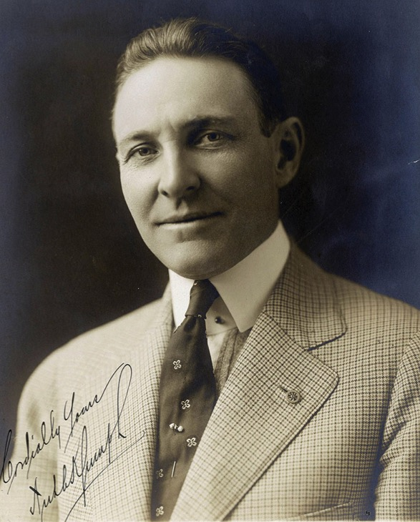
The “Father of the Rotary Foundation”, Arch Klumph had the vision of a Rotary endowment fund and the dedication to bring this dream to life.
Although Arch believed strongly in the need for the Foundation, he emphasized that all contributions should be voluntary. He did not want Rotarians to view the Foundation as a tax or assessment on clubs or members, which would have violated the association’s constitution.
Our job is:
- to create a living Legacy of the GIVING & GRANT CULTURE
- to inspire the SPIRIT & share the ART OF GIVING

Slide 11

First Contribution — 1917
Notes:
In 1917, the Rotary Club of Kansas City, Missouri, USA, (#13 ) made the first contribution, $26.50, to the endowment fund that Arch Klumph had suggested in his convention speech. But for almost a decade, the endowment went largely unknown and received very few contributions.
In 2017, the International Rotary Convention celebrated the 100th Anniversary of the TRF. Those who attended the Atlanta convention may recall the figure of $26.50. Representing the first donation in 1917 was featured in a number of fees and incentives for the convention and a challenge to each Rotarians to contribute $26.50 to TRF to honor our first century of service. And actually there were significant dollars raised from Rotarians to celebrate $26.50.

Slide 12
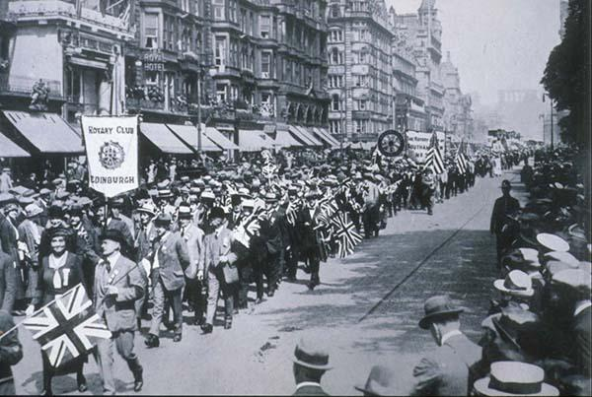
1921: Prioritizing peace
Rotarians meet in Edinburgh, Scotland, for the first convention held outside the U.S. They add the advancement of peace and international goodwill to the RI constitution. Prioritizing peace becomes part of the Object of Rotary when the Object is adopted at the 1922 Convention in Los Angeles, California, USA.
Rotarians parade through the streets of Edinburgh, Scotland, during the 1921 convention.

Slide 13
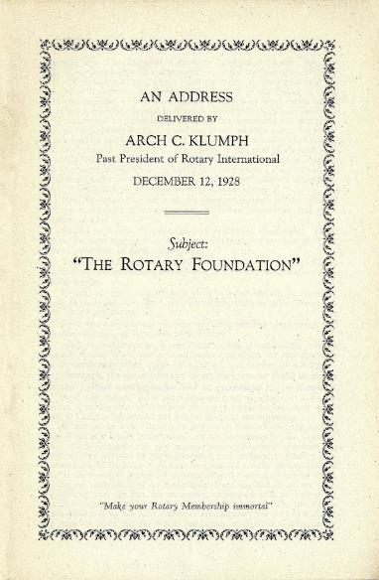
Educating to Create a Culture of Giving
We are determined that the Endowment Fund shall not be unpopular. … We truly believe that when each and every individual Rotarian understands this matter thoroughly and correctly, there will be few, if any, who do not participate, even though the sum may be extremely modest in amount.
— Arch Klumph, 1928
Notes:
* In 1927, Rotary leaders began to show greater interest in the endowment, and the following year, convention delegates formally changed its name to The Rotary Foundation. They also agreed to enlarge its scope and establish a five-member Board of Trustees.
* The Rotary President appointed the first trustees and named Arch Klumph the trustee chair. He served as chair for seven years, educating Rotarians about the Foundation and encouraging them to contribute.
* As mentioned in a previous slide Arch repeated “Although Arch believed strongly in the need for the Foundation, and again he emphasized that all contributions should be voluntary. He did not want Rotarians to view the Foundation as a tax or assessment on clubs or members, which would have violated the association’s constitution.
* Today, the Foundation has 15 trustees who manage the Foundation’s business. They are nominated by the RI president-elect and elected by the RI Board to serve four-year terms. The trustees elect a chair each year.

Slide 14
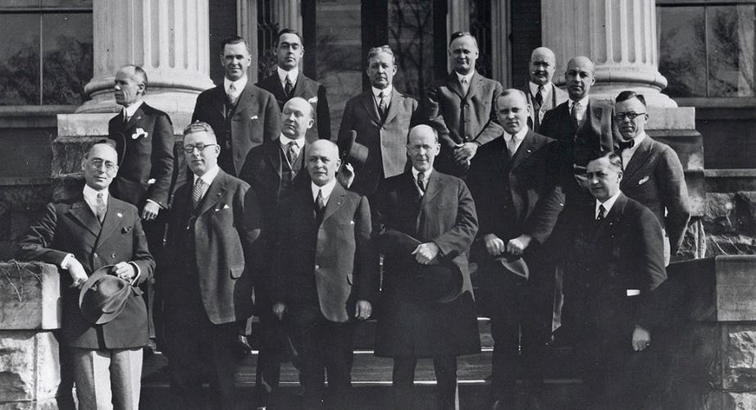
First Grant — 1930
Notes:
* In 1930, the Foundation made its first grant, $500 to the International Society for Crippled Children, now known as Easter Seals.
* Rotarian Edgar “Daddy” Allen had founded Easter Seals in 1919. Rotary founder Paul Harris served on the society’s board of directors.
* In this 1922 photo of the society’s founding members, Allen is in the front row, third from the left, and Paul Harris is standing next to him, fourth from the left.

Slide 15
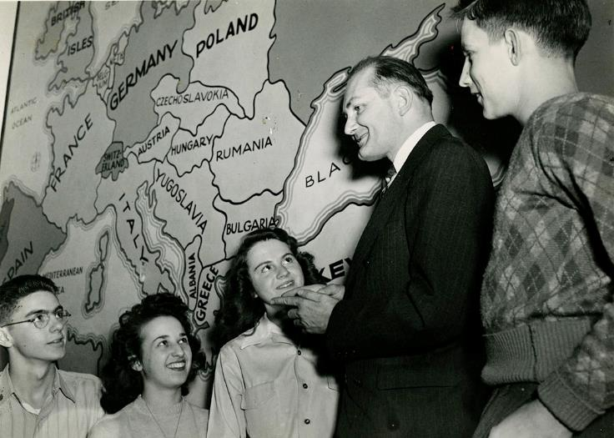
Early Foundation Activities — 1930s
106 YEARS OF DOING GOOD IN THE WORLD
Notes:
* During its early years, the Foundation explored ways to promote what was then known as the sixth object of Rotary: advancement of understanding, goodwill, and international peace.
* In the early 1930s, the Foundation sponsored essay contests for secondary school students on peace-related topics and recognized the winners at the 1931 and 1933 conventions.
* Institutes of International Understanding were another early initiative. The Foundation encouraged clubs to organize programs and invite prominent guest speakers to discuss critical world issues. The Foundation helped pay speakers’ expenses if the club could not afford them.
* The high school students shown here were attending an Institute for International Understanding in Sturgis, Michigan, USA.

Slide 16
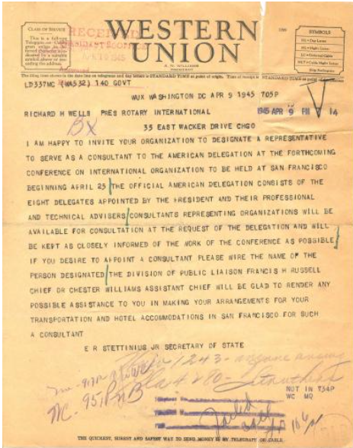
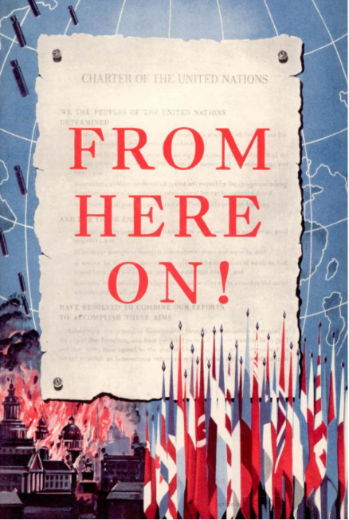
Rotary and the United Nations have a shared history of working toward peace and addressing humanitarian issues around the world.
Telegram inviting Rotary International to serve as a consultant to the U.S. delegation to the San Francisco Conference
Notes:
Did you know that Rotary International has a seat at the United Nations. In fact, as you see here is the Western Union Telegram inviting RI to designate an RI Representative from April to June 1945, delegations from 47 nations attended the United Nations Conference. Their task was to write a charter acceptable to all of the nation representatives. The delegations were assisted in this historic effort by a large number of staff, advisers, and consultants.
During World War II, Rotary informed and educated members about the formation of the United Nations and the importance of planning for peace. Materials such as the booklet “From Here On!” and articles in The Rotarian helped members understand the UN before it was formally established and follow its work after its charter.

Slide 17
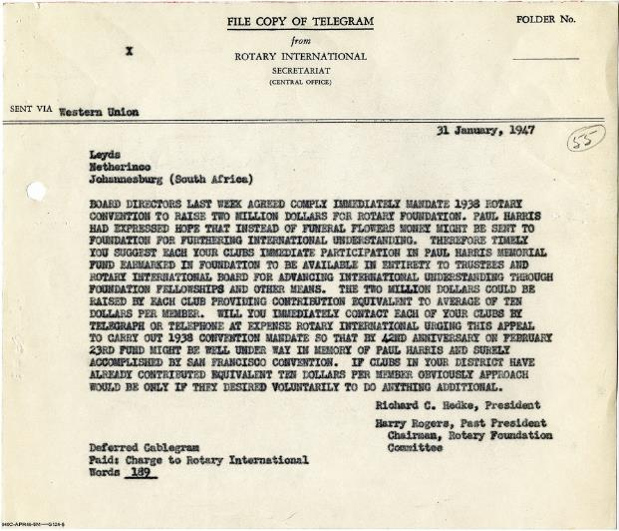

The Paul Harris Memorial Fund
“Paul Harris had expressed hope that instead of funeral flowers money might be sent to [the] Foundation
for furthering international understanding.”
106 YEARS OF DOING GOOD IN THE WORLD
Notes:
The Great Depression and World War II both impeded significant growth for the Foundation, but the need for promoting a lasting world peace generated great post-war interest in developing the Foundation.
It began in 1947, when Paul Harris died after a prolonged illness. Rotary’s beloved founder had told friends that if they wanted to honor him, they should donate to the Foundation. So Rotary established a special fund for the contributions that flooded headquarters as news of Paul’s death spread.
In the 18 months following his death, The Rotary Foundation received $1.3 million, which helped support the Foundation’s first program — scholarships for graduate study abroad.

Slide 18
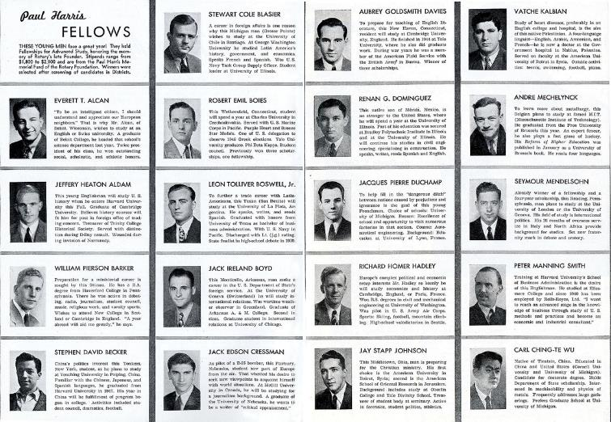
First Program: Scholarships for Graduate Study — 1947
105 YEARS OF DOING GOOD IN THE WORLD
Notes:
In 1947, the Foundation launched its first program: scholarships for graduate study. The first group of scholars, spotlighted here in The Rotarian magazine, began their studies in the 1947-48 academic year.
The program’s criteria have changed a few times during its seven decades, and so has its name — the students have been called Paul Harris Fellows, Ambassadorial Scholars, and Rotary Scholars. But the concept of sending promising students abroad for graduate study remains the same.
Notable Rotary Scholars have included Helmut Jahn, architect; Keith Rayner, former Anglican archbishop and primate of Australia; Naoko Yamazaki, astronaut; Sadako Ogata, Japanese diplomat and UN High Commissioner for Refugees; and Roger Ebert, Pulitzer Prize-winning film critic.
EXTRA: Watch a video of Roger Ebert talking about his year as a Rotary Scholar at https://vimeo.com/63594762

Slide 19
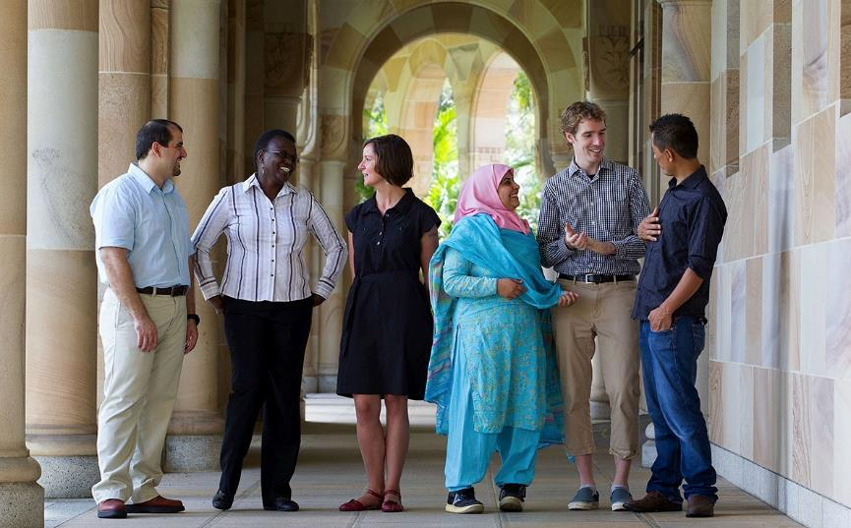
Today’s Scholars
106 YEARS OF DOING GOOD IN THE WORLD
Notes:
Today, Rotary Scholars pursuing graduate degrees receive Foundation support through global grants and district grants, and Rotary Peace Fellows study at now 7 Rotary Peace Centers.
Since the program began in 2002, the Rotary Peace Centers have trained more than 1,300 fellows who now work in more than 115 countries. Many serve as leaders in governments, NGOs, the military, education, law enforcement, and international organizations like the United Nations and the World Bank.
Like participants of past scholarship programs, today’s Rotary Scholars and peace fellows gain knowledge and skills that help them to further the Foundation’s humanitarian and peace-building missions.
* Each year, up to 100 Rotary Peace Fellows are chosen to participate in a master’s degree or certificate program at one of our six centers around the world.

Slide 20
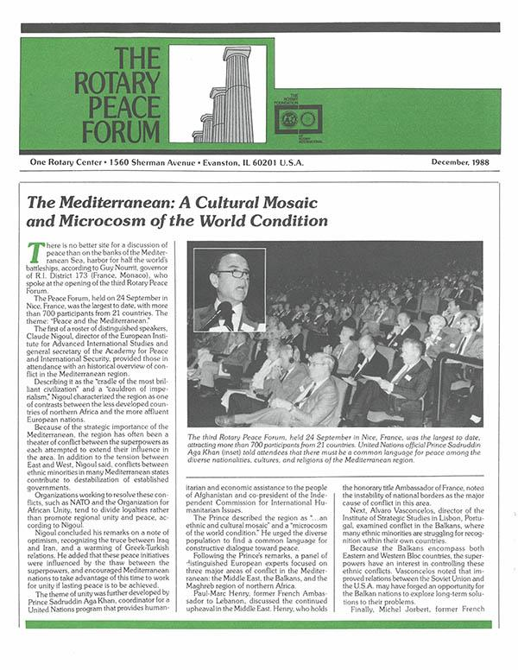
1988: Peace Forums and advocacy
The Foundation holds its first Peace Forum in Evanston, Illinois, USA, as part of a pilot program. The program is later broadened and peace-focused events continue under many names.
The Peace Forum newsletter shared key messages from the events with members around the world.

Slide 21
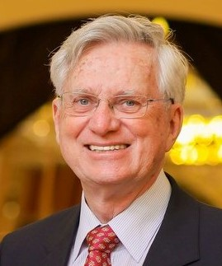


ROTARY PEACE CENTERS
Past District 5040 Governor Chris Offer. Member of the Rotary Club of Ladner Was the 2022-23 international Chair of the Rotary Peace Centers Committee, which every year selects the Rotary Peace Fellows for the 50 Master's Degree or 80 Professional Certificate programs in peace and conflict resolution at seven universities throughout the world
The seven universities are: Chulalongkorn University, in Bangkok, Thailand; University of Bradford, in Bradford, England; University of Queensland, in Brisbane, Australia; Uppsala University, in Uppsala, Sweden; Duke University and University of North Carolina, in Durham and Chapel Hill, North Carolina; International Christian University, in Tokyo; Makerere University, in Kampala, Uganda.

Slide 22

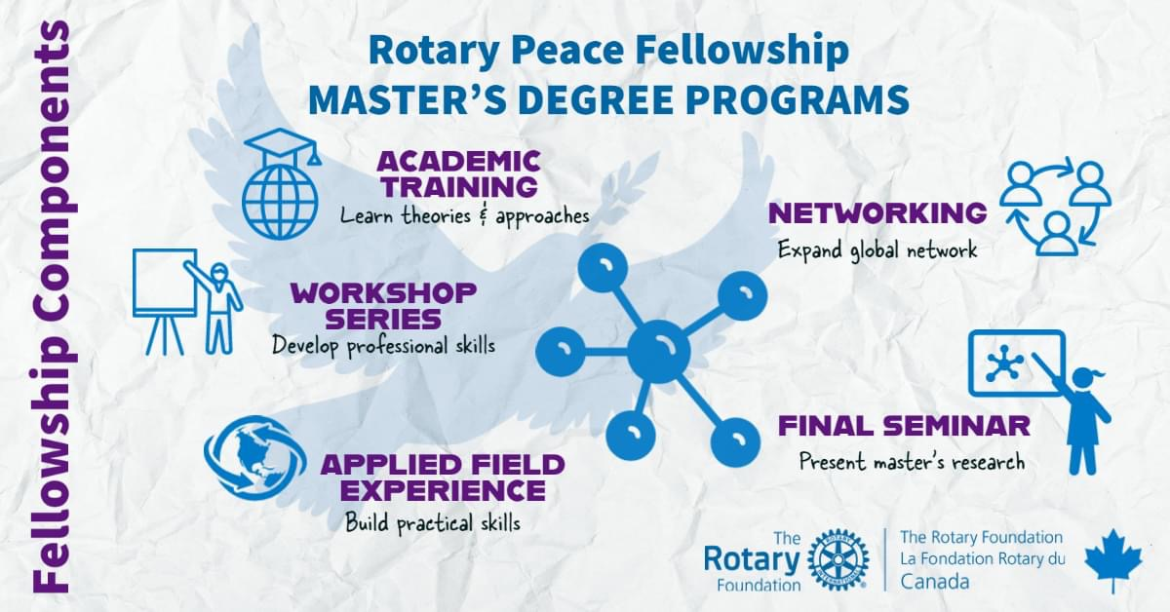

OUR ROTARY PEACE SCHOLAR
Vanessa Lanteigne our recent Peace Scholar
Notes:
Vanessa Lanteigne from the Sunshine Coast was awarded a fully funded master’s degree program at the Rotary International Peace Center located at Uppsala University in Sweden. Vanessa was sponsored by the Rotary Club of Sechelt and was an outgoing exchange student with the Pender Harbour Club. Vanessa spoke at our last district conference talking about how the program led to her speaking at the UN.

Slide 23
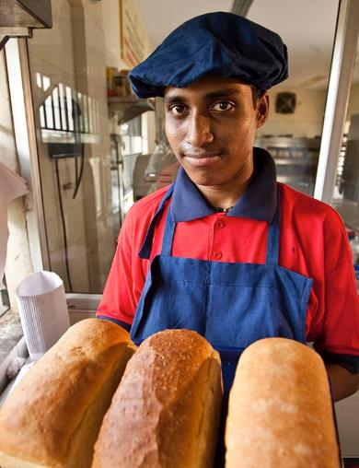
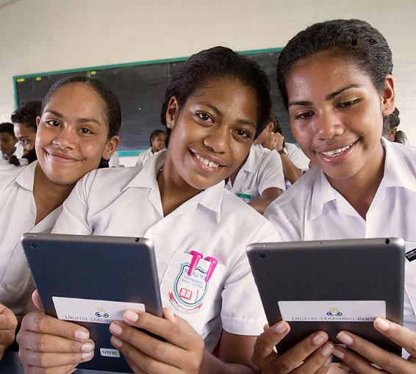
Matching Grants
106 YEARS OF DOING GOOD IN THE WORLD
Notes:
* In 1963-64, RI President Carl Miller focused on reducing the tensions of the Cold War by bringing people of different cultures and beliefs together. In 1964, the Trustees approved the Special Grants program, later called Matching Grants, which provided funding for clubs and districts to undertake projects that furthered international understanding. Members in two countries often worked together on humanitarian projects, and eventually this became a program requirement.
* Over the course of the program, the Foundation awarded more than 37,000 Matching Grants worth well over $500 million in more than 200 countries. The projects addressed a wide range of needs, providing everything from technical training to literacy programs to clean water.

Slide 24
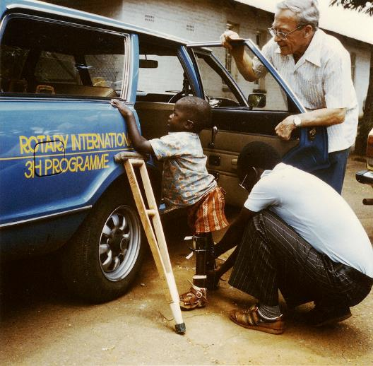
Health, Hunger, and Humanity (3-H) Grants — 1978
105 YEARS OF DOING GOOD IN THE WORLD
Notes:
* In the late 1970s, Rotary leaders began looking for a way to inspire large international projects to mark Rotary International’s 75th anniversary in 1980. In 1978, the Foundation created the Health, Hunger, and Humanity (3-H) program. In
* Throughout the three decades that followed, the 3-H program supported a wide range of other health-related projects, from eye camps to prosthetic limbs to mobile clinics in remote areas.

Slide 25
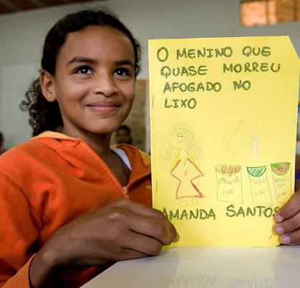
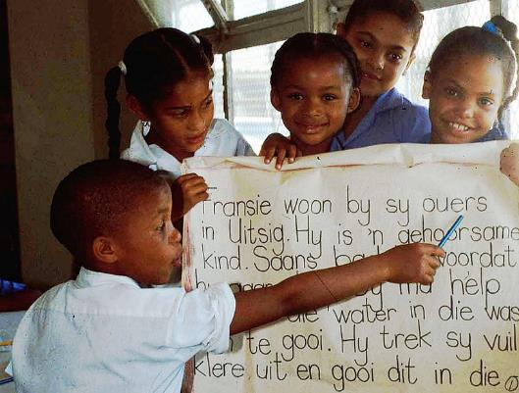
Health, Hunger, and Humanity (3-H)
106 YEARS OF DOING GOOD IN THE WORLD
Notes:
Literacy was another major focus of 3-H grants. Australian Rotarian Richard Walker developed a literacy training method called Concentrated Language Encounter (CLE) and used a grant to start a literacy program in Thailand. The program proved so successful that it was replicated in Brazil (shown here at left) and South Africa (shown at right), among other countries.

Slide 26
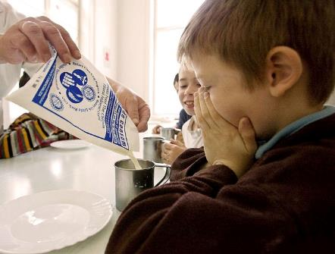
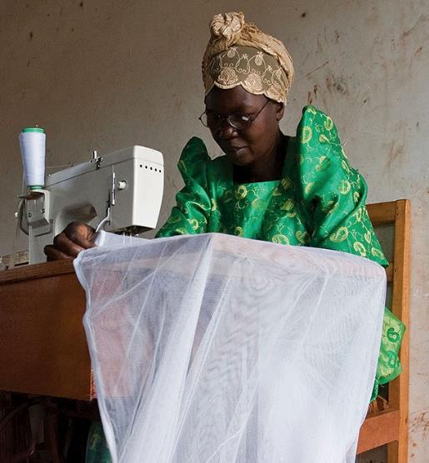
Health, Hunger, and Humanity (3-H)
105 YEARS OF DOING GOOD IN THE WORLD
Notes:
In addition to fighting disease and supporting education, 3-H grants:
Supplied food and milk to orphanages and hospitals in Romania
Provided sewing machines and training to women in Uganda, so that they could support themselves and their families
Built wells and sanitation systems in India, Bolivia, and many other parts of the world

Slide 27


2013: New grant model focuses on impact
The Foundation rolls out a simplified grant model that includes district and global grants. The matching grant, ambassadorial scholar, and Group Study Exchange programs are discontinued.

Slide 28
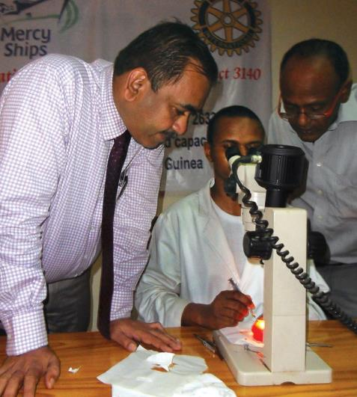
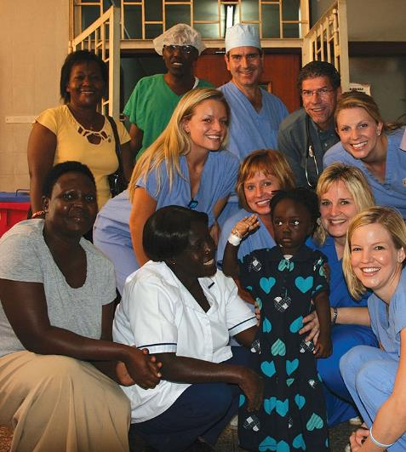
District Grants
Arun Chaudhadi
Salim Najar
106 YEARS OF DOING GOOD IN THE WORLD
Notes:
* District grants fund small-scale, short-term activities that address needs in local communities and communities abroad. Each district chooses which activities it will fund with these grants. Some districts choose to allocate smaller grants to support several club projects.
District grants can fund many kinds of district and club efforts, including:
* Humanitarian projects, including service travel and disaster recovery efforts
*

Slide 29
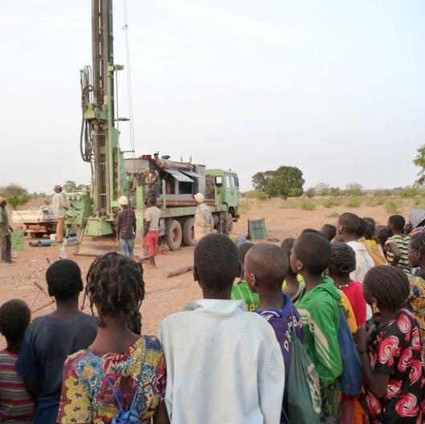
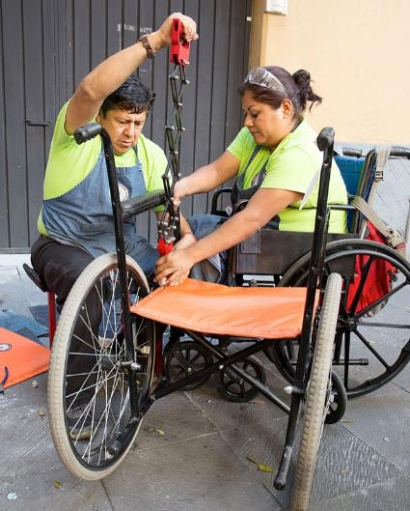
global Grants
106YEARS OF DOING GOOD IN THE WORLD
Notes:
Global grants support large-scale international activities with sustainable, measurable outcomes in one or more of Rotary’s seven areas of focus. Grant sponsors form international partnerships and work together to develop projects that respond to real community needs.
Global grants can fund:
Humanitarian projects
Scholarships for graduate-level academic studies
Vocational training teams
For example, the global grant project shown on the right supports a mobile repair shop that travels to cities in Mexico. Disabled workers employed by a project partner design, fabricate, and repair specialty wheelchairs and custom wheeled devices. Rotary clubs in each city coordinate permits, access to electricity, housing for workers, and marketing.
Another global grant in Burkina Faso, shown on the left, installed a well in an area where droughts are frequent and women and children had to walk several kilometers a day to get water. Many local residents watched the drilling continue through the night, excited by the promise of having clean drinking water.

Slide 30
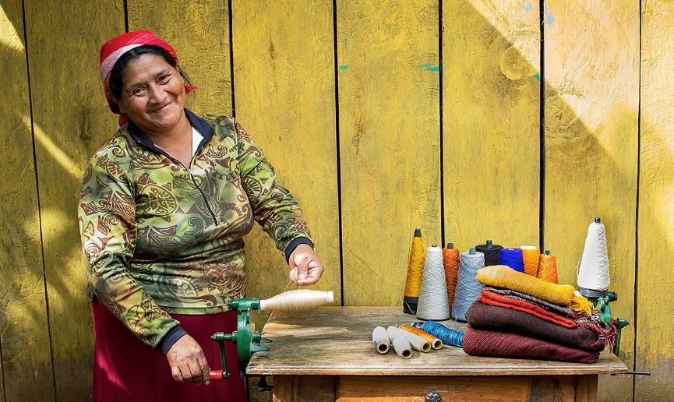
Global Grants
105 YEARS OF DOING GOOD IN THE WORLD
Notes:
A global grant such as the microcredit lending project sponsored by a Rotary club in Honduras and clubs from District 5340 in California, USA, helps poor women in Honduras become self-sufficient business owners.

Slide 31
Health, Hunger, and Humanity (3-H) Grants — 1978
The 3-H Grants program approved in 1978 was designed to support larger projects.
It allowed Rotarians to think big.
It was the introduction of this program that created the opportunity to address polio

Slide 32
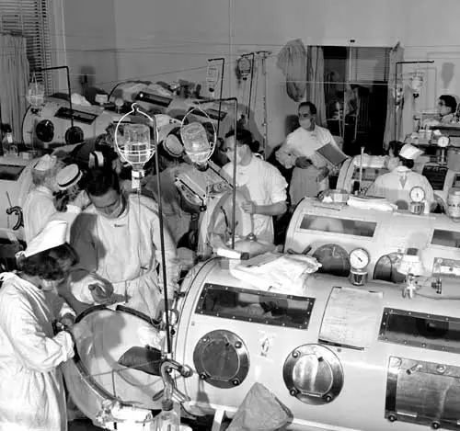
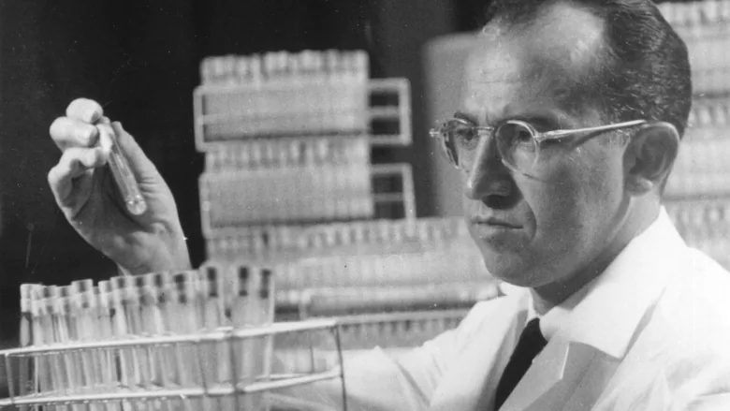
The Dreaded Polio
Dr Jonas Salk develops the polio vaccine in 1955
Notes:
In the 1920’s through to the 1950’s waves of polio affected thousand each year. The introduction of the polio vaccine developed by Dr Jonas Salk in 1955 saw Canada’s last case of polio in 1977 and the USA’s in 1979. The developed world was successful in quelling the disease but not in the rest of the world.
In 1978, Rotary had a committee, appointed by R.I. President Clem Renouf, to design a new direction for Rotary. It was called the Health, Hunger and Humanity Committee. This was a small committee to design a program for Rotary International to undertake projects far greater than any club or district could do. Rotary had never undertaken a corporate or worldwide project – just club programs. We knew that if we didn’t have an immediate success, the Rotary world would probably scrap the program the next year. So we looked for an “immediate success” project. We had about 16 projects proposed from around the world.

Slide 33
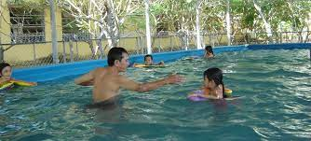
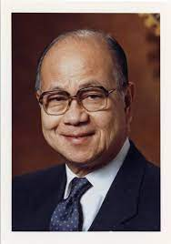
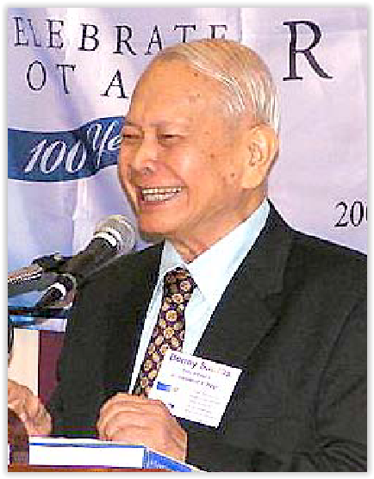
It started in the Philippines
Mateo A.T. Caparas President of Rotary International 1986-87
A law partner of Mateo A.T. Caparas, who later served as RI president in 1986-87 had two children catch polio after swimming in a pool. Mateo visited an old friend of his PDG Dr Bernie Santos of the Rotary Club of Malolos, Malolos was the village Mateo had grown up in along with Dr Santos. This sparked the desire to eradicate polio in the Philippines.
Dr. Sabino S. “Benny” Santos a PDG and Past Vice President of Rotary International secured the 3-H grant which funded vaccine for 6 million children. He organized the Rotary Clubs in the Philippines to make the program happen
Notes:
. One proposal was from the Philippines. Dr. Benny Santos wrote that if Rotary could provide the vaccine, they would mobilize all the Rotarians in the entire Philippines and immunize all the children. So, that was it. The project was approved and some 6 million children were immunized against polio. It was a huge success
On 29 September 1979, volunteers administered drops of oral polio vaccine to children at a health center in Guadalupe Viejo, Makati, Philippines. The event in metropolitan Manila was arranged and attended by Rotarians and delegates from the Philippine Ministry of Health. Mateo Caparas spoke at the event.
"We are here to mark the beginning, a very small beginning, of what we hope will be a great thing — the total eradication from the face of the earth of a dreaded disease, poliomyelitis," he said. "Great things always have a small beginning. When Paul Harris founded Rotary almost 75 years ago, there were just four people, and yet that organization which he founded has now flourished to cover 153 countries. It is our hope that in this small beginning, we would have, as I said, the great thing — the eradication of one of the scourges of mankind."

Slide 34
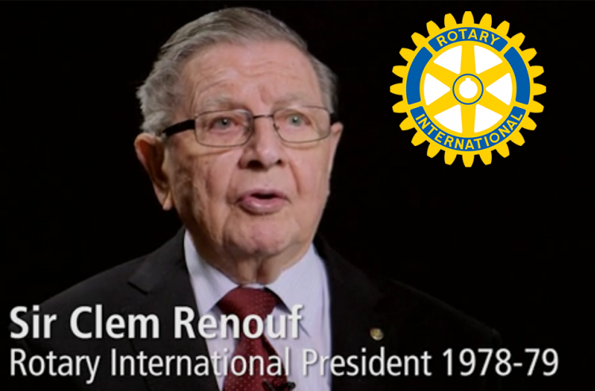
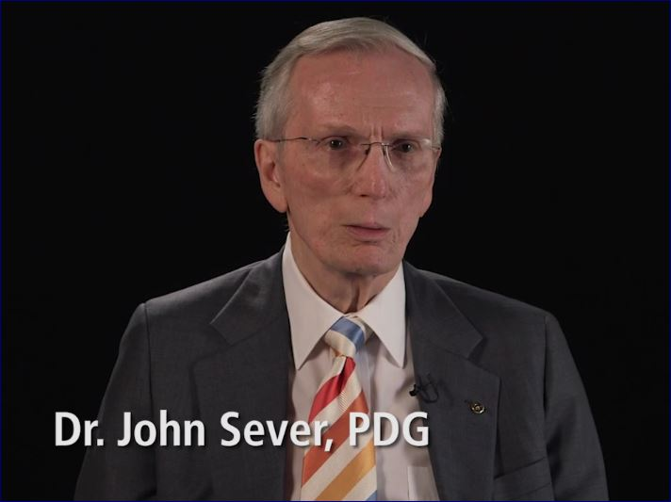
Two Men had a Vision to Eradicate Polio Worldwide
Notes:
In early 1979, on a flight home from the Philippines, Renouf read a magazine story about the eradication of smallpox. He wondered if Rotary’s new Health, Hunger and Humanities (3-H) Grants could be used to eliminate another disease. They, for the first time, allowed Rotary projects to be taken on by more than just one club or district.
Renouf consulted with a friend, John Sever, who was a district governor in Maryland, USA, and chief of infectious diseases at the United States National Institutes of Health. Sever happened to be friends with Jonas Salk and Albert Sabin, who developed polio vaccines in the 1950s and 1960s. After doing some research, Sever said that polio would be the best disease for Rotary to work on.
“Clem then set his sights on polio eradication as a Rotary worldwide project,
In November 1979, the RI Board agreed to set the eradication of polio as a primary goal of the 3-H program.
Renouf was instrumental in raising funds for the early effort. “In order to raise money, Clem asked all the clubs to contribute some cash, which was about $15 per member, for service projects, and the appeal raised the surprising amount of $7 million,” “Part of that money was then used to fund the first polio immunization project in the Philippines … The success was real

Slide 35
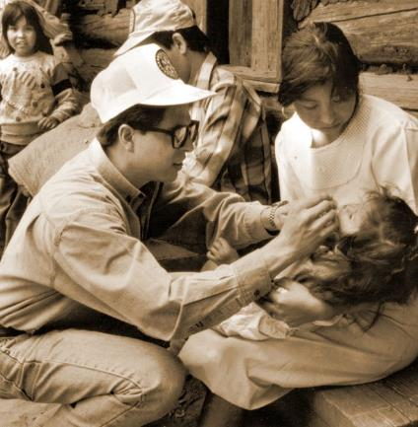
PolioPlus — 1985
1980
Rotary’s Council on Legislation endorses a proposal to “eliminate polio through immunization”
Immunization efforts continue as part of the 3-H program
1985
PolioPlus is launched
106 YEARS OF DOING GOOD IN THE WORLD
Notes:
The project in the Philippines was just the beginning.
The 1980 Council on Legislation endorsed a proposal from the RI Board to “eliminate polio through immunization.” This allowed Rotary to promote immunization without violating a 1923 decision that prohibited “corporate projects.”
Projects in Mexico and South America convinced the World Health Organization Rotary would belong term partner
In 1984, the RI Board made a series of decisions that resulted in what we now know as the PolioPlus program and established a fund to support it. Initially, the program was called Polio 2005, in reference to a goal of immunizing all the world’s children by 2005.
Rotary leaders announced these ambitious plans in early 1985, and later that year, they introduced the program’s new name: PolioPlus. The “Plus” initially referred to the additional vaccines that were administered along with polio vaccine. Today, it also reflects the idea that the infrastructure, fundraising, and advocacy methods implemented by the polio eradication effort will support future battles against infectious disease.

Slide 36
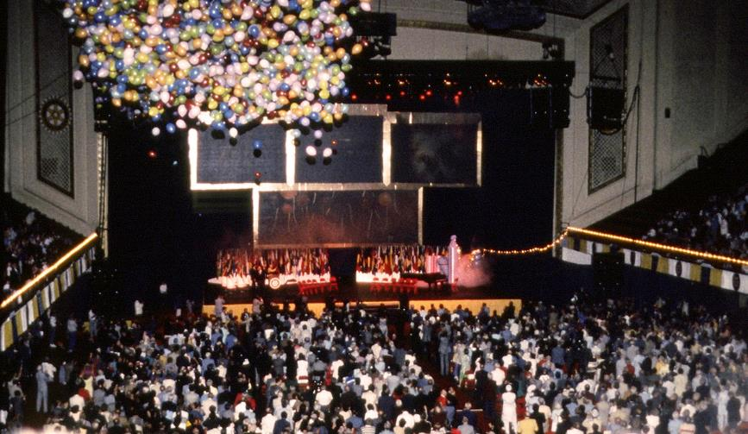
PolioPlus Campaign — 1980s
106 YEARS OF DOING GOOD IN THE WORLD
Notes:
Rotary began a three-year fundraising campaign with a goal of raising $120 million. The campaign focused on educating club members about the need to eradicate polio and the many benefits of a polio-free world. Rotary leaders met with other nongovernmental organizations and government officials to convince them of the feasibility of their goal and gain their support.
The campaign raised $247 million, more than double the goal. The effort was the first of its kind in Rotary’s history, and the occasion was celebrated at the 1988 Rotary convention in Philadelphia, Pennsylvania, USA.

Slide 37
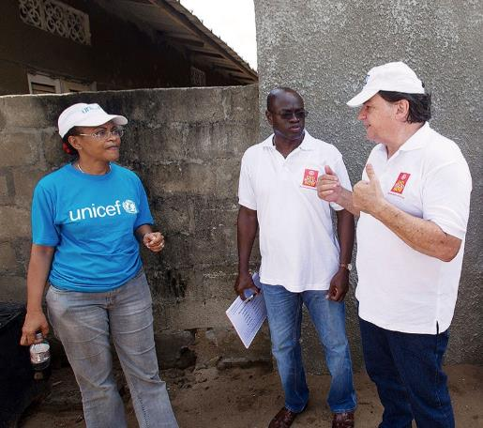
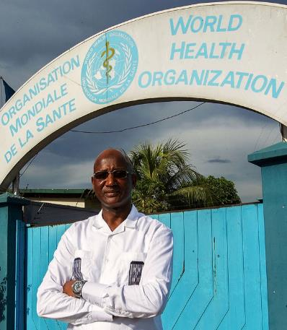
Global Polio Eradication Initiative — 1988
105 YEARS OF DOING GOOD IN THE WORLD
Notes:
Rotary’s early efforts set the stage for the formation of the Global Polio Eradication Initiative (GPEI) in 1988. ** True story” Originally we approached WHO…. Finally, t The GPEI’s original members were Rotary, the World Health Organization (WHO), the U.S. Centers for Disease Control and Prevention (CDC), and UNICEF.
At that time, 350,000 children were afflicted by polio every year. Today, that number has been reduced by 99.9 percent, and polio is endemic in only two countries — Afghanistan and Pakistan.
Over the years, others have joined the effort, including the Bill & Melinda Gates Foundation and governments throughout the world. Rotary continued its fundraising efforts and as of 2015 had contributed more than $1.5 billion to the eradication effort. In addition, Rotary’s advocacy has resulted in contributions of over $9 billion from world governments.

Slide 38
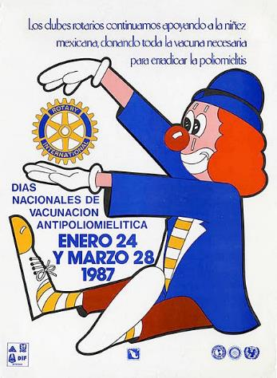
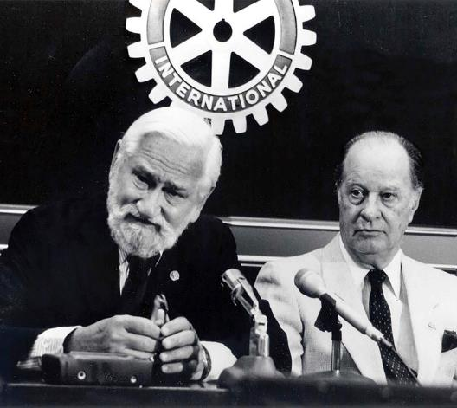
National Immunization Days
106 YEARS OF DOING GOOD IN THE WORLD
Notes:
* The polio eradication initiative owes much of its success to its adoption of mass immunizations, which were advocated by Dr. Albert Sabin (shown at left in the photo), who developed the oral polio vaccine, and Rotary leaders and physicians Carlos Canseco (shown at right in the photo) and D-7620 PDG Dr. John Sever – 1978-1979.
* For a typical National Immunization Day, or NID, thousands of immunization posts are set up throughout a country. Health workers and volunteers immunize millions of children in one day. In what’s known as social mobilization, both during the NID and before, volunteers hang posters, distribute handbills, and even ride through the streets with bullhorns to urge parents to bring all children younger than five to be vaccinated.
Those who receive the oral polio vaccine have their fingers marked with indelible ink. Over the following few days, health workers go from home to home, administering vaccine to eligible children with unmarked fingers. The process is repeated once a few months later, and then again, with the goal of reaching every child under age five every time.

Slide 39
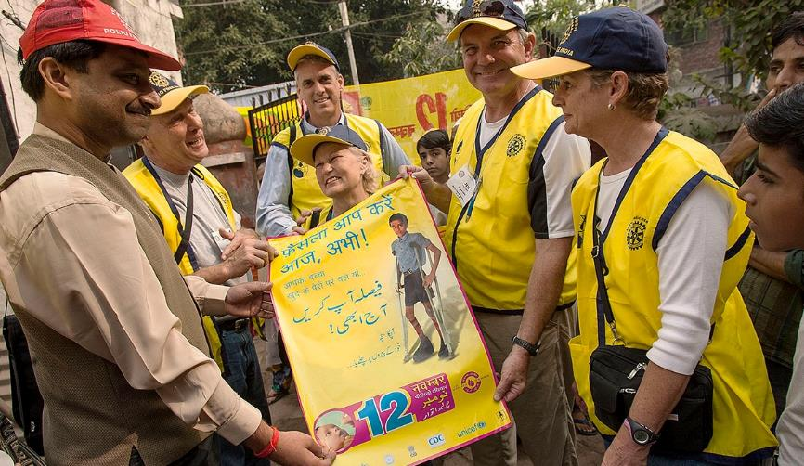
POLIOPLUS PARTNERS – 1995
105 YEARS OF DOING GOOD IN THE WORLD
Notes:
* The social mobilization that precedes an NID is critical to the success of mass immunizations. In 1995, the Foundation launched the PolioPlus Partners program to support social mobilization for National Immunization Days.
* Through PolioPlus Partners, a network of regional and national PolioPlus committees determine what supplies are needed, such as vaccine carriers, banners, brochures, and PolioPlus T-shirts, aprons, and caps to identify members of vaccination teams. The national committee chairs distribute the list, and the program provides funding.
* When India prepared for its first National Immunization Days in 1995, it identified a need for hundreds of aprons for volunteers. Japanese Rotarians contributed enough funds to buy not only aprons but also caps, posters, banners, and vaccine carriers. Indian Rotarians mobilized about 100,000 volunteers to publicize the upcoming immunizations and administer the vaccine.
In 2018, PDG Ken Solow 2015-2016 was the Producer of the Polio Documentary “Dare to Dream”. View this film https://daretodreamfilm.com/

Slide 40
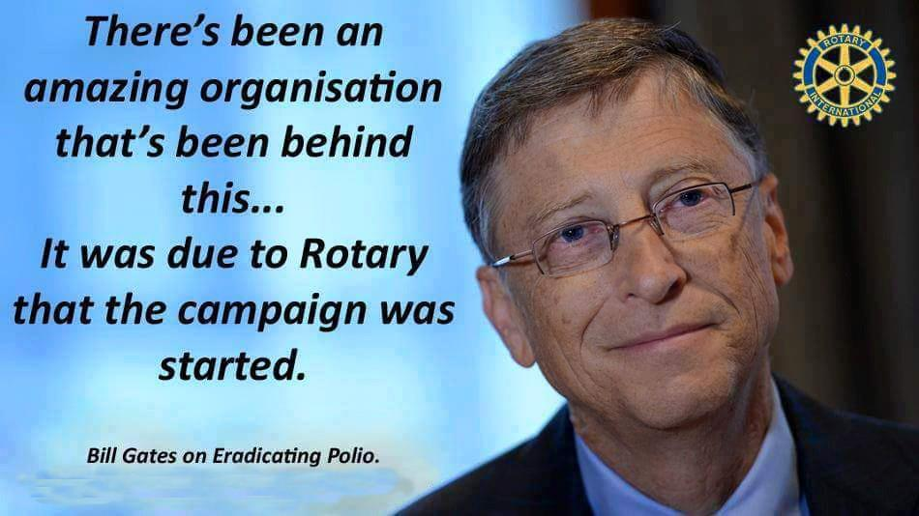

Slide 41
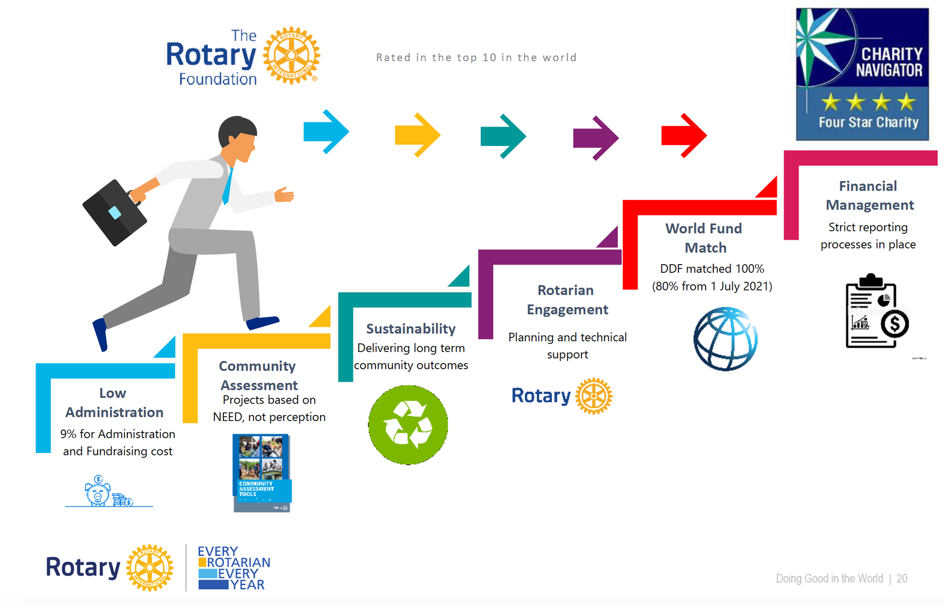
A Trusted Charity
Notes:
The Rotary Foundation has evolved from it’s first donation of $26.50 to becoming one of the best charities in the world.

Slide 42

Questions

