Slide 1


Slide 2
How the Foundation Works
This presentation is intended to give you an understanding of the mechanics of the Rotary Foundation, how it works. How the money flows, how it is managed, how it is disbursed, how you can contribute and how you can see your contributions. We want to make it a lot more understandable than the image on the right and open up the black box.

Slide 3
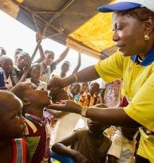


The Rotary Foundation’s Mission
The mission of The Rotary Foundation is to enable Rotarians to advance world understanding, goodwill, and peace through the improvement of health, the support of education, and the alleviation of poverty.
106 YEARS OF DOING GOOD IN THE WORLD
Notes:
Have attendee read the Mission:
Did you know Rotarians are the ENGINE The Rotary Foundation for Rotary’s humanitarian activities, from clubs’ and districts’ local service projects to global initiatives. Rotary also leads the ongoing international effort to eradicate polio worldwide.
Our Foundation is able to achieve its mission through the generous contributions and active participation of Rotarians and friends of Rotary.

Slide 4
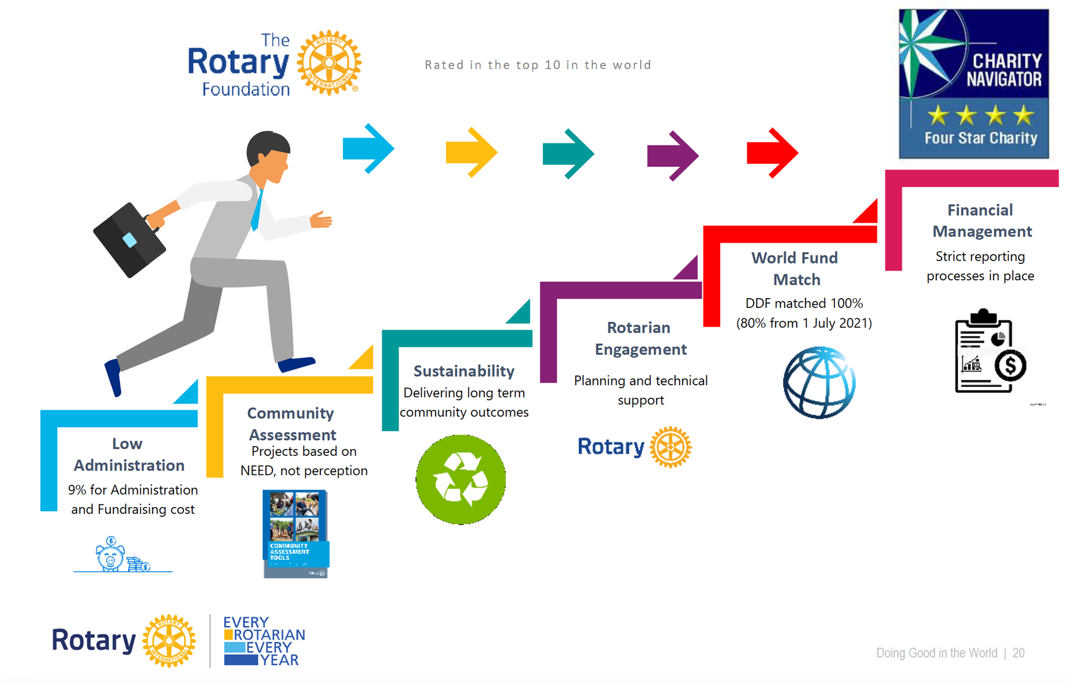
A Trusted Charity
Notes:
The Foundation has very low administration costs
All global projects must have a community needs assessment ensuring projects meet a real need
Projects must be sustainable, we do not want a project that fails after implementation due to the lack of local support or training
Rotarians must be involved
The world fund matches 80% of the DDF contributed by districts
There is rigorous tracking of project implementation and funds

Slide 5

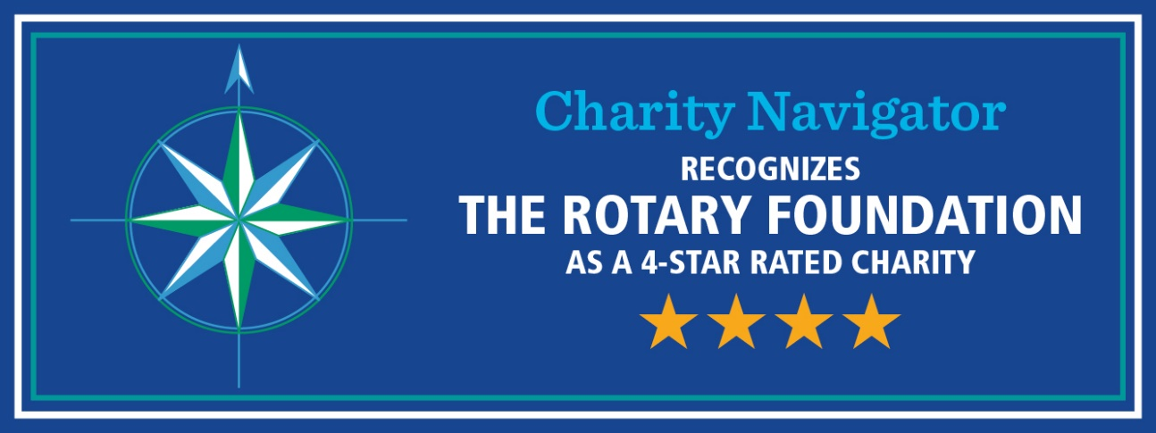
Did You Know This?
Do you realize that Rotarians ALONE are the source of funds to the Annual Fund that come back to the district to support our Community and Global grants.
Only 1% of the charities evaluated by Charity Navigator have received at least ten consecutive four-star evaluations.
Our efficiency is recognized 16 years consecutively by Charity Navigator.
108 YEARS OF DOING GOOD IN THE WORLD

Slide 6
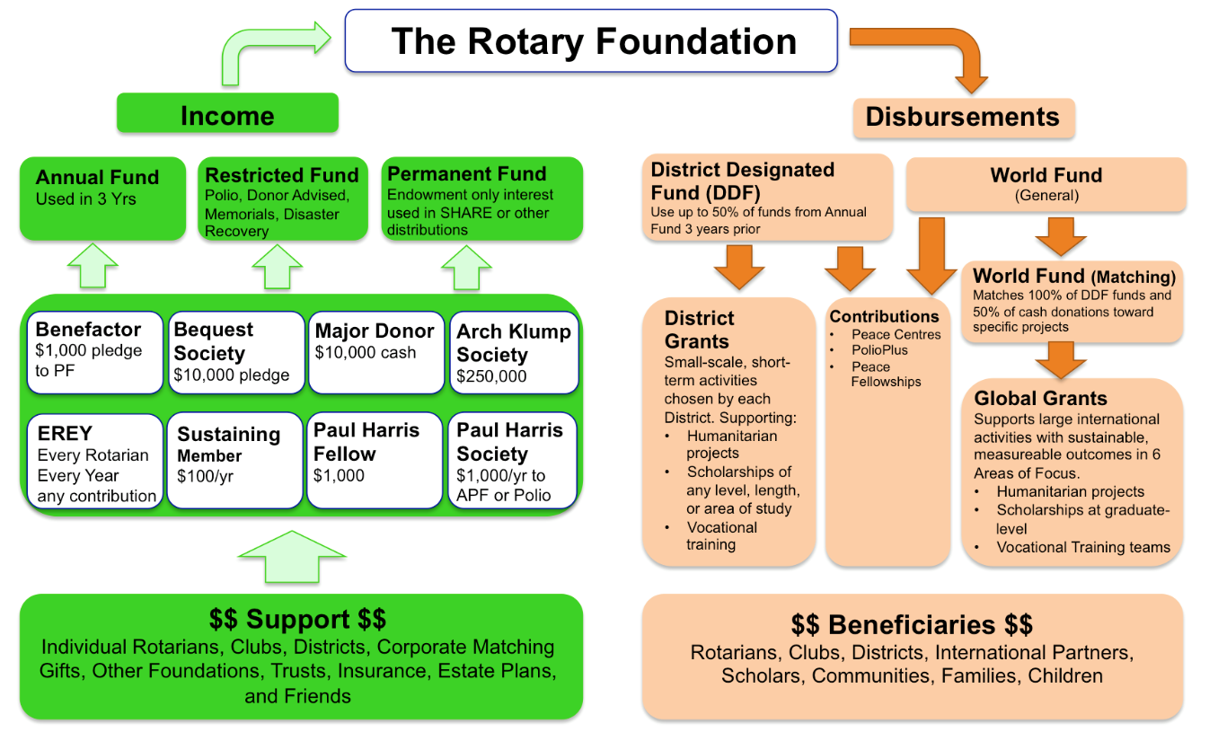
How the Money Flows
Matches 80% of District Designated Funds (DDF)

Slide 7



Our Rotary Foundation
Programs
- Polio
- Peace
Centers
- Grants
District
& Global
- Other Programs
Contributions
from
-Rotarians
- Rotary
Clubs
- Others
-Investments
PolioPlus
Annual Fund
DDF
47.5%
~ $100 M +
Held 3 years
World
Fund
47.5%
Operating Expense
5%
Endowment Fund
Earnings

Slide 8
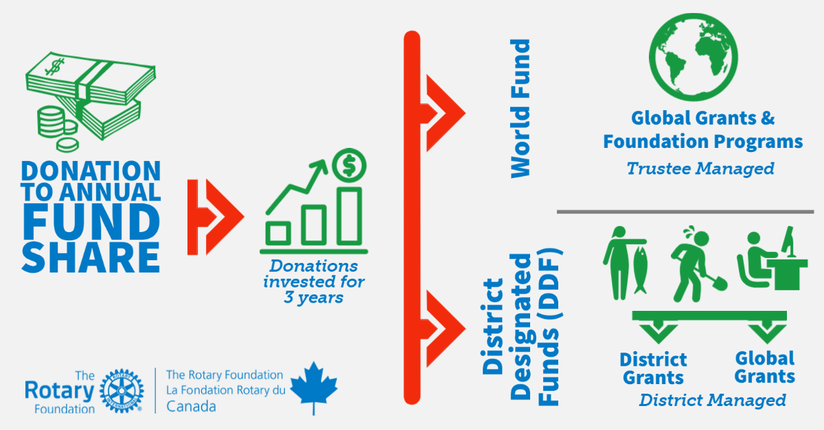
Who Manages the Grant Funds

Slide 9
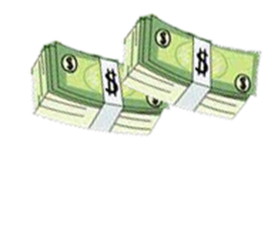
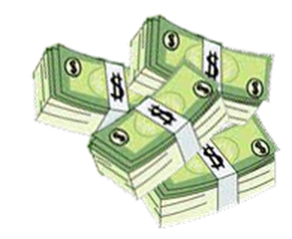
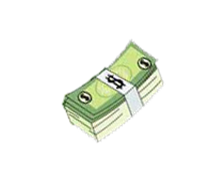

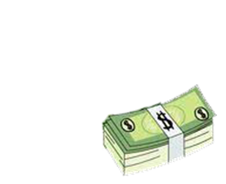
District Grant Funds available for 2025-26 ~ C$86,596
2022-2023
2025-2026
District Designated Funds (DDF) used for matching in Global Grants
3 years later
$63,209
47.5% Retained by
The Rotary Foundation The World Fund
(For Global Grants)
3 years later
$120,369
District Designated Funds (DDF) available
for District Grants
US$63,209
C$86,596*
Total Amount contributed
By D5040 clubs & individuals to the annual fund share
District Designated Funds are evenly split
$256,105
47.5% District Designated Funds, Global + District
Endowment Earnings add $6,050 for total $126,419
$120,369
Notes:
The District Designated Funds are held by the foundation and are available to spend 50% on Global Grants and 50% on district grants.
When we have enough approved District Grants to use at least 80% of the available funds, we create a spending plan showing all the district grant approved requests which we submit to the foundation. If approved we receive a block grant, the money is transferred to a district held grant account and we then disburse the funds.
Global Grant DDF are held by the foundation and distributed to approved projects
It is only through your contributions to the Annual Fund that we have money for grants.

Slide 10

Notes:
Global Grants are designed to focus the majority of the Foundation resources on larger, more sustainable projects that fall within the 7 areas of focus
Global grants are administered by the Rotary Foundation. You apply online through MyRotary. You must have a partner club in another district in another country. The minimum project budget is $30,000 and the maximum grant is $400,000.
Multiple clubs and districts may be involved. Clubs put up funds for a project, their district matches those funds from their District Designated Funds and then the Foundation matches 80% of the DDF.

Slide 11

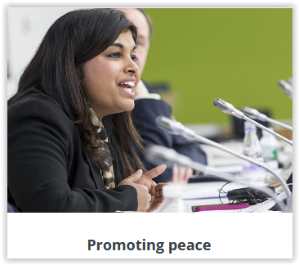
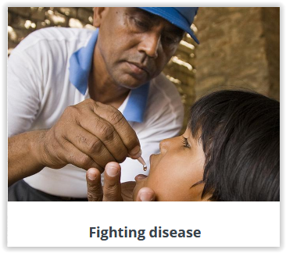
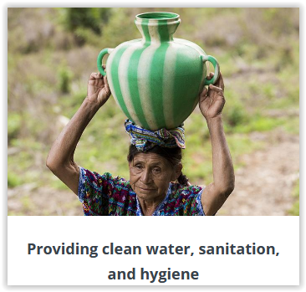
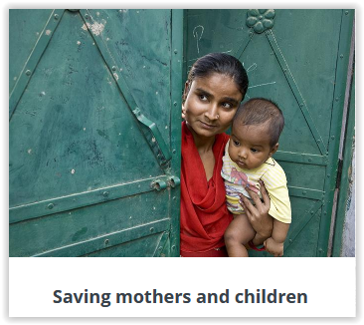



AREAS OF FOCUS
Global Grants can support projects in any of Rotary’s seven areas of focus
Supporting the Environment
Notes:
Global grants support large-scale international activities with sustainable, measurable outcomes in one or more of Rotary’s seven areas of focus. Grant sponsors form international partnerships and work together to develop projects that respond to real community needs.
Global grants can fund:
Humanitarian projects
Scholarships for graduate-level academic studies
Vocational training teams
Global Grants must be sustainable, which means they are designed and implemented so that the benefiting community can maintain long-term solutions to community needs after the grant funding ends.

Slide 12

Notes:
District grants fund small-scale, short-term projects that address needs in local communities and communities abroad. Each district chooses which projects it will fund with these grants. Some districts choose to allocate smaller grants to support several club projects.
Applications for district grants are done online through our district 5040 website
Any member applying for a district grant must participate in a district grant training session

Slide 13



ROTARY FOUNDATION GRANTS
These two guides, both available on the District 5040 website, member area, Grants, Documents. Reviewing these should be your first step in applying for a grant
Notes:
A must read for someone considering a Grant.

Slide 14
Ways to Support the Foundation
Annual Fund
Endowment Fund - Named Endowment
Polio Plus Fund
The Rotary Foundation
Restricted Giving – approved Global Grant
Planned Giving Benefactor / Bequest
Restricted Giving – Disaster Response Fund

Slide 15
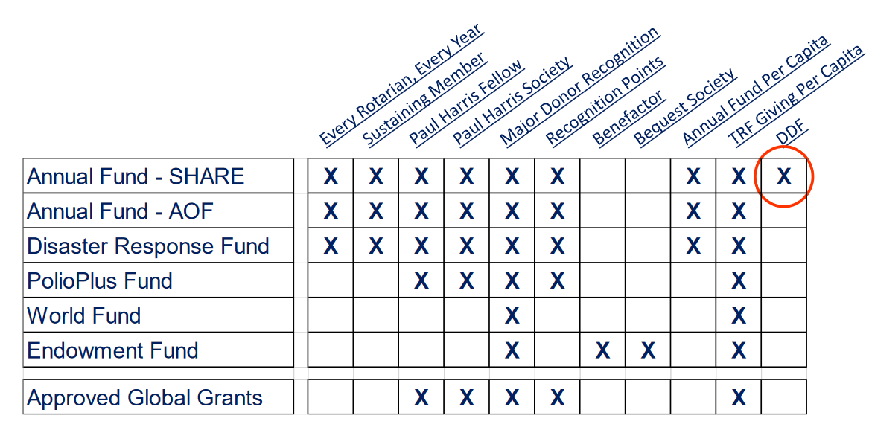
What Counts for What
Notes:
Note that only funds contributed to the Annual Fund Share result in district designated funds which come back to the district after three years

Slide 16
MEANINGFUL WAYS TO GIVE
Rotary Foundation Sustaining Member
When you give $100 or more per year to the Annual Fund.
Paul Harris Fellow
Become a Paul Harris Fellow when your cumulative donation level hits $1,000
When you give additional gifts of $1,000 or more to the Annual Fund, PolioPlus, or an approved Foundation grant.
Benefactor
When you include the Endowment Fund as a beneficiary in your estate plans or when you donate over $1,000 and less than $10,000 to the fund outright.

Slide 17
AS YOUR GIVING ACCELERATES
Bequest Society
When you make a commitment for future gifts of $10,000 or more to The Rotary Foundation, you’ll be invited to join the Bequest Society.
Major Donor
When your cumulative donations reach $10,000.
Level 1: $10,000 to $24,999
Level 2: $25,000 to $49,999
Level 3: $50,000 to $99,999
Level 4: $100,000 to $249,999

Slide 18
Substantial Commitment’s to The Rotary Foundation
Arch Klumph Society
When your cumulative donations reach $250,000. Recognition includes an induction ceremony and your picture and biography in the Arch Klumph Society interactive gallery at the Rotary International headquarters in Evanston, Illinois, USA.
  Trustees Circle: $250,000 to $499,999
  Chair’s Circle: $500,000 to $999,999
  Foundation Circle: $1,000,000 to $2,499,999
  Platinum Trustees Circle: $2,500,000 to $4,999,999
  Platinum Chair’s Circle: $5,000,000 to $9,999,999
  Platinum Foundation Circle: $10,000,000 and above
Legacy Society
When you promise a gift of $1 million or more to the Endowment, you’ll be listed in Rotary’s annual report and invited to exclusive Rotary International and Foundation events.

Slide 19
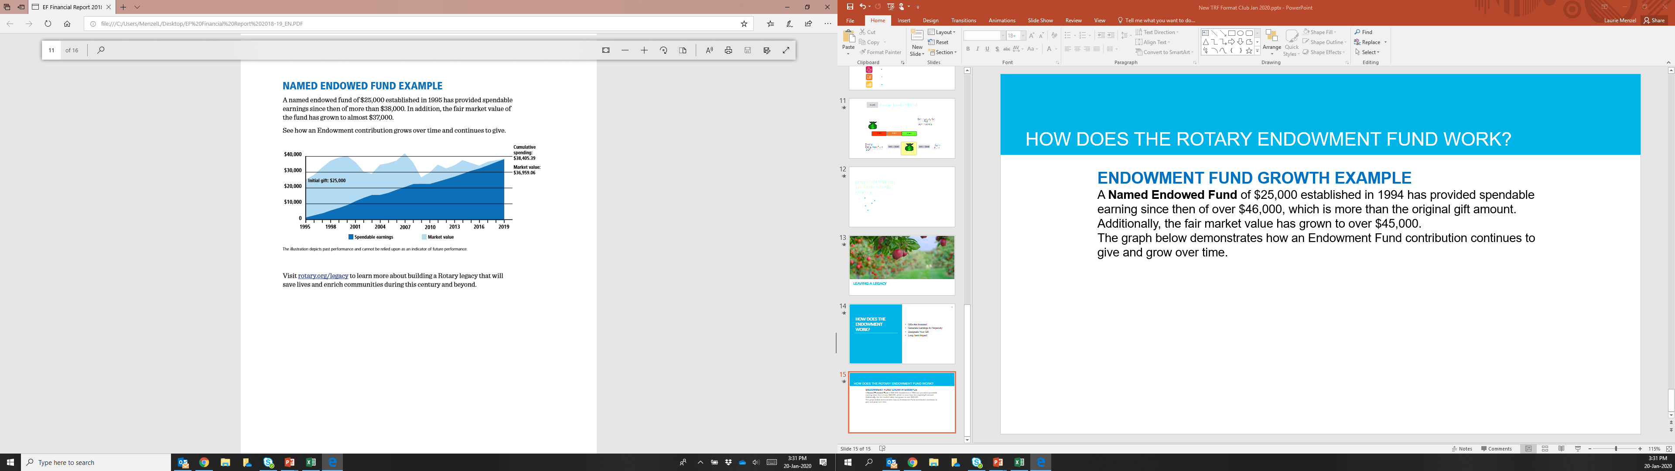
Named Endowed Fund
A Named Endowed Fund of $25,000 established in 1994 has provided spendable earning since then of over $38,000, which is more than the original gift amount. Additionally, the fair market value has grown to over $36,000.The graph demonstrates how an Endowment Fund contribution continues to give and grow over time.
Notes:
) Rotary strives to increase the value of your gift to the Endowment by preserving and investing your initial contribution and spending only a portion of the earnings. This strategy supports Rotary's causes today while generating funds that will further the work of future Rotarians committed to Doing Good in the World.
As with the Annual Fund, there are a number of ways to designate a gift within the Endowment Fund.
Earnings from gifts to EF-SHARE are split, with 50% going to World Fund and 50% going to District Designated Funds for the donor’s district. The difference is that with Annual Fund, the DDF portion of the gift will be applied one time. With Endowment Fund Share, the earnings from the gift are split each year. This means that although that yearly DDF amount is smaller than it would be with an AF gift, the DDF will continue to be given to the district every year as long as The Rotary Foundation exists. This like being a Paul Harris Society member forever. Donors may also choose to designate their Endowment Fund earnings to the World Fund, for Trustees to choose how to spend it. There are also options for the Rotary Peace Centers and for the Areas of Focus

Slide 20

Consider Including a Bequest to Rotary in your Estate Plans
Notes:
We can help with the process. Del Paterson is our major gifts officer

Slide 21
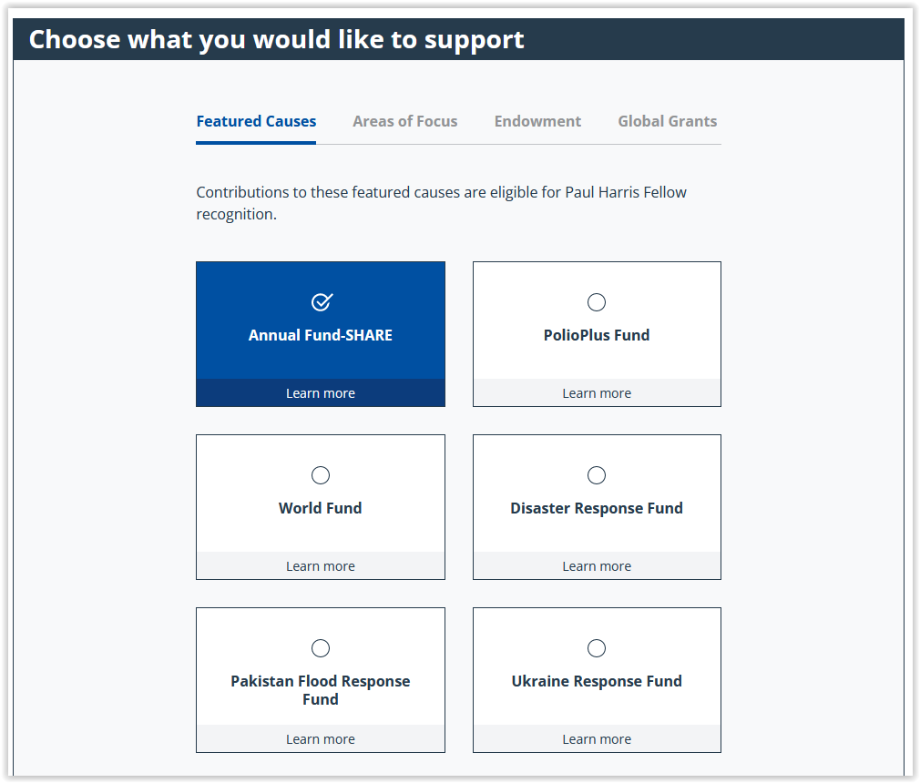
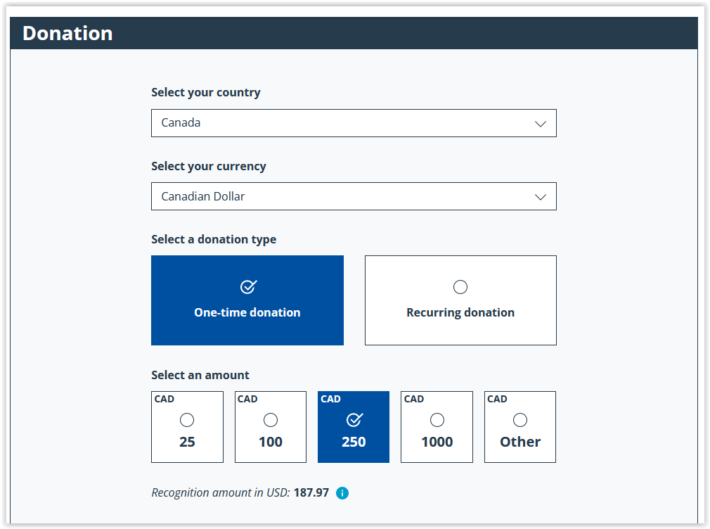
Donate on-line through the Rotary Foundation or on MyRotary

Slide 22
Rotary Direct
Regular and automatic giving to The Rotary Foundation
You subscribe to Netflix and Prime, why not subscribe to Humanity
with Rotary Direct?
Reasons for using TRF’s recurring giving program:
  Donor is connected directly to their giving (Deductions through dues are not always understood.)
  Club convenience! Club leadership work is minimized.
  Signing up once ensures continuous support.
  Signing up is simple. Recurring payments can be through a credit card. Set up online, on the phone, or by mail.
  It’s easier to give smaller amounts in more frequency.
  It’s efficient! It reduces TRF administration and marketing costs.
  Its secure! It’s the safest and most secure way to contribute.
  Making changes is easy! It’s easy to changes right on the RI website.
  Increasing the recurring amount gradually is less of a burden.
  Tracking the history by the giver giving is easy on the RI website.

Slide 23
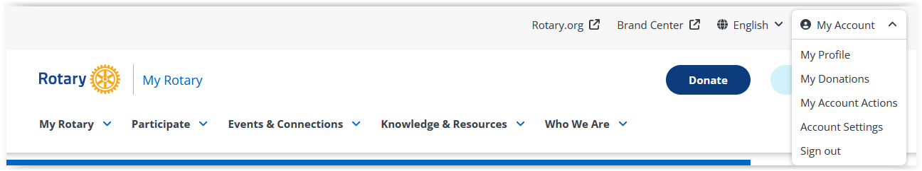
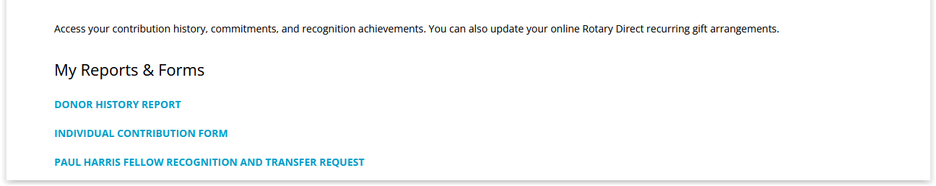
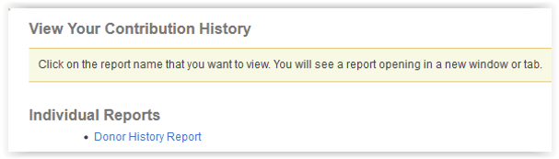
How to View Your Donor History
1
2
3
4

Slide 24
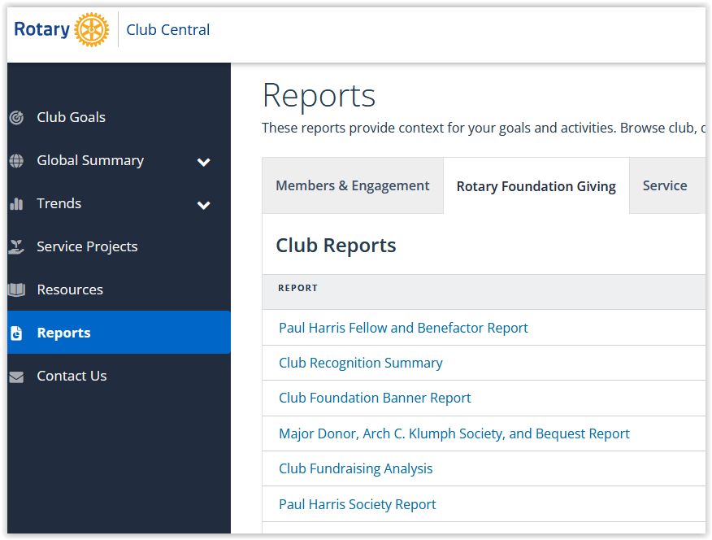

Slide 25
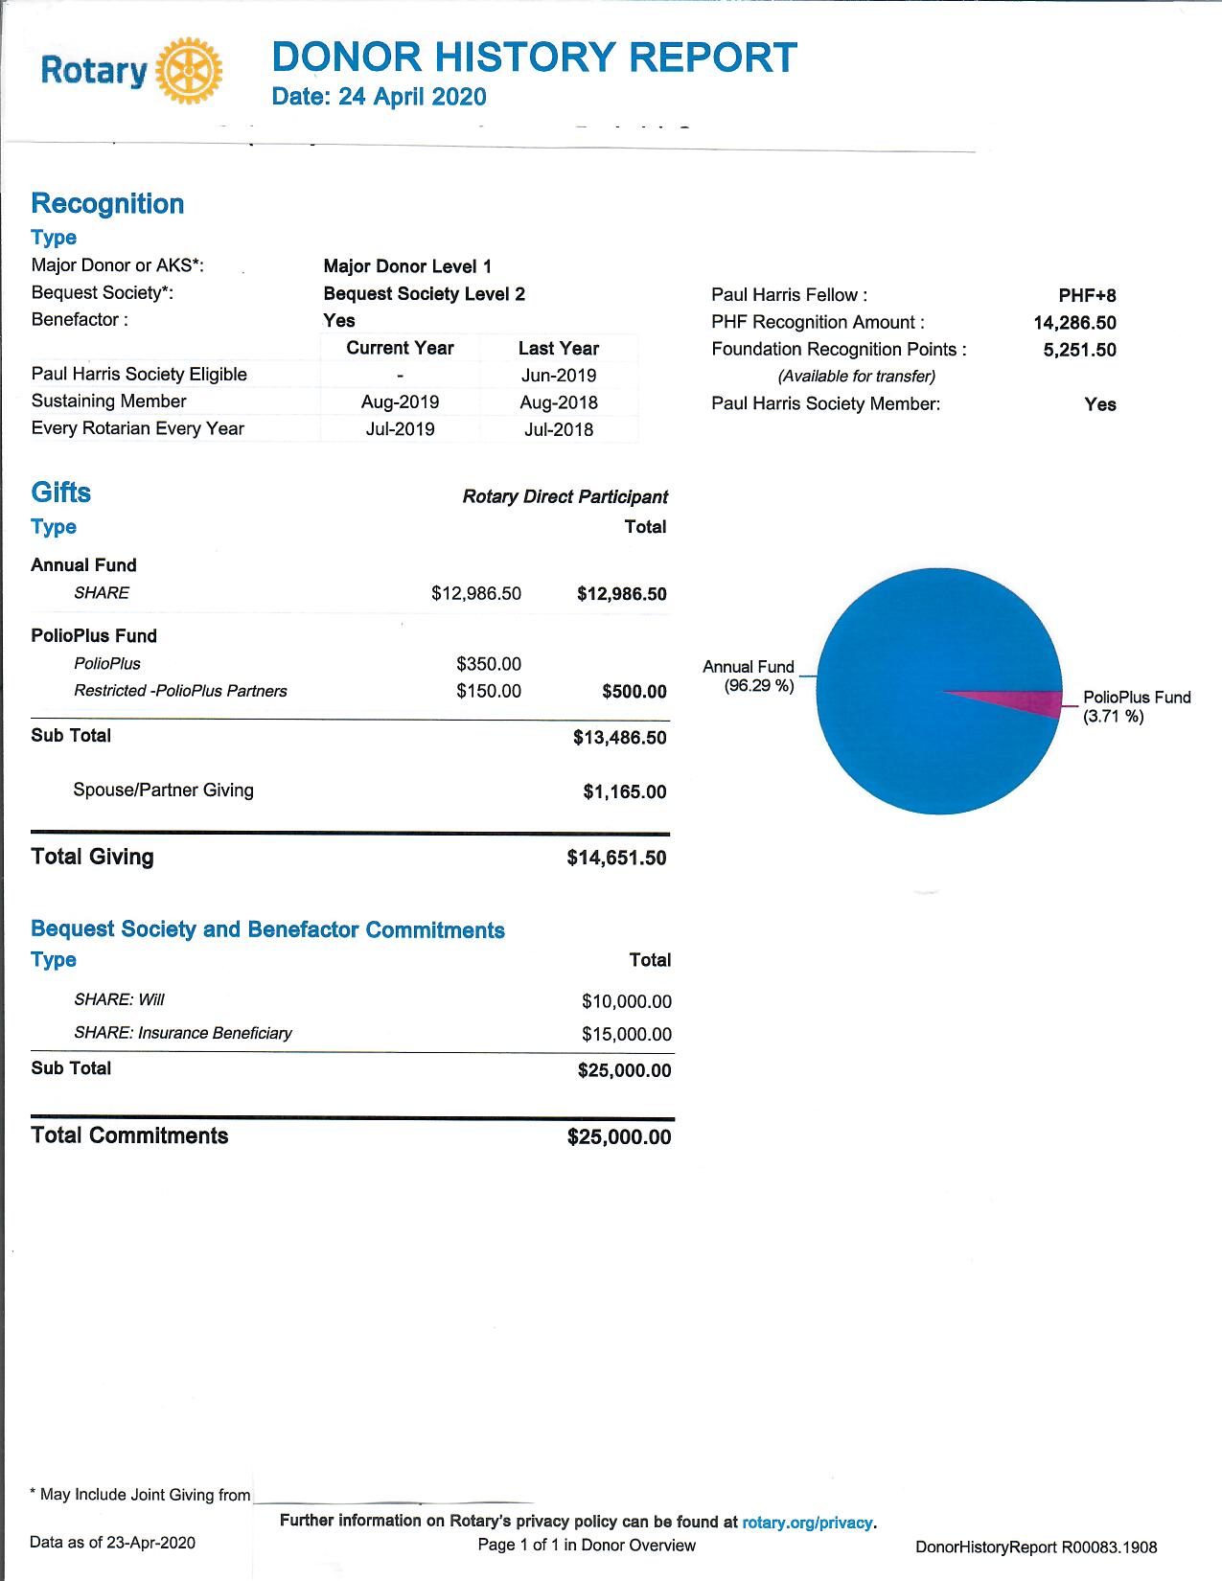

Slide 26

Questions

