Slide 1


Slide 2
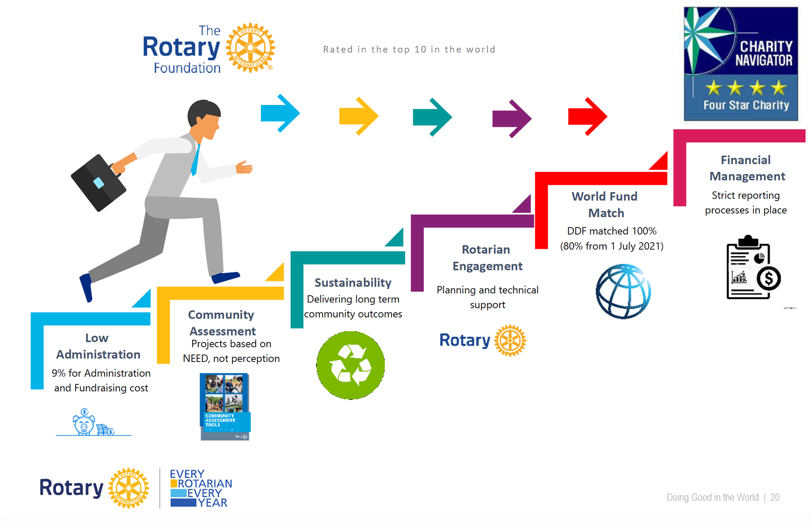
A Trusted Charity
Notes:
The Foundation has very low administration costs
All global projects must have a community needs assessment ensuring projects meet a real need
Projects must be sustainable, we do not want a project that fails after implementation due to the lack of local support or training
Rotarians must be involved
The world fund matches 80% of the DDF contributed by districts
There is rigorous tracking of project implementation and funds

Slide 3
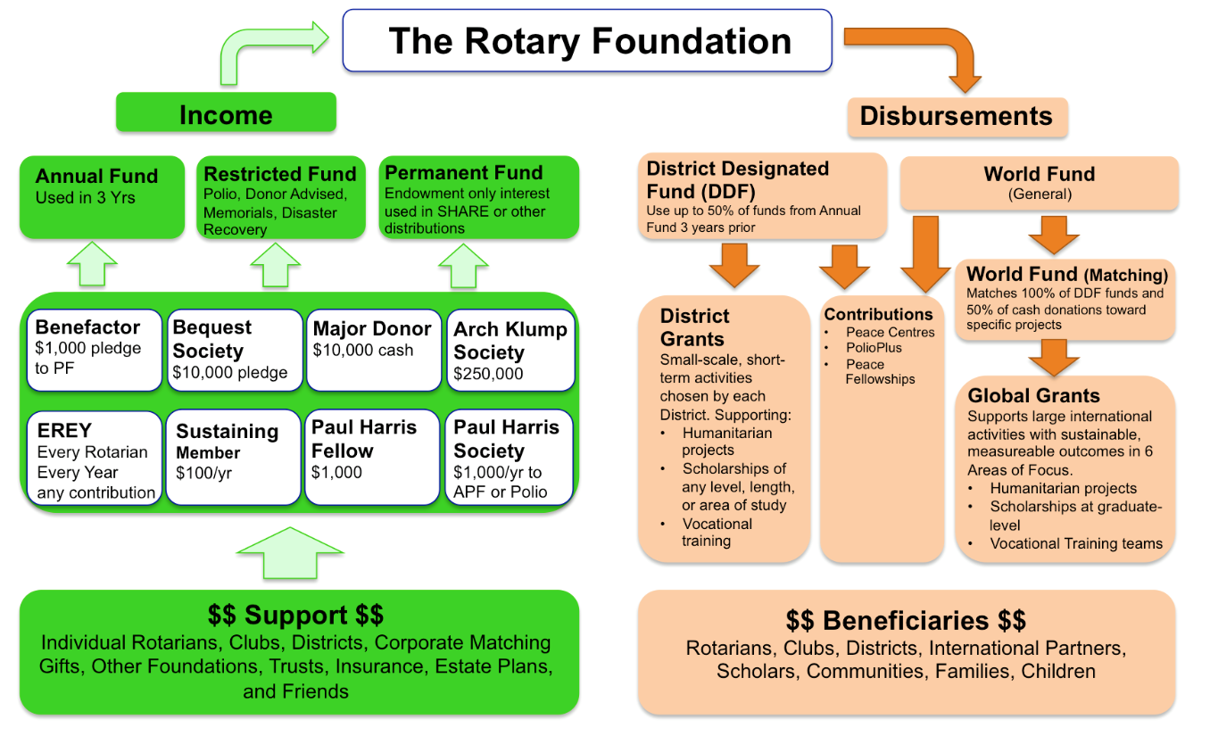
How the Money Flows

Slide 4


Did You Know This?
Do you realize that Rotarians ALONE are the source of funds to the Annual Fund that come back to the district to support our Community and Global grants.
Only 1% of the charities evaluated by Charity Navigator have received at least ten consecutive four-star evaluations.
Our efficiency is recognized 16 years consecutively by Charity Navigator.
108 YEARS OF DOING GOOD IN THE WORLD

Slide 5

The Rotary Foundation reached several major milestones in 2024-25 that will expand our reach and increase our impact
Together, we raised more than $569 million (unaudited) in gifts and commitments, surpassing our ambitious $500 million goal. Donors strengthened our future by contributing to the Endowment resulting in net assets and commitments of $2.050 billion as of 30 June 2025, exceeding our $2.025 billion by 2025 campaign goal! This generosity ensures that we will keep Doing Good in the World for generations to come.
Thanks to you, we’ve been achieving meaningful change. In 2024-25, The Rotary Foundation was able to: Award 1,424 global grants, 468 district grants, and 74 disaster response grants
Renew our agreement with the Gates Foundation, recommitting to the fight to end polio
Award the Programs of Scale grant to an initiative that works to build peace in Colombia
Partner with Symbiosis International University to create a Rotary Peace Center in India

Slide 6
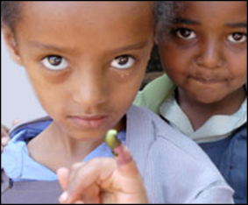
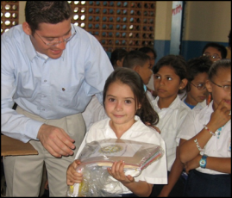
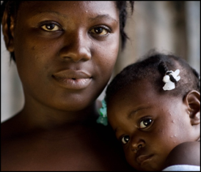
SUPPORTING THE ROTARY FOUNDATION
PolioPlus Fund
End Polio Now
Annual Fund
For Support Today
Endowment Fund
To Secure Tomorrow
Notes:
Rotarians support our Foundation through:
The PolioPlus Fund, dedicated to global polio eradication
The Annual Fund, primary source of funding for Foundation grants and activities
The Endowment Fund, which supports the Foundation in perpetuity

Slide 7
Ways to Support the Foundation
Annual Fund
Endowment Fund - Named Endowment
Polio Plus Fund
The Rotary Foundation
Restricted Giving – approved Global Grant
Planned Giving Benefactor / Bequest
Restricted Giving – Disaster Response Fund

Slide 8
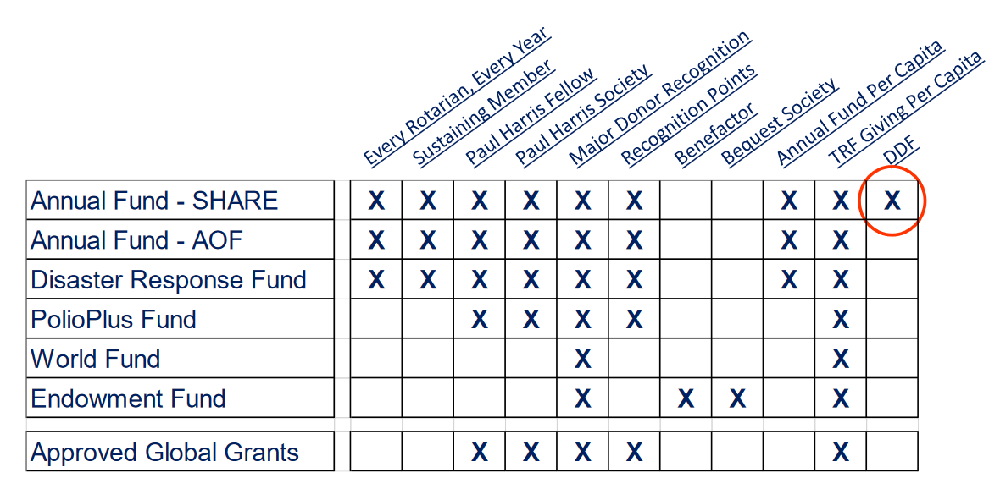
What Counts for What

Slide 9



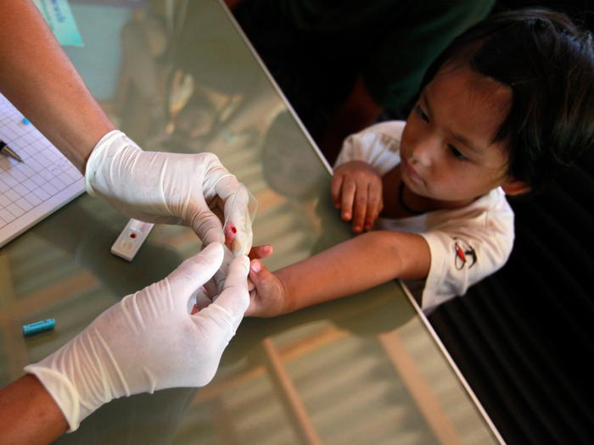

$100 Helps Provide
Two desks for a school in Honduras
School Supplies
50 mosquito nets for women and children in Tanzania
Malaria Tests
Water hygiene training

Slide 10
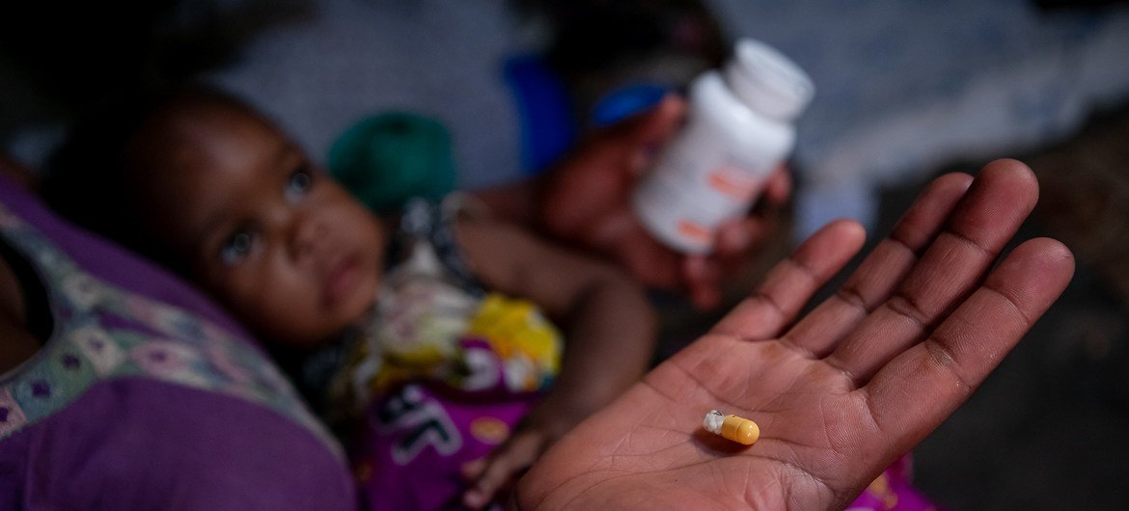

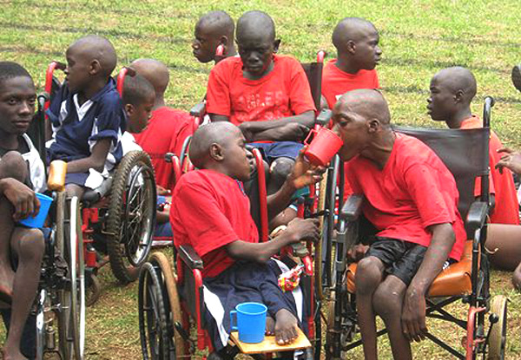

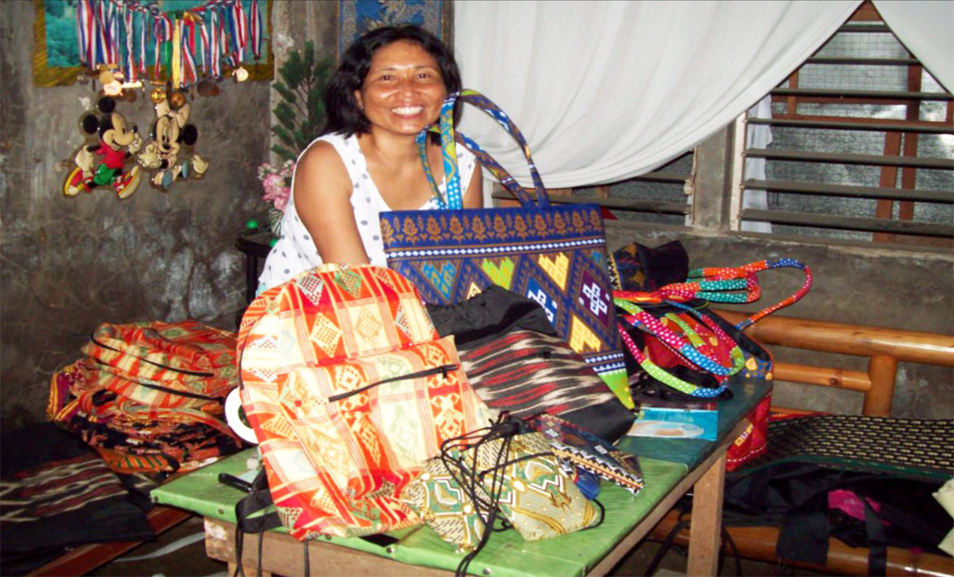
$1,000 helps provide
HIV Retroviral Drugs
400 pairs of eyeglasses for individuals in Nigeria
Mobility for disabled youth
Domestic abuse education
Microcredit loans for 23 women in the Philippines

Slide 11
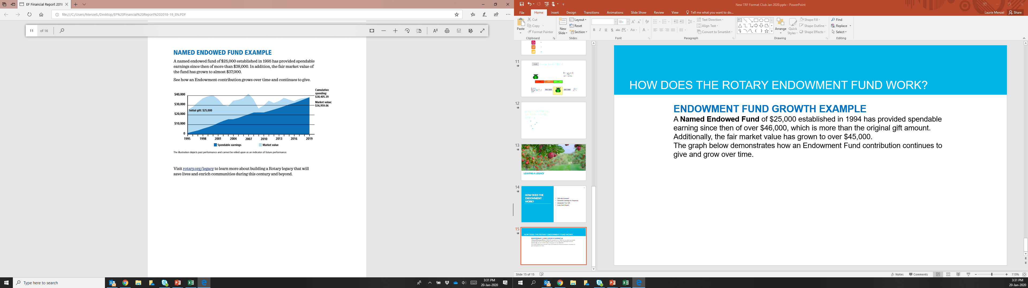
Named Endowed Fund
A Named Endowed Fund of $25,000 established in 1994 has provided spendable earning since then of over $38,000, which is more than the original gift amount. Additionally, the fair market value has grown to over $36,000.The graph demonstrates how an Endowment Fund contribution continues to give and grow over time.
Notes:
) Rotary strives to increase the value of your gift to the Endowment by preserving and investing your initial contribution and spending only a portion of the earnings. This strategy supports Rotary's causes today while generating funds that will further the work of future Rotarians committed to Doing Good in the World.
As with the Annual Fund, there are a number of ways to designate a gift within the Endowment Fund.
Earnings from gifts to EF-SHARE are split, with 50% going to World Fund and 50% going to District Designated Funds for the donor’s district. The difference is that with Annual Fund, the DDF portion of the gift will be applied one time. With Endowment Fund Share, the earnings from the gift are split each year. This means that although that yearly DDF amount is smaller than it would be with an AF gift, the DDF will continue to be given to the district every year as long as The Rotary Foundation exists. This like being a Paul Harris Society member forever. Donors may also choose to designate their Endowment Fund earnings to the World Fund, for Trustees to choose how to spend it. There are also options for the Rotary Peace Centers and for the Areas of Focus

Slide 12

Consider Including a Bequest to Rotary in your Estate Plans
Notes:
We can help with the process. Del Paterson is our major gifts officer

Slide 13

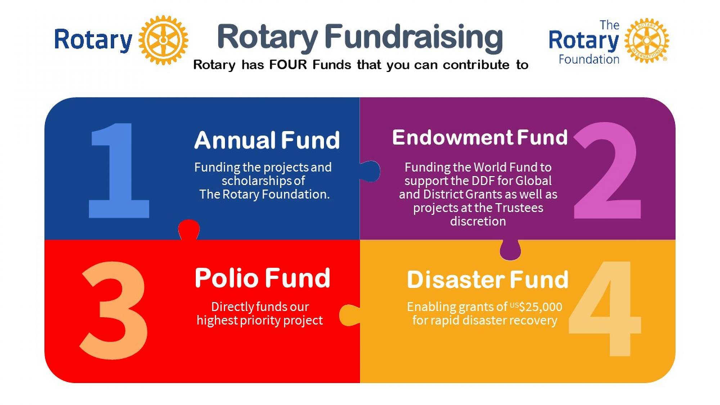
The Rotary Foundation – Contributions and Recognition

Slide 14

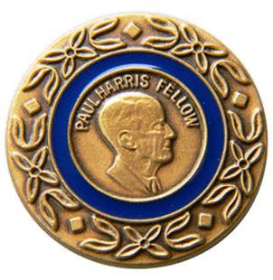
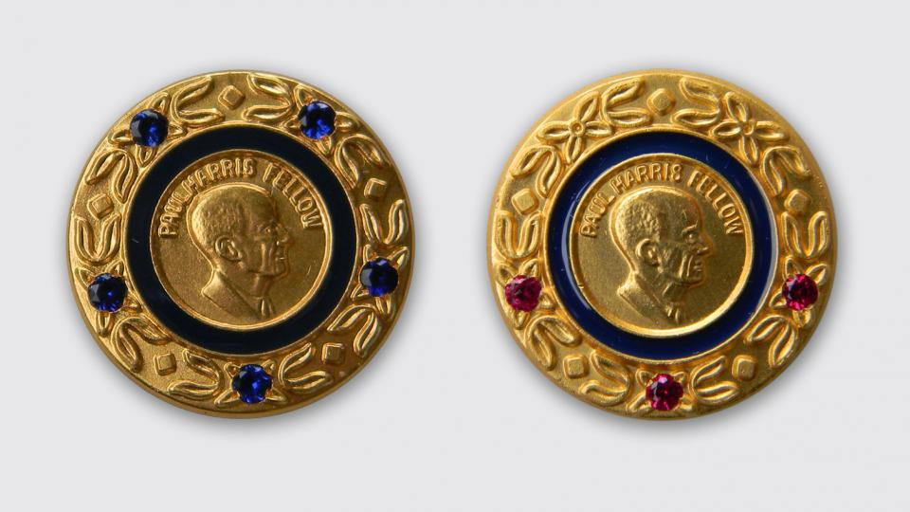


The Rotary Foundation – Recognition Made Simple
Rotary Foundation Sustaining Member
When you give $100 or more per year to the Annual Fund.
Paul Harris Society member
When you elect to contribute $1,000 or more annually to the Annual Fund, PolioPlus, or an approved Foundation grant.
Paul Harris Fellow
When you give $1,000 or more to the Annual Fund, PolioPlus, or an approved Foundation grant
Multiple Paul Harris Fellow
When you give additional gifts of $1,000 or more to the Annual Fund, PolioPlus, or an approved Foundation grant.
Major Donor
When your cumulative donations reach $10,000.
Arch Klumph Society
When your cumulative donations reach $250,000.

Slide 15
The Rotary Foundation – Recognition Made Simple
Benefactor
When you include the Endowment Fund as a beneficiary of $1,000 or more in your estate plans or when you donate $1,000 or more to the fund outright.
Bequest Society
When you make a commitment for future gifts of $10,000 or more to The Rotary Foundation

Slide 16

Club recognition
Notes:
We award Foundation banners to clubs that achieve outstanding giving:
The Every Rotarian, Every Year Club banner recognizes clubs with an average of $100 in giving per member, with every member contributing at least $25 to the Annual Fund.
The 100% Foundation Giving Club banner recognizes clubs with an average of $100 in giving per member, with every member contributing at least $25 to any Foundation fund.
The 100% Paul Harris Society Club banner recognizes clubs in which all members contribute at least $1,000 to the Annual Fund, PolioPlus Fund, or an approved global grant during a given Rotary year.
The 100% Paul Harris Fellow Club banner recognizes clubs in which every active member is a Paul Harris Fellow at the time the district governor requests the banner. This banner can be earned only once.

Slide 17
Rotary Foundation – Why Give?
Top 5 Reasons why I personally give to the Rotary Foundation

Slide 18
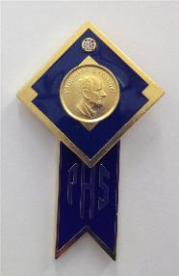

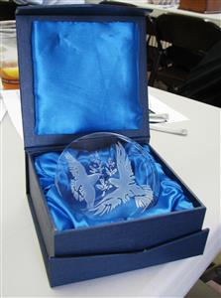





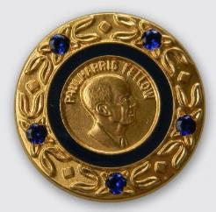
Number 5
The Cool Bling…

Slide 19
Number 4
It’s My Foundation
  It’s Your Foundation
    It’s Our Foundation

Slide 20

Number 3
They Respect my Donations With Aggressive Stewardship
For the 16th consecutive year, The Rotary Foundation has received the highest rating — four stars — from Charity Navigator, an independent evaluator of charities in the U.S.
Association of Fundraising Professionals named the Rotary Foundation the World’s Outstanding Foundation for 2016
92% of all Donations go directly to Program Awards

Slide 21

Number 2

Slide 22




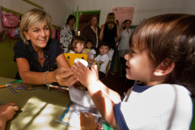
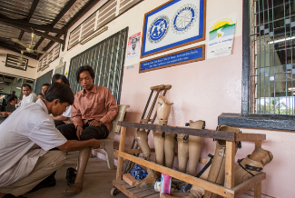
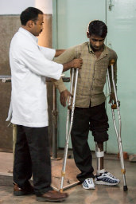



And the Number one reason I give to the Rotary Foundation
Because I can and they need me

Slide 23
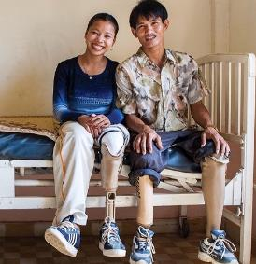

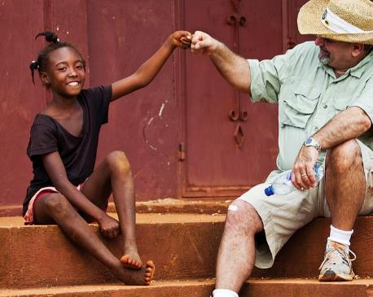
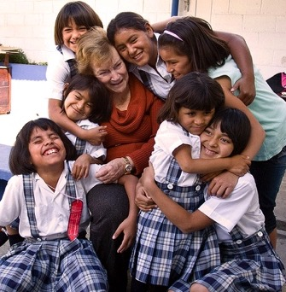
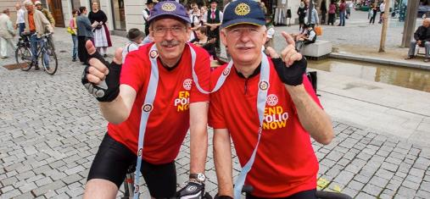
Another Reason
We should not live for ourselves alone, but for the joy in doing good for others
— Arch Klumph, 1929

Slide 24
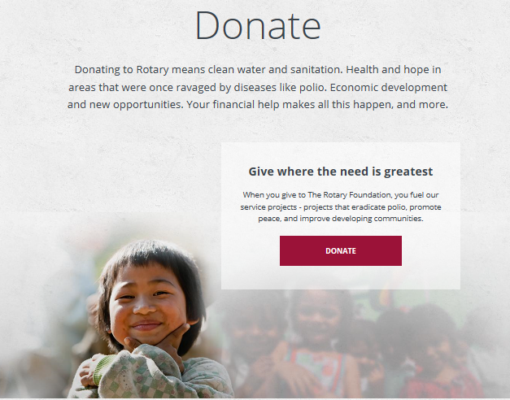
And one more reason
Because it’s
Easy…

Slide 25
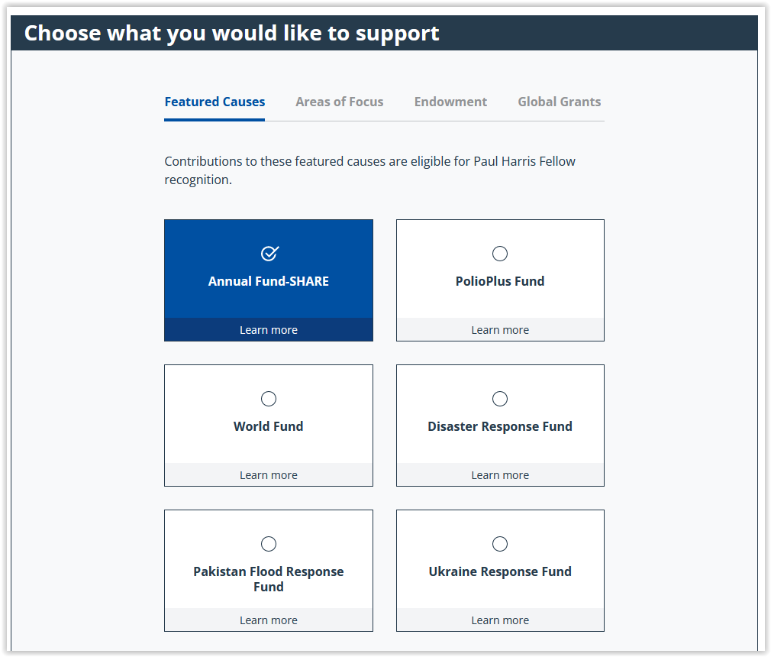
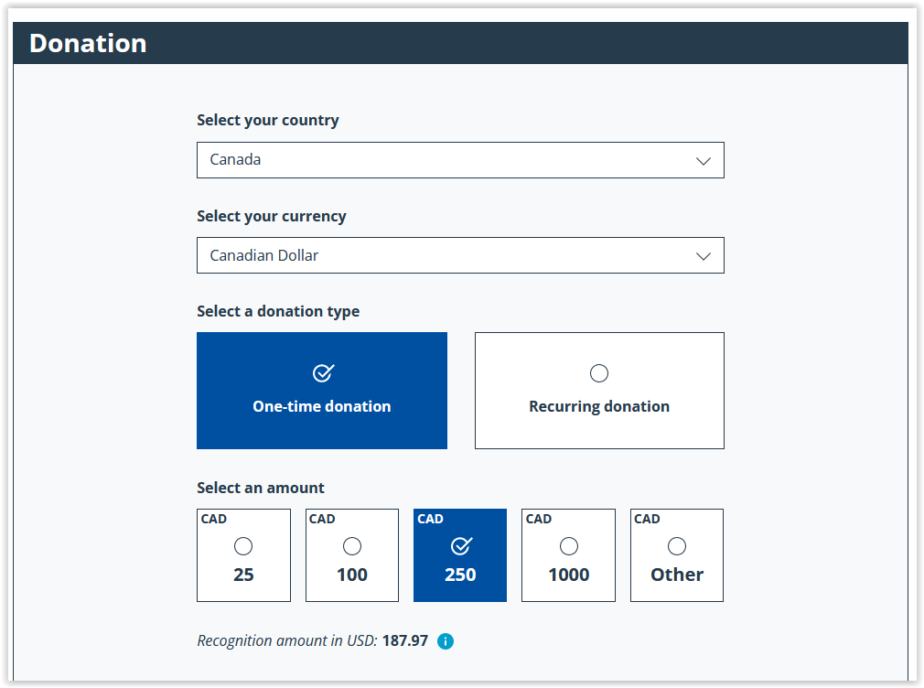
Donate on-line through the Rotary Foundation or on MyRotary

Slide 26
Rotary Direct
Regular and automatic giving to The Rotary Foundation
You subscribe to Netflix and Prime, why not subscribe to Humanity
with Rotary Direct?
Reasons for using TRF’s recurring giving program:
  Donor is connected directly to their giving (Deductions through dues are not always understood.)
  Club convenience! Club leadership work is minimized.
  Signing up once ensures continuous support.
  Signing up is simple. Recurring payments can be through a credit card. Set up online, on the phone, or by mail.
  It’s easier to give smaller amounts in more frequency.
  It’s efficient! It reduces TRF administration and marketing costs.
  Its secure! It’s the safest and most secure way to contribute.
  Making changes is easy! It’s easy to changes right on the RI website.
  Increasing the recurring amount gradually is less of a burden.
  Tracking the history by the giver giving is easy on the RI website.

Slide 27
Setup Payments in Rotary Direct – Tax Receipts at year end
Every Rotarian Every Year - $25 US $2.80 CA per month
Sustaining Member - $100US $12.50 CA per month
Paul Harris - $1,000US $112.50CA per month
Paul Harris Society - $1,000US every year
Polio Plus Society - $100US every year

Slide 28
OUR DISTRICT – HOW ARE WE DOING?
    Total Giving from District 5040 Rotary Clubs in 2024 – 25 was $818,708
    Annual Fund $422,275
    Polio Plus $80,858
    Endowment Fund $237,071
    Avg. Per capita to Annual Fund $353.96
    37% of members were EREY
All $US

Slide 29

It’s Our Foundation, Please Join me in Supporting it!

Slide 30

Questions

