Slide 1
GRANT
MANAGEMENT
SEMINAR
2024 - 2025

Slide 2
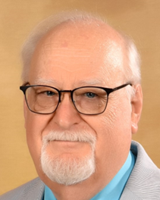
District 5050 Foundation
District Stewardship Chair
Past DRFC
Malcolm Kennedy
Rotary Club of Coquitlam Sunrise
malcolm.rotary@outlook.com
604-941-8606

Slide 3
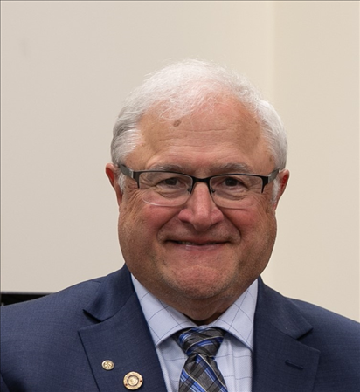
Land acknowledgement
Greetings from District 5050
District Governor Elect
Dave Duskin
District Governor 2024-2025

Slide 4
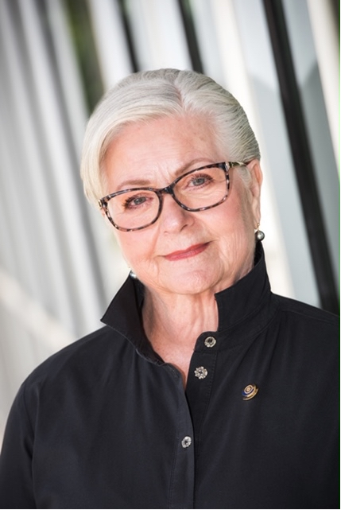
District Rotary Foundation Chair
Dean Rohrs
Rotary Club of Langley Central
dean@cbrplus.com
604-372-1160

Slide 5
District Assistant Governor Elect Area K
Mary Schoenfeldt
Everett Port Gardner
District Governor Aide
Pat Bond
North Delta

Slide 6
Goals for today
Qualify you and your club to receive District and Global Grants
Provide you with the tools needed to do a successful on-line application
Get you to YES

Slide 7
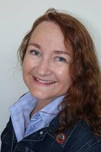
Agenda
Session 1 District Grants – Coreen
Pause for the cause
Session 2 Global Grants – Malcolm
Pause for the cause/lunch
End with signing of the MOU
District Grants Chair Coreen Rodger Berrisford
PNW Passport
coreenrotary@gmail.com
778-839-2674
District Stewardship Chair Malcolm Kennedy
Coquitlam Sunrise
malcolm.rotary@outlook.com
604-941-8606

Slide 8
District 5050 Foundation Team
Your District 5050 Foundation Team is made up of experienced and dedicated Rotarians
who work as the connection between
The Rotary Foundation and the
District 5050 membership.
We, like you, are volunteers

Slide 9
District 5050 Foundation Team
Brochure
Also available on
www.rotarydistrict5050.org
Foundation tab – grants

Slide 10
The Rotary Foundation
The Rotary Foundation (or in loving Rotary acronym, TRF) is a separate legal entity from Rotary International (RI) to maintain its charitable tax status.
The Foundation is managed by a 15-member Board of Trustees that is nominated by the RI President and appointed by the RI Board.

Slide 11
The Rotary Foundation
The MISSION of The Rotary Foundation is to enable Rotarians to advance world
understanding, goodwill and peace through the improvement of health, the support of education, and the alleviation of poverty.
The GOAL of the Rotary Foundation is to do good in the world.

Slide 12
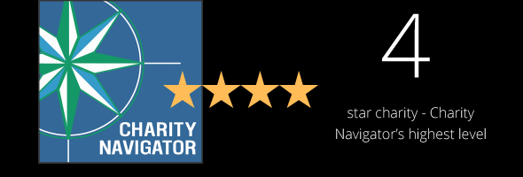
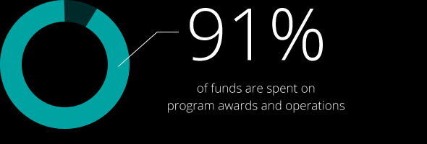
The Rotary Foundation
The past 100 + years, your Foundation has spent more than 4 billion on life-changing, sustainable projects.

Slide 13
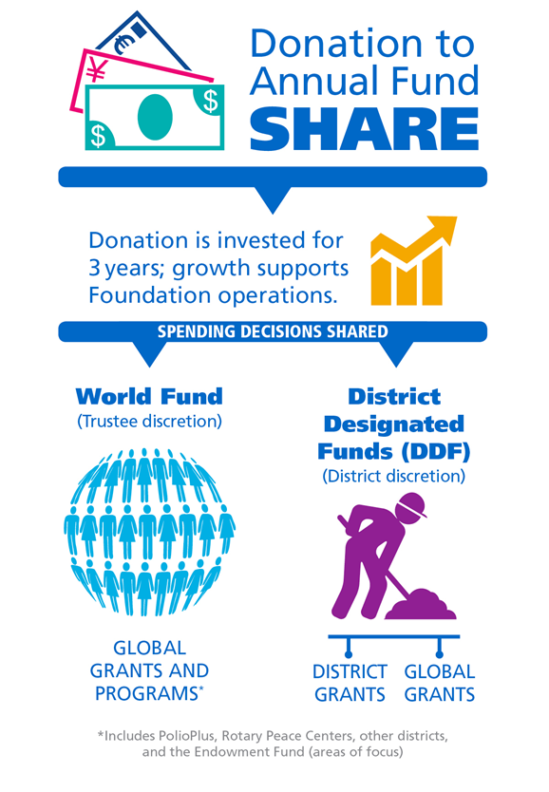

Slide 14
HOW WE FUND PROGRAMS – SHARE
District 5050 Rotarian Contributions to the
Annual Programs Fund ($374,388)
3 years (2020 - 21) after they are received, are returned to
50% ($187,194) District Designated Fund (DDF)
50% ($187,194) World Fund
District 5050 Designated Fund (DDF)
50% to District Grants ($93,597)
50% to Global Grants ($93,597)

Slide 15
District Grants (DG) vs Global Grants (GG)
District Grants
Funding between $500 - $10,000 USD
District will match $1 of club funds with up to $1 of USD DDF – you double your funds
Used for smaller local or international projects
Do not need Host club – if possible, try to work with local club – hands on necessary
District 5050 Grants committee responsible for Club Grant approval process

Slide 16
District Grants (DG) vs Global Grants (GG)
District Grants
Everything is to be done online at District 5050 website www.rotarydistrict5050.org
Available only once per year
April 1– August 31 open for applications
All District approved club applications are submitted to TRF as one District application

Slide 17
Global Grants (GG) vs District Grants (DG)
Global Grants
Host club required - two or more Rotary clubs must work together – both must be qualified Host sponsor is the partner in or near the international community
The international sponsor (you) is located outside of the host sponsor’s country.

Slide 18
Global Grants (GG) vs District Grants (DG)
Global Grants
Global grants minimum budget of $30,000
maximum World Fund award of $400,000.
Club(s) funds $10,715 x 2.8 = $30,180
Application found at My Rotary at ww.rotary.org
Open all year - not once like District Grants

Slide 19
GRANT
MANAGEMENT
SEMINAR
2024 - 2025

Slide 20
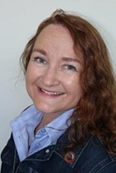
SESSION 1
District Grants
District Grants Chair
Coreen Rodger Berrisford

Slide 21
District Grants
Goal today is to familiarize you with the District Grant online application process
Our role is to guide you to FINAL APPROVAL
Used for smaller local or international projects

Slide 22
District Grants
Funding between $500 - $10,000 USD (if funds available)
District will match $1 of club funds with up to $1 of District Designated Funds USD (DDF)
Do not need Host club
All projects that receive Foundation grants must be initiated and managed by Rotarians

Slide 23
District Grants
Grants must be used for the approved purpose as we have submitted to TRF
If circumstances beyond your control result in a change in the approved purpose you need to contact the District Grants Chair before proceeding.
If the intent does not change, then an adjustment could be approved. If the intent changes, then the grant funds may need to be returned.

Slide 24
District Grants
Talk to your District Grants Chair ASAP!
District Grants that cannot finish or fail to file timely required 12-month progress and 18-month final reports are required to refund their grant funds in USD.
Unused District Grant funds are returned to TRF, we get those back the following year as Global Funding.
Contact the District Grants chair as soon as possible if you are having problems, we are here to assist you.

Slide 25
District Grants
All District Grant requests must follow the Guidelines as set out in the District Grant Management Manual – copy available at desk
Only Clubs that are qualified may apply –signed MOU, minimum of two members at a training session-one must be PE
Match: must be cash, not in kind or from another grant
USD funds - Use the rate you received when check cashed or exchange rate per RI rate at end of project – whichever is best for your club – tell us the rate you used – show in final report.

Slide 26
“Google” - Exchange Rate Rotary
If not on this page, then go to Oanda Website

Slide 27
District Grants
Clubs can apply for more than 1 Grant, but the Club MUST prioritize their request
Needs to have a PR Plan
Fill a humanitarian need
Align with 7 areas of Focus

Slide 28
District Grants
Hands on – involved members make a strong club. The more members involved in the project the better ROTARY is visible in the community
Cannot be a check writing exercise
Funds cannot be managed by or turned over to non-Rotarian entities, such as beneficiaries or cooperating organizations

Slide 29
District Grants
Fundraising not part of project - we don't want to see it as a budget item nor any description of how you fundraised to get the club portion of funds.
We look at your club/member donations to the Foundation – and check to ensure your Foundation Goals are entered into Club Central
Do not start project before
FINAL APPROVAL
planning is Ok

Slide 30
District Grants
Dedicated bank account required for each open grant that is used solely for receiving and disbursing Foundation grant funds – your club funds & DDF
A checking account allows for flexibility and ensures the availability of bank statements

Slide 31
District Grants
Conflict of Interest:
Exists when a Rotarian benefits financially or personally from a grant
Benefit can be directly to a Rotarian or indirectly to an associate of the Rotarian
Conflict can be real or perceived as real by other organizations

Slide 32
District Grants
Common Area of Conflict
Member of your club is the Executive Director / Board member of the organization you are going to support.
Make sure you are aware that this is a conflict and report it.
Careful wording can resolve area of conflict - did the Executive Director approach the club or did the club approach the Executive Director!

Slide 33
District Grants
All Grant proposals must be submitted by August 31, 2024
Everything is to be done online at District 5050 website www.rotarydistrict5050.org
Grants Committee will meet by mid-September
Goal is to have Funds Reserved for your club by end of September. If you are not going to proceed or need less funds than expected – we need to know within 5 days

Slide 34
District Grants
Once funds are reserved you move on to the next step
To the document section
Add your expense quotes
Add your bank statement
Add your club mailing address

Slide 35
District Grants
Completed District Grant Application deadline is December 1, 2024
The sooner you complete your application the sooner you get the funds
It is very important you give us the correct and complete mailing address of your club
Clubs will receive the District funds upfront
Do not start your project before you get FINAL approval

Slide 36
District Grants
First progress report is due at 12 months
The club has 18 months to complete the project and the FINAL REPORT
Unused funds must be returned to District 5050 in USD
You need documentation for the total of the project, the club’s contribution plus the grant award

Slide 37
District Grants
If you are submitting a grant request on behalf of multiple clubs, only one application is needed
There must be one main sponsoring club and one main contact person – they must be qualified

Slide 38
District Grants
First step – log into the District 5050 website www.rotarydistrict5050.org
Only qualified clubs will have access to the grant application
Only qualified members can make changes to the application
Grant Module will be open April 1, 2024

Slide 39
District Grants
Notes:
Speaking point: This is what the general public will see, you need to log in to get to the grants module

Slide 40
District Grants
Click on Grants
First time in select “Submit a Grant Request” second time “My Club Grants” not “District Grants”
Notes:
Speaking point: Go to my club grants not the district tab

Slide 41
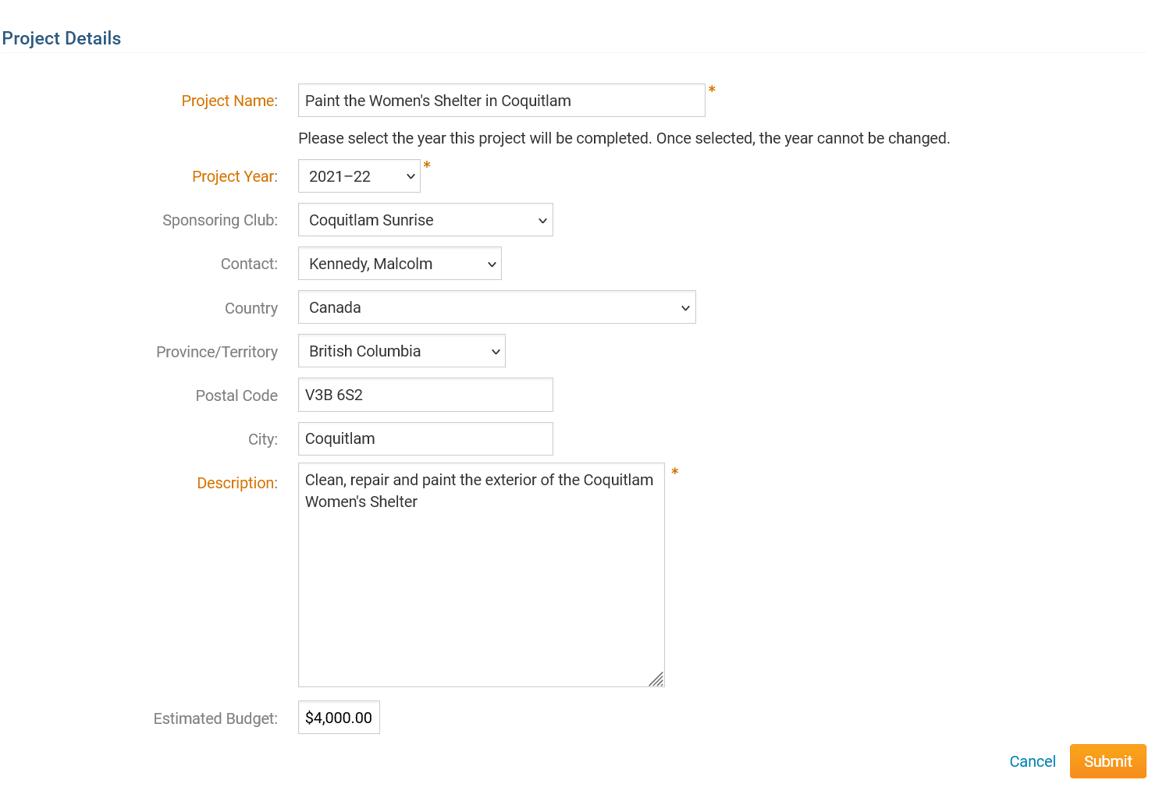
2024 -2025
Begin
Be brief –15 words or less
You are now “in the system” with this basic information we can see you are planning on applying for a District Grant.
Total Budget in USD
Notes:
Speaking point: total budget in USD

Slide 42
District Grants
Notes:
Speaking point: If you leave site you need to login again, go to view grants

Slide 43
District Grants
Notes:
Speaking point: Needs to be completed by August 31, 2015

Slide 44
District Grants
Notes:
Speaking point: you can cut and paste from another source

Slide 45
District Grants
This is where you input the details of your grant. Complete but brief is good. Make sure you update as you move to another section.
Notes:
Speaking point: Five boxes in total

Slide 46
District Grants
This is where you input the details of your grant. Complete but brief is good. Make sure you update as you move to another section.
Notes:
Speaking point: Make sure you update bas you go along – you can come back to file anytime

Slide 47
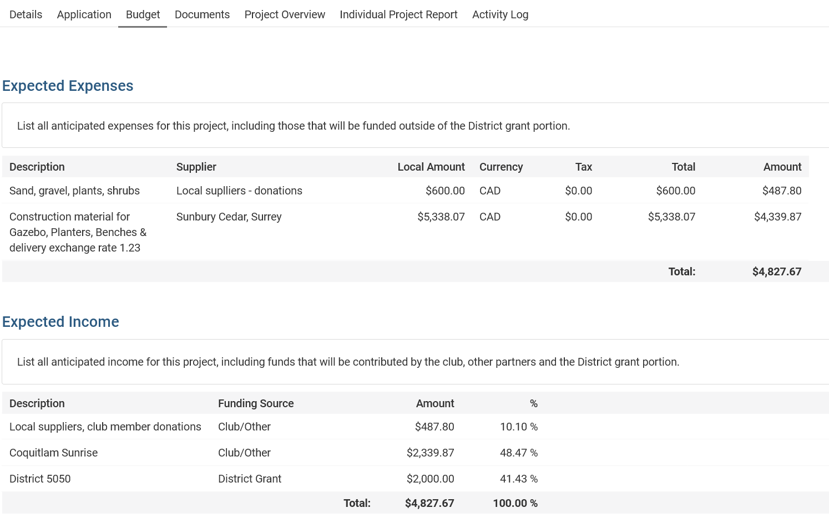
Income and expenses must match
CDN clubs add exchange rate used
Notes:
Speaking point: Remember you will need to justify your expense so be careful you only list what you actually will expense

Slide 48
District Grants
If you have written quotes add them here – mandatory before approval can be given
Notes:
Speaking point: you need to get quotes we only need to see the quote you selected, but you should keep on file the other quotes

Slide 49
District Grants
This will produce a PDF so you can share the application with your club
Notes:
Speaking point: you can print the file, it is in a PDF and share it with your committee or club

Slide 50
District Grants
This is what you need to complete by
August 31, 2024
The District committee will meet by mid-September
You will be informed by end of September if you have Funds Reserved and for what amount
At this point you need to upload written quotes, bank information and club mailing address by
December 1, 2024

Slide 51
District Grants
This where you can add a copy of your bank statement – and quotes if not added earlier
Notes:
Speaking point: if you have a approved quote before August 31 then add it here if not then it must be done before December 1

Slide 52
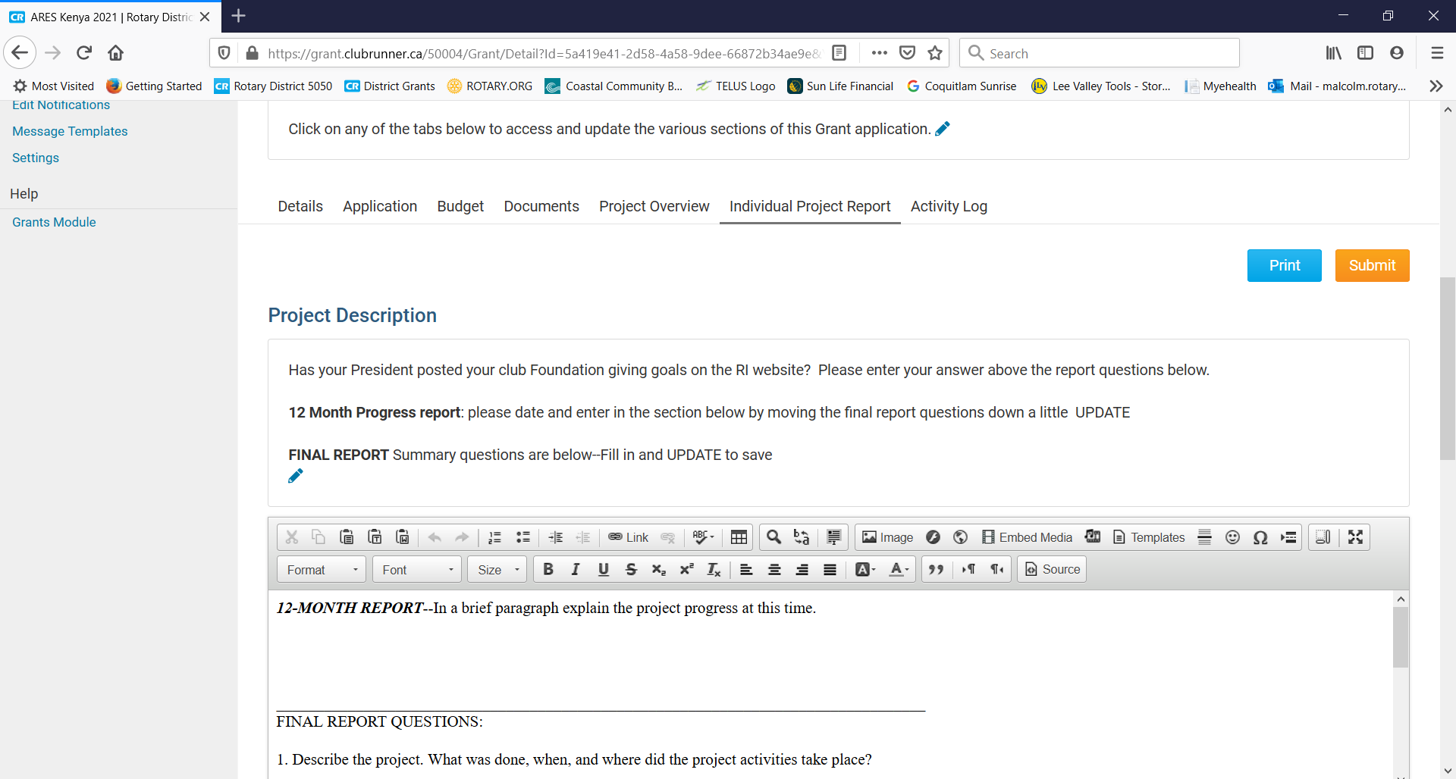
District Grants
Once your project is complete or at 12 months this report needs to be completed
Notes:
Speaking point: we need to know how your project is advancing, if you don’t need all the funds then please tell us
Only claim what you can provide receipts for

Slide 53
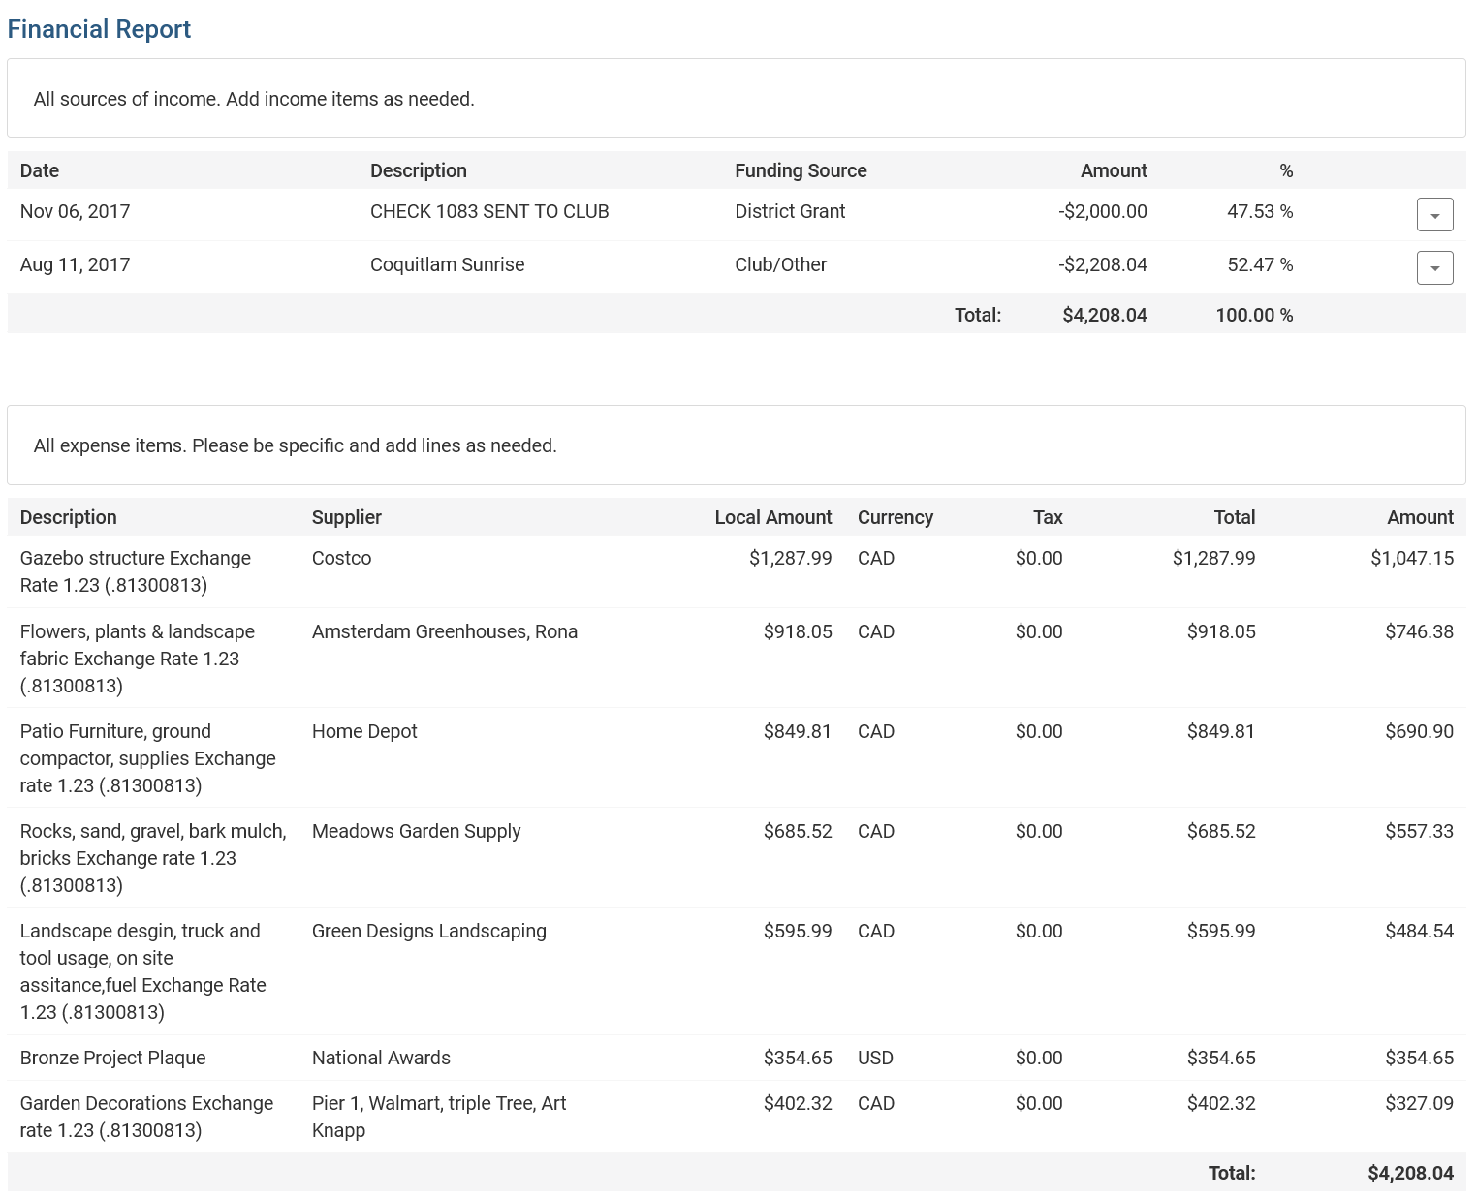
Income and Expenses must equal

Slide 54
District Grants
Expense receipts must be added for the expenses shown in the financial ‘Individual Project Report’
Notes:
Speaking point: scanned copies will be fine – you must keep copies for 5 years

Slide 55
District Grants – Important Dates
All Grant proposals must be submitted by August 31, 2024 – you can plan and apply for your grant as soon as April 1, 2024
Grants Committee will meet by mid-September
Goal is to have Funds Reserved for your club by end of September 2024
Completed Application deadline December 1, 2024
“Poor planning on your part does not
constitute an emergency on our part”
Notes:
Speaking point: scanned copies will be fine – you must keep copies for 5 years

Slide 56
Coreen’s four F process for District Grants
Funds Reserved
Final Approval
First Report
Final Report

