Slide 1
GRANT
MANAGEMENT
SEMINAR
2024 - 2025

Slide 2
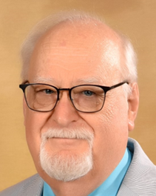
SESSION 2
Global Grants
District Stewardship Chair
Malcolm Kennedy

Slide 3
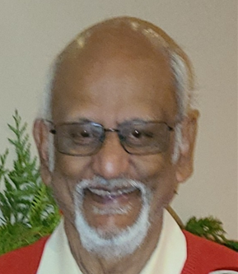
District Foundation Committee
Global Grants Chair
Raj Rajagopal
Rotary Club of White Rock
rajindcan@gmail.com
604-560-4770

Slide 4
Why are you here?
The Rotary Foundation (TRF) is a separate legal entity from RI to maintain its charitable tax status.
4-star charity – Charity Navigator’s highest level
MOU must be signed
Presidents are required to sign off on grants – need to understand the implications – plus final report

Slide 5
Why are you here?
Grant writers - new to grants – hopefully to expose you to the depth of the grant process and benefits $$$$$
Grant writers – experienced - share - plus how to avoid pitfalls
Foundation chairs to see the value of donating to the Rotary Foundation

Slide 6
REVIEWS AND APPROVALS

Slide 7
Global Grant - Match
With matched dollars, your $10,715 + investment results in a $30,180 project
Club(s) funds + 5% admin $10,715
District 5050(DDF) match $10,715
World Fund match DDF at 80% $ 8,750
Total funds available $30,180
Global grants have a minimum budget of $30,000 and a maximum World Fund award of $400,000.
There is no minimum World Fund match.

Slide 8
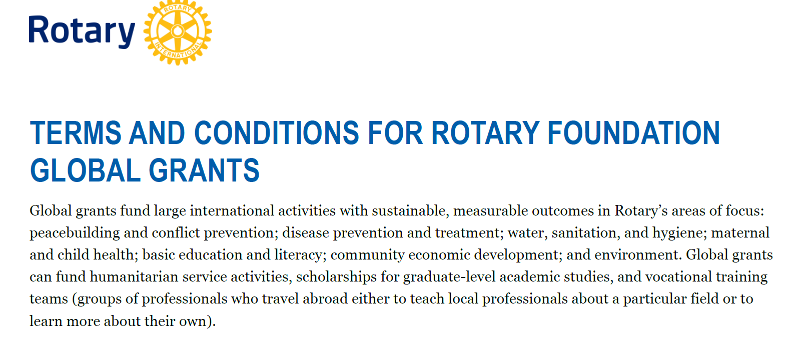
Where do you start
Must read 15-page document

Slide 9
Where do you start
Guide to Global Grants, (2022 edition - 40 Pages)
It’s for all Rotary members who are interested in applying for global grants or developing more effective and sustainable service projects.

Slide 10
Where do you start
To apply for a global grant, two or more Rotary clubs must work together.
The host sponsor is the partner in or near the international community that’s implementing the project.
The international sponsor (you)works with the host sponsor but is located outside of the host sponsor’s country.
All sponsors must meet global grant requirements and eligibility

Slide 11
Form three-person committees
Your club and the host club – all from the primary club
Establish a preliminary budget – minimum $30,000
(In D5050 is works out to $30,180)
Everything in USD

Slide 12
First Step
Contact your District Global Grants Chair - both clubs:
International (Raj)
Do we have funds available
Are you eligible
I can meet with your committee
Host
Are they in good standing - both Club and District

Slide 13
Club Qualification
www.Rotary.org

Slide 14
Global Grants
Grants need to be host community-driven.
The host community designs the grant based on local needs that they have identified.
Required to conduct a community assessment first and include the results in the grant application.
Hydro geological surveys must be completed as part of the community assessment for projects that will access groundwater.

Slide 15
PARTNERSHIP REQUIREMENTS
Host Sponsor (international country)
Initiates the project
• Conducts a community assessment
• Manages project implementation and budget
• Provides local assistance and support to vocational training teams and scholars during their time abroad

Slide 16
PARTNERSHIP REQUIREMENTS
International Sponsor (Your Club)
Provides financial assistance, technical support, and other guidance
Performs project tasks that can be done remotely, as well as participating in service during site visits
• Prepares any vocational training teams or scholars for travel and study abroad

Slide 17
PARTNERSHIP REQUIREMENTS
Both Sponsors
Must be qualified to participate in a global grant
• Develop a project plan
Have project committees that collaborate with each other for the length of the project
• Partner with a cooperating organization (a nongovernmental organization, community group, or government entity)

Slide 18
Must align with one
of Rotary’s 7 areas of focus

Slide 19
Global Grants
Are sustainable. Host communities must be able to address their own needs after the Rotary club has completed its work.

Slide 20
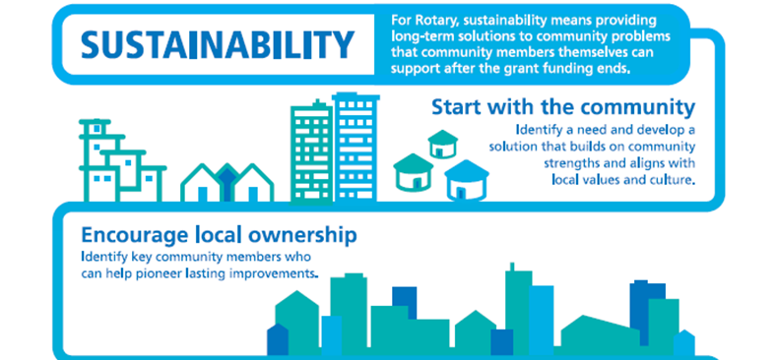

Slide 21
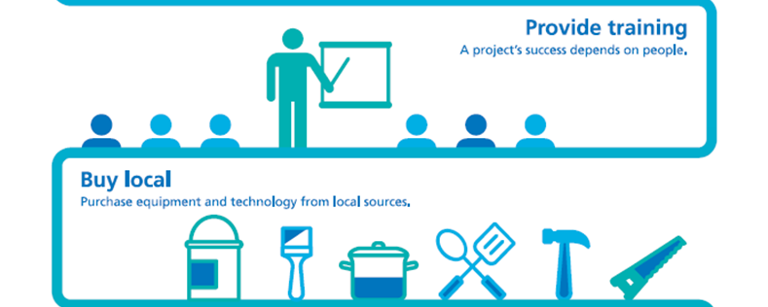

Slide 23
Global Grants
Are measurable. Sponsors select standard measures from the Global Grant Monitoring and Evaluation Plan supplement and may add their own measurements.

Slide 24
Global Grants
Support humanitarian and educational projects
Support vocational training teams that address a humanitarian need by providing or receiving professional training
Are sponsored by at least one Rotary club in the country where the grant project will take place (primary host sponsor) and one or more outside that country (primary international sponsor).

Slide 25
RAISE FUNDS
The Rotary Foundation never asks for funding from the community that benefits from a global grant-funded project. Since Rotary members have identified this community as one in need, we don’t collect funds from beneficiaries in exchange for receiving the grant or as part of the funds raised by our members

Slide 26
Restrictions – grants cannot fund:
Examples from Terms & Conditions
Continuous or excessive support of any one beneficiary, entity, or community
Purchase of land or buildings
Activities for which the expense has already incurred
Rotary Youth Exchange, RYLA, Rotary Friendship Exchange, Rotaract, Interact, or New Generations Service Exchange Programs

Slide 27
Restrictions – grants cannot fund:
Examples from Terms & Conditions
New construction of any permanent structure in which people live, work, or spend a significant amount of time, such as hospitals or container and mobile homes, or of structures in which people carry out activities such as manufacturing and processing.
If the grant depends on the construction of a building, that construction must be paid for with non-grant funds.

Slide 28
Restrictions – grants cannot fund:
Examples from Terms & Conditions
Renovations to complete buildings that are partially constructed (including buildings with only the exterior completed) but have never been occupied or operational
Travel for staff of a cooperating organization involved in a humanitarian project
Activities primarily carried out by an organization other than Rotary

Slide 29
Global Grants
Examples from Terms & Conditions
May be used to build infrastructure, such as toilet blocks and sanitation systems; access roads; dams; bridges; storage units; fences and security systems; water or irrigation systems; and greenhouses.
If your project will access groundwater, you need to have done a hydrogeological survey. The cost of that can be included in the grant budget.

Slide 30
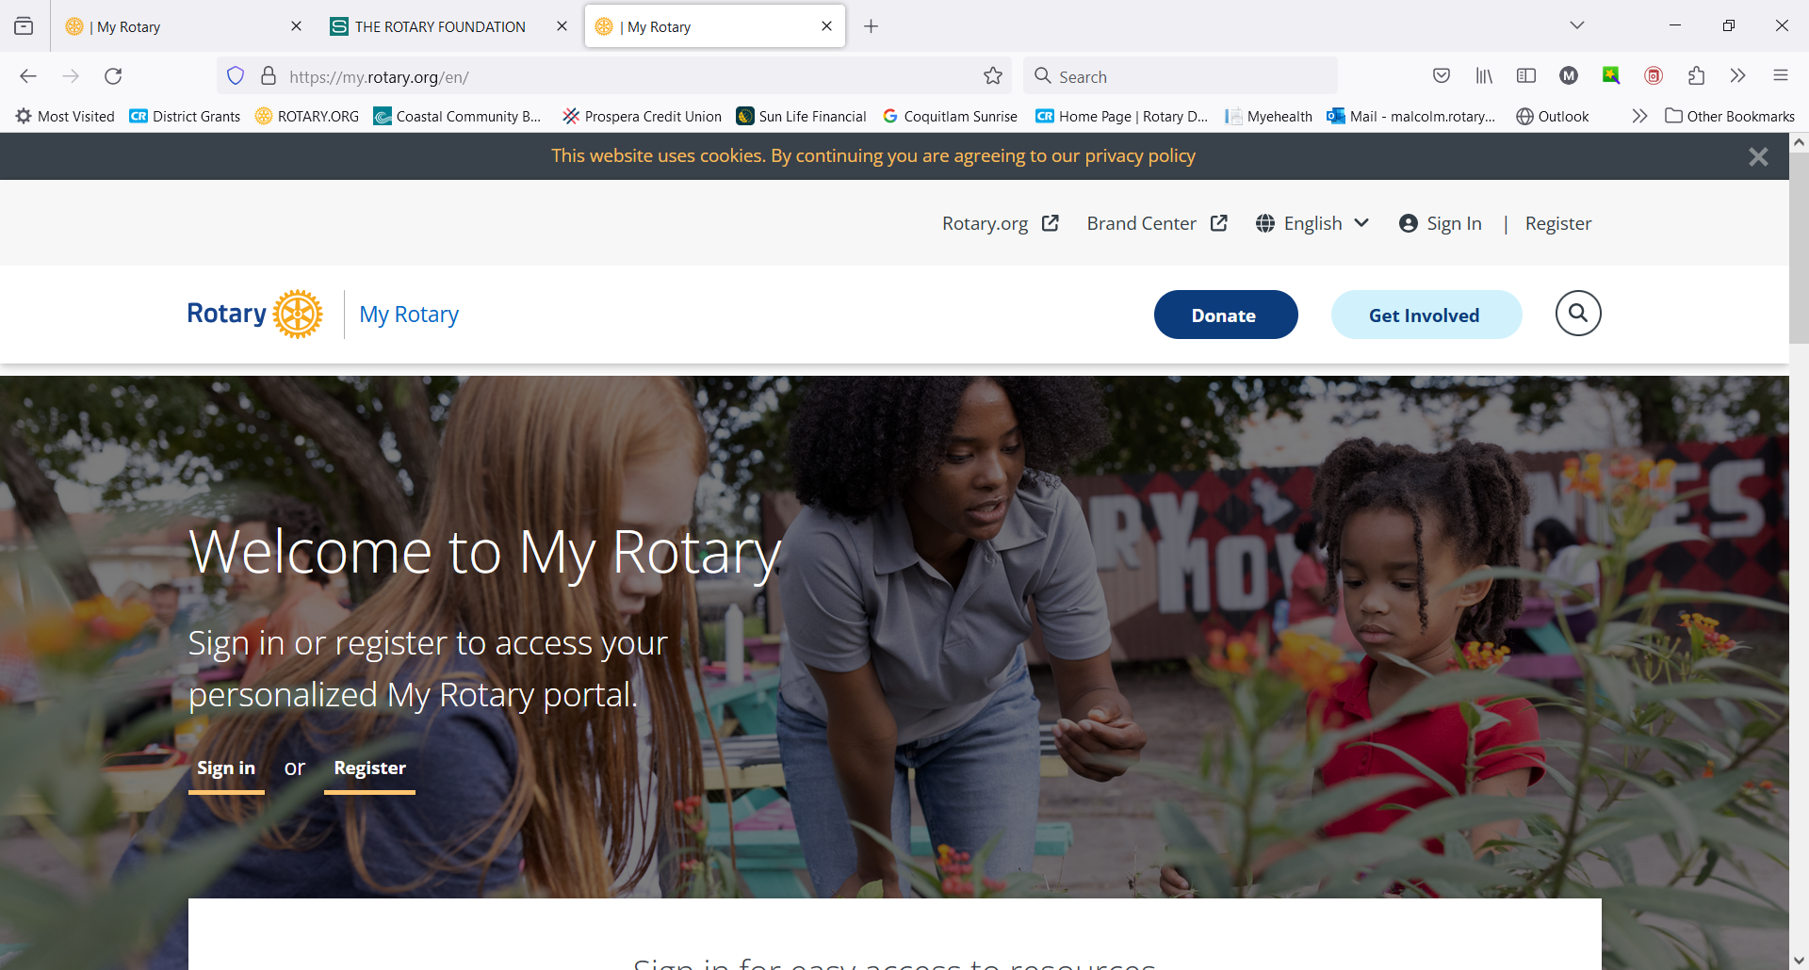
https://www.rotary.org
Click on My Rotary and sign in

Slide 32
Scroll down to

Slide 33
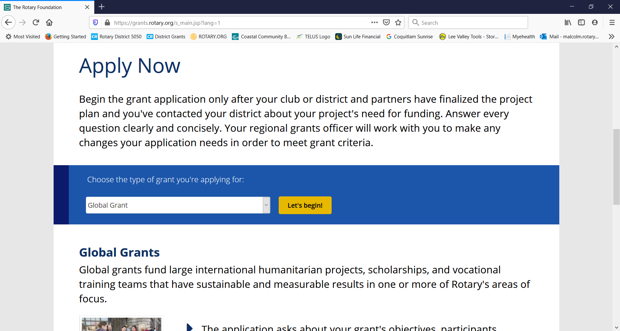

Slide 34
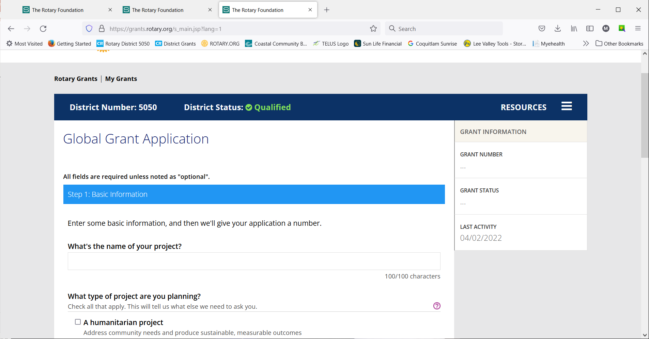

Slide 35
Grant Resources Questions about the grant process?
Application Supplement for Microcredit Projects
Areas of Focus Policy Statements
Community Assessment Results
Cooperating Organization Memorandum of Understanding
Global Grant Application Template
Global Grant Calculator
Global Grant Lifecycle
Global Grant Monitoring and Evaluation Plan Supplement

Slide 36
Grant Resources Questions about the grant process?
Global Grant Report Template
Global Grant Scholarship Supplement
Grant Travel
Guide to Global Grants
Guidelines for Rotary Foundation-Funded Project Signage
How to Use the Grant Center
Report Supplement for Microcredit Projects
RI Exchange Rates

Slide 37
Grant Resources Questions about the grant process?
Rotary Grants Staff Contact Sheet
Six Steps to Sustainability
Terms and Conditions for Rotary Foundation District Grants and Global Grants
Training Plan for Global Grants
Vocational Training Team Itinerary
Vocational Training Team Member Application
Returning Grant Funds to The Rotary Foundation

Slide 40
“Google” - Exchange Rate Rotary
If not on this page, then go to Oanda Website

Slide 41
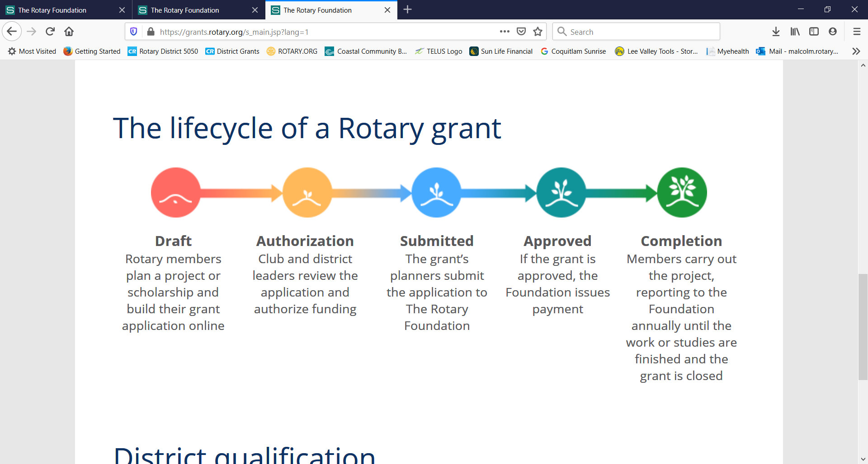

Slide 42
GRANT INELIGIBILITY
If your grant application doesn’t meet global grant criteria, your regional grants officer will work with you to make the changes needed to meet them. If you and your partner club can’t make these changes, your project will not be eligible for global grant funding.
Rotary Grants Staff Contact Sheet
They listen well and can read between the lines
Notes:
Speaking points:
Progress reports must be submitted within 12 months of receiving the first global grant payment and every 12 months afterward.
The final report must be submitted within two months of completing the project or activity.
Unused grant funds may be used for additional eligible and Foundation-approved expenses. Changes to a project must be approved by Rotary. Any unused funds returned to Rotary will be credited to the World Fund.

Slide 43
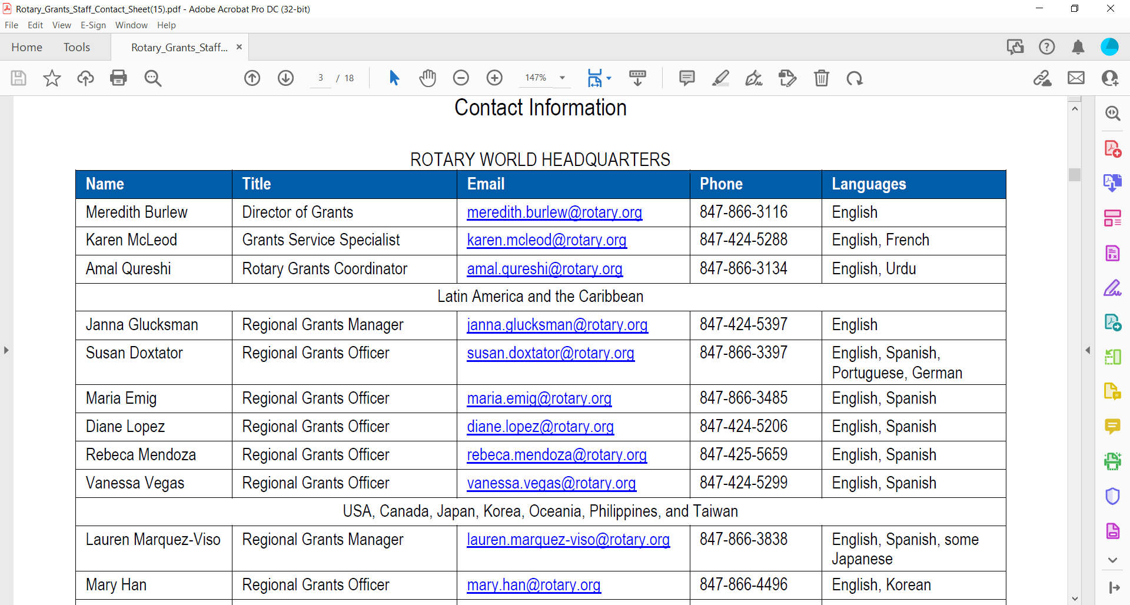
Regional Grants Officer
Make them your best friend

Slide 44
Reporting timeline

Slide 45
Push Back
Take it as a sign they want to fund your project
They need more details so you can meet their mandate
Re-read your application – look at it as if you are seeing it for the first time – remember you have knowledge that you probably haven’t shared
It is a lot of work – invest $10,715 – receive $30,180

Slide 46
Where does Raj fit in
First point of contact
Do we have funds? Rolling record of funds
Meet with your committee
During the Process
Conduit – share ideas, pitfalls
Listen when you are frustrated
Direct you to the right source of information
Follow-up on compliance
Do a program at your club – leverage/direct your donations

Slide 47
Changes
No world fund match for club contributions
World fund match for DDF now at 80%
Global grants have a minimum budget of $30,000 and a maximum World Fund award of $400,000. There is no minimum World Fund match.

Slide 48
Changes
Bank information needed as soon as the application is submitted – do not send funds until requested to do so
Simple schools no longer eligible
Additional area of focus, the environment

Slide 49
Changes
Programs of Scale Grants
Fund activities that benefit a large number of people in a significant geographic area using a sustainable, evidence-based intervention with measurable outcomes and impact. Each grant will support, for three to five years, activities that align with one or more of Rotary’s areas of focus.
How it works: Each year, one approved project will receive $2 million from The Rotary Foundation’s World Fund.

Slide 50
Changes
Disaster Response Grants
Fund small-scale, short-term activities that address needs caused by natural disasters in your community. Activities include providing basic items such as water, food, medicine, and clothing.
How it works: Districts in an affected area or country may apply for a maximum grant of $25,000, based on the availability of funds. A district may apply for subsequent grants after it successfully reports outcomes from previous grants.

Slide 51
Raj Rajagopal
rajindcan@gmail.com
604-560-4770
Please Donate to TRF
Doing Good in the World starts with members like you.

Slide 52
GRANT
MANAGEMENT
SEMINAR
2024 - 2025

Slide 53
District Stewardship Chair
Malcolm Kennedy

Slide 54
District Grant Management Manual
Copy provided at registration table
Points covered in Coreen’s presentation
If you follow these guidelines, it will save you a lot of time when applying for a District Grant
The Club is responsible for the use of funds for club-sponsored grants, regardless of who controls the funds
The Club must adhere to all TRF reporting requirements.

Slide 55
2023-2024 MOU
Memorandum of Understanding
Copy handed out by Malcolm, Coreen
Take 10 minutes now to read MOU and ask questions if you have concerns.
Signature page available from Coreen & Malcolm
One page per club.
The MOU must be filled in and returned before you leave this meeting – including club mailing address
Club Qualified for 1 Rotary Year, Members 3 years

Slide 56
Malcolm Kennedy
malcolm.rotary@outlook.com
604-941-8606

