Slide 1
GRANT
MANAGEMENT
SEMINAR
2026 - 2027

Slide 2
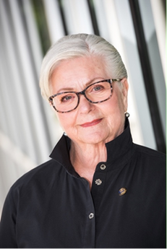
District Rotary Foundation Chair
Dean Rohrs
Rotary Club of Langley Central
deanh.rohrs@gmail.com
604-836-1454

Slide 3
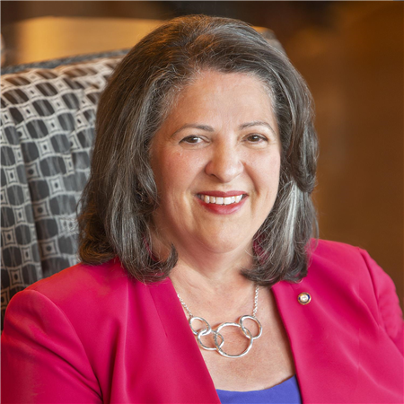
Greetings from District 5050
District Governor
Isabelle Martinez Hayer
District Governor 2025-2026

Slide 4
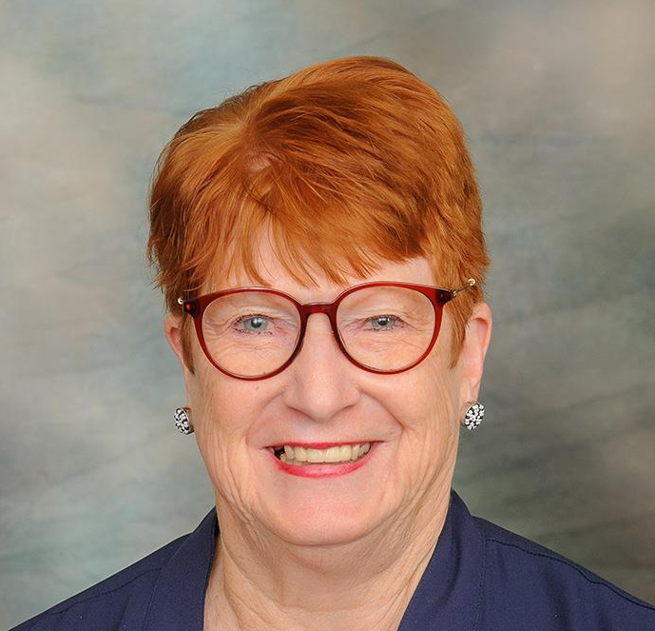
Greetings from District 5050
District Governor Elect
Kathleen Olson
District Governor 2026-2027

Slide 5
Goals for today
Qualify you and your club to receive District and Global Grants
Provide you with the tools needed to do a successful on-line application
Get you to YES

Slide 6
Agenda
Session 1 District Grants – Coreen
Pause for the cause
Session 2 Global Grants – Malcolm
Get you “qualified”
Memorandum of Understanding
Grant Management Manual
PowerPoint online at D5050 – April 1
Closing remarks DRFC Dean
Notes:
DRFC Dean

Slide 7
District 5050 Foundation Team
Your District 5050 Foundation Team is made up of experienced and dedicated Rotarians who work as the connection between
The Rotary Foundation and the
District 5050 membership.
We, like you, are volunteers

Slide 8
Your Foundation Team:
Chair: Dean Rohrs
Global Grants/Stewardship: Malcolm Kennedy
District Grants: Coreen Roger Berrisford
Annual Fund: Connie & Dennis Milliken
Endowment Fund: Carol Tichelman
International Projects: Terry McCauley
Polio Plus/Polio Plus Society: Christiana Flessner
Peace: Brad Whittaker
Major Gifts: Lee Harman
Fund Raising: Winston Conyers
Learning & Communication: Rod Thomson

Slide 9
Your Club Foundation Team:
Should be made up as follows:
Chair Grants person: Global Grants, District Grants, Peace Fellowships, etc
Stewardship:
Polio Fundraising:
Internal: EREY (Annual Programs Fund
Endowment Fund Polio, Projects
External: Fundraising Events
Programs and projects – Local and International.

Slide 10
Responsibilities of your role
Your chief responsibility as a TRF trained member of your club’s Rotary Foundation committee is to inspire your club’s members to give to the Foundation and participate in its activities.
Promote Foundation grants and activities and help members participate in them.
Inspire club members to give to The Rotary Foundation.
Explain where their donations go

Slide 11
The Rotary Foundation
The Rotary Foundation (or in loving Rotary acronym, TRF) is a separate legal entity from Rotary International (RI) to maintain its charitable tax status.
The Foundation is managed by a 15-member Board of Trustees that is nominated by the RI President and appointed by the RI Board.

Slide 12
The operations of Rotary International, a member organization, are overseen by its Board of Directors.
The Rotary Foundation is organized as a public charity operated exclusively for charitable purposes and governed by a Board of Trustees.

Slide 13
The Rotary Foundation
Our mission
The Rotary Foundation helps Rotary members to advance world understanding, goodwill, and peace by improving health, providing quality education, improving the environment, and alleviating poverty.

Slide 14
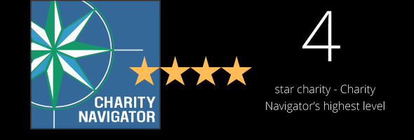
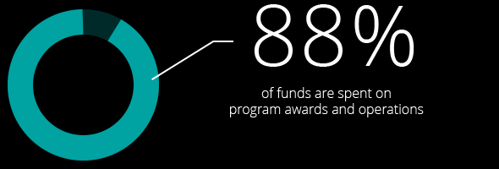
The Rotary Foundation
The past 100 + years, your Foundation has spent more than 4 billion on life-changing, sustainable projects.

Slide 15
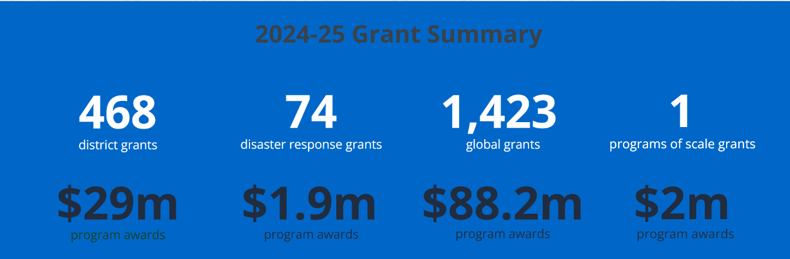

Slide 16

$100 USD Donation Benchmark
to The Rotary Foundation
from Every Rotarian Every Year
Rotary Direct
Visit www.rotary.org

Slide 17
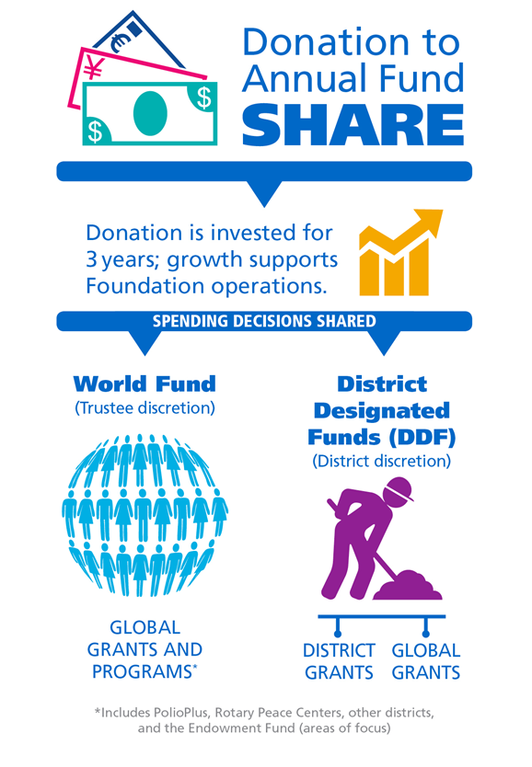

- 5% = 47.5 %each

Slide 18
District Grants
Used for smaller local or international projects
Funding between $500 - $10,000 USD (if funds available)
District will match $1 of club funds with up to $1 of District Designated Funds
Do not need Host club
Open for applications once per year

Slide 19
Global Grant - Match
With matched dollars, your $10,715 + investment results in a $30,180 project
Club(s) funds + 5% admin $10,715
District 5050(DDF) match $10,715
World Fund match DDF at 80% $ 8,750
Total funds available $30,180
Global grants have a minimum budget of $30,000 and a maximum World Fund award of $400,000.
There is no minimum World Fund match.

Slide 20
HOW WE FUND PROGRAMS – SHARE
District 5050 Rotarian Contributions to the
Annual Programs Fund are returned 3 years later
2022-23 donations = $338,000
50% ($169,000) District Designated Fund (DDF)
50% ($169,000) World Fund
District 5050 Designated Fund (DDF)
50% to District Grants ($84,500)
50% to Global Grants ($84,5000)
Notes:
To review: when we contribution to Annual Fund – SHARE, fifty percent (50%) of our contributions come back to our district through District Designated Funds (DDF) in three years to spend on educational and humanitarian activities chosen by us; even grants that may be used for projects in our local community.
The 5 percent that is earmarked to potentially pay for the Foundation’s operating expenses will come from the World Fund. It will be used only if it is needed to pay expenses when net investment returns are not sufficient, or to fully fund the operating reserve (up to three times annual operating expenses). If funds are not needed for these purposes, they will remain in the World Fund until the World Fund is measured to ensure sufficient funds for programs.
In the final step, the World Fund will be measured to ensure that it contains 50 percent of the three prior years’ worth of contributions, plus $5 million – a growth factor. Then and only then, surplus funds will be transferred to the Endowment Fund.
This funding model:
Builds our financial strength by ensuring that resources are available to meet current needs: programs and operating expenses.
Establishes a reserve to provide for unusual financial events (a rainy day fund): the operating reserve.
Ensures an increase in future programs through increased returns on the Endowment Fund.

Slide 21

Annual Program Fund
Today (EREY)
Invested for 3 years
results in ......
and a divorce....

Slide 22
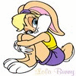
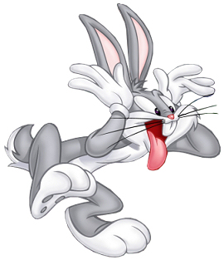
Annual Program Fund
Today (EREY)
Interest
Administration
Costs
47.5%
47.5%
5% Alimony (Admin)
District Grants
(50% of DDF)
Global Grants
DDF
Share
World Fund
Support of
Global Grants

Slide 23
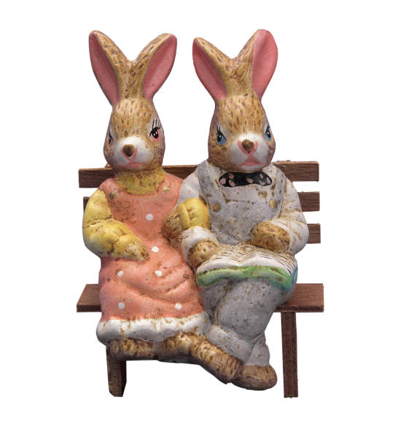
Endowment
Fund
Tomorrow
Funds are invested for perpetuity –
FOREVER!

