Slide 1
GRANT
MANAGEMENT
SEMINAR
2026 - 2027

Slide 2
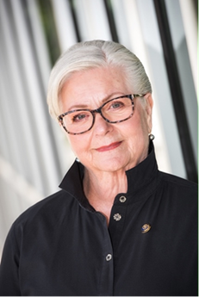
District Rotary Foundation Chair
Dean Rohrs
Rotary Club of Langley Central
deanh.rohrs@gmail.com
604-836-1454

Slide 3
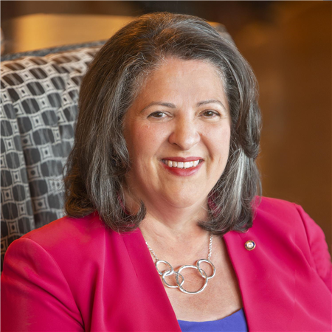
Greetings from District 5050
District Governor
Isabelle Martinez Hayer
District Governor 2025-2026

Slide 4
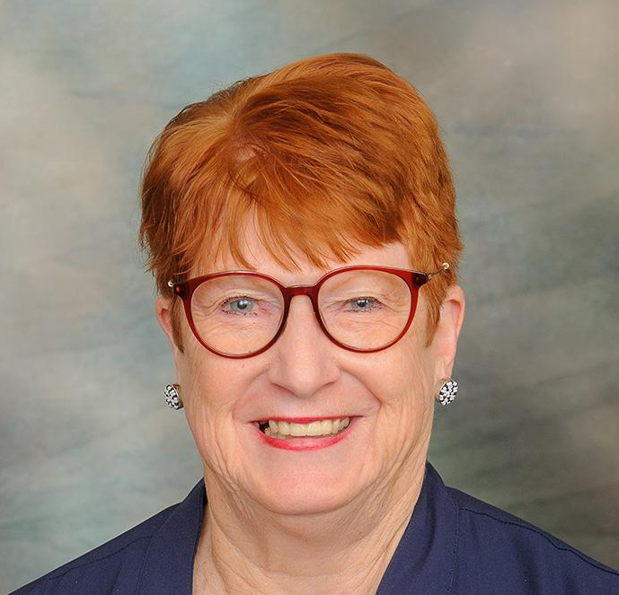
Greetings from District 5050
District Governor Elect
Kathleen Olson
District Governor 2026-2027

Slide 5
Goals for today
Qualify you and your club to receive District and Global Grants
Provide you with the tools needed to do a successful on-line application
Get you to YES

Slide 6
Agenda
Session 1 District Grants – Coreen
Pause for the cause
Session 2 Global Grants – Malcolm
Get you “qualified”
Memorandum of Understanding
Grant Management Manual
PowerPoint online at D5050 – April 1
Closing remarks DRFC Dean
Notes:
DRFC Dean

Slide 7
District 5050 Foundation Team
Your District 5050 Foundation Team is made up of experienced and dedicated Rotarians who work as the connection between
The Rotary Foundation and the
District 5050 membership.
We, like you, are volunteers

Slide 8
Your Foundation Team:
Chair: Dean Rohrs
Global Grants/Stewardship: Malcolm Kennedy
District Grants: Coreen Roger Berrisford
Annual Fund: Connie & Dennis Milliken
Endowment Fund: Carol Tichelman
International Projects: Terry McCauley
Polio Plus/Polio Plus Society: Christiana Flessner
Peace: Brad Whittaker
Major Gifts: Lee Harman
Fund Raising: Winston Conyers
Learning & Communication: Rod Thomson

Slide 9
Your Club Foundation Team:
Should be made up as follows:
Chair Grants person: Global Grants, District Grants, Peace Fellowships, etc
Stewardship:
Polio Fundraising:
Internal: EREY (Annual Programs Fund
Endowment Fund Polio, Projects
External: Fundraising Events
Programs and projects – Local and International.

Slide 10
Responsibilities of your role
Your chief responsibility as a TRF trained member of your club’s Rotary Foundation committee is to inspire your club’s members to give to the Foundation and participate in its activities.
Promote Foundation grants and activities and help members participate in them.
Inspire club members to give to The Rotary Foundation.
Explain where their donations go

Slide 11
The Rotary Foundation
The Rotary Foundation (or in loving Rotary acronym, TRF) is a separate legal entity from Rotary International (RI) to maintain its charitable tax status.
The Foundation is managed by a 15-member Board of Trustees that is nominated by the RI President and appointed by the RI Board.

Slide 12
The operations of Rotary International, a member organization, are overseen by its Board of Directors.
The Rotary Foundation is organized as a public charity operated exclusively for charitable purposes and governed by a Board of Trustees.

Slide 13
The Rotary Foundation
Our mission
The Rotary Foundation helps Rotary members to advance world understanding, goodwill, and peace by improving health, providing quality education, improving the environment, and alleviating poverty.

Slide 14
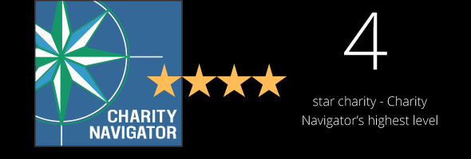
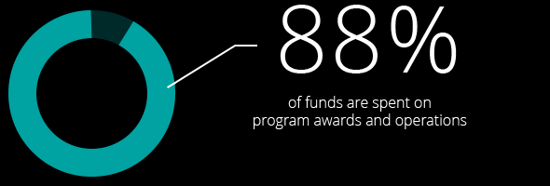
The Rotary Foundation
The past 100 + years, your Foundation has spent more than 4 billion on life-changing, sustainable projects.

Slide 15
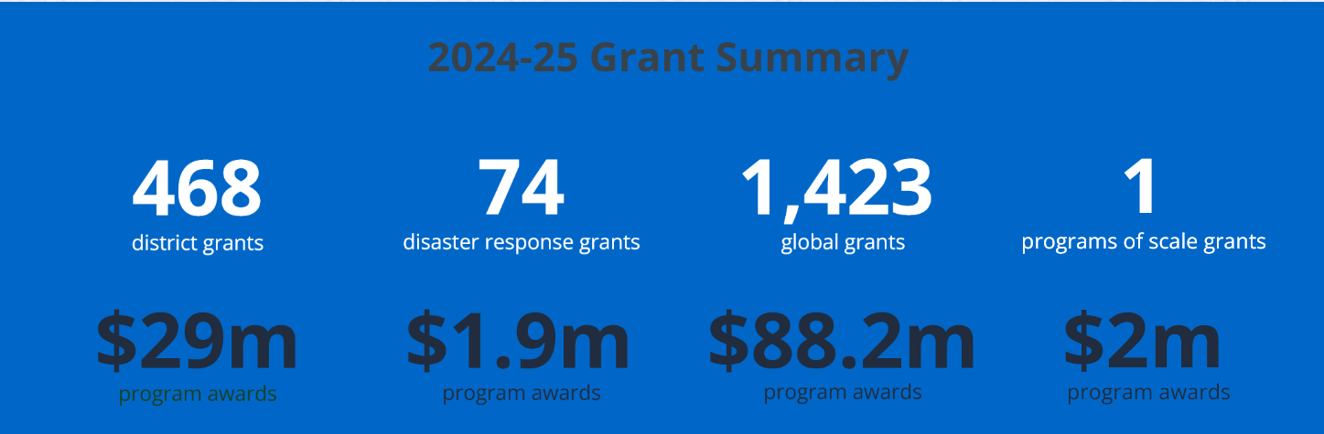

Slide 16

$100 USD Donation Benchmark
to The Rotary Foundation
from Every Rotarian Every Year
Rotary Direct
Visit www.rotary.org

Slide 17
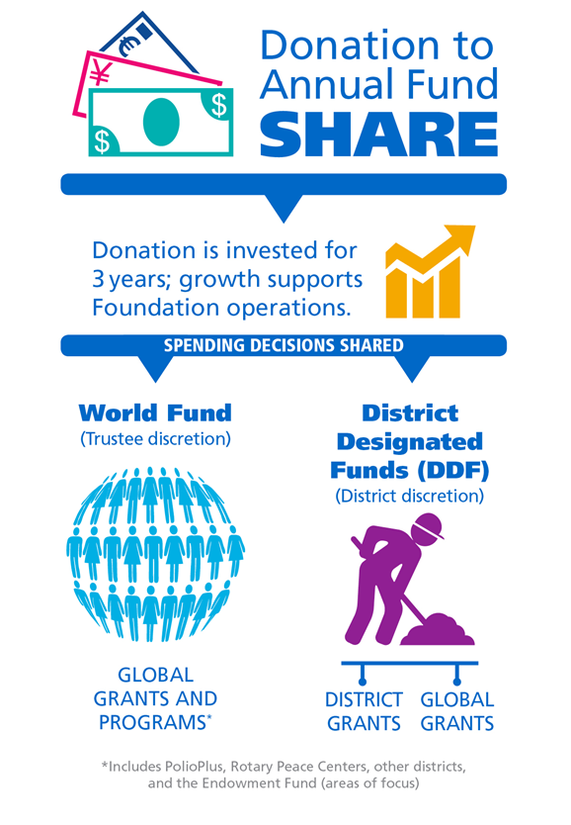

- 5% = 47.5 %each

Slide 18
District Grants
Used for smaller local or international projects
Funding between $500 - $10,000 USD (if funds available)
District will match $1 of club funds with up to $1 of District Designated Funds
Do not need Host club
Open for applications once per year

Slide 19
Global Grant - Match
With matched dollars, your $10,715 + investment results in a $30,180 project
Club(s) funds + 5% admin $10,715
District 5050(DDF) match $10,715
World Fund match DDF at 80% $ 8,750
Total funds available $30,180
Global grants have a minimum budget of $30,000 and a maximum World Fund award of $400,000.
There is no minimum World Fund match.

Slide 20
HOW WE FUND PROGRAMS – SHARE
District 5050 Rotarian Contributions to the
Annual Programs Fund are returned 3 years later
2022-23 donations = $338,000
50% ($169,000) District Designated Fund (DDF)
50% ($169,000) World Fund
District 5050 Designated Fund (DDF)
50% to District Grants ($84,500)
50% to Global Grants ($84,5000)
Notes:
To review: when we contribution to Annual Fund – SHARE, fifty percent (50%) of our contributions come back to our district through District Designated Funds (DDF) in three years to spend on educational and humanitarian activities chosen by us; even grants that may be used for projects in our local community.
The 5 percent that is earmarked to potentially pay for the Foundation’s operating expenses will come from the World Fund. It will be used only if it is needed to pay expenses when net investment returns are not sufficient, or to fully fund the operating reserve (up to three times annual operating expenses). If funds are not needed for these purposes, they will remain in the World Fund until the World Fund is measured to ensure sufficient funds for programs.
In the final step, the World Fund will be measured to ensure that it contains 50 percent of the three prior years’ worth of contributions, plus $5 million – a growth factor. Then and only then, surplus funds will be transferred to the Endowment Fund.
This funding model:
Builds our financial strength by ensuring that resources are available to meet current needs: programs and operating expenses.
Establishes a reserve to provide for unusual financial events (a rainy day fund): the operating reserve.
Ensures an increase in future programs through increased returns on the Endowment Fund.

Slide 21

Annual Program Fund
Today (EREY)
Invested for 3 years
results in ......
and a divorce....

Slide 22


Annual Program Fund
Today (EREY)
Interest
Administration
Costs
47.5%
47.5%
5% Alimony (Admin)
District Grants
(50% of DDF)
Global Grants
DDF
Share
World Fund
Support of
Global Grants

Slide 23

Endowment
Fund
Tomorrow
Funds are invested for perpetuity –
FOREVER!

Slide 24
GRANT
MANAGEMENT
SEMINAR
2026 - 2027

Slide 25
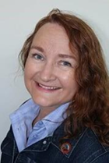
SESSION 1
District Grants
District Grants Chair
Coreen Rodger Berrisford
PNW Passport
coreenrotary@gmail.com
778-839-2674

Slide 26
District Grants
Goal today is to familiarize you with the District Grant on line application process
Our role is to guide you to FINAL APPROVAL
Used for smaller local or international projects

Slide 27
District Grants
Funding between $500 - $10,000 USD (if funds available)
District will match $1 of club funds with up to $1 of District Designated Funds USD (DDF)
Do not need Host club
All projects that receive Foundation grants must be initiated and managed by Rotarians

Slide 28
District Grants
Grants must be used for the approved purpose as we have submitted to TRF
If circumstances beyond your control result in a change in the approved purpose you need to contact the District Grants Chair before proceeding.
If the intent does not change then an adjustment could be approved. If the intent changes then the grant funds will need to be returned.
Talk to your District Grants Chair ASAP!

Slide 29
District Grants
District Grants that cannot finish or fail to file timely required 12-month progress and 18-month final reports are required to refund their grant funds in USD.
Unused District Grant funds are returned to TRF, we get those back the following year as DDF.
Contact the District Grants chair as soon as possible if you are having problems, we are here to assist you.

Slide 30
District Grants
All District Grant requests must follow the Guidelines as set out in the District Grant Management Manual – copy was emailed to you
Only Clubs that are qualified may apply–signed MOU, minimum of two members at a training session-one must be PE.

Slide 31
District Grants
Match: must be cash, not in kind or from another grant
USD funds - Use the rate you received when check cashed or exchange rate per RI rate at end of project – which ever is best for club – tell us the rate you used – show in final report.

Slide 32
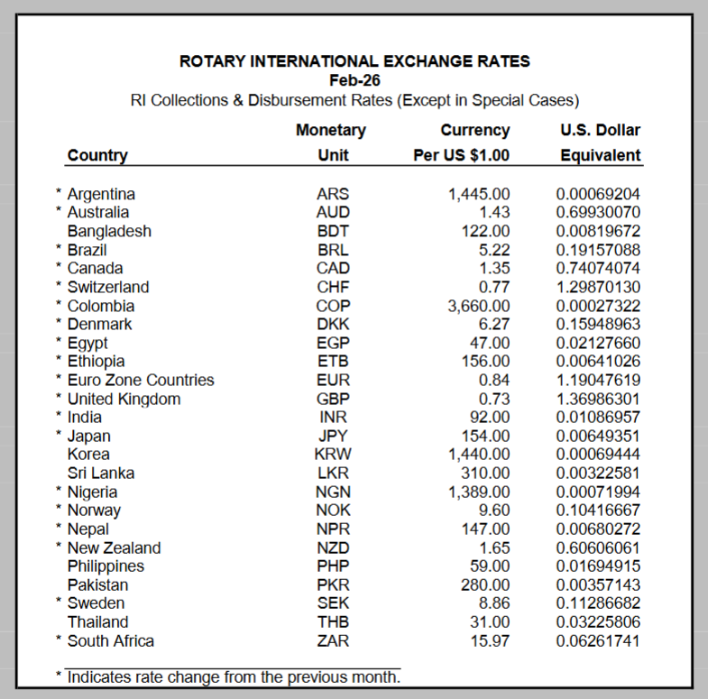
If not on this page, then go to Oanda Website

Slide 33

District Grants
Clubs can apply for more than 1 Grant, but the Club MUST prioritize their request
Needs to have a PR Plan
Fill a humanitarian need
Align with 7 areas of Focus

Slide 34
District Grants
Hands on – involved members make a strong club. The more members involved in the project the better ROTARY is visible in the community
Cannot be a check writing exercise
Funds cannot be managed by or turned over to non-Rotarian entities, such as beneficiaries or cooperating organizations

Slide 35
District Grants
Fundraising not part of project - we don't want to see it as a budget item nor any description of how you fundraised to get the club portion of funds.
We look at your club/member donations to the Foundation – and check to ensure your Foundation Goals are entered into Club Central
Do not start project before
FINAL APPROVAL
planning is Ok

Slide 36
District Grants
Dedicated bank account required for each open grant that is used solely for receiving and disbursing Foundation grant funds – your club funds & DDF
We need to see a copy of your bank account statement, not just a blank cheque
A checking account allows for flexibility and ensures the availability of bank statements

Slide 37
District Grants
Conflict of Interest:
Exists when a Rotarian benefits financially or personally from a grant
Benefit can be directly to a Rotarian or indirectly to an associate of the Rotarian
Conflict can be real or perceived as real by other organizations

Slide 38
Common Area of Conflict
Member of your club is the Executive Director / Board member of the organization you are going to support.
Make sure you are aware that this is a conflict and report it.
Careful wording can resolve area of conflict - did the Executive Director approach the club or did the club approach the Executive Director!

Slide 39
District Grants
All Grant proposals must be submitted by Midnight Monday, June 1, 2026
Everything is to be done on line at District 5050 website www.rotarydistrict5050.org
Grants Committee will meet by mid June
Goal is to have Funds Reserved for your club by end of June. If you are not going to proceed or need less funds than expected – we need to know within 5 days

Slide 40
District Grants
Once funds are reserved you move on to the next step
To the document section
Add your expense quotes
Add your bank statement
Add your club mailing address

Slide 41
District Grants
Completed District Grant Application deadline is August 15, 2026
The sooner you complete your application the sooner you get the funds
It is very important you give us the correct and complete mailing address of your club
Clubs will receive the District funds upfront

Slide 42
District Grants
Goal is to give you FINAL APPROVAL by mid September
Cheques/check by end of September early October
Do not start your project before you get FINAL approval

Slide 43
District Grants
First progress report is due at 12 months
The club has 18 months to complete the project and the FINAL REPORT
Unused funds must be returned to District 5050 in USD
You need documentation for the total of the project, the club’s contribution plus the grant award

Slide 44
District Grants
If you are submitting a grant request on behalf of multiple clubs, only one application is needed
There must be one main sponsoring club and one main contact person – they must be qualified

Slide 45
District Grants
First step – log into the District 5050 website www.rotarydistrict5050.org
Only qualified clubs will have access to the grant application
Only qualified members can make changes to the application
Grant Module will be open April 1, 2026

Slide 46

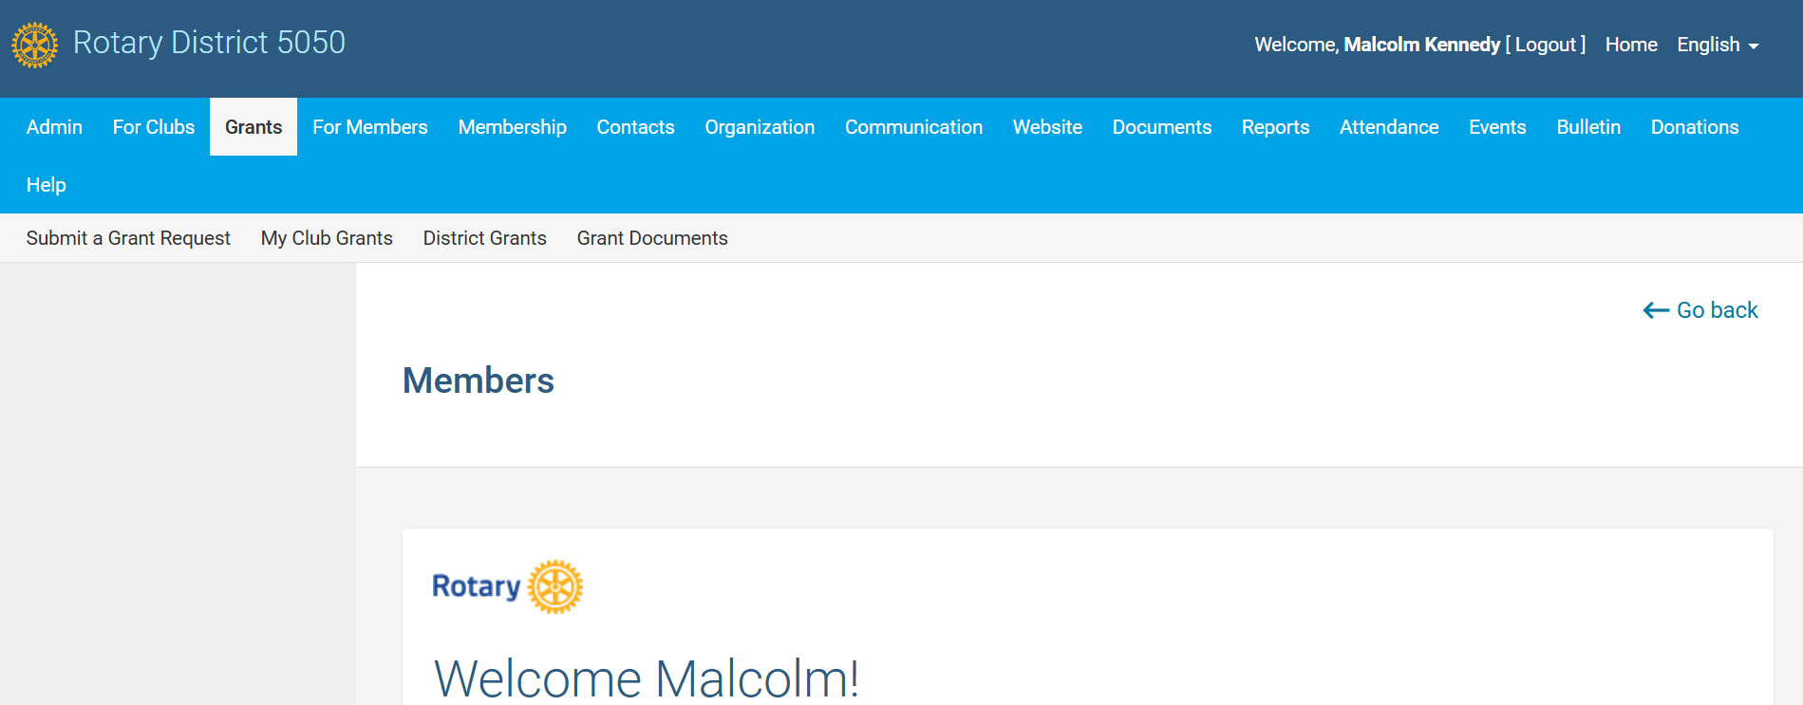
District Grants
Go to Rotary District 5050
Notes:
Speaking point: This is what the general public will see, you need to log in to get to the grants module

Slide 47
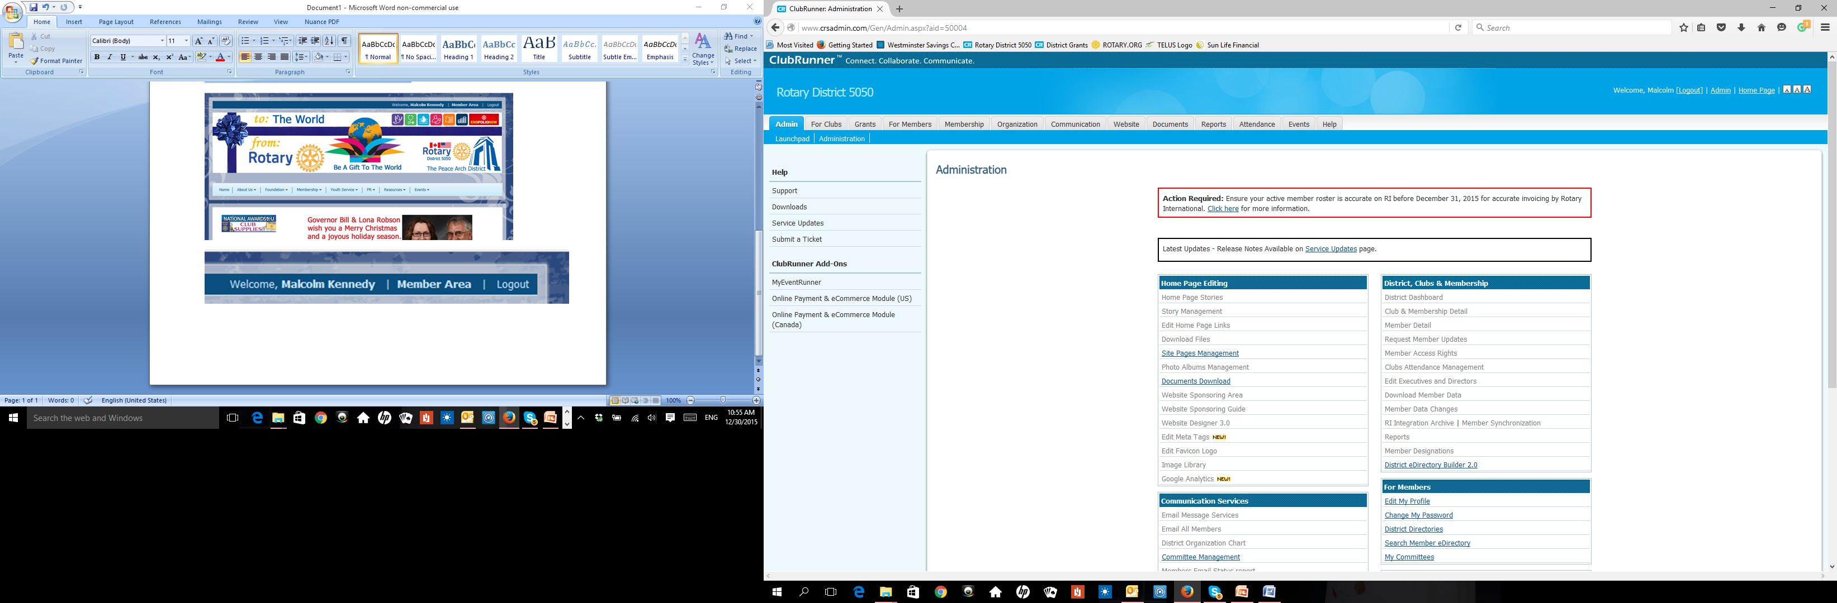
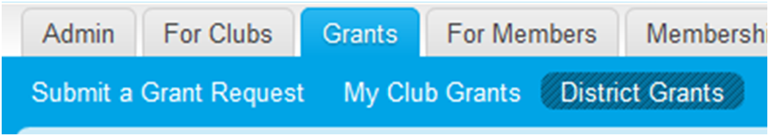

District Grants
Click on Grants
First time in select “Submit a Grant Request” second time “My Club Grants” not “District Grants”
Notes:
Speaking point: Go to my club grants not the district tab

Slide 48
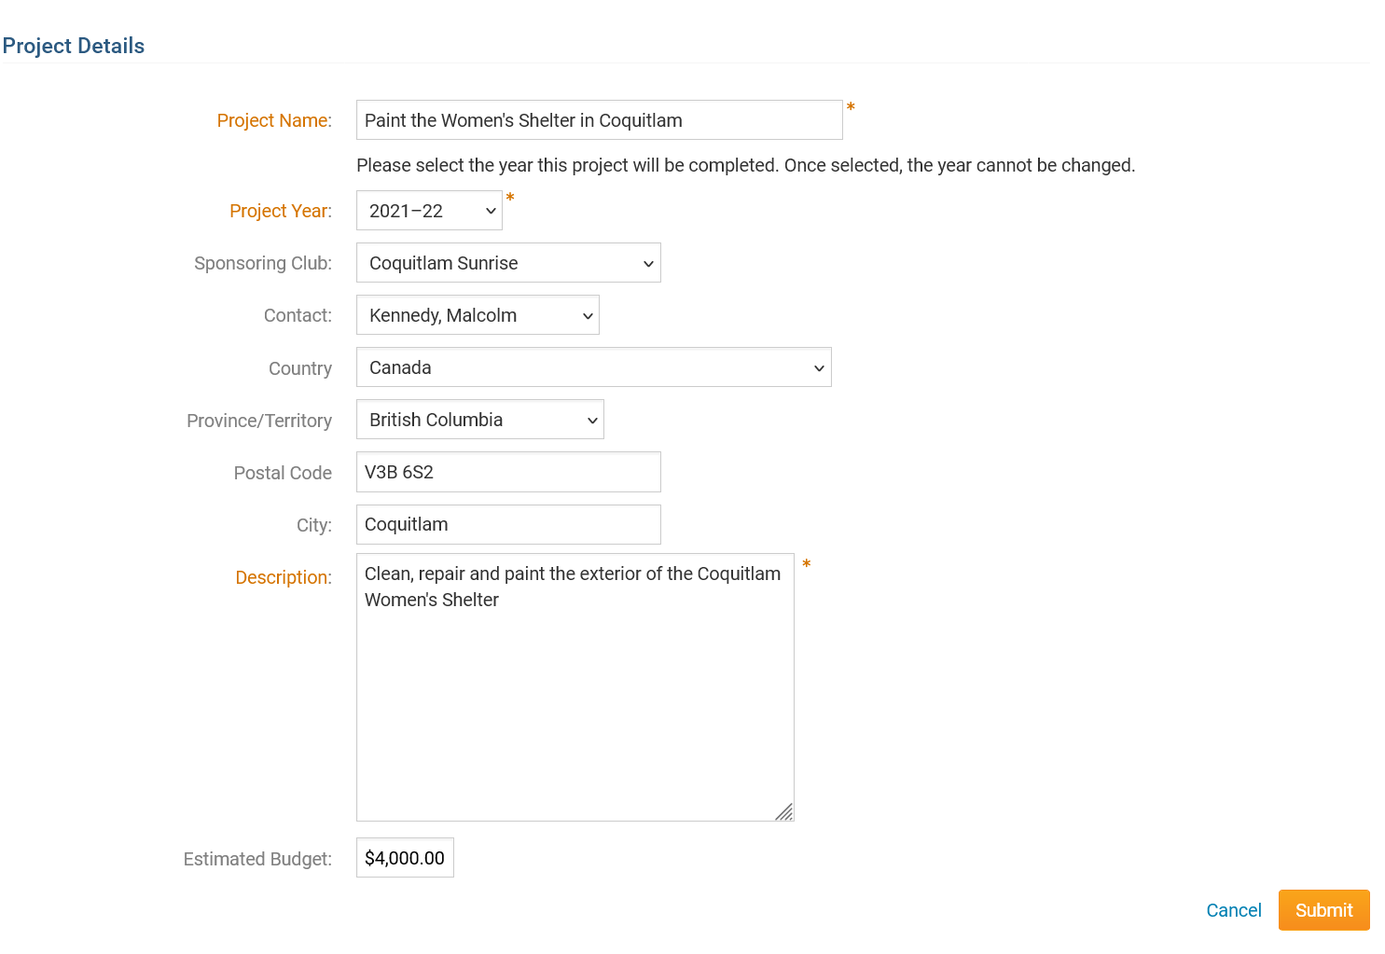
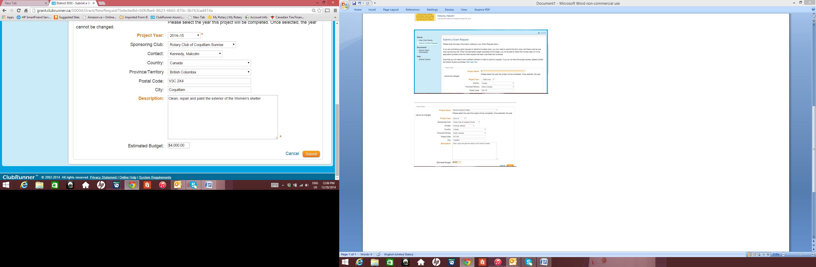
2026 -2027
Begin
Be brief –15 words or less
You are now “in the system” with this basic information we can see you are planning on applying for a District Grant.
Total Budget in USD
Notes:
Speaking point: total budget in USD

Slide 49
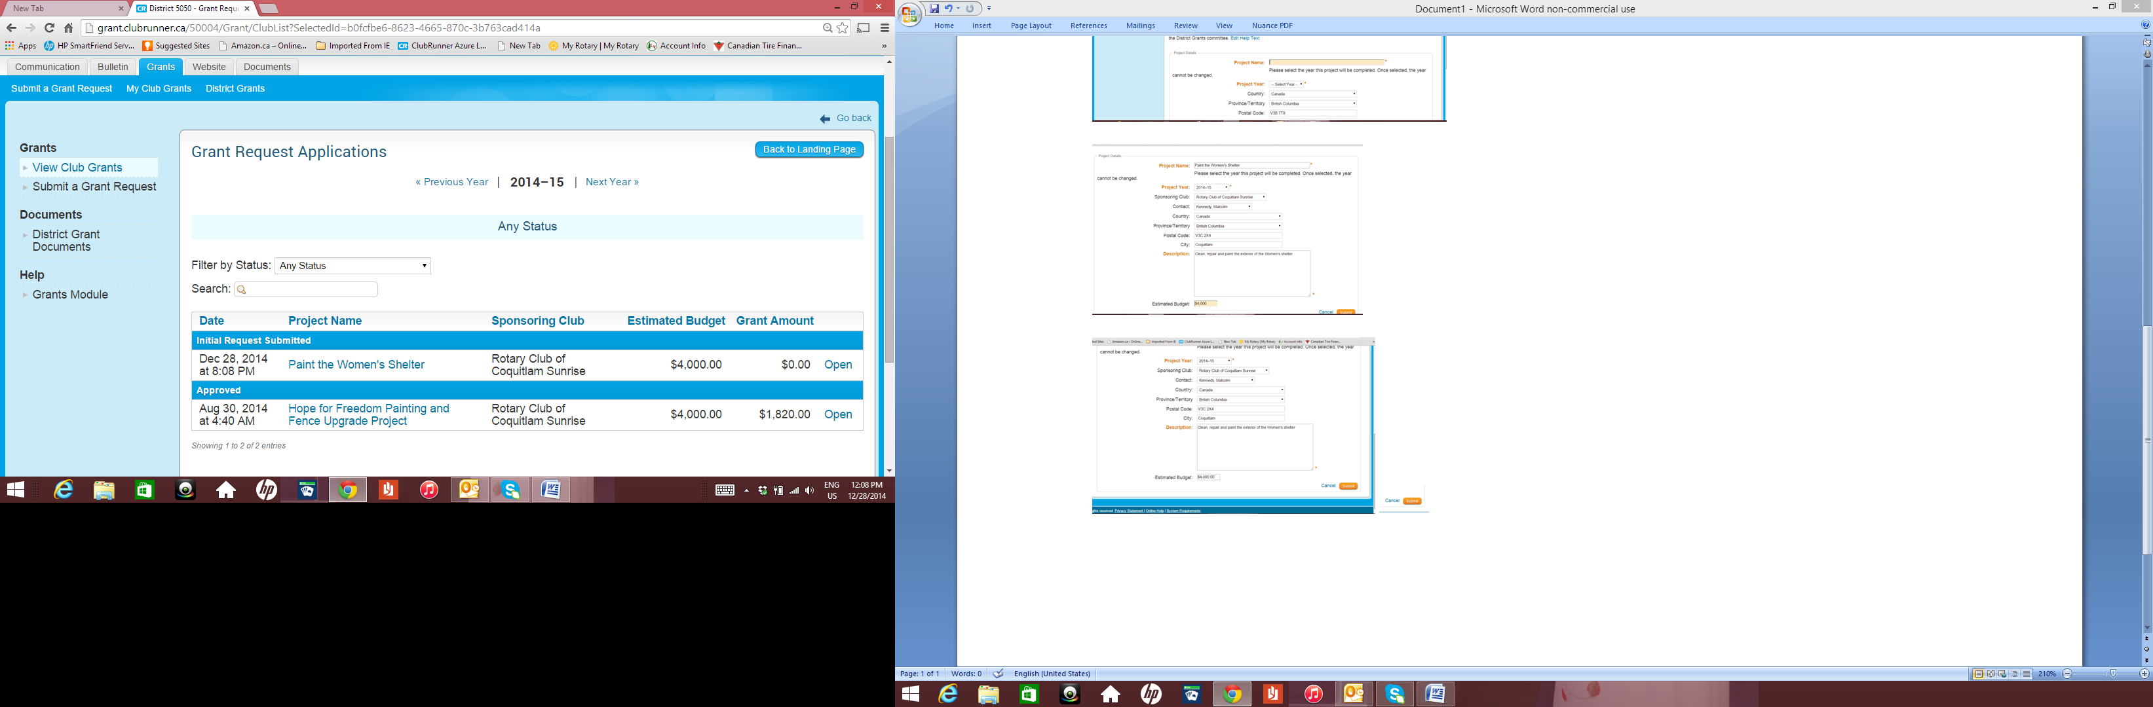

District Grants
2026-2027
Notes:
Speaking point: If you leave site you need to login again, go to view grants

Slide 50
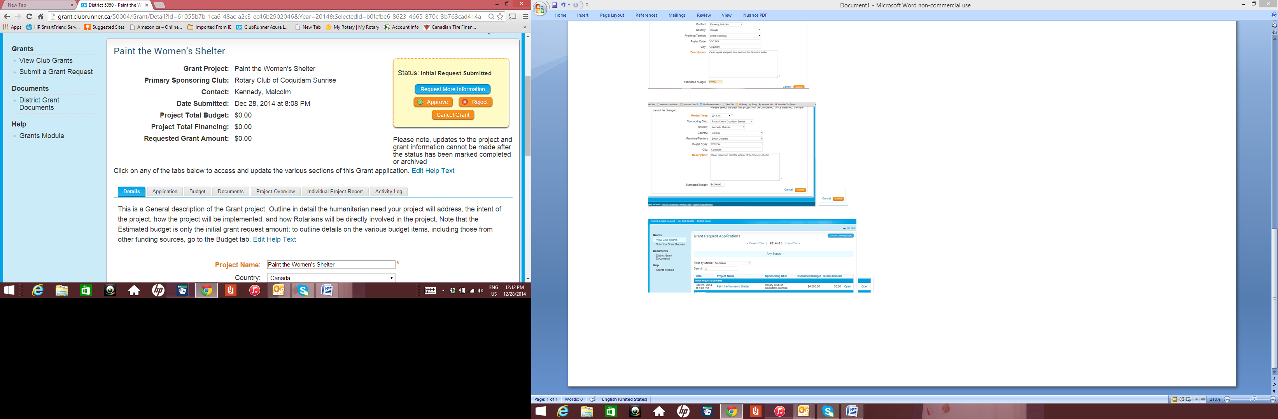
District Grants
Notes:
Speaking point: Needs to be completed by August 31, 2015

Slide 51
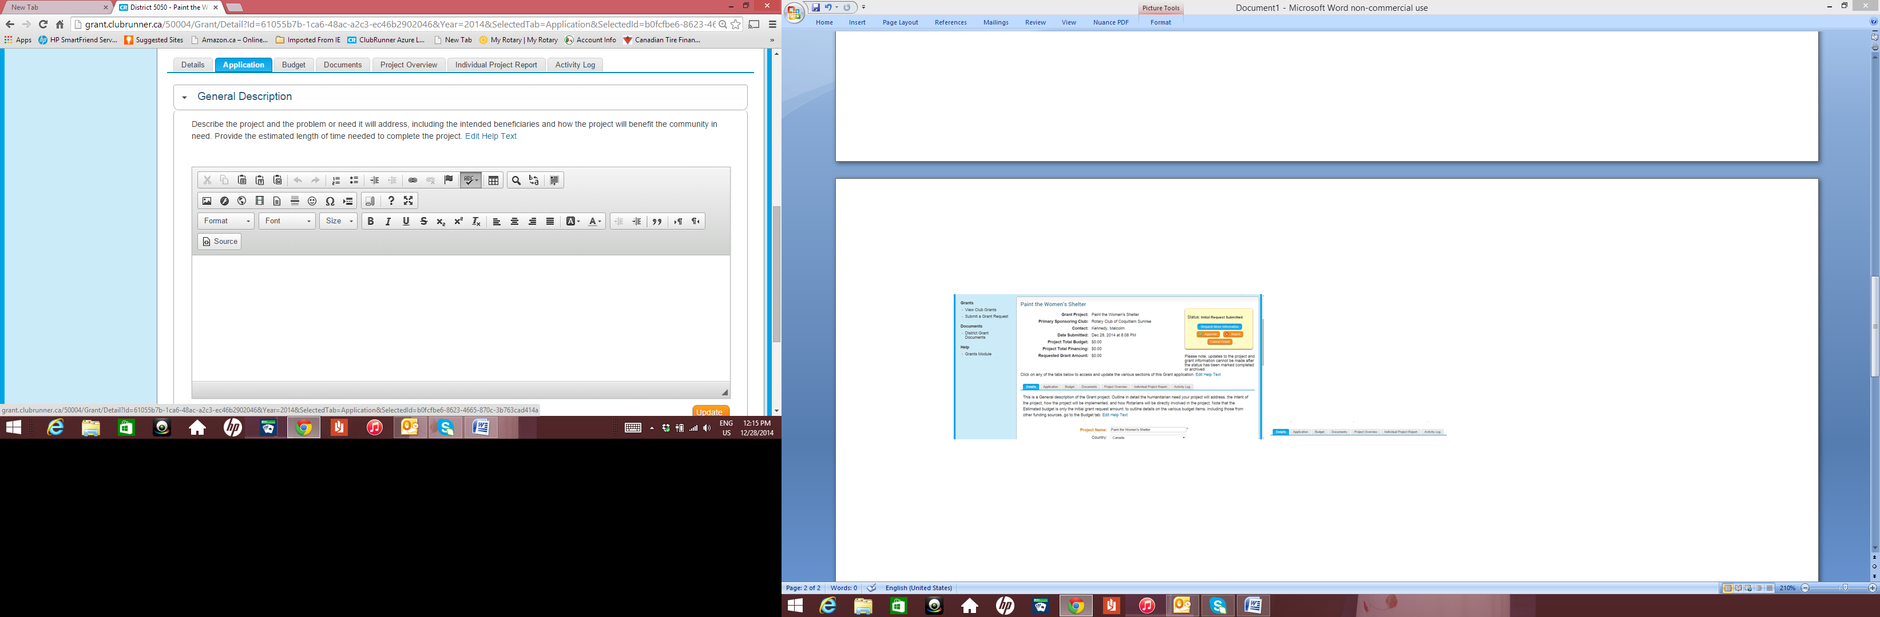
District Grants
Notes:
Speaking point: you can cut and paste from another source

Slide 52
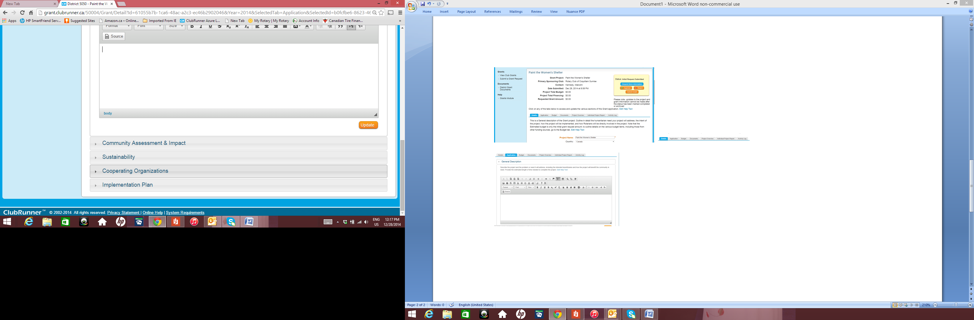
District Grants
This is where you input the details of your grant. Complete but brief is good. Make sure you update as you move to another section.
Notes:
Speaking point: Five boxes in total

Slide 53
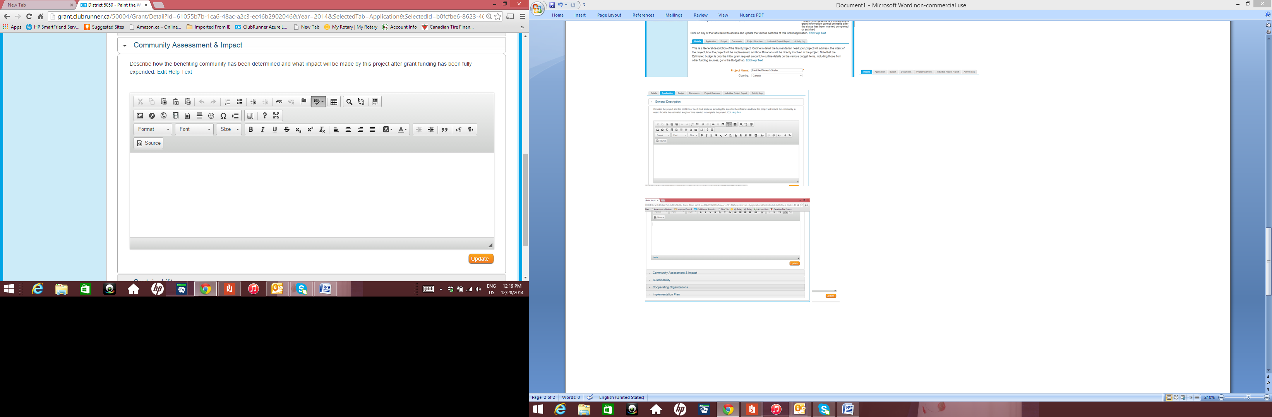
District Grants
This is where you input the details of your grant. Complete but brief is good. Make sure you update as you move to another section.
Notes:
Speaking point: Make sure you update bas you go along – you can come back to file anytime

Slide 54
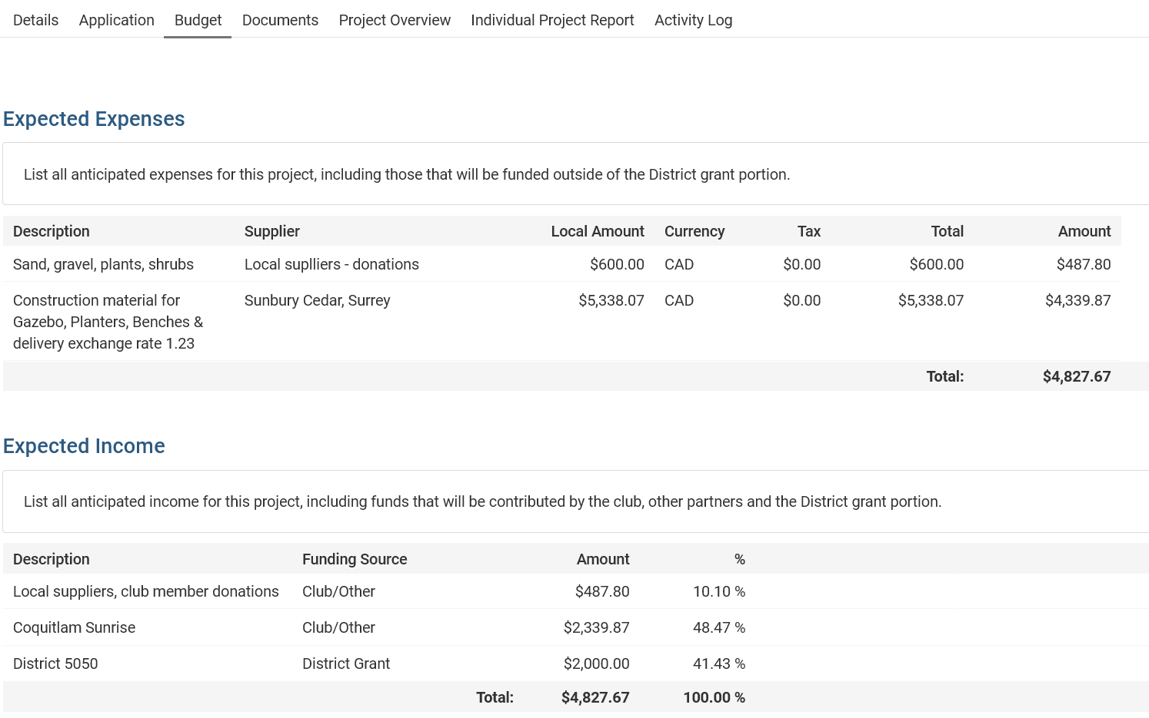
Income and expenses must match
Notes:
Speaking point: Remember you will need to justify your expense so be careful you only list what you actually will expense

Slide 55
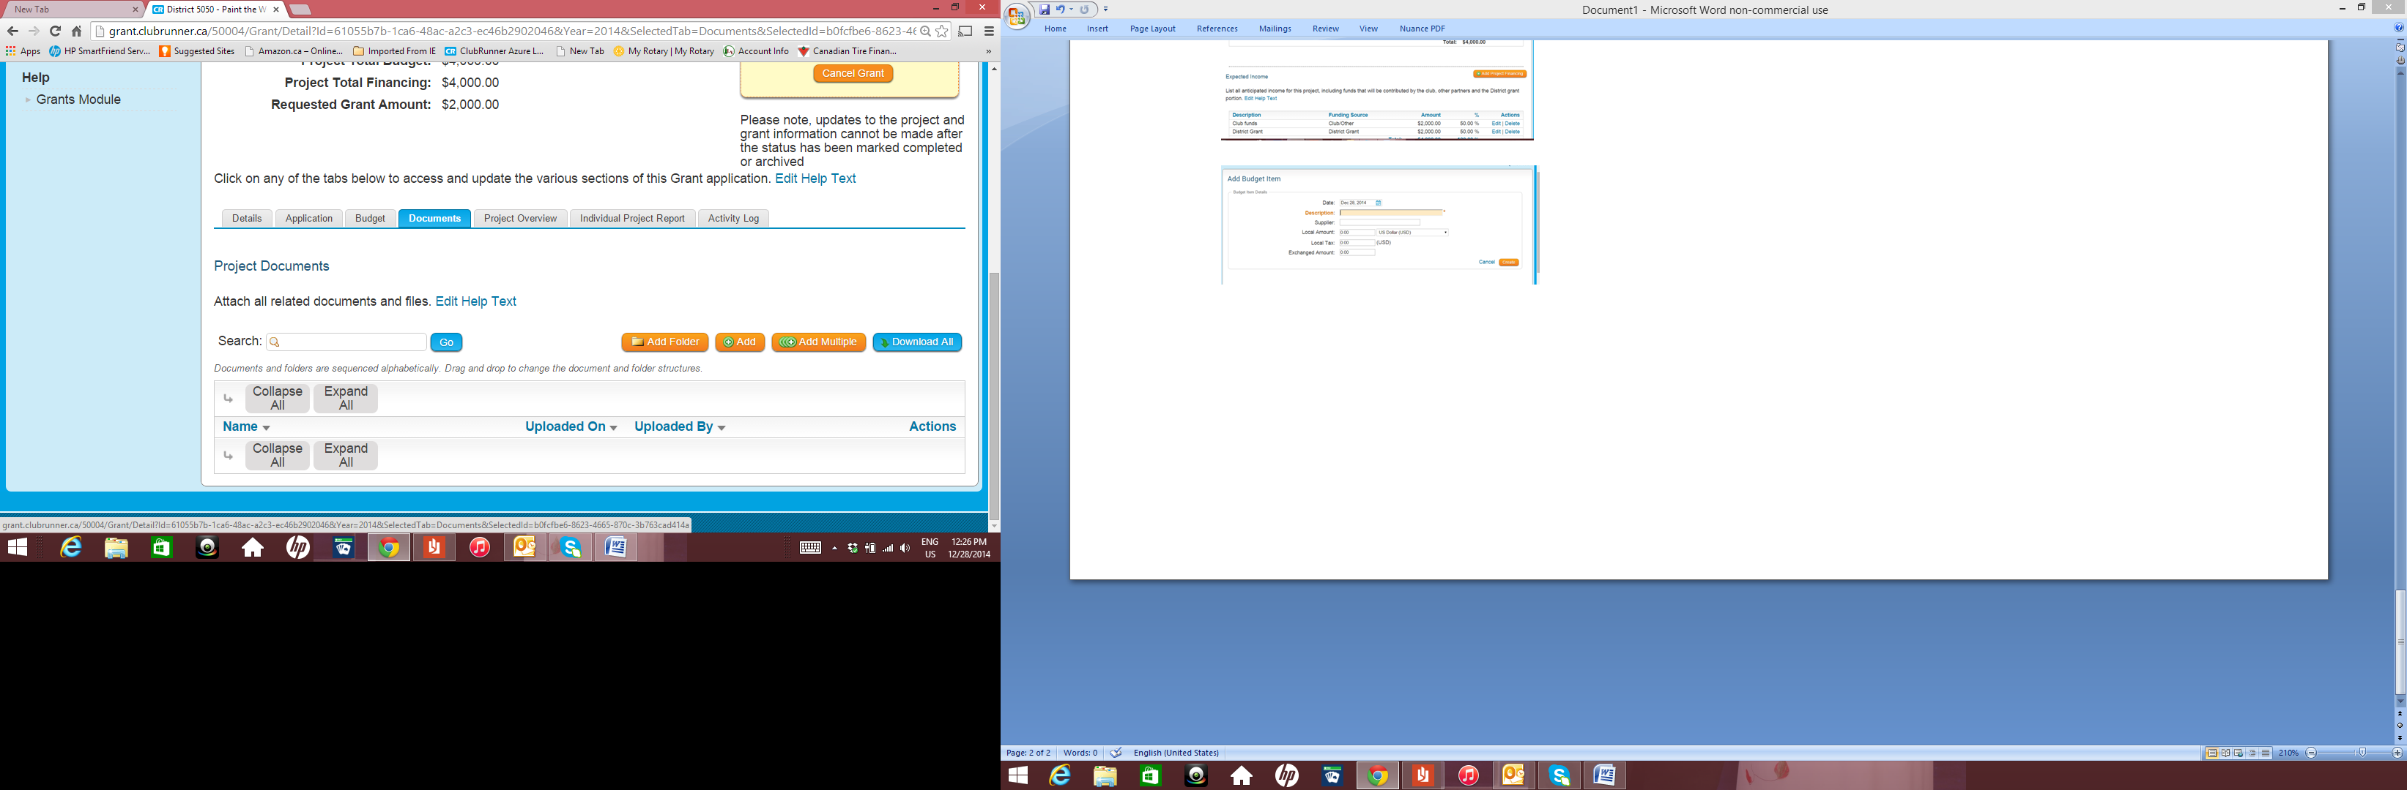
District Grants
If you have written quotes add them here – mandatory before approval can be given
Notes:
Speaking point: you need to get quotes we only need to see the quote you selected, but you should keep on file the other quotes

Slide 56
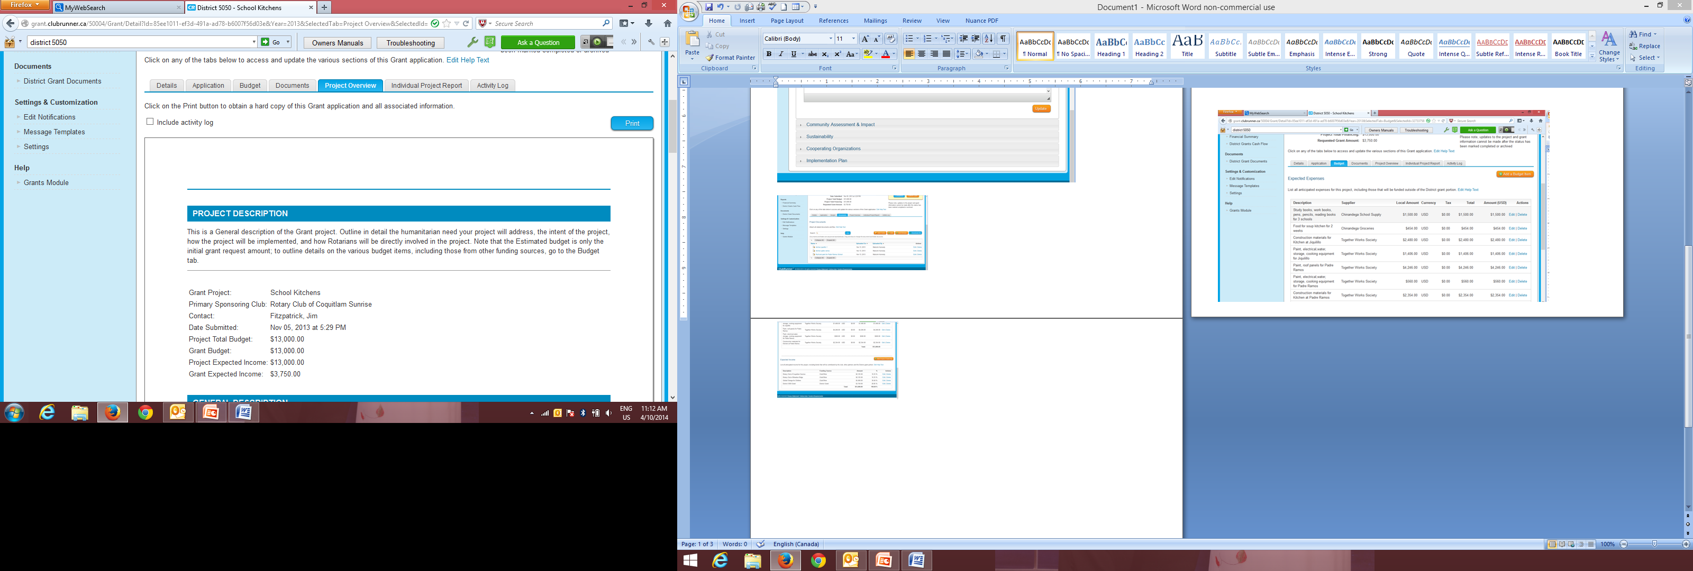
District Grants
This will produce a PDF so you can share the application with your club
Notes:
Speaking point: you can print the file, it is in a PDF and share it with your committee or club

Slide 57
District Grants
This is what you need to complete by
June 1, 2026
The District committee will meet by mid June
You will be informed by end of June if you have Funds Reserved and for what amount
At this point you need to upload written quotes, bank information and club mailing address by
August 15, 2026

Slide 58
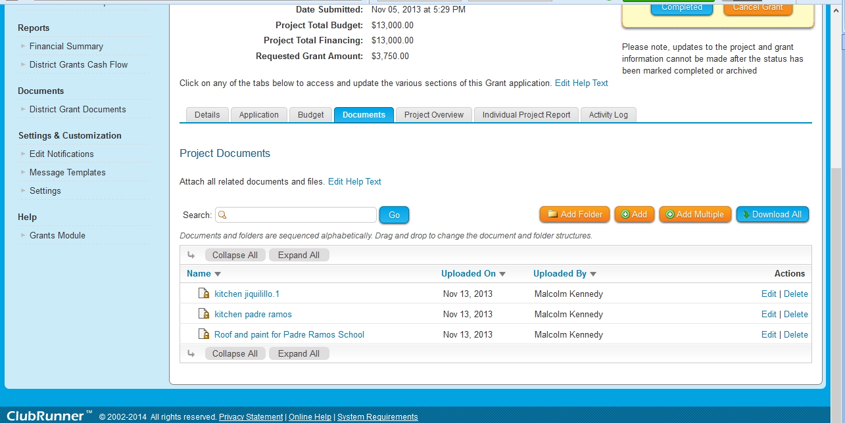
District Grants
This where you can add a copy of your bank statement – and quotes if not added earlier
Notes:
Speaking point: if you have a approved quote before August 31 then add it here if not then it must be done before December 1

Slide 59
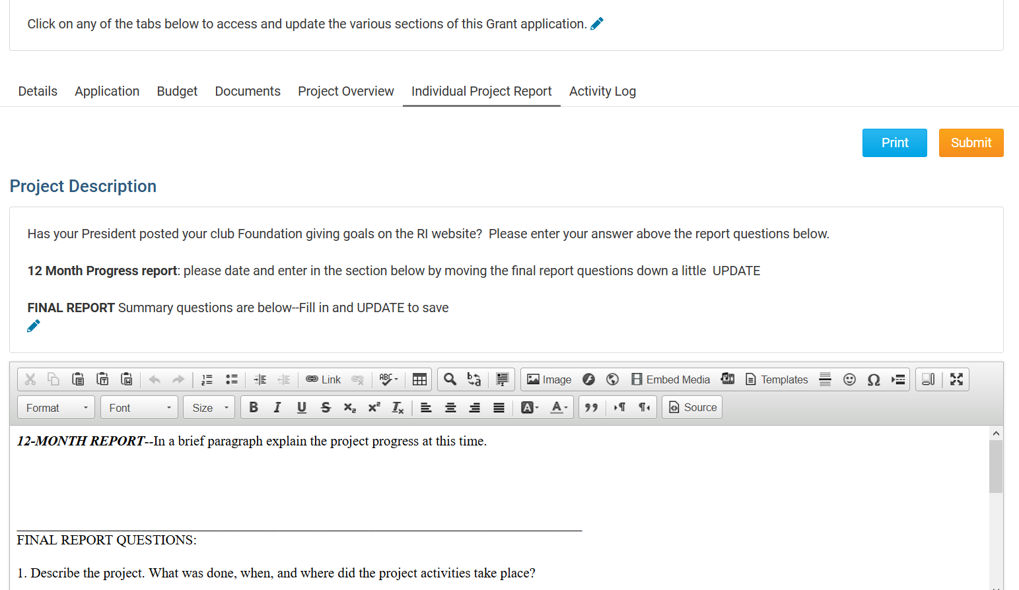
District Grants
Once your project is complete or at 12 months this report needs to be completed
Notes:
Speaking point: we need to know how your project is advancing, if you don’t need all the funds then please tell us
Only claim what you can provide receipts for

Slide 60

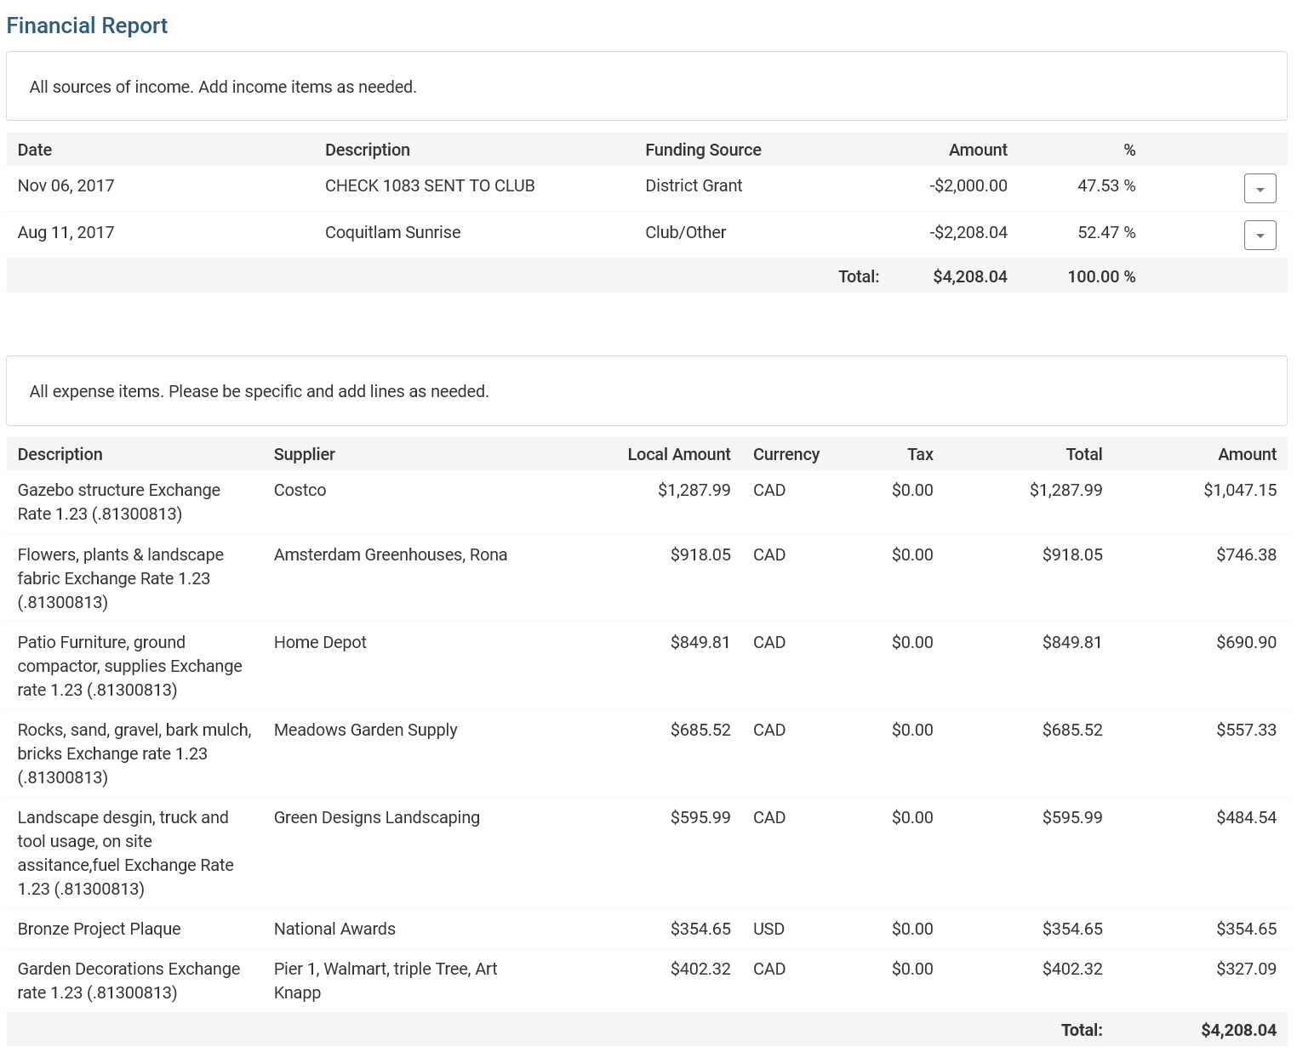
Income and Expenses must equal

Slide 61
District Grants
Expense receipts must be added for the expenses shown in the financial ‘Individual Project Report’
Notes:
Speaking point: scanned copies will be fine – you must keep copies for 5 years

Slide 62
District Grants – Important Dates
All Grant proposals must be submitted by June 1, 2026 – you can plan and apply for your grant as soon as April 1, 2026
Grants Committee will meet by mid-June
Goal is to have Funds Reserved for your club by end of June 2026
Completed Application deadline August 15, 2026
“Poor planning on your part does not constitute an emergency on our part”
Notes:
Speaking point: scanned copies will be fine – you must keep copies for 5 years

Slide 63
Coreen’s four F process for District Grants
Funds Reserved
Final Approval
First Report
Final Report

Slide 64
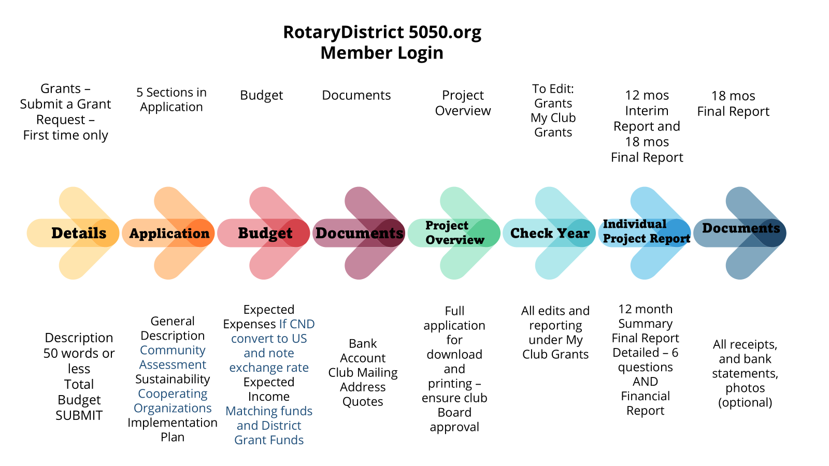

Slide 65
District Grant Management Manual
Points covered in Coreen’s presentation
If you follow these guidelines, it will save you a lot of time when applying for a District Grant
The Club is responsible for the use of funds for club-sponsored grants, regardless of who controls the funds
The Club must adhere to all TRF reporting requirements.

Slide 66

Coreen Rodger Berrisford
coreenrotary@gmail.com
778-839-2674
Please Donate to your
Rotary Foundation

Slide 67
GRANT
MANAGEMENT
SEMINAR
2025 - 2026

Slide 68
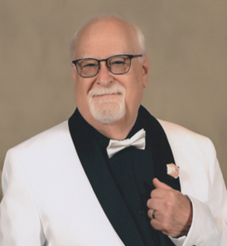
SESSION 2
Global Grants
District Global Grants Chair
District Stewardship Chair
Malcolm Kennedy
Rotary Club of Coquitlam Sunrise
malcolm.rotary@outlook.com
604-941-8606

Slide 69
Why are you here?
The Rotary Foundation (TRF) is a separate legal entity from RI to maintain its charitable tax status.
4-star charity – Charity Navigator’s highest level
MOU must be signed
Presidents are required to sign off on grants – need to understand the implications – plus final report

Slide 70
Why are you here?
Grant writers - new to grants – hopefully to expose you to the depth of the grant process and benefits $$$$$
Grant writers – experienced - share - plus how to avoid pitfalls
Foundation chairs to see the value of donating to the Rotary Foundation

Slide 71
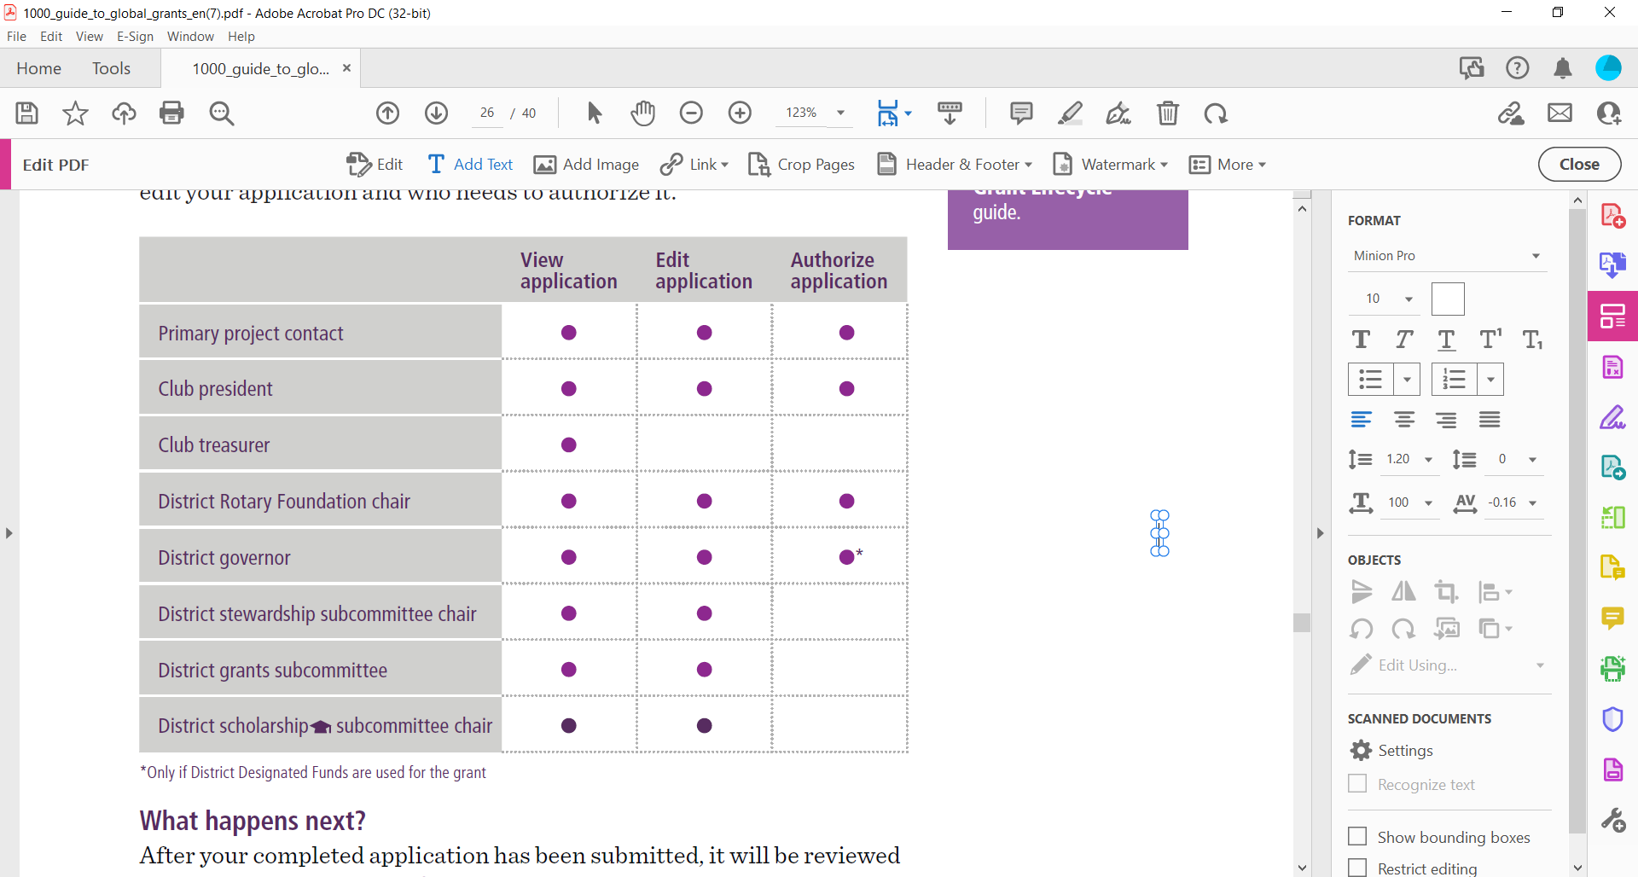
REVIEWS AND APPROVALS

Slide 72
Global Grant - Match
With matched dollars, your $10,715 + investment results in a $30,180 project
Club(s) funds + 5% admin $10,715
District 5050(DDF) match $10,715
World Fund match DDF at 80% $ 8,750
Total funds available $30,180
Global grants have a minimum budget of $30,000 and a maximum World Fund award of $400,000.
There is no minimum World Fund match.
NOTE: if you support another club ask for DDF match

Slide 73
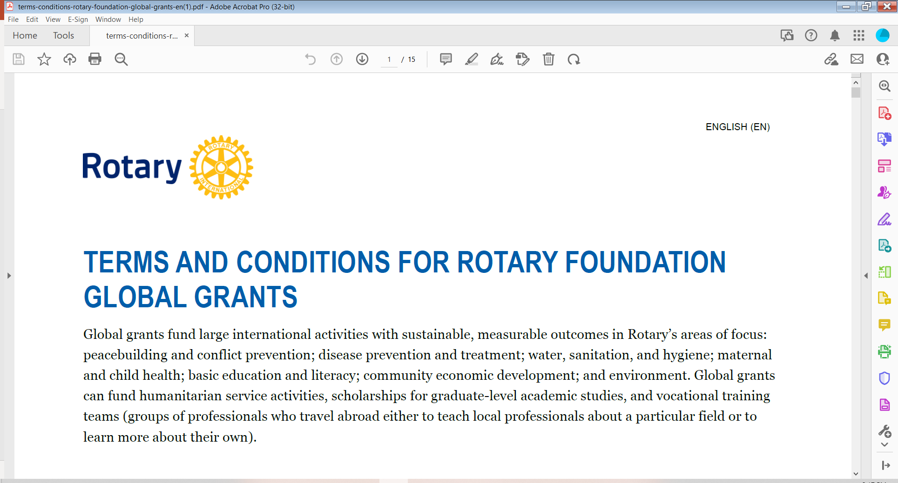
Where do you start
Must read 15-page document

Slide 74

Where do you start
Guide to Global Grants, (2025 edition - 52 Pages)
It’s for all Rotary members who are interested in applying for global grants or developing more effective and sustainable service projects.

Slide 75
Where do you start
To apply for a global grant, two or more Rotary clubs must work together.
The host sponsor is the partner in or near the international community (developing country) that’s implementing the project.
The international sponsor (you)works with the host sponsor, but is located outside of the host sponsor’s country.
All sponsors must meet global grant requirements and eligibility

Slide 76
Form three-person committees
Your club and the host club – all from the primary club
Establish a preliminary budget – minimum $30,000
(In D5050 is works out to $30,180)
Everything in USD

Slide 77
First Step
Contact your District Global Grants Chair - both clubs:
International (Malcolm)
Do we have funds available
Are you eligible
I can meet with your committee
Host
Are they in good standing - both Club and District

Slide 78
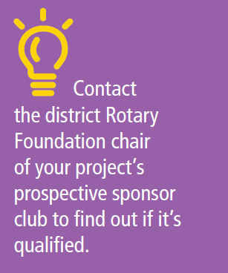
Club Qualification
www.Rotary.org

Slide 79
Global Grants
Grants need to be host community-driven.
The host community designs the grant based on local needs that they have identified.
Required to conduct a community assessment first and include the results in the grant application.
Hydro geological surveys must be completed as part of the community assessment for projects that will access groundwater.

Slide 80
PARTNERSHIP REQUIREMENTS
Host Sponsor (developing country)
Initiates the project
• Conducts a community assessment
• Manages project implementation and budget
• Provides local assistance and support to vocational training teams and scholars during their time abroad

Slide 81
PARTNERSHIP REQUIREMENTS
International Sponsor (Your Club)
Provides financial assistance, technical support, and other guidance
Performs project tasks that can be done remotely, as well as participating in service during site visits
• Prepares any vocational training teams or scholars for travel and study abroad

Slide 82
PARTNERSHIP REQUIREMENTS
Both Sponsors
Must be qualified to participate in a global grant
• Develop a project plan
Have project committees that collaborate with each other for the length of the project
• Partner with a cooperating organization (a nongovernmental organization, community group, or government entity)

Slide 83
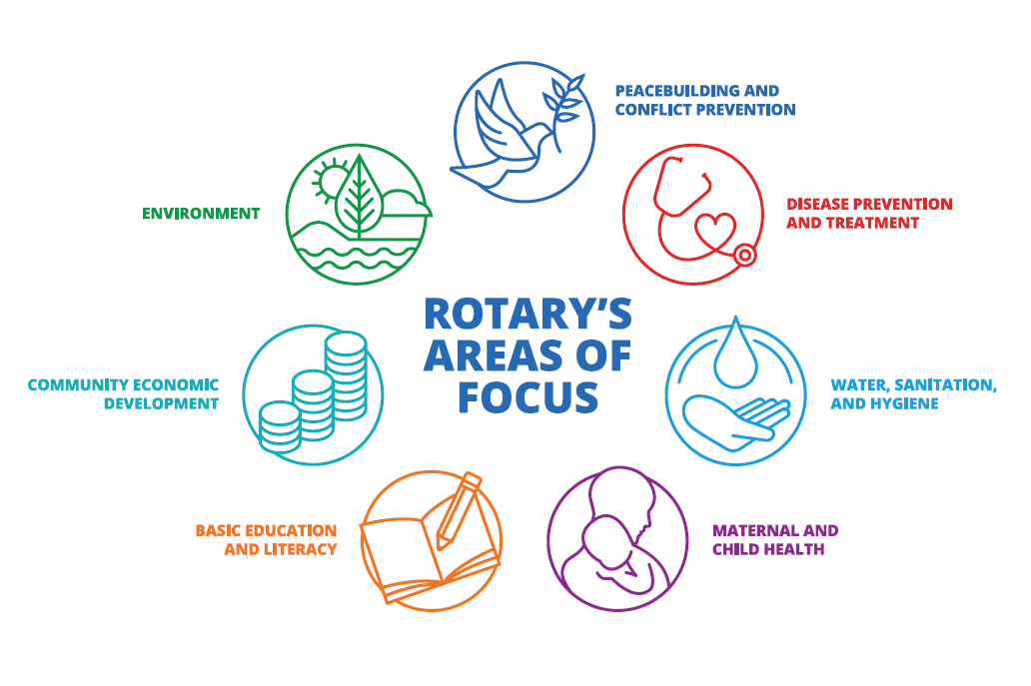
Must align with one
of Rotary’s 7 areas of focus

Slide 84
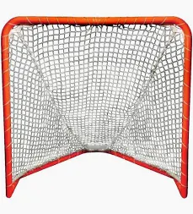
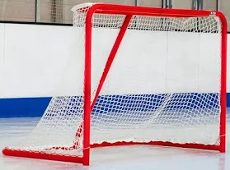
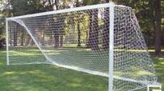

Slide 85
Global Grants
Are sustainable. Host communities must be able to address their own needs after the Rotary club has completed its work.
Are measurable. Sponsors select standard measures from the Global Grant Monitoring and Evaluation Plan supplement, and may add their own measurements.

Slide 86
Global Grants
Support humanitarian and educational projects
Support vocational training teams that address a humanitarian need by providing or receiving professional training
Vocational Training Teams (VTTs), are groups of professionals who travel abroad to either teach local specialists about a particular field or to learn more about their own, fostering knowledge transfer and improving communities.

Slide 87
Are sponsored by at least one Rotary club in the country where the grant project will take place (primary host sponsor) and one or more outside that country (primary international sponsor).

Slide 88
RAISE FUNDS
The Rotary Foundation never asks for funding from the community that benefits from a global grant-funded project. Since Rotary members have identified this community as one in need, we don’t collect funds from beneficiaries in exchange for receiving the grant or as part of the funds raised by our members

Slide 89
Restrictions – grants cannot fund:
Examples from Terms & Conditions
Continuous or excessive support of any one beneficiary, entity, or community
Purchase of land or buildings
Activities for which the expense has already incurred
Rotary Youth Exchange, RYLA, Rotary Friendship Exchange, Rotaract, Interact, or New Generations Service Exchange Programs

Slide 90
Restrictions – grants cannot fund:
Examples from Terms & Conditions
New construction of any permanent structure in which people live, work, or spend a significant amount of time, such as hospitals or container and mobile homes, or of structures in which people carry out activities such as manufacturing and processing.
If the grant depends on the construction of a building, that construction must be paid for with non-grant funds.

Slide 91
Restrictions – grants cannot fund:
Examples from Terms & Conditions
Renovations to complete buildings that are partially constructed (including buildings with only the exterior completed) but have never been occupied or operational
Travel for staff of a cooperating organization involved in a humanitarian project
Activities primarily carried out by an organization other than Rotary

Slide 92
Global Grants
Examples from Terms & Conditions
May be used to build infrastructure, such as toilet blocks and sanitation systems; access roads; dams; bridges; storage units; fences and security systems; water or irrigation systems; and greenhouses.
If your project will access groundwater, you need to have done a hydrogeological survey. The cost of that can be included in the grant budget.

Slide 93
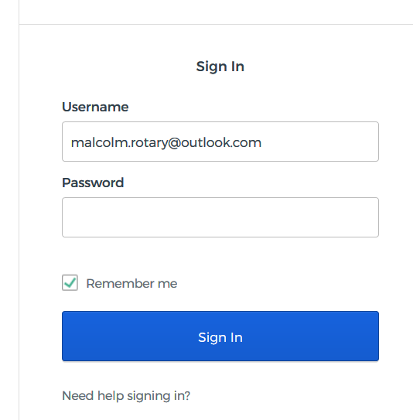
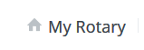
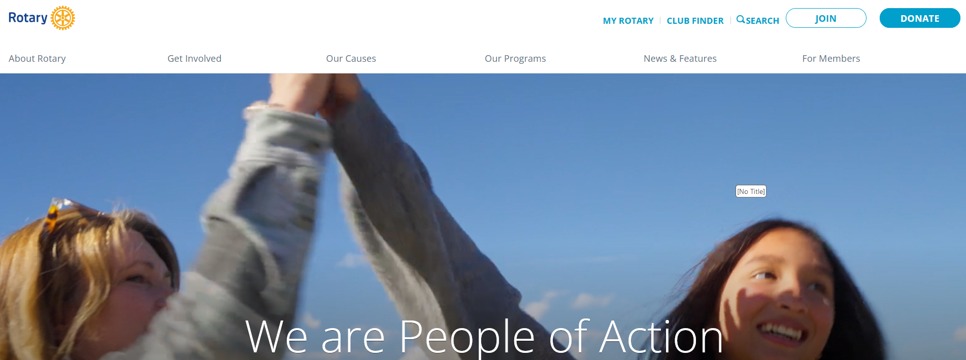
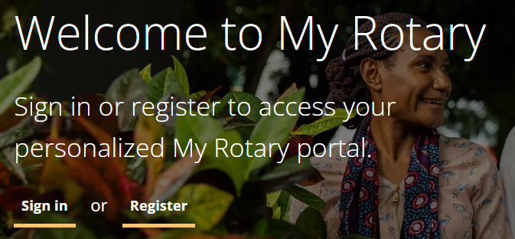
https://www.rotary.org
Click on My Rotary and sign in

Slide 94
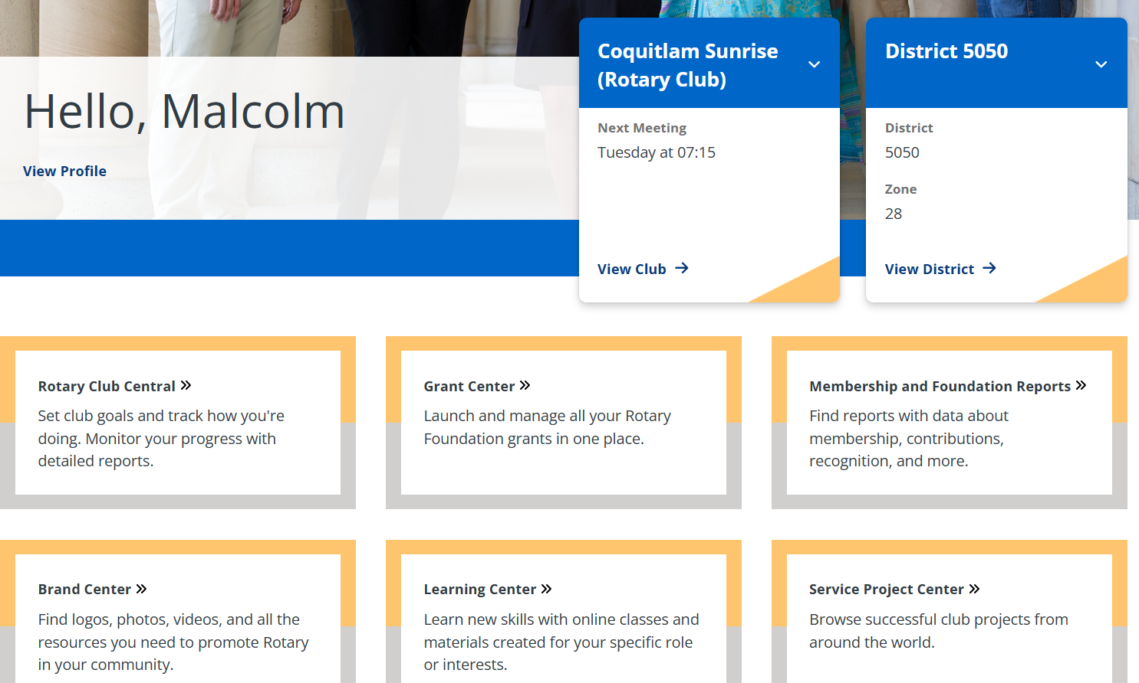

Slide 95
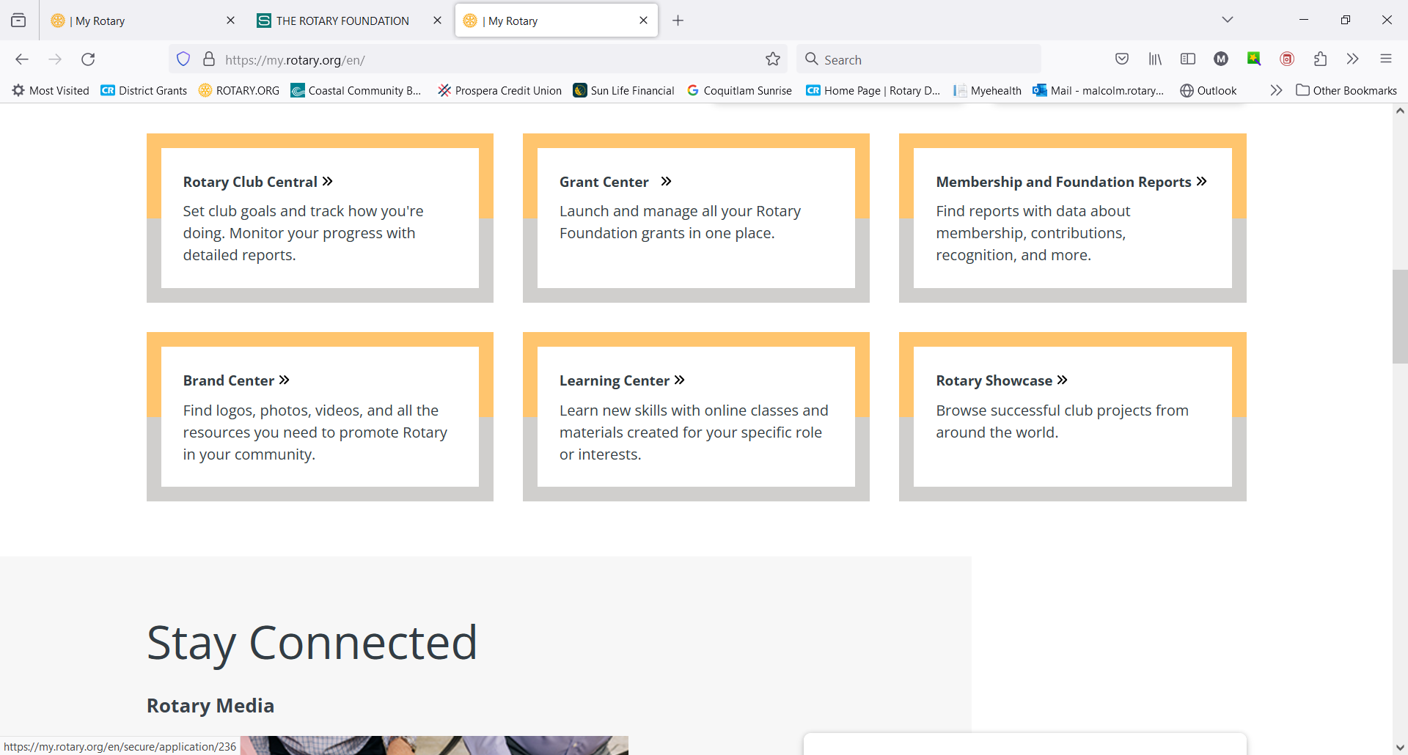

Slide 96
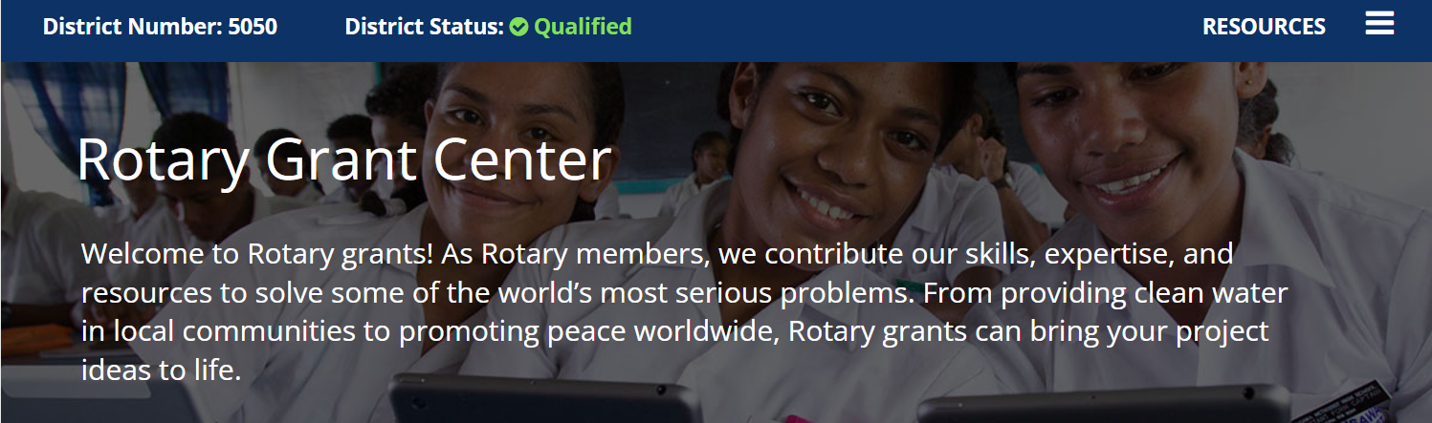
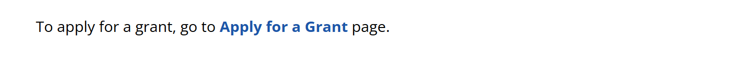
Scroll down to

Slide 97
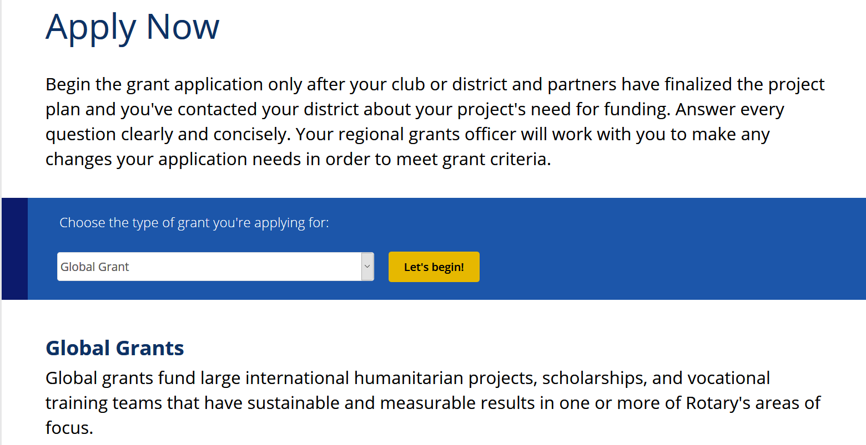

Slide 98
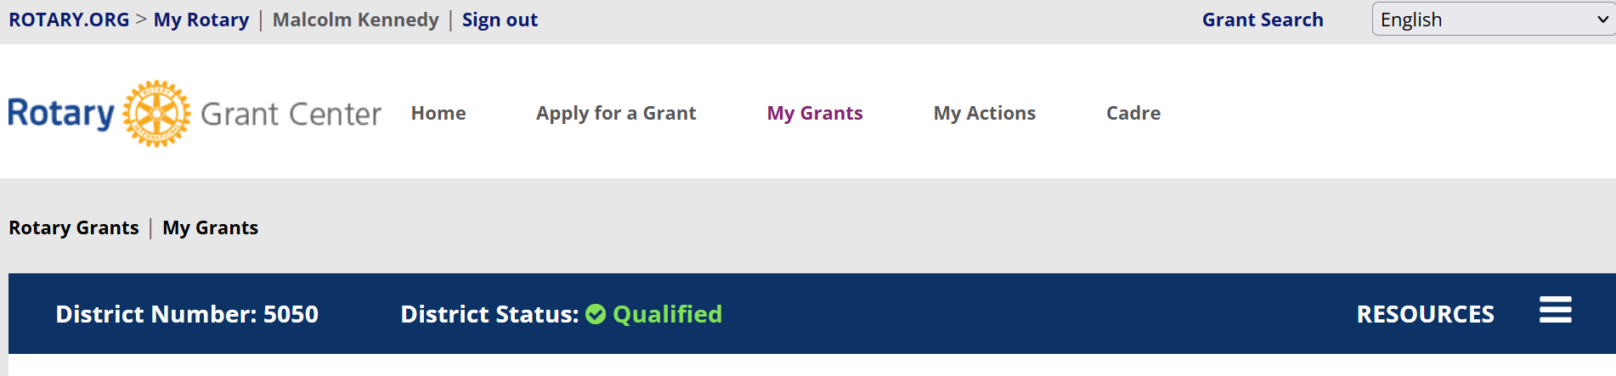

Slide 99
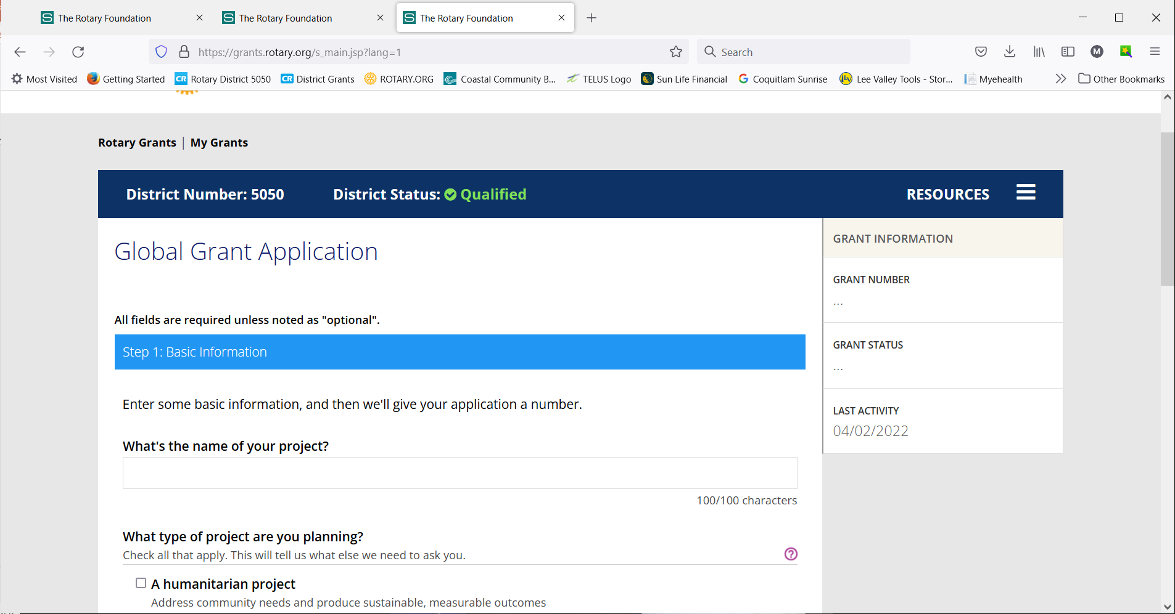

Slide 100
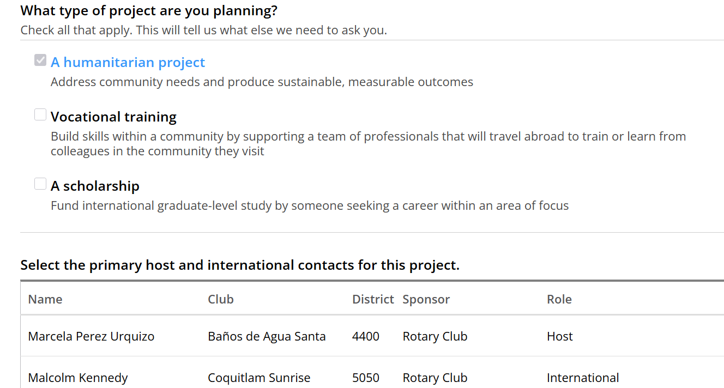

Slide 101
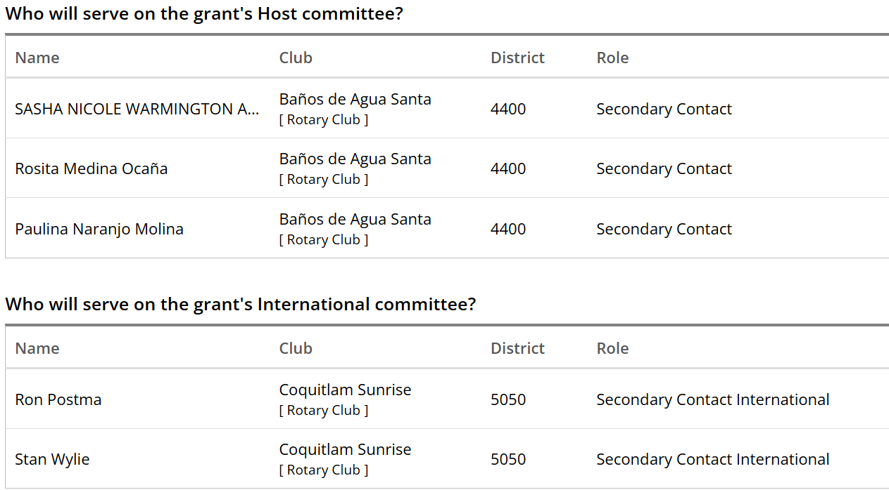

Slide 102
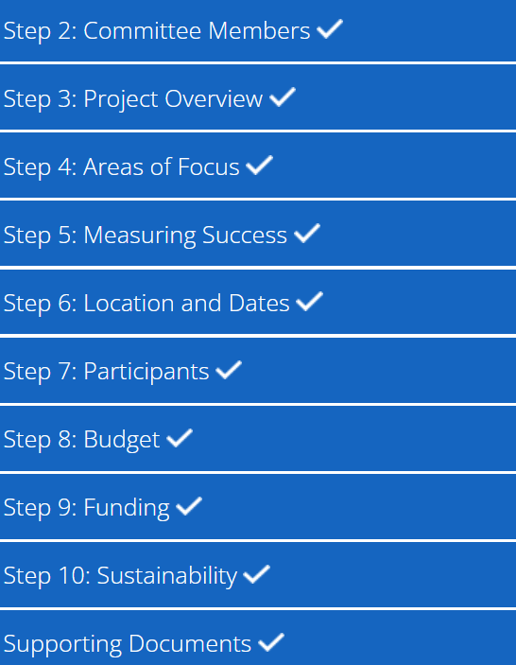

Slide 103
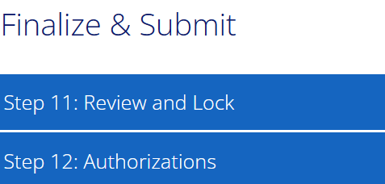

Slide 104
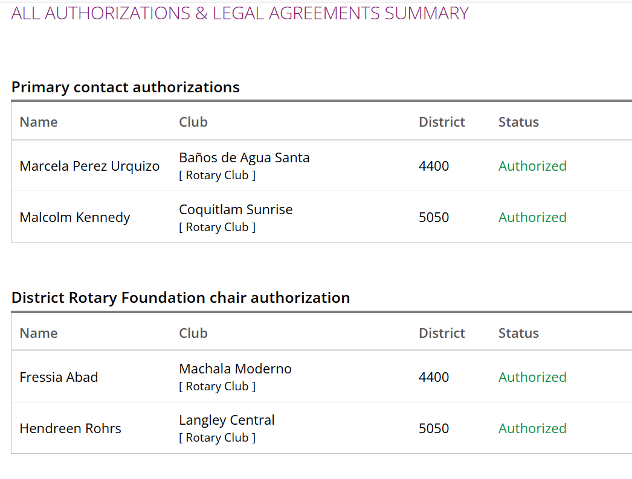

Slide 105


Slide 106


Slide 107


Slide 108
Grant Resources
Questions about the grant process?
Application Supplement for Microcredit Projects
Areas of Focus Policy Statements
Community Assessment Results
Cooperating Organization Memorandum of Understanding
Global Grant Application Template
Global Grant Calculator
Global Grant Lifecycle
Global Grant Monitoring and Evaluation Plan Supplement

Slide 109
Grant Resources
Questions about the grant process?
Global Grant Report Template
Global Grant Scholarship Supplement
Grant Travel
Guide to Global Grants
Guidelines for Rotary Foundation-Funded Project Signage
How to Use the Grant Center
Report Supplement for Microcredit Projects
RI Exchange Rates

Slide 110
Grant Resources
Questions about the grant process?
Rotary Grants Staff Contact Sheet
Six Steps to Sustainability
Terms and Conditions for Rotary Foundation District Grants and Global Grants
Training Plan for Global Grants
Vocational Training Team Itinerary
Vocational Training Team Member Application
Returning Grant Funds to The Rotary Foundation

Slide 111


Slide 112


Slide 113
If not on this page, then go to Oanda Website

Slide 114


Slide 115
GRANT INELIGIBILITY
If your grant application doesn’t meet global grant criteria, your regional grants officer will work with you to make the changes needed to meet them. If you and your partner club can’t make these changes, your project will not be eligible for global grant funding.
Rotary Grants Staff Contact Sheet
They listen well and can read between the lines
Notes:
Speaking points:
Progress reports must be submitted within 12 months of receiving the first global grant payment and every 12 months afterward.
The final report must be submitted within two months of completing the project or activity.
Unused grant funds may be used for additional eligible and Foundation-approved expenses. Changes to a project must be approved by Rotary. Any unused funds returned to Rotary will be credited to the World Fund.

Slide 116

Regional Grants Officer
Make them your best friend

Slide 117

Reporting timeline

Slide 118


Push Back
Take it as a sign they want to fund your project
They need more details so you can meet their mandate
Re-read your application – look at it as if you are seeing it for the first time – remember you have knowledge that you probably haven’t shared
It is a lot of work – invest $10,715 – receive $30,180
Notes:
Speaking points:
All documents should be accessible to everyone in the club. For example:
Keep documents in a binder or a file system, or
Scan documents and save them electronically to a shared network
Documents must be retained for a minimum of five years -- or longer if local law requires it.
Discussion questions:
What is your club’s system for document retention?
What types of documents need to be retained?

Slide 119
Where does Malcolm fit in
First point of contact
Do we have funds? Rolling record of funds
Meet with your committee
During the Process
Conduit – share ideas, pitfalls
Listen when you are frustrated
Direct you to the right source of information
Follow-up on compliance
Do a program at your club – leverage/direct your donations

Slide 120
Changes
Bank information needed as soon as the application is submitted – do not send funds until requested to do so

Slide 121
Changes
Programs of Scale Grants
Fund activities that benefit a large number of people in a significant geographic area using a sustainable, evidence-based intervention with measurable outcomes and impact. Each grant will support, for three to five years, activities that align with one or more of Rotary’s areas of focus.
How it works: Each year, one approved project will receive $2 million from The Rotary Foundation’s World Fund.

Slide 122
Changes
Disaster Response Grants
Fund small-scale, short-term activities that address needs caused by natural disasters in your community. Activities include providing basic items such as water, food, medicine, and clothing.
How it works: Districts in an affected area or country may apply for a maximum grant of $25,000, based on the availability of funds. A district may apply for subsequent grants after it successfully reports outcomes from previous grants.

Slide 123

Please Donate to TRF
Doing Good in the World starts with members like you.

Slide 124



Slide 125
2025-2026 MOU
Memorandum of Understanding
Copy was emailed along with a signature page
Signature page one page per member.
The MOU must be filled in and returned before you will be qualified – including club mailing address
Club Qualified for 1 Rotary Year, Members 3 years

Slide 126


Slide 127


Slide 128
District 5050 Foundation
District Stewardship Chair
Malcolm Kennedy
Rotary Club of Coquitlam Sunrise
malcolm.rotary@outlook.com
604-941-8606

Slide 129
District Rotary Foundation Chair
Dean Rohrs
Rotary Club of Langley Central
deanh.rohrs@gmail.com
604-836-1454

Slide 130


